Slide 1
HD HYUNDAI · TECHNICAL INTERVIEW
PRESCRIPTIVE DIGITAL TWIN
Predictive maintenance,.
turned into action.
A 24-hour failure-risk model and digital twin for industrial fleet operations, built end-to-end on the public Microsoft Predictive Maintenance dataset.
CANDIDATE
ROLE
REPOSITORY
TALK
Saurav Bhowmick
ML / MLOps Engineer
HD-Hyundai-Technical-Assignment
20 min · live demo
Notes:
- Open by naming the project and the audience.
- This is a prescriptive digital twin built on the public Microsoft Predictive Maintenance dataset — code is mine, the dataset is not.
- Twenty-minute slot, including a live demo at the end.
- Goal of the talk: defend every design choice, not just show the result.

Slide 2
01 · PROBLEM FRAMING
Stop reacting to breakdowns. Prescribe the next action.
REACTIVE
PREDICTIVE
PRESCRIPTIVE
Fix after failure
Estimate the risk
Decide the next step
Unplanned downtime, line stoppages, cascading damage. The default state of most plants.
A probability of failure in a forward window. Useful, but a single number is hard to act on.
Risk + likely component + evidence + recommended action. One object per machine, ready for an operator.
y = 0
y = 1
Otherwise. One row per machine per hour, evaluated against operator pages and work orders.
Failure of any component in (t, t + 24h]
Notes:
- Open by naming the project and the audience.
- This is a prescriptive digital twin built on the public Microsoft Predictive Maintenance dataset — code is mine, the dataset is not.
- Twenty-minute slot, including a live demo at the end.
- Goal of the talk: defend every design choice, not just show the result.

Slide 3
02 · DATASET
Microsoft Predictive Maintenance benchmark.
Five tables, 100 machines, one year of hourly telemetry. Realistic enough to defend, public enough to reproduce.
TELEMETRY
ERRORS
MAINTENANCE
FAILURES
MACHINES
876k
~3.9k
~3.3k
761
100
volt · rotate · pressure · vibration, hourly per machine
non-fatal error codes (error1–error5), timestamped
scheduled and reactive component replacements
ground-truth component failures — the label source
four models, age 0–20 years
COVERAGE
CLASS BALANCE
Jan 1 – Dec 31, 2015
≈ 0.42% positive
~8,760 hourly rows per machine. Single year — only one season of degradation observed.
Severe imbalance. Drives the choice of PR-AUC as the primary metric and class-weighted training.
Notes:
- Five tables: telemetry, errors, maintenance, failures, machines. 100 machines, one full year of hourly data.
- 876k telemetry rows, 761 ground-truth failures — that is roughly 0.42% positive at the row level.
- That class imbalance drives the metric choice on a later slide and the class-weighted training.
- Only one year, so seasonality and long wear cycles are not exercised — I will come back to this in limitations.

Slide 4
03 · ARCHITECTURE
Upload-driven staging, one atomic commit.
INGEST
VALIDATE
FEATURES
LABEL
TRAIN
5 CSVs · /upload-and-run
schema · ranges · joins
rolling · errors · maint
fail in (t, t+24h]
LR baseline → LightGBM
↓
EVALUATE
INFERENCE
HEALTH
TWIN
SERVE
PR-AUC · threshold tuning
predict_proba per row
risk → state · action
JSON object per machine
FastAPI · CLI · React UI
/MLflow runs · params · metrics
/Data-quality & drift report
/Dockerised, model baked at build
Notes:
- Walk left to right: upload, validate, features, label, train, evaluate, then inference, health, twin, serve.
- Upload-driven staging means the raw CSVs land in an isolated incoming directory and only replace the canonical files atomically after the pipeline succeeds.
- MLflow logs every run, a drift report runs each cycle, and the whole stack ships in a multi-stage Docker image.
- This is the spine — the next slide drills into the runtime flow from user click to operator action.

Slide 5
04 · SYSTEM FLOW
From CSV upload to operator action.
1 · USER
2 · FASTAPI · POST /UPLOAD-AND-RUN
React dashboard or curl
GATE
STAGE
CLEANUP
Drops 5 PdM CSVs into named slots and clicks Run analysis.
Process-wide lock · 429 on contention.
data/raw/.incoming/<uuid>/ — size-capped per file.
finally removes staging tree on any failure.
↓
3 · PIPELINE ON THE STAGED TREE
pdm.io
pdm.validate
pdm.features
pdm.labels + split
pdm.train
pdm.evaluate · drift
load_raw
schema · ranges
rolling · err · maint · age
y in (t, t+24h] · cutoff
LR + LightGBM · MLflow
PR-AUC · PSI report
↓
4 · ATOMIC COMMIT
5 · CANONICAL STATE
Each staged file os.replace-d into its canonical path; then .session.json sentinel written temp + rename.
data/raw/
artifacts/
A failed stage leaves the live dataset and the prior session untouched. Predictor cache is reset on success.
PdM_*.csv
model.joblib · metrics.json · threshold.json · plots · drift_report.md
↓
6 · SENTINEL-GATED READ API · 7 · TWIN ASSEMBLY → UI
GET /session · /info · /machines · POST /predict · GET /history · /metrics
pdm.predict
pdm.health
pdm.likely_component
pdm.twin
React dashboard
predict_proba(row)
state + prescription
rule-based ranker
JSON object
Operator sees risk, evidence, action.
Notes:
- This is the runtime story behind the architecture spine — the same components, traced as a request flow.
- User drops 5 CSVs in the dashboard. POST /upload-and-run takes a process-wide lock (concurrent uploads get 429) and stages every file under data/raw/.incoming/<uuid>/ with a per-file size cap (413 on overrun).
- The pipeline runs against the staged tree: io.load_raw → validate → features → labels + split → train (baseline + LightGBM, logged to MLflow) → evaluate + drift.
- Only on full success do we commit: each staged file os.replace-d into the canonical path, then the .session.json sentinel written temp + rename. A failed stage leaves the live dataset and the prior session untouched.
- After commit, the read endpoints are gated by the sentinel. /predict runs pdm.predict → health → likely_component → twin, and the React dashboard renders the JSON object the operator actually sees.

Slide 6
05 · DATA PIPELINE
Deterministic joins, validated at every step.
GUARANTEES
VALIDATE
01
Schema checks — dtypes, expected columns, allowed code ranges (error1–error5, comp1–comp4).
assert telemetry.columns == ["datetime","machineID", "volt","rotate", "pressure","vibration"] assert errors.errorID .isin({"error1",..,"error5"}).all() frame = (telemetry .merge(errors_hourly, how="left") .merge(maint_hourly, how="left") .merge(machines, how="left")) assert frame.duplicated( ["machineID","datetime"]).sum() == 0
02
Timestamp alignment — telemetry is the hourly grid; errors and maintenance are bucketed to that grid before joins.
03
Deterministic merges — left-joins on (machineID, datetime). No fuzzy windows; same input always yields same frame.
04
Missing & outliers — forward-fill for last-event features; rolling stats handle gaps inside their window.
05
Reproducibility — seeds pinned, config snapshotted into the run, artefacts written to artifacts/.
Notes:
- The pipeline is deterministic by design: same CSVs in, same DataFrame out, every time.
- Schema and range checks fail fast before any modelling work touches the data.
- Telemetry is the hourly grid; errors and maintenance are bucketed to that grid before any join.
- Missing values are handled inside their feature: forward-fill for last-event features, rolling stats absorb intra-window gaps.

Slide 7
06 · FEATURES
45 features. Every one is auditable.
ROLLING TELEMETRY
ERROR COUNTS
MAINTENANCE
MACHINE CONTEXT
24
6
4
5
mean & std of volt, rotate, pressure, vibration over 3h · 24h · 72h
per-code counts over 24h + total errors over 24h / 72h
hours_since_maint_comp1..4 — the interpretable feature
age_at_t_years + one-hot model1..4
SRC/PDM/FEATURES.PY · _ROLLING_STATS (VERBATIM)
closed='left' = leakage guard
def _rolling_stats(telemetry, cols, windows_h): out = telemetry[["datetime", "machineID"]].copy() t = telemetry.set_index("datetime") grouped = t.groupby("machineID", sort=False, group_keys=False) for w in windows_h: win = f"{w}h" rolled_mean = grouped[cols].rolling(win, closed="left").mean() rolled_std = grouped[cols].rolling(win, closed="left").std() rolled_mean.columns = [f"{c}_mean_{w}h" for c in cols] rolled_std.columns = [f"{c}_std_{w}h" for c in cols] rolled = pd.concat([rolled_mean, rolled_std], axis=1).reset_index() out = out.merge(rolled, on=["machineID", "datetime"], how="left") return out
Notes:
- 45 features across four families. The big group is rolling telemetry stats — mean and std on volt, rotate, pressure, vibration over 3h, 24h, 72h windows.
- Errors are per-code counts over 24h plus totals over 24h and 72h.
- The explicitly interpretable feature is hours-since-last-maintenance per component — that is what the prescription layer leans on.
- Code on this slide is the verbatim _rolling_stats function from src/pdm/features.py — closed='left' is the leakage guard that lets a feature at time t see only rows strictly before t.

Slide 8
07 · LABELS & SPLIT
Time-aware split. Leakage is non-negotiable.
LABEL RULE
LEAKAGE CONTROLS
y(machineID, t) = 1 if any failure in (t, t+24h], else 0.
Features at t use only data ≤ t.
Rolling windows are causal — no centred windows.
CUTOFF DATE
WHY SINGLE CUTOFF
Oct 1, 2015
Honest baseline
Failures after the test cutoff never enter training labels.
Train on Jan–Sep, hold out Oct–Dec. ~9 months train, ~3 months test.
Mirrors "train on history, score the future." K-fold across time would inflate scores.
A unit test asserts the labelling function on a hand-built fixture.
SRC/PDM/LABELS.PY · LABEL_IN_WINDOW (VERBATIM)
merged = pd.merge_asof( base, fail, left_on="datetime", right_on="fail_dt", by="machineID", direction="forward", allow_exact_matches=False, # window is strictly OPEN at t ) delta = merged["fail_dt"] - merged["datetime"] label = ((delta > pd.Timedelta(0)) & (delta <= horizon)).astype("int8")
Notes:
- One cutoff date, October 1, 2015. Train on Jan to Sep, hold out Oct to Dec.
- A single cutoff mirrors production: train on history, score the future. Time-aware K-fold here would inflate the numbers.
- The label function on the right is the verbatim label_in_window from src/pdm/labels.py — merge_asof forward with allow_exact_matches=False makes the window open at t and closed at t+horizon.
- tests/test_labels.py locks the boundary semantics in — leakage is non-negotiable.

Slide 9
08 · MODELLING
Beat a linear baseline. Then ship the gradient booster.
BASELINE
baseline_lr
PRODUCTION
lightgbm_v1
Logistic regression
LightGBM
Standard-scaled features, class-weighted loss.
Honest floor — interpretable, no surprises.
Anchors every metric we report for LightGBM.
Handles mixed-scale features and interactions natively.
Class-weighted, robust on the 0.42% positive rate.
Fast train, fast inference, exportable joblib artefact.
PR-AUC0.287
PR-AUC0.908
CONFIGS/DEFAULT.YAML · MODELS.FINAL (VERBATIM)
final: name: lightgbm params: n_estimators: 400 learning_rate: 0.05 num_leaves: 63 max_depth: -1 min_child_samples: 50 subsample: 0.9 colsample_bytree: 0.9 reg_lambda: 1.0 class_weight: balanced random_state: 42 n_jobs: -1
Notes:
- I always train a baseline. Logistic regression with class weighting gives an honest floor — PR-AUC of 0.287.
- LightGBM is the shipped model: handles mixed-scale features and interactions, fast to train, fast to serve.
- Hyperparameters at the bottom are the verbatim final.params block from configs/default.yaml.
- Headline: 0.908 vs 0.287 PR-AUC — that gap is the real argument for the gradient booster.

Slide 10
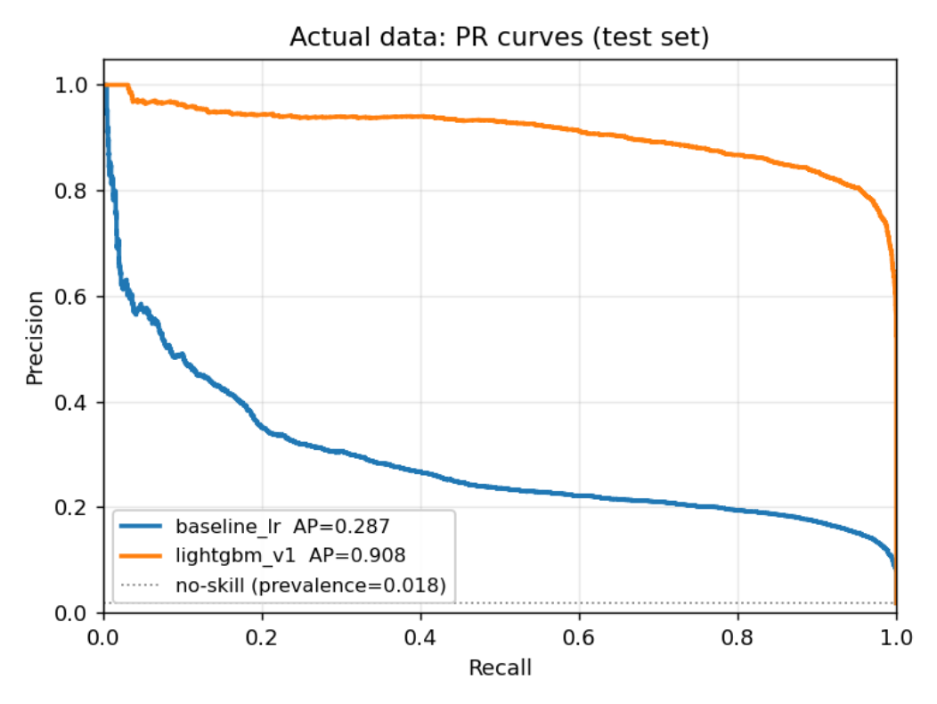
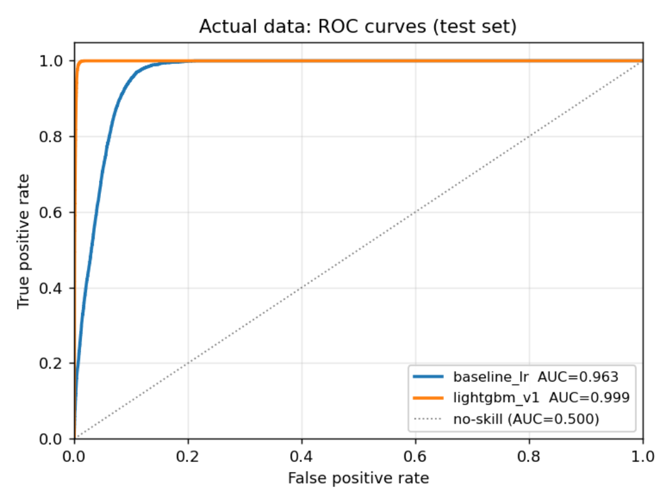
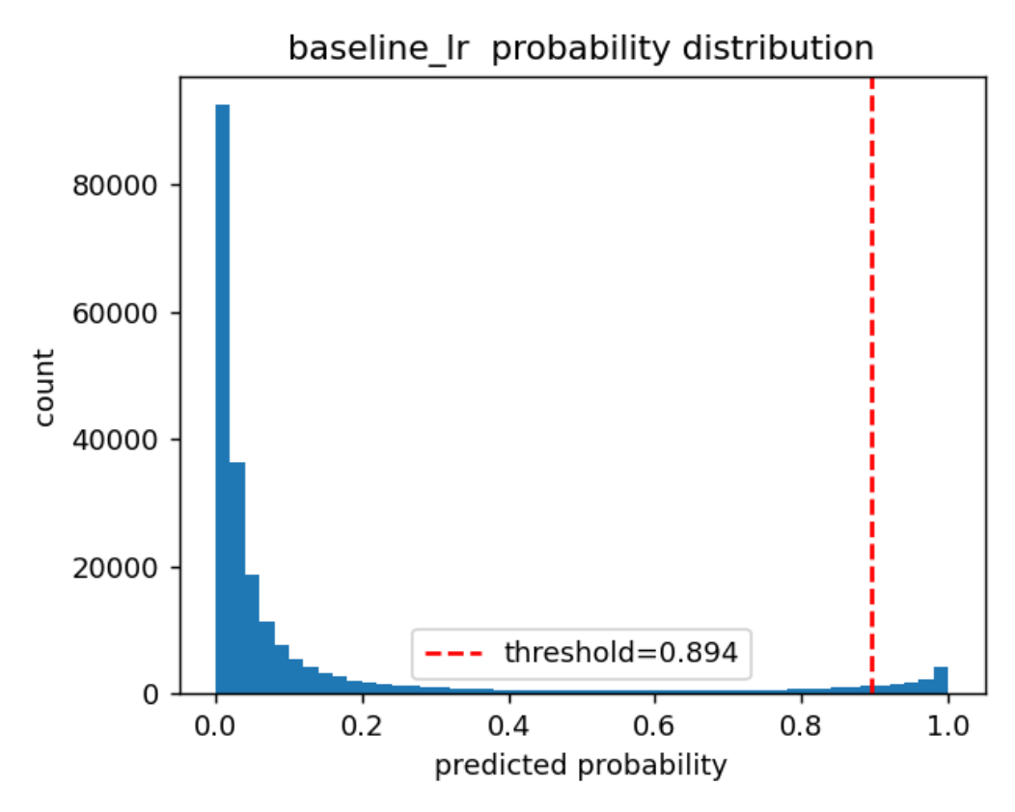
09 · EVALUATION
Real plots from the repo pipeline, real dashboard numbers.
PR CURVES · TEST SET
ROC CURVES · TEST SET
PROBABILITY HISTOGRAM · BASELINE_LR
baseline_lr AP=0.287 · lightgbm_v1 AP=0.908
baseline_lr AUC=0.963 · lightgbm_v1 AUC=0.999
artifacts/plots/prob_hist_baseline_lr.png
MODELS TRAINED ON YOUR DATA · DASHBOARD
threshold τ = 0.686 · F1-optimal
WHY PR-AUC LEADS
RUN
PR-AUC
ROC-AUC
PRECISION
RECALL
F1
Positive rate ≈ 1.8% at row level — ROC saturates near 1.0, PR doesn't. PR-AUC 0.287 → 0.908 is the honest gain.
baseline_lr
0.287
0.963
0.221
0.618
0.325
Logistic regression
OPERATIONAL HEADLINE
lightgbm_v1 ★
0.908
0.999
0.805
0.951
0.872
F1 jumps 0.325 → 0.872 at τ=0.686 — precision 0.805 with recall 0.951.
shipped model
PR/ROC curves above are the actual PNGs from pdm.evaluate on the held-out test split — training rows never enter these plots. Metrics row matches the live PdM Digital Twin dashboard exactly.
THRESHOLD Τ = 0.686
F1-max on Oct–Dec hold-out. Written to artifacts/threshold.json for the API at startup.
Notes:
- Numbers on the right are the exact results table from the repo README — both runs, every metric the brief asked for.
- PR-AUC is the primary metric because the positive rate is under one percent at row level.
- The baseline is honest: PR-AUC 0.287, false alarms 28.7 per machine-month — useful only as a floor.
- LightGBM lifts PR-AUC to 0.908 and drops false alarms to 3.03 per machine-month at threshold 0.686 — the operational number that matters to a plant.
- Plots for both models (PR curve, ROC curve, probability histogram) are produced by pdm.evaluate and written to artifacts/plots/ on every train run.

Slide 11
10 · LIKELY COMPONENT
Rule-based attribution on top of one binary head.
OPTION A
OPTION B
OPTION C · SHIPPED
Multi-class head
Post-hoc attribution
Rule-based ranking
One model per component or a 5-class softmax. Doubles training cost on a dataset where each class is already rare.
SHAP per prediction, top component by signed contribution. Strong, but explanations get noisy on a single hourly row.
When risk is elevated, rank components by hours_since_maint_compX against their typical service interval. Cheap, defensible, easy for an operator to read.
Rejected · data too thin
Future work
Defensible · deterministic
TWIN.PY · LIKELY_COMPONENT
overdue = { c: hours_since_maint[c] / typical_interval_hours[c] for c in ("comp1","comp2","comp3","comp4") } likely_component = max(overdue, key=overdue.get) confidence = "high" if overdue[likely_component] > 1.2 else "medium"
Notes:
- Three options were on the table: multi-class head, post-hoc attribution via SHAP, or rule-based.
- Multi-class needs more failures per component than this dataset offers — I rejected it.
- SHAP is excellent and is the future-work direction, but on one hourly row the explanation gets noisy.
- Rule-based ranking on hours-since-last-maintenance against typical service interval is cheap, deterministic, and easy for an operator to read.

Slide 12
11 · DIGITAL TWIN OUTPUT
One JSON object per machine, per timestamp.
POST /PREDICT · 200 OK
machineID 1 · 2015-12-15T20:00:00
FAILURE_RISK_24H
Calibrated probability from predict_proba.
{ "machineID": 1, "timestamp": "2015-12-15T20:00:00", "failure_risk_24h": 0.999, "health_state": "critical", "likely_component": "comp1", "confidence": "high", "main_evidence": [ "no maintenance on comp1 for 74.6 d", "volt_std_24h: 22.4" ], "prescription": "urgent_maintenance" }
HEALTH_STATE
Bucketed risk: healthy · watch · degraded · critical.
LIKELY_COMPONENT
Top-ranked of comp1..comp4.
MAIN_EVIDENCE
Two human-readable strings — the features driving the call.
PRESCRIPTION
One of continue · monitor · inspect · urgent_maintenance.
Notes:
- This is the actual /predict response for machine 1 at the timestamp shown — risk 0.999, critical, comp1 overdue.
- Six fields: risk, state, likely component, confidence, evidence, prescription.
- main_evidence is two human-readable strings — the no-maintenance gap on comp1 and the elevated voltage standard deviation.
- That object is what gets handed to the operator or downstream system — not a probability number.

Slide 13
12 · HEALTH & PRESCRIPTION
Risk becomes state. State becomes action.
RISK < 0.10
0.10 – 0.30
0.30 – 0.60
≥ 0.60
healthy
watch
degraded
critical
continue
monitor
inspect
urgent_maintenance
No action. Routine telemetry only.
Increase polling cadence; flag to shift lead.
Bench inspection of the likely component at next handover.
Pull from service window; replace the likely component.
SRC/PDM/HEALTH.PY · CLASSIFY_HEALTH + PRESCRIBE (VERBATIM)
def classify_health(prob, cfg): t = cfg["health_state"]["thresholds"] if prob < t["healthy_max"]: return "healthy" if prob < t["watch_max"]: return "watch" if prob < t["degraded_max"]: return "degraded" return "critical" def prescribe(state, confidence): if state == "healthy": return "continue" if state == "watch": return "monitor" if state == "degraded": return "inspect" return "urgent_maintenance" if confidence == "high" else "schedule_maintenance"
Notes:
- Four bands: healthy under 0.10, watch up to 0.30, degraded up to 0.60, critical above. Cutoffs come straight from configs/default.yaml.
- Each band maps to one action via prescribe(): continue, monitor, inspect, or maintenance.
- The 0.686 F1 threshold defines the alarm boundary above which inspection at minimum is warranted.
- Confidence override is a hard rule: a low-confidence critical never escalates to urgent_maintenance — it degrades to schedule_maintenance. The code on the right is the verbatim health.py functions.

Slide 14
13 · MLOPS
One command from CSV to container.
MAKEFILE · TARGETS
TRACKING
make install # uv-resolved env, pinned deps make validate # schema + range + join checks make features # build the 45-feature frame make train # baseline_lr + lightgbm_v1, logged to MLflow make evaluate # PR / ROC / confusion / threshold make drift # data-quality + drift report make predict # CLI inference -> twin JSON make api # uvicorn api.server:app make docker # multi-stage build, model baked in
MLflow at ./mlruns — params, metrics, model artefact per run.
ARTEFACTS
model.joblib, threshold.json, metrics.json, PR / ROC plots — written to artifacts/.
TESTS
pytest suite — schema, feature math, and a fixture-based test of the labelling function.
CONTAINER
Multi-stage Dockerfile runs the full pipeline at build → ships a ready-to-serve image.
DRIFT
Per-feature PSI + null-rate report between training window and most recent batch.
Notes:
- The Makefile is the contract: install, validate, features, train, evaluate, drift, predict, api, docker.
- MLflow tracks both runs — baseline and LightGBM — with full params and metrics, locally under mlruns.
- pytest covers schema, feature math, and the labelling function. A drift report compares the live batch against the training window with PSI and null rates.
- Docker is multi-stage: the pipeline runs at build time and the model is baked into the final image.

Slide 15
14 · LIVE DEMO
Raw CSV in, prescription out.
step 1
step 2
step 3
step 4
step 5
Upload CSVs
Train
Evaluate
Predict
Twin JSON
POST /upload-and-run
make train
make evaluate
make predict
/predict response
TERMINAL · PRESENTER SCRIPT
$ make install && make validate $ make train # ~30s on laptop, logs to ./mlruns $ make evaluate # writes artifacts/metrics.json + plots $ curl -X POST localhost:8000/predict \ -H "content-type: application/json" \ -d '{"machineID": 1, "timestamp": "2015-12-15T20:00:00"}' { "failure_risk_24h": 0.999, "health_state": "critical", "likely_component": "comp1", "prescription": "urgent_maintenance", ... }
Notes:
- This is the script I will run live. Install, validate, train, evaluate — about thirty seconds end-to-end on a laptop.
- Then a curl against /predict for machine 1 at the December 15th timestamp.
- The response is the twin object from the previous slide — critical, comp1, urgent_maintenance.
- The point is reproducibility: every interviewer in the room can clone the repo and rerun this in under five minutes.

Slide 16
15 · LIMITATIONS
What I would push back on first.
DATASET REACH
SINGLE-FAILURE APPROXIMATION
One year, 100 machines, four models
Any-component binary label
PR-AUC of 0.91 is on this slice. Seasonality, plant-to-plant variance, and longer wear cycles are not exercised.
Co-occurring failures collapse into one positive. Likely_component is heuristic, not learned.
THRESHOLD SENSITIVITY
EVIDENCE QUALITY
3.03 false alarms / machine-month
Two strings is a floor
Tighter τ cuts recall fast. Operator cost of a false alarm vs a missed failure is the right tuning input — not a held-out F1.
Current evidence is the top maintenance-age and the loudest rolling std. SHAP-backed evidence is the obvious next step.
Notes:
- I would rather raise the weaknesses than have you find them. Four of them.
- Dataset: one year, 100 machines — strong PR-AUC here is not a guarantee at fleet scale or across seasons.
- Single-failure approximation: co-occurring failures collapse into one positive and likely_component is heuristic.
- Threshold and evidence: the F1 threshold is a placeholder for a cost-curve. Two-string evidence is a floor — SHAP-backed evidence is the next step.

Slide 17
16 · WHAT COMES NEXT
From assignment to Hyundai-scale system.
INGESTION
OPERATIONS
Streaming telemetry
MES & CMMS integration
Kafka or OPC-UA into a feature store; same rolling logic, evaluated on a rolling clock instead of a CSV batch.
A critical twin opens a work order in CMMS automatically, with the likely component and evidence attached.
MODELLING
DECISION SUPPORT
Per-component heads
Fleet-level dashboards
Once volume per component is sufficient, replace the rule-based ranker with four calibrated classifiers and learn co-occurrence directly.
Aggregate twin objects by line, shift, and supplier — surface the smallest set of actions that reduce downtime risk the most.
Notes:
- Streaming ingestion via Kafka or OPC-UA — the same rolling logic on a real clock.
- A critical twin auto-opens a work order in CMMS with likely component and evidence attached — the obvious operational hook.
- Replace the rule-based ranker with calibrated per-component heads once we have the volume.
- Fleet dashboards that aggregate twin objects by line, shift, and supplier — surface the smallest action set that reduces downtime risk the most.

Slide 18
Q & A
Thank you.
Happy to go deeper on labelling, threshold economics, MLOps, or how this transplants onto a Hyundai shop-floor stack.
REPOSITORY
CANDIDATE
github.com/SauravBhowmick/HD-Hyundai-Technical-Assignment
Saurav Bhowmick
Notes:
- Hand back to the panel.
- Offer to go deeper on labelling, threshold economics, MLOps choices, or transplanting onto Hyundai's stack.
- Repository link on screen if anyone wants to look at the code during questions.

