Slide 1
After rainwater is collected from a roof, it should be filtered before it is stored in a tank. This is to ensure that it is kept in the best possible condition, to avoid degradation of biological material, development of odours etc. The roof and gutters of a building are not a sterile environment – therefore rainwater will pick up moss, dirt, leaves, bird faeces etc. on its way to the tank.
Mechanical Pre-tank Filters:
The most effective way of keeping rainwater clean is to prevent dirt and debris from entering the storage tank in the first place. To do this, most systems use a pre- or in-tank filter. These generally consist of a stainless steel element housed within a plastic body, though some inferior models are entirely plastic. The element is usually a stainless mesh or grill. The fineness of the mesh is measured in microns – the lower the micron rating, the finer the degree of filtration. So for example, Wisy® Vortex filters have a mesh rating of 280 microns (0.28mm) which will remove all but the finest particles without the mesh becoming blocked.
Pre-tank or in-tank filters will require cleaning, some more regularly than others, depending on the design. Filters with a horizontal mesh are likely to require cleaning more often than a vertical one. There are some more advanced models that have an in-built cleaning function using jets of water. There are even some filters manufactured from titanium that require no cleaning at all. One advantage of a pre-tank filter over an in-tank version is not having to open up the tank just to clean the filter.
For most purposes, such as flushing toilets, washing clothes and simple garden watering, a good quality pre- or in-tank filter will be all that is required. However, in some situations, further filtration or treatment may be needed, depending on the demands of the system. For example, certain industrial processes may require water to be filtered to a microscopic level, or some uses such as vehicle washes will require the water to be sterilised.

Slide 2
Microscopic Filtration
A much finer degree of filtration can easily be achieved through the use of particulate filters. These days such filters are generally in the form of a sealed housing containing a cartridge or bag which traps very fine particles to provide an even cleaner standard of water. Mostly these require the cartridge or bag to be changed periodically when they begin to clog up, though some of the coarser grades can be washed and
One important point is that such filters require pressure in order to function effectively; they work by the water being forced through. Hence such filters are generally only found on pumped water supplies.
More advanced versions have a stainless steel element with a ‘backwash’ function – to enable easy cleaning; this can either be done manually or automatically using a timer control. These are extremely effective and reduce maintenance, but are expensive items so are generally only used on larger systems. Another advanced method is the use of membrane technology. Here the water is forced under very high pressure through a layer of material with microscopic holes that trap the particles. Again such devices are generally only used on larger commercial projects.
More traditional filters are made up of layers of gravel and sand, – at different levels of coarseness. Water passes through by gravity, with different size particles removed as the water passes through each level.

Slide 3
Disinfection
While mechanical filters are effective at removing particles from water, they cannot remove bacteria. This is not an issue if the water is to be used just for WC flushing, washing machine use and garden watering. However, if the rainwater is also destined for personal use; drinking, showering, etc. or if there is a risk of water vapour being ingested (e.g. spray irrigation at a garden centre or nursery), then disinfection is an essential additional step.
There are several methods of doing this, such as chemical dosing, Reverse Osmosis (RO) or Ultra-Violet light (UV). RO systems tend to be expensive and waste a lot of water, and dosing systems rely on using hazardous chemical (e.g. chlorine). So the most common method is UV disinfection, being both safe and reliable if properly maintained.
Ultraviolet disinfection works by sterilising water as it passes over a glass tube where it is exposed to ultraviolet light of a particular wavelength and intensity. This process instantly sterilises the water by destroying any microorganisms present. The UV lamp will need replacing annually, and is a simple unskilled task.

Slide 4
Carbon Filters
If rainwater is to be used for drinking (this is rare, but if no other water supply is available there may be no choice) further treatment may be recommended in the form of carbon filtration. By passing the water through carbon, taste and odour are significantly improved and also discolouration to a degree. This is the same technology as used in the common household water filter jugs and under-sink units. Carbon is also effective at removing chlorine and other volatile organic substances (VOCs).
A Granular Activated Carbon module can be added to any rainwater system, or used as a stand-alone unit.

Slide 5
Sand filters are used as a step in the water treatment process of water purification.
There are three main types; rapid (gravity) sand filters, upward flow sand filters and slow sand filters. All three methods are used extensively in the water industry throughout the world. The first two require the use of flocculant chemicals to work effectively while slow sand filters can produce very high quality water with pathogens removal from 90% to >99% (depending on the strains), taste and odour without the need for chemical aids.[1] Sand filters can, apart from being used in water treatment plants, be used for water purification in singular households as they use materials which are available for most people.[2]
Sand bed filtration concept
A sand bed filter is a kind of depth filter. Broadly, there are two types of filters for separating particulate solids from fluids:
Surface filters, where particulates are captured on a permeable surface
Depth filters, where particulates are captured within a porous body of material.[4]
In addition, there are passive and active devices for causing solid-liquid separation such as settling tanks, self-cleaning screen filters, hydrocyclones and centrifuges.[4]
There are several kinds of depth filters, some employing fibrous material and others employing granular materials. Sand bed filters are an example of a granular loose media depth filter. They are usually used to separate small amounts (<10 parts per million or <10 g per cubic metre) of fine solids (<100 micrometres) from aqueous solutions.[5]:302–303 In addition, they are usually used to purify the fluid rather than capture the solids as a valuable material. Therefore they find most of their uses in liquid effluent (wastewater) treatment.

Slide 6
Slow sand filtration is an extremely efficient method for removing microbial contamination and will usually have no indicator bacteria present at the outlet. SSFs are also effective in removing protozoa and viruses (WHO n.y.). If the effluent turbidity is below 1.0 nephelometric turbidity units (NTU), a 90 to 99% reduction in bacteria and viruses is achieved (NDWC 2000). Yet, slow sand filtration is generally not effective for the majority of chemicals (WHO n.y.). However, it can be argued that chemical standards for drinking water are of secondary concern in water supply subject to severe bacterial contamination (WHO 1996).
Highly effective for
Bacteria
Protozoa
Viruses
Turbidity
Heavy metals (Zn, Cu, Cd, Pb)
Somewhat effective for
Odour, Taste
Iron, Manganese
Organic Matter
Arsenic
Not effective for
Salts
Fluoride
Trihalomethane (THM) Precursors
Majority of chemicals

Slide 7
The impurities present in rain water are dust and dissolved gases like oxygen, nitrogen and carbon dioxide and these gases are not poisonous, rain water is safe for drinking.
Ceramics Filter:
Advantages of ceramic filters
Natural filter media – just like activated carbon, ceramic is a natural filter media that doesn’t add anything to water while it filters it, and doesn’t remove healthy minerals.
Efficient against bacteria, cysts and some viruses – the small pore size and versatile pore structure of the ceramic is responsible for its success at removing particles and pathogens from water.
Cleanable – while they do have to be replaced in full after a certain period, ceramic filter candles are cleanable. This prolongs their service life and reduces replacement costs.
Affordable – ceramic filters are one of the most affordable type of filter media on the market.
Compatible with both pressure filters and gravity filters – ceramic filter cartridges can be used both in under-sink water filters or gravity water filters. These filters are used also as pre or post filters in reverse osmosis or UV water filters.
Disadvantages of ceramic filters
Does not remove chemical contaminants – chlorine and other chemicals are not removed by ceramic filters, however, most ceramic filters will contain activated carbon block inserts to remove organic compounds and chlorine. Some ceramic filters also contain ion exchange resin to remove heavy metals. Other filter candles can be treated with silver to prevent bacterial grow-through.
Not drop-proof – dropping a ceramic candle while replacing it or otherwise can lead to surface cracks an inner cracks that would undermine the efficiency of the filter, thus, it’s important to handle them with care.

Slide 8
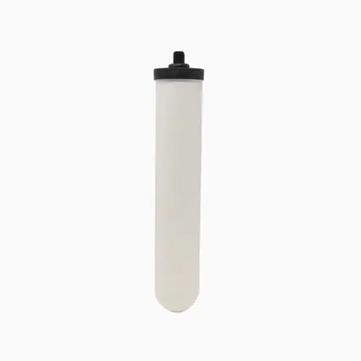
Cost:
₹1,499.00
SKU: W9121711 Categories: Ceramic Filter Candles, Wall-mounted Filters Tag: Water Filter Candles
The ceramic shell is filled with granular activated carbon, to give superior flow rates in a gravity filter. Benefits: Removal of particles, pathogenic bacteria, cysts, etc. with additional chlorine and organics removal capabilities. Size: 10″ (254mm) long x 2″ (49mm) diameter. 1 1/2″ (38mm) long mount

Slide 9
Carbon filter:
Advantages:
Natural filter media: this water filter media is created from materials such as bituminous, wood and coconut shell, no chemicals or other substances are added to water, therefore a natural filtration process is achieved;
Low-cost & easy maintenance: AC filters are one of the least expensive filters and don’t require much in terms of maintenance. Each brand and model of AC filter cartridge has a certain service life at the end of which the filter cartridge has to be replaced;
Excellent for enhancing the taste and odour of tap water;
Good at filtering out other carbon-based, organic chemicals and chemical disinfectants like chlorine as well as some microorganisms.
Disadvantages:
AC filters are not good at removing chemicals that are not attracted to carbon (e.g. sodium, nitrates, heavy metals, fluoride, etc.);
Short service life: when the bonding sites in these filters (the ones responsible for “trapping” contaminants) get filled with contaminants, AC filters stop working and need to be replaced;
The effectiveness of filtration is determined by factors such as the amount of AC and the time water stays in contact with the filter media. Its effectiveness decreases if water does not stay in contact long enough with the carbon filter media;
AC filters are not effective against some pathogenic bacteria and viruses, and can harbour bacteria, which can lead to bacterial grow-through, however, some filters have managed to avoid this issue by adding trace amounts of silver to inhibit bacterial growth (these filters are known as silver impregnated activated carbon filters).

Slide 10
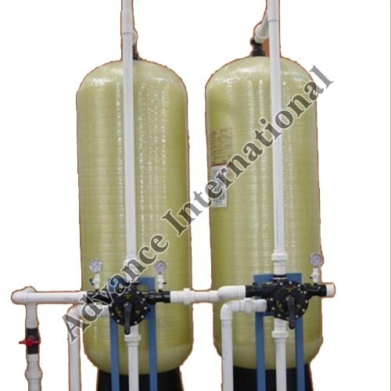
Cost:
₹3,500
Sold By - Advance International, New Delhi

Slide 11
Membrane Filters
Historically cloth has been used to filter water. In microstraining the water is filtered through fabric made from finely woven wire. In both these cases the cloth or fabric is a kind of membrane, albeit a coarse one. Modern technology allows manufacture of membranes from synthetic materials, to be less than about 1mm thick and be semi-permeable. Being semi-permeable means that the membrane is selective in what submicron-size particles can and cannot pass through it that is in the feed stream. During operation, permeable components in the water pass through the membrane with the water whilst impermeable submicron-size components are retained on the feed side. Consequently, the product stream is relatively free of the impermeable components and the waste stream is rich in impermeable components. Flow of water through such a semi-permeable membrane is achieved by pressure, usually produced by pumping.
There are four categories of membranes loosely defined by the types of materials rejected, operating pressure and nominal pore size. The categorisation of pore size is approximate since, for example a high-end UF membrane can have similar permeability to a low-end NF membrane:
Microfiltration (MF) - approx 0.1 µm pores: impermeable to particles, algae, animalcules and bacteria
Ultrafiltration (UF) – approx 0.01 µm pores: impermeable to small colloids and viruses
Nanofiltration (NF) – approx 0.001 µm pores: impermeable to dissolved organic matter (DOM) and divalent ions
Reverse osmosis (RO) – effectively non-porous: impermeable to monovalent ions
The predominant mechanism in MF and UF is straining, or simple size exclusion. In NF and RO separation of dissolved species involves mass transfer, a process of diffusion that depends on concentration, pressure and rate of flow through the membrane (flux). Consequently, membrane filtration usually refers to MF and UF but not NF and RO, whilst NF is usually considered to be a form of RO.
The thickness of membranes means that they have to be formatted in a way that provides structural strength, so they will not collapse because of the pressure difference across them, provide a large area for filtration but are compact and can be cleaned effectively. They are generally structured as thin tubes (hollow fibres) or as a coiled sheet. A coil is a sandwich of the semi-permeable membrane, a separating mesh, a thin sheet of impermeable material and a second layer of thin mesh. The layers of mesh provide the channels for flow to the inlet and from the outlet side of the membrane.
It is usual to include a preliminary stage of treatment before membrane filtration to protect the membrane from being fouled too rapidly by excluded material, although there are also ways to operate membrane filters to slow the rate of fouling of the membrane before having to apply a cleaning process. The routine, and frequent, cleaning process is flushing to remove the accumulated detritus on the feed side. However, over time there is a slow loss in membrane performance that can only be recovered by chemical cleaning.
Membrane filtration (MF, UF and low end NF) have become relatively common in potable water treatment, such as for removal of colour from otherwise relatively good quality water so avoiding complexities associated with coagulation, and for reliable exclusion of Cryptosporidium.

Slide 12
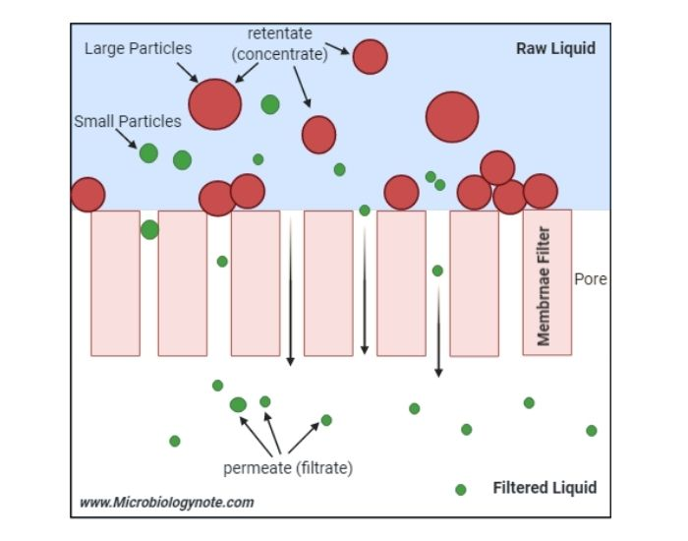
Membrane Filtration
In biology laboratories, membrane Filtration is widely used to sterilize liquids.
High tensile strength polymers such as cellulose acetate, cellulose nitrate, or polysulfone are the main constituents of the membrane filter.
The Membrane filter is also known as the molecular or biological filter.
A membrane filter is 150μm thick and contains about millions of microscopic pores. The diameter of these spores is uniform. Based on the requirement the size of these pores is adjusted, during the process of polymerization.
The most widely accepted membrane filter possesses a pore size of 0.22μm and 0.45μm.
The contaminants which are larger than the pore size are trapped on the surface of the membrane filter, that’s how they filtrate the liquids.
If the desired particles are larger than the contaminant then we can trap the desired particles or product on the membrane filter by decreasing the pore size. While the contaminants will pass through the membrane.
The filters can be attached in parallel or series for higher-order flexibility. The throughput will increase if we add a filter of the identical pore size in parallel.
It is an effective, accepted technique for the filtration of fluid samples.
The quality of water and the quantity of microorganisms can be determined by using this membrane filtration method.
The main purpose of the Membrane filtration technique is to ascertain the residence or absence of a particular coliform group that is usually existing in wastewater and groundwater.
Sometimes, during the membrane filtration technique, the membrane filter is placed over an absorbent paper of diameter 48mm with a thickness of 0.8mm. After that, it is incubated for the extension of bacterial colonies. It absorbs 1.8-2.2ml nutrient medium.
The absorbent pad soaks with the proper liquid broth medium to which 1.5% of agar may be supplemented.
An absorbent pad is made of filter paper disks. It is free from growth suppressing substances such as sulphites and other compounds to enhance the growth of bacteria.

Slide 13
Advantages of Membrane Filtration
It allows the filtration of any volumes of non-turbid water through the disk.
This method is inexpensive.
No requirement for chemicals.
Can remove 90–100% pathogens from the water sample.
This method is more energy efficient.
It doesn’t denature the proteins.
Heat sensitive media can be sterilized by using this method.
It allows the isolation and enumeration of bacterial colonies by transferring the disk from one medium to another.
As compared to the conventional MPN standard methods, membrane filtration provides a more rapid result. It takes 24 hours to provide the result.
It takes less time as compared to the MPN method.
It provides relevant and reliable results.

Slide 14
Disadvantages of Membrane Filtration
The turbid water can not be used in membrane filtration.
There may be a risk of bacterial abundance, as the water carries numerous microorganisms.
Glass filters are breakable and can break quickly.
The membrane filters can crack easily.
Only liquids are sterilized by this method.
Filters are costly to repair, mainly nano-filters.
Constitutional restrictions of supplies used in filters alter the effectiveness of this process such as damage of glass filters, fracture of the membrane filter, and consumption of the filtrate by Sietz filter.
Require a high differential pressure.
Clogging can occur.

Slide 15
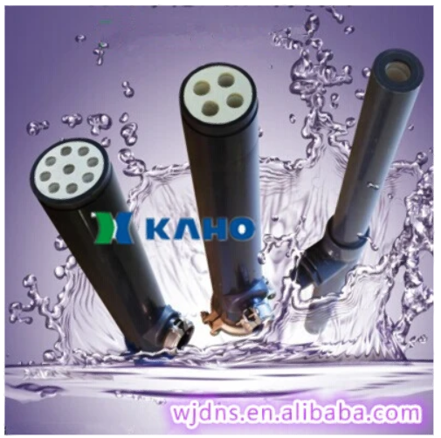
Microfiltration (MF) Cost:
Porex Same Model Microfiltration Membrane for Industrial Wastewater Treatment (KAHO)
Get Latest Price Chat with Supplier.
Min. Order / Reference FOB Price
1 Piece US $106/ Piece
Production Capacity: 10000PCS/Month
Transport Package: PE Bag Inside Carton Outside
Payment Terms: L/C, T/T, D/P, Paypal, Money Gram, Western Union
Type: Micro Filtration
Usage: Environmental Protection
Motive Force: Electric power
Style: Tube
Performance: Efficient Filtration
Certification: ISO

Slide 16
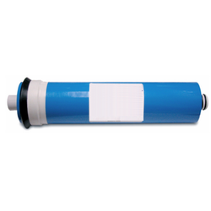
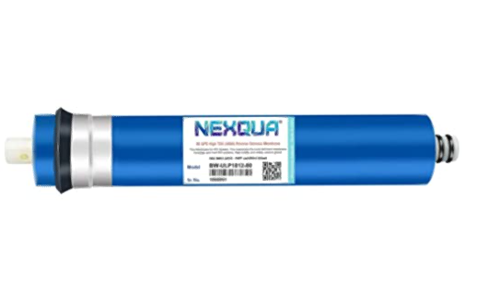
Ultrafiltration (UF) Cost:
Pratham Ultrafiltration Membranes, Material : Polyethylene
₹ 8,000/ Piece
Nexqua RO Membrane 80 gpd original ,purify water upto high 3000 TDS, suitable for RO Water Purifier Filter System
Brand: NEXQUA
Price: ₹ 799.00

Slide 17
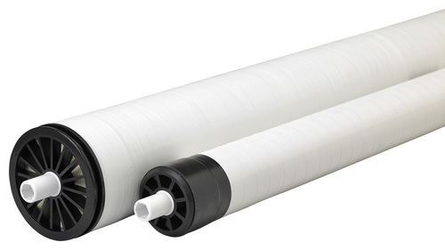
Reverse osmosis (RO) Cost:
White RO Membrane
₹ 500/ Piece
Membrane Material PVC
Shape Round
Application Water Purification
Color White

Slide 18
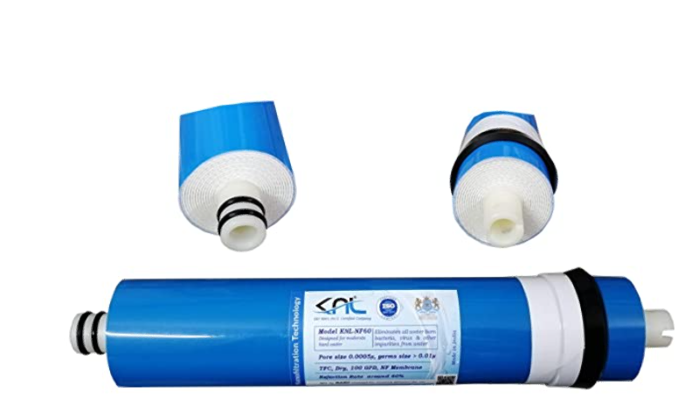
Nanofiltration membrane Cost:
KNL-NF60, TFC Dry 100 GPD NF Membrane, BARC Licensed, Flux Rate up to 22 ltrs/hr, Pore Size 0.0005 μ, Reduces tds Around 65%, Used for RO/NF (Reverse Osmosis) Water purifiers
Brand: KNL
Price: ₹ 1,400.00

