Slide 1
PUMPS

Slide 2
WHAT KIND OF PUMPS ARE AVAILABLE IN THE MARKET?
Depending on your needs and necessities there are two major types of pumps available in the market, namely - Domestic and Agricultural Pumps. They are engineered in a way that makes an appliance a perfect pick. Under the broad section of these two kinds of pumps there are several different types available which have their salient features. Read on to have a better understanding of it.
A. Domestic Pumps
As the name suggests, Domestic Pumps are those used in homes for daily water consumption. These pumps have a lower flow rate and less power as compared to the ones used for agricultural purposes, since they have to be pumped into small areas. The various domestic pumps are:
1. Self-Prime Regenerative Pumps
A Regenerative Pump has vanes fitted on either side of the rim that rotate in a ring-like conduit in the pump's casing. The fluid does not discharge from the tip of the impeller but is re-circulated back to the bottom of the impeller. This re-circulation or regeneration is how the pump re-primes itself.
These pumps are suitable for handling clear cold fresh water, free from abrasive particles and chemically aggressive substances. Suitable for domestic water supply, lawn sprinklers, gardens, etc. These pumps due to their self-priming capability can remove air and hence is suitable to suck water from pipelines and, therefore, does not require a foot valve.

Slide 3
2. Centrifugal Pumps
Centrifugal Pumps serve the purpose of circulating water by the conversion of rotational kinetic energy to the hydrodynamic energy of water flow. The rotational energy is derived from an electric motor. The other kind of a centrifugal pump with a similar mechanism is the Jet Centrifugal pump which uses a stream of sucked water for creating a jet to improve the drawing capacity from the underground resources.
These pumps are suitable for handling clear cold fresh water, free from abrasive particles and chemically aggressive substances. Suitable for domestic water supply, lawn sprinklers, gardens, small farms, irrigation, agricultural applications, draining of wells and tanks, filling water in swimming pools, etc. These pumps have higher discharge compared to regenerative pumps. The pump has to be installed with a good quality ISI foot valve. Excellent hydraulic performance and higher operating efficiency compared to regenerative pumps with lower maintenance costs.
3. Submersible Pumps
A Submersible Pump is a device with a sealed motor which is completely submerged in water bodies, especially open wells and bore wells. They are an efficient and wiser choice since they do not require any priming as they are already submerged into water. They are further divided into two types:
Open Well Submersible Pumps ( Water Cooled/Oil Cooled) (For Open-Well Applications)
Tube Well submersible Pumps ( Water Cooled/Oil Cooled) (For Bore well applications)
These pumps are suitable for handling clear cold fresh water, free from abrasive particles and chemically aggressive substances. Tube well submersible pumps are suitable for 3", 3.5" & 4" bore wells.

Slide 4
4. Bore Well Compressor Pumps
Bore Well Compressor Pumps are especially designed for drawing water from deep bore wells with specific diameters. Air pressure is used in this machine to lift the water from deep bores.
These pumps are best suited for comparatively less yield bore wells, having a depth of up to 600 ft. Compressor Pumps can be used in bore wells containing muddy water, where tube well pumps are not suitable. There are two types of compressor pumps, Monobloc and belt driven types. Discharge of the compressor pumps depends on the yield of the bore well.
5. Pressure Booster Pumps
A Pressure booster pump is a quality appliance, which you should go for if you want smooth and pressurized water supply in your home. They are especially engineered to supply you with required pressurized water according to your needs.
The automated pumping system is supplied with a pressure tank for constant water pressure across all openings connected to the piping system making it an ideal choice for use in residential buildings. As the water pressure drops to a set level, the pump automatically starts to pump water and as the consumption drops the pump stops automatically when the outlet pressure rises to pre-set stop pressure.
6. Shallow Well Pumps
Shallow Well Pumps, are a very novel pick for shallow wells. The reason being that they have great suction power and are a good choice for rural areas.
Shallow Well Pumps having suction head of up to 8 meters and hence can be chosen as an alternative if suction head is greater than 6 meters which is the capacity for normal self-prime pumps.

Slide 5
What to look for in a water pump?
Vertical Suction
This involves the distance through which water must be sucked out of its source in order to reach the pump. If your pump is mounted at well top, then the distance from water level to the pump position is the vertical suction. This parameter needs to be cross-checked against the pump suction head before purchasing.
Vertical Delivery Head
The vertical distance between the pump and the delivery tank is called the vertical delivery head. This height need to be matched with the pump delivery head to ensure that the selected pump suits your application.

Slide 6
Converting head in metre to pressure in bar
Pumps characteristic curves in metre of head can be converted to pressure - bar - by the expression:
p = 0.0981 h SG
where
h = head (m)
p = pressure (bar)

Slide 7
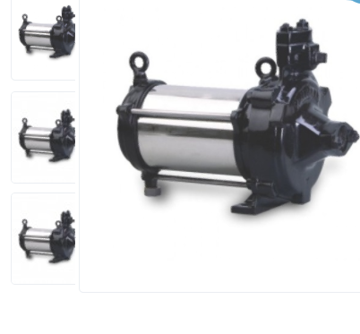
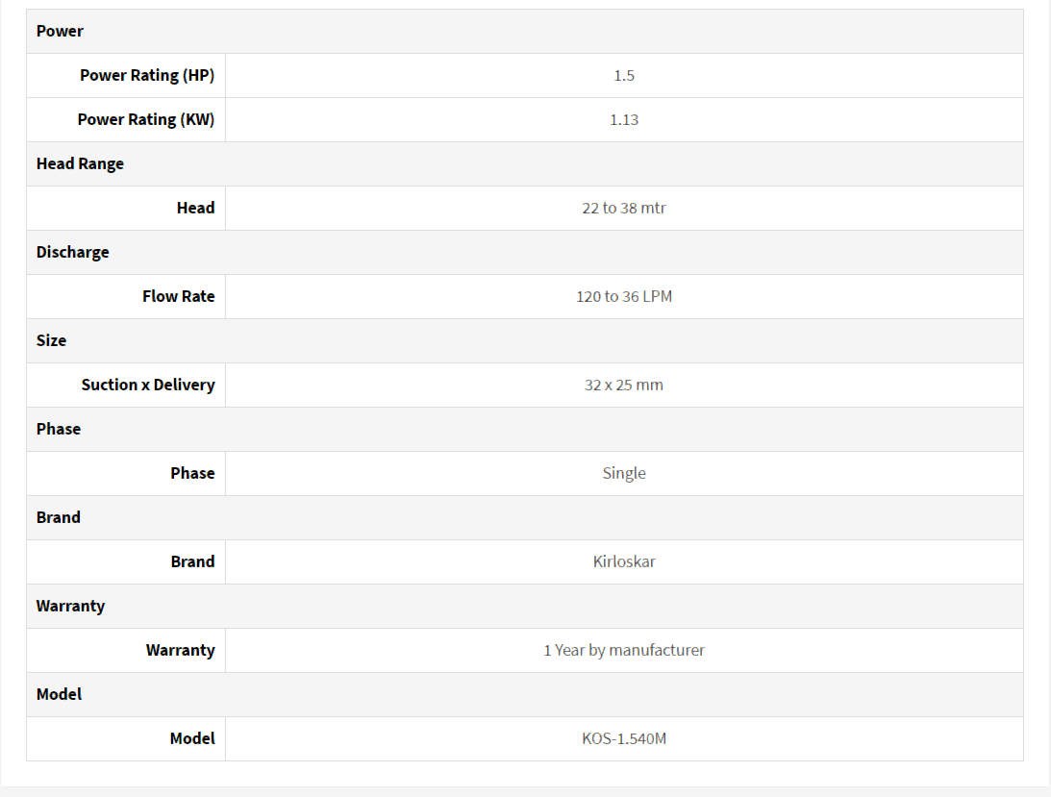
Pumps:

Slide 8
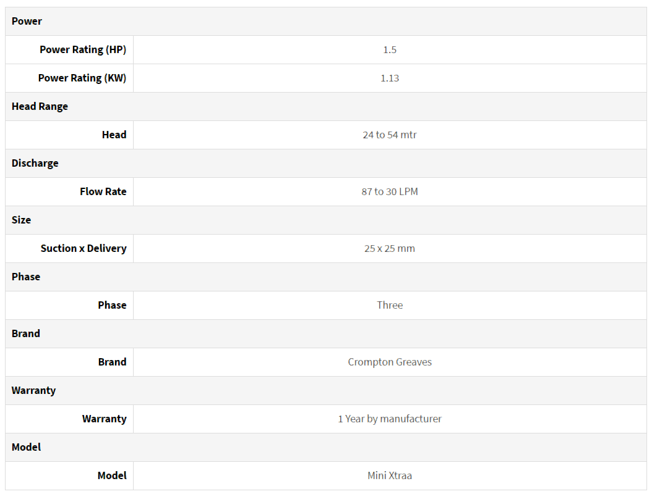
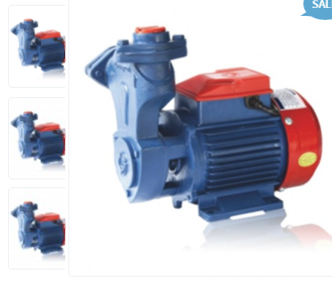

Slide 9
