Slide 1
HIGH PERFORMANCE DISTRIBUTED STORAGE
SAURAV KANCHAN
AISHWARYA KAMTAM
NIKITA CHORGHE
AKHIL KEDARE

Slide 2
Problem Statement
IPFS is a peer-to-peer version controlled filesystem that synthesizes learnings from many previous successful systems. IPFS combines a distributed Hash table, an incentivized block exchange, and a self-certifying namespace . IPFS is a peer-to-peer hypermedia protocol to make the web faster, safer, and more open. According to the characteristics of IPFS, we propose an improved P2P file system scheme. We address the high-throughput problem for individual users in network by introducing the role of content service providers. Consider data reliability and availability, storage overhead and other issues for service providers

Slide 3
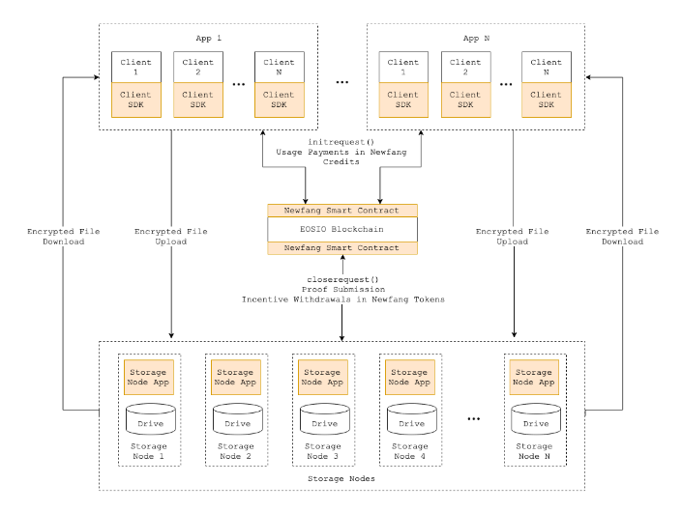
Proposed Methodology

Slide 4
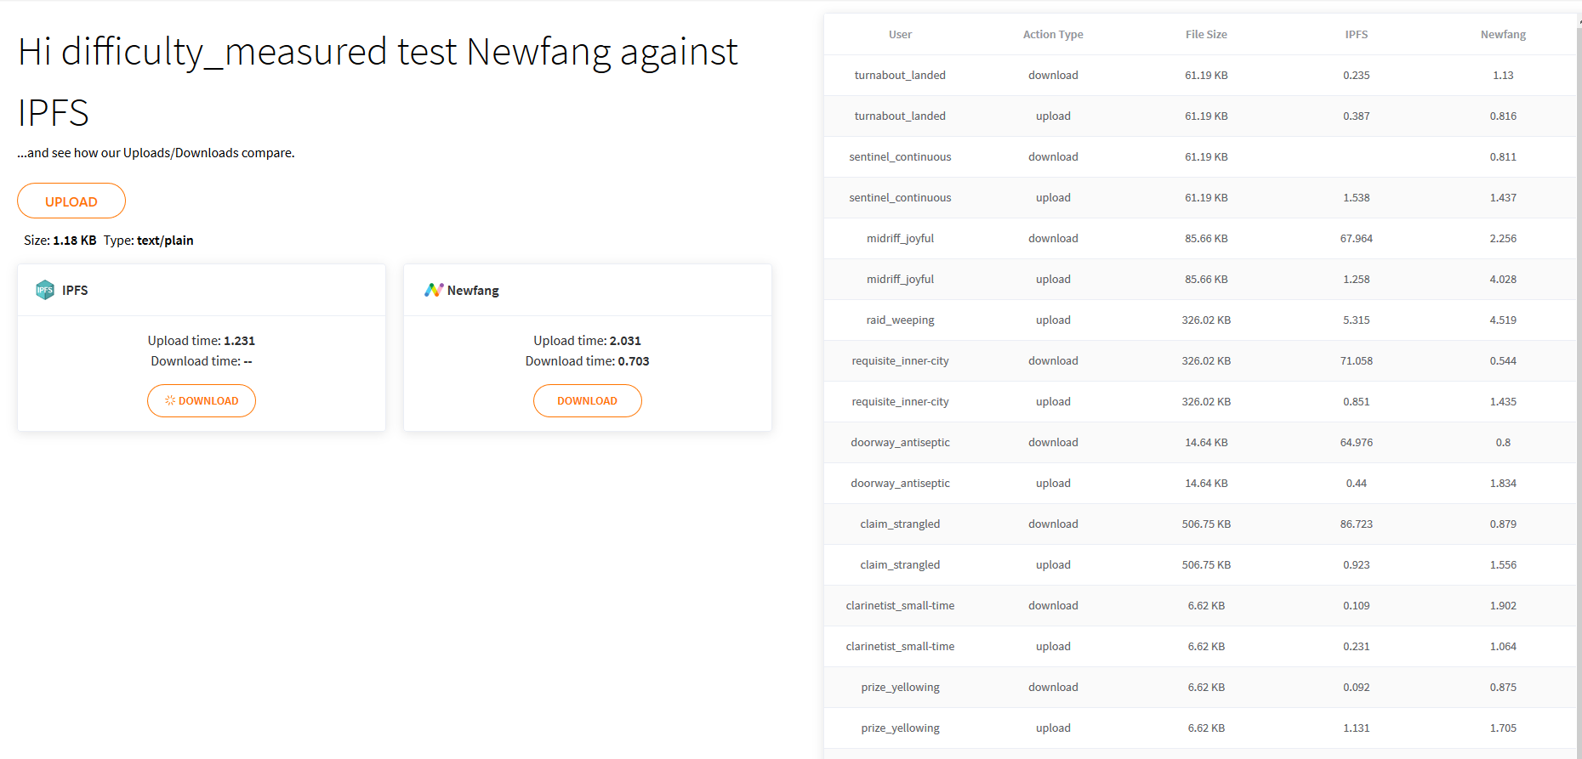

Slide 5
Requirements
Frontend :: HTML5, CSS3, JavaScript, VueJs
Backend :: NodeJs, RPC, IPFS, NGINX, LetsEncrypt, CertBot
Cloud Platform Used :: EC2 Instance of AWS

Slide 6
Cloud Platform required
Amazon EC2 Instance Types
Amazon EC2 provides a wide selection of instance types optimized to fit different use cases. Instance types comprise varying combinations of CPU, memory, storage, and networking capacity and give you the flexibility to choose the appropriate mix of resources for your applications. Each instance type includes one or more instance sizes, allowing you to scale your resources to the requirements of your target workload.

