Slide 1


Knowledge graph for nutritions and mental health
Guided By : Dr. K.M. Pooja Ma’am
IIT2021254 - Amul Shaturia
IIB2021028 - Akhila Miryala
IIB2021034 - Saurav Kumar
IIT2021217 - Satyam Thakur
IIB2021018 - Ashwani Jha

Slide 2
Problem:
There is currently no such knowledge graph that encodes relationships between food, biochemicals and mental illnesses.
A large amount of knowledge about these relationships is available in the form of unstructured text in biomedical literature articles.

Slide 3
Introduction :
To address this limitation,
We have developed knowledge graph.
A knowledge graph that represents relations between nutrition and mental health, extracted from biomedical abstracts.
What type of relationship this graph shows……
Food-Health Relationships
Chemical Interactions
Disease Associations
nutritions Factors

Slide 4
What is already Known
Data: available relationships from DOID ontologies and BC5CDR Corpus.
Model: this study uses scispaCy’s model for Named Entity Recognition (NER) and common PAS patterns in biomedical text as base models.
Disease Ontology (DOID): A standardized ontology specifically designed for human diseases. Its purpose is to provide descriptions of disease terms and related medical vocabulary concepts.
What we did
Regarding NER and RE, introduces some DT-based rules, which modifies the detected entity, develops PAS patterns and 4 noun-phrase patterns to detect complex relationships between entities.

Slide 5
Data Collection
To retrieve PubMed abstracts relevant to our study, we collected three different categories of keywords from existing ontologies:
Mental health keywords were extracted from MFODM and ASDTTO.
Nutrition keywords were obtained from FOODON.
Biochemical keywords from CHEBI.
These are freely available dictionaries of entities focused on chemical compounds and nutritions.

Slide 6
BC5CDR Dataset
The BC5CDR corpus is a valuable resource for chemical-disease relation extraction. It consists of 1,500 PubMed articles that have been meticulously annotated with:
4,409 chemicals
5,818 diseases
3,116 chemical-disease interactions
How we utilize BC5DR in NER :
Dataset Preparation: we start by obtaining the BC5CDR dataset, which contains annotated biomedical articles with mentions of chemicals and diseases.The dataset includes labeled entities (chemicals and diseases) along with their corresponding spans in the text.

Slide 7
Named Entity Extraction
There is an existing model for chemicals and diseases, i.e. spaCy NER BC5CDR, trained on the BC5CDR corpus. We have used this model as the base model to identify chemical and disease entities.
We followed hybrid approach for (NER) which involves the following steps:
Base Model: Utilizes spaCy’s NER BC5CDR model trained on the BC5CDR corpus to identify chemical and disease.
Post-Processing: Employs DTs to modify the entities detected by the base model. This step extends the entity spans to include surrounding words, ensuring that each entity constitutes a complete and meaningful phrase.
Dictionary Matching: Compiles a dictionary of terms from various ontologies to detect nutrition, biochemical, and mental health entities. This dictionary is integrated into spaCy’s general NLP pipeline.

Slide 8
What this we are improving….
Regarding NER and RE, DT-based rules, which modifies the detected entity, develops PAS patterns and 4 noun-phrase patterns to detect complex relationships between entities.
In application, KG contains 5 relevant entities and th­­­eir new relationships extracted from several citations .
Nutrition : Vitamins
Biochemical : proteins, fats
mental health : Anxiety
Chemical : Benzene
Disease : Malaria

Slide 9
Problem with base model : ‘‘The Vitamin C deficiency is widely associated to stress-related diseases’’
Wrongly extracted entity : “Vitamin C”
Correct Entity should be : complete noun phrase ‘‘Vitamin C deficiency’’
To address this issue, we have used post-processing step for NER, using the results of rule based DT.
DT represent the syntactic structure of sentences.
Each word in a sentence is linked to its governing word (head) through dependency relations.
For ex : “Vitamin C deficiency causes mental stress” , the word “deficiency” depends on “Vitamin C”

Slide 10
Example of the handcrafted rules mentioned in paper “KnowUREnvironment”.
1. Noun Phrase (NP) Rules:
An NP consists of a main noun along with words that modify it.
For ex : “vitamin C deficiency,” the NP is “vitamin C deficiency.”
If the base model detects only part of an NP (like “vitamin C”), the rules extend it to include the main noun (“deficiency”).
This ensures that each recognized entity constitutes a meaningful and complete phrase.
2. Adjective Rules:
These rules handle mentions corresponding to adjectives.
When an adjective modifies an entity (e.g., “low iron levels”), the rules ensure that the entire phrase is captured.
So, if the base model detects “low iron,” the rules extend it to “low iron levels.”

Slide 11
Relation Extraction :
Our main focus is to detect new relations between nutrition and health entities, which are not present in existing datasets.
The most similar existing dataset is the BC5CDR corpus, which includes Chemical-induce-Disease (CID) relations.
Ex :
“Long-term exposure to benzene, lead to the development of acute myeloid leukemia”
Benzene : A common industrial solvent
myeloid leukemia : A serious form of blood cancer.
So to find the relations which are not straight forward or directly available.
We are leveraging the power of Dependency Parsers/Trees(DTs) to extract the relationships

Slide 12
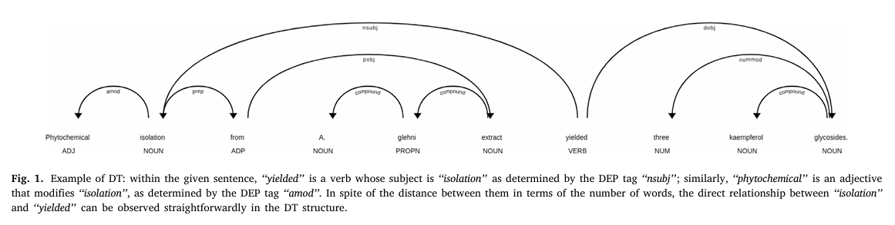
“Phytochemical isolation from a glehni extract yielded three kaempferol glycosides”
Example of DT: within the given sentence, ‘‘yielded’’ is a verb whose subject is ‘‘isolation’’ as determined by the DEP tag ‘‘nsubj’’; similarly, ‘‘phytochemical’’ is an adjective that modifies ‘‘isolation’’, as determined by the DEP tag ‘‘amod’’. In spite of the distance between them in terms of the number of words, the direct relationship between ‘‘isolation’’ and ‘‘yielded’’ can be observed straightforwardly in the DT structure.

Slide 13
How DTs gives relations :
Parsing Sentences: The first step is to parse the input sentence using a dependency parser.
Extracting Relationships: After identifying entities, the dependency tree is traversed to extract relationships between them. This is done by examining the dependency relations between the words that represent the entities.
Dependency Relations: Dependency relations capture how words are connected in a sentence. Some common dependency relations include:
nsubj (nominal subject): The noun phrase that serves as the subject of a clause.
dobj (direct object): The noun phrase that is the object of the verb.
nmod (noun modifier): A noun phrase that modifies another noun.
amod (adjectival modifier): An adjective that modifies a noun.
prep (prepositional modifier): A prepositional phrase modifying a verb, noun, or adjective.

Slide 14
Example: Consider the sentence
“Our body produces 2-Hydroxypropanoic acid that causes muscle cramps”
"2-Hydroxypropanoic acid" is the subject (nsubj) of "causes",
"muscle cramps" is the direct object (dobj) of "causes".
The dependency tree representation of this sentence will reflect this relationship.
Building Relationships
By analyzing the dependency relations between entities, relationships can be constructed.
For example, if "2-Hydroxypropanoic acid" is the nominal subject(nsubj) of a verb and "muscle cramps" is the direct object(dobj) of that same verb, we can infer that 2-Hydroxypropanoic acid causes muscle cramps.

Slide 15
Entity Normalization :
‘‘serotonin’’ is commonly referred either ‘‘5- hydroxytryptamine’’ or ‘‘5-HT’’,
‘‘ADHD’’ is an abbreviation of ‘‘attention deficit hyperactivity disorder’’.
Given such variations, it is important to normalise textual entity mentions to determine the exact concept that they describe.
This allows our KG to encode information about relationships between concepts, regardless of their representation.
Our approach normalises detected entities by mapping them to concepts in the target ontologies listed in following Table.

Slide 16
Table for Ontologies :
Abbreviation Ontology Name
DOID Human Disease Ontology
ASDTTO Autism Spectrum Disorder Phenotype Ontology
FOODON The FoodOn Food Ontology
MFOMD MFO Mental Disease Ontology
PR Protein Ontology
SYMP Symptom Ontology

Slide 17
Entity normalization is a multi-step process :
Exact String Matching: Initially, entities are searched in Medical Subject Headings (MeSH) database. If a match is found, the corresponding MeSH ID is assigned to the entity.
Cosine Similarity Matching: For entities not found in MeSH, cosine similarity matching is used against terms in seven different ontologies. If the cosine similarity exceeds 95%, the unique ID from the matched ontology is assigned to the entity.
KG Population: After normalization, each entity is represented as a unique concept node in the knowledge graph, with edges denoting extracted relationships from PubMed abstracts.

Slide 18
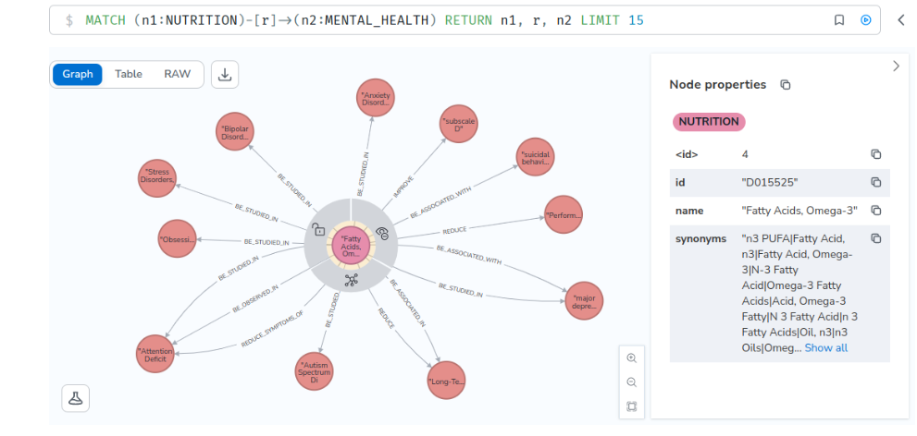
Neo4j: This query aims to extract the 10 directed relations from Nutrition to Mental Health. You can easily custom the query to get the desired information as instructed in CQL.

Slide 19
Neo4J workspace : https://workspace-preview.neo4j.io/connection/connect
NEO4J_URI= neo4j+s://921e6f9a.databases.neo4j.io
NEO4J_USERNAME= neo4j
NEO4J_PASSWORD= tQr_-EKRoD6zV5PhMgA_NqGxJCPkfobZBk140oknFk0
AURA_INSTANCEID=921e6f9a
AURA_INSTANCENAME=Instance01
Query:
MATCH (n1:NUTRITION)-[r]->(n2:MENTAL_HEALTH) RETURN n1, r, n2 LIMIT 10

Slide 20
Reference:
L. Qian, G. Zhou, F. Kong, Q. Zhu, P. Qian, Tree kernel-based semantic relation extraction using unified dynamic relation tree, in: 2008 International Conference on Advanced Language Processing and Web Information Technology, 2008, pp. 64–69.
Q. Tao, X. Luo, H. Wang, Enhancing relation extraction using syntactic indicators and sentential contexts, in: 2019 IEEE 31st International Conference on Tools with Artificial Intelligence, (ICTAI), 2019, pp. 1574–1580.
8] J.P. Buchmann, E.C. Holmes, Entrezpy: A python library to dynamically interact with the NCBI entrez databases, Bioinformatics 35 (2019) 4511–4514.
G. Popovski, S. Kochev, B. Korousic-Seljak, T. Eftimov, Foodie: A rule-based named-entity recognition method for food information extraction, in: ICPRAM, 2019.

Slide 21
Thank You !

