Slide 1

DATA WRANGLING Final Project
Group 7

Slide 2
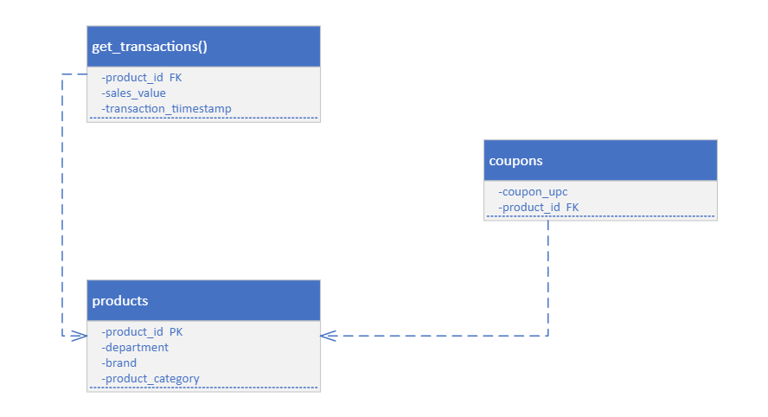
Our Data : library(completejourney)

Slide 3
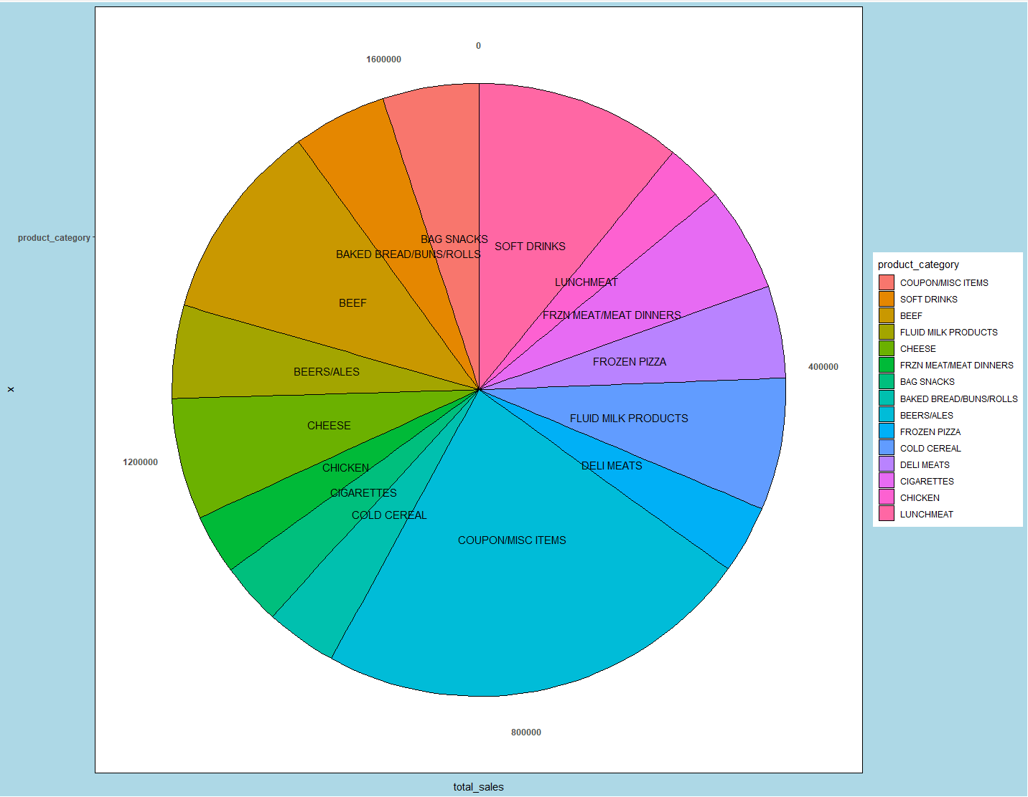
Analysis 1: Brand preference for most market share product categories
Top 15 Products Categories by Sales total

Slide 4
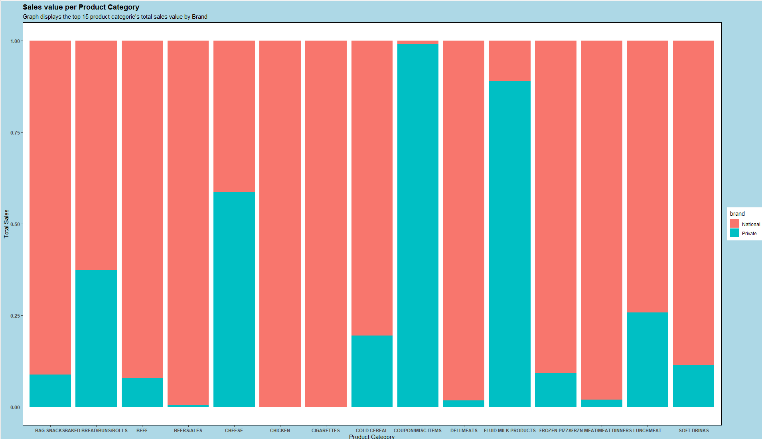

Slide 5
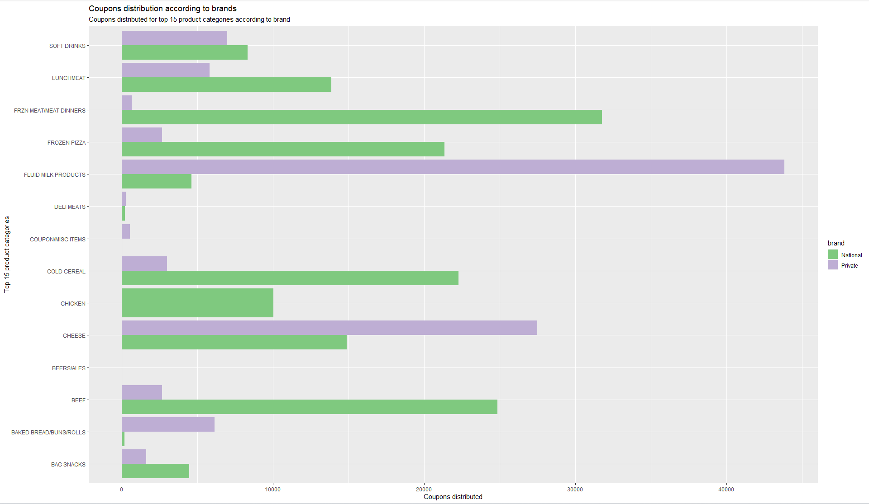

Slide 6
Analysis and Observations Drawn
No private labels sell Chicken and Cigarettes
Among the top 15 sold product categories, customers prefer buying dairy products like Fluid Mild Products and Cheese from Private Brands
Coupons are sold mainly by Private Brands
Most private coupons are given out for dairy products like Fluid Milk Products and Cheese which has significantly increased the Private label sales of those product categories
Similarly, most National coupons are given out for Frozen Meat and Meat Dinners which has significantly increased the National label’s sales of those product categories

Slide 7
Proposed Solution
Hence, we suggest that to increase the total sales of the poorly performing private product categories, more coupons should be given out for those categories

Slide 8
Analysis 2: Meat purchasing trend

Slide 9
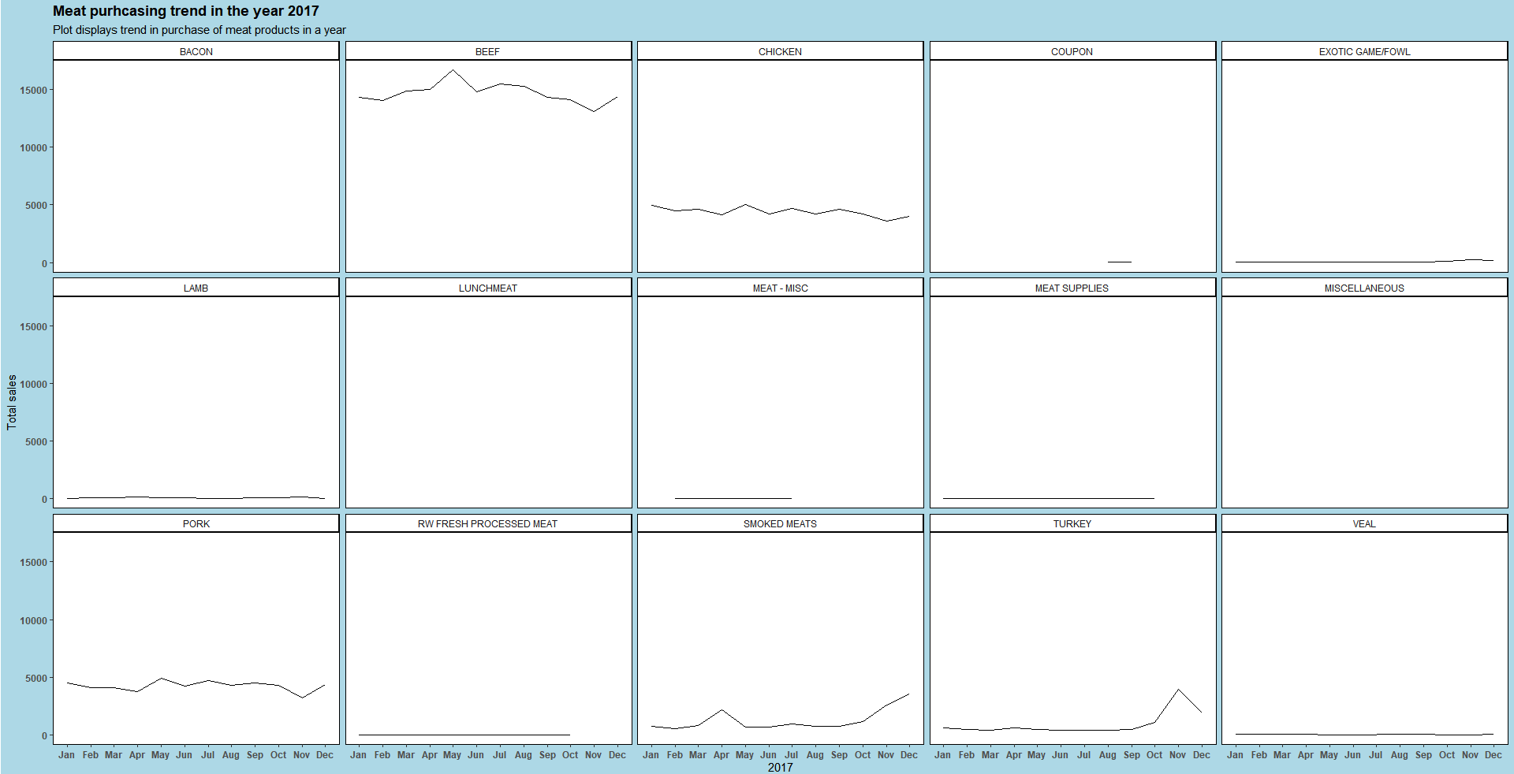

Slide 10
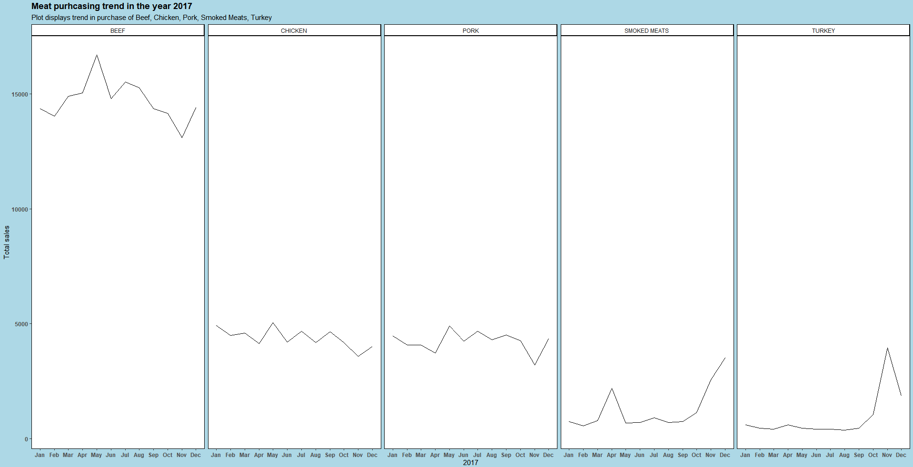

Slide 11
Analysis and Observations Drawn
Top 3 meats purchased are Beef, Chicken and Pork
Analysis of meat products purchased in 2017 shows that purchase of turkey rises in the month of November only and there is a decrease in beef, chicken, pork purchase in the same month
Smoked meat is purchased more in the month of April and December due to holiday season
Sale of rest of the meats is constant throughout the year

Slide 12
Proposed Solution
In the month of November, we should increase the stock and price of Turkey products to increase revenue of this category
Decrease the price and stock of Beef, Chicken, Pork meat products to boost their sales

Slide 13
Limitations
There is no coupon data for “Cigarettes” and negligible coupon data for “Beers/Ales” which affects the analysis
While analyzing the sales of Smoked meats, we have not considered the temperature at that time. Irregular cold seasons might alter the sales of smoked meats as people won’t prefer going out and having a BBQ in cold temperatures

Slide 14
Questions?

