Slide 1
AGENTIC AI HEALTH SYMPTOM CHECKER
CAPSTONE PROJECT
Presented By:
Name-SAURAV PANIGRAHI
College-IIIT BHUBANESWAR
Branch-Computer Science & Engineering

Slide 2
OUTLINE
Problem Statement (Should not include solution)
Proposed System/Solution
System Development Approach (Technology Used)
Algorithm & Deployment
Result (Output Image)
Conclusion
Future Scope
References

Slide 3
Problem Statement
Inaccurate self-diagnosis and delayed medical attention are growing concerns, especially with the widespread use of unverified online health information. Many individuals rely on general internet searches to understand their symptoms, leading to misinformation, panic, or neglect. Additionally, access to reliable medical guidance in regional languages remains limited, especially in underserved communities. There is a pressing need for an intelligent, multilingual AI system that can accurately interpret user-described symptoms in natural language, retrieve verified medical knowledge, and offer educational, non-diagnostic guidance. The solution must empower users to make informed health decisions while minimizing the risks of misdiagnosis and promoting timely medical consultation.

Slide 4
Proposed Solution
To address the challenges of health misinformation, delayed diagnosis, and lack of accessible health support, I propose developing an AI-powered Agentic Health Symptom Checker. This intelligent assistant will allow users to input their symptoms using natural language (e.g., “I have a headache and sore throat”) and receive trustworthy, informative responses.
Core Features:
Natural Language Symptom Analysis The AI agent will use advanced NLP techniques to understand symptoms described in everyday language across multiple languages and dialects.
Medical Knowledge Integration It will retrieve and synthesize data from trusted sources such as WHO, CDC, national health portals, and peer-reviewed journals, ensuring medically accurate and up-to-date information.
Personalized Health Guidance: Based on symptom analysis, the agent will provide:
Probable conditions (not diagnoses)
Urgency level (mild, moderate, or severe)
Self-care/home remedy suggestions
Recommendations on when to seek professional help.
Ethical & Educational Focus To avoid self-diagnosis risks, the AI will focus on educating users, promoting preventive care, and encouraging timely consultations with certified healthcare professionals.

Slide 5
System Approach
System Requirements:
Platform: IBM Cloud (Watsonx.ai, Watson Assistant)
Local: Python 3.9+, VS Code (optional), stable internet
Libraries & Services:
IBM Cloud Services
Watson Assistant – For building the conversational AI interface
Watsonx.ai / Watson NLP – To understand and analyse user symptoms
IBM Knowledge Studio – (Optional) for custom entity extraction (e.g., symptom terms)

Slide 6
Algorithm & Deployment
User Input (Natural Language)
User enters symptoms (e.g., “I have a sore throat and fever”) via Watson Assistant.
Symptom Extraction
Use Watson NLP or IBM Knowledge Studio to extract key symptom entities (e.g., sore throat, fever).
Symptom Normalization
Map extracted symptoms to standardized medical terms (e.g., using ICD-10 or SNOMED mappings).
Knowledge Retrieval
Use custom pipeline to search trusted sources (WHO, CDC) for possible causes and care suggestions.
Contextual Analysis
Based on symptom combinations, age (if provided), and urgency patterns:
Suggest possible conditions (non-diagnostic)
Determine urgency level (self-care vs. consult)
Recommend home remedies or when to see a doctor
Response Generation
Watson Assistant formulates an easy-to-understand reply with:
Probable causes
Risk level
Educational content
Referral or next steps

Slide 7
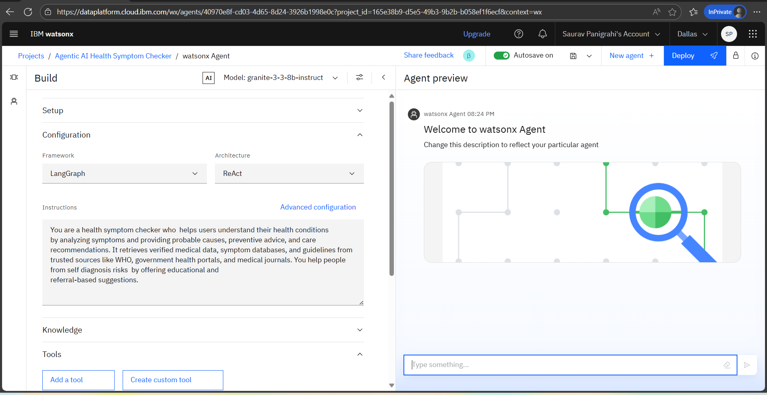
Result

Slide 8
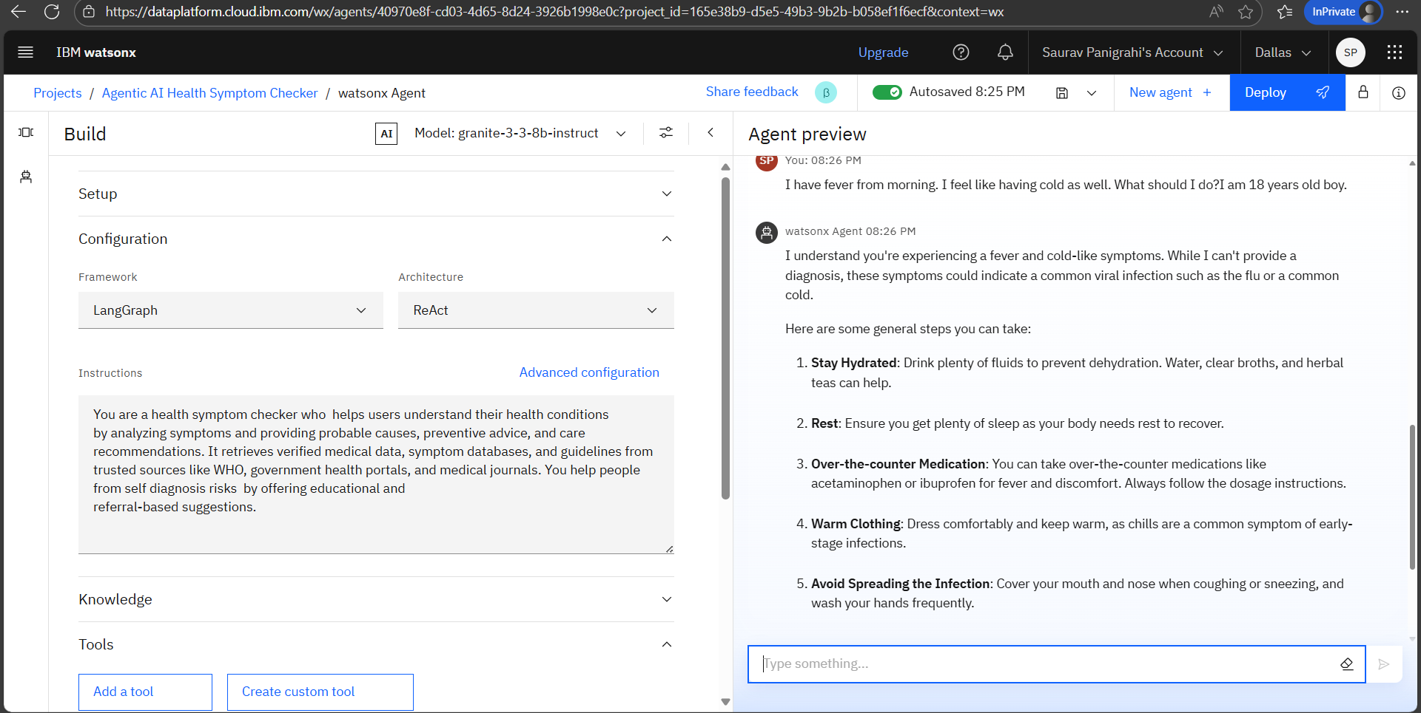

Slide 9
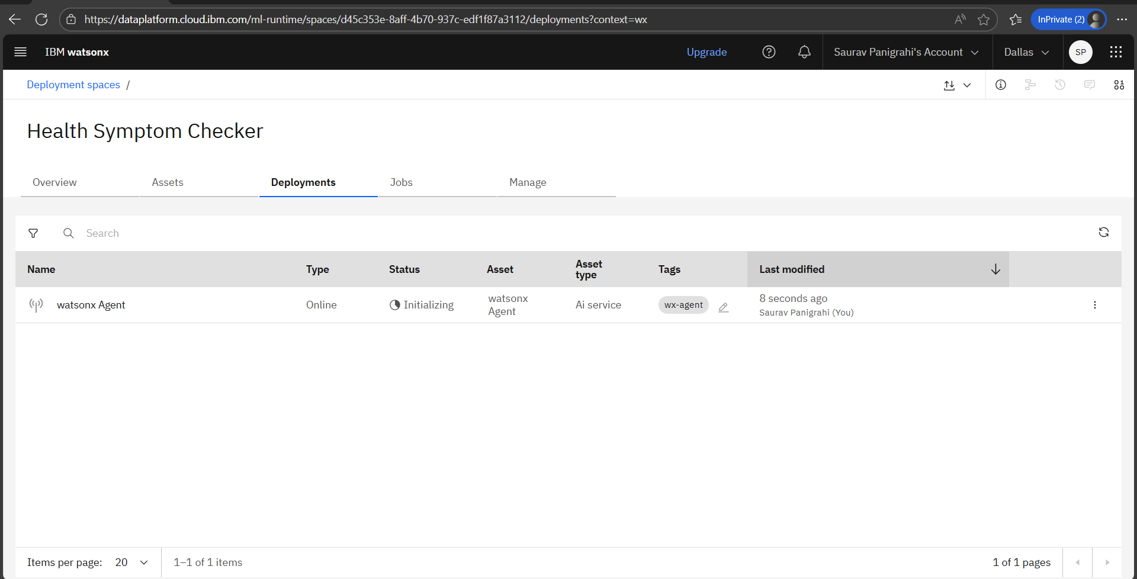

Slide 10
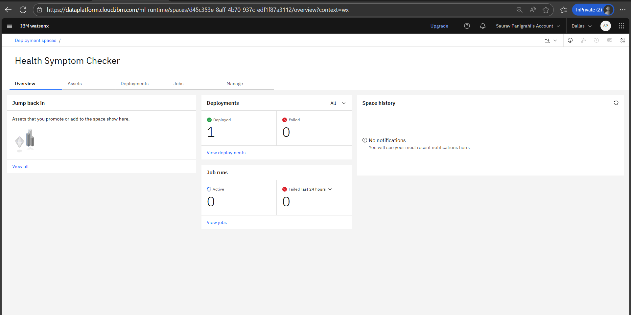

Slide 11
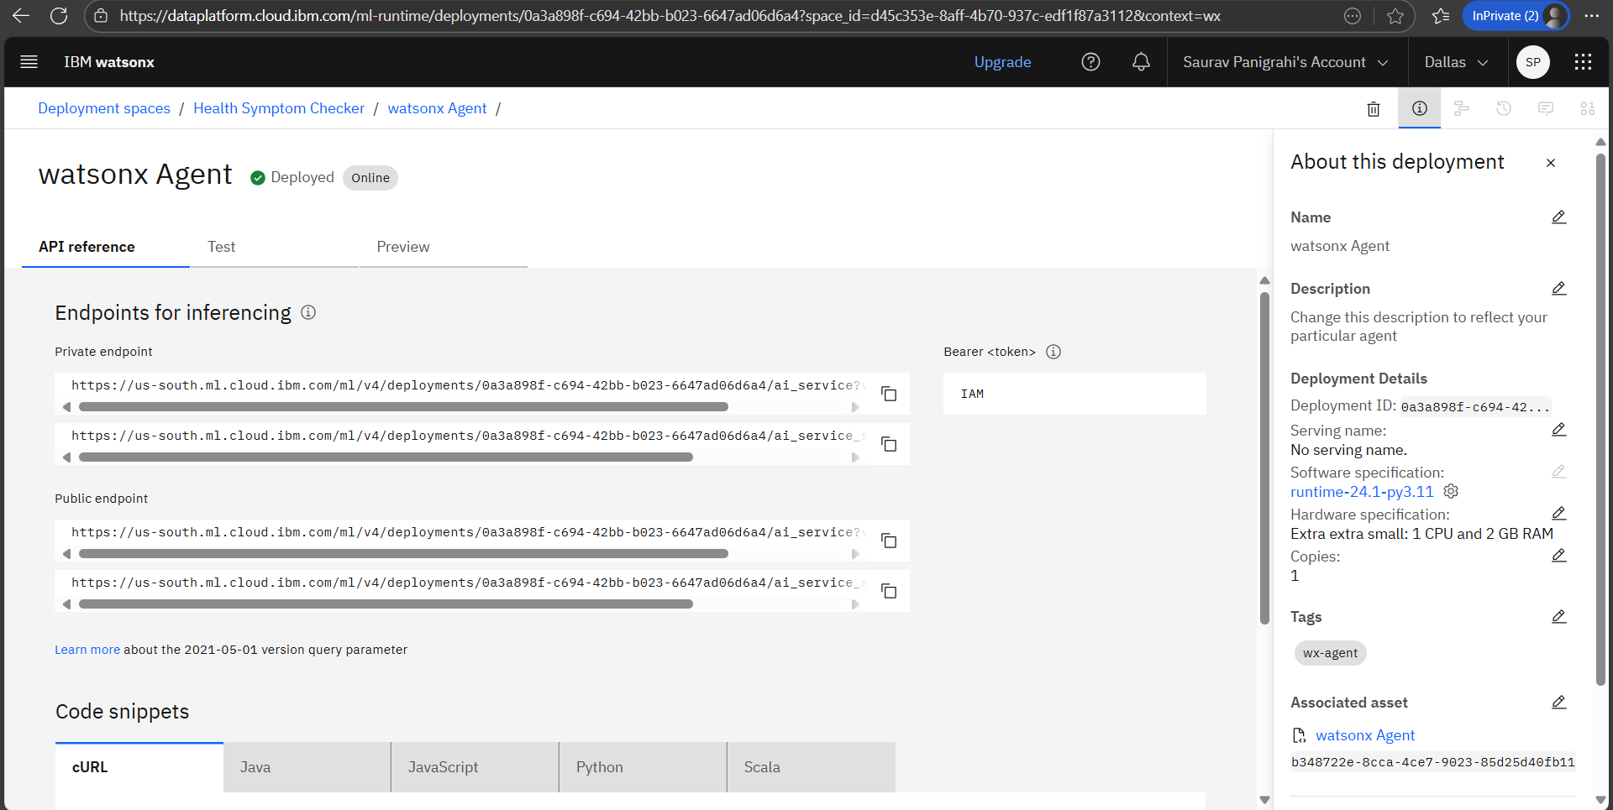

Slide 12
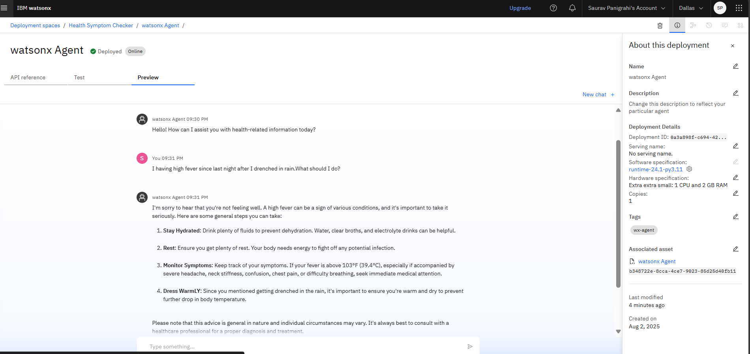

Slide 13
Conclusion
The Agentic AI Health Symptom Checker provides an accessible, intelligent, and safe way for users to understand their symptoms using natural language. By leveraging IBM Cloud services like Watson Assistant, and Watson NLP the system delivers trustworthy, evidence-based guidance without replacing professional medical advice. This solution empowers individuals to take early, informed actions about their health, reduces the risk of misinformation, and encourages timely medical consultation. With its modular, scalable design, it can be expanded in the future to support more conditions, languages, and integrations with healthcare systems.

Slide 14
Future scope
Multi-language Support Expand the agent to support regional and global languages to improve accessibility for non-English speakers.
Voice Interaction Integrate speech-to-text and text-to-speech for voice-based symptom reporting, enabling hands-free usage.
Integration with Wearables & Health Data
Connect with smartwatch sensor health apps to personalize suggestions based on vitals like heart rate, temperature, etc.
Mental Health Support Extend capabilities to include preliminary screening and educational guidance on mental health symptoms.
Continuous Learning & Feedback Loop Use user feedback to refine response accuracy and update medical databases regularly.

Slide 15
References
WHO – https://www.who.int (Medical guidelines & symptom info)
CDC – https://www.cdc.gov (Disease symptoms & care advice)
IBM Watson Assistant – https://www.ibm.com/cloud/watson-assistant (Cloud-based AI service used)

Slide 16
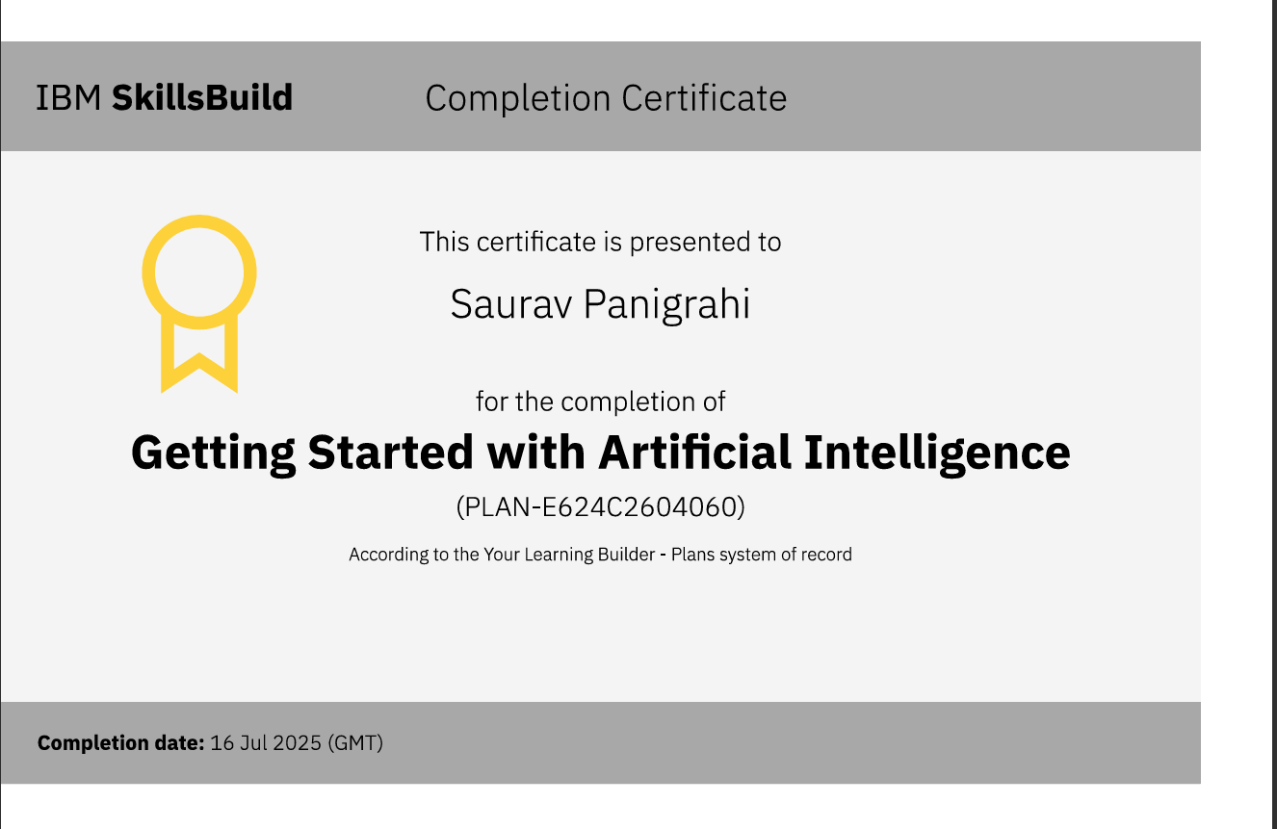
IBM Certifications

Slide 17
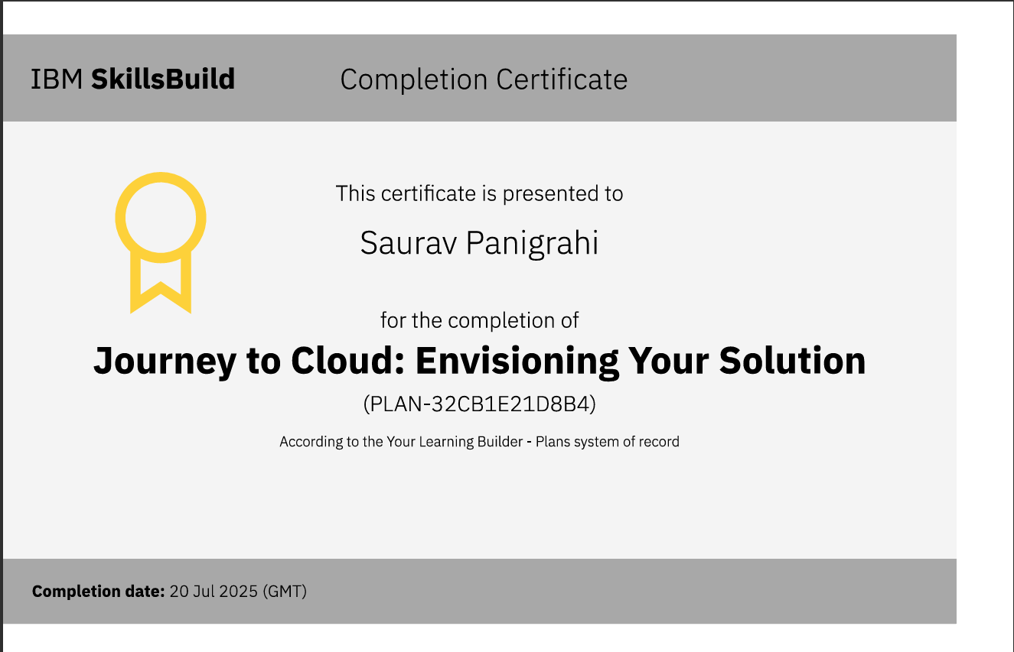
IBM Certifications

Slide 18
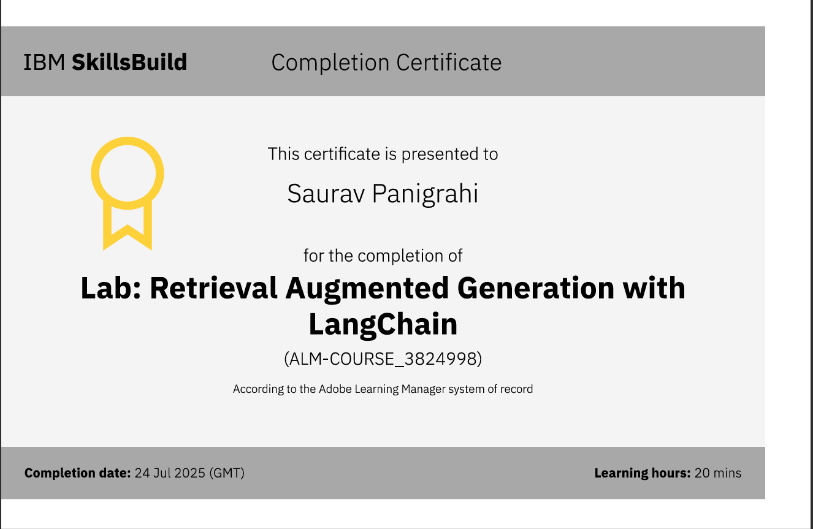
IBM Certifications

Slide 19
THANK YOU

