Slide 1
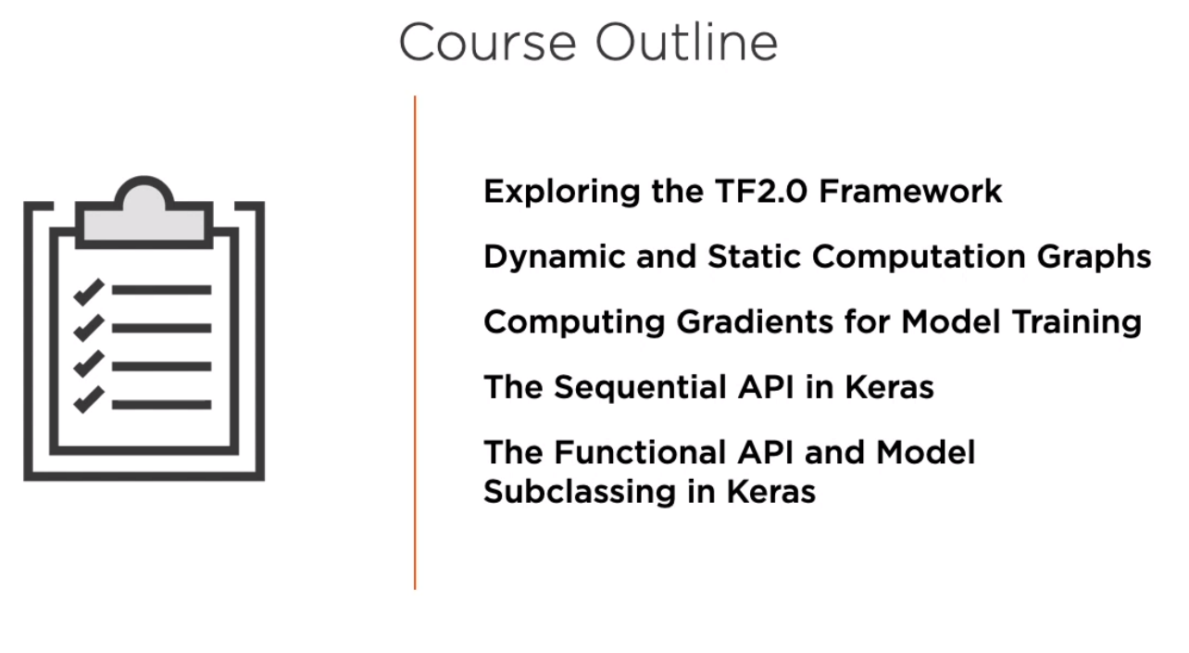

Slide 2
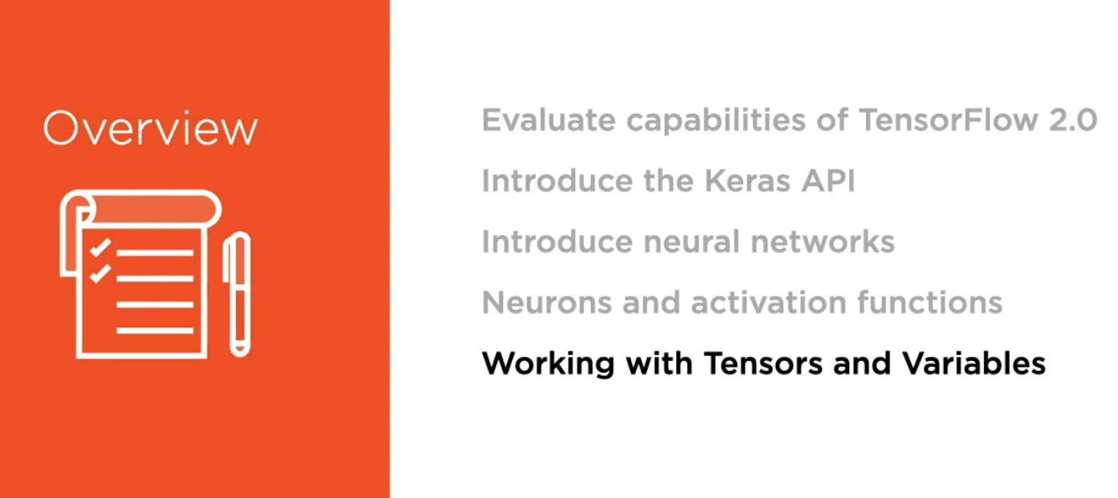
Module 1: Exploring the TensorFlow 2.0 Framework

Slide 3
Contents in Brief in Module 1
A. TensorFlow 1.x vs TensorFlow 2.0
B. Introducing Neural Networks
C. Neurons and Activation Functions

Slide 4

A. TensorFlow 1.x vs TensorFlow 2.0

Slide 5
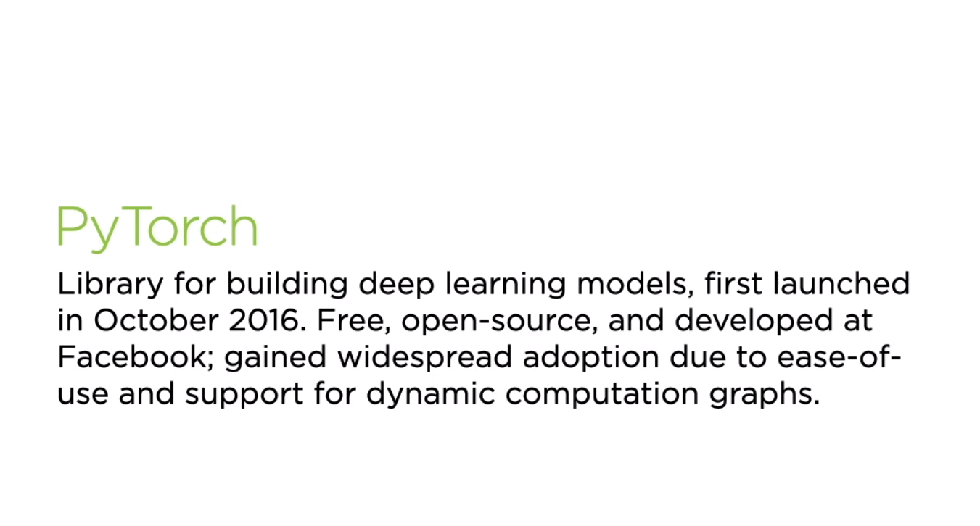
A. TensorFlow 1.x vs TensorFlow 2.0

Slide 6
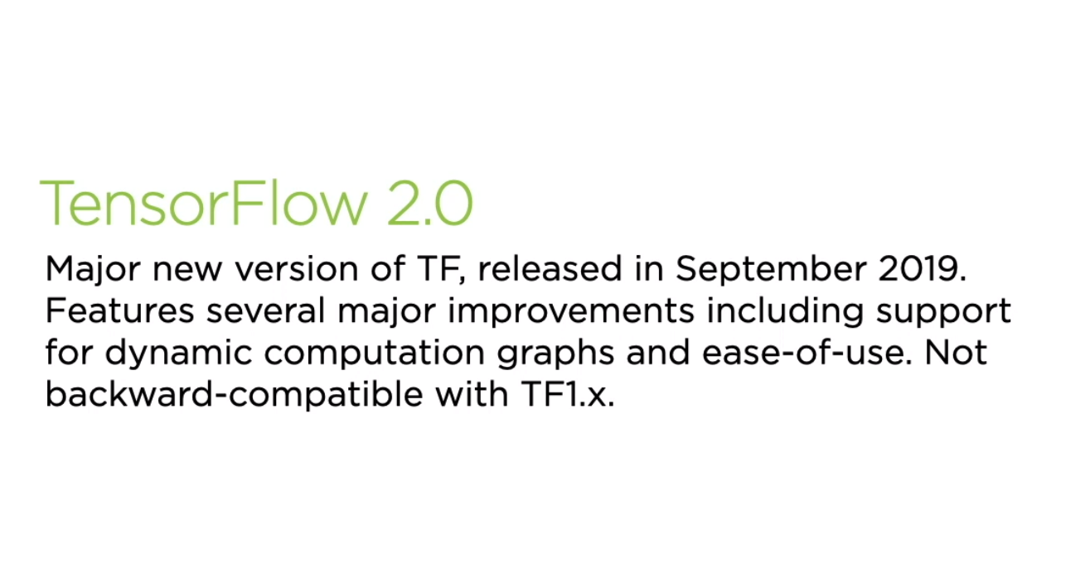
A. TensorFlow 1.x vs TensorFlow 2.0

Slide 7
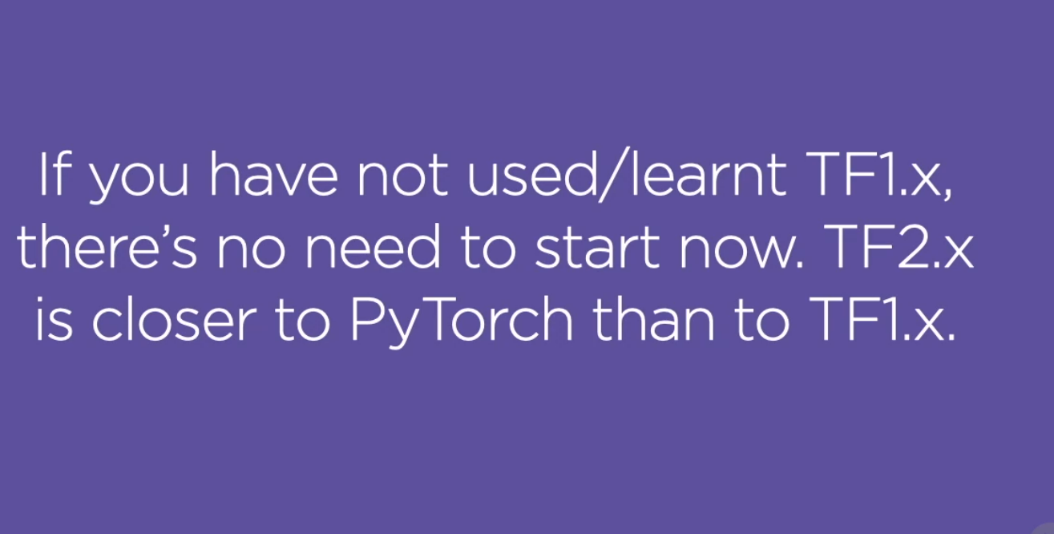
A. TensorFlow 1.x vs TensorFlow 2.0

Slide 8
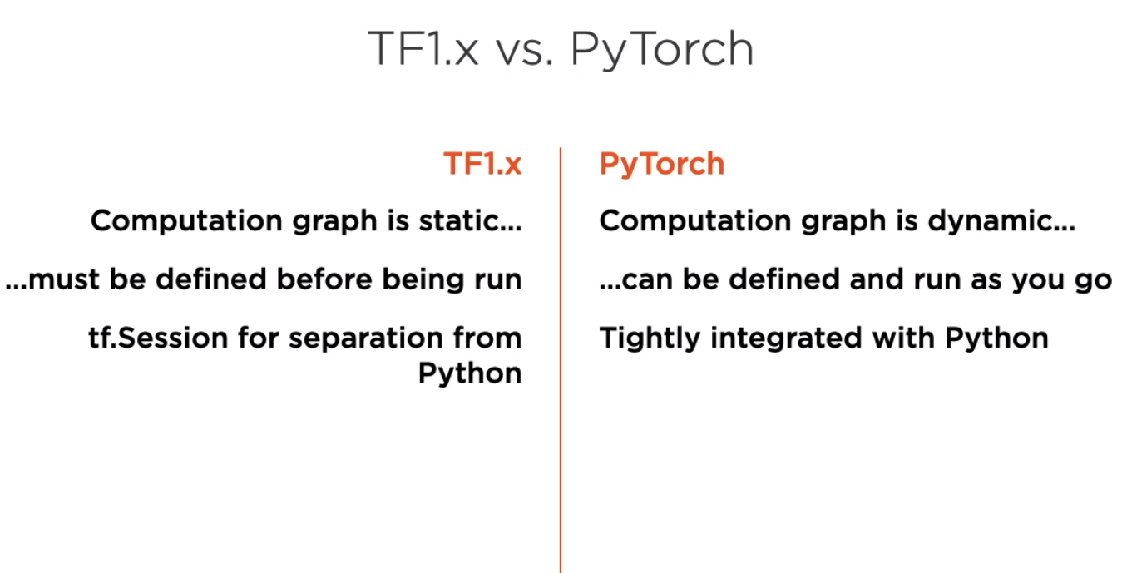
A. TensorFlow 1.x vs TensorFlow 2.0

Slide 9
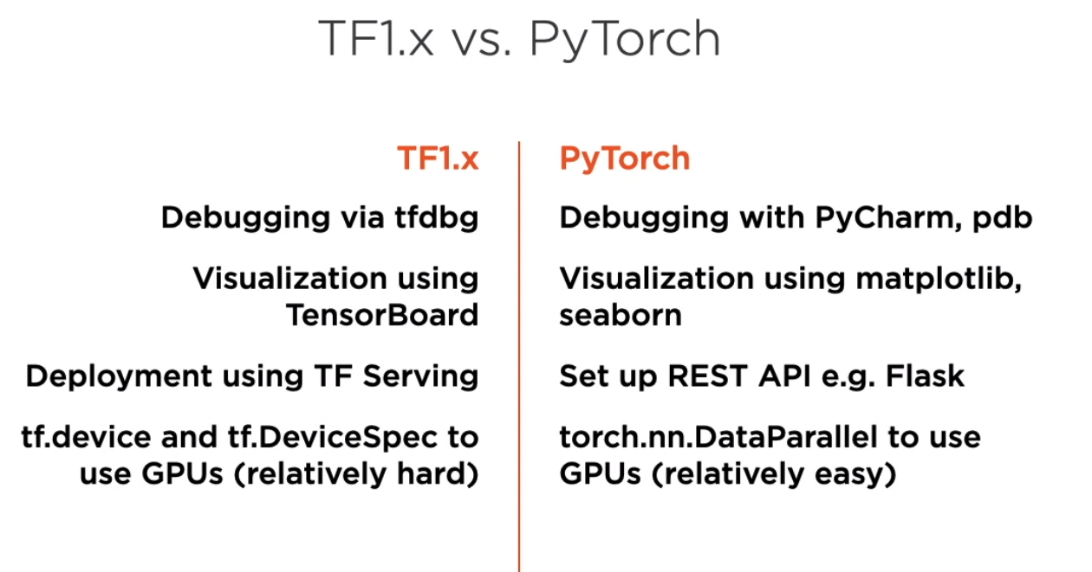
A. TensorFlow 1.x vs TensorFlow 2.0

Slide 10
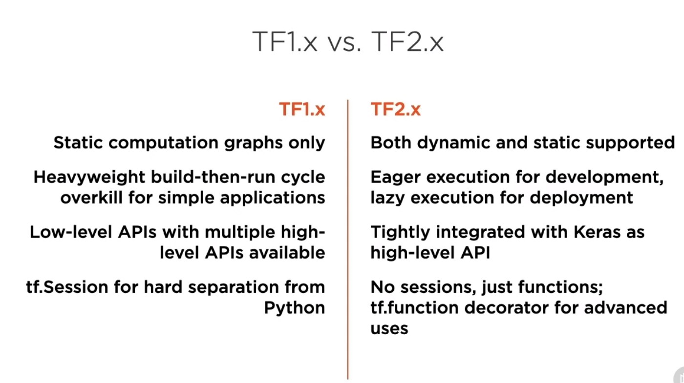

Slide 11
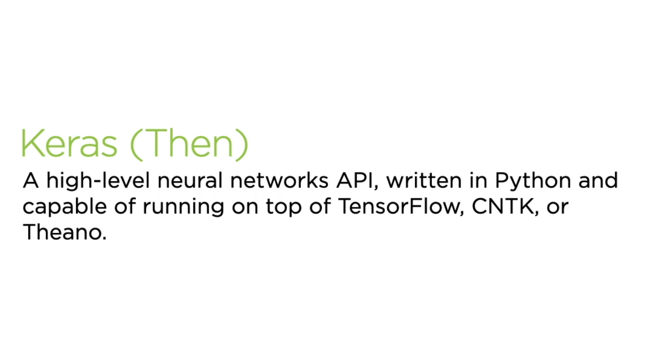
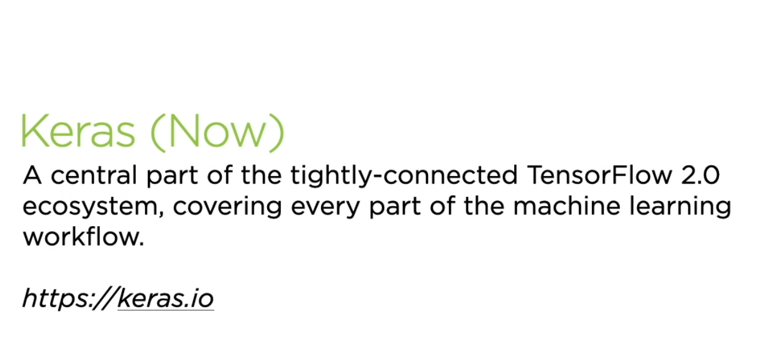

Slide 12
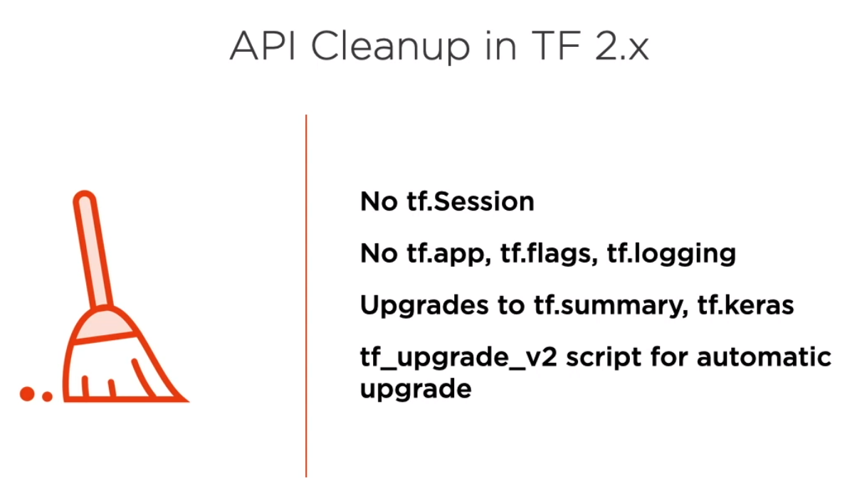
A. TensorFlow 1.x vs TensorFlow 2.0

Slide 13
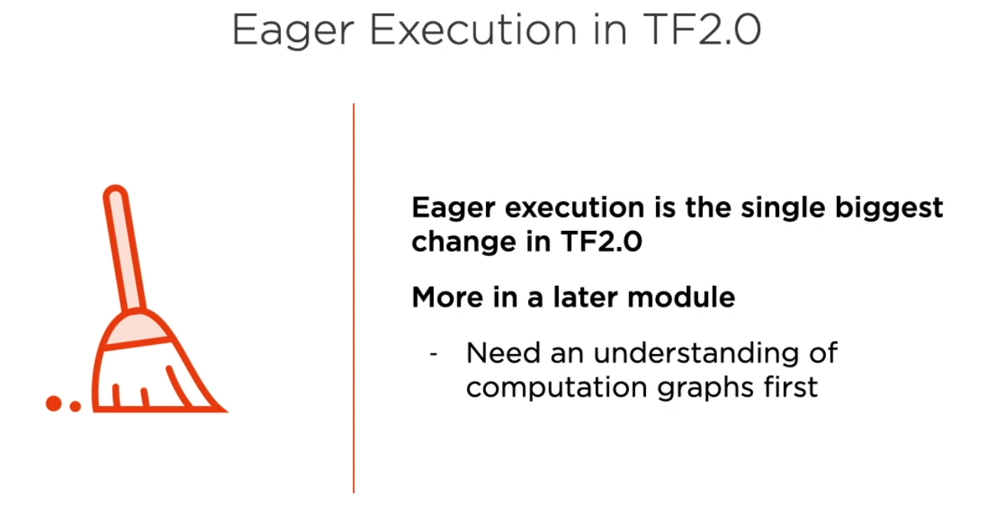
A. TensorFlow 1.x vs TensorFlow 2.0

Slide 14

B. Introducing Neural Networks

Slide 15
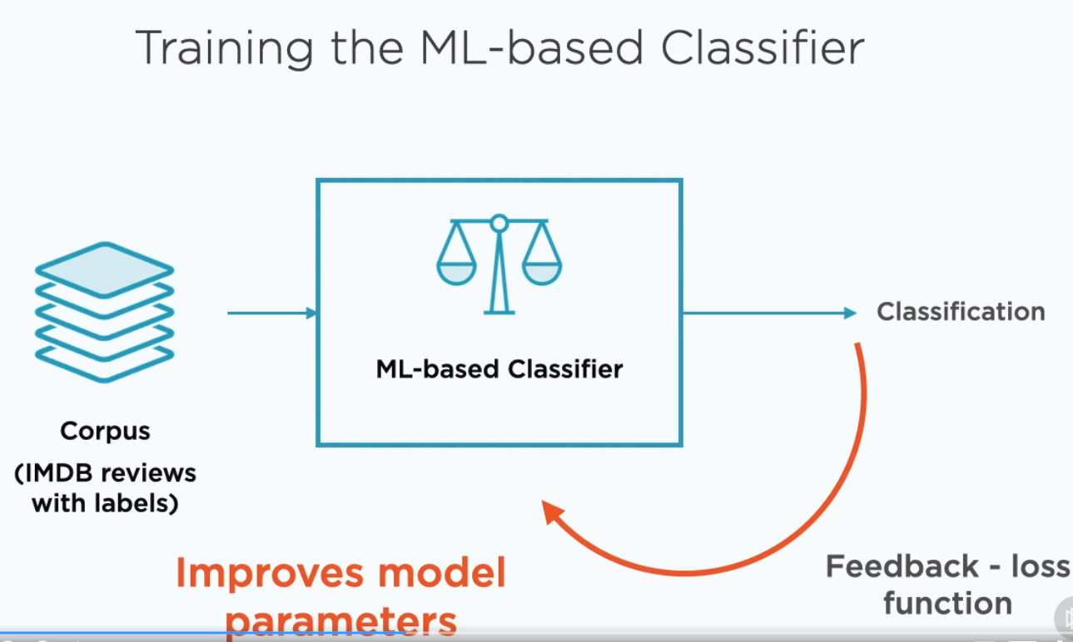
B. Introducing Neural Networks

Slide 16
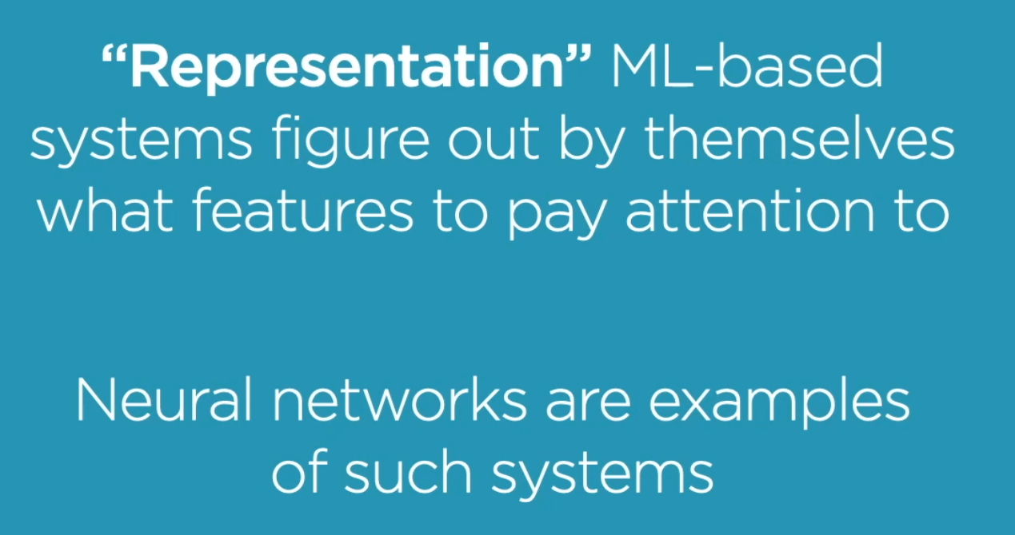
B. Introducing Neural Networks

Slide 17
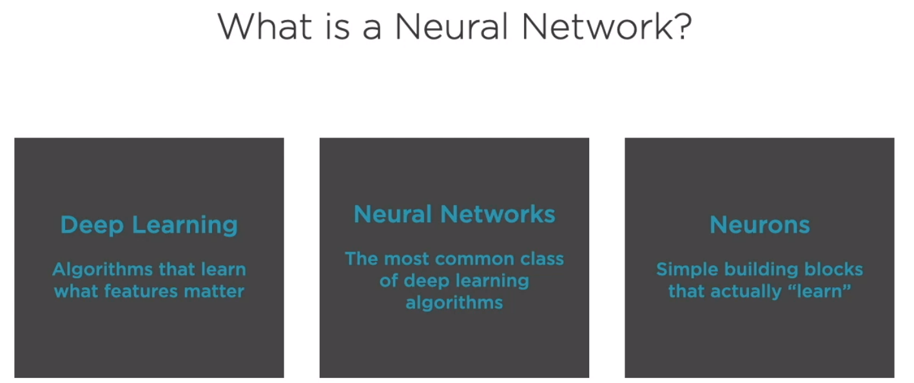
B. Introducing Neural Networks

Slide 18
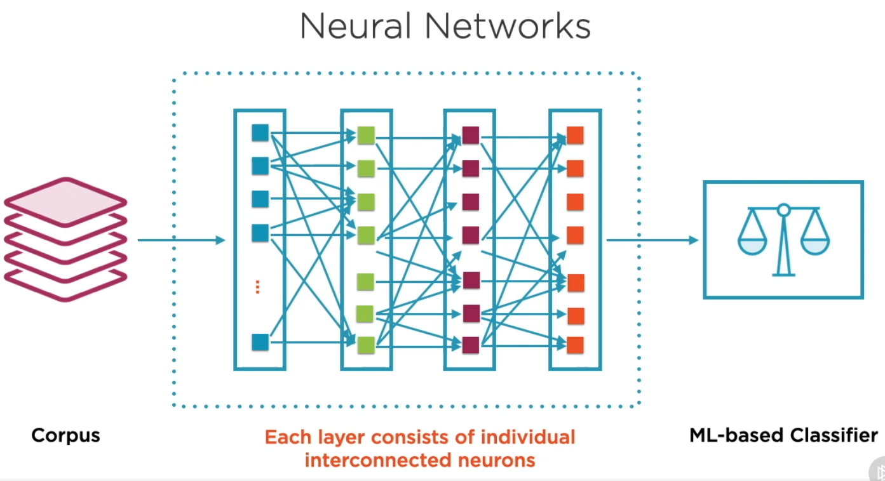
B. Introducing Neural Networks

Slide 19
C. Neurons and Activation Functions

Slide 20
