Slide 1
CAPSTONE USING K-MEANS CLUSTERING
26TH February,2019

Slide 2
Which Neighborhood in Toronto is the best option for a new business establishment and what type of business would be healthy investment?
Analysis object:

Slide 3
Data sources:
Toronto post code:
https://en.wikipedia.org/wiki/Postal_codes_in_Canada#Table_of_all_postal_codes
Venues:
Longitude and latitude data
Foursquare location data

Slide 4
Methodology
Data cleaning:
Neighborhood, its latitude and longitude
Venue, its latitude and longitude
Venue type
Data preparation
Feature selection
Clustering

Slide 5
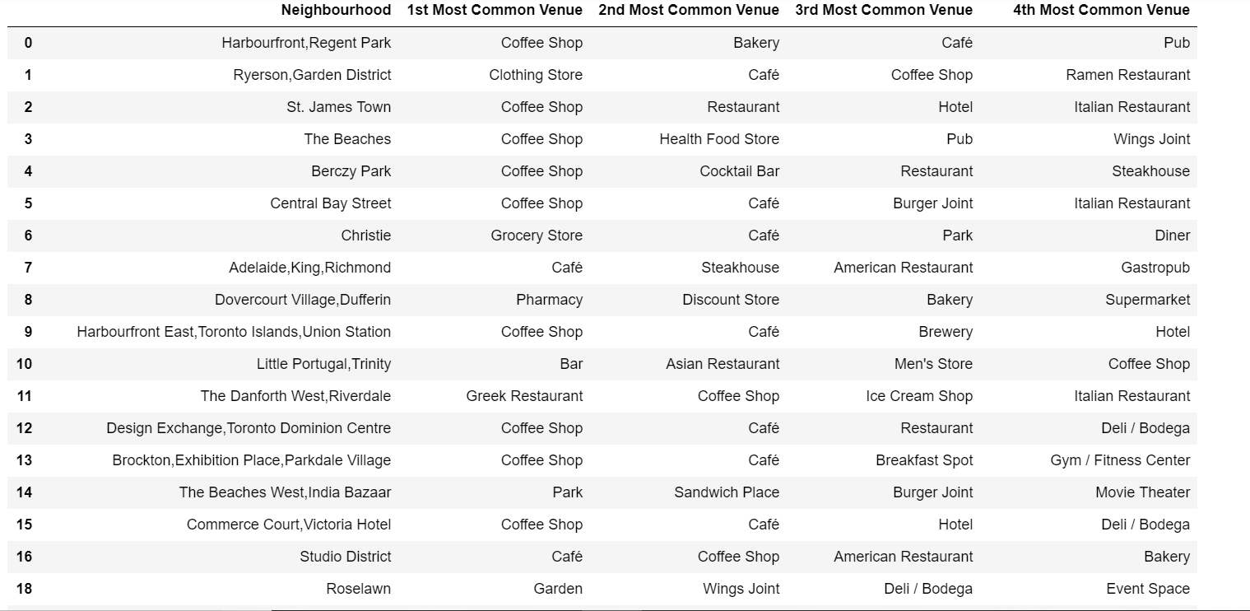
Cluster 1

Slide 6
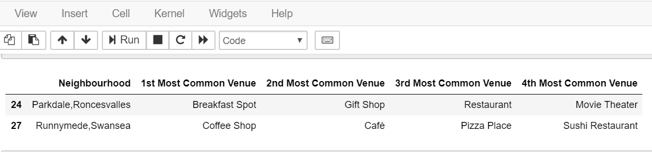
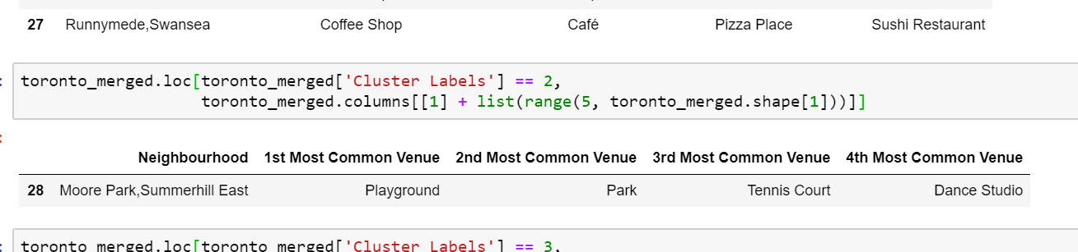
Cluster 2
Cluster 3

Slide 7
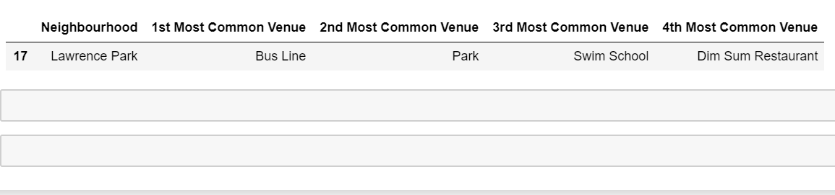
Cluster 4

Slide 8
Conclusion
Therefore, it can be clearly seen that different neighborhood have their own attractions. However, coffee shops deems to be the major attraction,.

