Slide 1

SMART GRID
Management System
PRESENTED BY
CB.SC.U4CSE23544 · S Bhuvanesh
CB.SC.U4CSE23546 · Saurav Gopinath E K
Page 1

Slide 2
PROBLEM DEFINITION
DECENTRALIZED ENERGY SHARING
Individual household agents with solar panels and batteries must decide whether to store, consume, or sell electricity back to the grid — with no central authority coordinating them.
Agents communicate surplus and deficit signals and cooperate through an auction or negotiation protocol so the neighborhood balances peak load on its own.
The system models autonomous households that manage local energy, negotiate peer-to-peer trades and use the utility grid when local resources are insufficient.
Page 2

Slide 3
WHY MULTI AGENT?
AUTONOMY & COOPERATION
01
Local decisions plus agent-to-agent communication let the neighborhood coordinate without a central authority. Households act as autonomous agents — each senses its own solar generation, battery state, and demand, then decides locally to store, consume, sell, or buy energy without waiting for a central controller.
02
A centralized controller can become a coordination bottleneck as the number of households grows. Local agents can make decisions and coordinate with nearby agents
03
Agents cooperate on individual energy states, and since other agents' actions change the shared environment, the state stays dynamic.
Page 3

Slide 4
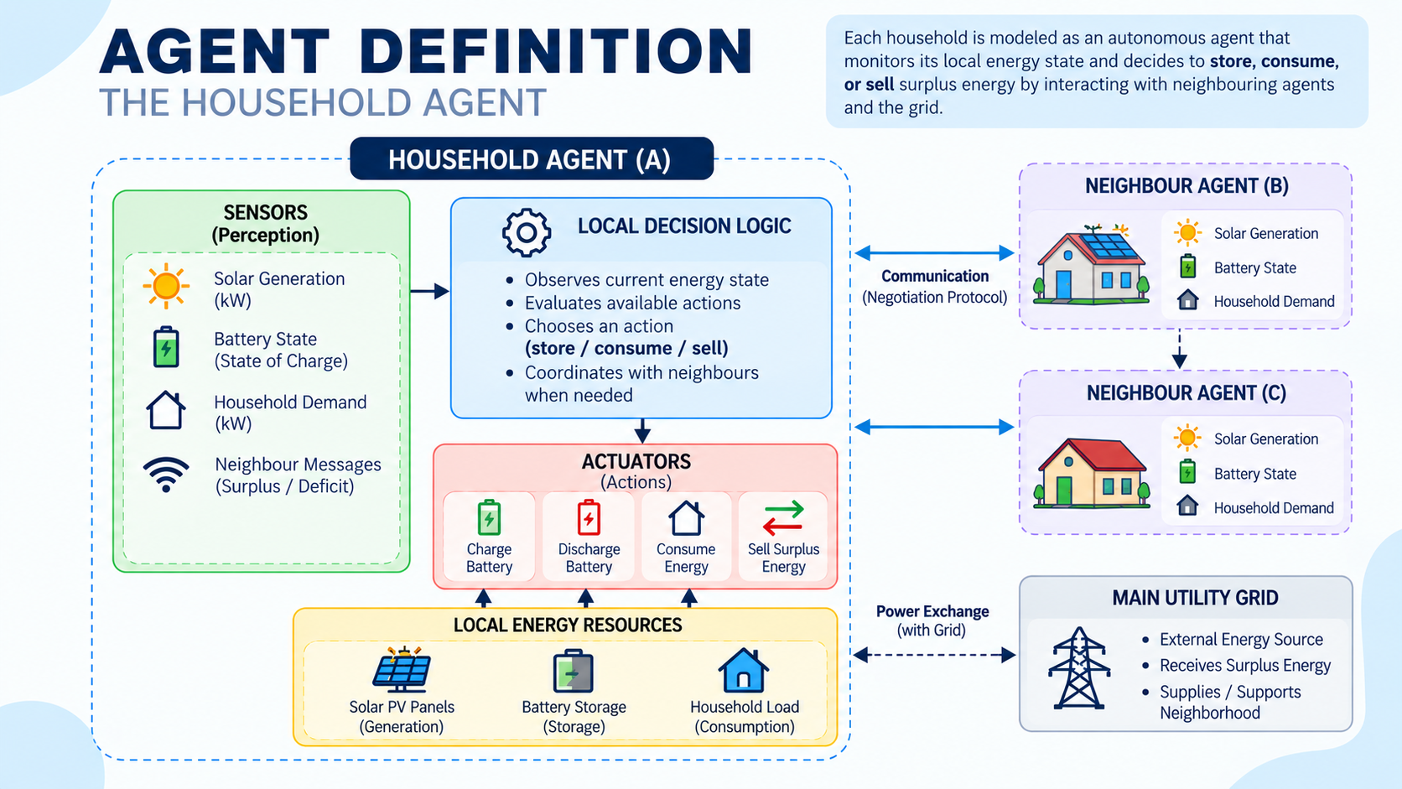
Page 4

Slide 5
LOCAL ACTIONS, GLOBAL IMPACT
PEAS FRAMEWORK
PERFORMANCE
ENVIRONMENT
Balance neighborhood load, cut energy cost where possible, maximize renewable use, and avoid shortages or overload.
Household nodes, solar generation, batteries, electricity demand, the grid, and every other household agent on the network — many agents acting at once reshapes the whole neighborhood's load.
ACTUATORS
SENSORS
Charge the battery, discharge stored energy, consume energy, sell or supply surplus, or buy/obtain energy as the model requires.
Household demand, solar generation, battery state, grid signals, and messages received from neighboring agents.
Global Impact: an individual agent's actuator decision to ‘sell surplus energy’ directly reduces the overall peak load deficit of the shared neighborhood grid.
Page 5

Slide 6
G
DISCRETE-TIME DECISIONS
Agents sense,decide,communicate and act at defined time steps during simulation.
ENVIRONMENT
SEVEN KEY PROPERTIES
A
B
C
MULTI-AGENT
PARTIALLY OBSERVABLE
DYNAMIC
Multiple autonomous household agents act within the same shared neighborhood environment.
No single household has complete, instantaneous knowledge of the whole neighborhood state.
The state keeps changing as demand, generation, battery levels, and other agents' actions shift.
D
E
F
STOCHASTIC
COOPERATIVE
SEQUENTIAL
Solar generation and weather-driven demand are uncertain, so outcomes are never fully predictable.
Agents share surplus/deficit signals, aiming to balance demand together rather than compete.
Today's storage and trading decisions carry over, shaping tomorrow's battery and energy states.
Page 6

Slide 7
COMMUNICATION
SURPLUS-DEFICIT NEGOTIATION
01
Household A reports a surplus, Household B reports a deficit, and the two negotiate a trade under the auction protocol.
02
Agents exchange surplus/deficit information and battery state so that energy-sharing decisions reflect current local conditions.
03
Incoming messages reshape an agent’s decision — a nearby surplus can turn a planned ‘buy’ into a ‘wait.’
04
More agents mean more messages — As the number of agents increases, overhead and delay become a real multi-agent bottleneck.
Page 7

Slide 8
ALGORITHMIC MODELING
SEARCH: SINGLE VS MULTI-AGENT
A single household can use informed search, such as A*, to evaluate possible store/consume/sell actions. However, as the number of households increases, the joint state space grows rapidly, making centralized planning more computationally expensive. We therefore model coordination using decentralized negotiation, where each agent communicates its surplus or deficit and coordinates energy sharing with neighbouring agents
Comparative Breakdown: Centralized search considers a larger joint state space as more households are added, while decentralized negotiation evaluates local information and coordinates agents through communication. This reduces the need for a single controller to plan the complete neighbourhood state.
Search Model
State: Solar generation + battery state + household demand + neighbouring surplus/deficit
Actions: Charge, discharge, consume, buy, sell
Goal: Satisfy demand while maintaining battery constraints and reducing grid dependence
Search: A* can evaluate local action sequences; decentralized negotiation handles multi-agent coordination
Cost/Heuristic: Energy cost + shortage/overload penalty + battery constraint
Page 8

Slide 9
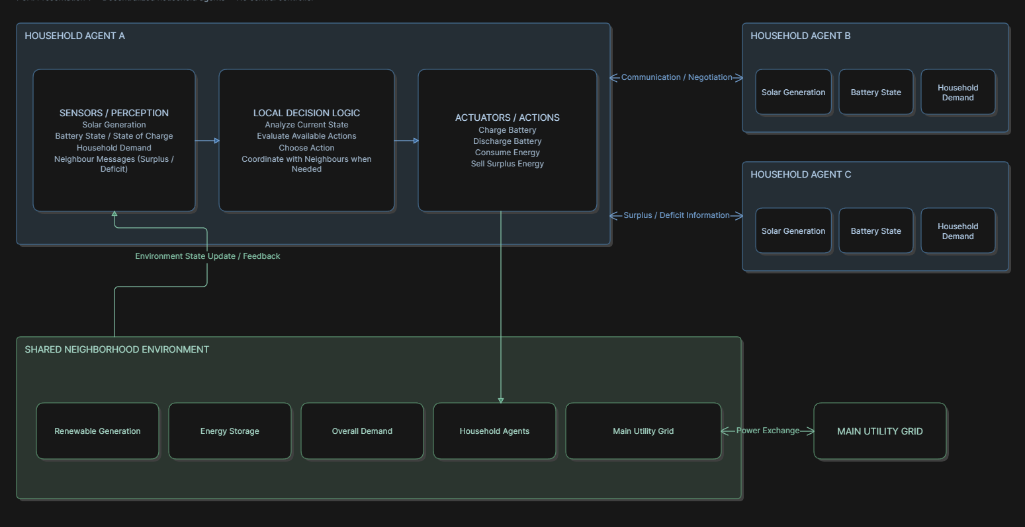
PROPOSED ARCHITECTURE
Page 9

Slide 10
WHAT COULD GO WRONG
KEY CHALLENGES
VOLATILITY
SCALING
Dynamic energy demand and unpredictable solar generation keep shifting the state agents must plan around.
Coordinating many agents without a central authority risks unstable or inefficient allocation.
OVERHEAD
COORDINATION
Message overhead and delay slow negotiation as the neighborhood scales up.
Coordinating local household decisions while maintaining neighbourhood-wide load balancing becomes more difficult as the number of agents increases.
Each household has local information and may not have complete knowledge of the neighbourhood's current state.
PARTIAL OBSERVABILITY
Page 10

Slide 11
TOOLS AND TECHNOLOGIES
Layer | Tool / Version | Primary Role | Selection Rationale
Runtime | Python 3.13.5 | Simulation engine | Modern language features and clear simulation logic.
MAS Framework | Mesa 3.5.1 | Agent-based modeling | Provides agents, models, and discrete timesteps.
Network | NetworkX 3.7 | Peer communication graph | Represents decentralized prosumer connections.
Numerics | NumPy 2.5.1 | Solar and battery calculations | Efficient numerical operations for energy balance.
Testing | Pytest 9.1.1 | Automated verification | Tests agent logic, negotiation, and A* planning. (112 tests reported)
Dashboard | HTML5, CSS3, JS | Browser-based SCADA UI | Runs in browser without a frontend build toolchain.
Visualization | Canvas + SVG | Charts and power-flow display | Renders dispatch curves and animated flow indicators.
Communication | FIPA ACL | Agent message structure | Uses REQUEST, OFFER, ACCEPT, and REJECT message types.
Data | CSV / JSON | Benchmark input and output | Includes benchmark_microgrid_dataset.csv and dashboard_data.json
Page 11

Slide 12
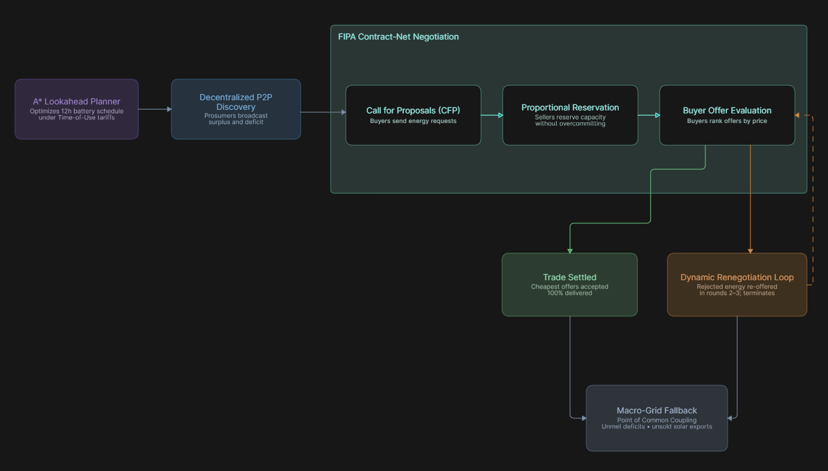
MULTI AGENT -INTERACTION
Page 12

