Slide 1
HR Workforce Analytics – Tech Company
Workforce, Performance & Attrition Insights
Prepared by: Saurav Chauhan – Data Analyst

Slide 2
Data Quality & Preparation
• Standardized Gender, Employment Type and Attrition labels
• Cleaned missing education and location values
• Removed unrealistic age and experience values
• Kept missing performance ratings intentionally

Slide 3
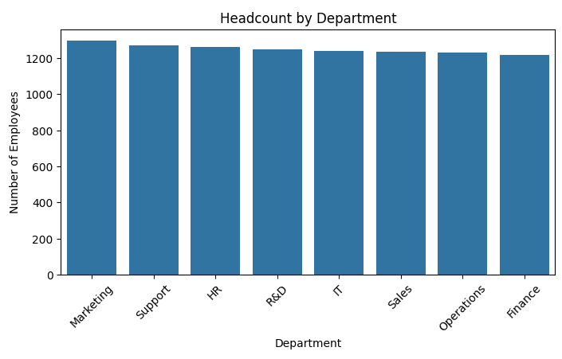
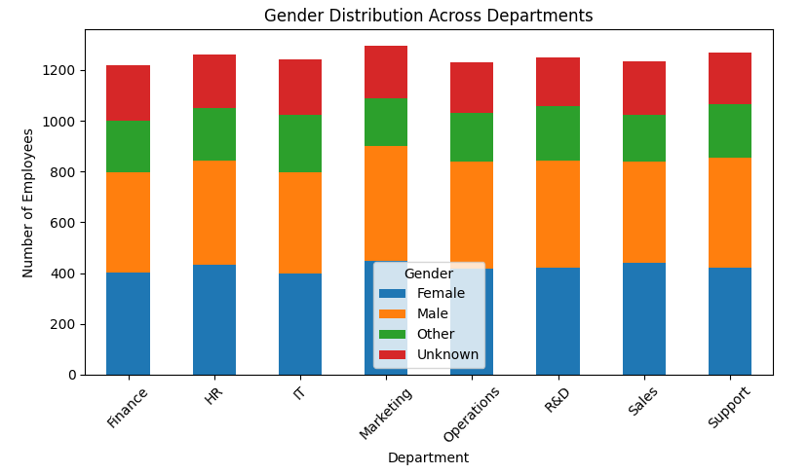
Workforce Composition
• Workforce distribution across departments
• Gender mix varies significantly across teams

Slide 4
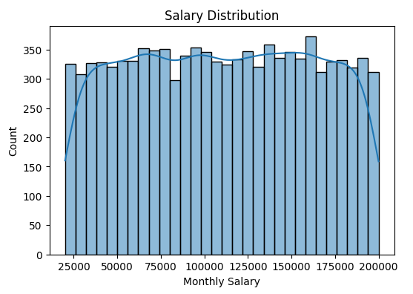
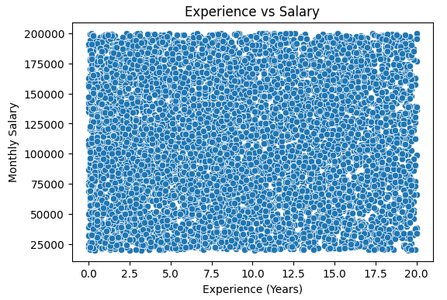
Salary & Compensation Insights
• Salary spread shows large variation
• Experience does not always convert into higher salary
Paste: Salary Distribution Chart
Paste: Experience vs Salary Chart

Slide 5
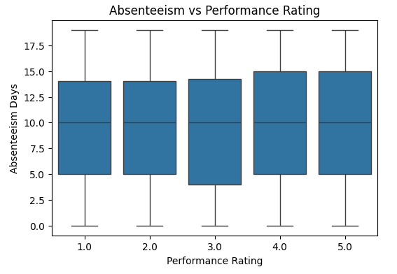
Performance & Productivity
• High performance is not always linked with high overtime
• Higher absenteeism aligns with lower performance bands
Paste: Performance vs Overtime Chart
Paste: Absenteeism vs Performance Chart

Slide 6
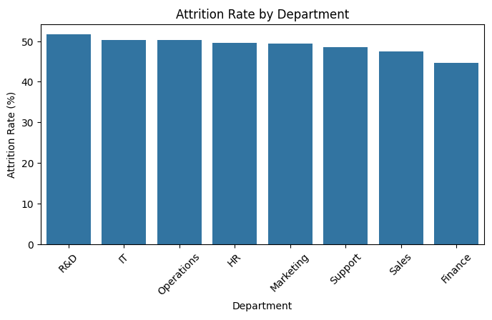
Attrition Risk Analysis
• Department-wise attrition shows clear risk areas
• Targeted retention strategies required for high-risk teams
Paste: Attrition by Department Chart

Slide 7
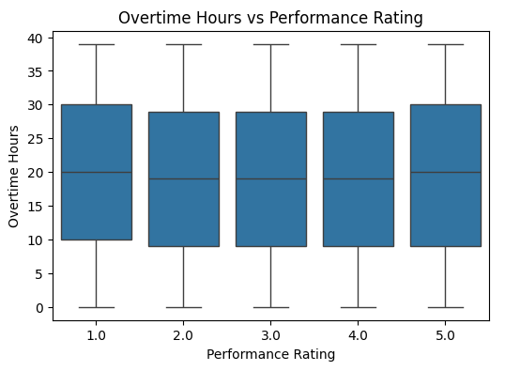
Career Growth & Promotion
• Promotion cycles vary significantly across departments
• Longer promotion gaps show higher attrition tendency
Paste: Promotion Gap Tables / Charts

Slide 8
Key HR Insights
• Certain departments show consistently higher attrition
  • Salary dispersion exists within similar experience groups
  • Performance is not driven by overtime alone
  • Promotion delays visible in some teams

Slide 9
Business Recommendations
• Review compensation in high-attrition departments
  • Introduce structured promotion review cycles
  • Monitor overtime to prevent burnout
  • Launch targeted retention programs

