Slide 1
Leveraging Foundational Models
for Video Archival Data
YOUR PHOTO
replace this shape
Segment-level metadata for a community-television archive, published with an auditable estimate of how strongly independent models corroborate it.
Saurav Kumar Vellattuparambil Vijayakumar
Student number 40490925
Supervisor: Dr Awais Rauf
MSc Artificial Intelligence · ECS8056
School of EEECS, Queen's University Belfast
Notes:
Say your name and student number aloud here — the handbook requires both on screen and it is the first thing an assessor checks.

Slide 2
THE PROBLEM
An archive you cannot search inside
NVTV is a Belfast community broadcaster with a public archive of the city’s civic life.
Every programme has a title. Nothing describes what happens inside it.
To find one moment, an archivist watches the whole programme.
Manual annotation was excluded for this corpus, closing the usual route to a gold standard.
WHAT A SINGLE-MODEL PIPELINE PUBLISHES
people_count: 3
visual_tags: interview, podium
transcript: "…medication study…"
Three models agreed, or one model guessed — the record looks identical either way. A missing field can be worked around. A confidently wrong field silently corrupts the catalogue.
Notes:
The contrast card is the whole motivation: identical-looking output, completely different support underneath.

Slide 3
AIM
Publish the corroboration, not just the metadata
Produce segment-level metadata using only pretrained models, and attach to every published field an auditable estimate of how strongly independent sources support it.
01
Segment the corpus reproducibly and resumably
02
Generate five fields from ≥ 2 independent families each
03
Score agreement without self-similarity or empty promotion
04
Quantify sampling, degradation and a hosted annotator
05
Benchmark seven open-weight VLMs against the consensus
Notes:
Five objectives, five research questions — they map one to one.

Slide 4
THE DATA
47 programmes, segmented and verified
47
626
5.09 h
123 / 503
archival programmes
NVTV, 2016
fixed 30-second clips
zero failures
total duration
FFprobe-verified
calibration / evaluation
split at source level
FFmpeg stream copy — no re-encoding; every clip FFprobe-verified after writing.
Atomic publication: each worker renames on success, so an interrupted run leaves no truncated file.
The split is assigned per source, so no programme contributes clips to both halves.
Boundary continuity verified across all 579 adjacent pairs — maximum drift 0.0000 s.
Notes:
Zero failures out of 626 is worth saying aloud — it is the claim the V&V section backs.

Slide 5
METHOD
Every field, at least two unrelated families
Transcript
Whisper small + turbo
two decoder configs — the weakest pair, reported as such
On-screen text
Tesseract + EasyOCR
classical line recogniser vs neural detector
Keywords
KeyBERT, YAKE, TF-IDF
three rankers — but one transcript
Visual tags
CLIP ViT-B/32 + ViT-L/14
capacity differs, mechanism does not
People count
BLIP-VQA, ViLT-VQA, DETR
captioner, transformer, detector — three routes to one integer
The models fail in different ways — that is the point. Agreement between unrelated mechanisms carries information that agreement between two checkpoints of one architecture does not.
Notes:
Do not read the table aloud. Say the closing line: diversity of failure modes is the mechanism.

Slide 6
THE RECORD
What the system actually publishes
1
Self-similarity excluded
"people_count": {
"value": 1,
"status": "observed",
"models": ["BLIP-VQA",
"ViLT-VQA", "DETR"],
"agreement_score": 0.812,
"needs_caution": false
}
a source never corroborates itself
2
Empty output never promoted
silence is not_detected, never high agreement
3
Strict dual-engine OCR veto
both engines, two frames, 0.80 cross-engine
A hallucinated name in a catalogue is the most damaging error available here, so on-screen text is deliberately conservative.
Notes:
Rule 2 matters most: without it, a corpus of quiet low-text clips would report near-perfect reliability.

Slide 7
LIVE DEMO
The review dashboard
The clip plays beside its record. A field supported by four independent families is safe to publish; a field carrying needs_caution goes to a human first. The deliverable is not a list — it is a triaged list.
Notes:
Switch to screen capture here. Have the dashboard and a clip already loaded — nothing should be seen booting.

Slide 8
CONFIGURATION
Nothing is trained — and that is deliberate
An archive with no annotated reference cannot supervise training, and a system whose product is a reliability estimate must not be tuned against labels it does not have.
Zero-shot
12
123 clips
every checkpoint at its
published revision
configuration parameters
in place of hyperparameters
the calibration split every
choice was made on
Sampling policy chosen by the RQ1 ablation; OCR thresholds set to bias toward precision.
Two parameters rest on library defaults and are disclosed as untuned.
The 503-clip evaluation split was never used for any selection decision.
Notes:
Assessors will be waiting for the training section. Answering it confidently beats leaving a gap.

Slide 9
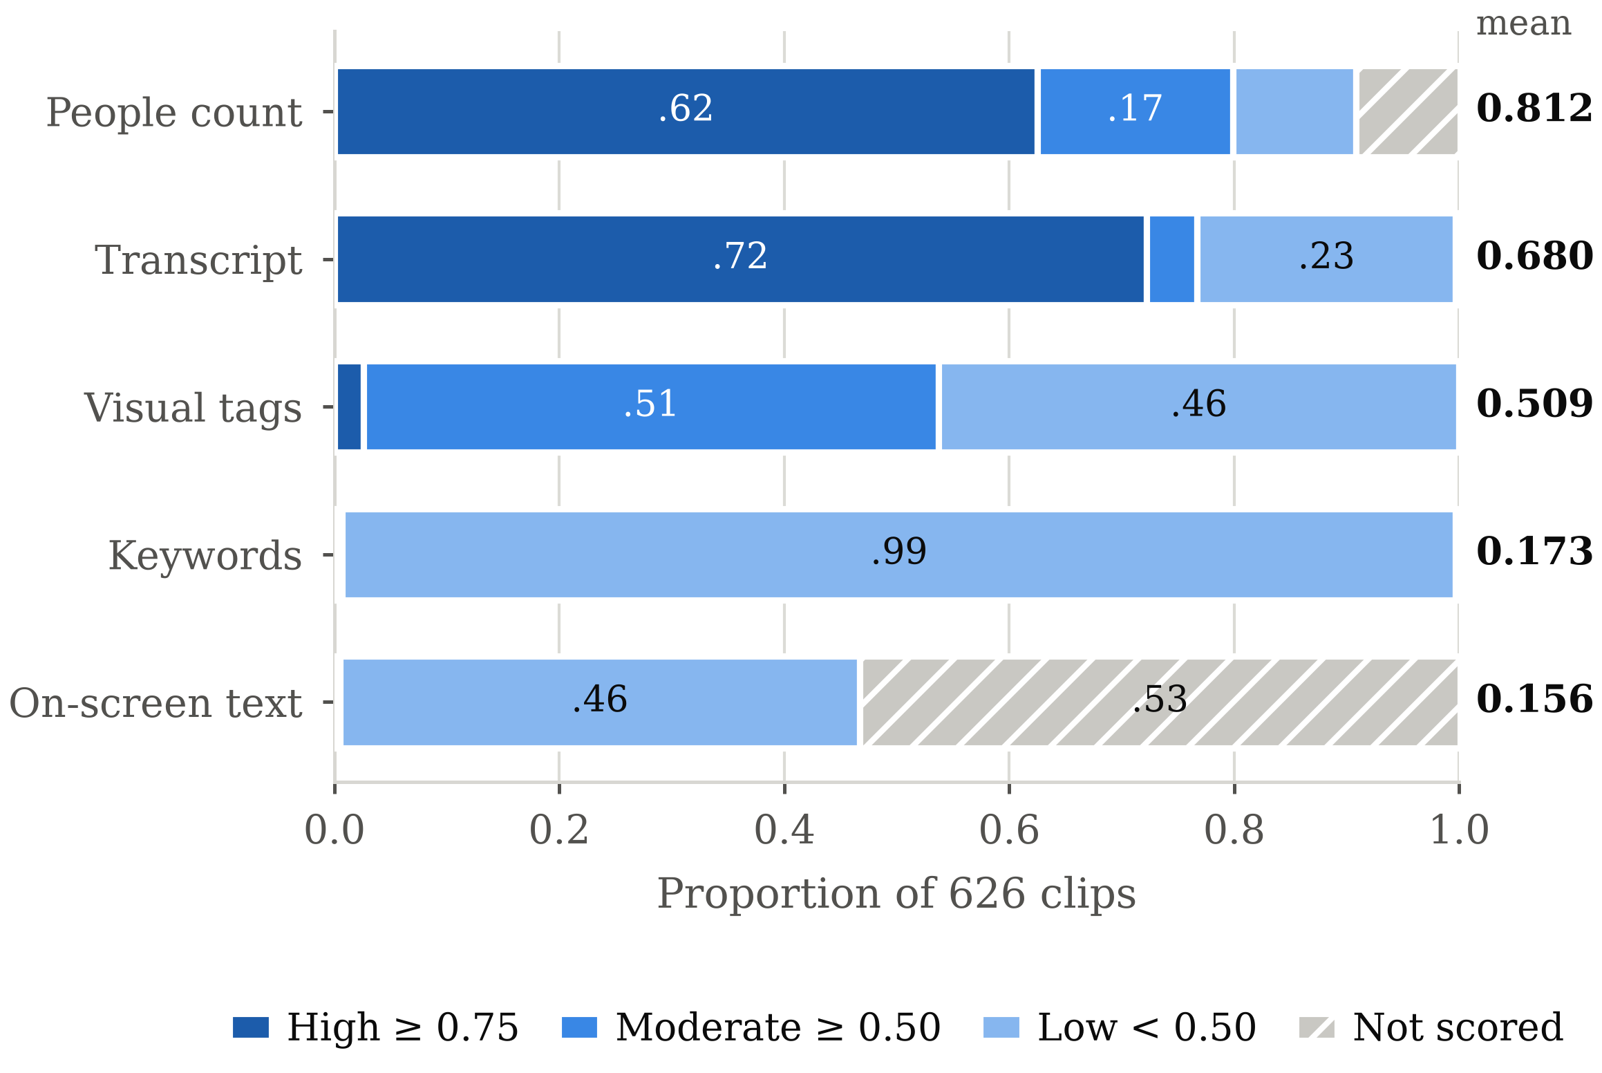
RQ2 · 626 CLIPS
Agreement ranks independence, not difficulty
People count 0.812 — four unrelated families.
Keywords 0.173 — three extractors, one transcript.
On-screen text conflicts on 53.4% of clips and reaches high agreement on none.
The ordering is the ordering of source independence.
Notes:
This is the headline finding. Keywords are not weak because the task is hard — they are weak because there is one input.

Slide 10
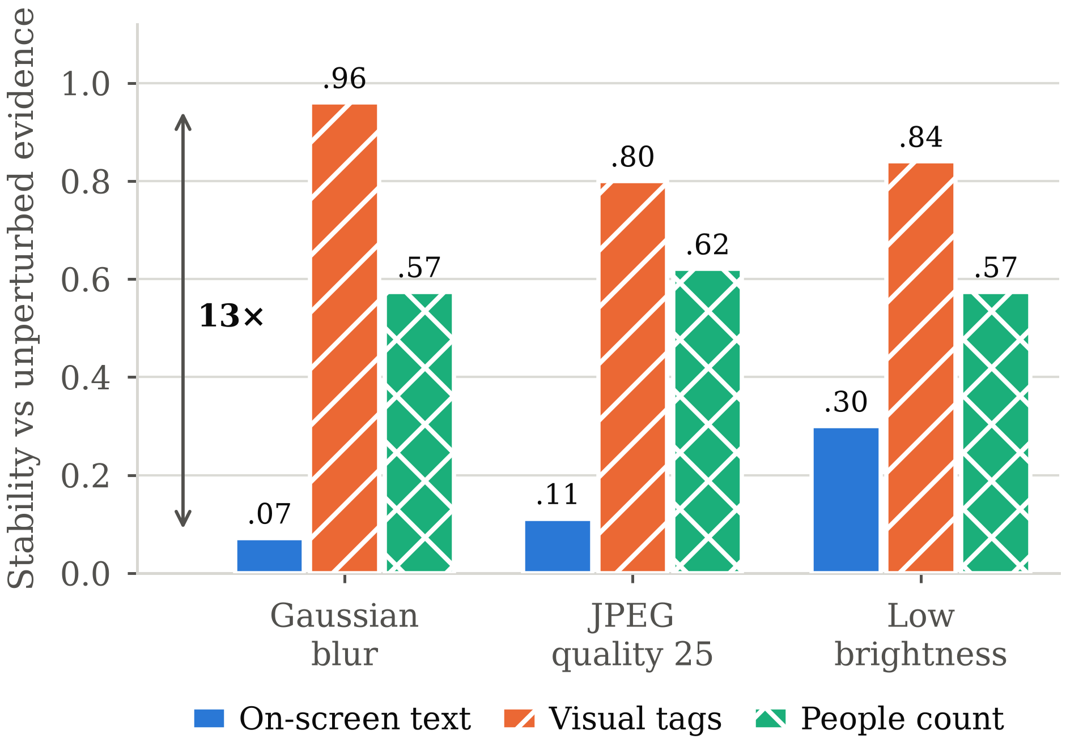
RQ3 · 5 CLIPS
Robustness is field-specific, not system-wide
Under blur, visual tagging holds 0.96 of its output.
On-screen text retains 0.07 — a thirteen-fold spread under one perturbation.
CLIP reads global scene semantics that survive low-pass filtering; character recognition does not.
Deployment rule: on degraded material, treat the text field as absent, not as evidence of absence.
Notes:
n = 5. Directionally clear, statistically weak — say so.

Slide 11
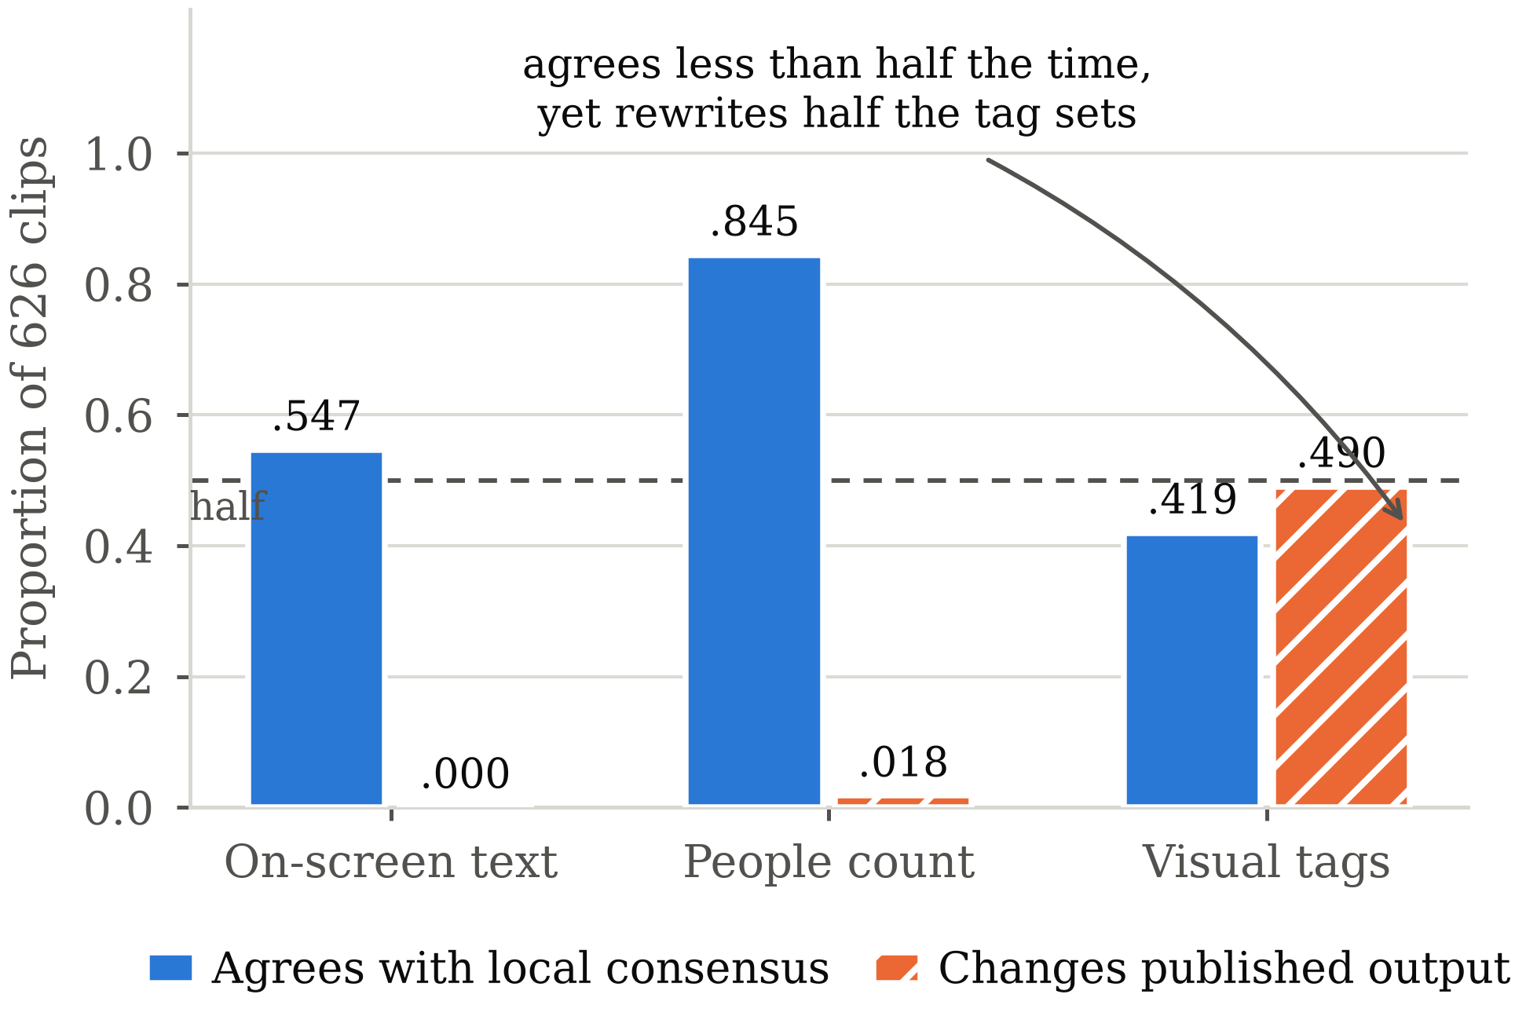
RQ4 · 626 CLIPS
A third annotator refuted my own hypothesis
The hosted annotator agrees with the local consensus only 0.419 of the time …
… yet rewrites 49.0% of published visual-tag sets.
On on-screen text the dual-engine veto holds it to exactly zero changes.
Equal weighting is neutral only when families are independent — and two CLIP variants are not.
Notes:
The uncomfortable result, and the most useful one. The provenance machinery makes it visible but cannot fix it.

Slide 12
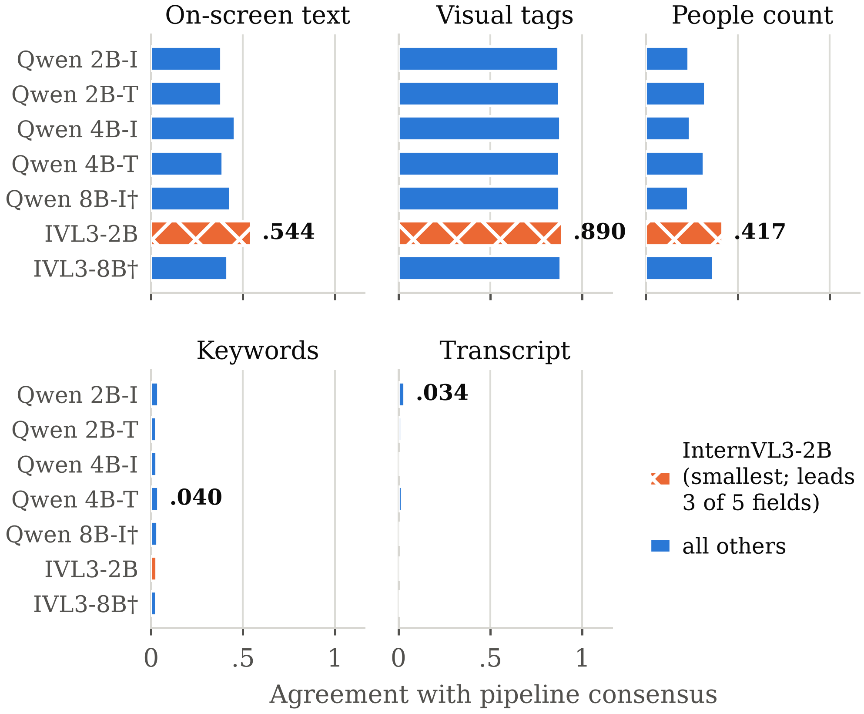
RQ5 · 21,489 SCORES
Scale did not predict agreement
Seven open-weight models, one protocol, 626 clips.
InternVL3-2B — the smallest — leads three of five fields.
It beats its own 8B sibling on all three.
Every model scores at or near zero on transcript: none of them accepts audio.
Notes:
Both 8B models ran int4 on the MIG slice, so this is not evidence that scale hurts — only that 2B sufficed here.

Slide 13
RESULTS
The useful findings contradicted expectation
8 of 11
3
0
anticipated outcomes
refuted or partly refuted
confirmed — all following
deductively from the design
empirical expectations about
scale or deliberation upheld
Agreement was expected to track task difficulty. It tracks source independence.
Three keyword extractors were expected to give three-way corroboration. They give one view, three times.
Degradation was expected to affect fields comparably. The spread is thirteen-fold.
Larger models were expected to agree more. The smallest led.
Notes:
Frame this as confidence, not failure: pre-registering expectations is what makes the refutations meaningful.

Slide 14
LIMITATIONS
What these numbers do not say
No human reference
Every figure measures corroboration between automatic sources — never accuracy.
Correlated sources
Two CLIP variants and two Whisper checkpoints share an architecture, inflating their fields.
Blind to upstream error
If speech recognition fails, all three keyword extractors agree on the same wrong text.
Underpowered ablations
RQ1 uses 8 clips and RQ3 uses 5. Directional, not significant.
Single setting
One broadcaster, one city, one year, one run per model.
Notes:
Say these plainly. An examiner who finds a limitation you did not name trusts nothing else you said.

Slide 15
FUTURE WORK
The next step is small and decisive
A few hundred human-annotated clips would convert every agreement figure in this project into a measure of validity.
Persist per-family candidate lists so the CLIP-pair inflation can be measured rather than declared.
Replace equal weighting with measured per-source reliability weights.
Add an audio-capable model to the benchmark, and a video-native one.
Re-annotate the shot-boundary partition — 72.2% of published clips span at least one shot cut.
Gate the ASR stage on Whisper’s own language identification, and add speaker diarisation.
Notes:
Lead with the human-annotation item — it is the one that unlocks everything else.

Slide 16
The contribution is not better metadata.
It is metadata that tells you how much to trust it.
626 clips · five fields · every published value carrying its evidence status, its supporting models and an auditable agreement score.
Saurav Kumar Vellattuparambil Vijayakumar · 40490925 · Supervisor: Dr Awais Rauf
Notes:
Close on this line, then thank the viewer. Do not add new information here.

