Slide 1
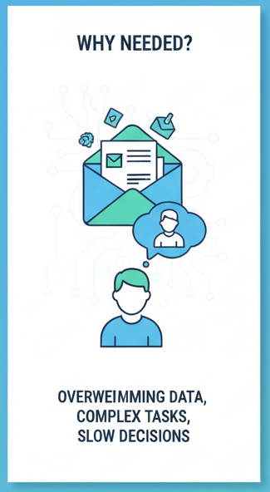
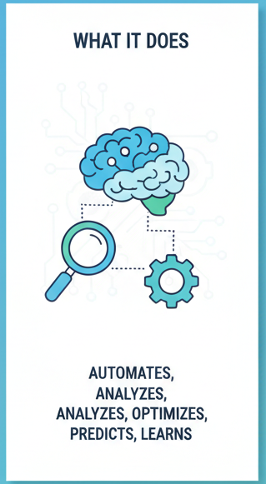
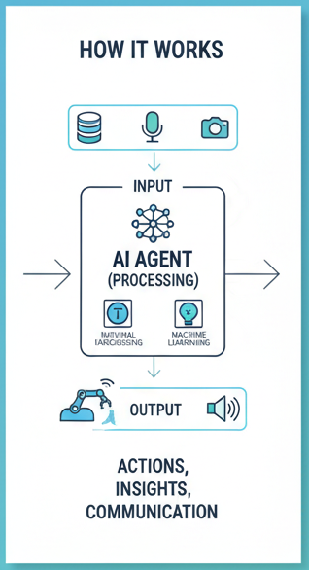
AI Agent

Slide 2
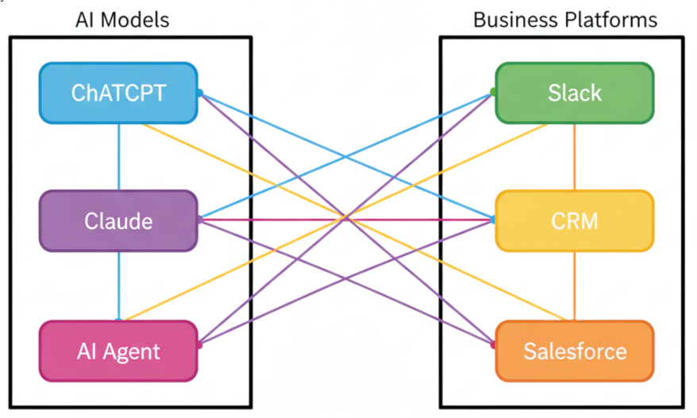
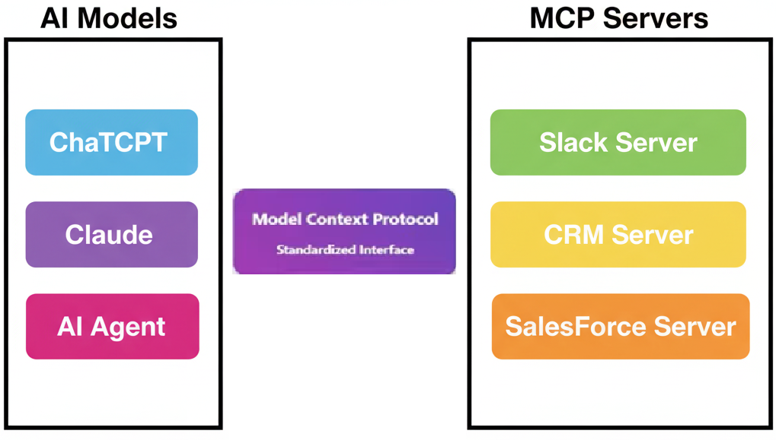
MCP (Model Context Protocol)
Limitation of Traditional AI Agent :
* Lacks standardized process to manage Stateful Interactions across different AI models and external services. * Resulted in fragmented workflows with separate logic for each integration.
MCP brings in standardization to manage context across tools and models in a consistent, secure manner. “Instead of building M x N custom integrations, with MCP we build M + N standardized connection”
X Without MCP
√ With MCP
3 AI Models x 3 Data Source = 9 Custom Integrations
3 AI Models + 3 Data Source = 6 MCP Connections
* Each integration requires custom development
* Maintenance nightmare * No Standardization * Exponential Complexity
* Standardized protocol
* Reusable Components * Linear Complexity * Community ecosystem

Slide 3
Use Cases
NIKE may decide to build AI Agents to Autonomously perform certain tasks to bring in efficiency. The agent achieves its goal by interacting with the company's vast, often siloed, internal systems, tools, and data. MCP, acting as a bridge, streamlines the process of accessing the company resources by the autonomous AI agents.
Hypothetical Use Cases
1. Autonomous Supply Chain Orchestration AI Agent Goal: Proactively manage inventory to avoid stockouts of a popular Shoe model in the Indian market due to an unexpected delay at a manufacturing plant elsewhere.
Need for MCP: The agent must perform a series of interconnected, real-time actions across different platforms-
* Manufacturing ERP (Tool): To receive a real-time alert about the delay and estimate new delivery times.
* Demand Forecasting System (Context): To verify the continued high demand prediction for the product in India.
* Inventory Management System (Tool): To check stock levels in all regional Indian distribution centers.
* Logistics & Carrier Platform (Tool): To automatically re-route in-transit goods or issue an order to transfer inventory from a slower-selling region to India to fill the gap.
MCP enables the agent to make adaptive, real-time decisions by standardizing the complex two-way data exchange between systems, replacing rigid, hard-coded logic with flexible, prompt-driven actions.

Slide 4
Use Cases
2. Context-Aware Customer Service Agents AI Agent Goal: Resolve a customer inquiry that involves a product return, a credit for a loyalty program, and a personalized recommendation for the next purchase.
Need for MCP: The customer service AI agent needs a complete, consolidated view of the customer across multiple back-end systems to act autonomously and provide a human-like, seamless experience:
* CRM System (Tool): To verify customer identity, purchase history, and past service interactions (context).
* Loyalty Program Database (Tool): To issue the credit/points directly.
* Order and Returns System (Tool): To process the return and generate a shipping label.
* Recommendation Engine (Tool): To cross-reference the customer's size, style preference, etc. against current inventory to suggest the next product.
MCP provides the structured context and tool access necessary for the agent to complete this multi-system workflow without escalation to a human agent, dramatically increasing efficiency and customer satisfaction.

Slide 5
Playwright MCP
Playwright's MCP solves the core problem of integrating advanced AI agents (like LLMs) with real browser automation for smarter, more efficient, and self-maintaining testing and web tasks.
The Problem: Traditional automation tools, including Playwright itself (without MCP), are deterministic—they execute exactly what is scripted – rule based.
The MCP Solution: MCP acts as a standardized context bridge and server. It allows AI agents to send natural language commands (e.g., "Login with test user and verify the welcome message") and translates them into Playwright actions.

