Slide 1
Hola PyTorch

Slide 2
Awesome open-source projects
Real-Time-Voice-Cloning
Clone a voice in 5 seconds to generate arbitrary speech in real-time
Flair
State of the art NLP
YOLOv3
CV - Real time object detection and classification

Slide 3
What is PyTorch?

Slide 4
PyTorch
Open source deep learning framework
Focus on flexibility and speed
Easy access to underlying GPU

Slide 5
Topics
Deep Learning Review
Basics of PyTorch
Code it up
Build a Classifier

Slide 6
Deep Learning Review

Slide 7
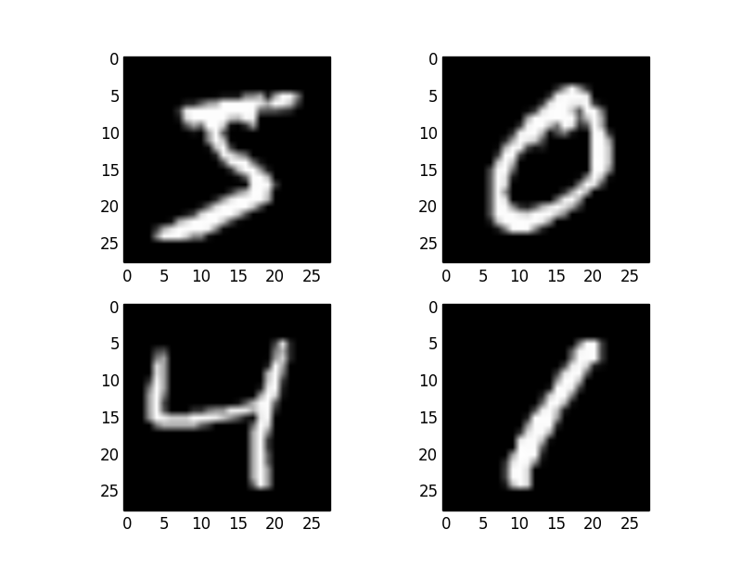

Slide 8
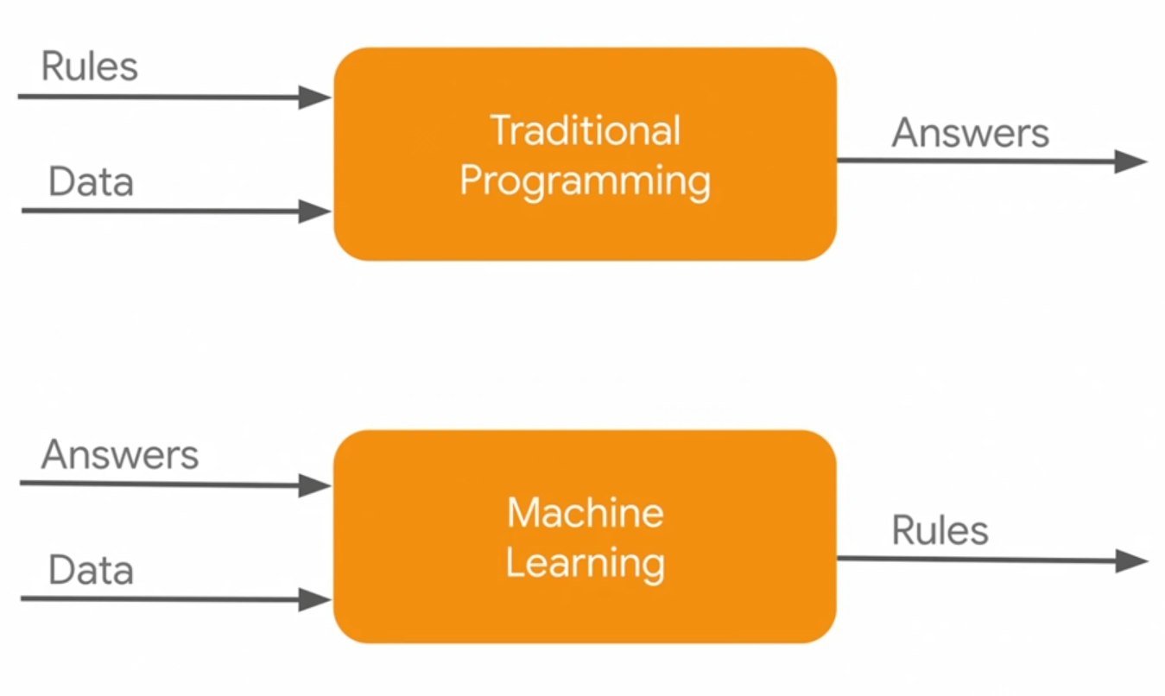

Slide 9
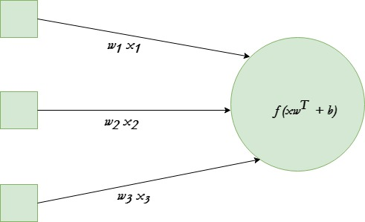

Slide 10
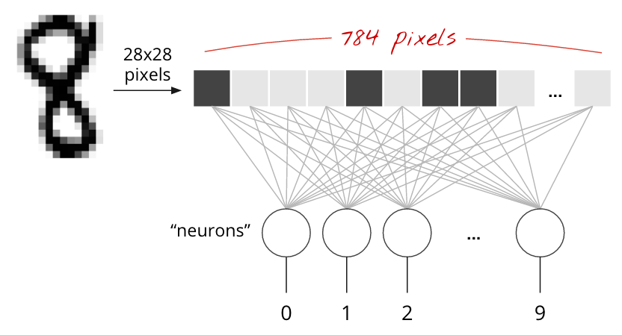

Slide 11
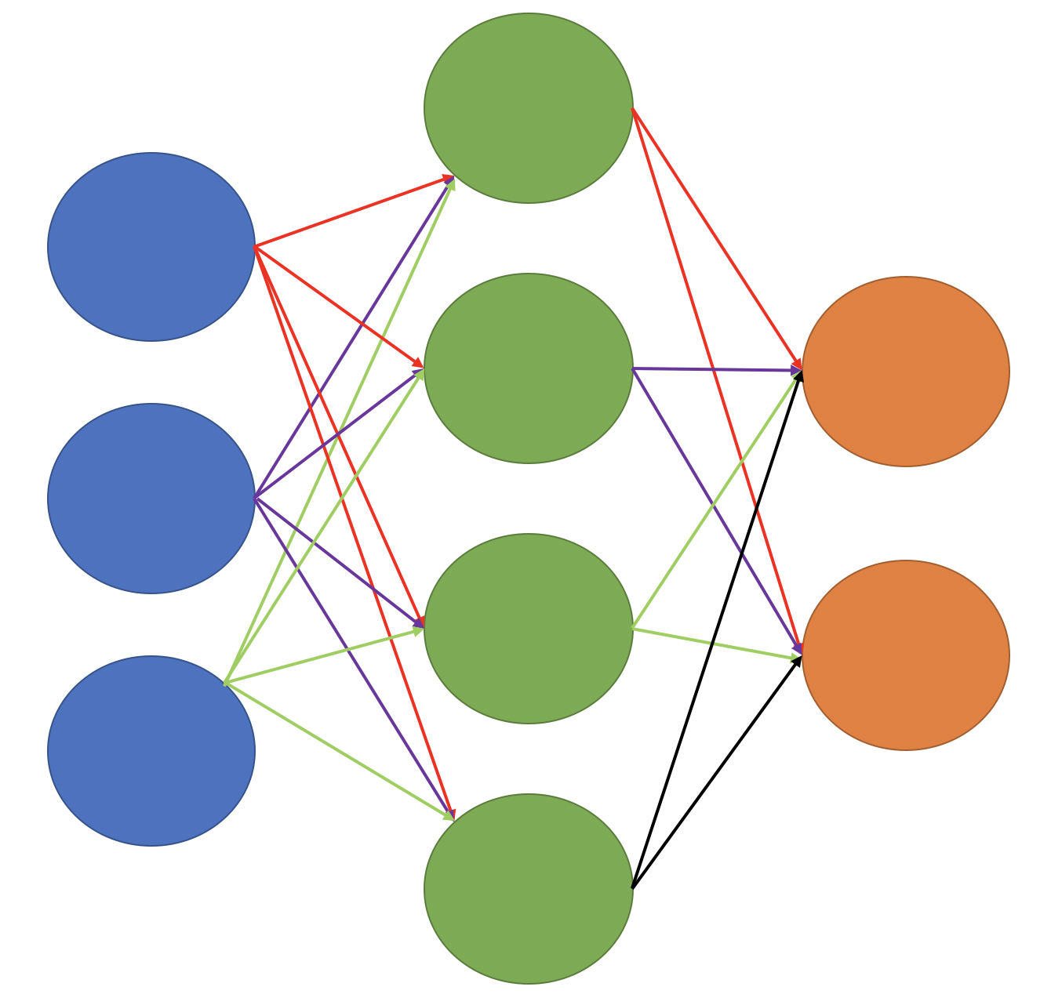

Slide 12
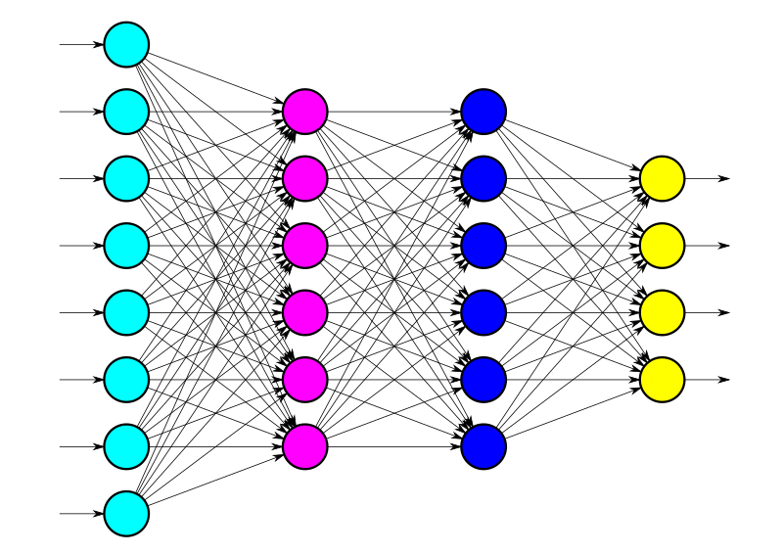

Slide 14
Questions?

Slide 15
Training a Neural Network
Forward pass
Compute loss
Backpropagate
Repeat

Slide 16
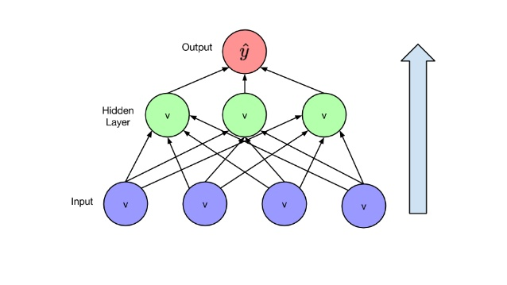
Forward Pass

Slide 17
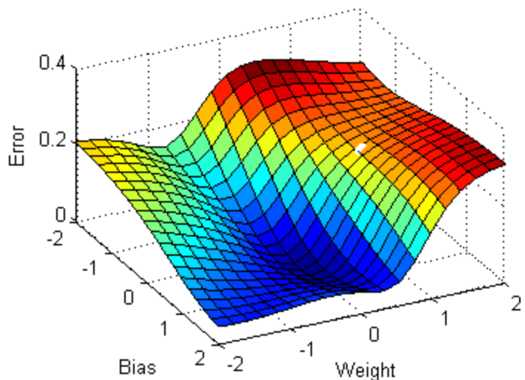
Compute Loss

Slide 18
Minimizing Loss

Slide 19
Backpropagate
Compute gradients of loss
Adjust weights and biases

Slide 20
Questions?

Slide 22
Basics of PyTorch

Slide 23
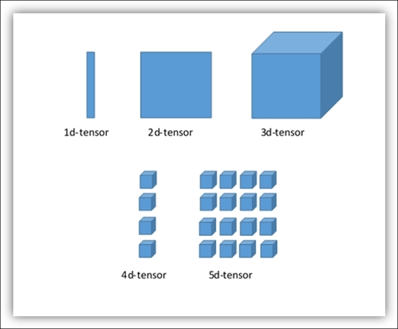
Tensors

Slide 24
Tensors in PyTorch
Multi-dimensional matrix containing elements of a single data type
Can be stored on a specific device

Slide 25
Autograd
Provides automatic differentiation for tensor operations
Define-by-run framework
Central to neural nets in PyTorch

Slide 26
Questions?

Slide 27
Pipeline in PyTorch
Network layers
Loss function
Optimizer
Epochs

Slide 28
Loss Function
Loss functions available as torch.nn modules
torch.nn.MSELoss()
torch.nn.CrossEntropyLoss()

Slide 29
Optimizer
Modify weights and biases according to gradients
Available as modules in torch.optim
Learning rate
Optimizer.step()

Slide 30
Epochs
Forward pass + backpropagation = single epoch
Train over multiple epochs

Slide 31
Questions?

Slide 32
Let’s code!

Slide 33
Enjoyed this?
Check out our courses on YouTube
Instagram - instagram.com/dscvitvellore
Facebook - facebook.com/dscvitcellore
LinkedIn - linkedin.com/company/dscvit

