Slide 1
Temperature & Humidity Sensing
Jason Pearson • Justin Koehler • Percel Dangledryer

Slide 2
Introduction
Background
Design Decisions
Design
Implementation
Testing
Maintenance
Security
Summary

Slide 3
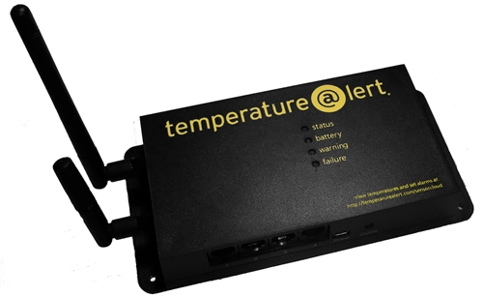
Background
Current Setup:
1 Temperature@lert sensor in each server room.
Too few sensors relative to the high cost of equipment
No central management server

Slide 4
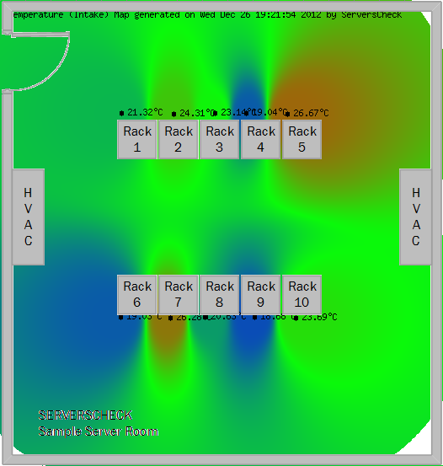
Background – Why More
Notes:
Don’t forget to doctor this picture
Animate dead zones

Slide 5
Background – Previous Team
Developed site that communicates with current sensors.
Features include room/group management and user authentication with permission levels
Implementation in Laravel 3
Sensors report only real-time temperature

Slide 6
Background – Unmet Needs
Additional metrics desired such as humidity
Ability to connect to sensors other than Temperature@lert
In-house built sensors that are
Extensible
Low-cost
Modifiable
Open source

Slide 7
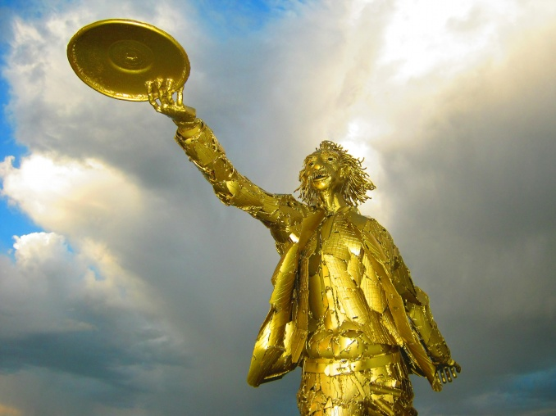
Background - Client
Western Michigan University
Dr. John Kapenga

Slide 8



Design Decisions - Environment
Raspberry Pi
Low-cost
Readily available
Widely documented
Extensible
Laravel
Open source
Most popular PHP framework
Secure
Reliable MVC
Externally Hosted
Safe off-site location
Easy maintenance
Notes:
Pi – cheap, overnightable from

Slide 9


Design Decisions - Improvement
Boot Strap
Open source
Well Documented
Tablet and Phone Support
Google Charts
Open source
Mobile support
Notes:
Pi – cheap, overnightable from

Slide 10


Design Decisions - Language
Sensor driver
Python for speed, doesn’t need compilation
Web Site
LAMP Stack
Laravel Framework
Notes:
LAMP – elaborate to it standing for linux, apache2, mysql, php – all open source, free, secure, fast, reliable
Laravel – secure,

Slide 11
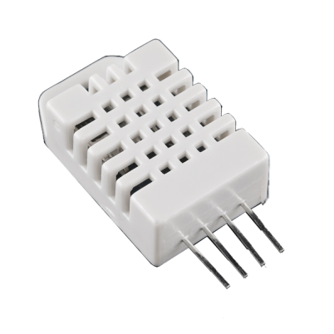
Design Decisions - Hardware
DHT22 Sensor
Temperature Accuracy ±0.5º C
Temperature Range -40 to 80°C
Humidity Accuracy ±0.1Φ
Humidity Range 0-100%
Raspberry Pi
Expandable to 17 concurrent sensors
Runs a full web server
Wireless N adapter
Long range
Low price
Notes:
Φ is relative humidity
Web server - debugging

Slide 12
Design
Laravel
Pi Hosted XML
Pi
Linux
Sensor
Apache
MySQL
PHP

Slide 13
Design – Pi and Sensor Communication
Uses Python to communicate to the device
Python sends a request
Sensor responds
Output written to XML file

Slide 14
Design – Pi and Server Communication
Apache hosts XML file for server to retrieve
Server has different drivers for different devices
Parses XML according to driver
Temperature information handled by server
Notes:
Admin choose refresh interval – 1 minute, 2 minute, 5, 10 etc
Apache hosts, server fetches, server stores in mysql, server queries database for specified drivers with time range, laravel preprocesses php, bootstrap renders based on device

Slide 15
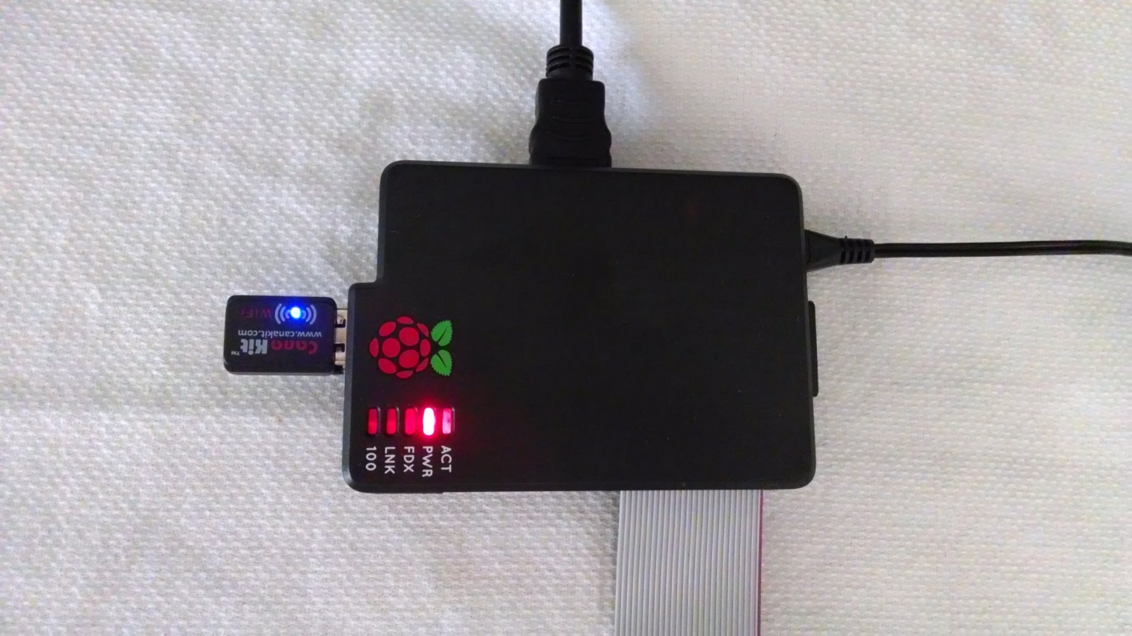
Implementation
Notes:
Get a new picture, sucka

Slide 16
Implementation – The Rest Of The Story
Pictures of site mockups
Google charts displaying the data
Pictures of sensor, pi, both connected (and separate)
Colorful picture of a brief section of code – code that talks to sensor (python snippet where it calls the library)
Notes:
Pictures of site mockups
Google charts displaying the data
Pictures of sensor, pi, both connected (and separate)
Colorful picture of a brief section of code – code that talks to sensor (python snippet where it calls the library)

Slide 17
Testing – What Was Used
Laravel built in testing framework
One hundred virtual sensors for load testing
Extreme temperature sensing
Notes:
P-unit logo
Add testing room, add testing devices, write testing code

Slide 18
Security
Yes Percel, what security is in place?
Laravel Sessions
Input Sanitization
Passwords Hashed

Slide 19
Possible Enrichments
HTTP used for hosting XML on pi but HTTPS could be used instead if extra security is desired
Upgrade to newer web framework
Reporting for other sensors such as
Movement
Radiation
CO or CO2 Levels
Vibration sensing
Laser break beam sensing
Notes:
(for earthquake prone states…california…)

Slide 20
TODO
http://stackoverflow.com/questions/561066/php-fatal-error-allowed-memory-size-of-134217728-bytes-exhausted-codeigniter
Change query for main page less stuff
Change page to fetch only specified interval, refresh if changed
For more than 1 day, do min, max, avg for each day 3 is better than 24*60

Slide 21
Summary
Loo Loo Loo, I didn’t come to any meetings, loo loo loo.

Slide 22
Questions?

