Slide 1
Simulating a fixed-bed downdraft wood gasifier
1D kinetic model, 2D axisymmetric extension and validation against Jayah et al. (2003), Biomass and Bioenergy 25, 459-469
Gasification & Reforming Processes | Batch 09 | October 2026
Notes:
Introduce the assignment: fixed-bed gasifier topic, simulation in Python, validated against Jayah et al. 2003, the NERD 80 kW tea-drying gasifier in Sri Lanka.

Slide 2
What we found
0.43
1.42 / 2.01
93 K
11 cm
%-pt MAE on the calibration run (Jayah's model: 0.46)
%-pt MAE for CO / H2 over the nine independent runs
axial temperature MAE vs six thermocouples (Jayah's model: 121 K)
optimum hearth length with the measured 12.8 % heat loss (Jayah: 32-33 cm)
Mean gas composition and heating value are reproduced; run-to-run differences are not (R² about the 1:1 line ≤ 0)
The model agrees with Jayah on the direction of every parametric effect and on heat loss being decisive
It disagrees on the remedy: insulating the hearth helps far more than lengthening it to 33 cm
Notes:
Headline numbers. The first is a calibration target so it is not independent; the nine runs and thermocouples are independent. Be upfront that R-squared is negative: the measured spread between runs is about 1-2 percentage points, similar to the model error.

Slide 3
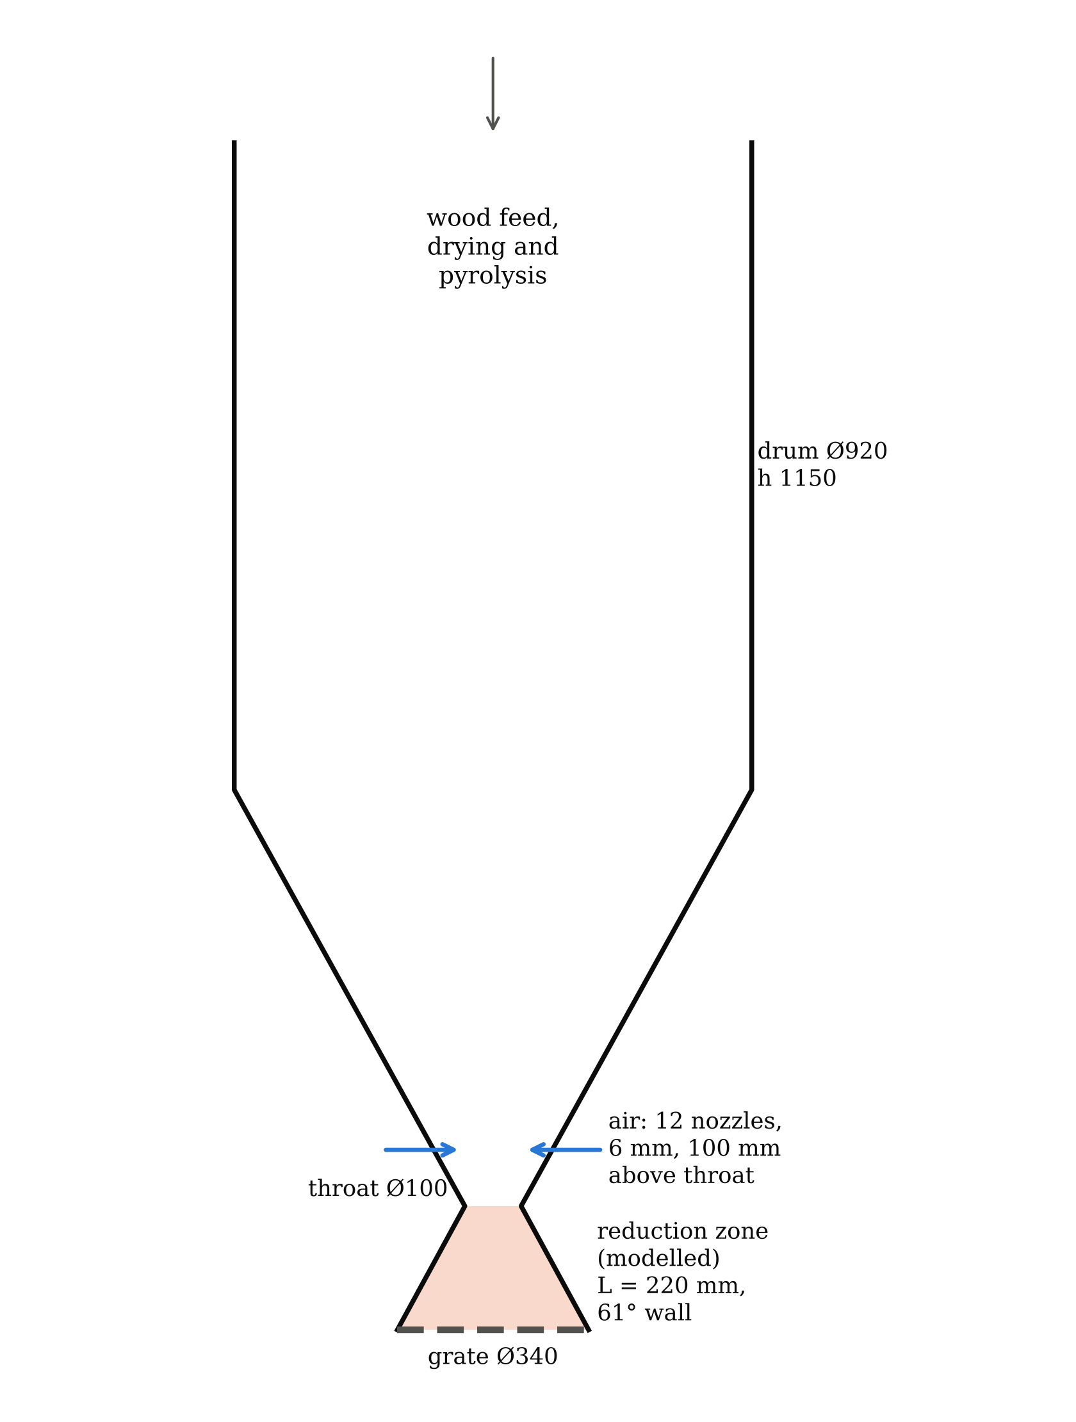
The NERD gasifier and the paper's data
Reactor: 80 kWth, throat Ø100 mm, 12 air nozzles, 220 mm conical reduction zone (61° wall), no insulation
Fuel: rubber wood, 3.3 / 4.4 / 5.5 cm chips, 12.5-18.5 % moisture (d.b.)
Air-fuel ratio: 1.86-2.37 kg/kg, i.e. equivalence ratio 0.30-0.38 (stoichiometric air 6.22 kg/kg)
Validation data: Table 3 (nine gas analyses), Table 5 (calibration run), Fig. 5 (six axial temperatures), Table 7 (parametric study)
Not reported, so assumed: feed rate per run (18.6 kg/h from Table 4), bed voidage 0.48, char density 250 kg/m³
Notes:
Everything in bold-face comes from the paper; the last line lists what we had to assume because the paper does not give it.

Slide 4
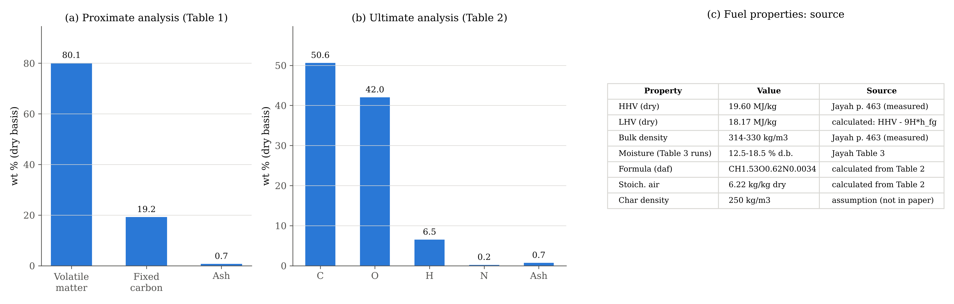
Feedstock: rubber wood
Fixed carbon (19.2 %) becomes the char that is gasified in the reduction zone; the volatiles (80.1 %) burn with the air above the throat
Dry LHV 18.17 MJ/kg and formula CH1.53O0.62N0.0034 are calculated from the paper's analyses
Notes:
Tables 1 and 2 of the paper. The right-hand table marks which properties are measured, calculated or assumed.

Slide 5
Model structure: three linked parts
1
Throat sub-model
2
1D reduction zone
3
2D axisymmetric
Volatiles + air -> CO, CO2, H2, H2O, N2 (WGS equilibrium, CH4 fixed at 1.2 %). Temperature from an enthalpy balance, anchored to Jayah's 1604 K
Species, char, gas and char temperatures, particle shrinkage. Boudouard, water-gas, methanation, WGS. Wall loss U·P·(Tg - T∞). Stiff Radau solver
12 annular cells following the cone; each runs the 1D physics; radial dispersion of heat and species; wall loss only at the outer cell
Calibrated (3 parameters, never on validation data)
Wall coefficient U = 114.4 W/m²K: gives the 12.8 % heat loss Jayah measured
Char-reactivity factors η(Boudouard) = 0.47, η(water-gas) = 0.14: fitted to the CO, H2 and CO2 of Table 5
Notes:
Key viva point: the mixed adiabatic throat temperature is about 1345 K, lower than Jayah's 1604 K, so we keep Jayah's level and take only the change with AFR, moisture and air temperature from the energy balance. Water-gas shift units are ambiguous in the literature; the fast reading gives a far worse gas.

Slide 6
Calibration run: matches as well as Jayah's own model
MAE 0.43 %-pts (Jayah's model 0.46)
Table 5 = Run 7 (AFR 1.86, 14.7 % moisture) with 2.5 cm chips, as the paper states
This is a calibration target, so the fit is not evidence by itself; the next slides use independent data
Notes:
Explain the Table 5 / Run 7 chip-size inconsistency in the paper if asked.

Slide 7
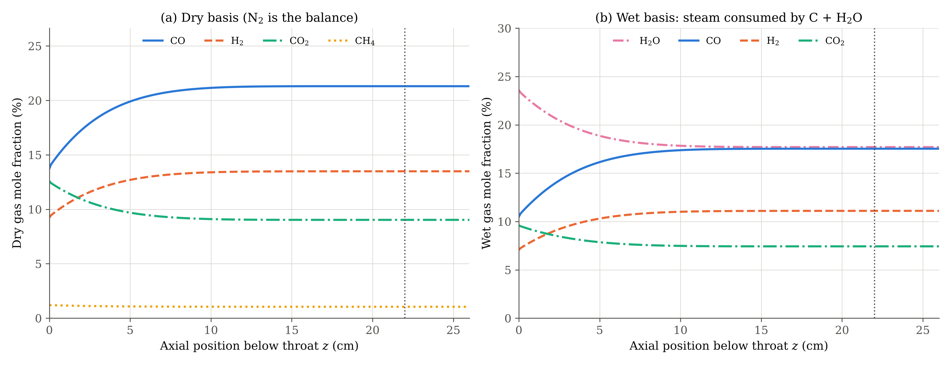
Axial species: conversion happens in the first 10 cm
CO 13.7 -> 21.3 %, H2 9.2 -> 13.5 %, CO2 12.6 -> 9.0 %, steam 23.6 -> 17.7 % (wet); then the bed is too cold and the gas freezes
Notes:
Reference case: Fig. 5 conditions, AFR 2.20, 2.5 cm chips.

Slide 8
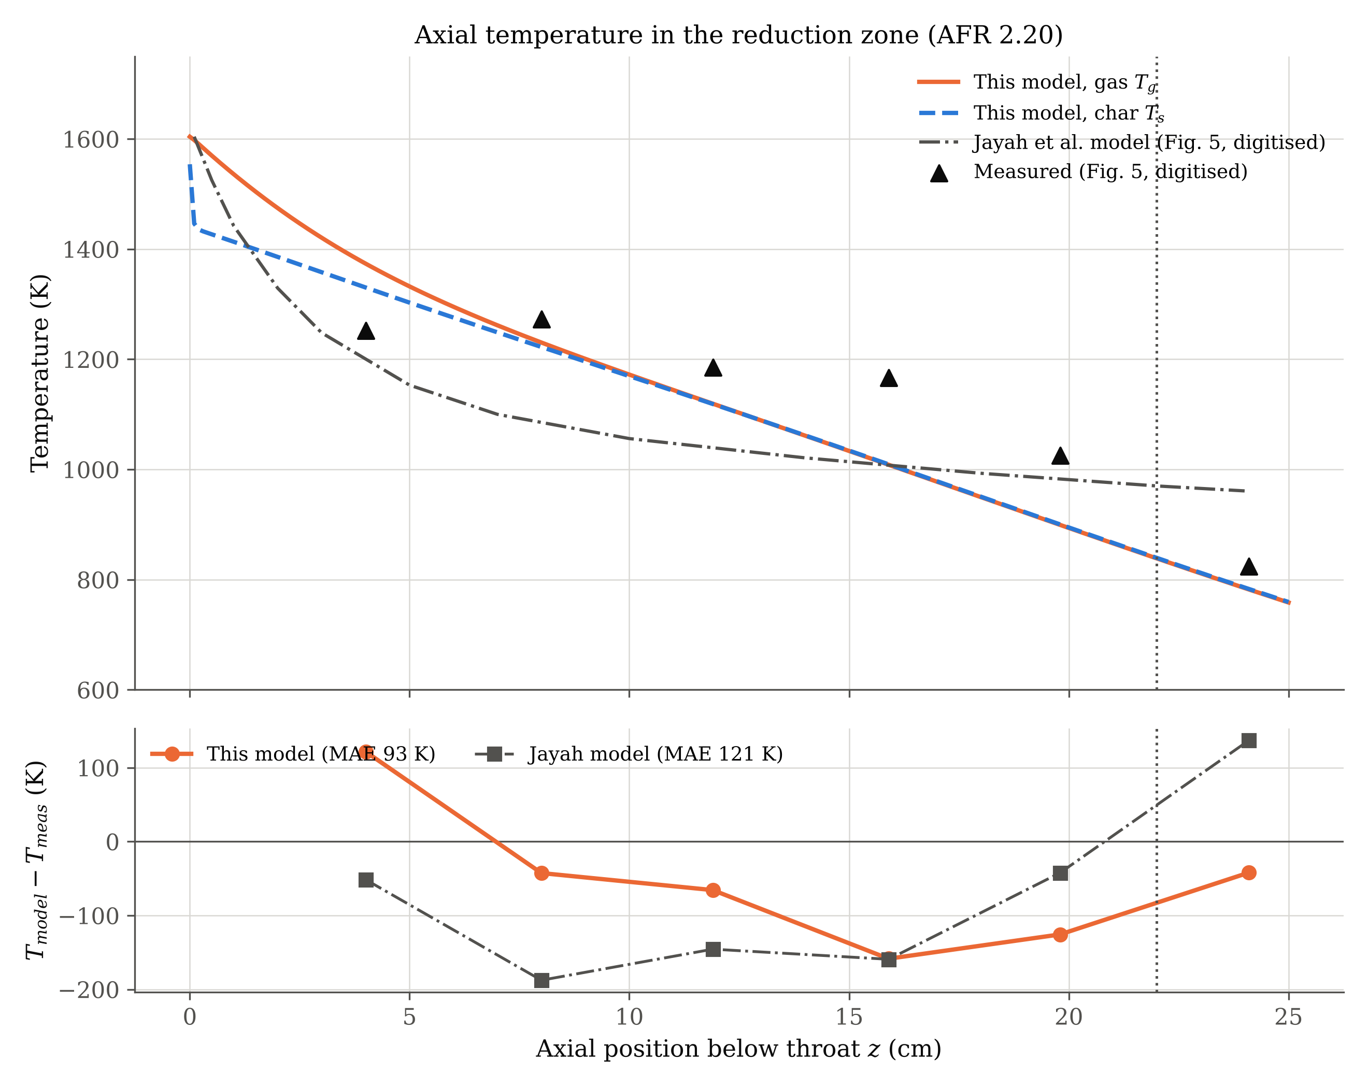
Temperature: closer to the thermocouples than Jayah's model
93 K vs 121 K
MAE of this model vs Jayah's model at the six measured points (not fitted)
Gas enters at 1604 K, char at 1554 K; the phases equilibrate by 7.6 cm
71 % of the cooling is wall loss, the rest endothermic reaction
Largest errors: too hot at 4 cm, too cold at 16-20 cm
Notes:
Both measured points and Jayah's model curve were digitised from the paper's Fig. 5 (six points, not seven as in our earlier draft).

Slide 9
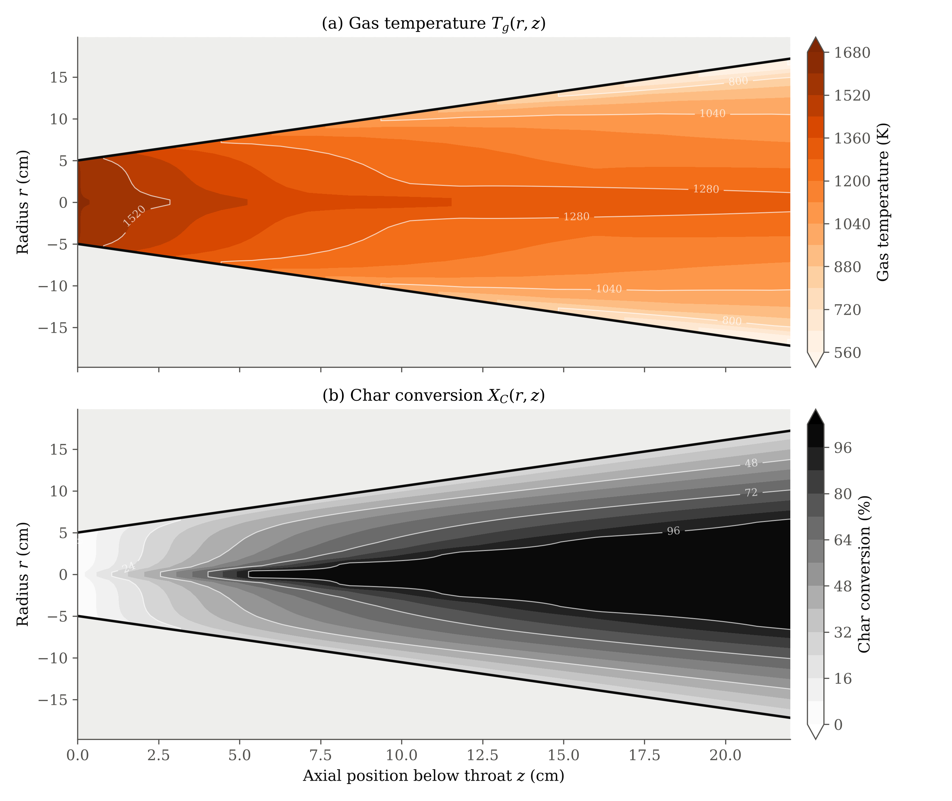
2D: a hot core and a cold wall layer
Exit: 1292 K on the axis, 558 K in the wall cell
Core char is 99.8 % converted by 11 cm; near the wall only 30 %
Radial dispersion includes radiation through the bed, which dominates at these temperatures
It is a reduced-order dispersion model: no velocity profile, channelling or nozzle jets; not CFD
Notes:
Each radial cell runs the same physics as the 1D model; with very strong mixing the 2D model collapses to the 1D result (a unit test checks this).

Slide 10
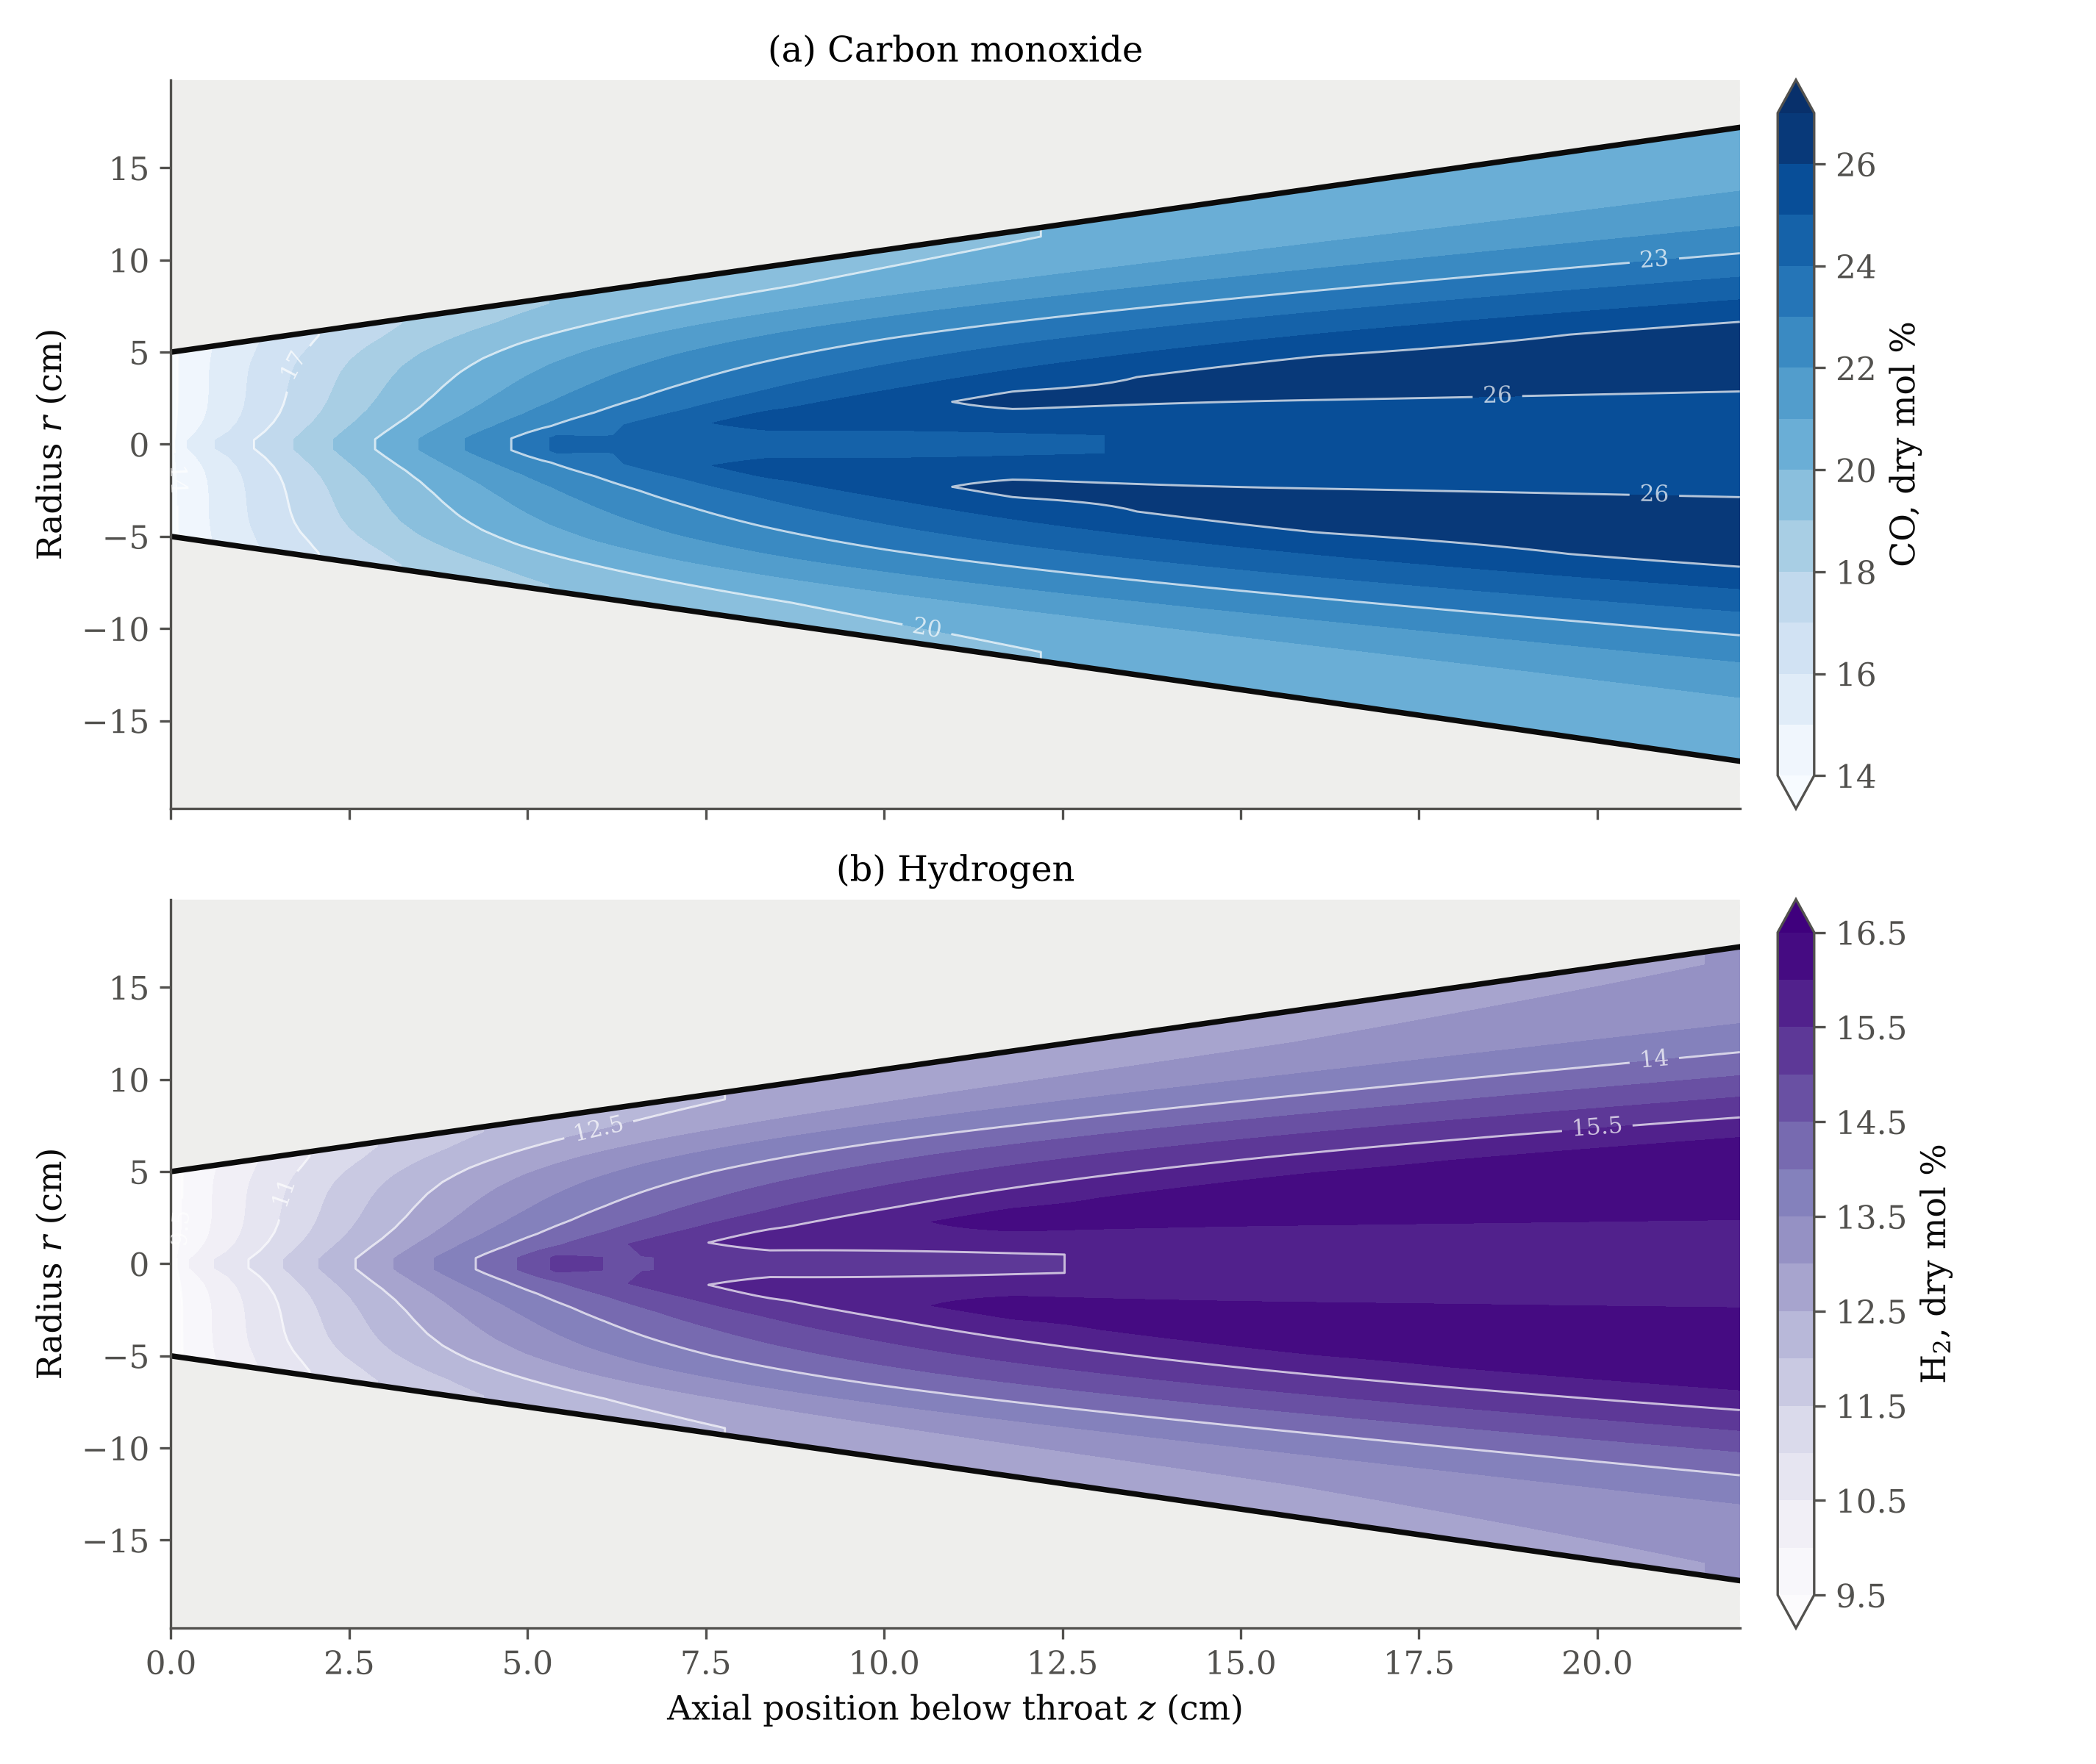
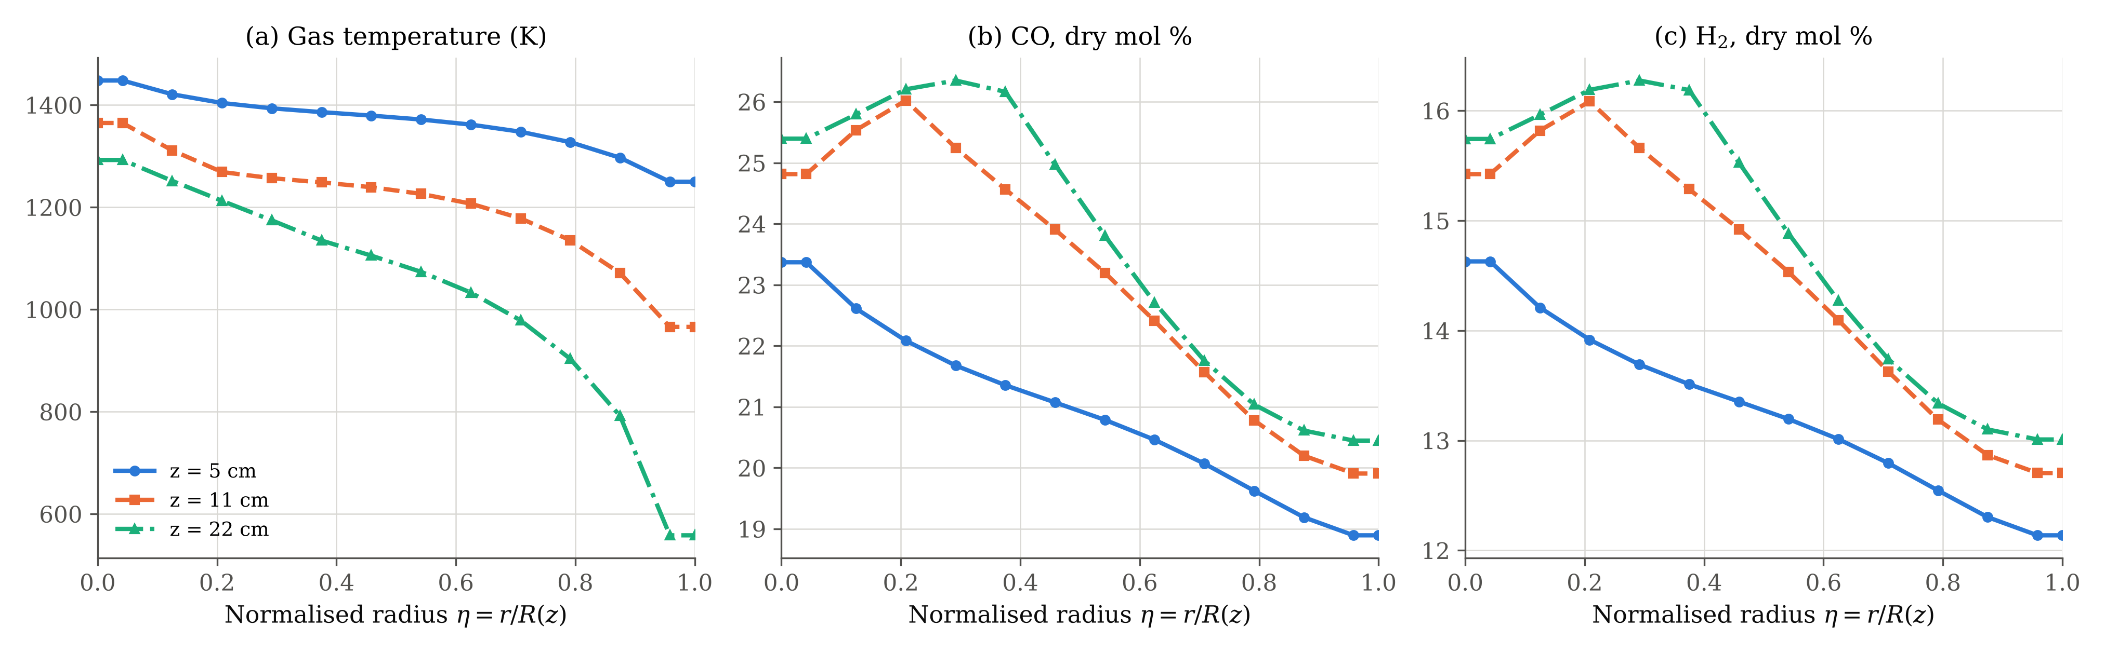
2D species: richest gas in the core
Exit CO 25.4 % on the axis vs 20.4 % at the wall; H2 15.7 vs 13.0 %
Once core char is used up, the CO peak moves just off the axis where char is still reacting
Flow-weighted 2D exit: CO 22.8, H2 14.3, CO2 8.3 %
Notes:
CO2 and H2O contours are in the report (Fig. 8 there).

Slide 11
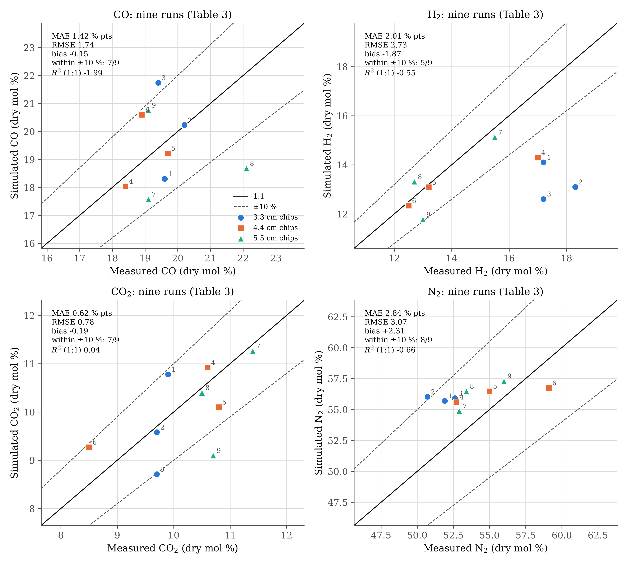
Nine independent runs: right level, not the trends
 | MAE | Bias | Meas. std | R²
CO | 1.42 | -0.15 | 1.00 | -1.99
H2 | 2.01 | -1.87 | 2.19 | -0.55
CO2 | 0.62 | -0.19 | 0.80 | 0.04
N2 | 2.84 | +2.31 | 2.39 | -0.66
LHV | 0.30 | -0.27 | 0.24 | -1.21
Errors in %-points (LHV in MJ/Nm³); all statistics computed in code
H2 is too low in Runs 1-4; N2 too high, i.e. less gas per unit air
R² < 0 because the measured spread (1-2 %-pts) is about the size of the error, and the model's CO-vs-AFR trend is not in the data
Notes:
Our earlier draft quoted R-squared of 0.81 etc.; those were typed constants. These are computed.

Slide 12
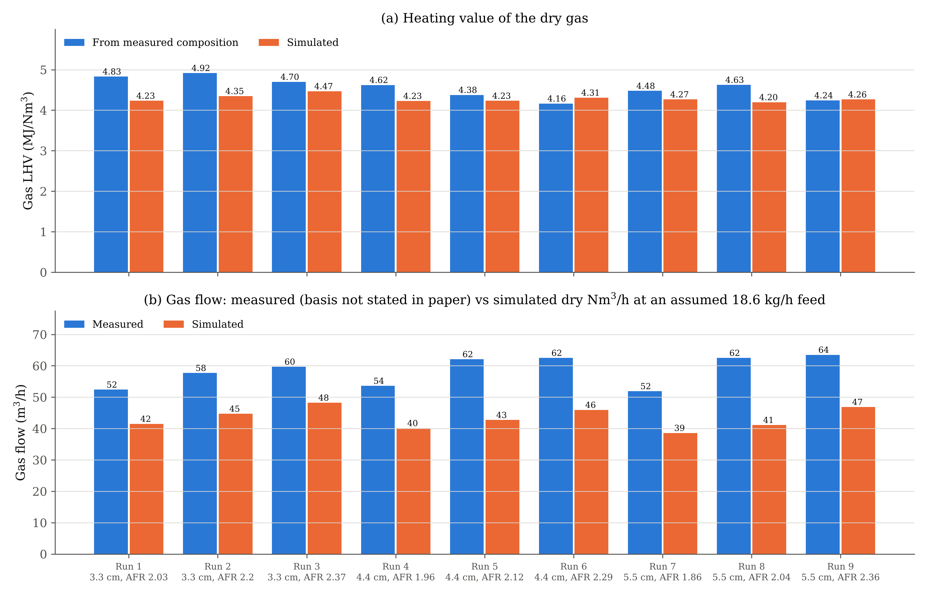
Heating value fits; gas flow cannot be tested properly
LHV within 0.30 MJ/Nm³ on average
Simulated dry flow is 66-81 % of the measured flow
The paper gives no per-run feed rate and does not say whether the measured flow is wet, dry or at what temperature
Matching the flow would need 23.0-28.3 kg/h of dry wood instead of the assumed 18.6 kg/h
Notes:
Composition and LHV are intensive, so they barely depend on the feed-rate assumption (see feed sweep in the report).

Slide 13
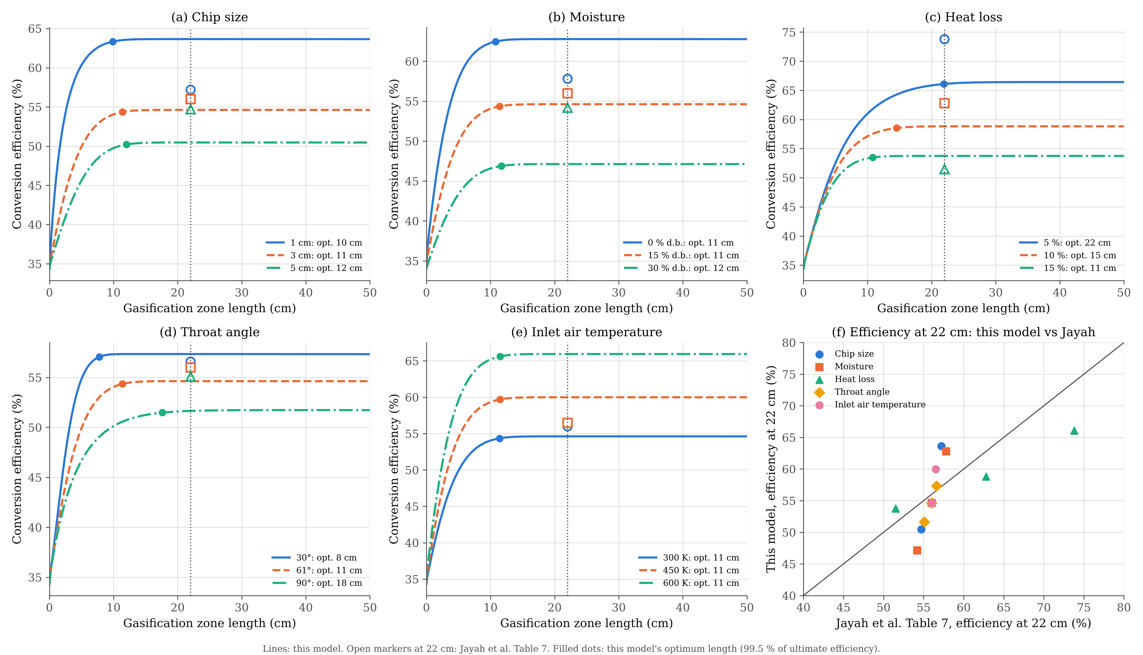
Parametric study: same directions, different optimum
Base case at 22 cm: 54.6 % (Jayah 56.0 %)
Every effect has Jayah's sign; heat loss is the strongest lever
Optimum length 11 cm, not 32-33 cm: the bed is too cold for gasification beyond ~12 cm
At 5 % heat loss the optimum becomes 22 cm and efficiency 66.1 %
Recommendation: insulate the hearth first; the existing 22 cm is then close to optimal
Notes:
Open markers are Jayah's Table 7 values at 22 cm. Moisture, chip size and air temperature act more strongly in our model because they act through the throat temperature and steep kinetics.

Slide 14
Limitations we want to be clear about
Throat temperature
Water-gas shift
Absolute level taken from Jayah (1604 K); our mixed energy balance gives 1345 K
Rate units are ambiguous in the literature; the fast reading gives CO 9 %, H2 23 % on the calibration run
Calibration
Paper data gaps
Effective U = 114 W/m²K puts all measured loss in the hearth; calibration-run char conversion is only 17 %
No per-run feed rate or flow basis; chip size of Run 7 inconsistent; Fig. 5 trial conditions not stated
CH4 and tar
2D model
CH4 imposed (as in Jayah); tar not modelled
Radial dispersion only, not CFD; no velocity profile or channelling
Notes:
Raise these before the examiners do.

Slide 15
Conclusions
Calibration run reproduced to 0.43 %-pts, as well as Jayah's own model
Nine independent runs: MAE 1.42 (CO), 2.01 (H2), 0.62 (CO2) %-pts; H2 biased low; trends between runs not captured
Axial temperature within 93 K of the thermocouples, better than Jayah's model (121 K)
2D model: hot core, cold wall layer, core char exhausted by about 11 cm
Design: heat loss dominates; insulating the hearth is worth more than extending it to 33 cm
Code, data and report: Python repository, run_simulation.py reproduces every number
Notes:
Close with the design recommendation and invite questions.

