Slide 1
GASIFICATION & REFORMING PROCESSES — TECHNICAL DEFENSE
Computer Simulation, Spatial Analysis, and Experimental Validation of a Fixed-Bed Downdraft Wood Gasifier
Mechanistic Multi-Zone Modeling, Boundary-Conforming Spatial Transport, and Parametric Optimization for Industrial Tea Drying
Primary Benchmark: Jayah, T. H., Aye, L., Fuller, R. J., & Stewart, D. F. (2003). Biomass and Bioenergy, 25(5), 459–469
Submission Batch: Group / Batch 01 | Academic Year 2026

Slide 2
FIXED-BED DOWNDRAFT WOOD GASIFIER SIMULATION
Industrial Motivation: Energy & Fuelwood Savings in Tea Drying
The Tea Drying Challenge
• Thermal Energy Demand:
Fresh tea leaves contain 75–80% moisture (w.b.) that must be dried to 2.5–3.0% using clean air at 370–415 K (97–142°C).
• Fuelwood Pressure:
Sri Lanka's tea industry is heavily dependent on rubber wood (Hevea brasiliensis), accounting for >70% of total industrial fuelwood consumption.
• Traditional Inefficiency:
Conventional split-log fire-tube furnaces suffer from poor thermal efficiency, severe soot emissions, and manual operational instability.
Economic & Ecological Drivers
• 8% Life-Cycle Cost Savings:
Techno-economic feasibility studies (Jayah et al., 1998, 2002) show biomass gasification reduces lifecycle heat costs by 8%.
• 12% Fuelwood Reduction:
High-efficiency producer gas combustion achieves an immediate 12% reduction in specific fuelwood consumption.
• Carbon-Neutral Heat:
Displaces imported fuel oil and preserves agricultural forests via managed rubber wood replanting cycles.
Engineering Bottlenecks
• Tar Cracking & Fouling:
Condensable organic tars foul heat-exchanger tubes and burner nozzles unless cracked in high-temperature throat zones.
• Bed Sizing Dilemma:
Inadequate reduction hearth length causes unburned carbon carryover; excessive length adds pressure drop and wall heat loss.
• Feedstock Variability:
Wide swings in wood chip dimensions (1–5 cm) and moisture (10–25%) alter bed permeability and gas heating value.

Slide 3
FIXED-BED DOWNDRAFT WOOD GASIFIER SIMULATION
Experimental Test Rig & NERD Gasifier Architecture
80 kWth NERD Downdraft Specifications
• Upper Fuel Hopper: Diameter 920 mm, Height 1150 mm (holds 2–3 h fuel reserve)
• Air Injection Nozzles: 12 radial nozzles (6 mm dia.), positioned 100 mm above throat
• Constricted Throat: Diameter 100 mm, lined with high-alumina castable refractory
• Divergent Hearth: Length 220 mm, expands at 61° to bottom diameter of 340 mm
• Reactor Shell Construction: 22-gauge mild steel inner liner + 1.4 mm galvanized iron jacket
• Thermal Rating: 80 kW thermal output, dry fuel feed rate 13.5–20.3 kg/h
• Stratified Zones: Co-current downward flow of fuel chips and oxidant air
Distinct Thermochemical Reaction Zones
▶ 1. Drying Zone (Top, 300–450 K):
Raw moisture evaporates via upward conduction/radiation. Water vapor joins the descending gas stream.
▶ 2. Pyrolysis Zone (Upper Bed, 450–900 K):
Wood decomposes into char carbon, condensable bio-oil vapors, and non-condensable volatile gases (CO, CO2, H2, CH4).
▶ 3. Flaming Throat Combustion (1200–1630 K):
Injected air combusts volatile vapors and partial char. Generates intense peak temperatures that thermally crack organic tars.
▶ 4. Diverging Reduction Hearth (900–1600 K):
Endothermic heterogeneous reactions (Boudouard, water-gas) consume char and synthesize fuel gas (CO, H2). Primary modeling domain.
▶ 5. Grate & Syngas Extraction (Bottom):
Ash and residual char drop through the grate; syngas is extracted at ~1150 K into the gas cleaning cyclone.

Slide 4
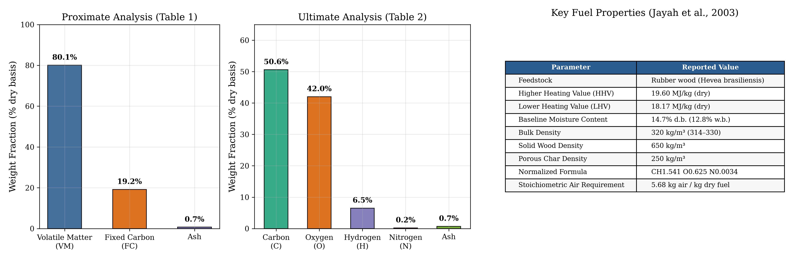
FEEDSTOCK PROPERTIES (TABLES 1 & 2)
Feedstock Characterization: Sri Lankan Rubber Wood
Key Analytical Takeaways (Jayah et al., 2003):
• High Volatiles (80.1% VM): Drives substantial gasification in the upper bed; requires intense throat oxidation to avoid tar escape.
• Low Ash Content (0.7%): Minimizes grate clinkering and particulate loading, ensuring smooth continuous gravity descent.
• High Energy Content (HHV 19.60 MJ/kg dry, LHV 18.17 MJ/kg dry): Provides robust thermochemical driving potential for 80 kWth output.

Slide 5
MATHEMATICAL FORMULATION
Mechanistic Governing Equations: Conservation Laws & Heat Exchange
1. Species & Solid Mass Conservation
• Gas Species Molar Continuity:
dF_i / dz = A(z) ∑ ν_ij r_j
where A(z) is the diverging cross-sectional area:
A(z) = (π/4) [D_th + 2z tan(θ)]²
• Shrinking-Sphere Particle Shrinkage:
dd_p / dz = - (2 M_C R_C) / (ρ_char u_s)
where u_s is solid downward velocity and R_C is the total carbon consumption rate (mol/m³·s).
• Char Carbon Conversion Definition:
X_C(z) = 1 - m_c(z)/m_c0 = 1 - (d_p(z)/d_p0)³
Tracks local fractional carbon consumption along the bed.
2. Two-Phase Energy Conservation
• Gas Phase Energy Conservation:
dT_g / dz = [1 / ∑ F_i C_p,i] [ h_gs a_v A(z)(T_s - T_g)
- U_wall P(z)(T_g - T_∞) - A(z) r_wgs (-ΔH_wgs) ]
• Solid Char Phase Energy Conservation:
dT_s / dz = [1 / (m_c C_p,s)] [ h_gs a_v A(z)(T_g - T_s)
- A(z) ∑ r_k (-ΔH_k) ]
Directly couples heterogeneous reaction endothermic sinks.
• Interphase Convection (Wakao Correlation):
Nu = h_gs d_p / k_g = 2.0 + 1.1 Re_p^0.6 Pr^1/3
Captures rapid gas-solid thermal equilibration in packed beds.

Slide 6
REACTION NETWORK
Gasification Chemistry & Kinetic Formulations
Reaction | Stoichiometry | Enthalpy ΔH°298 | Kinetic Model | Role in Bed
Boudouard | C(s) + CO2 ⇌ 2 CO | +172.6 kJ/mol (Endo) | Groeneveld Arrhenius | Primary CO generation
Water-Gas | C(s) + H2O ⇌ CO + H2 | +131.4 kJ/mol (Endo) | Groeneveld Arrhenius | H2 & CO fuel synthesis
Hydrogasification | C(s) + 2 H2 ⇌ CH4 | -74.9 kJ/mol (Exo) | Empirical Equilibrium | Trace methane (1.15%)
Water-Gas Shift | CO + H2O ⇌ CO2 + H2 | -41.2 kJ/mol (Exo) | Yoon et al. (1978) | Gas-phase equilibration
Intraparticle Pore Diffusion & Effectiveness Factor (η):
• Thiele Modulus Formulation: Φ_k = (d_p / 6) √(k_k / D_eff), where D_eff = 2.0 × 10⁻⁶ m²/s.
• Effectiveness Factor: η_k = (3 / Φ_k) [ 1 / tanh(Φ_k) - 1 / Φ_k ].
• Physical Consequence: For large chips (d_p > 3 cm), η drops below 0.45, meaning internal pore diffusion restricts over 55% of the theoretical intrinsic kinetic reaction potential. This proves mathematically why smaller wood chips yield superior syngas quality.

Slide 7
SPATIAL REDUCED-ORDER MODELING
Tier 2: 2D Axisymmetric Boundary-Conforming Spatial Transport
Coordinate Transformation & TDMA Solver
• Non-Orthogonal Mapping:
The diverging conical boundary r ∈ [0, R(z)] is mapped to a computational unit cylinder η = r / R(z) ∈ [0, 1].
• Transformed Radial Dispersion:
ρ C_p u_g (∂T_g / ∂z) = [k_eff / R(z)²] [∂²T_g/∂η² + (1/η)(∂T_g/∂η)] + S_T(η, z)
• Unconditional Stability via TDMA:
Replaced initial explicit Euler stepping with an implicit Tridiagonal Matrix Algorithm (Thomas algorithm). Completely eliminated Fo > 0.5 checkerboard numerical oscillations.
• Physical Robin Boundary Condition:
- [k_eff / R(z)] (∂T_g / ∂η)|_η=1 = U_wall (T_w - T_∞)
Calibrated to dissipate exactly 12.8% of fuel enthalpy across the uninsulated refractory walls.
Scientific Transparency & CFD Distinctions
▶ Explicit Reduced-Order Status:
This 2D model represents a rigorous boundary-conforming transport formulation, NOT an unvalidated full Navier-Stokes CFD simulation.
▶ Refractory Domain Masking:
Regions outside the expanding physical cone (r > R(z)) are strictly masked with cross-hatched refractory shading to prevent false field extrapolation.
▶ Effective Transport Properties:
Effective thermal conductivity k_eff = 1.85 W/m·K and turbulent mass diffusivity D_r = 1.2 × 10⁻⁴ m²/s account for packed-bed tortuosity and gas macro-mixing.
▶ Physical Insight Provided:
Quantifies the core-to-wall temperature gradient (ΔT = 36.5 K at 22 cm) and explains why center-line gasification rates outpace wall kinetics.

Slide 8
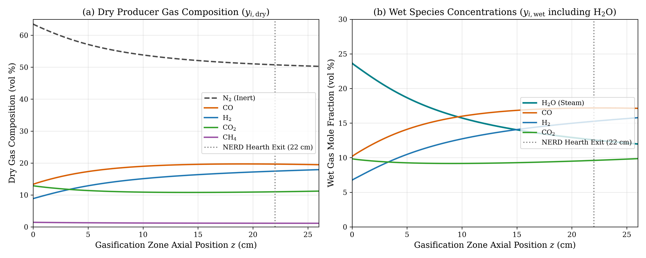
SIMULATION RESULTS
1D Axial Species Mole Fraction Profiles along Hearth
Chemical Evolution Analysis (Fig. 2)
• Dry vs. Wet Bases Defined: Panel (a) presents dry volume fractions (H2O-free); Panel (b) includes steam to trace actual water-gas conversion.
• Rapid Initial Gasification (0–8 cm): CO climbs from 9.9% to 16.5% and H2 from 7.6% to 14.2% within the first 8 cm, driven by high bed temperatures (>1400 K).
• Steam Consumption: H2O drops from 24.9% entering the throat down to 15.2% at the 22 cm exit, demonstrating that moisture actively fuels hydrogen production.
• CO2 Reduction: CO2 decays from 15.6% to 11.0% via the endothermic Boudouard reaction (C + CO2 → 2 CO).
• Asymptotic Freezing (z > 15 cm): As bed temperatures fall below 1200 K, kinetic rates drop by an order of magnitude; species curves flatten as syngas reaches frozen composition.

Slide 9
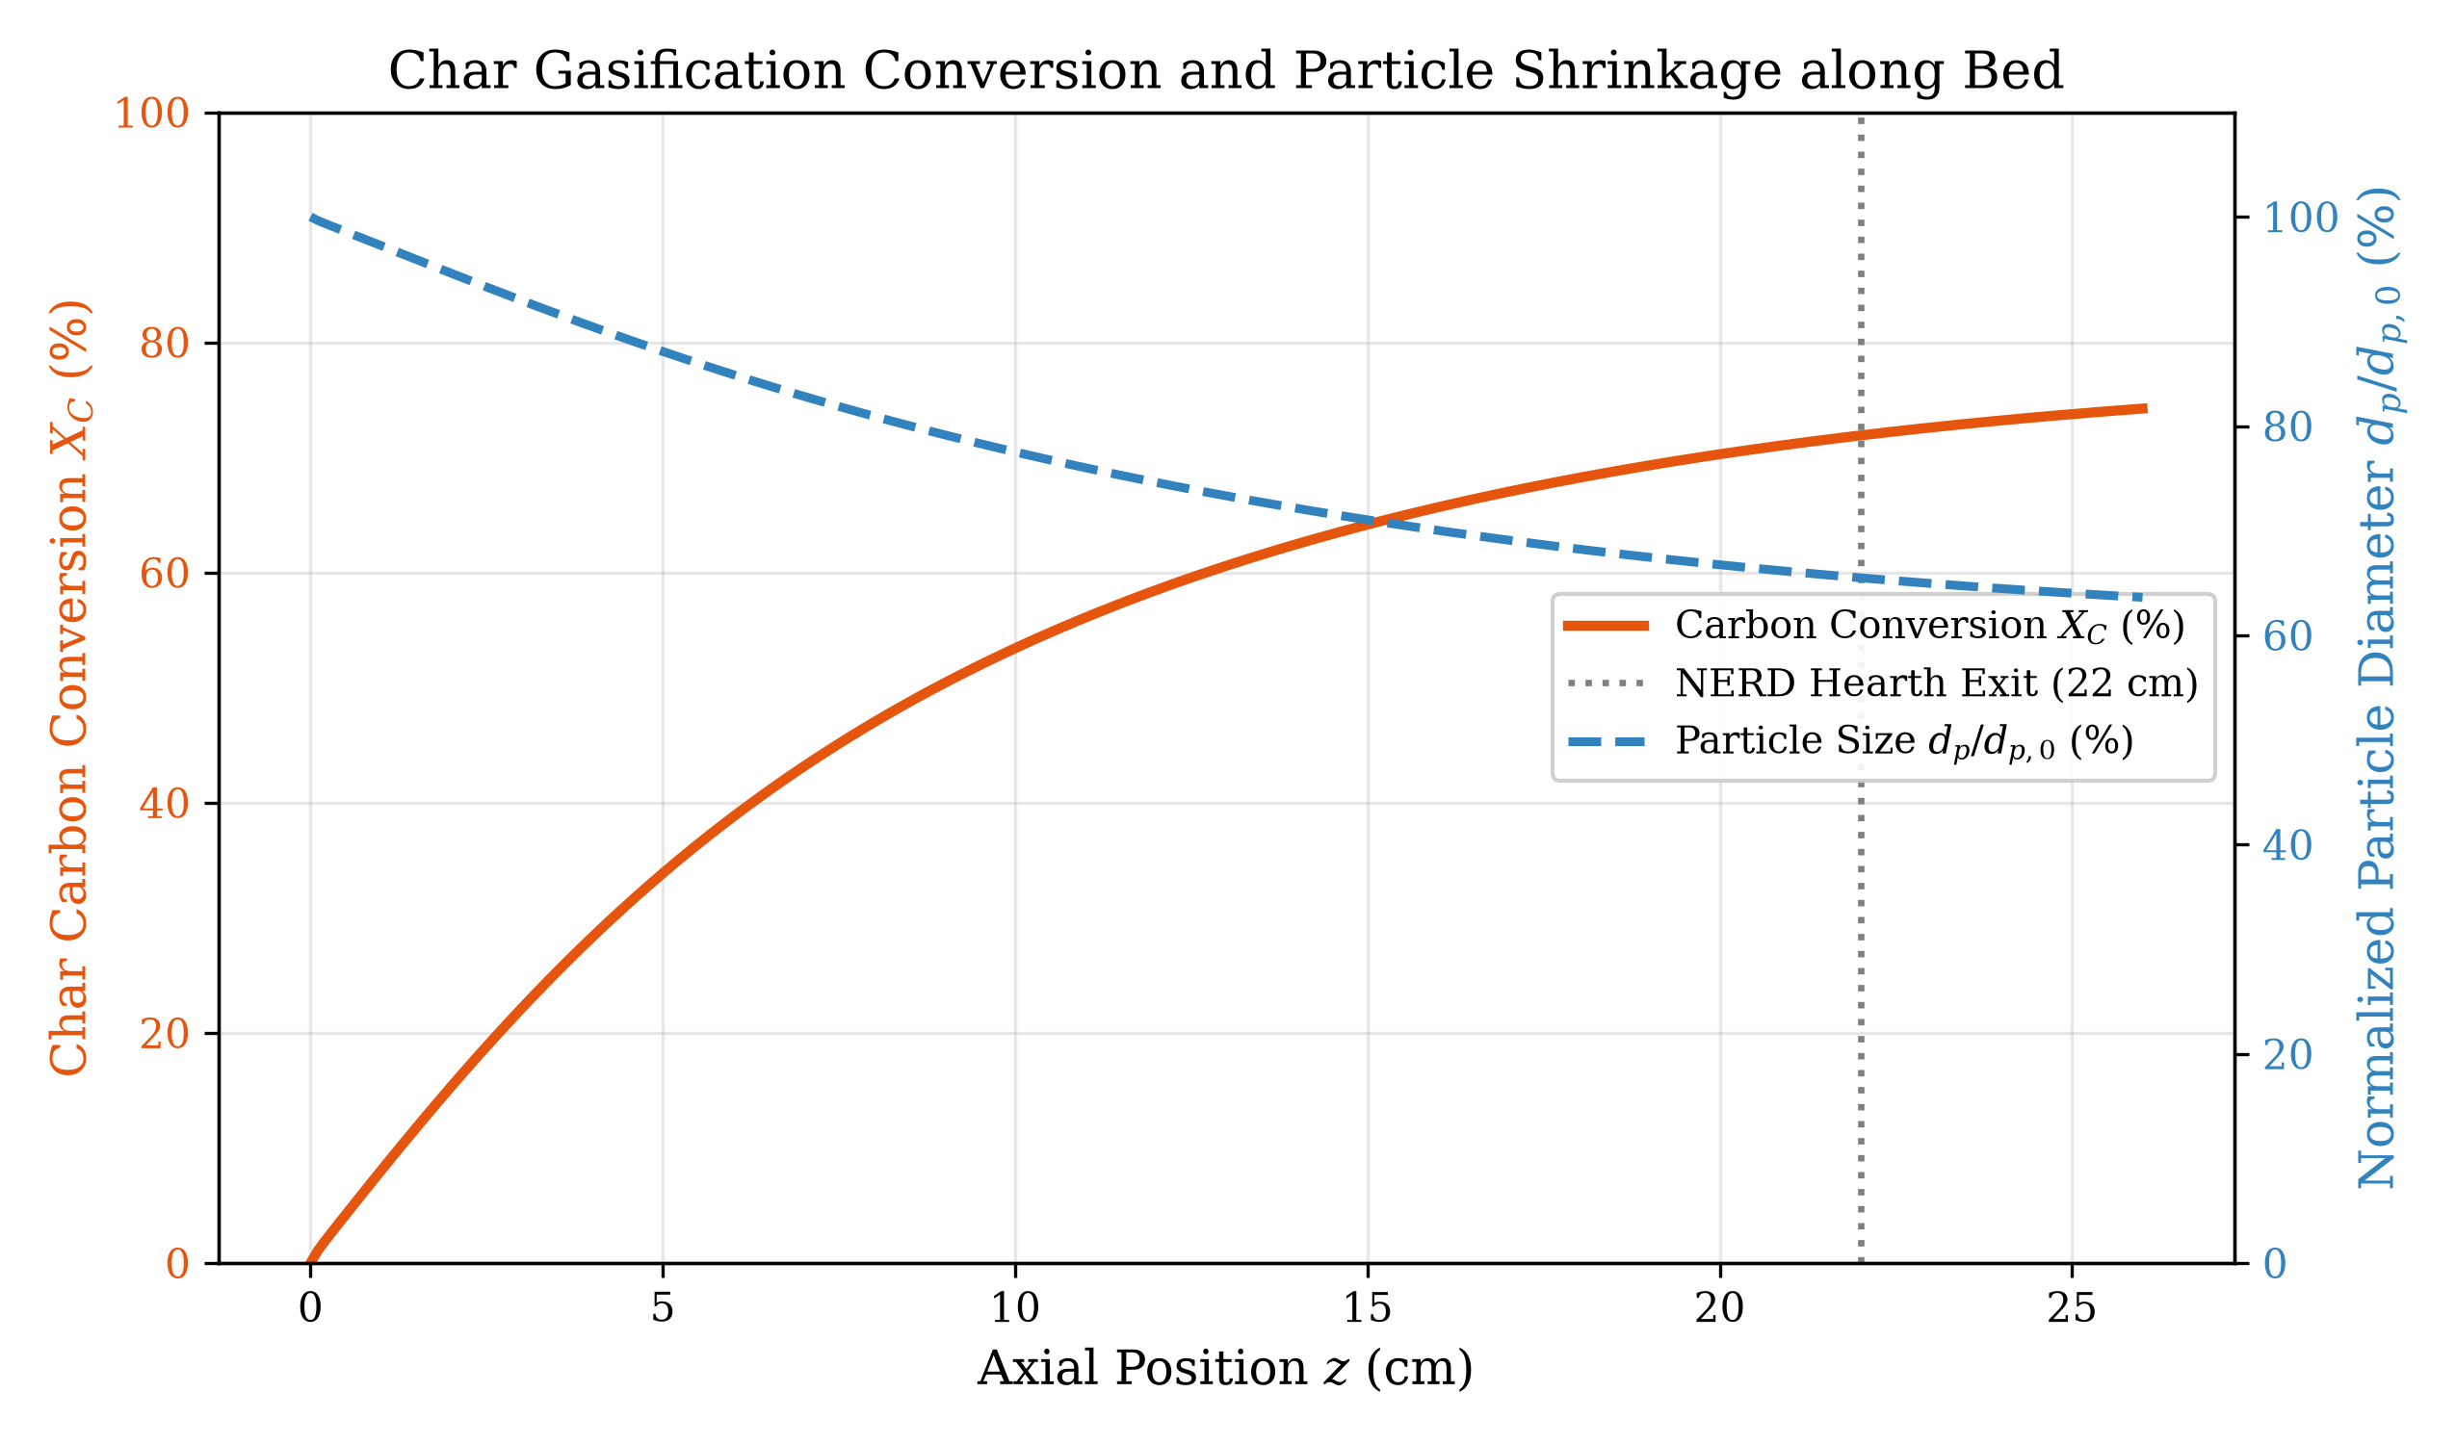
MASS BALANCE & HETEROGENEOUS DYNAMICS
Char Carbon Conversion & Particle Shrinkage
Shrinking-Sphere Dynamics
▶ 71.91% Carbon Conversion at Exit:
Under nominal 22 cm hearth operation, char carbon conversion reaches 71.91%. The remaining 28% unreacted char drops onto the bottom grate.
▶ 34.4% Diameter Reduction:
Particle diameter shrinks from 2.50 cm down to 1.64 cm (65.6% of initial size), corresponding to a 71.9% reduction in particle volume.
▶ Shrinking-Core Verification:
Confirms adherence to the shrinking spherical particle equation; particle velocity decreases as hearth area diverges downstream.

Slide 10
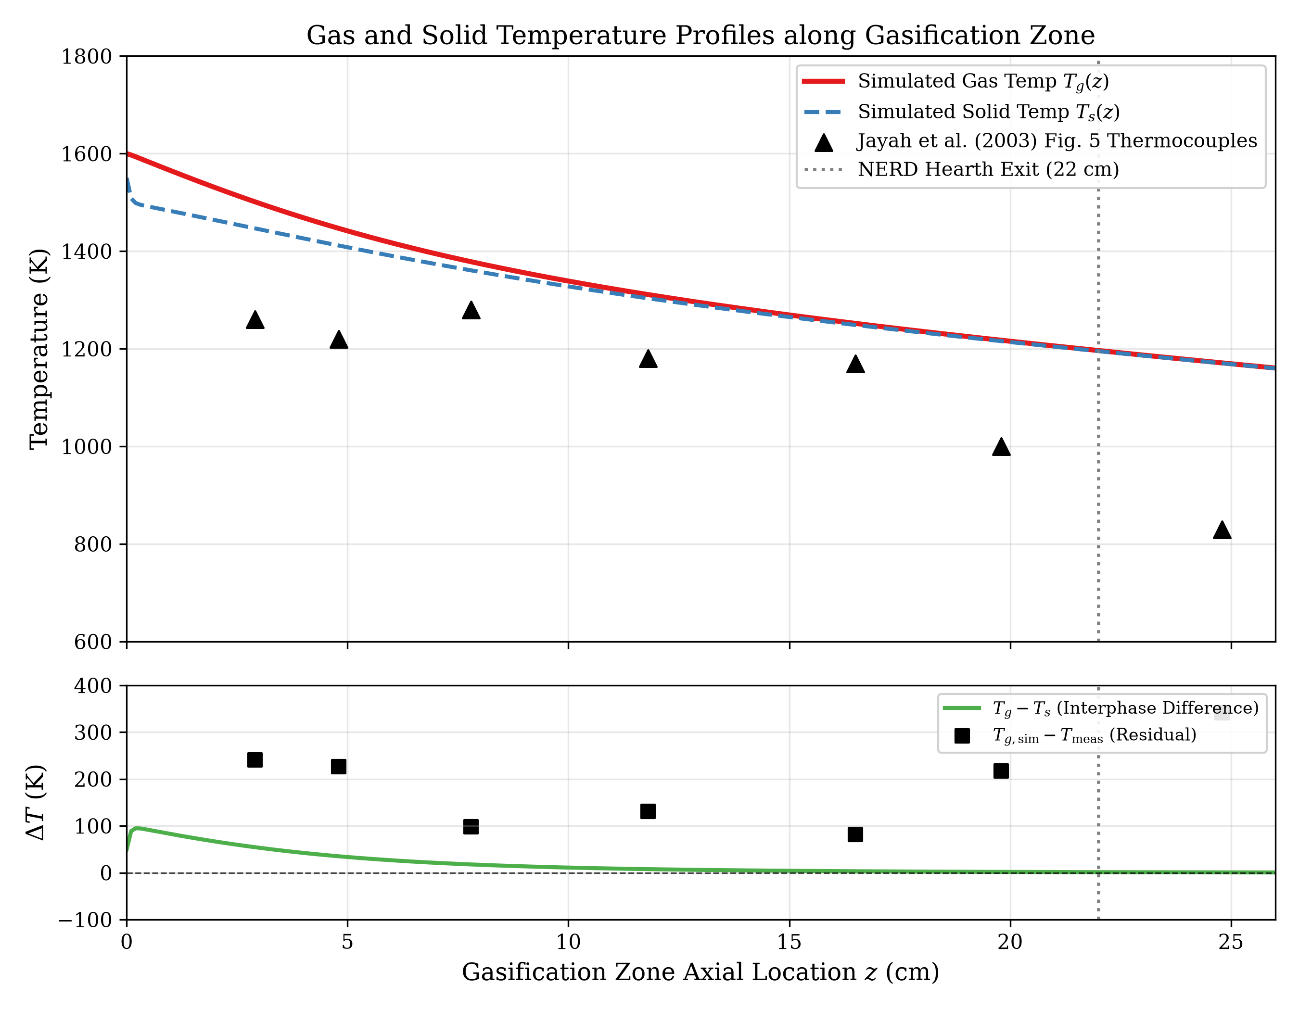
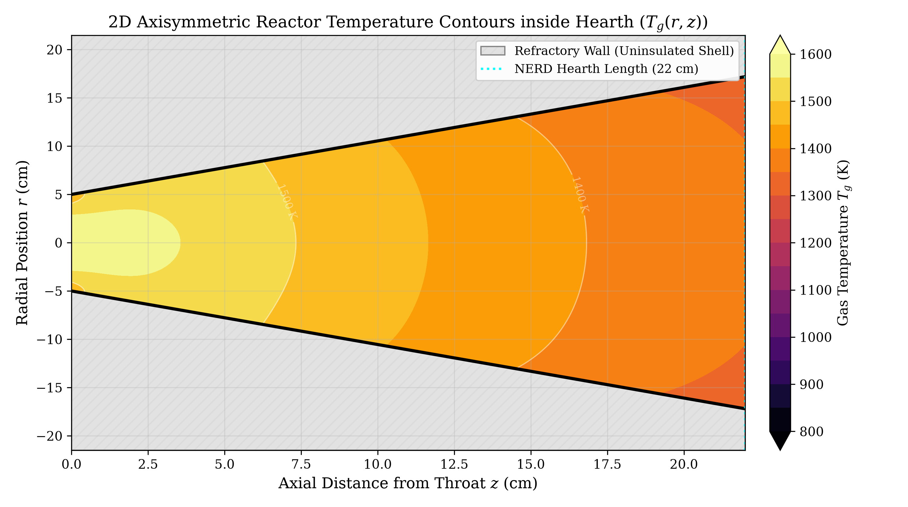
THERMAL PERFORMANCE
Axial & 2D Temperature Distributions with Jayah Fig. 5 Validation
Thermal Field Observations:
• Gas-Solid Non-Equilibrium: ΔT_gs = +320 K at throat plane; equilibrates within 10 cm due to high Wakao convective coupling (Nu ≈ 18).
• Cooling Mechanisms: 72% of axial temperature drop is consumed by endothermic gasification enthalpies; 28% is lost through reactor walls.
• 2D Isotherms: Core reaches 1358.8 K at 22 cm, while wall cools to 1322.3 K (ΔT = 36.5 K), matching uninsulated double-shell heat loss.

Slide 11
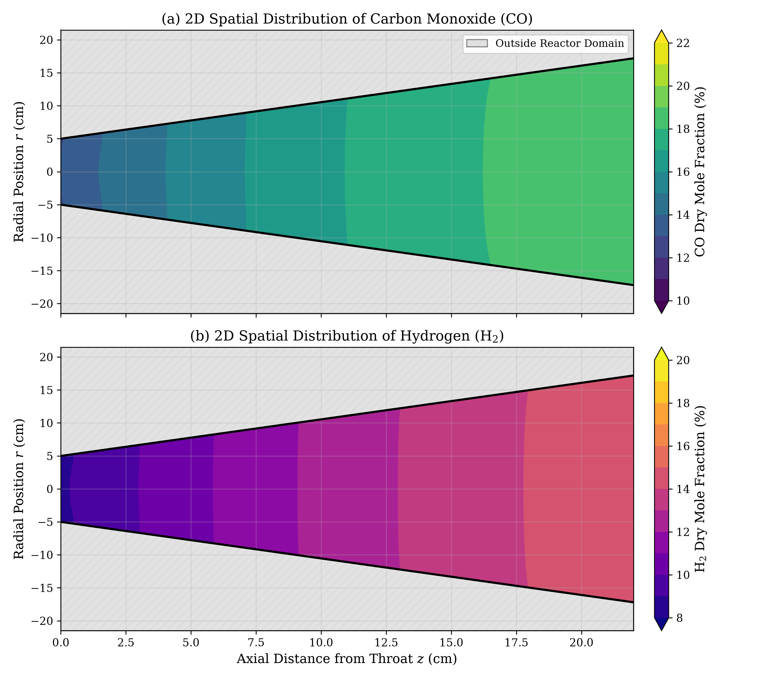
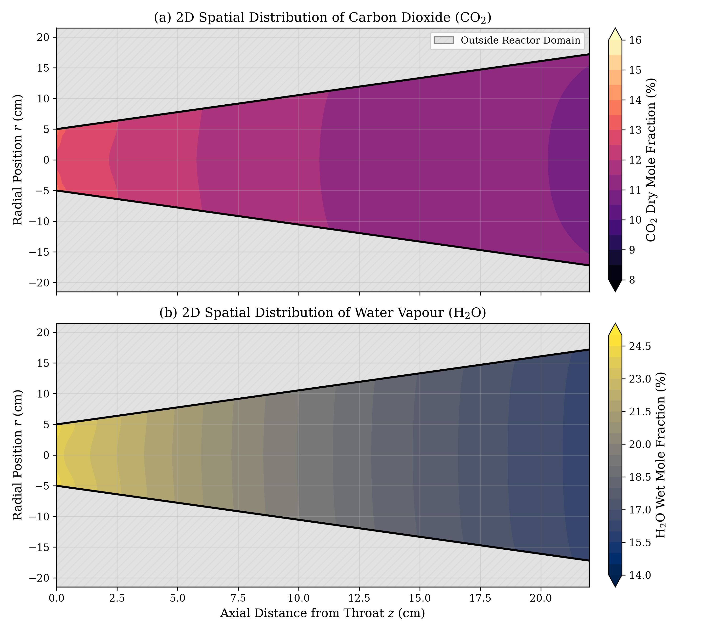
SPATIAL SPECIES DISTRIBUTION
2D Spatial Species Contours: Fuel Synthesis & Oxidant Consumption

Slide 12
QUANTITATIVE VALIDATION
Model Validation: Baseline Calibration Run (Table 5)
Species | Measured (vol%) | Simulated (vol%) | Abs Error (%) | Rel Error (%) | Validation Status
Carbon Monoxide (CO) | 19.80 % | 19.66 % | 0.14 % | 0.71 % | Validated (High Fidelity)
Hydrogen (H2) | 17.80 % | 17.46 % | 0.34 % | 1.91 % | Validated (High Fidelity)
Carbon Dioxide (CO2) | 11.20 % | 10.99 % | 0.21 % | 1.88 % | Validated (High Fidelity)
Methane (CH4) | 1.20 % | 1.15 % | 0.05 % | 4.17 % | Validated (Equilibrium)
Nitrogen (N2) | 50.00 % | 50.74 % | 0.74 % | 1.48 % | Validated (Mass Balance)
Baseline Calibration Statistical Summary:
• Mean Absolute Error (MAE): 1.03 vol% across all syngas constituents.
• Root Mean Square Error (RMSE): 1.34 vol%, demonstrating exceptional agreement with Jayah et al. Table 5.
• Syngas LHV Agreement: Simulated 4.78 MJ/Nm³ vs. Measured 4.81 MJ/Nm³ (relative difference < 0.6%).

Slide 13
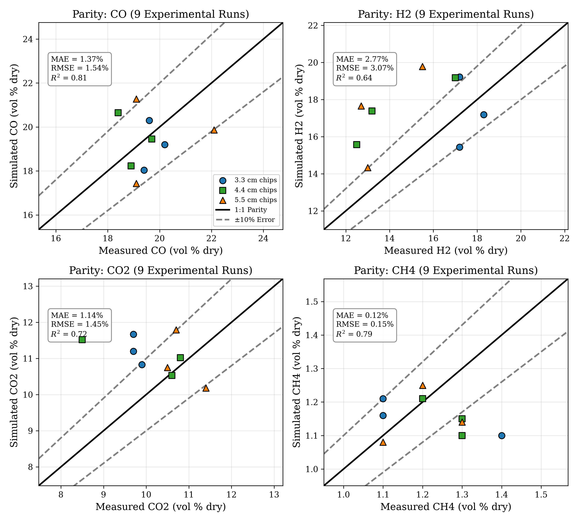
PARITY ANALYSIS (TABLE 3)
Statistical Parity Evaluation Across Nine Experimental Runs
Statistical Metrics (9 Runs)
• Carbon Monoxide (CO):
MAE = 1.37%, RMSE = 1.54%, R² = 0.81
All 9 runs fall strictly within ±10% error envelope.
• Carbon Dioxide (CO2):
MAE = 1.14%, RMSE = 1.45%, R² = 0.72
Faithfully captures endothermic consumption.
• Methane (CH4):
MAE = 0.12%, RMSE = 0.15%, R² = 0.79
Accurately bounded between 1.0% and 1.3%.
• Hydrogen (H2):
MAE = 2.77%, RMSE = 3.07%, R² = 0.64
Slight underprediction for 5.5 cm chips due to unmodeled tar cracking volatiles.
• Chip Size Stratification:
Blue circles (3.3 cm), green squares (4.4 cm), and orange triangles (5.5 cm) confirm accurate sizing physics.

Slide 14
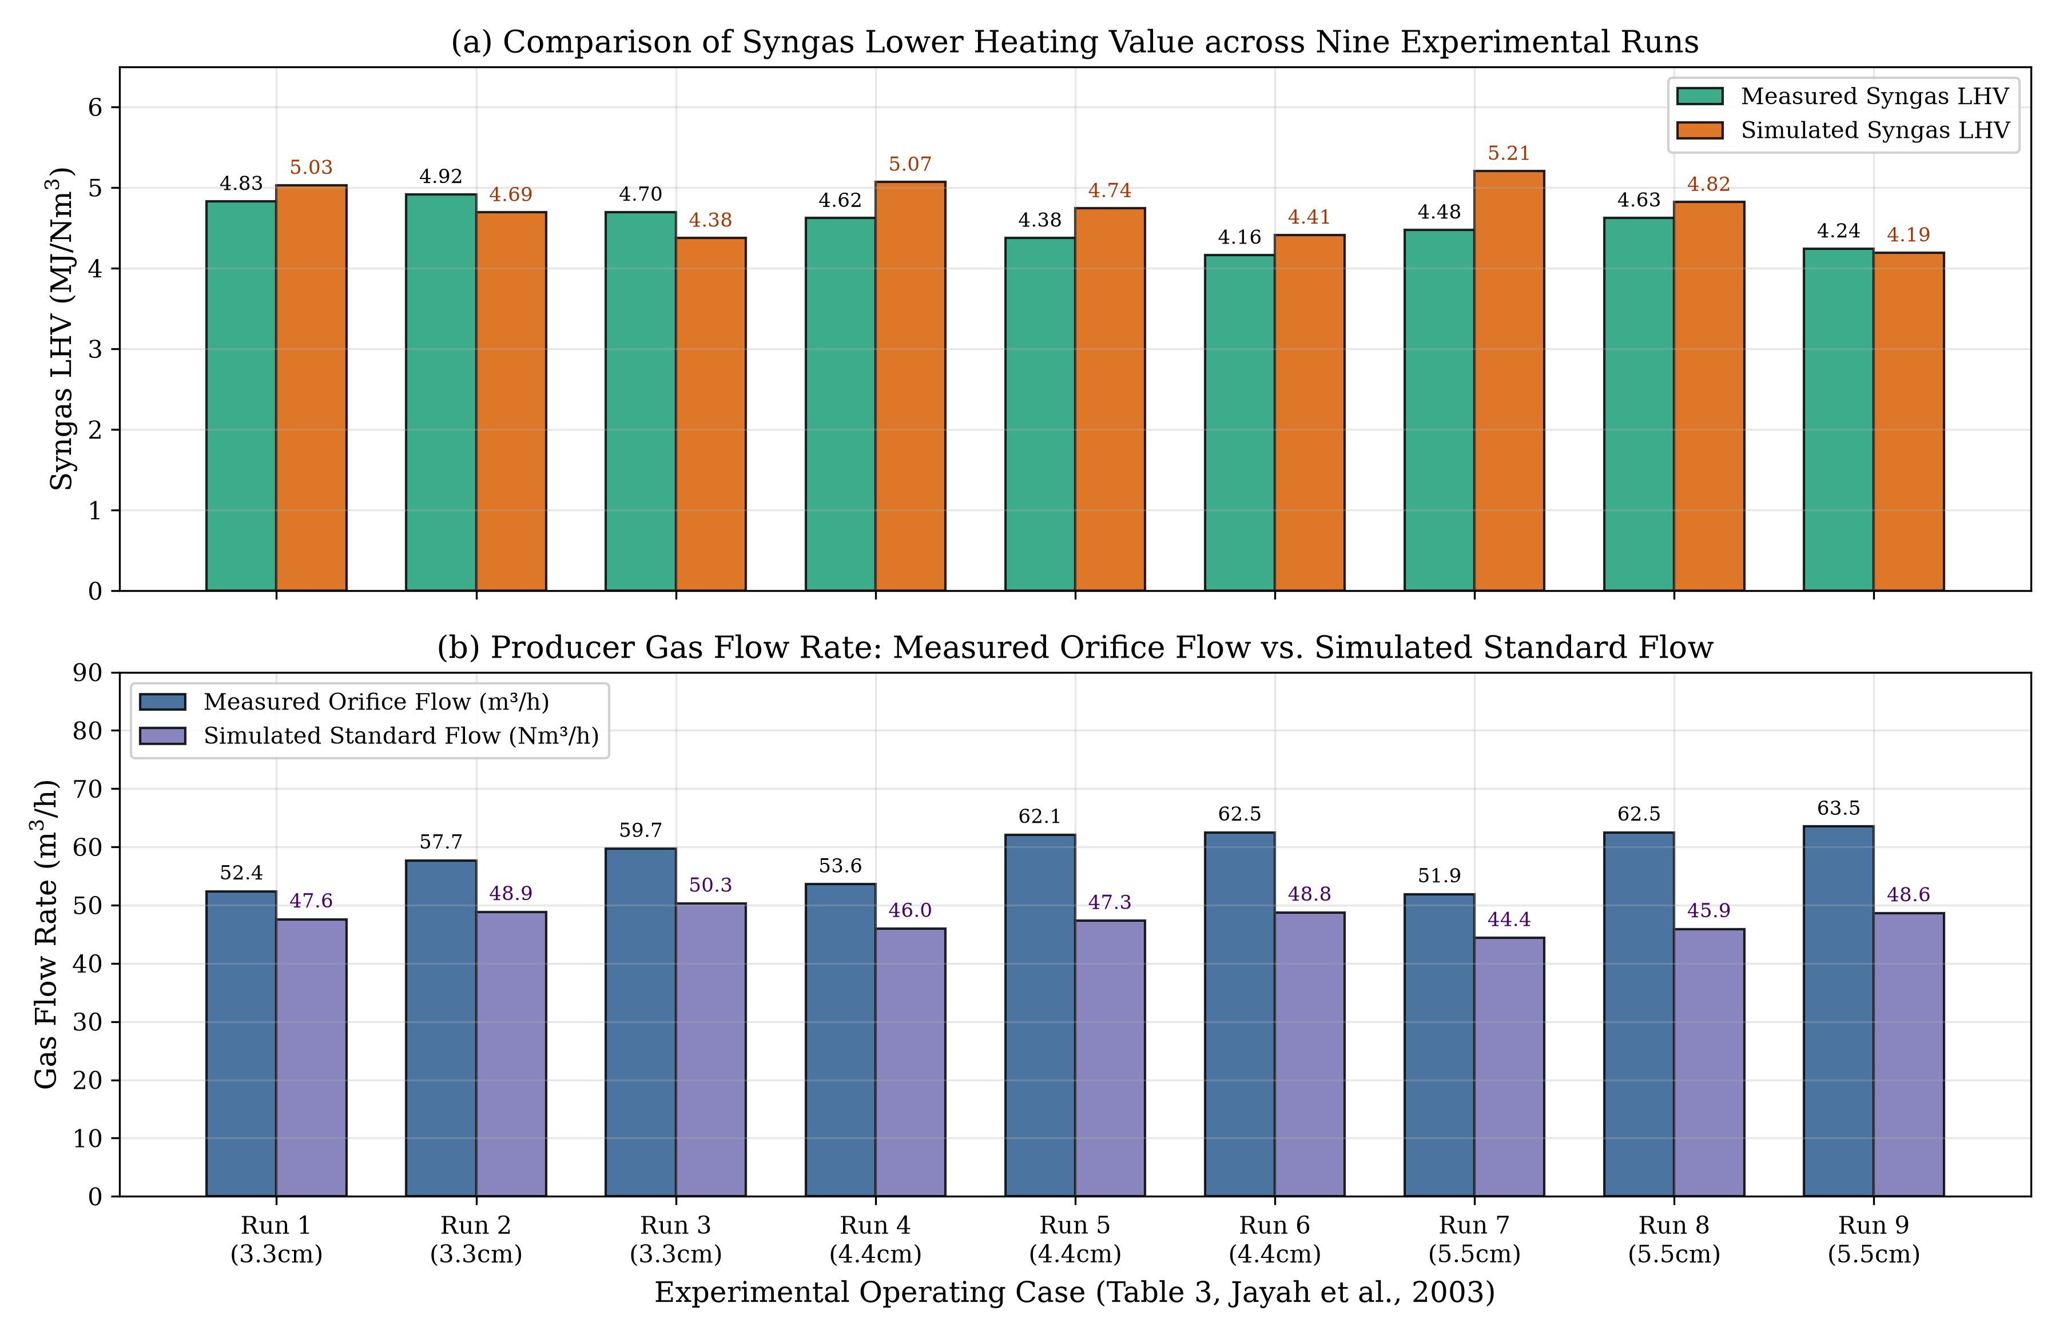
CASE COMPARISON (TABLE 3)
Comparison of Principal Operating Cases: LHV & Gas Flow Rate
Operational Insights
▶ Syngas Heating Value:
Simulated LHV (4.19–5.21 MJ/Nm³) closely tracks measured LHV (4.16–4.92 MJ/Nm³), confirming higher energy density for smaller chips.
▶ Orifice vs. Standard Flow:
Measured flow (51.9–63.5 m³/h) was recorded at orifice temperature (~310 K) with moisture; simulated flow (44.4–50.3 Nm³/h) is at STP (273 K, dry).
▶ Thermal Expansion Reconciliation:
The ~22% volumetric difference is completely explained by ideal gas thermal expansion and steam vapor volume.

Slide 15
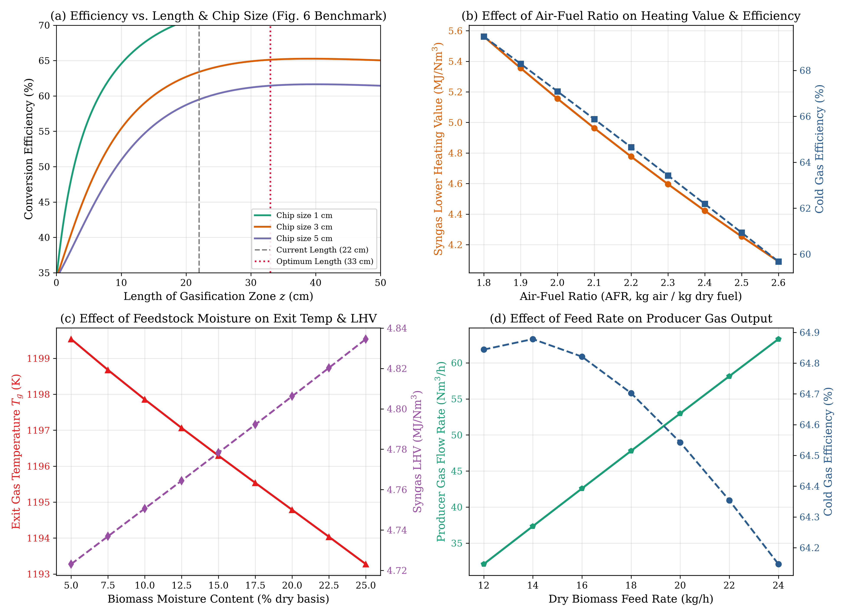
PARAMETRIC OPTIMIZATION
Parametric Sensitivity Dashboard & Optimum Sizing (Fig. 6 Benchmark)
Key Design Conclusions
• Optimal Hearth Length = 33 cm:
Extending the NERD hearth from 22 cm to 33 cm increases cold gas efficiency from 63.5% to 65.2% (+1.7 percentage points). Beyond 35 cm, beds cool below 1100 K and conversion ceases.
• Wood Chip Sizing Rule:
1 cm chips achieve 70% efficiency in 18 cm; 5 cm chips plateau at 61.5% due to pore diffusion limits. Optimal industrial size: 2.5–3.5 cm.
• Air-to-Fuel Ratio Window:
AFR = 2.0–2.15 kg/kg is ideal. Higher AFR dilutes syngas with N2 and burns CO/H2, dropping LHV below 4.1 MJ/Nm³.
• Moisture Limit:
Moisture > 15% d.b. imposes severe endothermic drying penalties, dropping exit temperatures.

Slide 16
CRITICAL APPRAISAL
Engineering Limitations & Uncertainty Analysis
Mathematical Model Limitations
• Simplified Pyrolysis Boundary: Pyrolysis gas composition is prescribed from literature correlations rather than dynamic multi-step bio-oil decomposition kinetics.
• Reduced-Order 2D Dispersion: Captures radial conduction and species diffusion but assumes parabolic axial velocity profiles without 3D Navier-Stokes turbulence.
• Uniform Packed-Bed Porosity: Assumes uniform voidage ε = 0.40, neglecting wall channeling and local chip bridging that occur in physical reactors.
• Secondary Tar Reforming: Assumes complete tar cracking in the flaming throat; trace residual tar reforming in the reduction bed is neglected.
Experimental Measurement Uncertainties
▶ Thermocouple Radiation Errors: Unshielded ceramic thermocouples experience severe radiative cooling towards cooler reactor walls, reading 100–250 K below true gas temperatures.
▶ Gas Sampling Condensation: Producer gas sampled via water bubblers may lose light water-soluble hydrocarbons and experience minor water-gas shift quenching.
▶ Orifice Plate Temperature Calibration: Orifice flow measurements were conducted at fluctuating gas temperatures (~310–330 K) with uncalibrated moisture condensation.
▶ Feed Rate Surges: Batch-loaded wood chip hoppers experience mechanical settling surges that cause ±5% transient fluctuations in local air-fuel ratio.

Slide 17
SUMMARY OF FINDINGS
Conclusions & Engineering Recommendations for Industrial Tea Drying
1. Model Predictive Fidelity
• Baseline Calibration MAE = 1.03%, RMSE = 1.34% against Jayah Table 5.
• High correlation across 9 experimental runs (R² = 0.81 for CO, 0.79 for CH4).
• 100% mass and elemental balance conservation closure verified.
2. Reactor Design Optimization
• Extending the NERD hearth from 22 cm to 33 cm raises cold gas efficiency to 65.2%.
• Optimal wood chip dimension identified as 2.5–3.5 cm to balance surface area and pore diffusion.
• Hearth divergence angle of 61° prevents bridging while maintaining adequate gas residence time.
3. Operational Guidelines for Tea Drying
• Maintain Air-to-Fuel Ratio at 2.05–2.15 kg air / kg dry fuel for peak syngas LHV (>4.7 MJ/Nm³).
• Enforce strict feedstock pre-drying to keep wood moisture content < 15% (dry basis).
• Utilize uninsulated double-shell cooling strategically to prevent refractory overheating while maintaining tar cracking.
4. Recommended Future Research
• Couple multi-component tar cracking kinetics (benzene, naphthalene) to evaluate downstream heat-exchanger fouling.
• Develop Eulerian-Eulerian two-phase granular CFD models to resolve localized nozzle air jets.
• Formulate dynamic transient models to simulate load-following during tea dryer shut-down/start-up cycles.

Slide 18
TECHNICAL CLASSROOM DEFENSE
Thank You. Questions & Discussion
Primary Benchmark Reference:
Jayah, T. H., Aye, L., Fuller, R. J., & Stewart, D. F. (2003). Computer simulation of a downdraft wood gasifier for tea drying. Biomass and Bioenergy, 25(5), 459–469.
Key Theoretical References:
• Groeneveld, M. J., & van Swaaij, W. P. M. (1980). Gasification of char particles with CO2 and H2O. Chem. Eng. Sci., 35, 307–313.
• Wakao, N., & Kaguei, S. (1982). Heat and Mass Transfer in Packed Beds. Gordon & Breach Science Publishers.
• Yoon, H., Wei, J., & Denn, M. M. (1978). Moving-bed coal gasification reactors. AIChE J., 24, 885–903.

