Slide 1
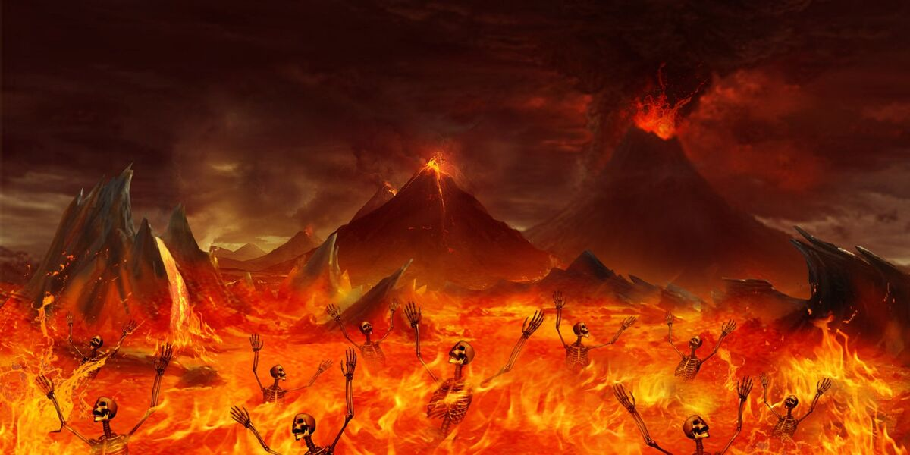
Psychosocial
Song by: slipknot

Slide 2
I did my time, and I want time
So effusive fade, it doesn't cut

Slide 3
The soul is not so vibrant
The reckoning, the sickening

Slide 4
Packaging subversion
Pseudo-sacrosanct perversion

Slide 5
Go drill your deserts
Go dig your graves

Slide 6
Then fill your mouth with all the money you will save
Sinking in, getting smaller again

Slide 7
I'm done, it has begun
I'm not the only one

Slide 8
And the rain will kill us all
Throw ourselves against the wall

Slide 9
But no one else can see
The preservation of the martyr in me

Slide 10
Psychosocial!
Psychosocial!

Slide 11
Psychosocial!
Psychosocial!

Slide 12
Psychosocial!
Psychosocial!

Slide 13
Oh, there are cracks in the road we laid
But where the temple fell

Slide 14
The secrets have gone mad
This is nothing new

Slide 15
But when we killed it all
The hate was all we had

Slide 16
Who needs another mess?
We could start over

Slide 17
Just look me in the eyes and say I'm wrong
Now there's only emptiness

Slide 18
Venomous, insipid
I think we're done

Slide 19
I'm not the only one

Slide 20
And the rain will kill us all
Throw ourselves against the wall

Slide 21
But no one else can see
The preservation of the martyr in me

Slide 22
Psychosocial!
Psychosocial!

Slide 23
Psychosocial!
Psychosocial!

Slide 24
Psychosocial!
Psychosocial!

Slide 25
The limits of the dead!

Slide 26
The limits of the dead!

Slide 27
The limits of the dead!

Slide 28
The limits of the dead!

Slide 29
Fake anti-fascist lie (psychosocial!)
I tried to tell you, but (psychosocial!)

Slide 30
Your purple hearts are giving out (psychosocial!)
Can't stop a killing idea (psychosocial!)

Slide 31
If it's hunting season (psychosocial!)
Is this what you want? (Psychosocial!)

Slide 32
I'm not the only one

Slide 33
And the rain will kill us all
Throw ourselves against the wall

Slide 34
But no one else can see
The preservation of the martyr in me

Slide 35
And the rain will kill us all
Throw ourselves against the wall

Slide 36
But no one else can see
The preservation of the martyr in me

Slide 37
The limits of the dead!

Slide 38
The limits of the dead!

