Slide 1
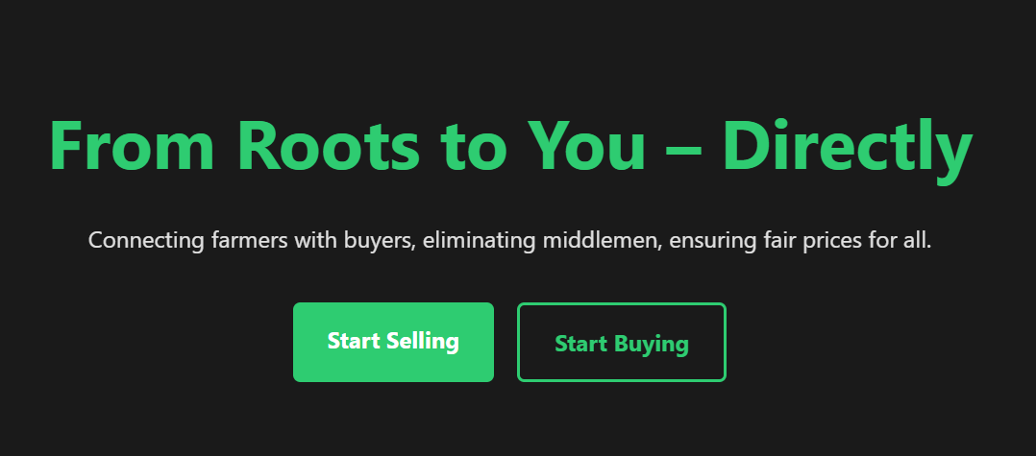

Root2Us – Connecting Farmers to Buyers
Root2Us eliminates middlemen to ensure fair pricing and transparency.
Built with WAMP stack, it features responsive UI and animations.
by Saustav Chakraborty

Slide 2

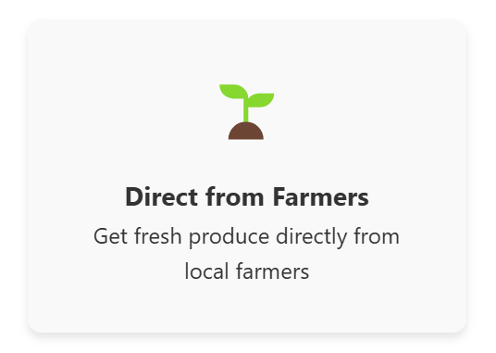
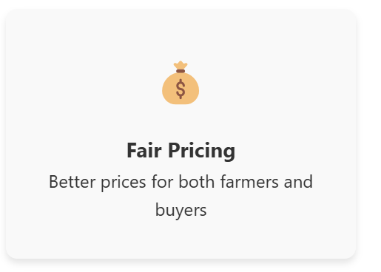
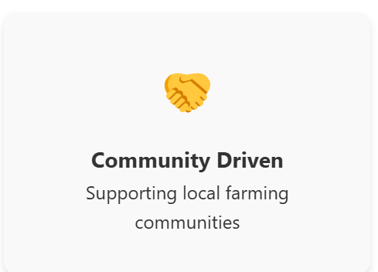
Key Features of Root2Us
Role-based login
Secure dashboards tailored for Farmer, Buyer, and Admin roles.
Product listings with images
Farmers upload produce photos with descriptions and prices.
Admin approval
Admins review listings to maintain quality control.
WhatsApp contact
Buyers reach farmers instantly for direct communication.

Slide 3
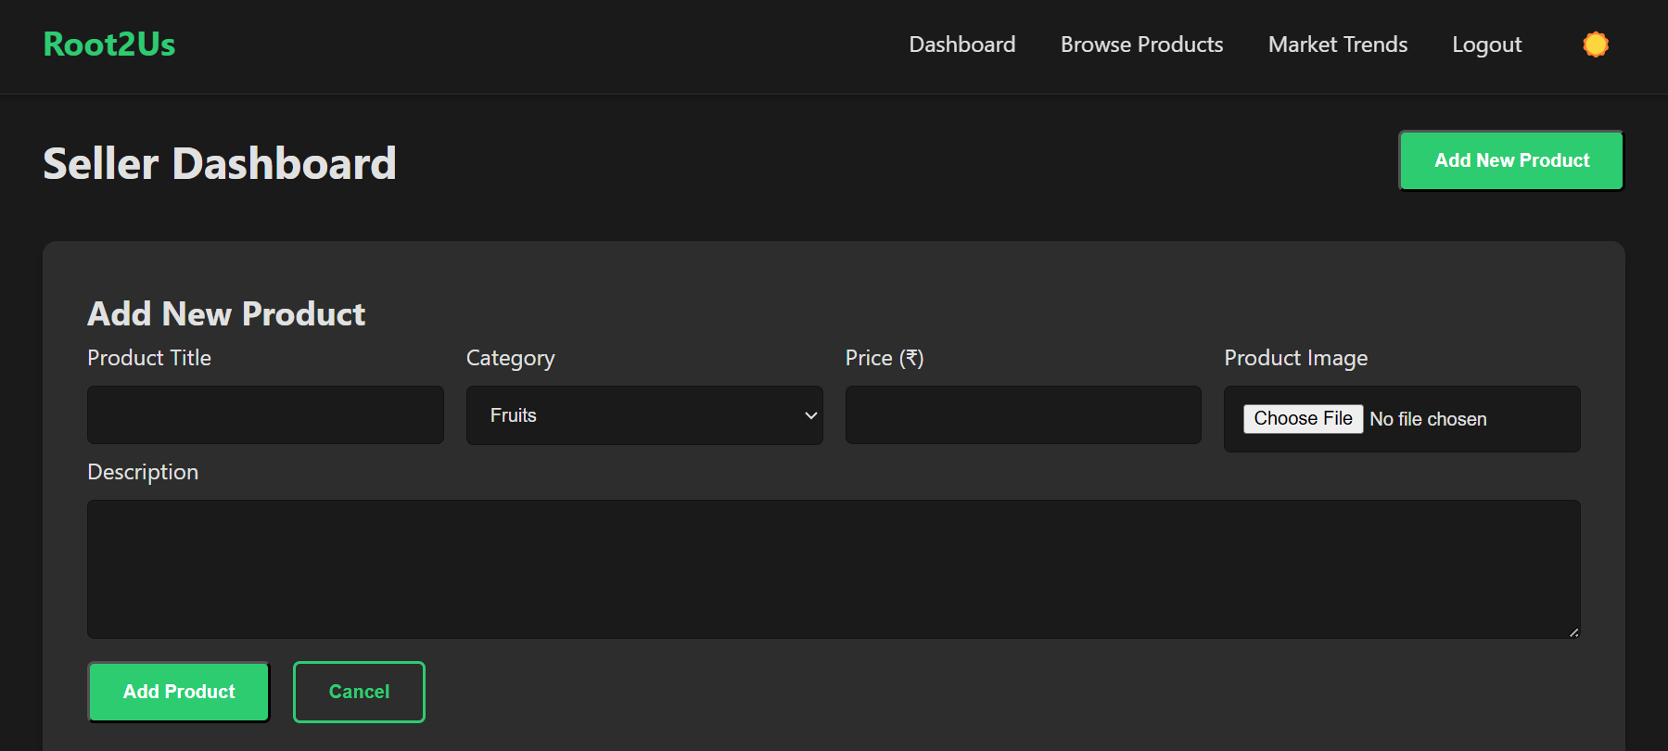
Technologies Behind Root2Us
Frontend
Backend & Database
Hosting & Features
HTML, CSS, JavaScript ensure accessibility and compatibility.
WAMP provides local environment; Cloudinary for image storage.
PHP powers server logic; MySQL stores users and listings.

Slide 4

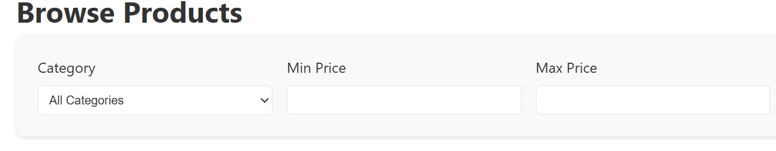



Future Enhancements Planned
Online Payments
Integrate gateways like Stripe for secure transactions.
Real-time Chat
Enable live messaging between buyers and farmers.
Mobile App
Accessible app for rural users with limited PC access.
Multilingual Support
Platform available in regional languages for wider reach.

Slide 5
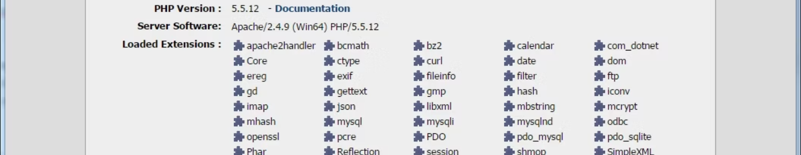
How to Run Root2Us Locally
Access in Browser
Import Database
Open localhost/Root2Us/ to launch app.
Place Files
Use phpMyAdmin to import provided database file.
Start WAMP Server
Move project folder to 'C:/wamp64/www/' directory.
Ensure Apache and MySQL services are running properly.

Slide 6
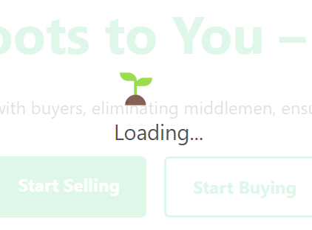
Wrapping Up: The Root2Us Vision
Strong Foundation
Empowering Farmers
Root2Us offers a solid base for digital agriculture solutions.
It enables fair market access and direct buyer connections.
Growth Potential
Upcoming features will broaden platform capabilities.

