Slide 1

The New Era of Retail
An Analysis of the Value Between Space and Sales

Slide 2

Our problem
BUSINESS PROBLEM:
With nuances within the realm of CRE being uncovered throughout the course of COVID, many large businesses are seeking to re-evaluate the value of physical space. One asset class which has been heavily scrutinized in a world of evolving technology, is retail.
With the emerging and strengthening presence of ecommerce, we seek to analyze if there a measurable value in utilizing more physical space for retail (brick and mortar). Does this space translate into higher inventory and as a result higher profits?
This Photo by Unknown Author is licensed under CC BY-SA

Slide 3
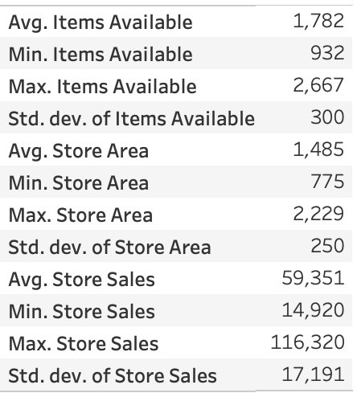
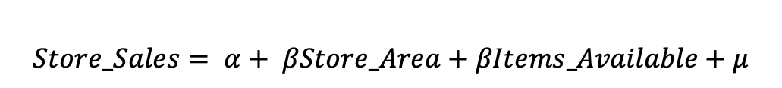
Our approach
Regression analysis
Utilizing Python, we aimed to analyze the relationships between Store Area, No. of Items Available and Store Sales as demonstrated below:
$$Store_Sales= α+ βStore_Area+βItems_Available+μ$$

Slide 4
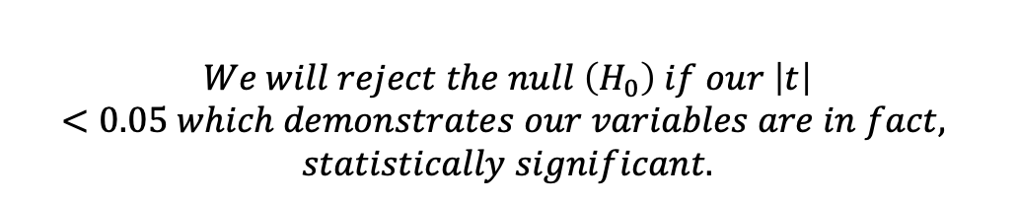
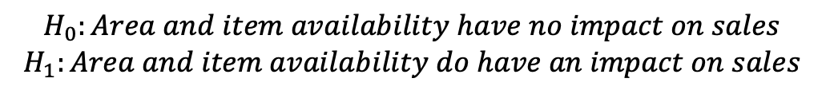
HYPOTHESIS
$$H_{0}:Area and item availability have no impact on sales$$
$$H_{1}:Area and item availability do have an impact on sales$$
$$We will reject the null \left(H_{0}\right) if our \left|t\right|<0.05 which demonstrates our variables are in fact,$$
$$statistically significant.$$

Slide 5
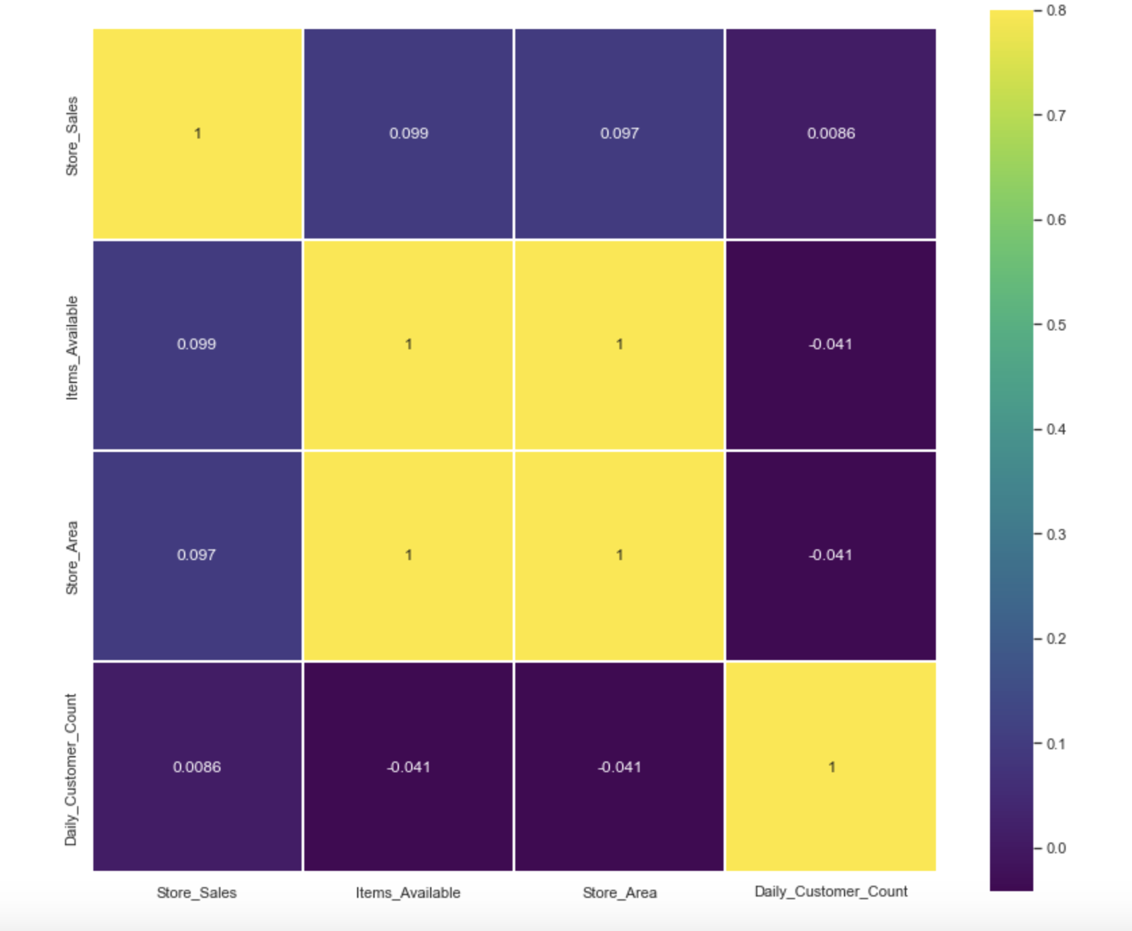
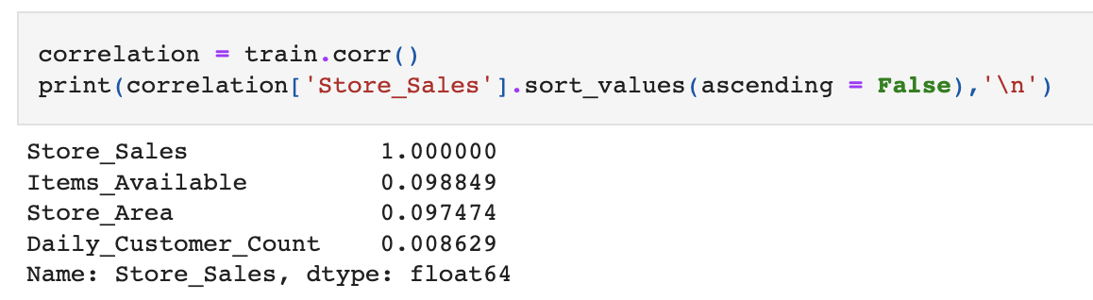
PRELIMINARY FINDINGS
Linear regressions are present within our data set
This relationship is strong between inventory and sales, but much weaker between space and sales
We have perfect correlation between inventory and space, therefore we aim to remove one from our data set

Slide 6
TRAINING THE MODEL

Slide 7
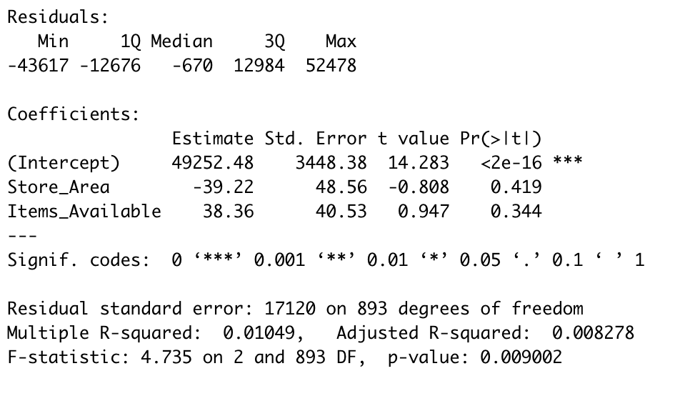
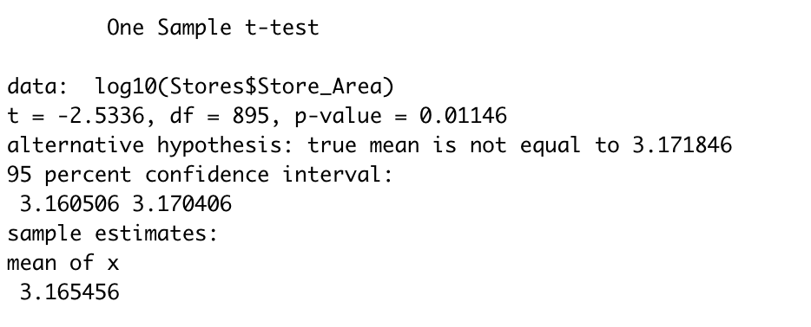
TO CONCLUDE
FINDINGS & SIGNIFICANCE
LIMITATIONS & BIASES
Neither space nor inventory prove to be significant statistical contributors to sales
Unaccounted for variables, heteroskedasticity, autoskedasticity

