Slide 1
https://sph.savalione.com/2019/11/14/business-model/

Slide 2
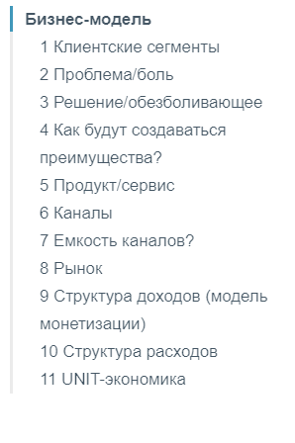

Slide 3
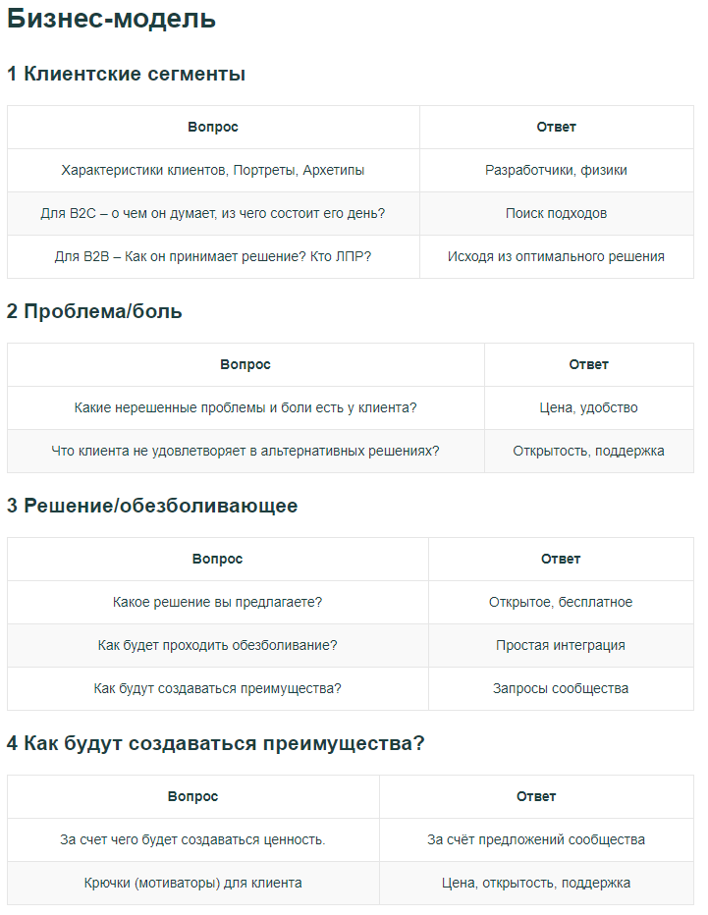

Slide 4
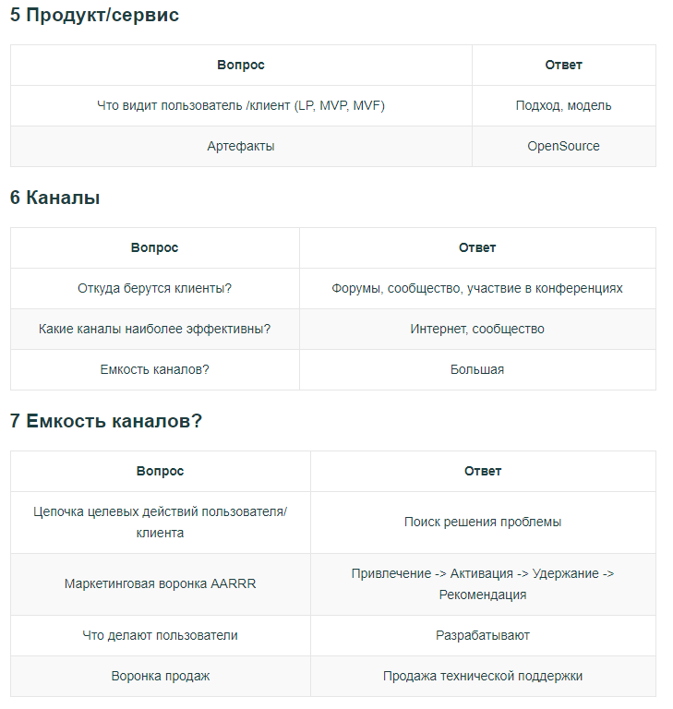

Slide 5
