Slide 1
https://sph.savalione.com/2019/11/07/market-analysis-and-evaluation/

Slide 2
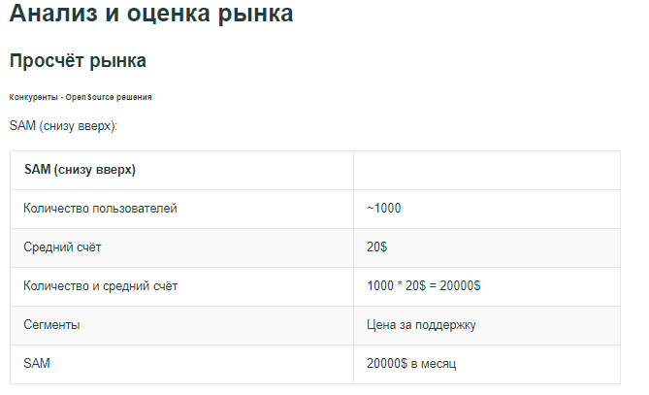

Slide 3
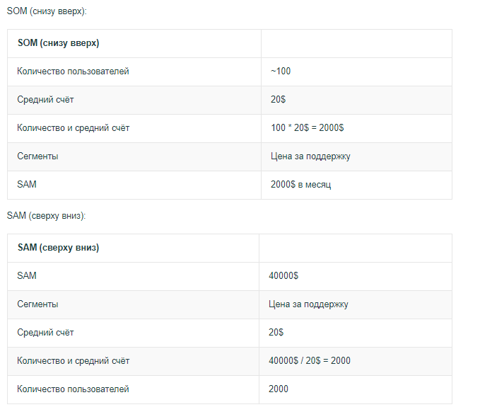

Slide 4
