Slide 1

Sava Langauge
By: Alex Sava

Slide 2
Basic Info
I wrote my program as an interpreter which would run the given program in my language, statement by statement, using java; rather than as a compiler which would translate the given program from my language into a java file.
Because I’m still using java as the underlying runtime environment, the programs in my language won’t be able to do anything that java can’t do.
A large majority of my program simply deals with parsing large statements using regex to get them into bits and pieces that I can manage.

Slide 3
Syntactic choices
Most of my syntactic choices I decided on for my language came from languages I’ve been working with this year.
The conditional statement from my language (do … if … otherwise do …) was inspired by SML where the conditional statements follow the format “if … then … else”.
I chose to only work with binary values because of the assembly class I’m taking. where we work in a lower-level programming language.
My print statements start with the keyword console because they are specifically outputting to the console.

Slide 4
Challenges
Most of the challenges of course had to do with regex.
I do not use it very often and it was such a large part of this project that I had to make sure I nailed it otherwise nothing would work.
Related to regex, I also struggled with making my language less strict.
I didn’t want an extra space or a missing one to crash interpretation, but I couldn’t get it to completely work without keeping my language strict when it came to some syntactic choices so be careful with spacing, indenting, and the like.
Outside of that, I found myself constrained in ways I didn’t want such as how I was limited in the number of command line arguments I allowed or how the language is limited in how deep nesting can go.

Slide 5
Language Tutorial
My programming language is made up of statements separated by delimiters.
There are 5 different types of statements: variable assignment, conditionals, loops, print statements, and exit statements.
Two that I would like to quickly elaborate on before going further in depth are loops and exit statements.
Loops are equivalent to java for loops and while loops do not exist in my language as there isn’t really a need for two types of loops since you can do everything you could want with either one.
Exit statements simply stop any further interpretation of the program. They exist to solve the problem of early termination seen in the second program we needed to write for our language. Without them, I wouldn’t be able to “return” and stop further interpretation once the solution was reached for the prime problem.

Slide 6
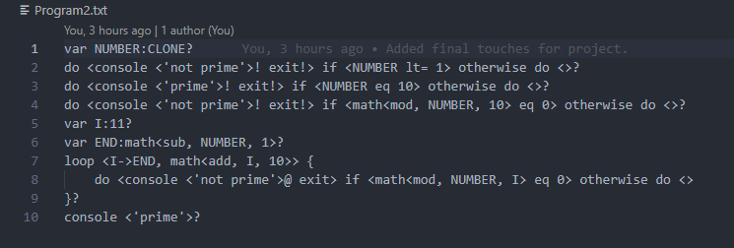
EXAMPLE PROGRAM
Showcasing what Program2.txt looks like in my programming language.
Note: CLONE is used to access command line argument one. This can be used up to CLFIVE (5 args).
CLZERO is not available as that is reserved for the filename used by the java program.

Slide 7
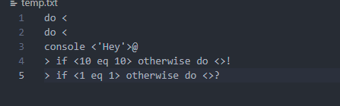
Program Depth
In order to parse the input program correctly each state is separate by a delimiter.
There are 6 delimiters for up to a depth of 5. [?, !, @, #, $, %] in that order.
The program begins at depth 0 and the depth increases for each statement nest.
do <do <console <'Hey'>@> if <10 eq 10> otherwise do <>!> if <1 eq 1> otherwise do <>?
This statement is valid and showcases how depth is defined.
The outer statement do <…> if <1 eq 1> otherwise do <>? Is on the 0th level
The inner (nested) statement do <…> if <10 eq 10> otherwise do <>! Is on the 1st level.
The final double nested statement <console <‘Hey’>@ is on the 2nd level.
In reality, you don’t necessarily need the delimiters because each depth only contains one statement (no need to separate statements), but they help clarify what’s going on.
It’s also possible to format it like the picture in the top right to make it easier to see.

Slide 8
Variable Assignment
Variable assignment follows the format: var VARIABLE:1001
Assignment is prefaced by the var keyword.
Variable names are only allowed to be made up of upper-case letters ([A-Z]).
Variables are only allowed to be assigned to an unsigned binary value, a variable, or an arithmetic expression.
Being assigned to an arithmetic expression would look like: var NUMBER:math<add, 100, 1> where math<add, 100, 1> is equivalent to 4 + 1 so NUMBER = 5.
Because I’m using Integer.parseInt() in order to convert from Binary string to integer we must use unsigned binary strings rather than 2s complement since that is what it accepts. However, we want to be able to have negative numbers so luckily parseInt can parse negative binary values in the form “-10” (-2).

Slide 9
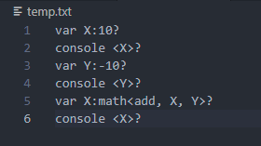

Variable Assignment Depiction
Showcasing variable assignment and reassignment alongside console output.

Slide 10
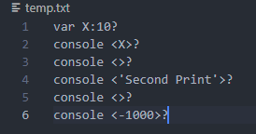
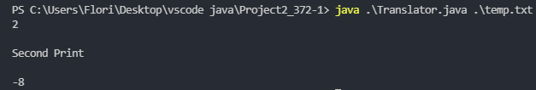
Print statements
Print statements are relatively simple and take the form of: console <‘Hello’>
Print statements are prefaced by the console keyword.
You are able to print a variable, a binary value, or a string literal, or nothing at all.
You are only able to print one thing per statement.
Print statements using Java’s System.out.println() method so they are followed by a newline character.

Slide 11
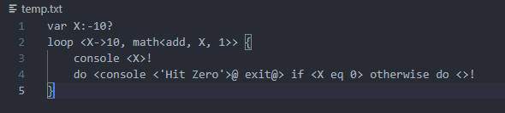
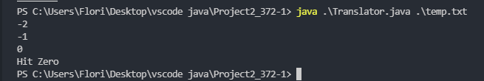
Exit statements
Exit statements are simply made up of the keyword: exit
They are equivalent to Java’s System.exit(0)

Slide 12
Conditionals
Conditionals follow the form: do <…> if <…> otherwise do<…>
You must always include the otherwise do <…> but can leave the inside empty if you do don’t want to do anything when false and vice versa with do <..>.
The conditional is inside the if <…> block which evaluates and decides which path to take.
The do <…> and otherwise do <…> can hold 0 or more statements which are separated by delimiters.
The conditional can be made up of and, or, not comparators as well as eq, !eq, gt, gt=, lt, and lt= comparators.
If you would like to see an example of a conditional, you can look to the previous slide “Program Depth” (slide 6).

Slide 13
Arithmetic
Arithmetic can only be used as a part of other statements, not as a statement of its own.
Arithmetic takes the form of math<operator, leftOperand, rightOperand>
The five valid operators include add, sub, mul, div, and mod.
If the left operand is a variable, the variable’s value will change to reflect the arithmetic done.
math<add, 10, 1> is equivalent to (10 + 1) or in base 10 (2 + 1).
An example of using arithmetic in a program can be seen on the next slide or on the slide “Variable Assignment Depiction” (slide 8).

Slide 14
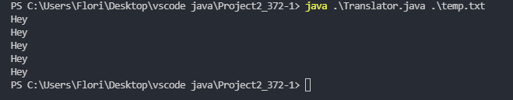

Loops
Loops are equivalent to java loops.
They use <= and >= to compare the starting value to the end value.
They choose the comparator based on the operator for the arithmetic incrementation.
<= for add, mul and >= for sub, div, mod although I can’t see the uses in looping with mod.
Incrementing the index is done by using an arithmetic expression.
If you are not using a variable for the starting value, you can use the keyword op in the arithmetic expression to increment the index, however, it will not be accessible inside the loop.

Slide 15
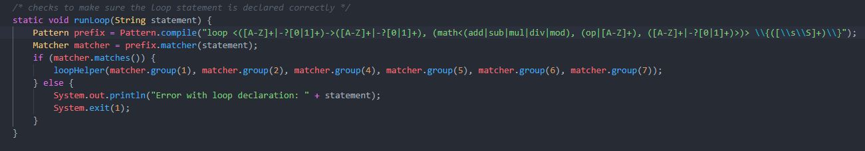
Extra Note
Most of the work being done in the program has to do with regex.
For example, the following function is used in part to handle loop interpretation. We can see the large and complicated regex used to verify everything is syntactically correct before we go on to run the loop in another function.

Slide 16
Going further
The first thing I would do If I wanted to expand my programming language would be to expand the number of data types allowed for programs. Adding just floats, strings, and characters would allow for much larger variety of programs written in my language.
I would also have to rework how I split my statements up as the current method only allows for a recursive depth up to 5. That means that programs written in my language can’t recurse more than 5 times or have nested statements more than 5 layers deep.
Last but not least, I would like to make my programming language less strict so that a single space placed in the wrong spot won’t crash the interpreter.

Slide 17
Github
If anything is missing or you would like to see my programs, grammar, or translator, you can find the project on my github at:
https://github.com/Savaesthetic/Project2_372

