Slide 1
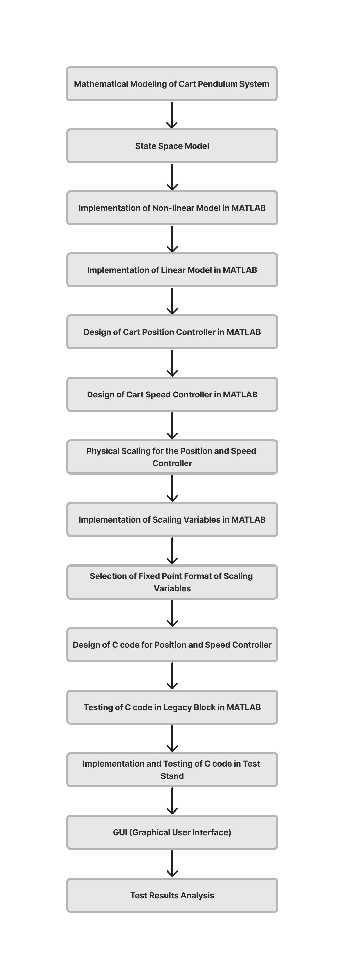
Sequential Process Flow for Cart Pendulum Control

Slide 2
Physical Scaling
MATLAB script for required variables for scaling
P_0 = 1; % Rated cart position (m) P_0k = 57147; % Sensor reading for rated cart position F_0 = 20; % Rated force (N) F_0k = 200; % DAC increments for rated force V_0 = 1; % Rated cart speed (m/s) V_0k = 571.47; % Sensor reading for rated cart speed A_0 = 2*pi; % Rated pendulum angle (rad) A_0k = 4095; % Sensor reading for rated pendulum angle Av_0 = 2*pi; % Rated pendulum angular velocity (rad/s) Av_0k = 40.95;; % Sensor reading for rated pendulum angular velocity

Slide 3
MATLAB script for controller coefficient
Gp_s = (P_0/P_0k)*P_D*(F_0k/F_0); % Scaled proportional gain Gi_s = (P_0/P_0k)*pi_d*Ts*(F_0k/F_0); % Scaled integral gain ktd_s(1) = (Av_0/Av_0k)*kt_d(1)*(F_0k/F_0); ktd_s(2) = (A_0/A_0k)*kt_d(2)*(F_0k/F_0); ktd_s(3) = (V_0/V_0k)*kt_d(3)*(F_0k/F_0); ktd_s(4) = (P_0/P_0k)*kt_d(4)*(F_0k/F_0); ktd_s = [ktd_s(1) ktd_s(2) ktd_s(3) ktd_s(4)]; % Scaled state feedback vector gain

Slide 4
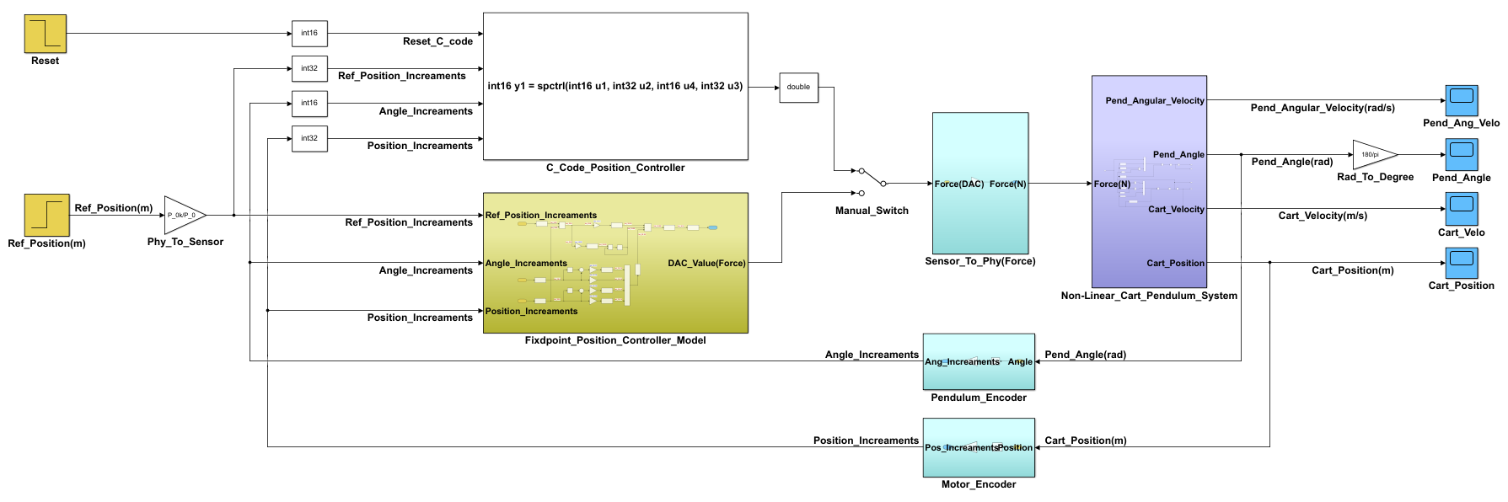
Legacy Code MATLAB Model

Slide 5
Simulation Comparison

Slide 6
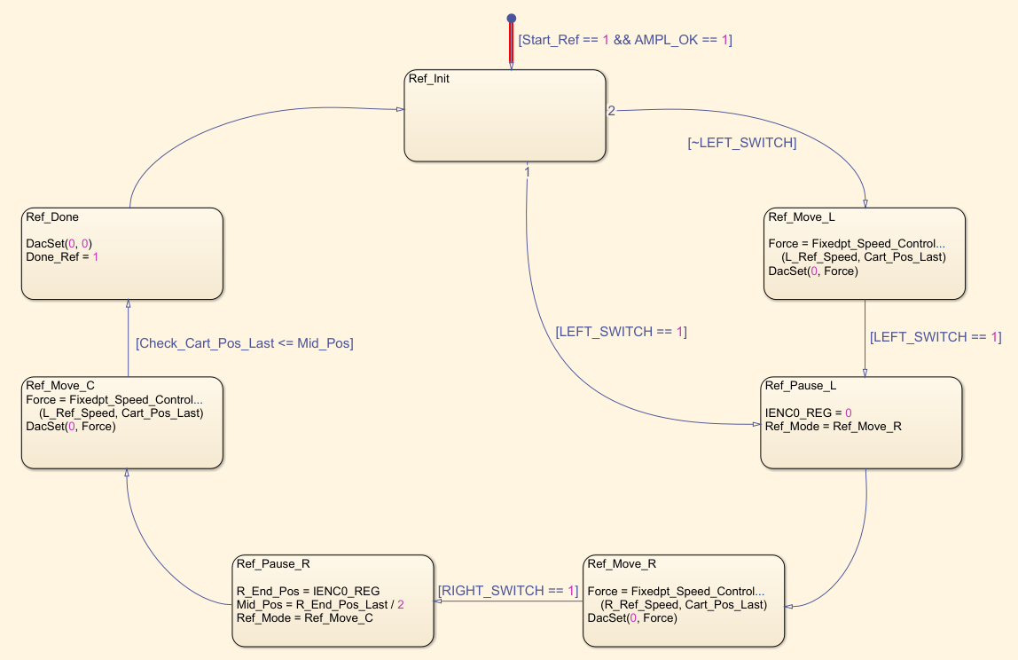
State Diagram for Referencing Phase

Slide 7
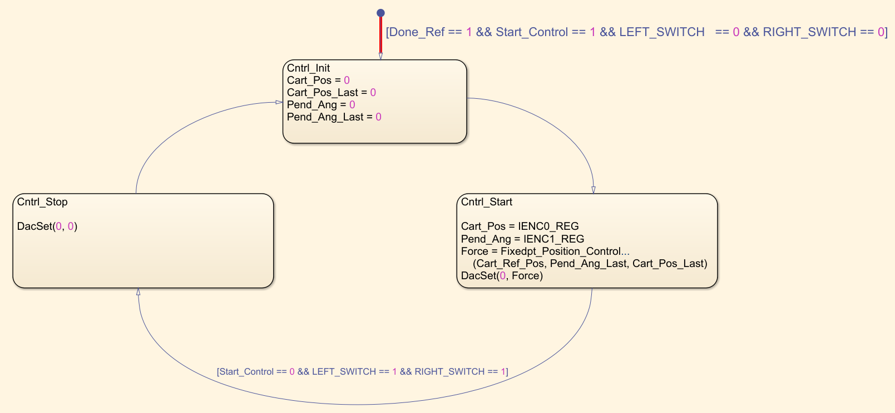
State Diagram for Controlling Phase

