Slide 1
Student Name
Nikhil Savaliya
Institute Name
Digicrome Academy

Slide 2


Exploratory Data Analysis (EDA) for Real Estate Pricing
Uncovering the Dynamics of House Valuation in a Dynamic Market. As a key member of the analytics team in a leading real estate company, this comprehensive analysis aims to identify and understand the myriad variables that significantly influence house prices. By leveraging advanced data analytics techniques and visualization tools, the goal is to uncover patterns, correlations, and trends within the dataset, enabling the company to make informed decisions and strategically position properties for better business opportunities.

Slide 3
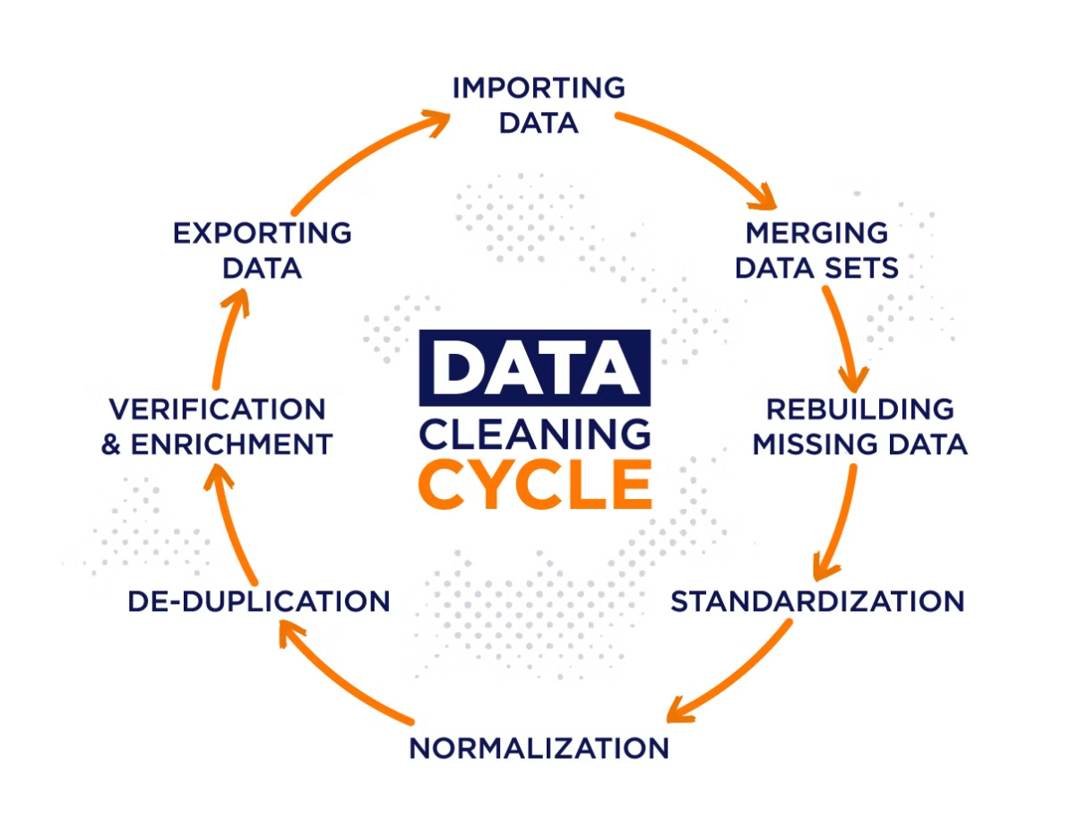

Slide 4
Cleaning the Data
1
Handling Missing Values
2
Removing Duplicates
3
Addressing Anomalies
Addressing missing data points to ensure data quality and integrity.
Eliminating duplicate entries to avoid skewing the analysis.
Identifying and resolving any inconsistencies or outliers in the dataset.

Slide 5
Univariate Analysis
Exploring Distributions
Visualizing Trends
Identifying Key Drivers
Utilizing histograms, kernel density plots, and other visualizations to gain insights.
Pinpointing the variables that have the most significant impact on house prices.
Analyzing the individual variables to understand their characteristics and patterns.

Slide 6
Multivariate Analysis
Correlation Matrices
Scatterplot Matrices
Identifying Patterns
Examining the relationships and dependencies between multiple variables.
Visualizing the interplay of various features and their influence on house prices.
Uncovering hidden connections and trends that may impact pricing strategies.

Slide 7
Feature Engineering
1
Creating New Variables
Introducing features that capture relevant information for pricing analysis, such as price per square foot or property age.
2
Enhancing Predictive Power
Developing new variables that can improve the model's ability to predict house prices accurately.
3
Improving Insights
Leveraging feature engineering to uncover deeper insights and relationships within the dataset.

Slide 8
Size and Amenity Impact
Size Influence
Amenity Preferences
Segmenting the Market
Analyzing the relationship between key features like bedrooms, bathrooms, and square footage with house prices.
Exploring how specific amenities, such as a swimming pool or garage, impact the perceived value of a property.
Applying clustering techniques to group houses with similar amenity profiles, revealing distinct market segments and pricing strategies.

Slide 9
Historical Pricing Trends
Temporal Analysis
1
Examining how house prices have changed over different time periods, considering external factors like economic indicators.
2
Identifying Patterns
Utilizing time-series visualizations to understand how market trends influence house prices and predict future valuation trends.
Informing Strategies
3
Leveraging insights from historical pricing data to develop more effective pricing strategies and stay ahead of market dynamics.

Slide 10
Recommendations and Insights
Pricing Strategies
Competitive Positioning
Optimizing Property Values
Provide actionable recommendations to the real estate company on how to strategically price properties based on the insights gained from the comprehensive exploratory data analysis.
Suggest ways the company can leverage the identified market trends, customer preferences, and pricing dynamics to gain a competitive edge in the dynamic real estate landscape.
Offer insights on how the company can enhance property values and improve customer satisfaction by focusing on the key factors that significantly influence house prices.

Slide 11
Historical Pricing Trends
Examining how house prices have changed over different time periods is crucial for understanding the real estate market dynamics. By analyzing historical pricing data, we can identify key patterns and trends that inform more effective pricing strategies.
Utilizing time-series visualizations, we can uncover how external factors like economic indicators have influenced house price fluctuations over time. This temporal analysis provides valuable insights into market cycles and allows us to predict future valuation trends more accurately.
By leveraging the insights gained from historical pricing data, the real estate company can develop more informed and adaptable pricing strategies. This helps them stay ahead of market changes and make data-driven decisions to maximize property values and profitability.

Slide 12

Conclusion
In conclusion, our comprehensive exploratory data analysis has provided invaluable insights to help the real estate company optimize their pricing strategies and stay competitive in the dynamic market. By deeply understanding the historical pricing trends, analyzing customer preferences, and uncovering the key drivers of property values, we have developed a robust set of recommendations to guide the company's future decision making.
The insights gained from examining market cycles and external factors impacting house prices will enable the company to anticipate and adapt to changes more effectively. Similarly, the sentiment analysis and segmentation insights on customer preferences will allow them to tailor their offerings and marketing to better meet the evolving needs of different buyer profiles.
Ultimately, the combination of data-driven pricing strategies, targeted positioning, and optimized property values will empower the real estate company to solidify its competitive edge and continue delivering exceptional value to its clients. This conclusion summarizes the key takeaways from our in-depth exploration, setting the stage for the company to capitalize on the opportunities identified and drive sustained growth in the years ahead.

Slide 13


