Slide 1
PYTHON GUI CALCULATOR USING TKINTER

Slide 2
Student Name
N
Nikhil Savaliya
Institute Name
Digicrome Academy

Slide 3


Agenda
A
Designing a user-friendly GUI calculator.
Simple and easy to use.
Enhancing user experience through GUI interactions.
Customizable widgets

Slide 4
INTRODUCTION
Create manual calculator .
Create python GUI calculator with the help of tkinter library .
Create git hub account and add all the necessory files into the new repository .

Slide 5
About python GUI
Graphical user interface(GUI) A GUI allows user to interact with a program visually. Guis are built from GUI components. A GUI component is an object.
Graphical user interface ( GUI )
A GUI allows user to interact with a program visually.
GUIS are built from GUI components.
A GUI components is an object with which the user interacts via the mouse and keyboard.

Slide 6
About Tkinter
Tkinter is the standard GUI library for python. Python when combined with Tkinter provides a fast and easy way to create GUI applications.
Tkinter provides a powerful object-oriented interface to the Tk GUI toolkit.
It’s built in library so no need to install only write from tkinter import * and library ready to use for any user.

Slide 7
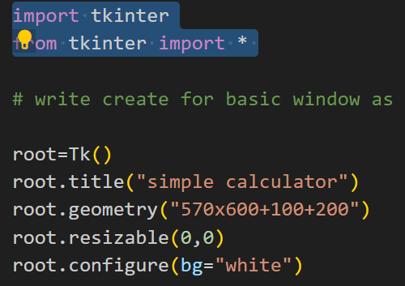
How it work ?
Tk() – To create a main window, tkinter offers a method Tk()
Root – It helps to display the root window and manages all the other components of the tkinter application.
mainloop() – is an infinite loop used to run the application ,wait for an event to occur and process the event as long as the window is not closed.
7
“

Slide 8
Tkinter provides various controls, such as buttons, labels and text boxes used in a Gui application. There are many types of widget provides in Tkinter like button , canvas , entry , frame , Label , menu etc.
Tkinter offers access to the geometric configuration of the widgets which can organize the widgets in parent windows. There are mainly three geometry manager classes class.
1. pack ( ) – organizes the widgets in blocks
2. grid ( ) – organizes the widgets in grid (table – like structure)
3. place ( ) – organizes the widgets by placing them on specific positions

Slide 9
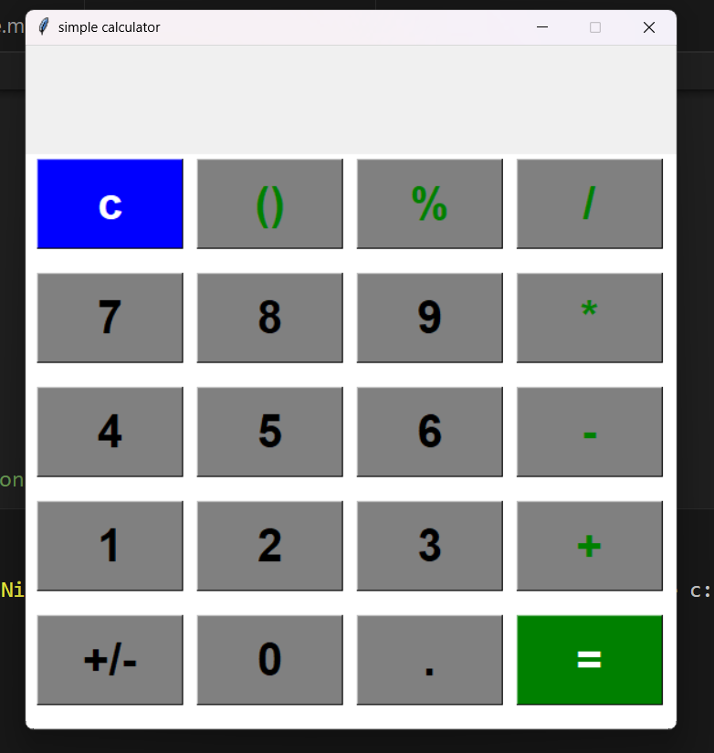
Display overview of simple calculator

Slide 10
Designing engaging GUI calculator
Visually appealing layout : - discuss the significance of an organized and visually appealing layout for better user experience.
Styling for user-friendly interface : - Emphasis the role of styling in creating a use-friendly and attractive GUI calculator.
Color scheme importance : - Highlight the impact of a well – chosen color scheme on user engagement and aeshthetics.

Slide 11
Enhancing user experience through GUI interactions
Efficient button click
Intuitive input handling
Real – time display updates
Illustrating the significance of responsive and intuitive button clicks for seamless user interaction.
Highlighting the role of user-friendly input handling in enhancing the overall user experience.
Emphasizing the impact of instant display updates in providing a dynamic and engaging user interface.

Slide 12
Thank you

