Slide 1
PYTHON GUI CALCULATOR USING TKINTER

Slide 2
Student Name
N
Nikhil Savaliya
Institute Name
Digicrome Academy

Slide 3


Agenda
A
Introduction
Project overview
Methodology

Slide 4
INTRODUCTION
Create manual calculator .
Create python GUI calculator with the help of tkinter library .
Create git hub account and add all the necessory files into the new repository .

Slide 5
About python GUI
Graphical user interface(GUI) A GUI allows user to interact with a program visually. Guis are built from GUI components. A GUI component is an object.
Graphical user interface ( GUI )
A GUI allows user to interact with a program visually.
GUIS are built from GUI components.
A GUI components is an object with which the user interacts via the mouse and keyboard.

Slide 6
About Tkinter
Tkinter is the standard GUI library for python. Python when combined with Tkinter provides a fast and easy way to create GUI applications.
Tkinter provides a powerful object-oriented interface to the Tk GUI toolkit.
It’s built in library so no need to install only write from tkinter import * and library ready to use for any user.

Slide 7
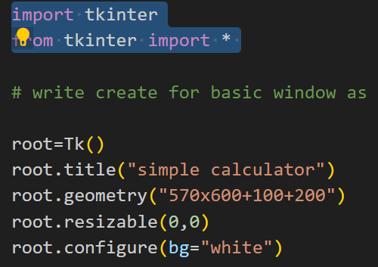
How it work ?
Tk() – To create a main window, tkinter offers a method Tk()
Root – It helps to display the root window and manages all the other components of the tkinter application.
mainloop() – is an infinite loop used to run the application ,wait for an event to occur and process the event as long as the window is not closed.
“

Slide 8
Tkinter provides various controls, such as buttons, labels and text boxes used in a Gui application. There are many types of widget provides in Tkinter like button , canvas , entry , frame , Label , menu etc.
Tkinter offers access to the geometric configuration of the widgets which can organize the widgets in parent windows. There are mainly three geometry manager classes class.
1. pack ( ) – organizes the widgets in blocks
2. grid ( ) – organizes the widgets in grid (table – like structure)
3. place ( ) – organizes the widgets by placing them on specific positions

Slide 10
Plan for product launch
Deploy strategic networks with compelling e-business needs
Planning
Synergize scalable e-commerce
Marketing
Disseminate standardized metrics
Design
Coordinate e-business applications
Foster holistically superior methodologies
Launch
Strategy

Slide 11
Timeline
Deploy strategic networks with compelling e-business needs
Sep 20XX
Synergize scalable e-commerce
Nov 20XX
Disseminate standardized metrics
Jan 20XX
Coordinate e-business applications
Mar 20XX
Foster holistically superior methodologies
May 20XX

Slide 12
Areas of focus
F
B2B market scenarios
Develop winning strategies to keep ahead of the competition
Capitalize on low-hanging fruit to identify a ballpark value
Visualize customer directed convergence
Cloud-based opportunities
Iterative approaches to corporate strategy
Establish a management framework from the inside

Slide 13
How we get there
ROI
Niche markets
Supply chains
Envision multimedia-based expertise and cross-media growth strategies
Visualize quality intellectual capital
Engage worldwide methodologies with web-enabled technologies
Pursue scalable customer service through sustainable strategies
Engage top-line web services with cutting-edge deliverables
Cultivate one-to-one customer service with robust ideas
Maximize timely deliverables for real-time schemas

Slide 14
Summary
At Contoso, we believe in giving 110%. By using our next-generation data architecture, we help organizations virtually manage agile workflows. We thrive because of our market knowledge and great team behind our product. As our CEO says, "Efficiencies will come from proactively transforming how we do business."

Slide 15
Thank you
Mirjam Nilsson​
mirjam@contoso.com
www.contoso.com

