Slide 1
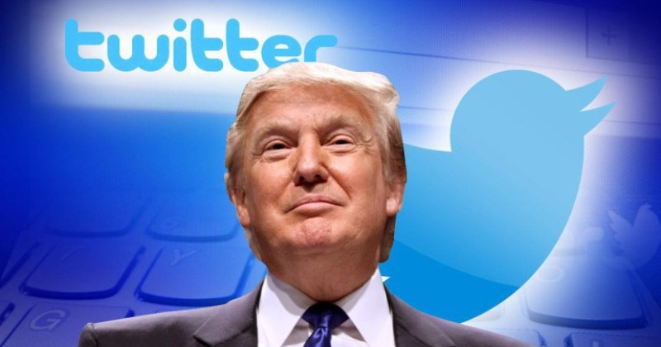
Make Twitter Great Again Group 17
Georgy Zakharov
Justin Kaipada
Savan Patel
Karn Bhavsar

Slide 2
Project Description
Gather metadata of Trump’s Tweets
Store in a Database
Present robust yet simple interface to stored information
Allows Users to interpret data for their own informed opinion

Slide 3





Tools used
Back-End:
Python, Flask, SQLAlchemy, PostgreSQL, Tweepy (python twitter API), Pandas
Front-End:
HTML, CSS, JS, Bootstrap

Slide 4
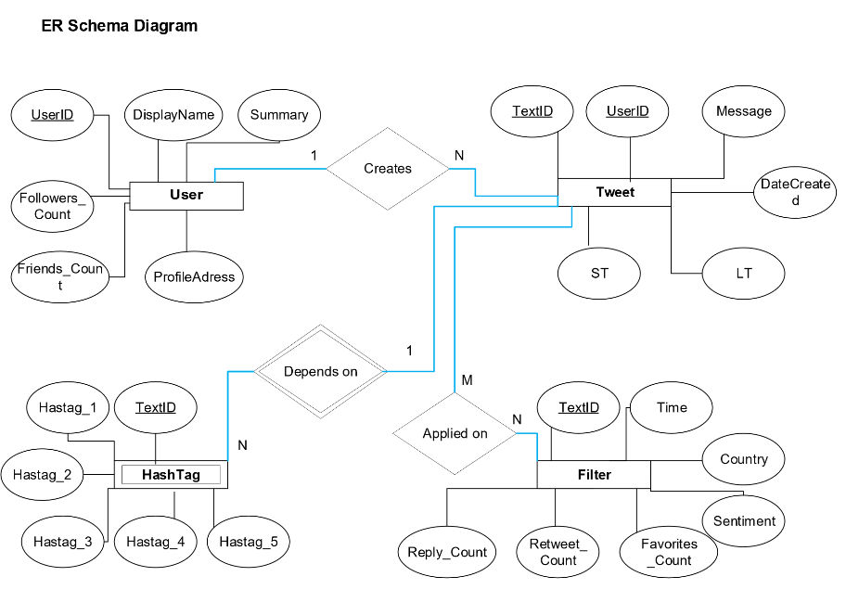
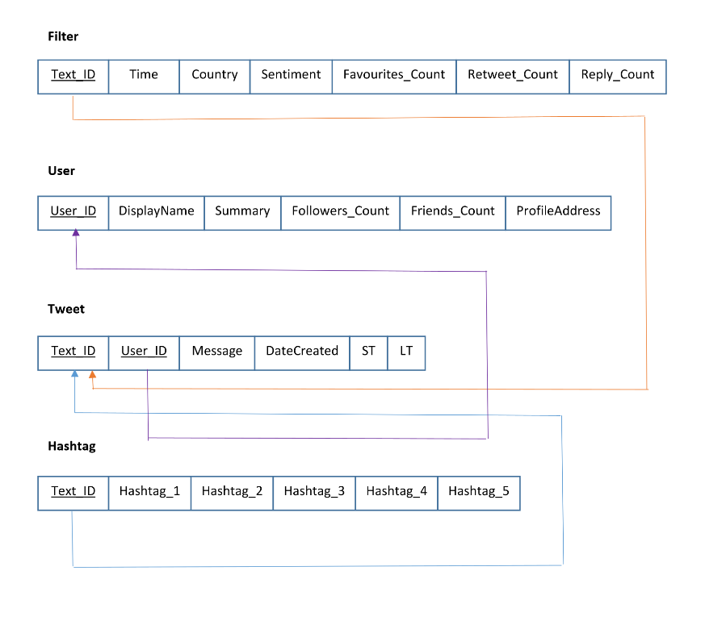
Initial Design

Slide 5
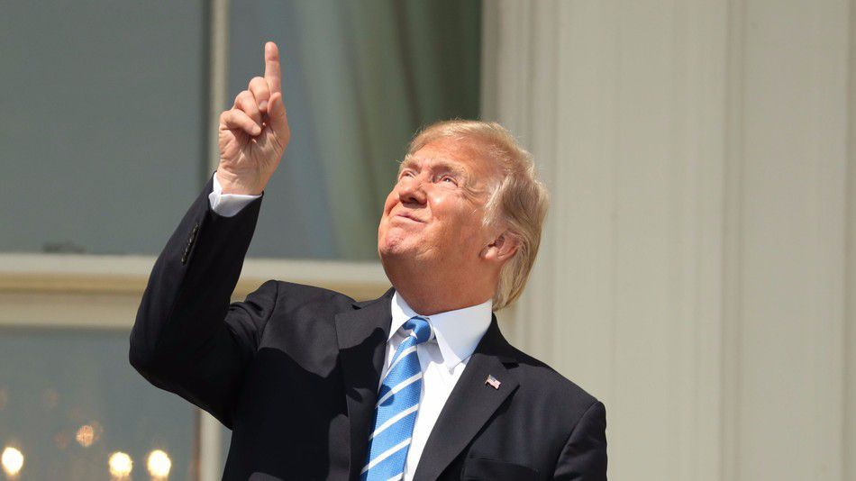
Demo

Slide 6
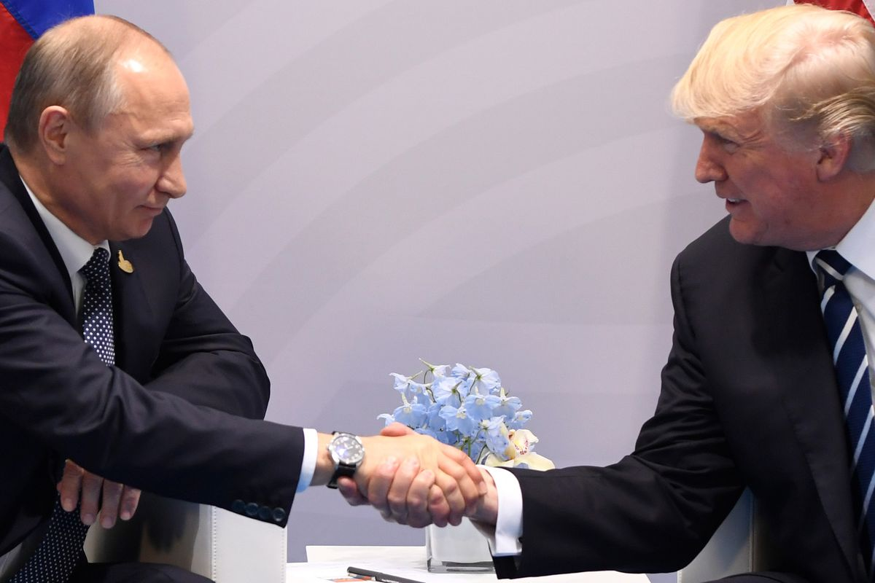



Future work

Slide 7
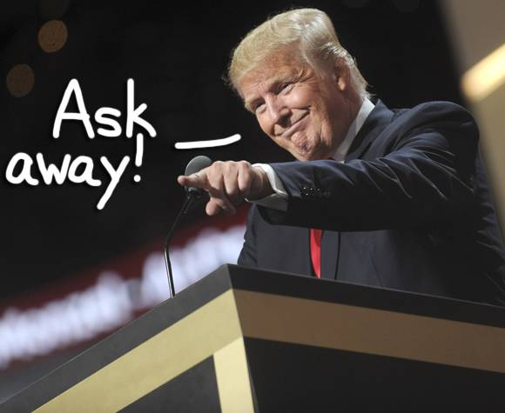
Any Last questions?

