Slide 1
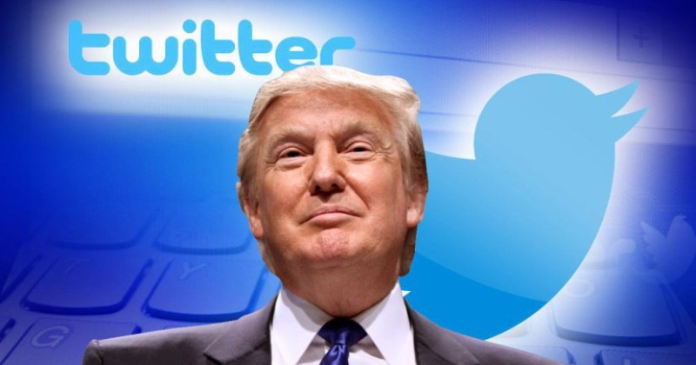
Make Twitter Great Again
Georgy Zakharov
Justin Kaipada
Savan Patel
Karn Bhavsar

Slide 2
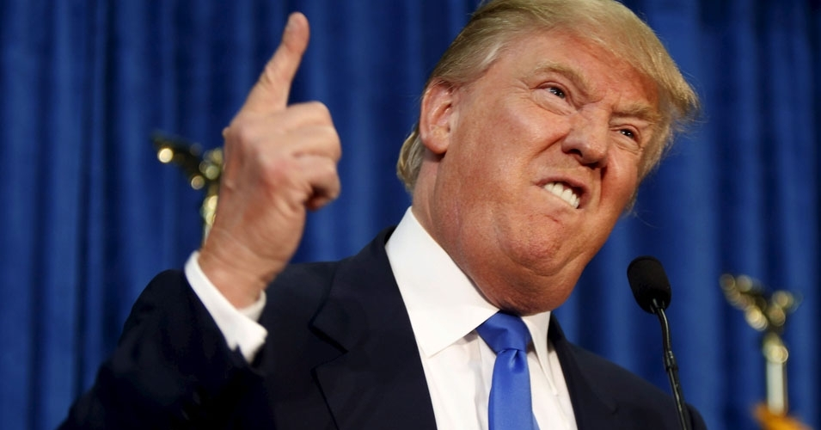
Lets begin

Slide 3
Project Description
Gather metadata of Trump’s Tweets
Store in a Database
Present robust yet simple interface to stored information
Allows Users to interpret data for their own informed opinion

Slide 4





Back-end

Slide 5



Front-end

Slide 6
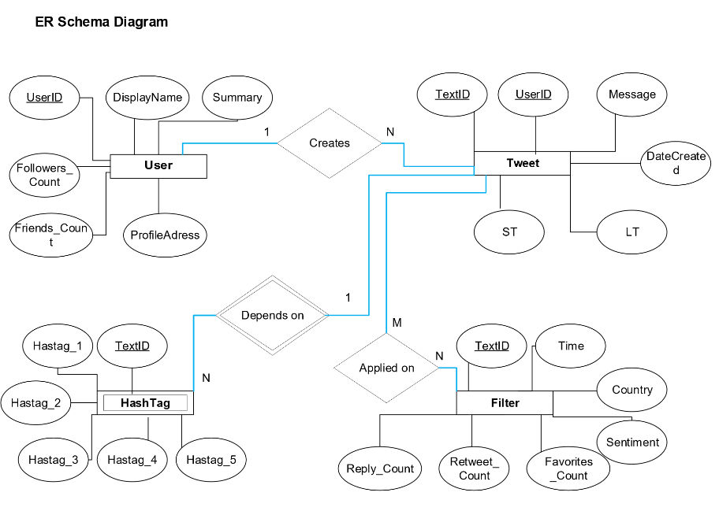
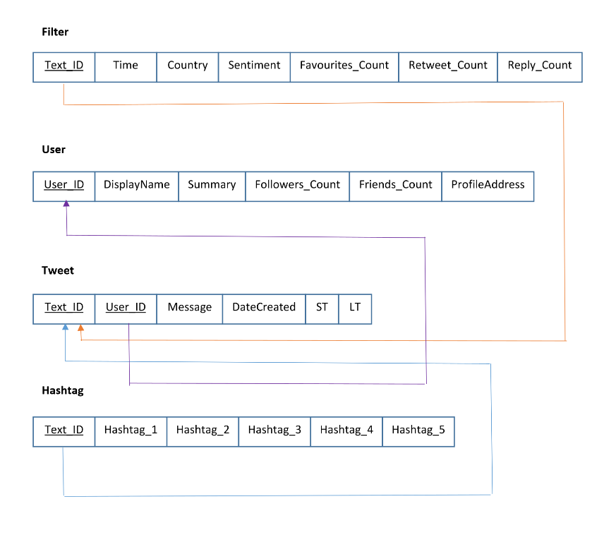
Initial Design

Slide 7
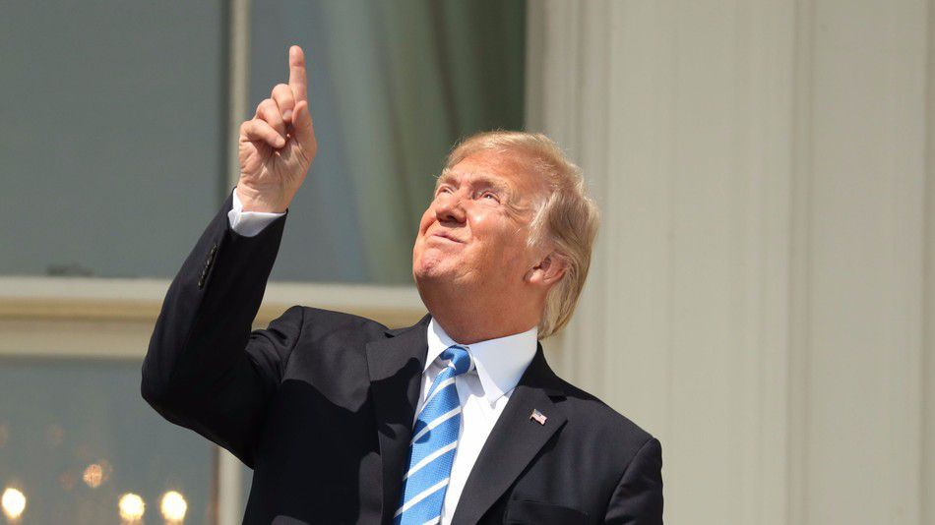
Demo

Slide 8
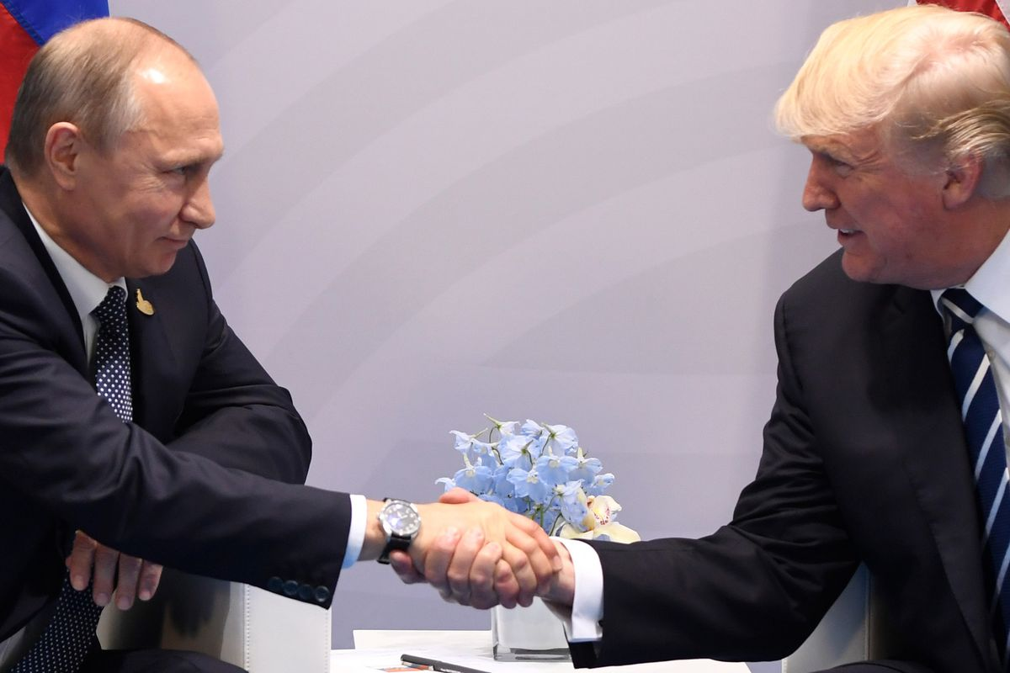



Future work

Slide 9
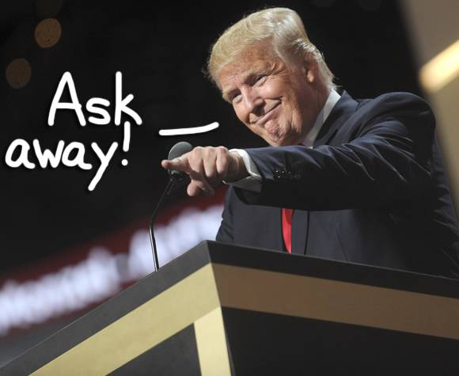
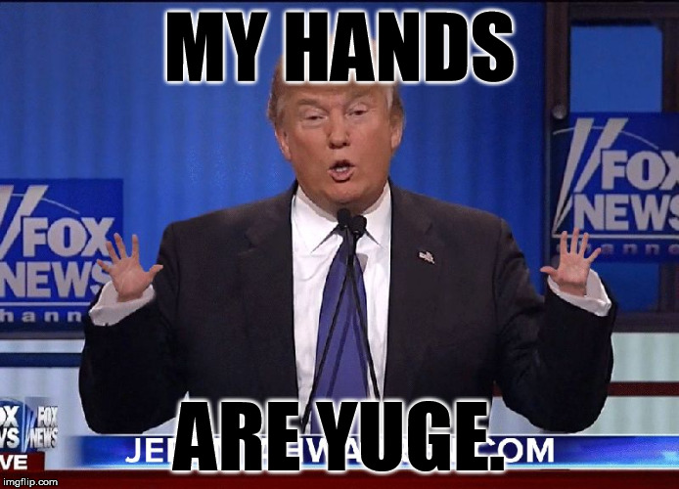
Any Last questions?

