Slide 1
SOFE 2715U Data Structures Course Project
By: Savan Patel, Karn Bhavsar, Sai Pedamallu and Paul Gege

Slide 2
Overview of the two projects
The two projects that we picked are K-Means and Convex Hull
K-Means:
Algorithm: Lloyd’s Algorithm
Data Structures: Linked List
Convex Hull:
Algorithm: Jarvis March
Data Structures: Lists and arrays

Slide 3
K-Means Overview of Algorithm
Lloyd's Algorithm:
Works by selecting n data points as centers and choosing the closest center for cluster
To get the best possible cluster, it selects a new cluster
This keeps on repeating until a certain amount of iterations
When a new centroid is found there will be new data points added or removed from the clusters
Our Algorithm:
Follow the same approach as Lloyd’s Algorithm
Manually give it the number of clusters we want
Make it iteratively assign each data points to the cluster corresponding to its nearest center
Assign data points to clusters
Compute for new centers for the clusters until best solution is found

Slide 4
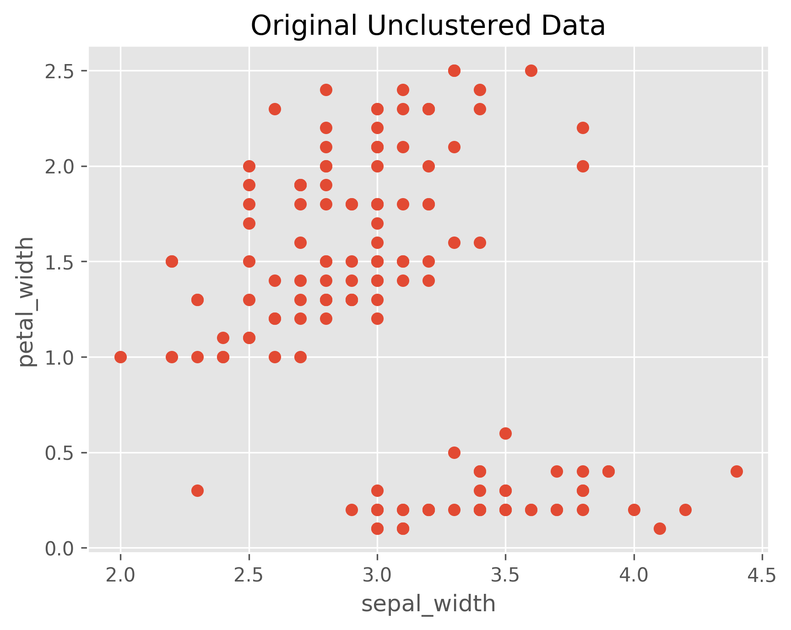
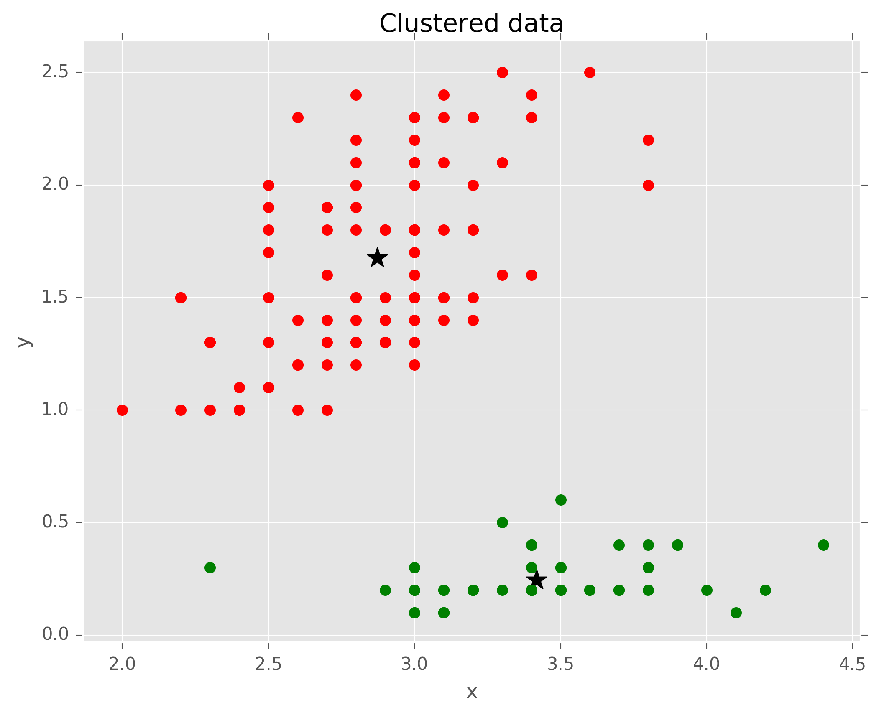
K-Means Exercise 1 Solution

Slide 5
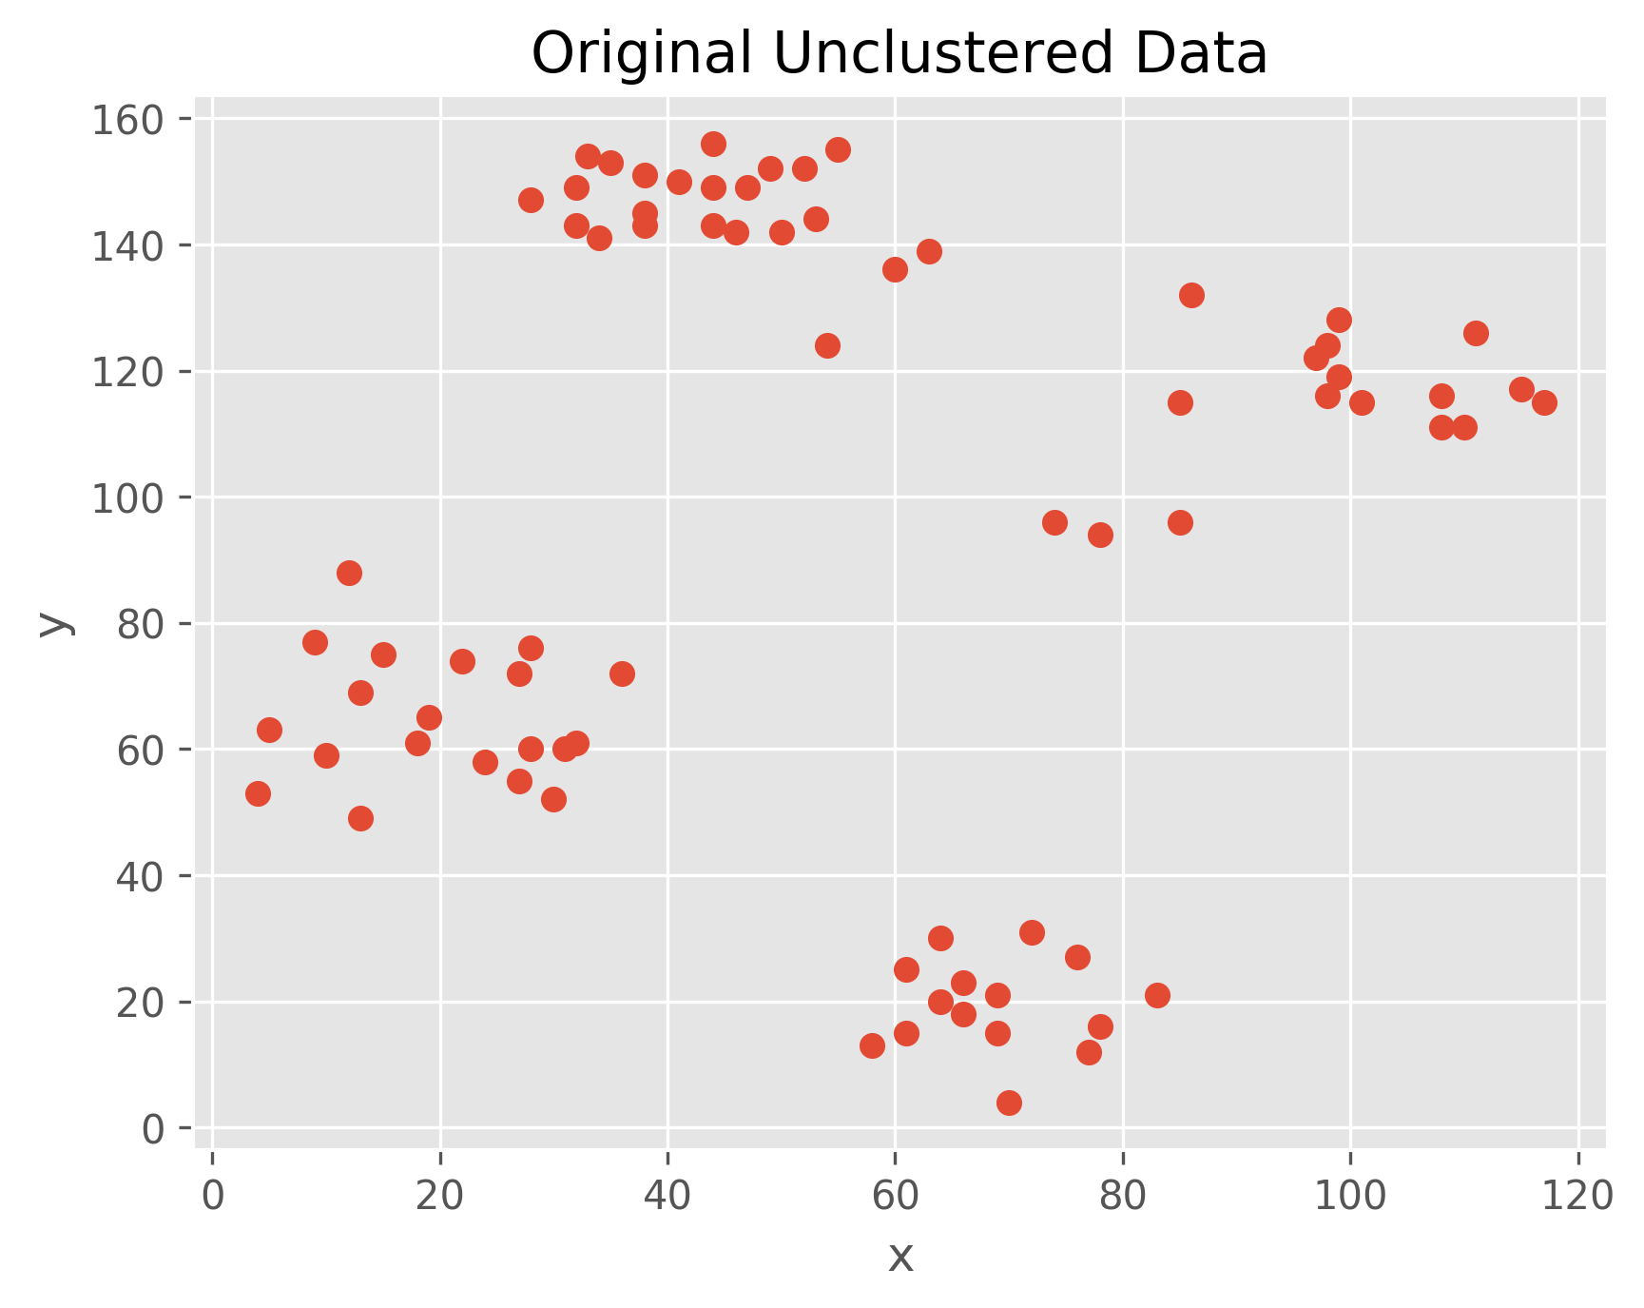
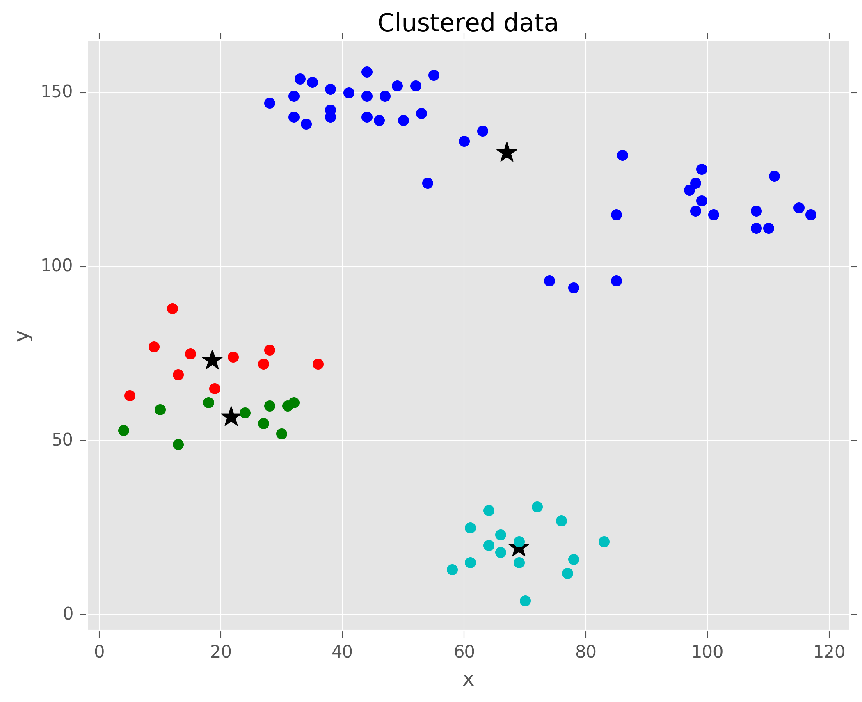
K-Means Exercise 2 Solution

Slide 6
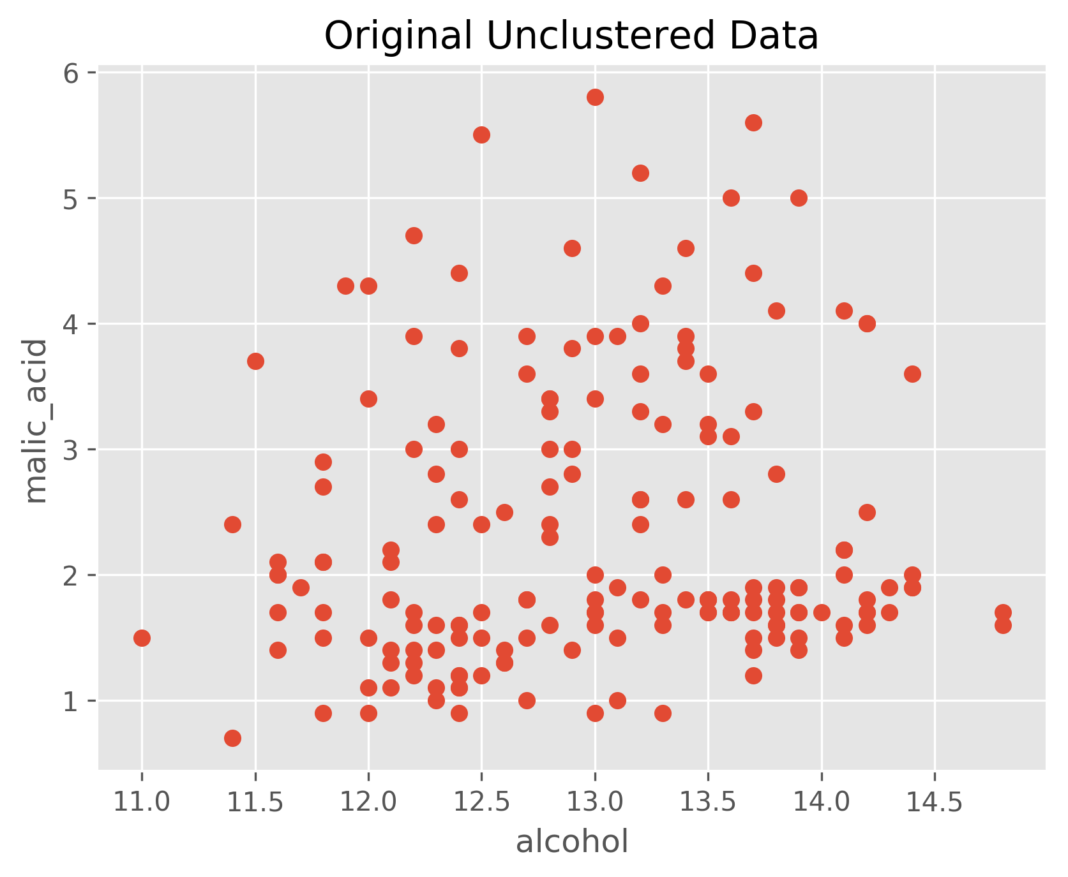
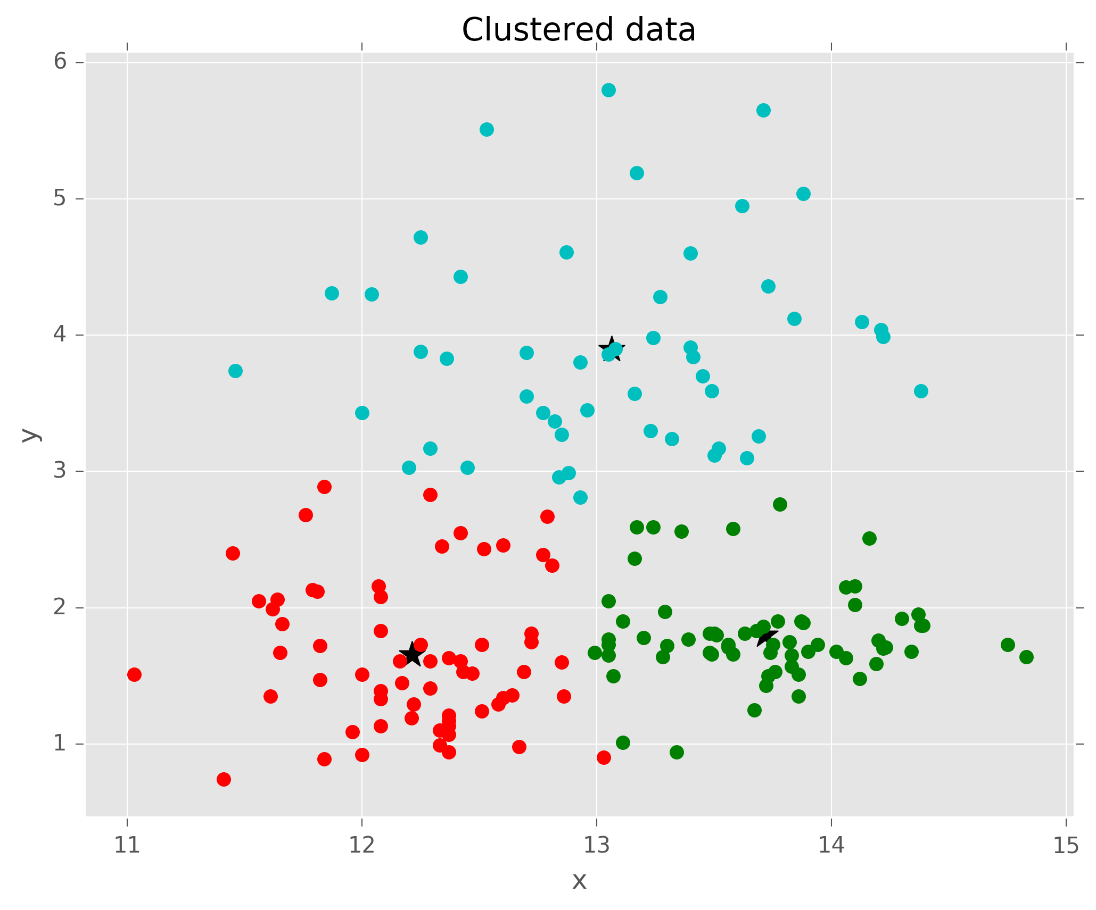
K-Means Exercise 3 Solution

Slide 7
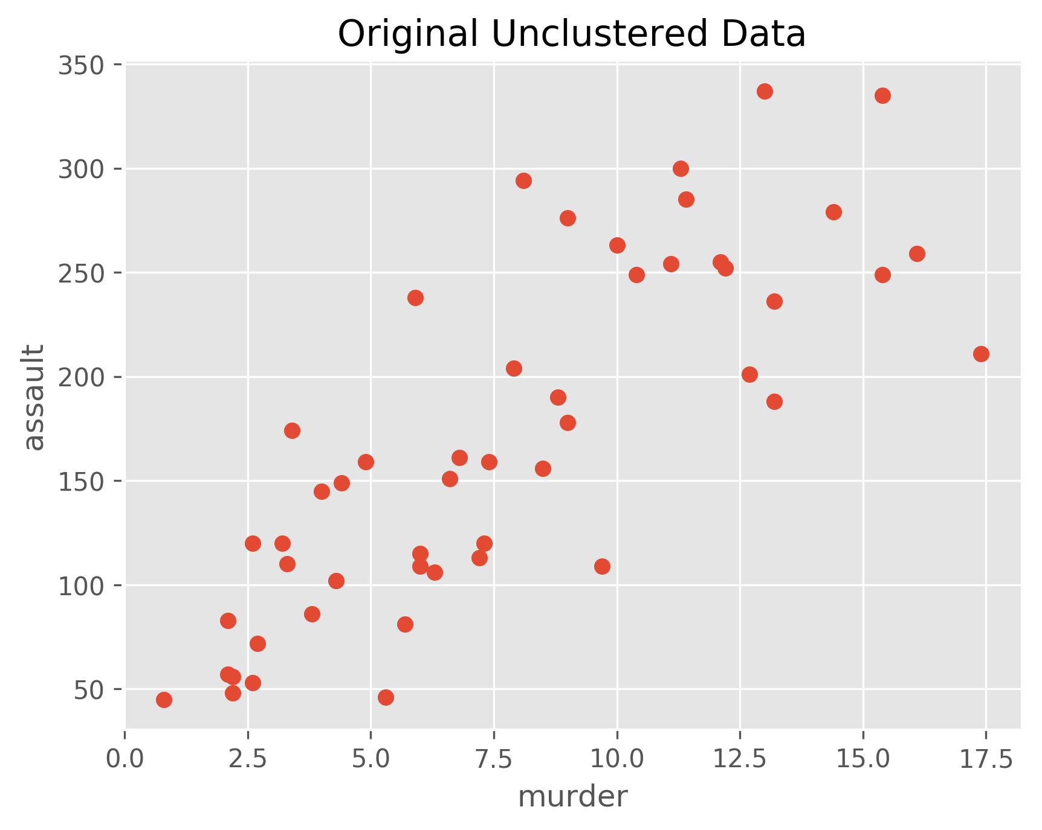
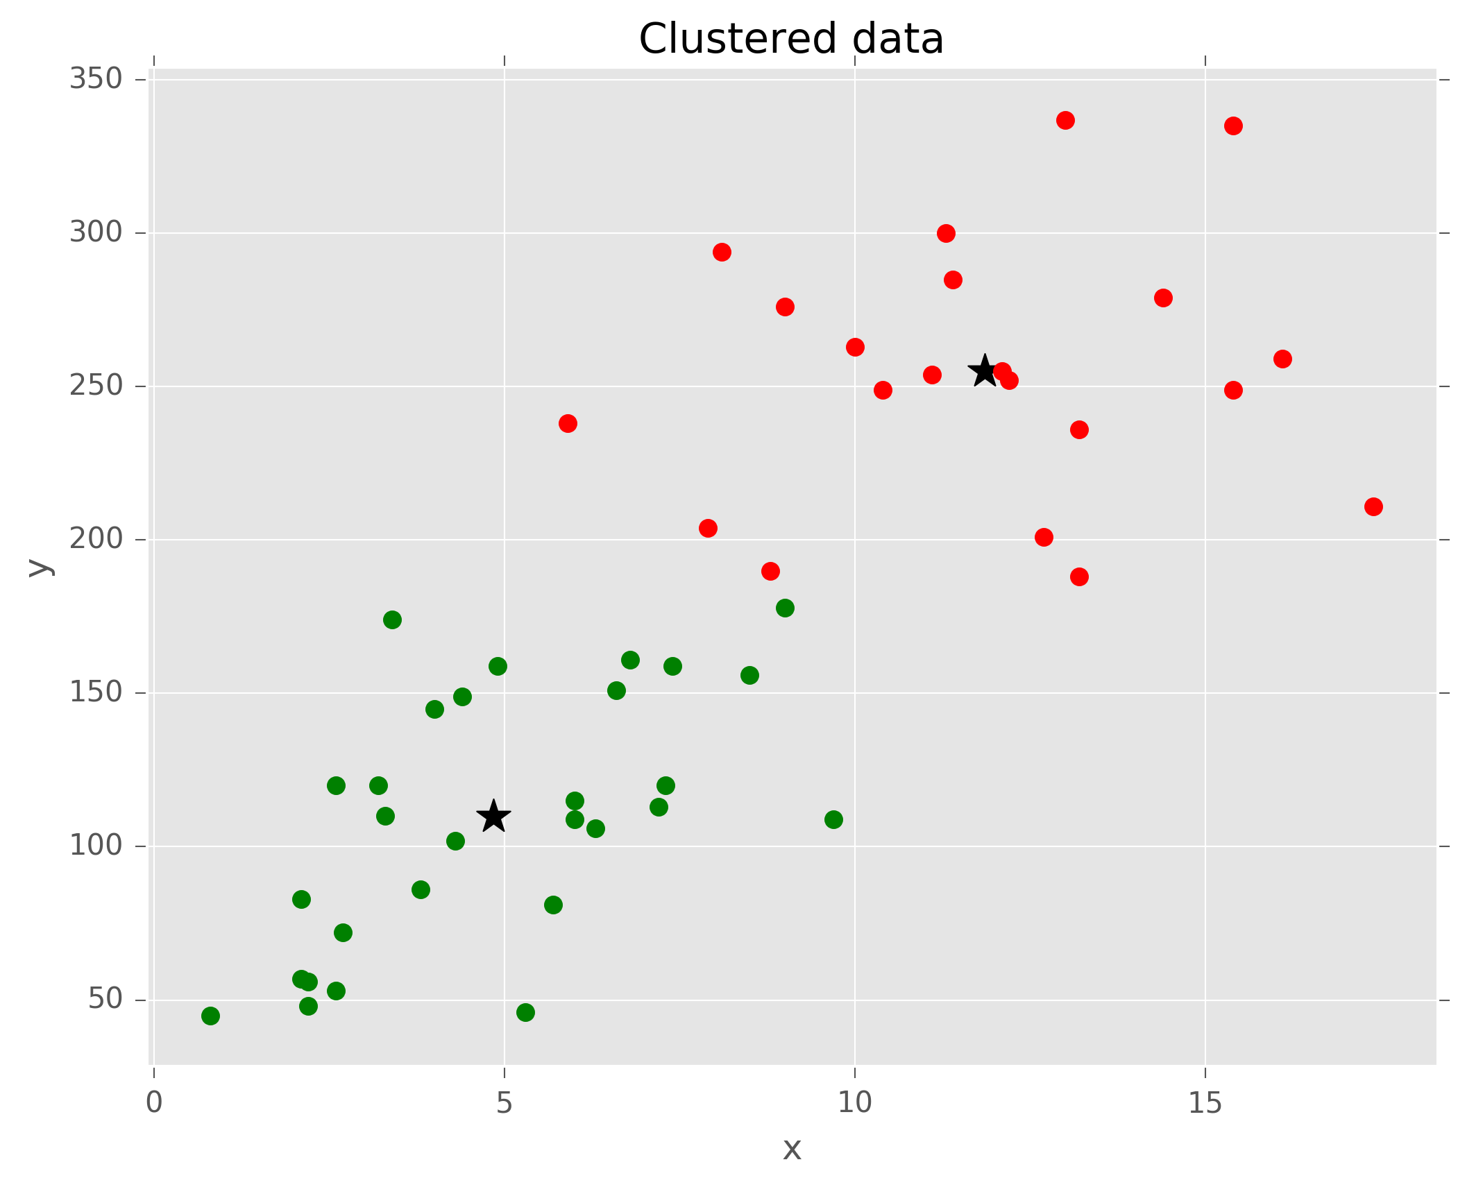
K-Means Exercise 4 Solution

Slide 8
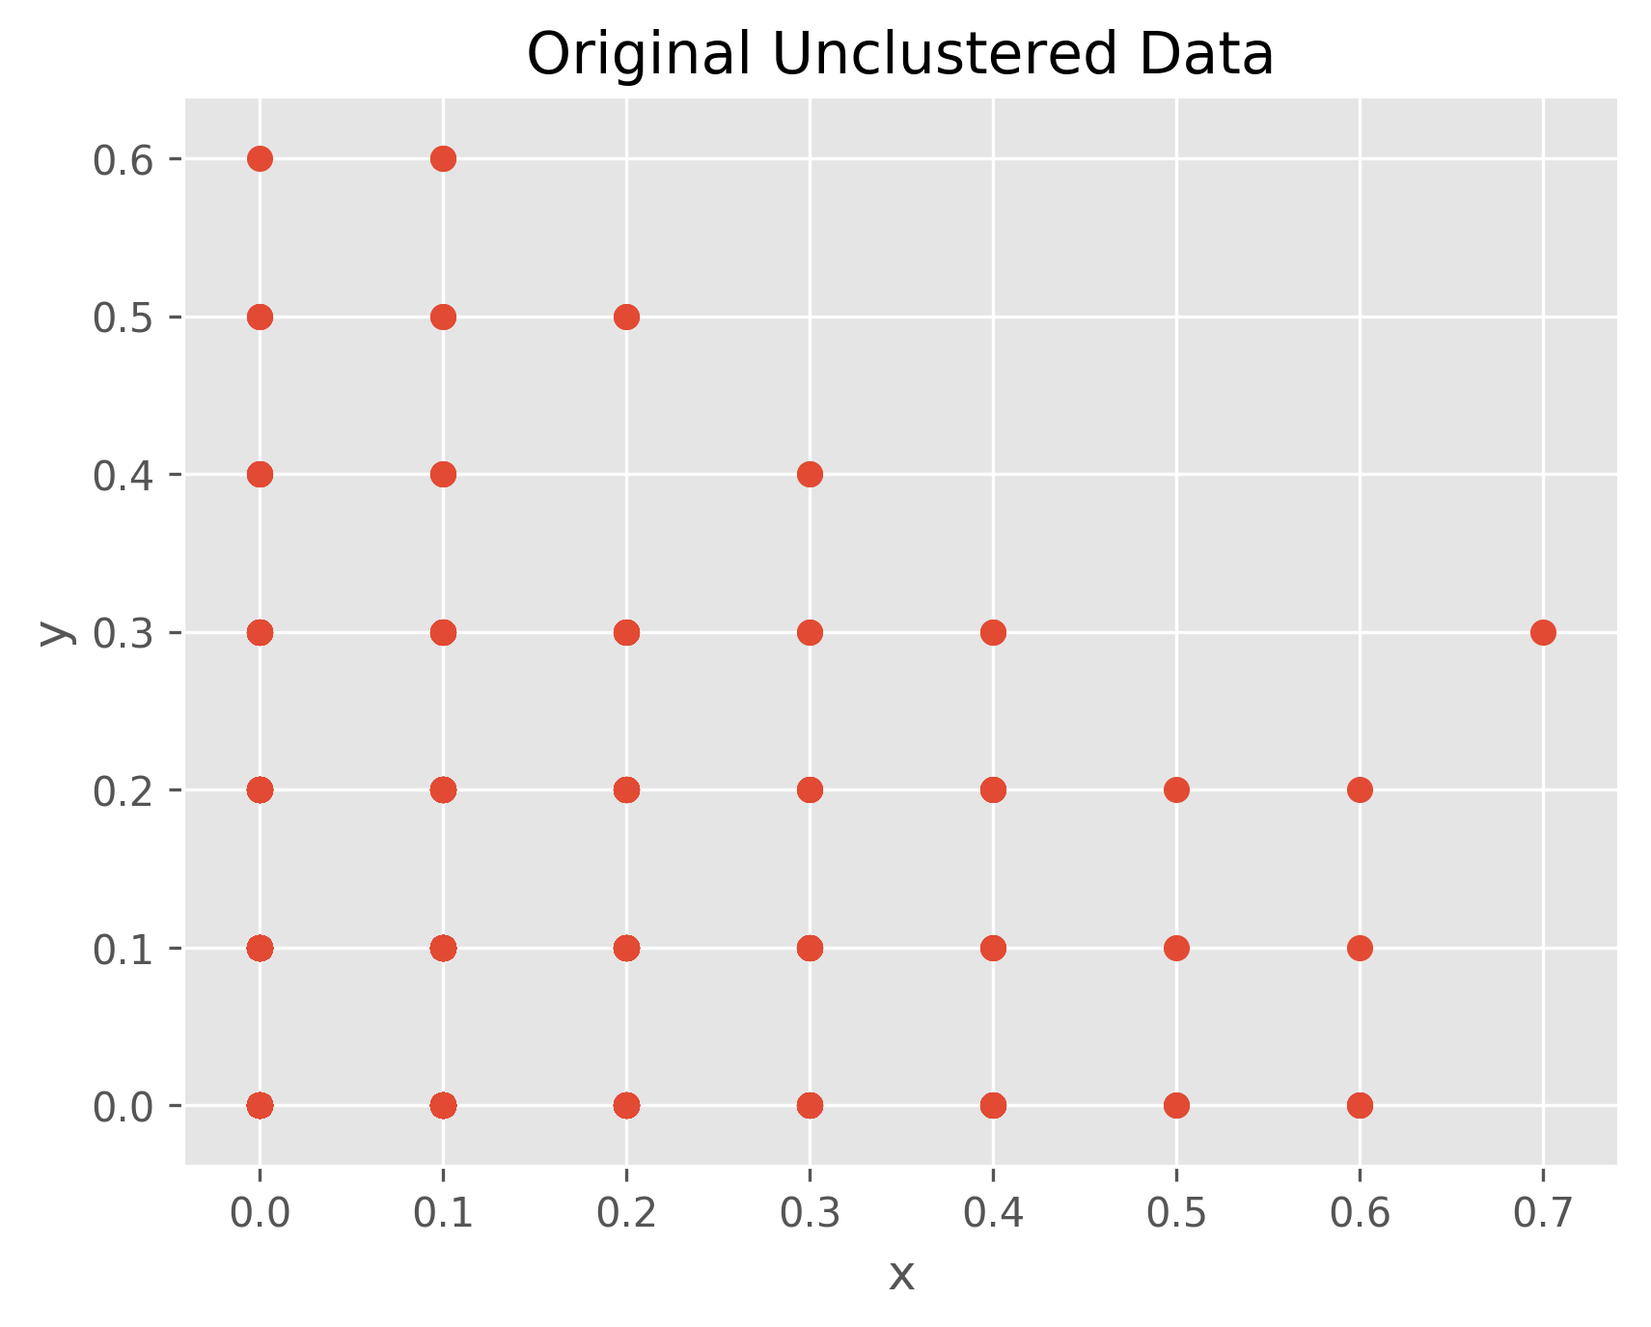
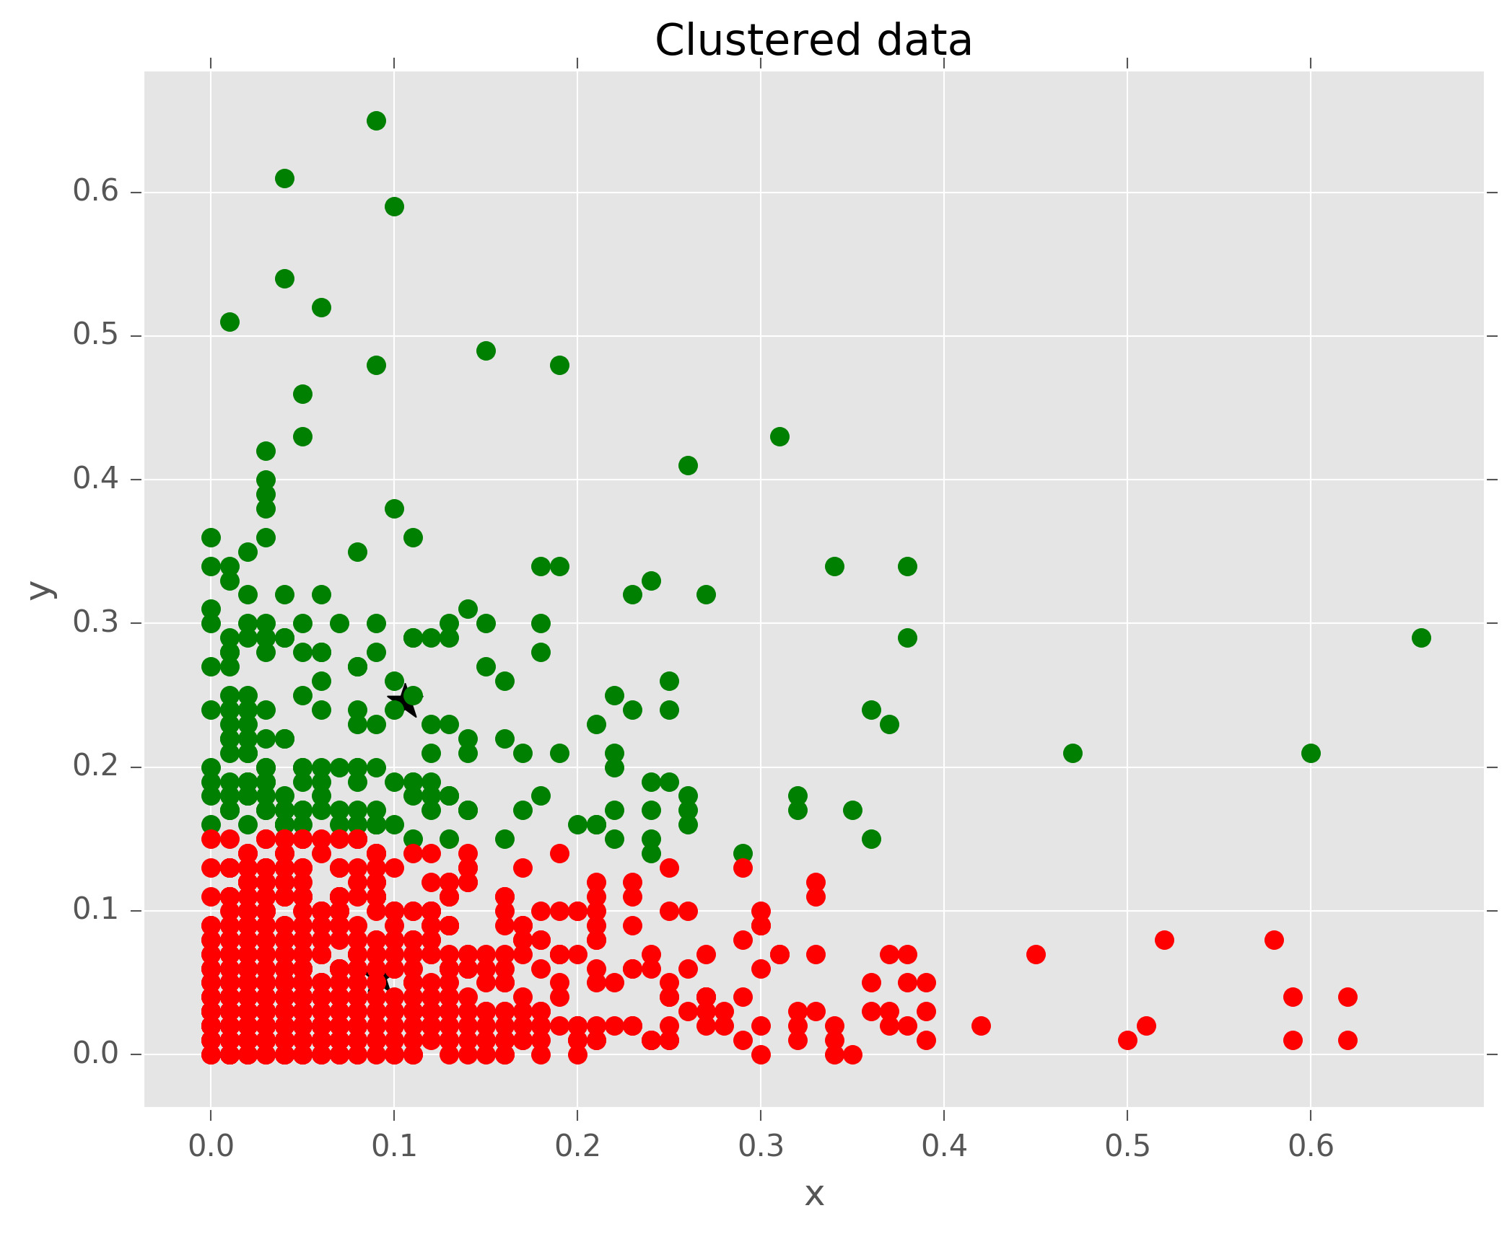
K-Means Exercise 5 Solution

Slide 9
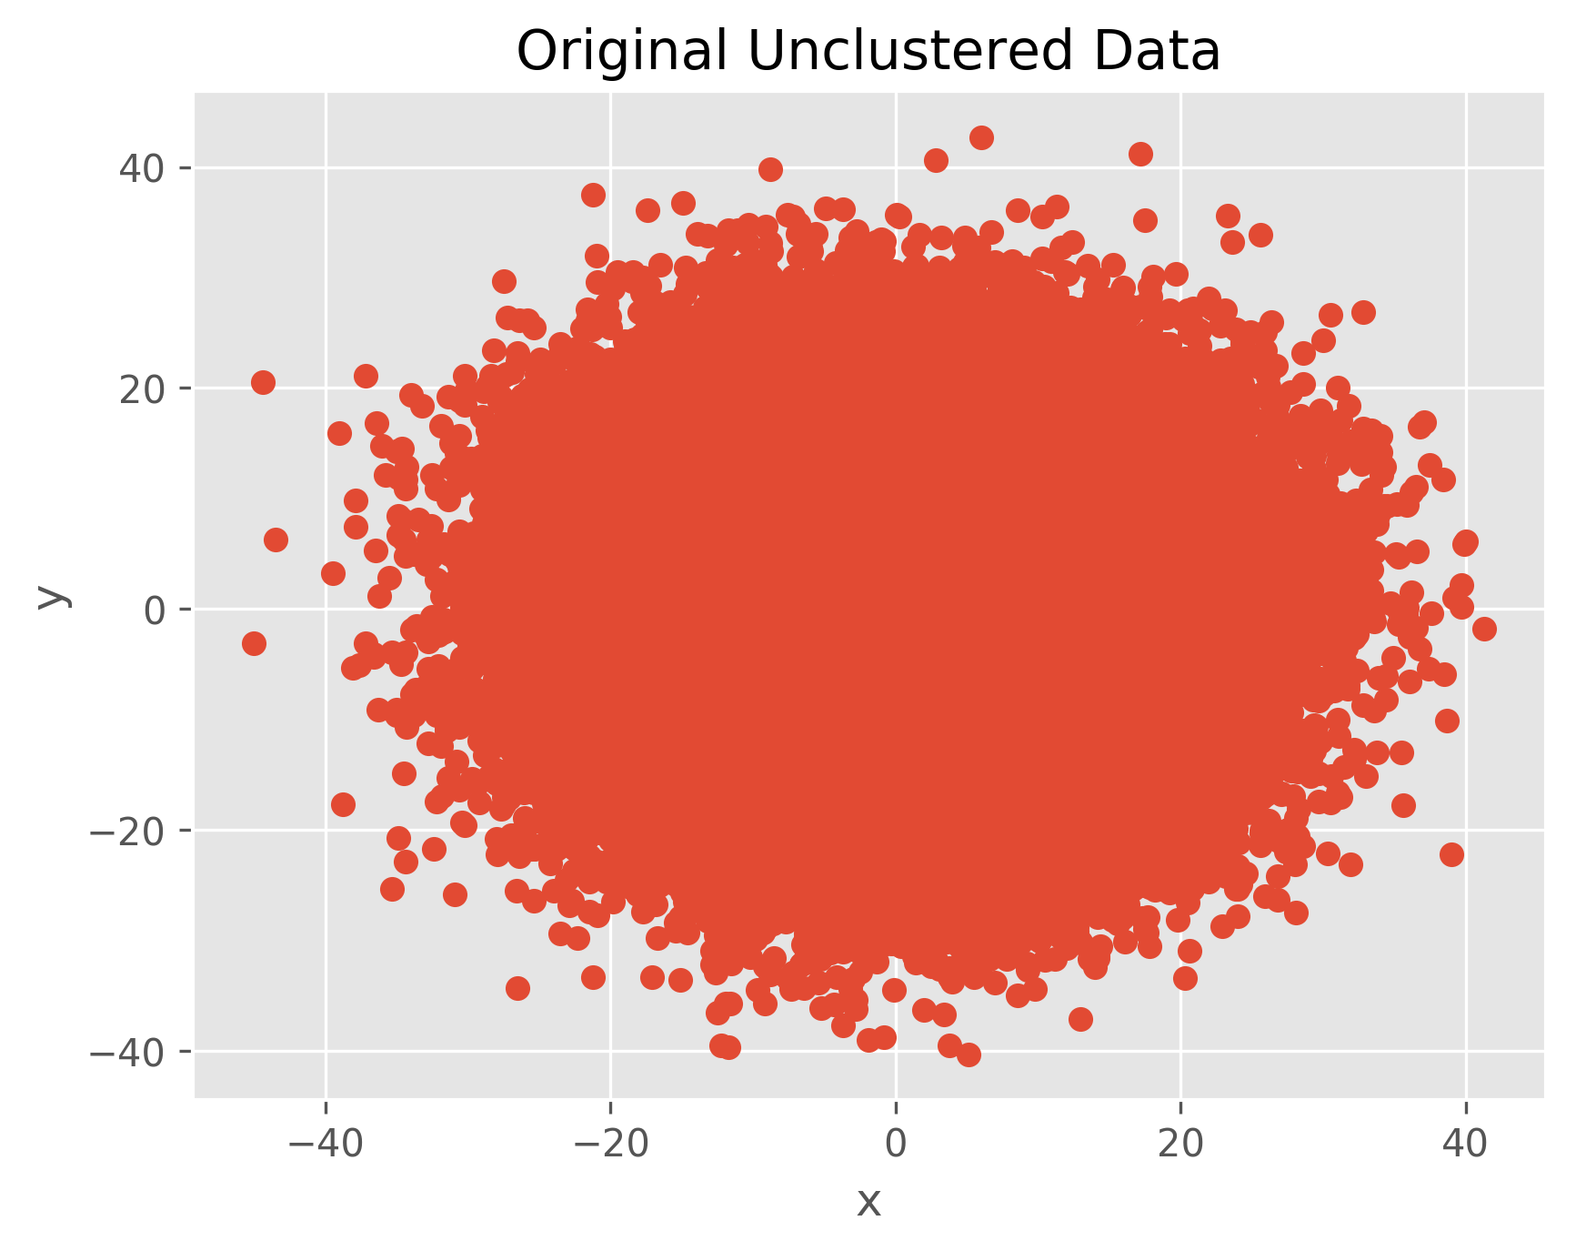
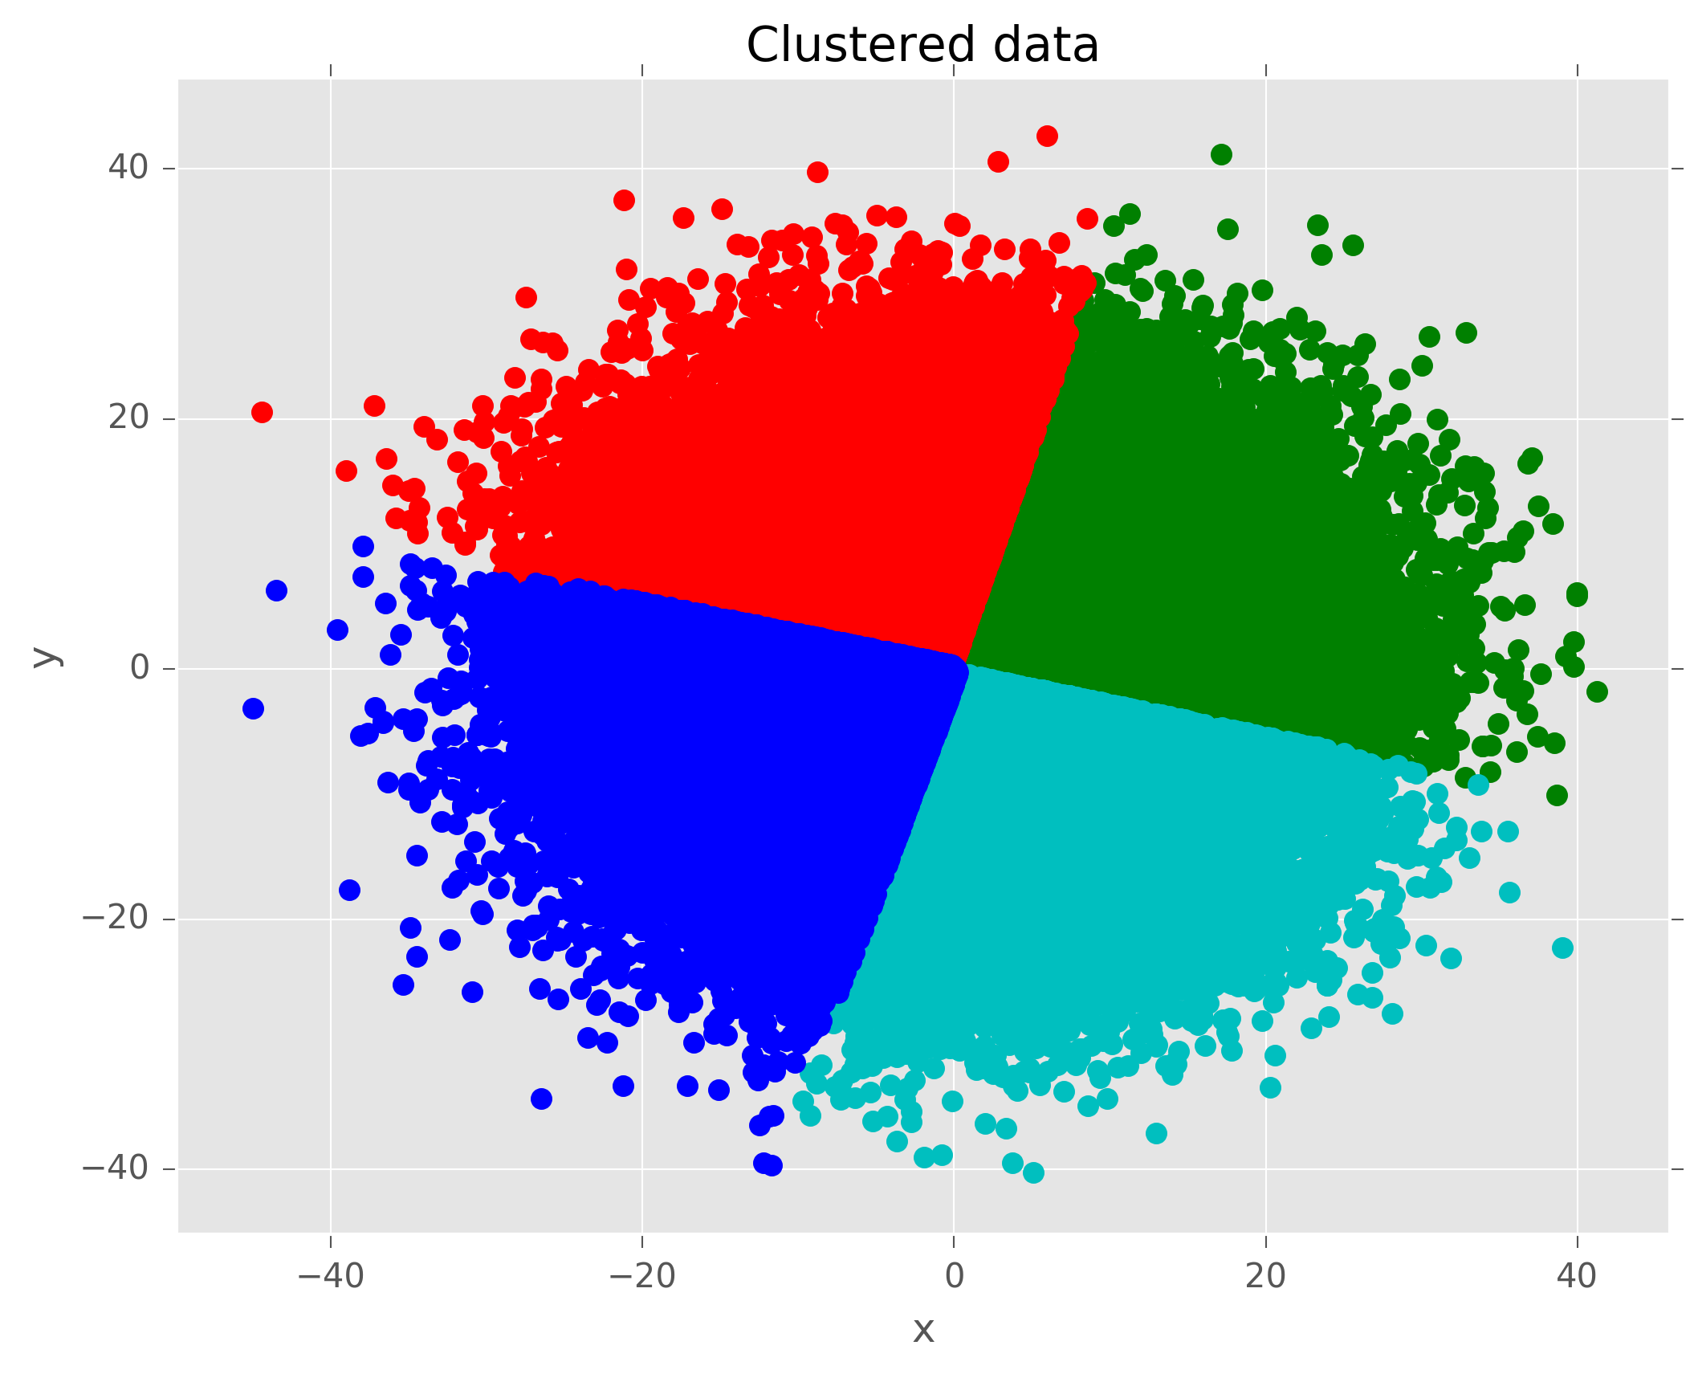
K-Means Exercise 6 Solution

Slide 10
K-Means Time it took to run each exercise
Exercise-1.csv K = 2 | Exercise-2.csv K = 4 | Exercise-3.csv K= 3 | Exercise-4.csv K=2 | Exercise-5.csv K=2 | Exercise-6.csv K=4
11.51 s | 9.73 s | 13.88 s | 9.59 s | 34.36 s | 3000 s
For all exercises the running time is less than a minute for both unclustered and clustered expect exercise 6 which took 50 mins (3000 s)
It takes that long because of its time complexity which big o(n^2)
It has to iterate 300 times before it can compute the k-means
Factors that might affect the time:
Speed of the CPU on the computer
Overall performance of the computer the program is running on
If any applications open on the computer

Slide 11
Convex Hull Overview of Algorithm
Gift Wrapping Algorithm (also known as Jarvis March):
It Start by choosing the left most point
Search through all points until the greatest interior angle is found
Once found, we moved to the new point by selectively choosing the angle based on the last two point
This then stretch our one dimensional gift wrap along the exterior of an random distribution of points until you have reached your starting point
Our Algorithm:
Follows the same approach as Gift Wrapping Algorithm
Uses lists and arrays as our data structures

Slide 12
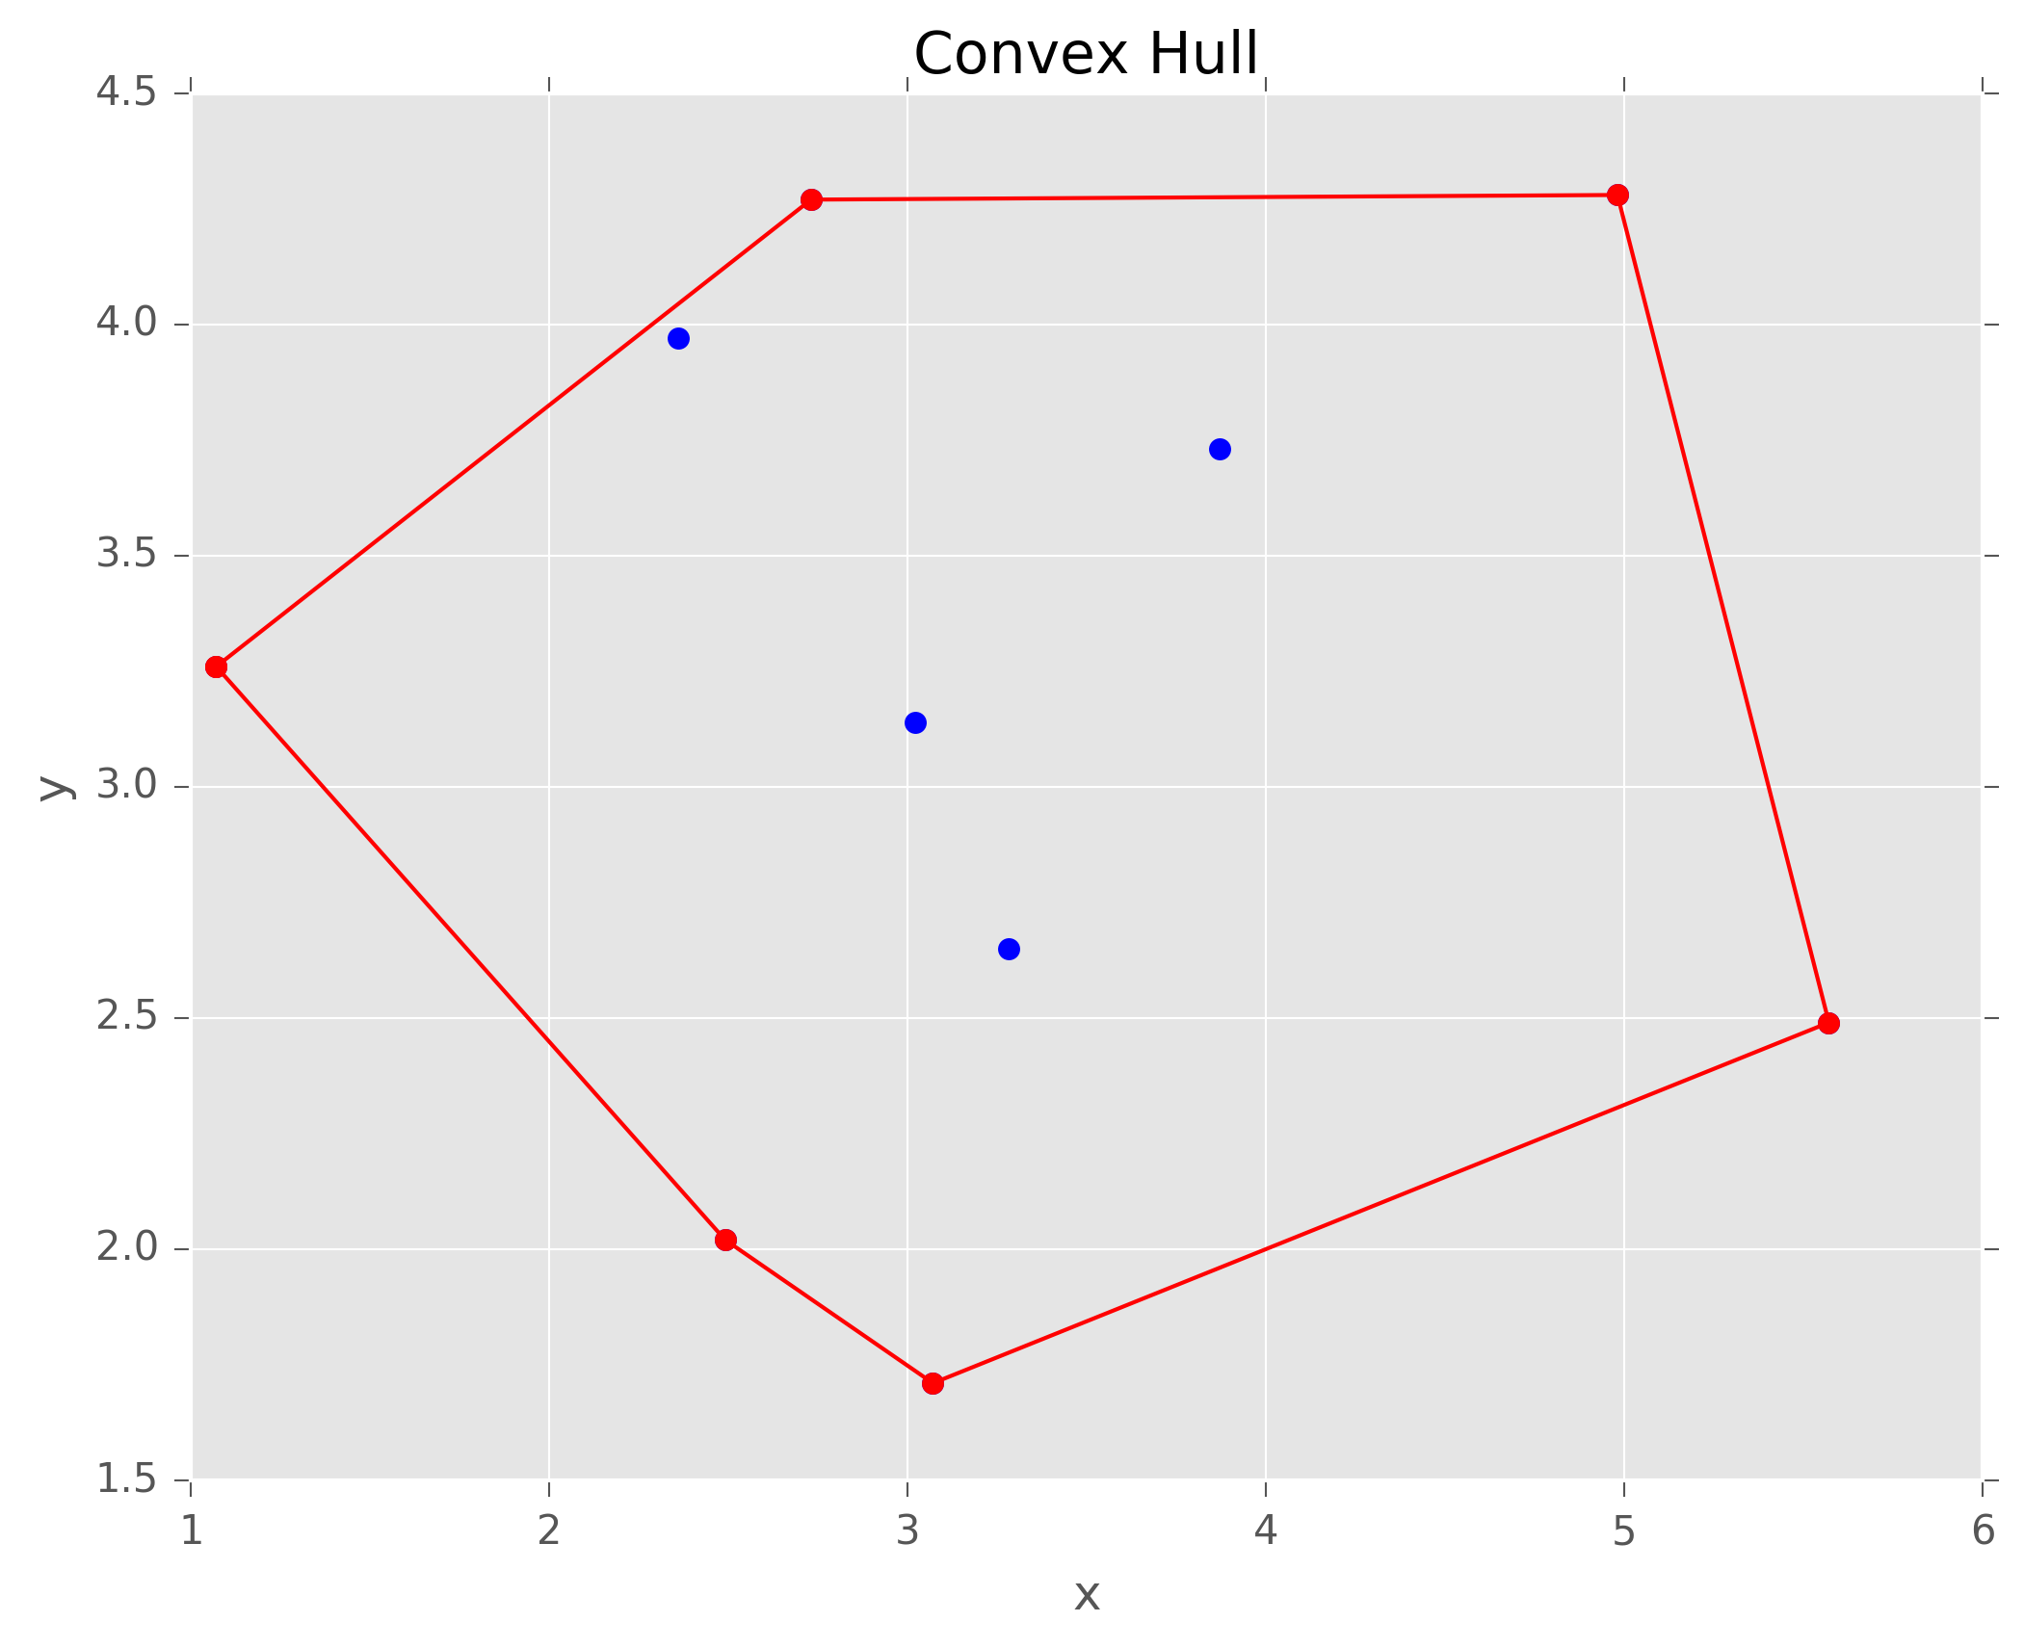
Convex Hull Exercise 1 Solution

Slide 13
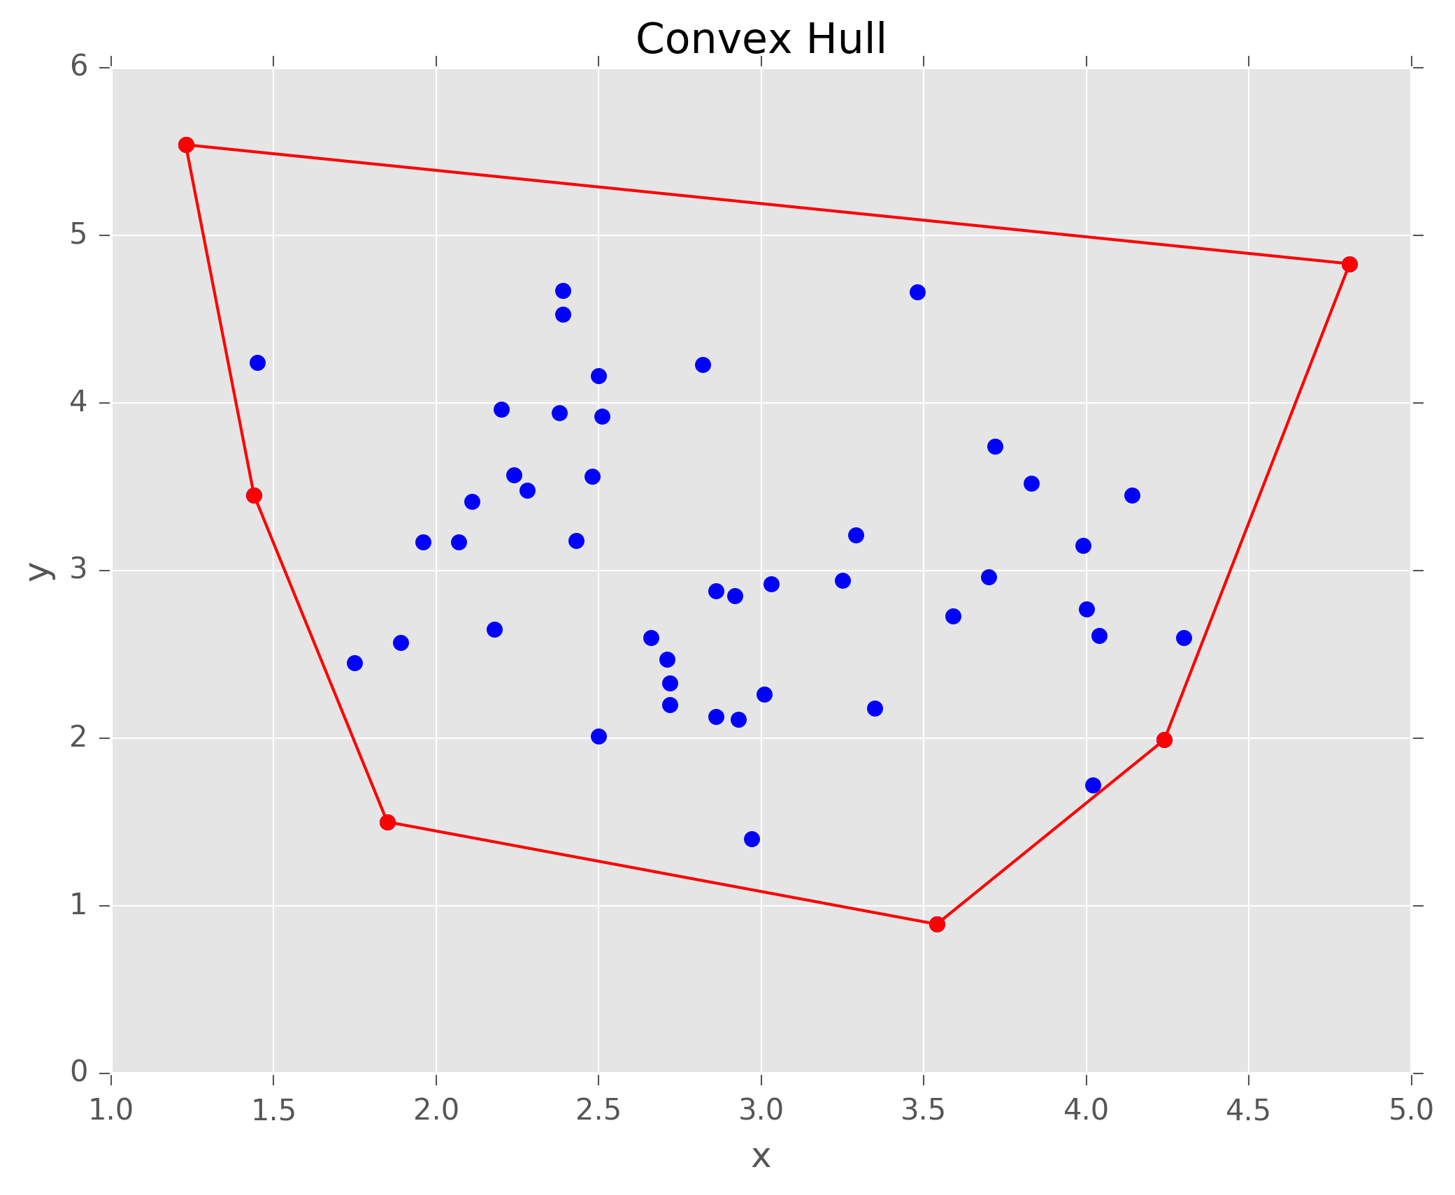
Convex Hull Exercise 2 Solution

Slide 14
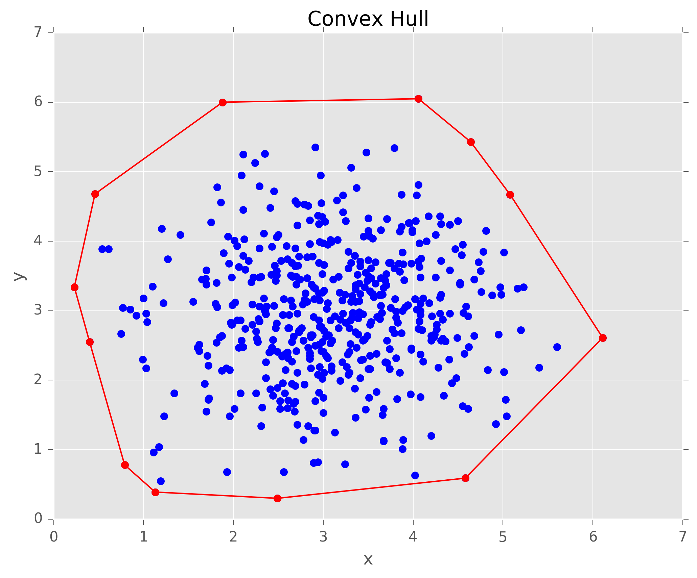
Convex Hull Exercise 3 Solution

Slide 15
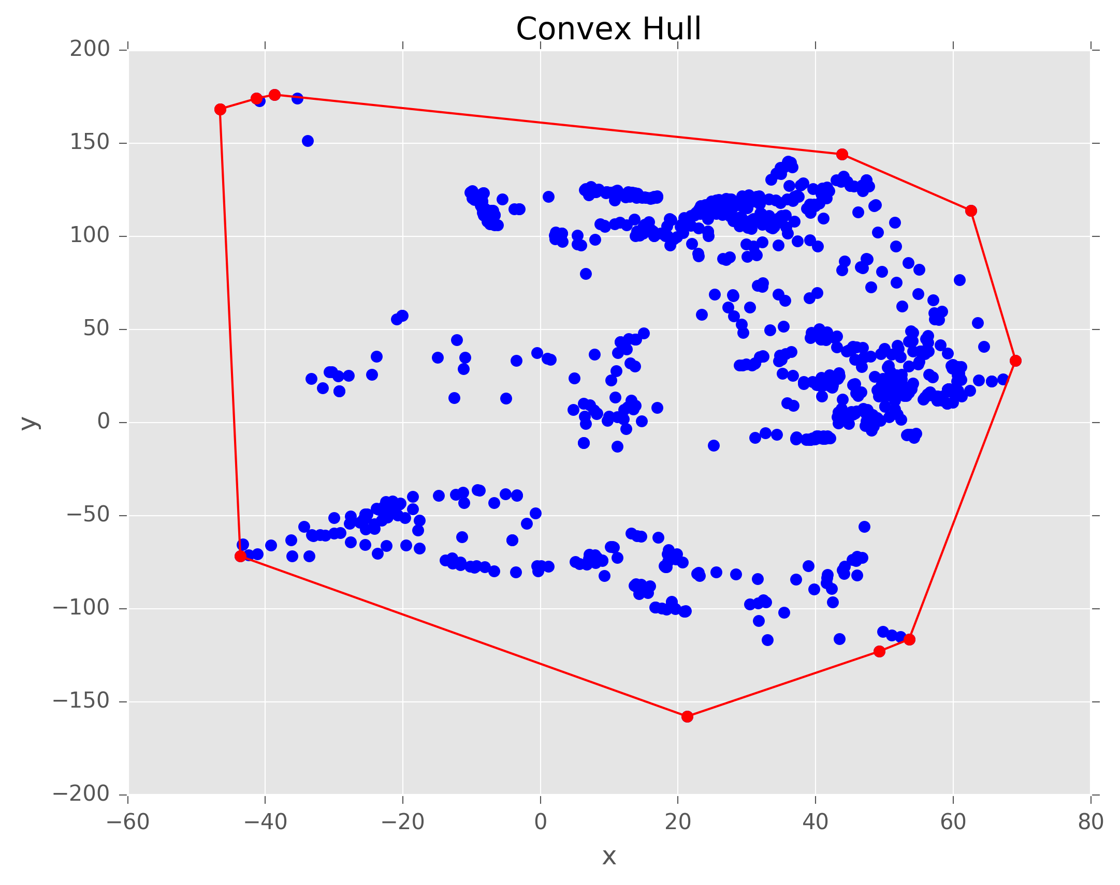
Convex Hull Exercise 4 Solution

Slide 16
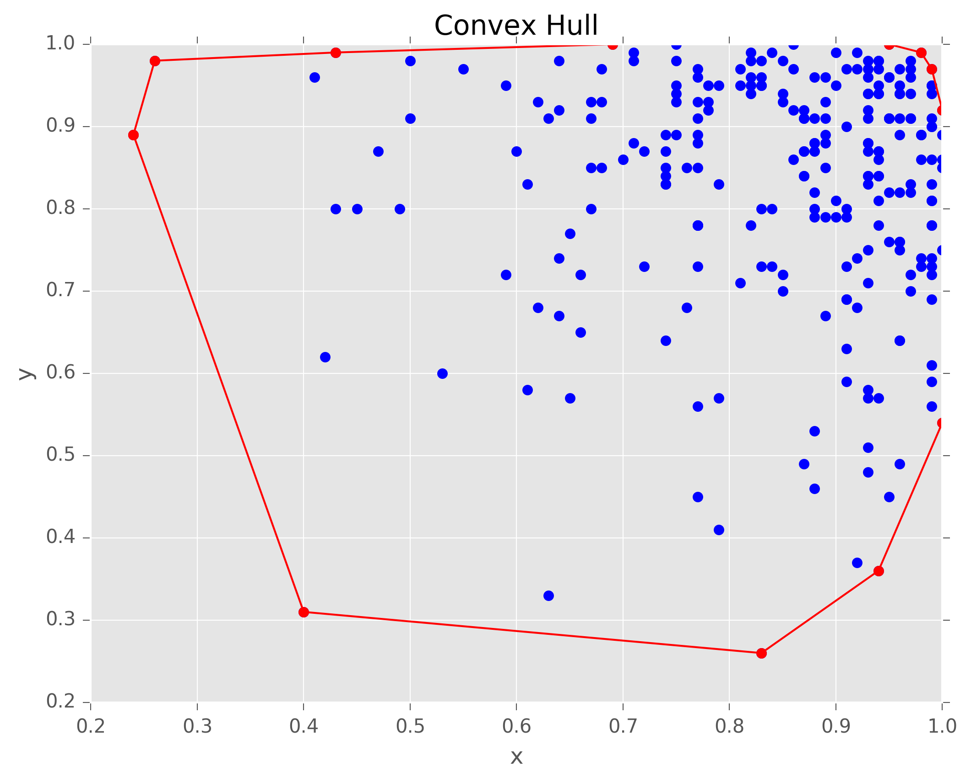
Convex Hull Exercise 5 Solution

Slide 17
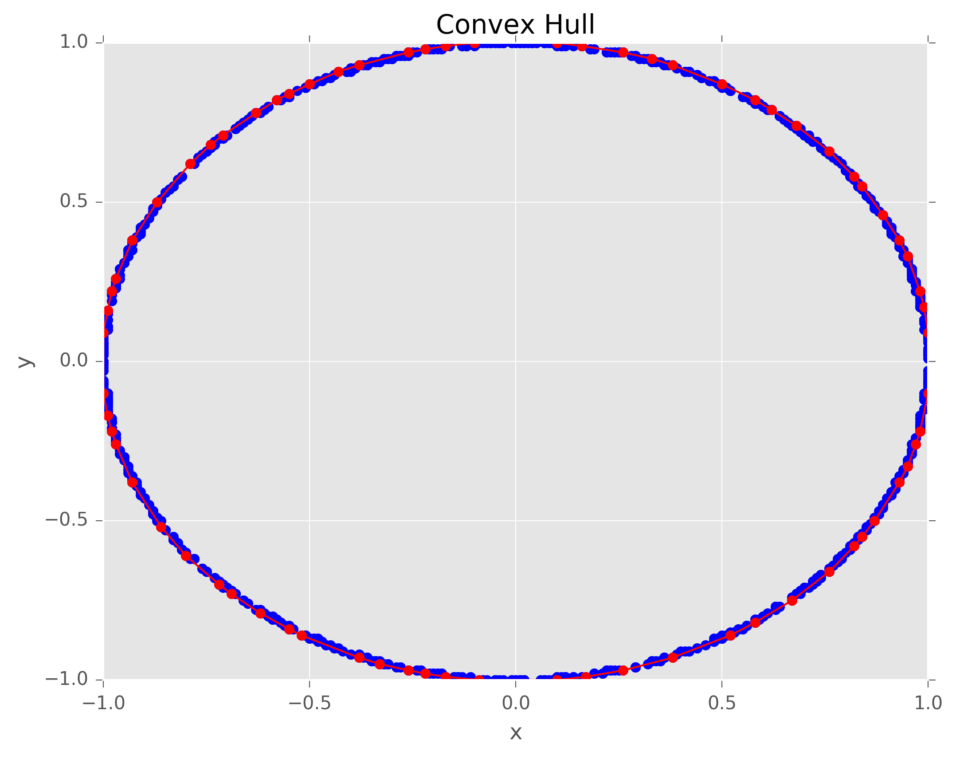
Convex Hull Exercise 6 Solution

Slide 18
Convex Hull Time it tool to run each exercise
Exercise-1.csv | Exercise-2.csv | Exercise-3.csv | Exercise-4.csv | Exercise-5.csv | Exercise-6.csv
11.40 s | 7.42 s | 7.62 s | 7.36 s | 7.30 s | 7.53 s
For all exercises the running time is less than 20 s which is pretty good
This is because the time complexity is big o (n*log*n)

