Slide 1


SMART INDIA HACKATHON 2024
TITLE PAGE
Problem Statement ID – SIH1673
Problem Statement Title- Farmers Disease Diagnostic/
Reporting Portal - Mobile
Portal Al Based
Theme- Agriculture, FoodTech &Rural Development
PS Category- Software
Team ID-28686
Team Name (Registered on portal)- plantDoctor

Slide 2
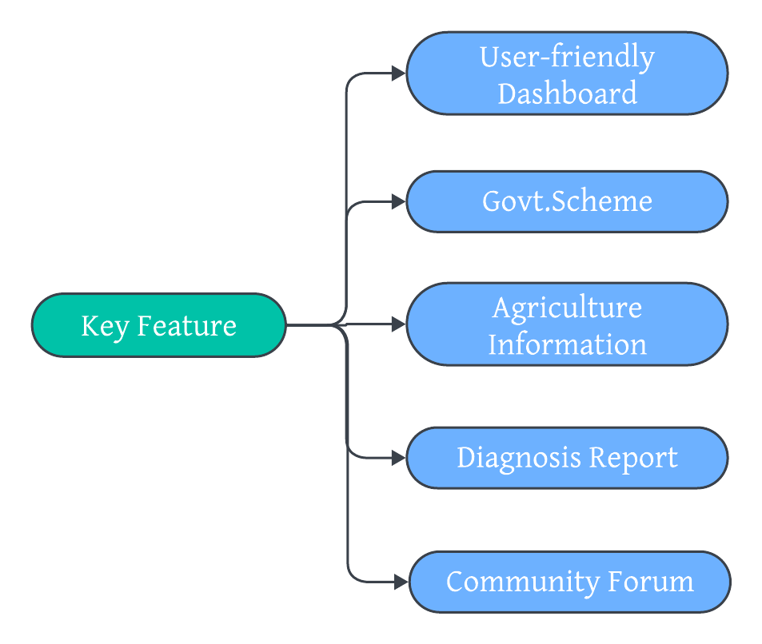
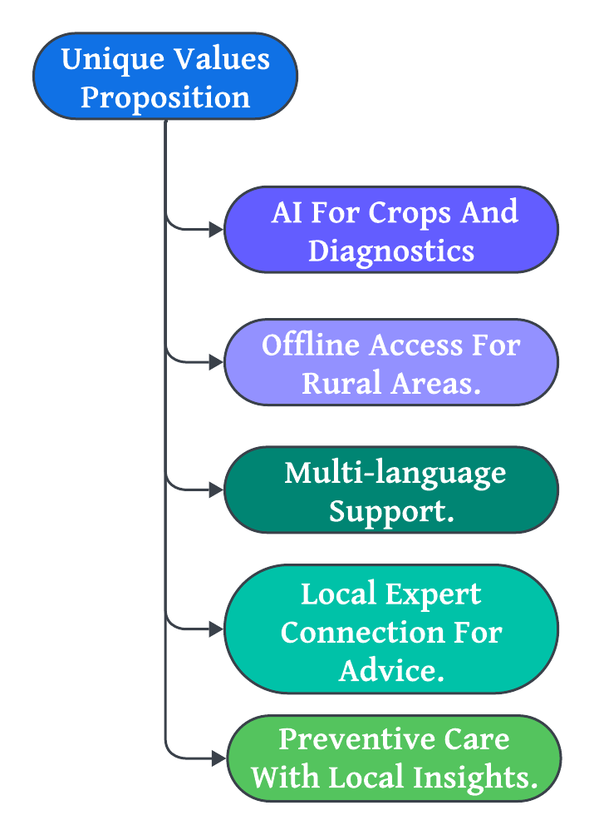
IDEA TITLE
plantDoctor
Proposed Solution (Describe your Idea/Solution/Prototype)
plantDoctor - Your AI-powered assistant for diagnosing and protecting crop health.
Benefits
Knowledge
Sharing
Promotes Sustainability
Reduce losses

Slide 3
TECHNICAL APPROACH
plantDoctor
Technologies to be used:
Frontend: HTML5, CSS3, JavaScript Backend: Node.js or Python AI Integration Database: SQLite or MongoDB
Working Prototype
Phase 1: Basic frontend with image upload functionality.
Phase 2: Backend setup with API integration for AI diagnosis.
Phase 3: Display diagnostic results and Allow for expert consultant
Image Upload from Mobile/Website
Send Image to Backend
AI API Processes Image
Display Results & Suggestions
Diagnosis & Report Generated
Methodology and Process for Implementation

Slide 4
FEASIBILITY AND VIABILITY
plantDoctor
Feasibility And Analysis
Technologically feasible using existing AI and mobile technologies.
Low-cost development with free-tier platforms and APIs.
User-friendly for smartphone-equipped farmers.
Challenges
Limited Internet Access in rural areas..
AI Accuracy issues with low-quality images.
Farmer Adoption of new technology.
Strategies
Offline Access for syncing data later.
Clear Image Guidelines to improve AI results.
Education & Support through workshops and tutorials.

Slide 5
IMPACT AND BENEFITS
Potential Impact :
Benefits:
Faster disease detection Expert advice for remote farmers. Empowers farmers with technology.
Social: Community support and knowledge sharing.Economic: Reduces losses, boosts profits. Environmental: Promotes sustainable farming
plantDoctor
Potential Impact and Benefits of s2s:

Slide 6
RESEARCH AND REFERENCES
plantDoctor
UC Davis Plant Sciences: Dataset of plant images and disease information.
FAO Crop Database: Global crop database for research and reference.
International Society for Precision Agriculture: Professional organization for precision agriculture.
Plantix-AI for plant Diagnosis: AI tools for crop diagnostics.

