Slide 1
Virtual Router
Savan Kiran
Jasmine Dhillon
Bhanu Prakash Meka

Slide 2
Overview
Enhance Router Security
By dividing responsibilities
Control OS (Monitors working of Router OS and helps in detecting attacks and recovering from them)
Router OS (Handles all the traditional responsibilities of a router)
Achieve virtualization on a commercial router

Slide 3
Xen
Architecture (why Xen?)
Source and Compilation (what is Xen?)
Build output (how Xen?)

Slide 4
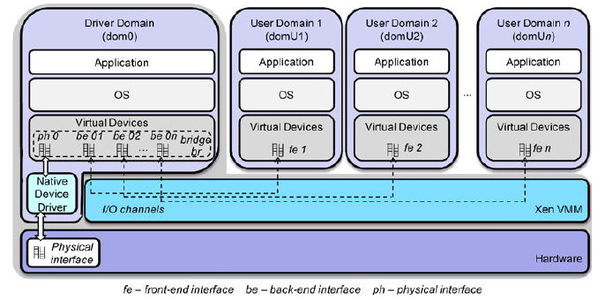
Xen - Architecture

Slide 5
Xen – Architecture contd.
Type-1 hypervisor (Bare metal)
Supports ARM architecture
Control & Data plane virtualization
Advanced interface between Driver and Guest domains
Open source

Slide 6
Xen - Source
Xen source code has 4 modules
Xen core
Main components of xen hypervisor – dom0, domU and driver stubs
Tools
Xen command line tools and interface between dom0 and domUs
Stubdom
(Extended feature) Instead of keeping all hardware drivers in dom0, move them to a separate stubdom for security reasons
Docs
Manual pages & other documents for Xen

Slide 7
Xen - Compilation
ARM cross-compilation
Necessary as the target hardware is different from host
Create a sandboxed environment
Using ‘sbuild’ and ‘schroot’
Install ARM32-eabi-hf toolchain
Compile Xen inside the sandbox
make dist CROSS_COMPILE=arm-linux-gnueabihf- XEN_TARGET_ARCH=arm32

Slide 8
Xen – Build output
Xen binaries
Xen config files
Can modify to adapt Xen to the hardware before actually installing Xen
Xen init scripts
Can modify to match the right boot sequence between Xen components and dom0
Xen libraries
Libraries necessary for Xen to work
Xen docs

Slide 9
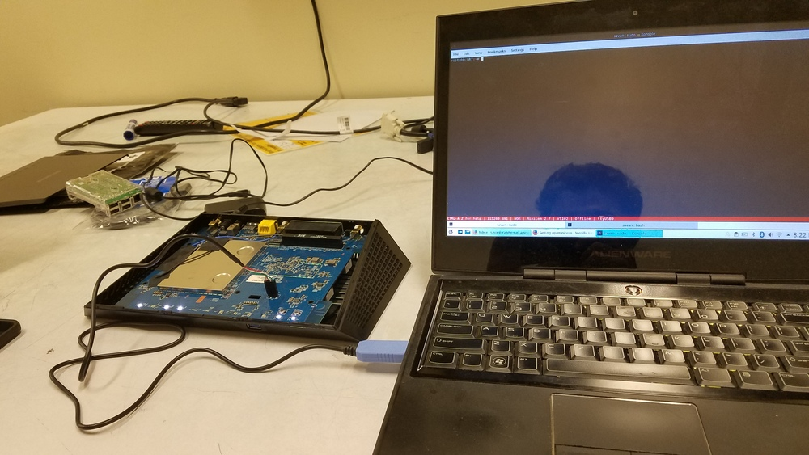
Netgear Nighthawk R7000 router

Slide 10
Netgear R7000 - Specification
CPU
Broadcom BCM4709A0 ARMv7 1GHz 2 core processor
Doesn’t support hardware virtualization
However, Xen supports para-virtualization
Memory
256 MB
Flash
128 MB
Stock DD-WRT image is ~20 MB
Xen compiled is ~7 MB
Sufficient space left for a DomU
Filesystem
Squash FS – Compressed, Read-only

Slide 11
Netgear R7000 – Specification contd.
Bootloader
Common Firmware Environment (CFE)
Written by Broadcom
Made open source recently
Has extended features to flash and control how a system boots
Serial Communication
Via USB-TTL (UART) cable
Allows to interact with the bootloader and observe boot sequence
Stock OS
DD-WRT (Linux based)
But provides no device-tree which Xen requires to understand the hardware

Slide 12
Netgear R7000 – Porting Xen
Xen output files are distributed in folders –
/boot
/etc
/usr
Problem 1: Xen can’t be added to router firmware directly
Because it has a read-only filesystem
Solution –
Re-compile DD-WRT from source along with Xen
Requires a steeper learning curve to compile DD-WRT
Or use firmware-mod-kit to extract, modify and rebuild firmware image
Simple and elegant way to modify firmware binary

Slide 13
Netgear R7000 – Flashing steps
Setup static IP on host
Start TFTP server on host
While booting, press ctrl-C to exit to CFE console
Pull image from TFTP server and flash
flash 192.168.1.104:output-firmware.bin flash0.trx

Slide 14
Netgear R7000 – Bootloader CRC check
Problem 2: CFE in DD-WRT does a CRC check for the authenticity of the image before flashing it
This prevents Man-In-The-Middle (MITM) attack by which an adversary can display his firmware as an authentic DD-WRT firmware to a naïve user
Solution –
Modify CFE to circumvent CRC check & re-flash
Problem 3: Modified CFE skipped the CRC check, but failed in the next step because of invalid header in the binary
Solution –
Understand why this is happening and fix the header
Use a different binary format
flash tool accepts .trx and .chk formats apart from .bin

Slide 15
Alternative hardware – Raspberry Pi
Why Raspberry Pi-3 a good choice ?
Meant for development environment, so no proprietary software
Specification
CPU -
1.2 GHz 64bit quad core ARMv8
Supports hardware virtualization
Memory – 1GB
Simple to bring up Debian OS on Pi
On the plus side, Debian supports Xen out-of-the-box
Unfortunately, we had a Raspberry Pi-2 with ARMv6
With no hardware virtualization and far inferior specification

Slide 16
Inference
Achieving type-1 virtualization on a commercial router –
Problems & possible solutions –
A lot of proprietary software to deal with
Fortunately, in the course of this project, we’ve solved most of these problems and very close to getting Xen on Netgear R7000 router
Little (and confusing) documentation on how to flash the hardware or bootloader
OpenWRT & DD-WRT development forums for the rescue. However, you still need a lot of time to go through all the ill maintained documents and posts

Slide 17
Inference contd.
Achieving type-1 virtualization on a commercial router –
Problems & possible solutions contd. –
Adapting Xen to the hardware is difficult
One of the first problem we encountered was - no device tree in DD-WRT. This complicates Xen’s work in understanding the underlying hardware
We’re guessing we would run into more such problems
Very difficult to port generic OS like Debian or Arch Linux because of hardware driver mismatch
If we could achieve this, Debian or Arch Linux support Xen out-of-the-box

Slide 18
Project Source and Documentation
https://bitbucket.org/SavanUA/virtual_router/
Documentation

Slide 19
Useful links
Xen Project Overview
OpenWRT - Netgear R7000 instructions
Xen ARM
Xen ARM Cross-compiling
Serial console wiki
Devicetree
Porting Xen on a new SOC
How to de-brick your Netgear R7000 router
DD-WRT development and firmware-mod-kit
CFE bootloader documentation

Slide 20
Reference
Egi, Norbert, et al. "Evaluating xen for router virtualization." Computer Communications and Networks, 2007. ICCCN 2007. Proceedings of 16th International Conference on. IEEE, 2007.
Anhalt, Fabienne, and Pascale Primet. Analysis and evaluation of a XEN based virtual router. Diss. INRIA, 2008.
Fernandes, Natalia C., et al. "Virtual networks: Isolation, performance, and trends." Annals of telecommunications-annales des télécommunications 66.5-6 (2011): 339-355.
Barham, Paul, et al. "Xen and the art of virtualization." ACM SIGOPS Operating Systems Review. Vol. 37. No. 5. ACM, 2003.
Bourguiba, Manel, Kamel Haddadou, and Guy Pujolle. "Evaluating and enhancing xen-based virtual routers to support real-time applications." 2010 7th IEEE Consumer Communications and Networking Conference. IEEE, 2010.
Bourguiba, Manel, Kamel Haddadou, and Guy Pujolle. "Evaluating Xen-based virtual routers performance." International Journal of Communication Networks and Distributed Systems 6.3 (2011): 268-282.

