Slide 1
Transaction
Chapter - 15

Slide 2
Transaction Concept
  Collections of operation that form a single logical unit of work is called as transaction
  A transaction is a unit of program execution that accesses and possibly updates various data items.
  Two main issues to deal with:
    Failures of various kinds, such as hardware failures and system crashes
    Concurrent execution of multiple transactions

Slide 3
ACID Properties
To preserve integrity of data, the database system must ensure:
1 Atomicity.
  Either all operations of the transaction are properly reflected in the database or none are.
  Transaction to transfer $50 from account A to account B:
    1. read(A)
    A := A – 50
    write(A)
    read(B)
    System crash
    5. B := B + 50
    write(B)

Slide 4
  read(A) – transfer data item A from database to buffer
  write(A) – transfer data item A from buffer to database
  Atomicity requirement — if the transaction fails after step 3 and before step 6, the system should ensure that its updates are not reflected in the database, else an inconsistency will result.
  Although system must be inconsistent at some point. But that state is replaced by consistent state
  Responsibility – Transaction management component

Slide 5
ACID Properties
  2 Durability.
  After a transaction completes successfully, the changes it has made to the database persist, even if there are system failures.
  Durability requirement — once the user has been notified that the transaction has completed (i.e., the transfer of the $50 has taken place), the updates to the database by the transaction must persist despite failures.
  Responsibility – Recovery management component

Slide 6
ACID Properties
  3 Consistency.
  Execution of a transaction in isolation preserves the consistency of the database.
  If transaction is consistent before ,transaction must be consistent after.
    Consistency requirement – the sum of A and B is unchanged by the execution of the transaction.
    Responsibility – application programmer

Slide 7
  4 Isolation.
  Although multiple transactions may execute concurrently, each transaction must be unaware of other concurrently executing transactions.
  Intermediate transaction results must be hidden from other concurrently executed transactions.
    That is, for every pair of transactions T_{i} and T_{j},
    T_{j} finished execution before T_{i} started, or T_{j} started execution after T_{i} finished.
    Isolation requirement — if between steps 3 and 6, another transaction is allowed to access the partially updated database, it will see an inconsistent database ie A + B will be less
    Can be ensured by running transactions serially.
    Responsibility – Concurrency Control component

Slide 8
Transaction State
Active
  Initial state; the transaction stays in this state while it is executing
Partially committed
  after the final statement has been executed.
Failed
  after the discovery that normal execution can no longer proceed.
Aborted
  Transaction may not always complete its execution successfully which is called as aborted and Changes are undone and is called as rolled back
  after the transaction has been rolled back and database is restored to its prior state , at that system has two options :
    restart the transaction – if some hardware or software error
    kill the transaction – logical error. Rewrite application program

Slide 9

Transaction State
Committed
  after successful completion
  Committed transaction takes database to new consistent state
  Transaction is said to be terminated if it has either committed or aborted

Slide 10
Transaction State
  We must be cautious when dealing with observable external writes ie on terminal or printer
  If write occurs it cannot be erased.
  So for that allow writes only after transaction has entered committed state.
  One way is to implement scheme is store data temporary and to perform the actual write only after the transaction enters the committed state.

Slide 11
Implementation of Atomicity and Durability
  The recovery-management component can support atomicity and durability as follows:
The shadow-copy scheme:
  assume that only one transaction is active at a time.
  a pointer called db_pointer always points to the current consistent copy of the database.
  When transaction wants to update, it creates copy of database
  It performs updates on new copy, leaving original copy unchanged
  If transaction has to be aborted, system deletes new copy

Slide 12
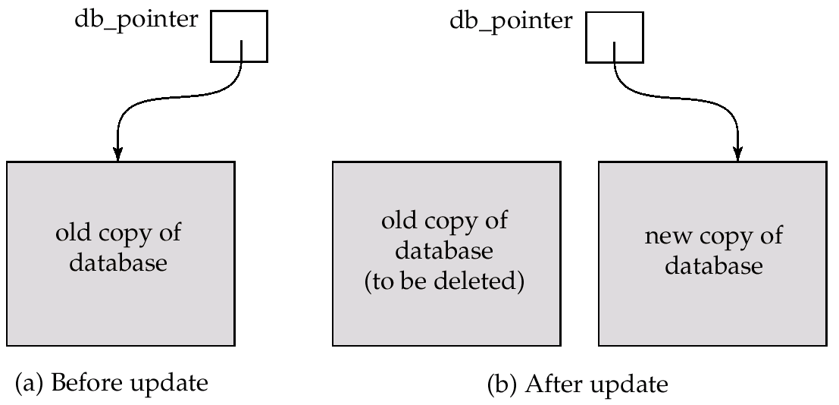
Implementation of Atomicity and Durability (Cont.)
  If transaction completes, it is committed as follows:
    Write all pages of new copy to disk
    Update db_pointer to point to new copy. This new copy becomes current copy of database
    Old copy is deleted
  Transaction is said to be committed when updated db_pointer is written to disk

Slide 13
Implementation of Atomicity and Durability
Handling of transaction and system failure:
  If transaction fails before db_pointer is updated, abort transaction by deleting new copy
  If system fails before updated db_pointer written to disk. When system will restart it will get old contents of database
  If system fails after db_pointer is written to disk then it will take new copy of database
  Write operation of db_pointer should be atomic(either write whole db_pointer or none)
  If some of the bytes of the pointer were updated by the write, but others were not, the pointer is meaningless, and neither old nor new versions of the database may be found when the system restarts.

Slide 14
  Thus, the atomicity and durability properties of transactions are ensured by the shadow-copy implementation of the recovery-management component.
Disadvantage:
  Inefficient: single transaction requires copy of entire database
  Does not allow concurrent transactions

Slide 15
Concurrent Executions
  Multiple transactions are allowed to run concurrently in the system.
  Advantages/reasons of concurrency are:
  increased processor and disk utilization
    CPU activity and I/O system can operate parallel for different transaction.
    leading to better transaction throughput: one transaction can be using the CPU while another is reading from or writing to the disk. And thus processor and disk spend less time idle.
  reduced average response time/waiting time for transactions:
    short transactions need not wait behind long ones if the transaction run serially.
    If the transaction on different part of database then it better to run concurrently. Because it reduce the delays in running transaction.

Slide 16
  Concurrency control schemes : - / E.g of Concurrent concurrent execution.
E.g
  Consider the bank have severel accounts and a set of transactions that access and update those accounts.
  Let T1 and T2 be two transactions that transfer funds from one account to another
  Transaction T1 transfers $50 from account A to account B.

Slide 17
    T1 read(A)
    A := A – 50
    write(A)
    read(B)
    B := B + 50
    write(B)
  Transaction T2 transfers 10 percent of the balance from account A to account B. It is defined as
  T2 : read(A);
  temp := A * 0.1;
  A := A − temp;
  write(A);
  read(B);
  B := B + temp;
  write(B).

Slide 18
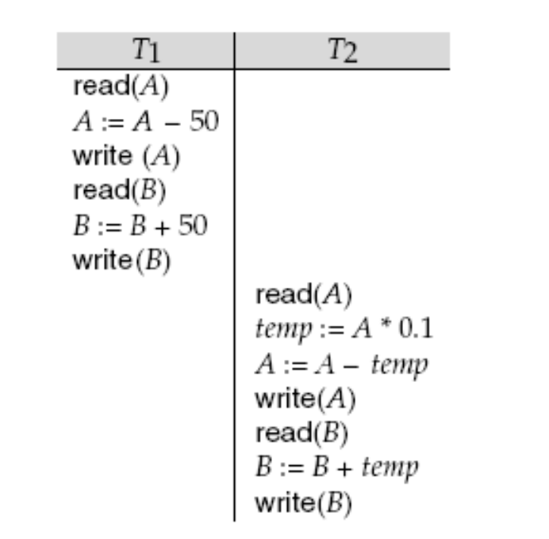
  Current balance of A is 1000. and B is 2000
  two transactions are executed one at a time in the order T1 followed by T2.
  Fig. Schedule -1 serial schedule T1 followed by T2

Slide 19
  A and B—that is, the sum A + B—is preserved after the execution of both transactions.
  As A = 855 and B = 2145 rs.
  A+B = 3000

Slide 20
Schedules
Schedules
  sequences that indicate the chronological order in which instructions/operations of concurrent transactions are executed.
  A schedule for a set of transactions must consist of all instructions of those transactions.
  must preserve the order in which the instructions appear in each individual transaction.

Slide 21

Example Schedules
  Let T₁ transfer $50 from A to B, and T₂ transfer 10% of the balance from A to B. The following is a serial schedule (Schedule 1 in the text), in which T1 is followed by T2.

Slide 22
  Schedule 1 is called the serial.
  where the instructions belonging to one single transaction appear together in that schedule.
  When the database system executes several transactions concurrently, the corresponding schedule no longer needs to be serial.
  If two transactions are running concurrently,the operating system may execute one transaction for a little while, then perform a context switch, execute the second transaction for some time, and then switch back to the first transaction for some time,

Slide 23

Example Schedule (Cont.)
  Let T₁ and T₂ be the transactions defined previously. The following schedule (Schedule 3) is not a serial schedule, but it is equivalent to Schedule 1. (A+B) = 855+2145 = 3000
A=1000
A= 1000-50
A=950
A=950
Temp=95
A=950-95
A=855
B=2000
B=2000+50
B=2050
B=2050
B=2050+95
B=2145
In both Schedule 1 and 3, the sum A + B is preserved.

Slide 24

  Not all concurrent executions result in a correct state. The following concurrent schedule (Schedule 4 in the text) does not preserve the value of the the sum A + B.
  A=1000
A=1000
Temp=100
A=1000-100 = 900
B=2000
A=950
B=2000
B = 2000+50 = 2050
B=2050
B = 2000+100 = 2100
B=2100

Slide 25
  A = 950 and B = 2100 so total A+ B = 3050

Slide 26
Serializability
  Basic Assumption – Each transaction preserves database consistency.
  Thus serial execution of a set of transactions preserves database consistency.
  A (possibly concurrent) schedule is serializable if it is equivalent to a serial schedule. Different forms of schedule equivalence give rise to the notions of:
    1. conflict serializability
    2.view serializability
  for simplified schedules consist of only read and write instructions.

Slide 27
Conflict Serializability
  Instructions l_{i} and l_{j} of transactions T_{i} and T_{j} respectively, conflict if and only if there exists some item Q accessed by both l_{i} and l_{j}, and at least one of these instructions wrote Q.
  1. l_{i} = read(Q), l_{j} = read(Q). l_{i} and l_{j} don’t conflict.
  2. l_{i} = read(Q), l_{j} = write(Q). They conflict.
  3. l_{i} = write(Q), l_{j} = read(Q). They conflict
  4. l_{i} = write(Q), l_{j} = write(Q). They conflict
  Intuitively, a conflict between l_{i} and l_{j} forces a (logical) temporal order between them.
  If l_{i} and l_{j} are consecutive in a schedule and they do not conflict, their results would remain the same even if they had been interchanged in the schedule.

Slide 28
Conflict Serializability (Cont.)
  If a schedule S can be transformed into a schedule S´ by a series of swaps of non-conflicting instructions, we say that S and S´ are conflict equivalent.
  We say that a schedule S is conflict serializable if it is conflict equivalent to a serial schedule
  Example of a schedule that is not conflict serializable:
  T₃ T₄
  read(Q)
  write(Q)
  write(Q)
  We are unable to swap instructions in the above schedule to obtain either the serial schedule < T₃, T₄ >, or the serial schedule < T₄, T₃ >.

Slide 29

Conflict Serializability (Cont.)
  Schedule 3 below can be transformed into Schedule 1, a serial schedule where T₂ follows T₁, by series of swaps of non-conflicting instructions. Therefore Schedule 3 is conflict serializable.
A=950
B=2050
A=950
A=950
A=855
A=950
A=855
B=2050
B=2145
b=2000
B=2050
b=2050
B=2145

Slide 30
View Serializability
  Let S and S´ be two schedules with the same set of transactions.
  S and S´ are view equivalent if the following three conditions are met:
  1. For each data item Q, if transaction T_{i} reads the initial value of Q in schedule S, then transaction T_{i} must, in schedule S´, also read the initial value of Q.
  2. For each data item Q if transaction T_{i} executes read(Q) in schedule S, and that value was produced by transaction T_{j} (if any), then transaction T_{i} must in schedule S´ also read the value of Q that was produced by transaction T_{j} .
  3. For each data item Q, the transaction (if any) that performs the final write(Q) operation in schedule S must perform the final write(Q) operation in schedule S´.

Slide 31
Ti -S | Tj
 | Write(Q)
Read(Q) Write(Q) | Read(Q)
Ti-S’ | Tj
 | Write(Q) Dfjlsjfd
Read(Q) Sdfds Sdf Write(Q) | Sdfsd

Slide 32
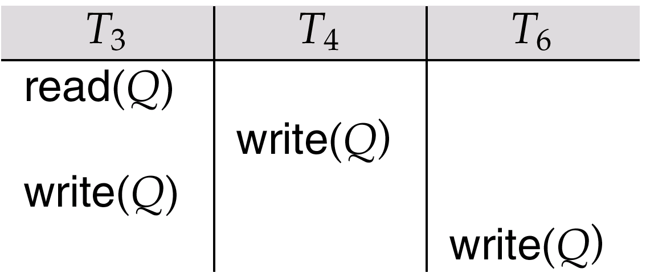
View Serializability (Cont.)
  A schedule S is view serializable it is view equivalent to a serial schedule.
  Every conflict serializable schedule is also view serializable.
  Schedule 9 (from text) — a schedule which is view-serializable but not conflict serializable.
  Every view serializable schedule that is not conflict serializable has blind writes.

Slide 33
T₃ T₄
read(Q)
write(Q)
write(Q)

Slide 34
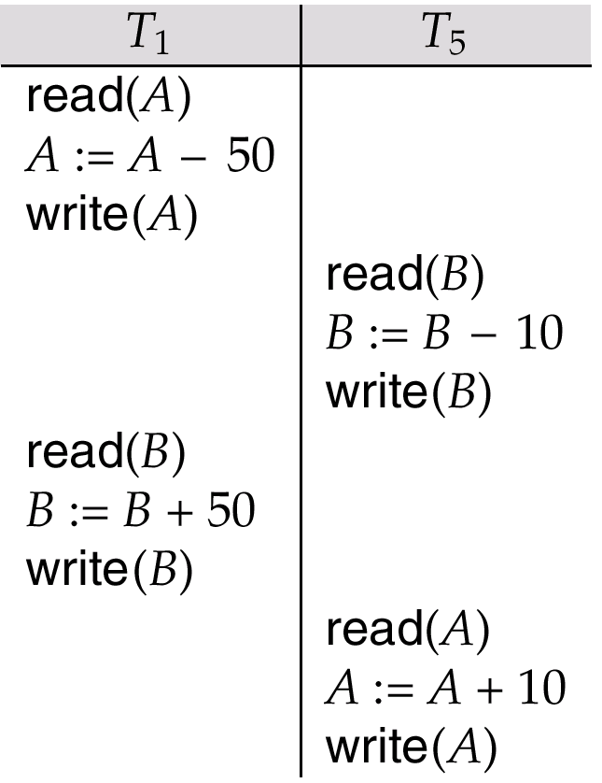
Other Notions of Serializability
  Schedule 8 (from text) given below produces same outcome as the serial schedule < T₁, T₅ >, yet is not conflict equivalent or view equivalent to it.
Determining such equivalence requires analysis of operations other than read and write.

Slide 35
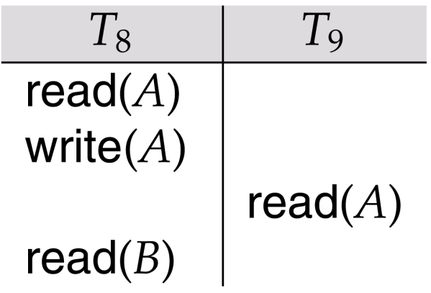
Recoverability
Need to address the effect of transaction failures on concurrently
running transactions.
Recoverable schedule —
  if a transaction T_{j} reads a data items previously written by a transaction T_{i} , the commit operation of T_{i} appears before the commit operation of T_{j}.
  The following schedule (Schedule 11) is not recoverable if T₉ commits immediately after the read
If T₈ should abort, T₉ would have read (and possibly shown to the user) an inconsistent database state. Hence database must ensure that schedules are recoverable.
950

Slide 36
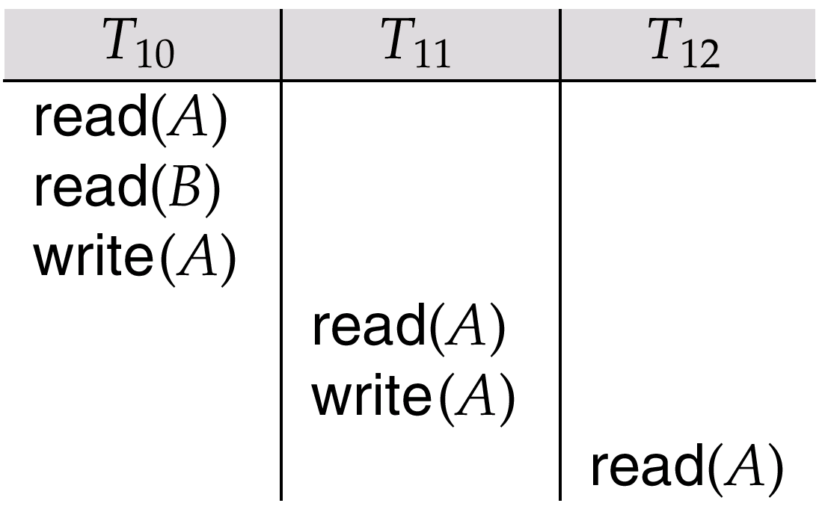
Recoverability (Cont.)
Cascading rollback
  a single transaction failure leads to a series of transaction rollbacks. Consider the following schedule where none of the transactions has yet committed (so the schedule is recoverable)
  If T₁₀ fails, T₁₁ and T₁₂ must also be rolled back.
  Can lead to the undoing of a significant amount of work

Slide 37
End of Chapter

Slide 38
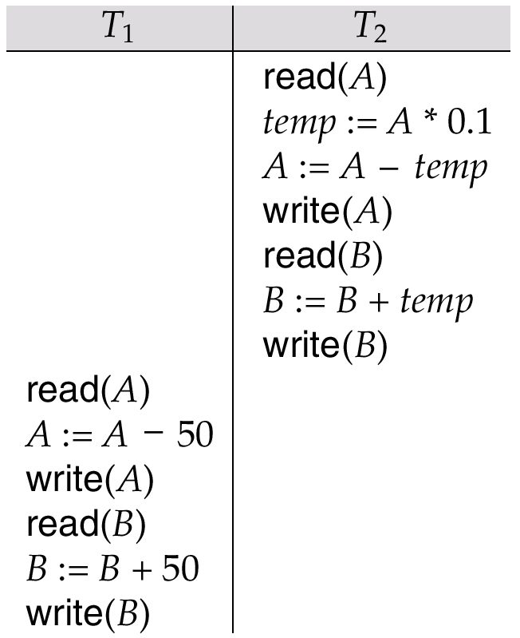
Schedule 2 -- A Serial Schedule in Which
T₂ is Followed by T₁

Slide 39
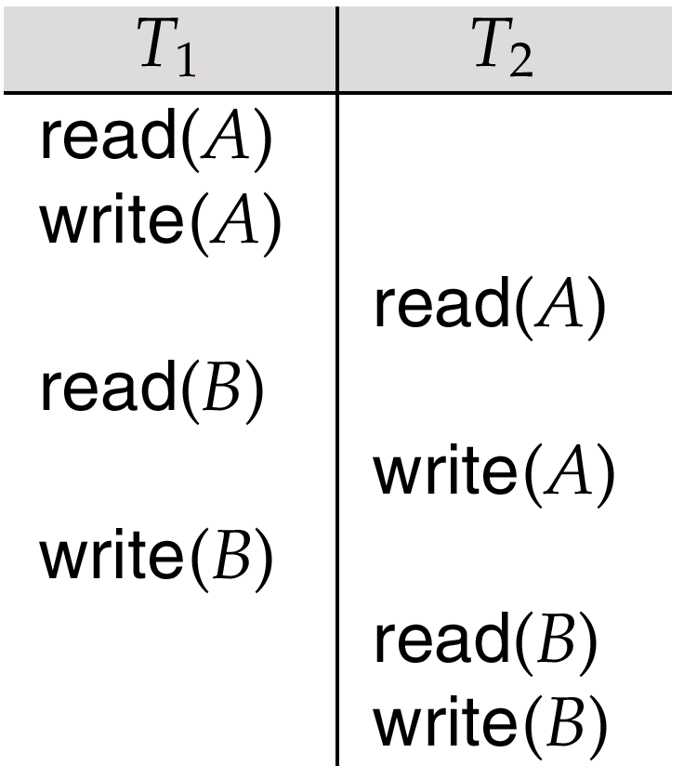
Schedule 5 -- Schedule 3 After Swapping A Pair of Instructions

Slide 40
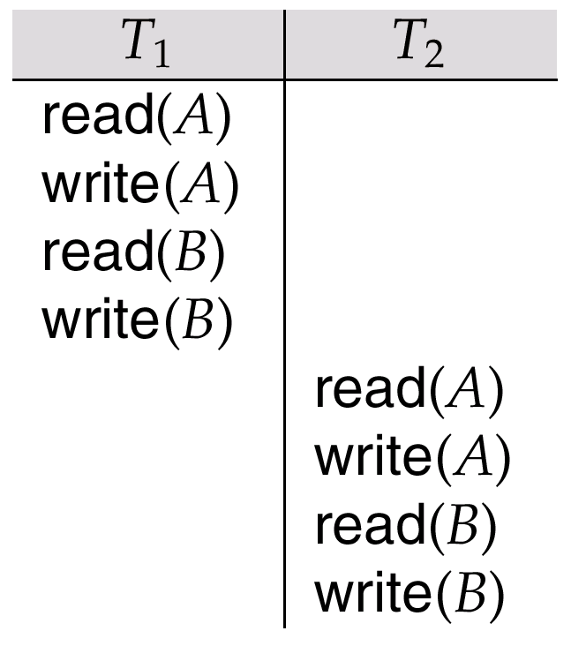
Schedule 6 -- A Serial Schedule That is Equivalent to Schedule 3

