Slide 1
Relational Model
Chapter -3

Slide 2
Chapter 3: Relational Model
Structure of Relational Databases
Relational Algebra
Modification of the Database
Views

Slide 3

Example of a account Relation

Slide 4

The branch Relation

Slide 5

The customer Relation

Slide 6

The depositor Relation

Slide 7

The loan Relation

Slide 8

The borrower Relation

Slide 9
Basic Structure
  Database consists of tables.
  Each table is contain a attribute.
  And each attribute has a set of permitted values called the domain of attribute.
  D1,D2.. D3 is attribute domain of table .
  D1 → set of acc_no , D2 → branch_name , D3→ balance
  Then any row of account table must consist of value(v1,v2,v3) where v1 ∈ D1, v2 ∈D2 ,v3 ∈ D3

Slide 10
  Formally, given sets D₁, D₂, …. D_{n} a relation r is a subset of
  D₁ x D₂ x … x D_{n}
  Thus a relation is a set of n-tuples (a₁, a₂, …, a_{n}) where
  each a_{i} ∈ D_{i}
  Example: if
  customer-name = {Jones, Smith, Curry, Lindsay}
  customer-street = {Main, North, Park}
  customer-city = {Harrison, Rye, Pittsfield}

Slide 11
    Then r = { (Jones, Main, Harrison),
    (Smith, North, Rye),
    (Lindsay, Park, Pittsfield)}
    is a relation over customer-name x customer-street x customer-city
    If tuple variable t is refer to the first tuple of relation the notation t[acc_no] represent A101. same
    t[1] represent value of first attribute in the first tuple.

Slide 12
Attribute Types
  Attribute values are (normally) required to be atomic, that is, indivisible
    (each attribute contain a one value for one tuple)
    E.g. multivalued attribute values are not atomic
    E.g. composite attribute values are not atomic
  The special value null is a member of every domain
  The null value causes complications in the definition of many operations

Slide 13
Relation Schema
  A₁, A₂, …, A_{n} are attributes
  R = (A₁, A₂, …, A_{n} ) is a relation schema
  E.g. Customer-schema =
  (customer-name, customer-street, customer-city)
  r(R) is a relation on the relation schema R
  E.g. customer (Customer-schema)

Slide 14
Relation Instance
  The current values (relation instance) of a relation are specified by a table
  An element t of r is a tuple, represented by a row in a table
attributes
(or columns)
customer-name
customer-street
customer-city
Jones
Smith
Curry
Lindsay
Main
North
North
Park
Harrison
Rye
Rye
Pittsfield
tuples
(or rows)
customer
  Order of tuples is irrelevant (tuples may be stored in an arbitrary order)

Slide 15
Database
  A database consists of multiple relations
  Information about an enterprise is broken up into parts, with each relation storing one part of the information
  E.g.: account : stores information about accounts
  depositor : stores information about which customer owns which account
  customer : stores information about customers
  Storing all information as a single relation such as
  bank(account-number, balance, customer-name, ..)

Slide 16
  results in
    repetition of information (e.g. two customers own an account)
  the need for null values (e.g. represent a customer without an account)

Slide 17
Relational Algebra
  Procedural language
  Six basic operators
    select
    project
    union
    set difference binary operation
    Cartesian product
    Rename unary operation
  The operators take one or more relations as inputs and give a new relation as a result.
Unary operation

Slide 18
Select Operation
  It select tuples that satisfy a given predicate.
  Notation: σ _{p}(r)
  p is called the selection predicate
  Defined as:
  where p is a formula in propositional calculus consisting of terms connected by ∧ (and), ∨ (or), ¬ (not)
  Each term is one of
  <attribute> op <attribute> or <constant>
  where op is one of: =, ≠, >, ≥. <. ≤
  Example of selection:
  Select the tuples from account which are from branch perryidge.
  σ _{branch-name=“Perryridge”}(account)

Slide 19
Dispplay tuple having balance > 500
σ _{balance>500}(account)

Slide 20
Select Operation – Example
Relation r
A
B
C
D
α
α
β
β
α
β
β
β
1
5
12
23
7
7
3
10
σ_{A=B ^ D > 5} (r)
A
B
C
D
α
β
α
β
1
23
7
10

Slide 21
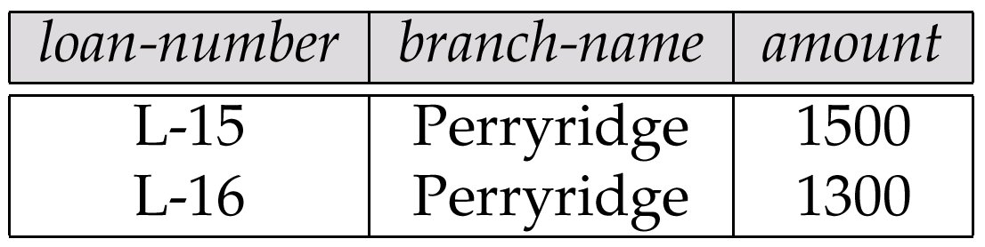
Loan information having in branch perryridge account >1200
Result of σ branch-name = “Perryridge” ^ amount >1200 (loan)

Slide 22
Project Operation
  Notation:
  ∏_{A1, A2, …, Ak} (r)
  where A₁, A₂ are attribute names and r is a relation name.
  The result is defined as the relation of k columns obtained by erasing the columns that are not listed
  Duplicate rows removed from result, since relations are sets
  E.g. To eliminate the branch-name attribute of account
  ∏_{account-number, balance} (account)
  select account-number,balance from account;

Slide 23
Project Operation – Example
A
B
C
Relation r:
α
α
β
β
10
20
30
40
1
1
1
2
A
C
A
C
∏_{A,C} (r)
α
α
β
β
1
1
1
2
α
β
β
1
1
2
=

Slide 24
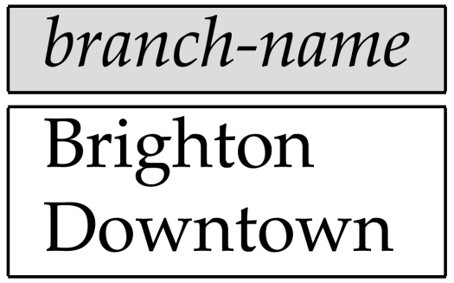
find the branch name who have branch in city brooklyn
Π_{branch-name}(σ_{branch-city =} “_{Brooklyn}”^{(branch))} σ_{branch-city =} “_{Brooklyn}”^{(branch)}
Π_{branch-name}⁽σ_{branch-city =} “_{Brooklyn}”^{(branch)}

Slide 25
Display customername who lives in stampford
Sigma customer-city=“stampford”(customer)
Pi _{customer-name} (Sigma _{customer-city=“stampford”}(customer)

Slide 26
Union Operation
  Notation: r ∪ s
  Defined as:
  r ∪ s = {t | t ∈ r or t ∈ s}
  For r ∪ s to be valid.
  1. r, s must have the same arity (same number of attributes)
  2. The attribute domains must be compatible (e.g., 2nd column
  of r deals with the same type of values as does the 2nd column of s)

Slide 27
Union Operation – Example
A
B
A
B
α
α
β
1
2
1
α
β
2
3
  Relations r, s:
s
r
r ∪ s:
A
B
α
α
β
β
1
2
1
3

Slide 28
  Duplication is avoided(duplicate row are eliminate)
  E.g. to find all customers name with either an account or a loan
  ∏_{customer-name} (depositor) ∪ ∏_{customer-name} (borrower)

Slide 29
Set Difference Operation
  It allow to find tuples that are in one relation but not in another.
  Notation r – s
  Defined as:
  r – s = {t | t ∈ r and t ∉ s}
  that is tuples in r but not in s.
  Set differences must be taken between compatible relations.
    r and s must have the same arity
    attribute domains of r and s must be compatible

Slide 30
Set Difference Operation – Example
A
B
A
B
α
α
β
1
2
1
α
β
2
3
s
r
Relations r, s:
r – s:
A
B
α
β
1
1

Slide 31
Find the customer name who have account in bank but not taken any loan.
Π_{customer-name}(depositor) - Π_{customer-name} (borrower)
Customer-name
Johnson
Lindsay
Turner

Slide 32
Find the names of all customers who have a loan at the Perryridge branch but do not have an account at any branch of the bank.
∏_{customer-name} (σborrower.loan-number = loan.loan-number
(σ_{branch-name = “Perryridge”}(borrower x loan))) –
∏_{customer-name}(depositor)

Slide 33
Cartesian-Product Operation
  It allows to combine information from any two relation.
  Notation r x s
  Defined as:
  r x s = {t q | t ∈ r and q ∈ s}
  Assume that attributes of r(R) and s(S) are disjoint. (That is, R ∩ S = ∅).
  If attributes of r(R) and s(S) are not disjoint, then renaming must be used.

Slide 34
Cartesian-Product Operation-Example
A
B
C
D
E
Relations r, s:
α
β
1
2
α
β
β
γ
10
10
20
10
a
a
b
b
r
s
r x s:
A
B
C
D
E
α
α
α
α
β
β
β
β
1
1
1
1
2
2
2
2
α
β
β
γ
α
β
β
γ
10
10
20
10
10
10
20
10
a
a
b
b
a
a
b
b

Slide 35
Composition of Operations
  Can build expressions using multiple operations
  Example:
  σ_{A=C}(r x s)
  r xs
  σ_{A=C}(r x s)
A
B
C
D
E
α
α
α
α
β
β
β
β
1
1
1
1
2
2
2
2
α
β
β
γ
α
β
β
γ
10
10
20
10
10
10
20
10
a
a
b
b
a
a
b
b
A
B
C
D
E
α
β
β
1
2
2
α
β
β
10
10
20
a
a
b

Slide 36
  If the relation schema for r = borrower X loan then
  It conatinas all attributes of borrower and loan
  [ borrwer.customer_name , borrower.loan_no, loan.loan_no, loan.branch_name, loan.amount]
  E.G Find the name of all customer who have a loan at the perryridge branch
  σ _{branch-name=“Perryridge”}(branchXloan)

Slide 37
  Assume that we have n1 tuples in borrower and n2 tuples in loan. Then, there are
  n1 ∗ n2 ways of choosing a pair of tuples—one tuple from each relation; so there are n1 ∗ n2 tuples in r
  In general, if we have relations r1(R1) and r2(R2), then r1 × r2 is a relation whose
  schema is the concatenation of R1 and R2.

Slide 38
  relation schema for r = borrower × loan, we construct a tuple of r out of each possible pair of tuples: one from the borrower relation and one from the loan relation

Slide 39
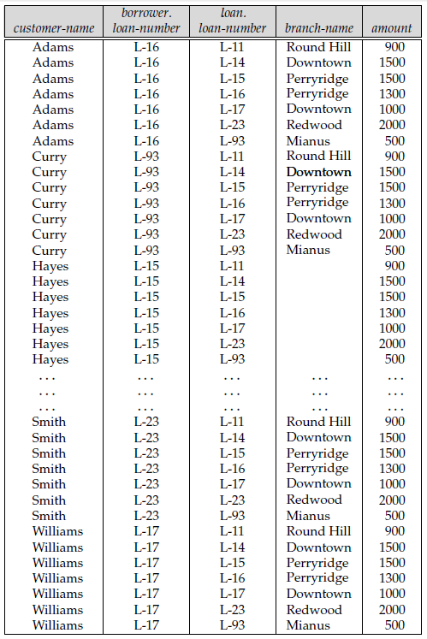

Slide 40
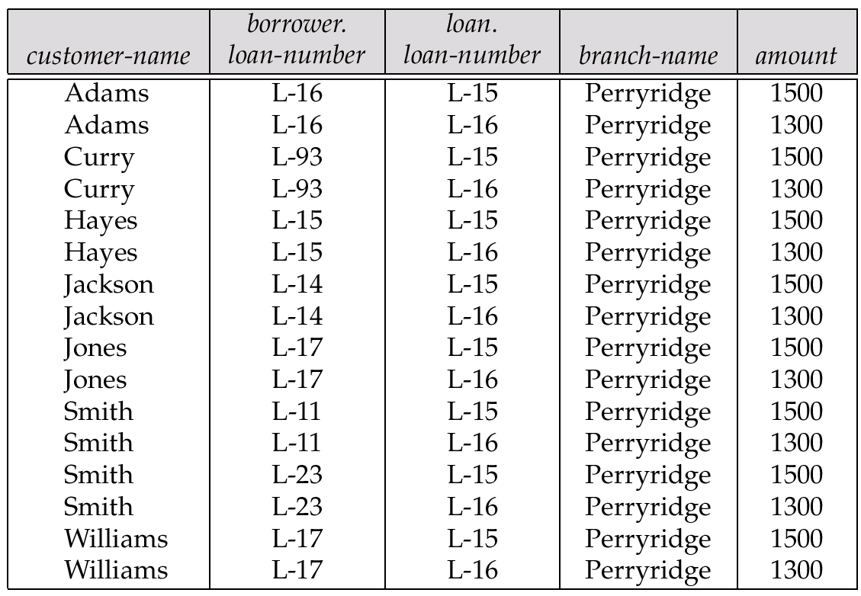
σ_{branch-name =“Perryridge”(}borrower × loan)
Cartesian product with condition

Slide 41
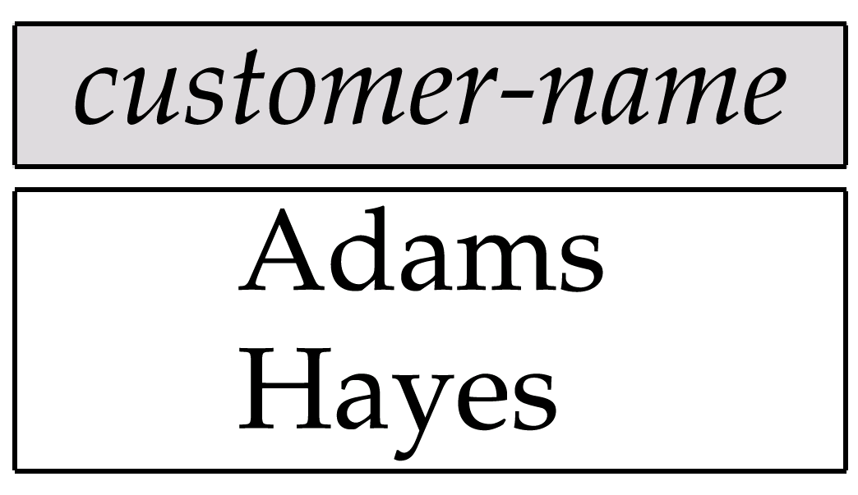
  (σ borrower.loan_number=loan.loan_number(σ _{branch-name=“Perryridge”}(borrowerXloan)) → will give all the attributes .
of cartesian product
  Π_{customer-name} (σ borrower.loan_number=loan.loan_number(σ _{branch-name=“Perryridge”}(borrowerXloan))

Slide 42
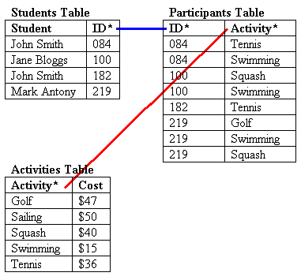
E.G 2 id is primary key
In student table
Activity is primary key
In activity table

Slide 43
Find the name students who has participate in activity swimming
  (student X participant) show all the combination of records and fields it contains is
  (student.student,student.ID,participant.activity,participant.id)

Slide 44
(studentXparticipant)
Student.student | Student.ID | Participant.id | Participant.activity
John Smith | 084 | 084 | tennis
John Smith | 084 | 084 | swimming
John Smith | 084 | 100 | sqaush
John Smith | 084 | 100 | swimming
John Smith | 084 | 182 | tennis
John Smith | 084 | 219 | golf
John Smith | 084 | 219 | Swimming
John Smith | 084 | 219 | sqaush

Slide 45
σ participant.activity=”swimming”^{(student x participant)}
student | studentID | Participant.id | Participant.activity
John smith | 084 | 084 | swimming
John smith | 084 | 100 | swimming
John smith | 084 | 219 | Swimming
Jane Blogge | 100 | 084 | swimming
Jane Blogge | 100 | 100 | swimming
Jane Blogge | 100 | 219 | Swimming
John smith | 182 | 084 | swimming
John smith | 182 | 100 | swimming
John smith | 182 | 219 | Swimming
Mark antony | 219 | 084 | swimming
Mark antony | 219 | 100 | swimming
Mark antony | 219 | 219 | Swimming

Slide 46
σ _{student.ID=participant.ID}
(σ participant.activity=”swimming”^{(student x participant)})
Π_{student.student}(σ _{student.ID=participant.ID}
(σ participant.activity=”swimming”^{(student x participant)}))
student | studentID | Participant.id | Participant.activity
John smith | 084 | 084 | swimming
Jane Blogge | 100 | 100 | swimming
Mark antony | 219 | 219 | Swimming

Slide 47
Rename Operation
  Allows us to give a name to the results of relational-algebra expressions.
  Allows us to refer to a relation by more than one name.
  Notation: ρ _{x} (E)
  returns the expression E under the name X
  If a relational-algebra expression E has arity n, then ρ_{x} _{(A1, A2, …, An)} (E)
  returns the result of expression E under the name X, and with the
  attributes renamed to A1, A2, …., An.

Slide 48
ρ _{stud_part} (studentxpraticipant)
Stud_part is then name student x participant
ρ stud_part(stud_name,stud_id,part_id,part_activity) (stude
ntxpraticipant)

Slide 49
  E.G Find the largest account balance
    Find the balance which are not largest
    Take the difference between account and temporary relation created by first step
  Rename account relation as d
  The query is:
∏_{balance}(account) - ∏_{account.balance}
(σ_{account.balance < d.balance} (account x ρ_{d} (account)))

Slide 50
  E.g find the name of all customer who live on the same street and in the same city as Smith
  Customer
  City and street where the smith is living
  Sresult ← ρ_{simth-add(street,city)}
  ₍π_{customer-street,customer-city}(σ_{cusomter-name=“smith”}(customer))

Slide 51
  σcustomer.cusomter_street=smith_add.street ^ customer.customer_city = smith_add.city (customer X sresult)
  π_{customer_street,customer_city}(σcustomer.cusomter_name=smith_add.street ^ customer.customer_city = smith_add.city (customer X sresult))

Slide 52
Additional Operations
  We define additional operations that do not add any power to the
  relational algebra, but that simplify common queries.
  Set intersection
  Natural join
  Division
  Assignment

Slide 53
Set-Intersection Operation
  It is used to find the common from both the relation.
  Notation: r ∩ s
  Defined as:
  r ∩ s ={ t | t ∈ r and t ∈ s }
  Assume:
    r, s have the same arity
    attributes of r and s are compatible
  Note: r ∩ s = r - (r - s)

Slide 54
Set-Intersection Operation - Example
Relation r, s:
r-s r- (r-s) =
r ∩ s
A B
A B
α
α
β
1
2
1
α
β
2
3
r
s
A B
A | B
 | 2
1
β 1
A B
α 2

Slide 55
Example Queries
  Find the names of all customers who have a loan, an account, or both, from the bank
  ∏_{customer-name} (borrower) ∪ ∏_{customer-name} (depositor)
Find the names of all customers who have a loan and an
account at bank.
  ∏_{customer-name} (borrower) ∩ ∏_{customer-name} (depositor)

Slide 56
Natural-Join Operation
  Notation: r s
  Let r and s be relations on schemas R and S respectively.
  Then, r s is a relation on schema R ∪ S obtained as follows:
  Consider each pair of tuples t_{r} from r and t_{s} from s.
  If t_{r} and t_{s} have the same value on each of the attributes in R ∩ S, add a tuple t to the result, where
      t has the same value as t_{r} on r
      t has the same value as t_{s} on s

Slide 57
  Example:
    R = (A, B, C, D)
    S = (E, B, D)
    Result schema = (A, B, C, D, E)
    r s is defined as:
    ∏_{r.A, r.B, r.C, r.D, s.E} (σ_{r.B = s.B} ∧ _{r.D = s.D} (r x s))

Slide 58
Natural Join Operation – Example
Relations r, s:
A
B
C
D
B
D
E
α
β
γ
α
δ
1
2
4
1
2
α
γ
β
γ
β
a
a
b
a
b
1
3
1
2
3
a
a
a
b
b
α
β
γ
δ
∈
r
s
r s
A
B
C
D
E
α
α
α
α
δ
1
1
1
1
2
α
α
γ
γ
β
a
a
a
a
b
α
γ
α
γ
δ

Slide 59
Division Operation
r ÷ s
  Suited to queries that include the phrase “for all”.
  Let r and s be relations on schemas R and S respectively where
    R = (A₁, …, A_{m}, B₁, …, B_{n})
    S = (B₁, …, B_{n})
    Then devision is r ÷ s

Slide 60
Division Operation – Example
A
B
Relations r, s:
B
α
α
α
β
γ
δ
δ
δ
∈
∈
β
1
2
3
1
1
1
3
4
6
1
2
1
2
s
r ÷ s:
A
r
α
β

Slide 61
Another Division Example
Relations r, s:
A
B
C
D
E
D
E
α
α
α
β
β
γ
γ
γ
a
a
a
a
a
a
a
a
α
γ
γ
γ
γ
γ
γ
β
a
a
b
a
b
a
b
b
1
1
1
1
3
1
1
1
a
b
1
1
s
r
r ÷ s:
A
B
C
α
γ
a
a
γ
γ

Slide 62
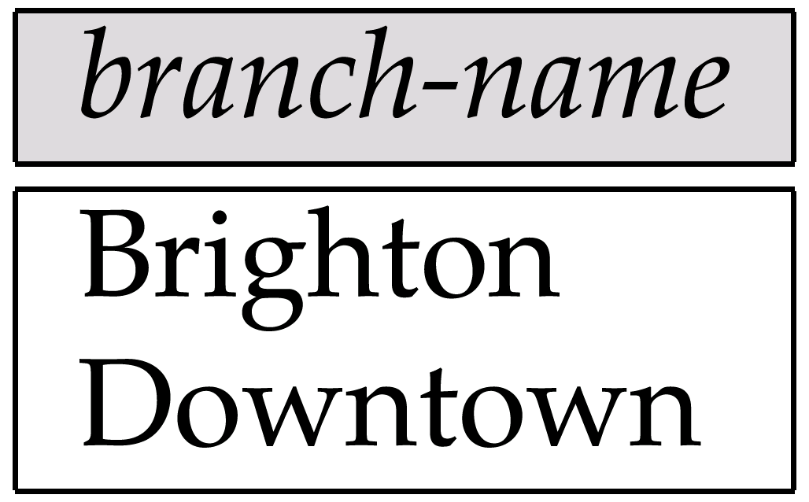
find all customers who have an account at all branches located in broklyn
Result of Π_{branch-name}(σ_{branch-city =} “Brooklyn”^{(branch))}

Slide 63
account
depositor

Slide 64
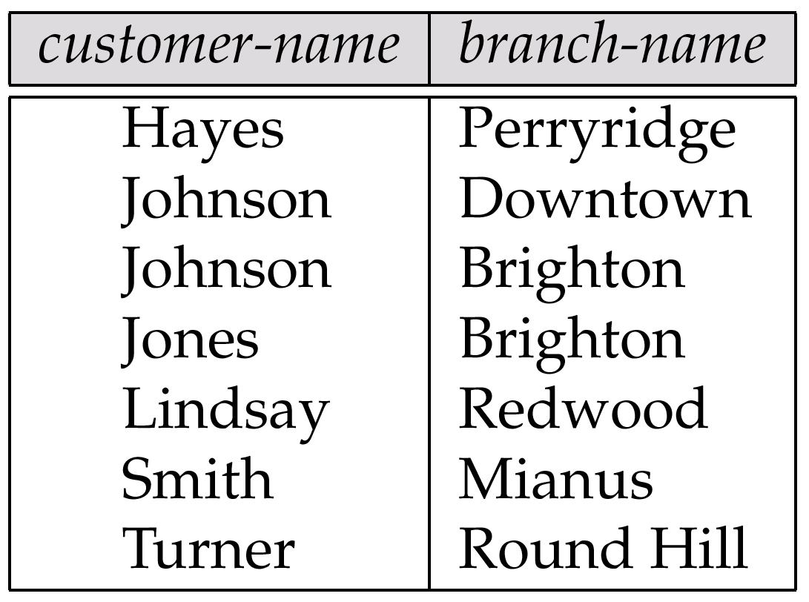
Result of Π_{customer-name, branch-name}(depositor account)
Return all the customer name and branch name who are having an account

Slide 65
Π_{customer-name, branch-name} (depositor account) ÷
Π_{branch-name}(σ_{branch-city =} “Brooklyn”^{(branch))}

Slide 66
Assignment Operation
  The assignment operation (←) provides a convenient way to express complex queries.
  We can assign part of relational algebra expression to temporary relation variable
    Assignment must always be made to a temporary relation variable.
  Example: Write r ÷ s as
  temp1 ← ∏_{R-S} (r)
  temp2 ← ∏_{R-S} ((temp1 x s) – ∏_{R-S,S} (r))
  result = temp1 – temp2
    The result to the right of the ← is assigned to the relation variable on the left of the ←.
    Queries can be written as program having series of assignments

Slide 67
Extended Relational-Algebra-Operations
  Generalized Projection
  Outer Join
  Aggregate Functions

Slide 68
Generalized Projection
  Extends the projection operation by allowing arithmetic functions to be used in the projection list.
  ∏ _{F1, F2, …, Fn}(E)
  E is any relational-algebra expression
  Each of F₁, F₂, …, F_{n} are are arithmetic expressions involving constants and attributes in the schema of E.
  Given relation credit-info(customer-name, limit, credit-balance), find how much more each person can spend:
∏customer-name, limit – credit-balance (credit-info)

Slide 69
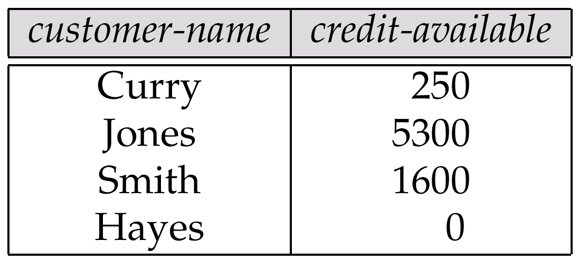
  Result of aggregation does not have a name
    Can use rename operation to give it a name
  customer-name, (salary+500) as credit-available(employee)
∏customer-name, (limit – credit-balance) as credit-available(credit-info)

Slide 70
Aggregate Functions and Operations
  Aggregation function takes a collection of values and returns a single value as a result.
  avg: average value
  min: minimum value
  max: maximum value
  sum: sum of values
  count: number of values
  There can be multiple occurences of values on which aggregate function works
Aggregate operation in relational algebra
_{G1, G2, …, Gn} g _{F1( A1), F2( A2),…, Fn( An)} (E)
  E is any relational-algebra expression
  G₁, G₂ …, G_{n} is a list of attributes on which to group (can be empty)
  Each F_{i} is an aggregate function
  Each A_{i} is an attribute name

Slide 71
Aggregate Operation – Example
Relation account
branch-name
account-number
balance
Perryridge
Perryridge
Brighton
Brighton
Redwood
A-102
A-201
A-217
A-215
A-222
400
900
750
750
700
Find total sum of balance amount of all accounts
g _{sum(balance)} (account)
Sum(balance)
3500

Slide 72
  We may want to eliminate duplicate values
  Function name is hyphenated with “distinct” word
  2750
  e.g.Find number of branches in account relation
g _{sum-distinct(balance)} (account)
g count-distinct(branch-name) as no-of-branches (account)
no-of-branches
3

Slide 73
Aggregate Operation – Example
We may want to group tuples on some attribute and then apply aggregate
function
e.g. find sum of balance for each branch seperately
  Relation account grouped by branch-name:
branch-name
account-number
balance
Perryridge
Perryridge
Brighton
Brighton
Redwood
A-102
A-201
A-217
A-215
A-222
400
900
750
750
700
_{branch-name} g _{sum(balance)} (account)
branch-name
balance
Perryridge
Brighton
Redwood
1300
1500
700

Slide 74
Aggregate Operation – Example
e.g. find sum of balance and maximum of balance for each branch seperately
  Relation account grouped by branch-name:
branch-name
account-number
balance
Perryridge
Perryridge
Brighton
Brighton
Redwood
A-102
A-201
A-217
A-215
A-222
400
900
750
750
700
_{branch-name} g _{sum(balance),max(balance)} (account)
branch-name
sum(balance)
max(balance)
Perryridge
Brighton
Redwood
1300
1500
700
900
750
700

Slide 75
Outer Join
  An extension of the join operation that avoids loss of information.
  Computes the join and then adds tuples form one relation that do not match tuples in the other relation to the result of the join.
  Uses null values

Slide 76
Outer Join – Example
Relation loan
loan-number
branch-name
amount
L-170
L-230
L-260
Downtown
Redwood
Perryridge
3000
4000
1700
Relation borrower
customer-name
loan-number
Jones
Smith
Hayes
L-170
L-230
L-155

Slide 77
Outer Join – Example
Inner Join ; tuples common in both relation
loan Borrower
loan-number
branch-name
amount
customer-name
L-170
L-230
Downtown
Redwood
3000
4000
Jones
Smith
Left Outer Join
loan Borrower
loan-number
branch-name
amount
customer-name
L-170
L-230
L-260
Downtown
Redwood
Perryridge
3000
4000
1700
Jones
Smith
null
loan-number
branch-name
amount
customer-name
L-170
L-230
L-155
Downtown
Redwood
null
3000
4000
null
Jones
Smith
hayes

Slide 78
Outer Join – Example
Right Outer Join
loan borrower =
loan-number
branch-name
amount
customer-name
L-170
L-230
L-155
Downtown
Redwood
null
3000
4000
null
Jones
Smith
Hayes
Full Outer Join
loan borrower
loan-number
branch-name
amount
customer-name
L-170
L-230
L-260
L-155
Downtown
Redwood
Perryridge
null
3000
4000
1700
null
Jones
Smith
null
Hayes

Slide 79
Modification of the Database
  The content of the database may be modified using the following operations:
    Deletion
    Insertion
    Updating
  All these operations are expressed using the assignment operator.

Slide 80
Deletion
  It is similar to selection, except that selected tuples are removed from the database.
  Can delete only whole tuples; cannot delete values on only particular attributes
  r ← r – E
  where r is a relation and E is a relational algebra query.

Slide 81
Deletion Examples
  Delete all account records in the Perryridge branch.
account ← account – σ _{branch-name = “Perryridge”} (account)
Delete all loan records with amount in the range of 0 to 50
loan ← loan – σ _{amount ≥ 0 and amount ≤ 50} (loan)

Slide 82
Insertion
  To insert data into a relation, we either:
    specify a tuple to be inserted
    write a query whose result is a set of tuples to be inserted
  in relational algebra, an insertion is expressed by: r U { }
  r ← r ∪ E
  where r is a relation and E is a relational algebra expression.
  The insertion of a single tuple is expressed by letting E be a constant relation containing one tuple.

Slide 83
Insertion Examples
  Insert information in the database specifying that Smith has $1200 in account A-973 at the Perryridge branch.
account ← account ∪ {(A-973, “Perryridge”, 1200)}
depositor ← depositor ∪ {(“Smith”, A-973)}

Slide 84
Updating
  A mechanism to change a value in a tuple without changing all values in the tuple.
  Use the generalized projection operator to do this task.
  r ← ∏ _{F1, F2, …, FI,} (r)
  Each F_{i} is either
  the ith attribute of r, if the ith attribute is not updated or if the attribute is to be updated.
  F_{i} is an expression, involving only constants and the attributes of r, which gives the new value for the attribute.

Slide 85
Update Examples
  Make interest payments by increasing all balances by 5 percent.
account   _{AN, BN, BAL * 1.05} (account)
Pay all accounts with balances over $10,000 6 percent interest
and pay all others 5 percent
account ← ∏ _{AN, BN, BAL * 1.06} (σ _{BAL > 10000} (account))
∪ ∏_{AN, BN, BAL * 1.05} (σ_{BAL ≤ 10000} (account))

Slide 86
Views
  In some cases, it is not desirable for all users to see the entire logical model (i.e., all the actual relations stored in the database.)
  E.g -> Consider a person who needs to know a customer’s loan number but has no need to see the loan amount. This person should see a relation described, in the relational algebra, by
  ∏_{customer-name, loan-number} (borrower loan)
  Any relation that is not part of logical model but is made visible to a user as a “virtual relation” is called a view.

Slide 87
View Definition
  A view is defined using the create view statement which has the form
  create view v as <query expression>
  where <query expression> is any legal relational algebra query expression. The view name is represented by v.
  Once a view is defined, the view name can be used to refer to the virtual relation that the view generates.

Slide 88
View Examples
  Consider the view (named all-customer) consisting of branches and their customers.
create view branch-customer as
∏_{branch-name, customer-name} (borrower loan)

Slide 89
View
  Some database allow to store view relation but make sure that it changes if changes made to actual relations. Such views are called as materialized views.
  Process of keeping view update is called as view maintenance.

Slide 90
Updates Through View
  Database modifications expressed as views must be translated to modifications of the actual relations in the database.
  Consider the person who needs to see all loan data in the loan relation except amount. The view given to the person, branch-loan, is defined as:
  create view branch-loan as
  ∏_{branch-name, loan-number} (loan)
  Since we allow a view name to appear wherever a relation name is allowed, the person may write:
branch-loan ← branch-loan ∪ {(“Perryridge”, L-37)}

Slide 91
Updates Through Views (Cont.)
  An insertion into loan requires a value for amount. The insertion can be dealt with by either.
    rejecting the insertion and returning an error message to the user.
    inserting a tuple (“L-37”, “Perryridge”, null) into the loan relation
  Some updates through views are impossible to translate into database relation updates
  create view loan-info as
  ∏_{customer-name, amount} (borrower loan)
  loan-info ← loan-info ∪ {(“Johnson”, 1900)}

Slide 92
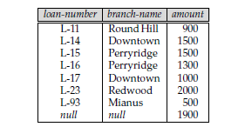
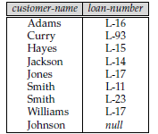
  In loan relation tuple added will be {(null,null,1900)} and in borrower {(Johnson,null)}
  The update will not give the correct effect since the view does not add the tuple(johnson,1900).
  There is no way to update 2 tables using null to get update on view loan_info.

Slide 93
End of Chapter 3

