Slide 1

Seminar 1.7
The Story of Git and GitHub
Savankumar Sutariya
MA065
Notes:
And my topic is….

Slide 2
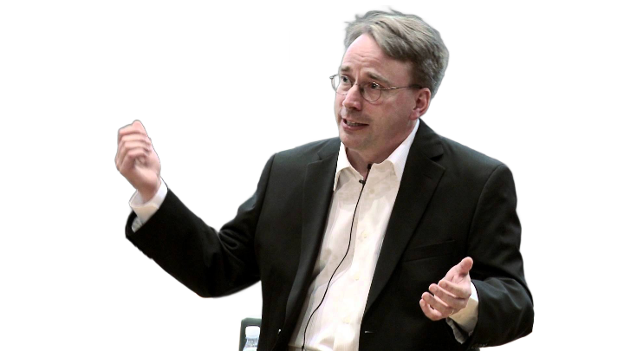
Seminar 1.7
The Story of Git and GitHub
Savankumar Sutariya
MA065
Linus Torvalds
Notes:
A story of linus(લીનસ) Torvalds (ટોર્વલ્ડ્સ)

Slide 3

Seminar 1.7
The Story of Git and GitHub
Linus Torvalds
Linux
Savankumar Sutariya
MA065
Notes:
In the year 1991
Started working on a Hobby project

Slide 4
The Story of Git and GitHub
Linux
1991
Personal Project
Notes:
Named linux
With a great Vision he decided to make it Open Source

Slide 5
The Story of Git and GitHub
Linux
Linus Torvalds
1991
1991-2002
Personal Project
Made Open Source

Slide 6
The Story of Git and GitHub
Linux
Linus Torvalds
1991
1991-2002
2002-2005
Personal Project
Made Open Source
Used Bitkeeper
Notes:
Company that built BitKeeper broke down
Which lead to revoke the free usage of the tool
Now to maintain the workflow
Linus came up with a new version control system git

Slide 7
The Story of Git and GitHub
Linux
2005
Launched Git
Notes:
Which was initially used to manage the development of linux software

Slide 8
The Story of Git and GitHub
Notes:
Which was initially used to manage the development of linux software

Slide 9
The Story of Git and GitHub
Notes:
Which was initially used to manage the development of linux software

Slide 10

The Story of Git and GitHub
Notes:
Which was initially used to manage the development of linux software

Slide 11

The Story of Git and GitHub
Notes:
Which was initially used to manage the development of linux software

