Slide 1

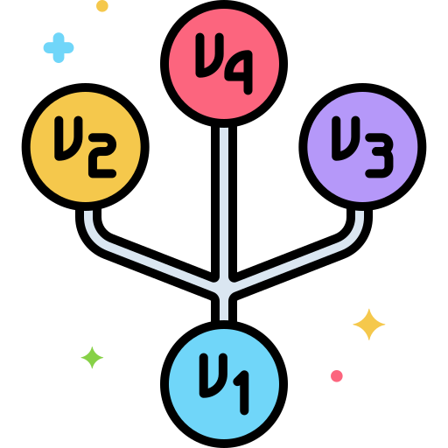
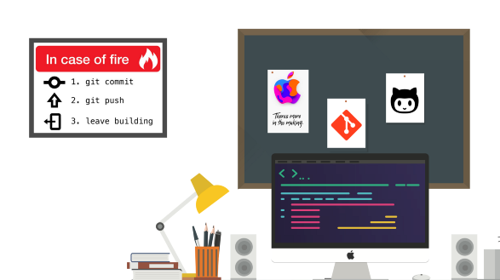
Seminar 1.5
Table of Contents
What is a version Control System?
Types of version control systems
Centralized VCS
Distributed VCS
Is remote work here to stay?
What's next in tech workspace
Git
Points for discussion
MA065
SUTARIYA SAVANKUMAR

Slide 2



Git Workflow
Table of Contents
Undo changes
Local unstaged
Local staged
Undo commit
Points for discussion

Slide 3
Git
(Unstaged) Changes
Undo changes

Slide 4
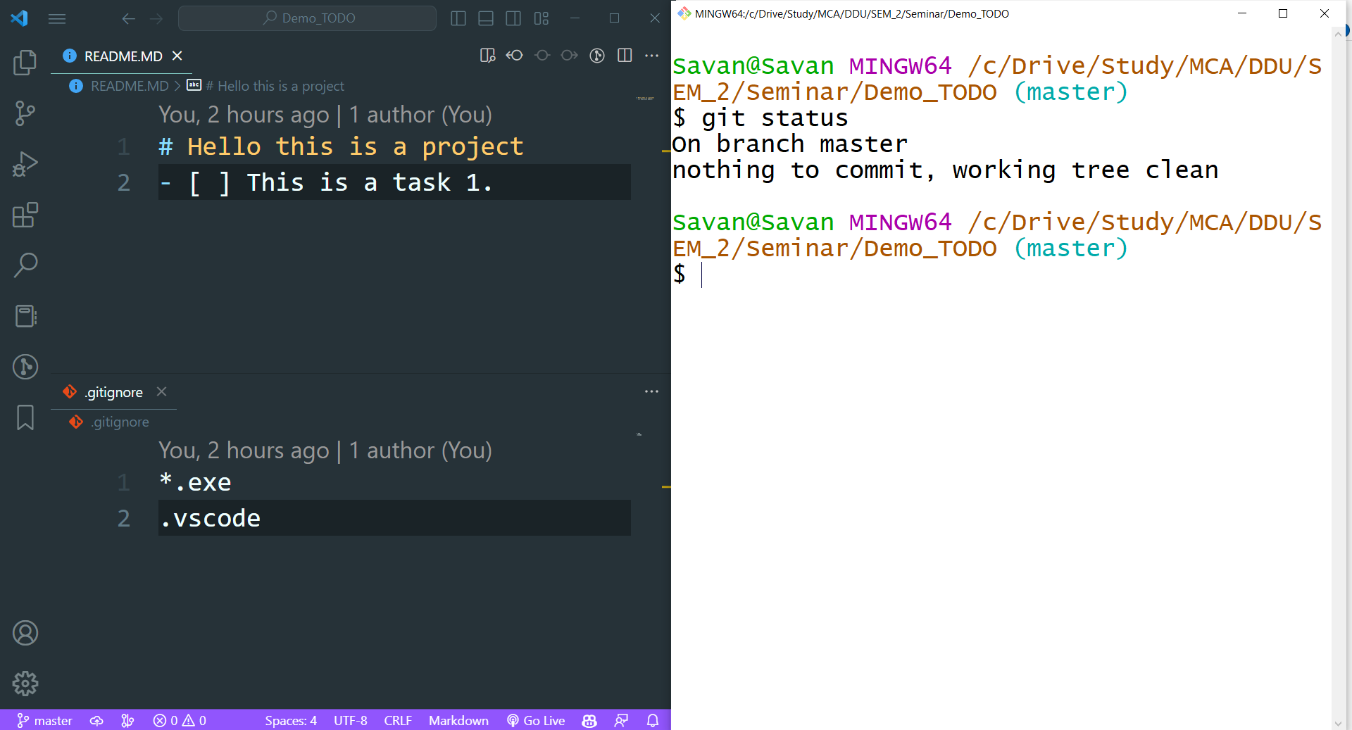
Git
Clean working directory

Slide 5
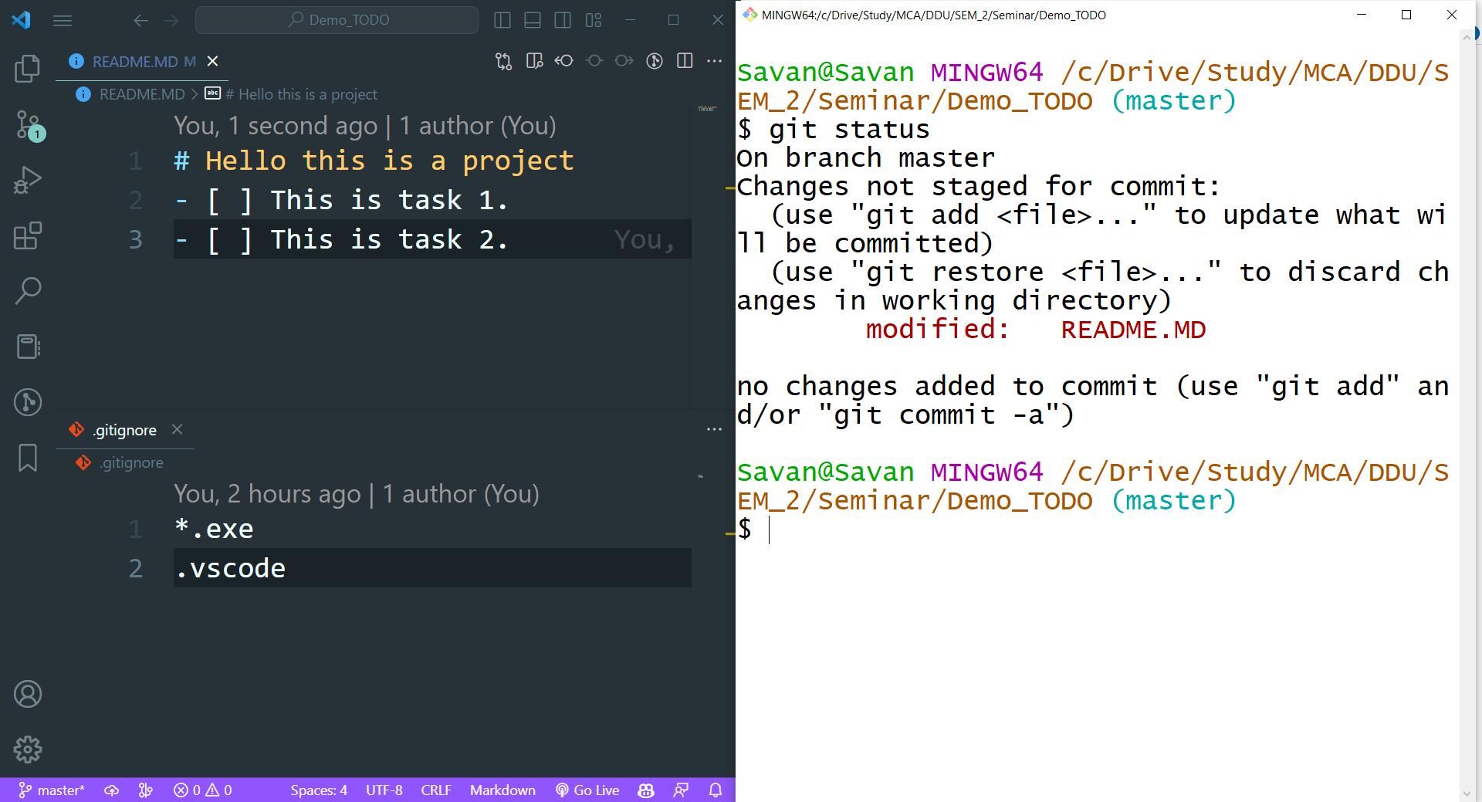
Git
A new task in TODO

Slide 6
Git
$ git restore
git restore is a command that helps you undo changes you made to files or recover deleted files in a Git project.
Basic Commands

Slide 7
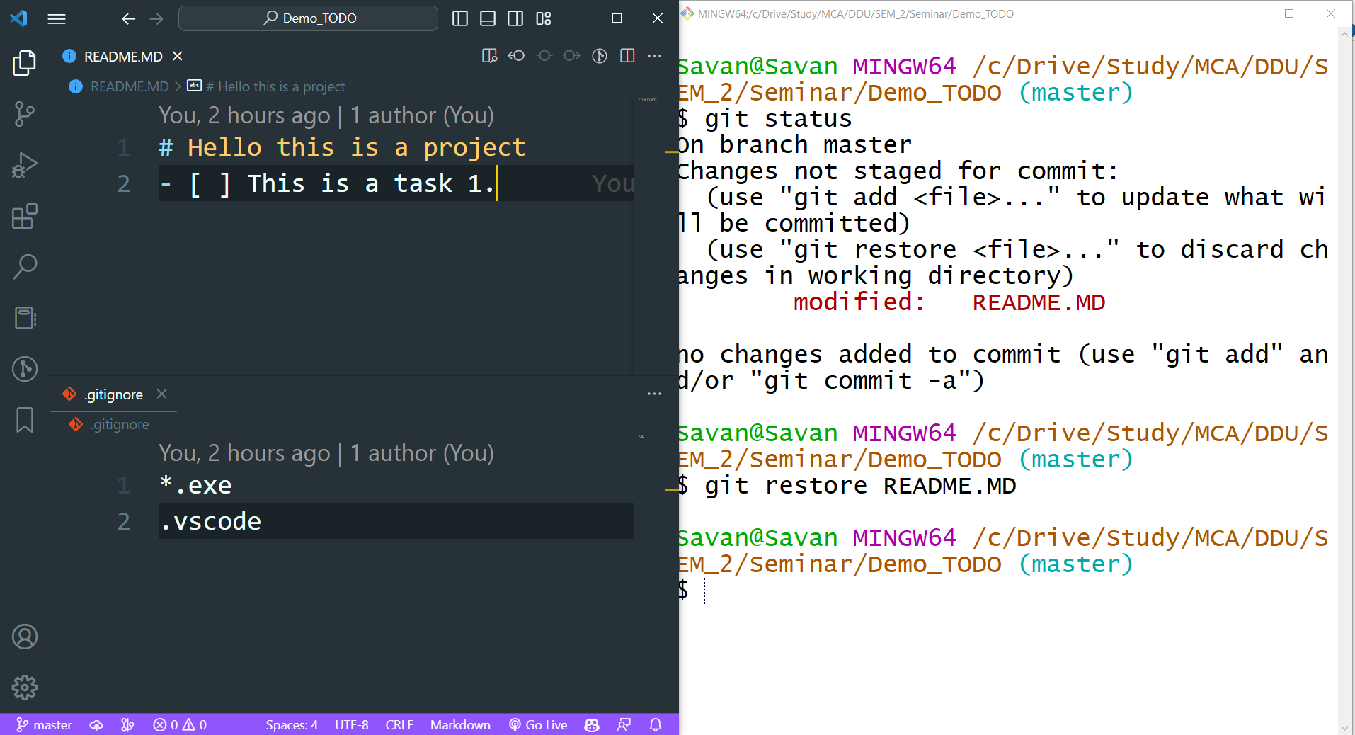
Git
Restored

Slide 8
Git
(Staged) Changes
Undo changes

Slide 9
(Staged) Changes
Git
Step1: Unstage the file
$git restore --staged
Undo changes

Slide 10
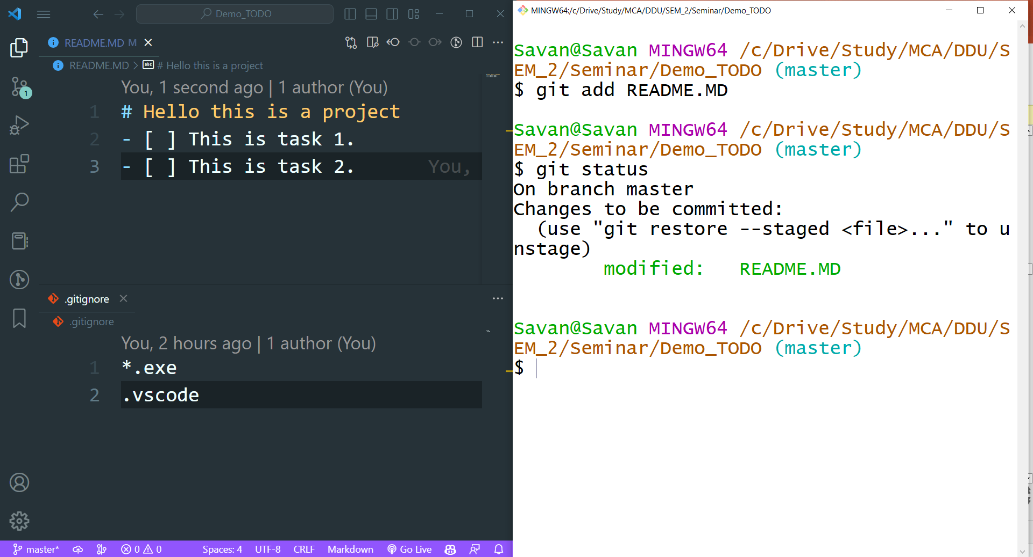
Git
A changed file is on stage

Slide 11
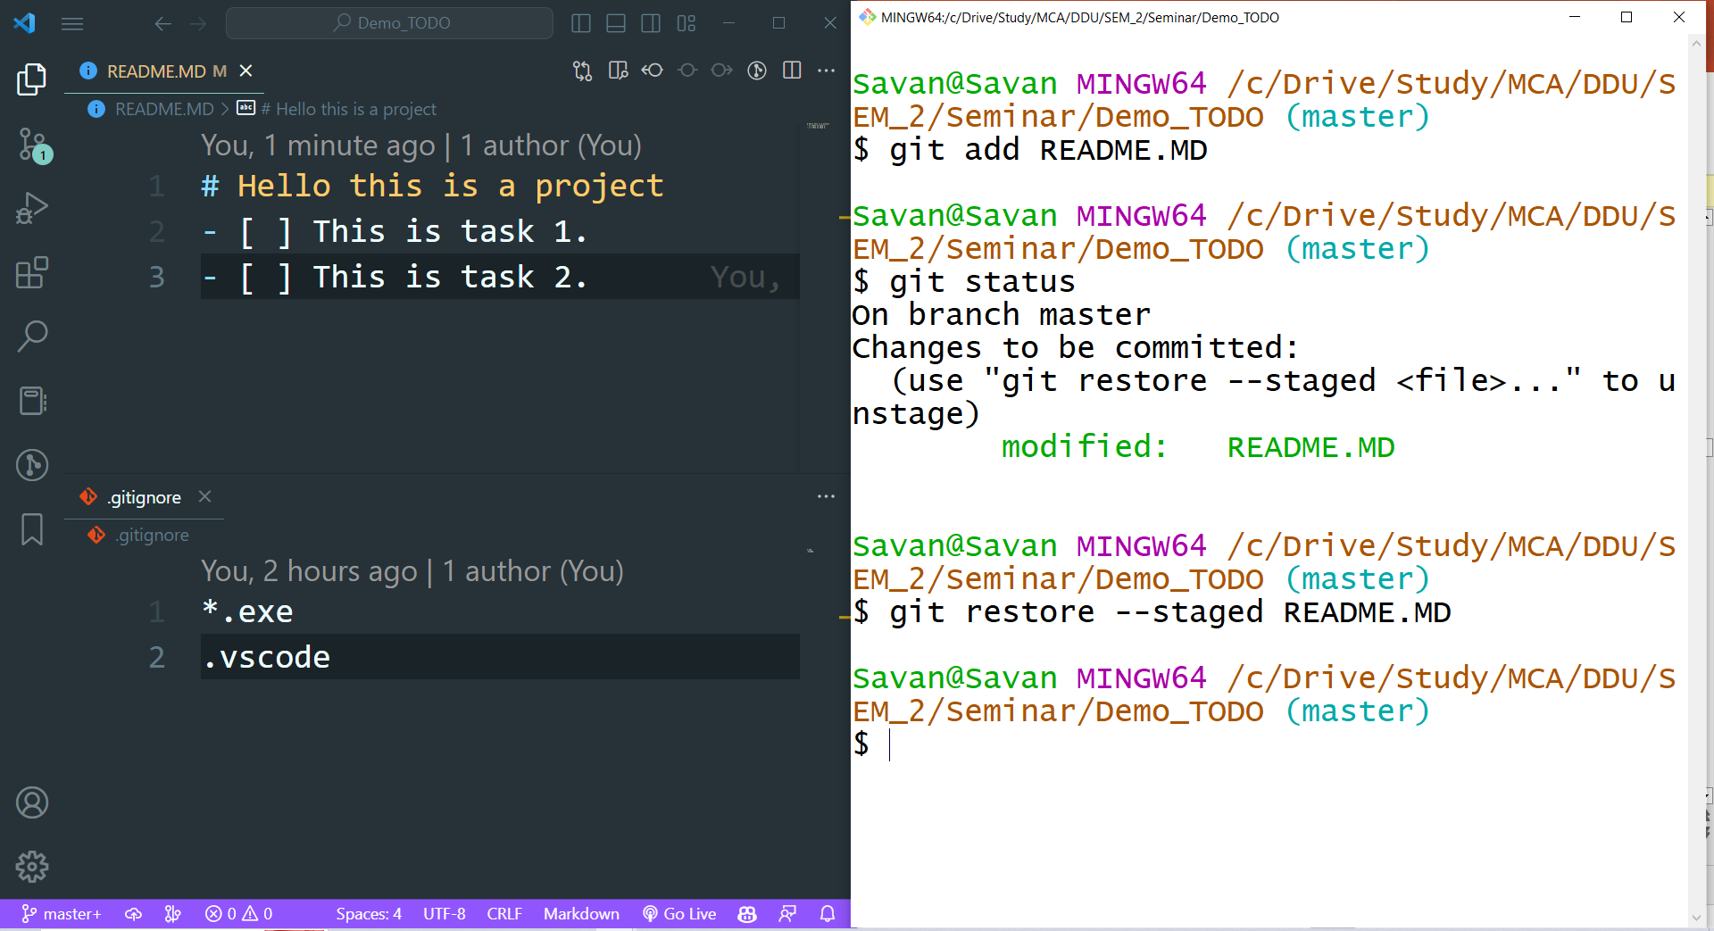
Git
Unstaged the file

Slide 12
(Staged) Changes
Git
Step1: Unstage the file
Step2: restore the change
Undo changes

Slide 13
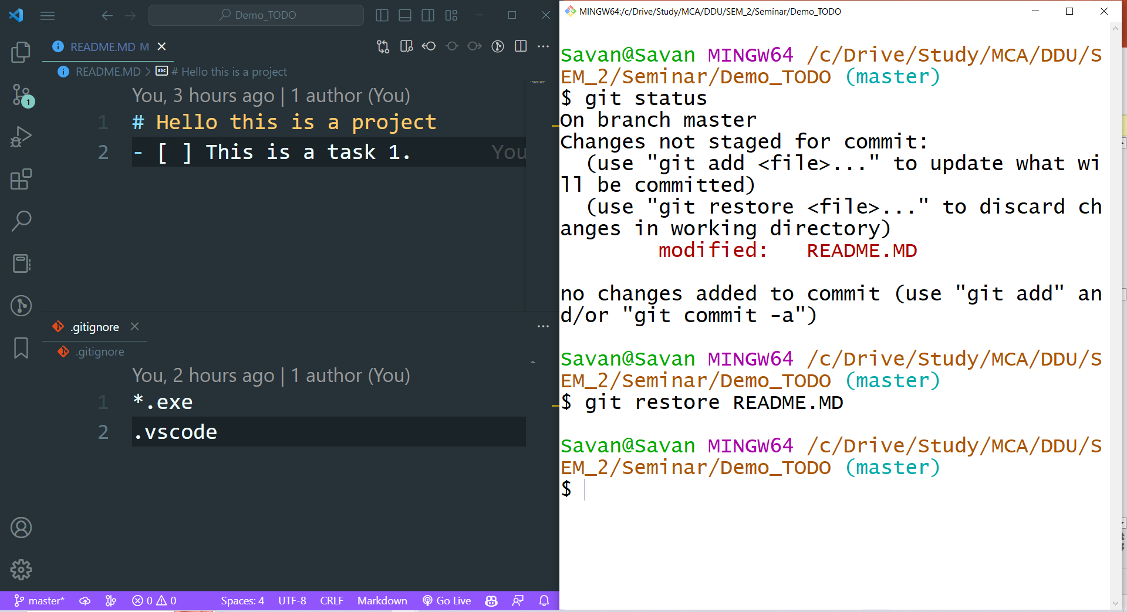
Git
Restored

Slide 14
Git
(Commited) Changes
Undo changes

Slide 15
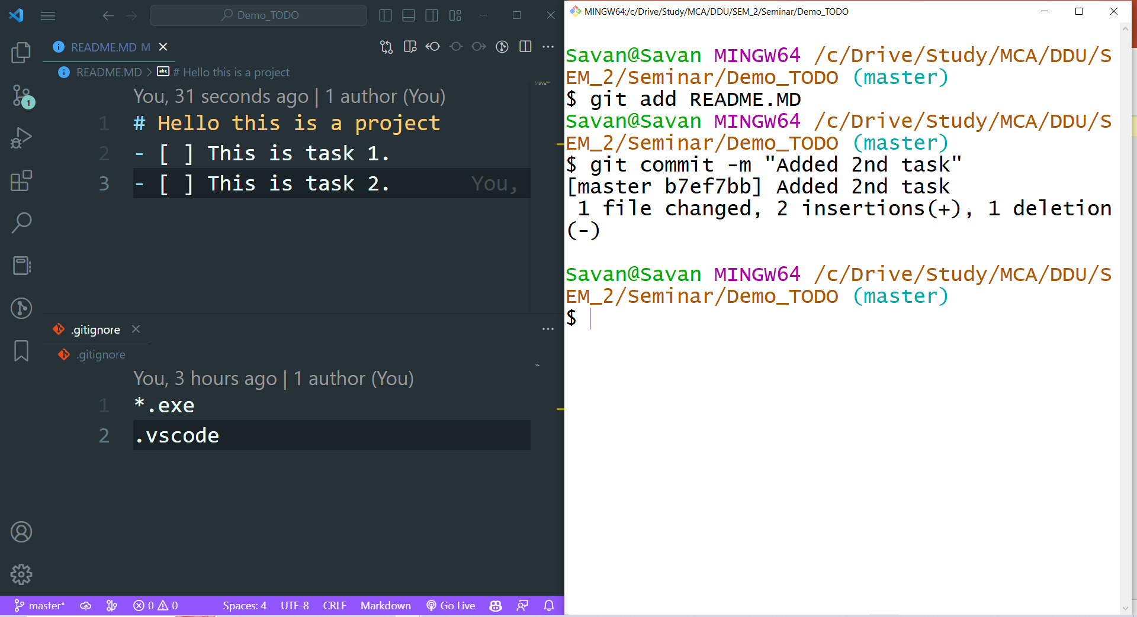
Git
Added 2nd task
Committed a change

Slide 16
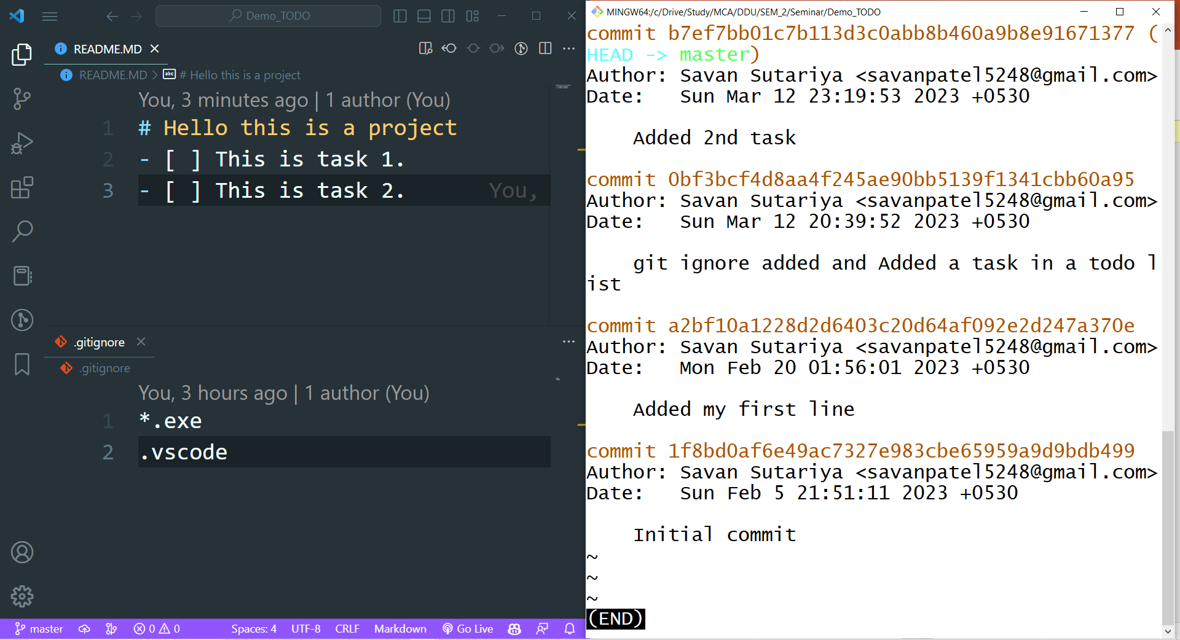
Git
Commit log

Slide 17
Git

Slide 18
(Commited) Changes
Git
git reset --hard HEAD~1
Undo changes

Slide 19
Git
$ git reset
You can use it to move the current branch to a specific commit, or even remove a commit entirely. However, be careful when using this command as it can cause data loss or create inconsistencies in the repository's history.
Basic Commands

Slide 20
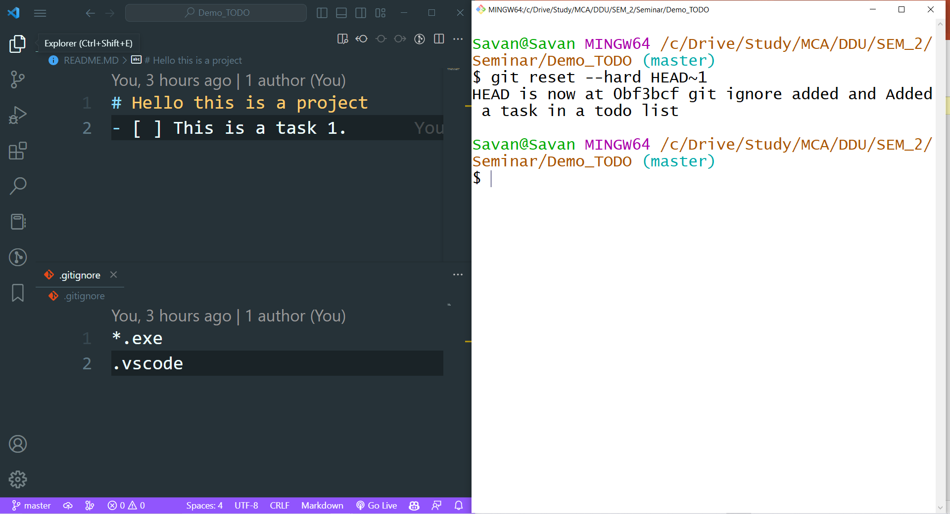
Git
Reset

Slide 21
Git
Progress..
$ git init
$ git add
$ git commit
$ git status

Slide 22
Git
Progress..
$ git init
$ git add
$ git commit
$ git status
$ git restore
$ git reset

Slide 23
Thank You ☺

