Slide 1
Project_EDA
File created on: 9/28/2026 3:32:07 PM

Slide 2
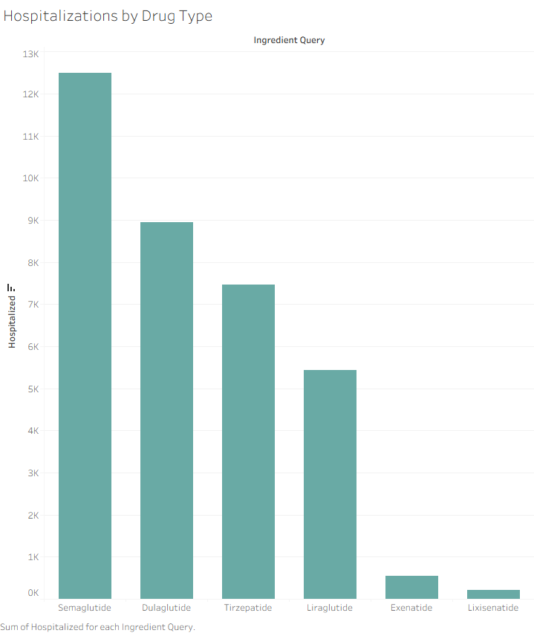

Slide 3
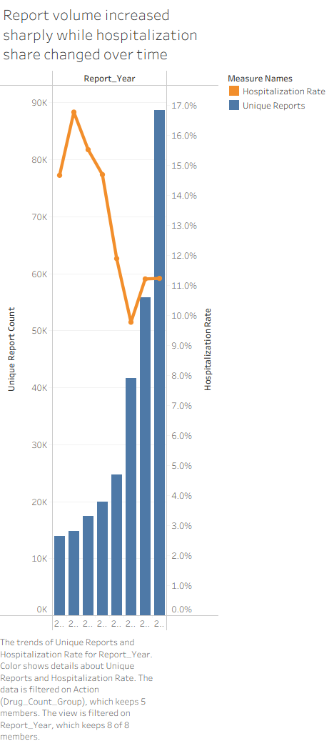

Slide 4


Slide 5


Slide 6
