Slide 1
Clustering
Jay Urbain, PhD
Credits: Tom Mitchell, Jiawei Han, Micheline Kamber, and Jian Pei

Slide 2
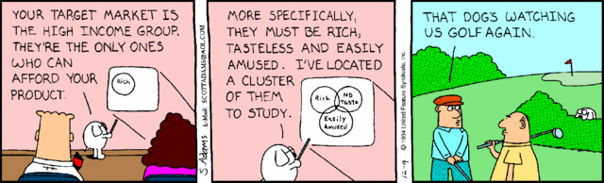
Cluster Analysis: Basic Concepts and Methods
Cluster Analysis: Basic Concepts
Partitioning Methods
Hierarchical Methods
Density-Based Methods
Grid-Based Methods
Evaluation of Clustering
Summary
2
2
Notes:
2

Slide 3
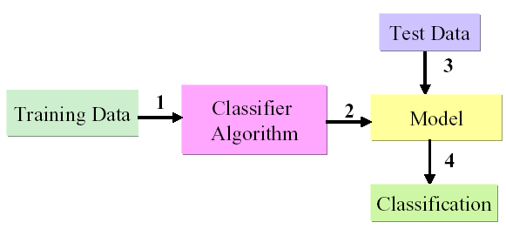
Supervised Learning
Supervised Learning
Learn by example from training data with a class label
Create model by running algorithm on training data
Identify a class label for the incoming new data

Slide 4
Supervised Learning Algorithms
Supervised Learning Algorithms
Linear Regression
Logistic Regression
Naive Bayes
Bayes Nets
Neural Networks
Decision Trees
Support Vector Machine

Slide 5
Unsupervised Learning Algorithms
There are many machine learning situations in which class labels are not available, so unsupervised methods are needed.
Unsupervised Learning Algorithms
Clustering – many
Association Rules - Apriori
PCA – Principal Component Analysis
Topic Models
Collaborative Filtering

Slide 6
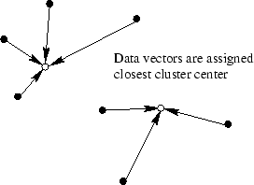
What is Cluster Analysis?
Cluster: A collection of data objects
similar (or related) to one another within the same group
dissimilar (or unrelated) to the objects in other groups
Cluster analysis (or clustering, data segmentation, …)
Finding similarities between data according to the characteristics found in the data and grouping similar data objects into clusters

Slide 7
What is Cluster Analysis?
Unsupervised learning: no predefined classes (i.e., learning by observations vs. learning by examples: supervised)
Typical applications
As a stand-alone tool to get insight into data distribution, data exploration
As a preprocessing step for other algorithms

Slide 8
Applications of Cluster Analysis
Data reduction:
Summarization: Preprocessing for regression, PCA, classification, and association analysis
Compression: Image processing: vector quantization
Hypothesis generation and testing
Prediction based on groups:
Cluster & find characteristics/patterns for each group – define as class
Finding K-nearest neighbors:
Localizing search to one or a small number of clusters
Outlier detection: Outliers are often viewed as those “far away” from any cluster

Slide 9
Clustering: Application Examples
Biology: taxonomy of living things: kingdom, phylum, class, order, family, genus and species
Information retrieval: document clustering
Land use: Identification of areas of similar land use in an earth observation database
Marketing: Help marketers discover distinct groups in their customer bases, and then use this knowledge to develop targeted marketing programs
City-planning: Identifying groups of houses according to their house type, value, and geographical location
Earth-quake studies: Observed earth quake epicenters should be clustered along continent faults
Climate: understanding earth climate, find patterns of atmospheric and ocean
Economic Science: market research

Slide 10
Basic Steps to Develop a Clustering Task
Feature selection
Select info concerning the task of interest
Minimal information redundancy
Proximity measure
Similarity of two feature vectors, or feature distributions
Clustering criterion
Expressed via a cost function, maximum likelihood estimate, or rules
Clustering algorithms
Choice of algorithms
Validation of the results
Validation test (also, clustering tendency test)
Interpretation of the results
Integration with applications, visualization

Slide 11
Quality: What Is Good Clustering?
A good clustering method will produce high quality clusters:
high intra-class similarity: cohesive within clusters
low inter-class similarity: distinctive between clusters
The quality of a clustering method depends on:
the similarity measure used by the method
its implementation, and
its ability to discover some or all of the hidden patterns
How to improve the quality of clusters?

Slide 12
Measure the Quality of Clustering
Dissimilarity/Similarity metric
Similarity is expressed in terms of a distance function, typically metric: d(i, j)
The definitions of distance functions are usually rather different for Boolean, categorical, ordinal, discrete, & continuous variables
Weights should be associated with different variables based on applications and data semantics
Quality of clustering:
There is usually a separate “quality” function that measures the “goodness” of a cluster.
Its hard to define “similar enough” or “good enough”
The answer is typically highly subjective
Open research question

Slide 13
Considerations for Cluster Analysis
Partitioning criteria
Single level vs. hierarchical partitioning (often, multi-level hierarchical partitioning is desirable)
Separation of clusters
Exclusive/hard (one customer belongs to only one region, e.g., k-means) vs. non-exclusive/soft (one document may belong to more than one class: e.g., Expectation Maximization clustering)
Similarity measure
Distance-based (e.g., Manhattan (L1), Euclidian (L2), Cosine); connectivity-based (e.g., density or contiguity, network); and maximum likelihood.
Clustering space
Full space (often when low dimensional) vs. subspaces (often in high-dimensional clustering)

Slide 14
Requirements and Challenges
Scalability
Clustering all the data vs. samples
Ability to deal with different types of attributes
Numerical, binary, categorical, ordinal, linked, and combinations
Constraint-based clustering
User may give inputs on constraints
Use domain knowledge to determine input parameters
Interpretability/visualization and usability
Others
Discovery of clusters with arbitrary shape
Ability to deal with noisy data
Incremental clustering and insensitivity to input order
High dimensionality

Slide 15
Major Clustering Approaches (I)
Partitioning approach:
Construct various partitions and then evaluate them by some criterion, e.g., minimizing the sum of squared errors
Typical (hard) methods: k-means, k-medoids, CLARANS
Hierarchical approach:
Create a hierarchical decomposition of the set of data (or objects) using some criterion
Typical methods: Diana, Agnes, BIRCH, CAMELEON
Density-based approach:
Based on connectivity and density functions
Typical methods: DBSACN, OPTICS, DenClue
Grid-based approach:
Based on a multiple-level granularity structure
Typical methods: STING, WaveCluster, CLIQUE

Slide 16
Major Clustering Approaches (II)
Model-based:
A model is hypothesized for each of the clusters and tries to find the best fit of that model to each other
Typical methods: EM, Topic, SOM, COBWEB
Frequent pattern-based:
Based on the analysis of frequent patterns
Typical methods: p-Cluster
User-guided or constraint-based:
Clustering by considering user-specified or application-specific constraints
Typical methods: COD (obstacles), constrained clustering
Link-based (network) clustering:
Objects are often linked together in various ways
Massive links can be used to cluster objects: SimRank, LinkClus

Slide 17
Cluster Analysis: Basic Concepts and Methods
Cluster Analysis: Basic Concepts
Partitioning Methods
Hierarchical Methods
Density-Based Methods
Grid-Based Methods
Evaluation of Clustering
Summary
17
17
Notes:
17

Slide 18
Partitioning Algorithms: Basic Concept
Partitioning method: Partitioning a database D of n objects into a set of k clusters, such that the sum of squared distances is minimized (where c_{i} is the of cluster C_{i -}) – represented by centroid or medoid, etc.
Given k, find a partition of k clusters that optimizes the chosen partitioning criterion:
Global optimal: exhaustively enumerate all partitions – how large?
Heuristic methods: k-means and k-medoids algorithms
k-means (MacQueen’67, Lloyd’57/’82): Each cluster is represented by the center of the cluster (centroid, average; weak, strong linkage)
k-medoids or PAM (Partition around medoids) (Kaufman & Rousseeuw’87): Each cluster is represented by one of the objects in the cluster

Slide 19
The K-Means Clustering Method
Given k, the k-means algorithm is implemented in four steps:
Partition objects into k non-empty subsets (randomly)
Compute seed points as the centroids of the clusters of the current partitioning (the centroid is the center, i.e., mean point, of the cluster)
Assign each object to the cluster with the nearest seed point
Go back to Step 2, stop when the assignment does not change (convergence criteria)

Slide 20
An Example of K-Means Clustering
K=2
Arbitrarily partition objects into k groups
Update the cluster centroids
The initial data set
Loop if needed
Reassign objects
Partition objects into k nonempty subsets
Repeat
Compute centroid (i.e., mean point) for each partition
Assign each object to the cluster of its nearest centroid
Until no change
Update the cluster centroids

Slide 21
Comments on the K-Means Method
Strength: Efficient: O(tkn), where n is # objects, k is # clusters, and t is # iterations. Normally, k, t << n.
Comment: Often terminates at a local optimum
Weakness
Applicable only to objects in a continuous (convex) n-dimensional space
Use the k-modes method for categorical data or convert categorical data types to numerical
In comparison, k-medoids can be applied to a wide range of data
Need to specify k, the number of clusters, in advance (there are ways to automatically determine the best k (see Hastie et al., 2009)
Sensitive to noisy data and outliers
Sub-optimal clusters with non-convex shapes (stuck in local minima)

Slide 22
Variations of the K-Means Method
Most of the variants of the k-means differ in:
Selection of the initial k
Dissimilarity calculations
Strategies to calculate cluster means
Handling categorical data: k-modes
Replacing means of clusters with modes (categorical feature counts)
Use new dissimilarity measures to deal with categorical objects
Using a frequency-based method to update modes of clusters
A mixture of categorical and numerical data: k-prototype method

Slide 23
What Is the Problem of the K-Means Method?
The k-means algorithm is sensitive to outliers!
Since an object with an extremely large value may substantially distort the distribution of the data
K-Medoids: Instead of taking the mean value of the object in a cluster as a reference point, medoids can be used, which is the most centrally located (most representative) object in a cluster
10
10
9
9
8
8
7
7
6
6
5
5
4
4
3
3
2
2
1
1
0
0
1
2
3
4
5
6
7
8
9
10
0
0
1
2
3
4
5
6
7
8
9
10

Slide 24
PAM: A Typical K-Medoids Algorithm CLARA: sample
Total Cost = 20
10
9
8
Arbitrarily choose k objects as initial medoids
Assign each remaining object to nearest medoid
7
6
5
4
3
2
1
0
0
1
2
3
4
5
6
7
8
9
10
K=2
Select/sample a nonmedoid object,O_{ramdom}
Total Cost = 26
Do loop
Until no change
10
10
9
Compute total cost of swapping (using nonmedoid as new medoid)
9
Swapping O and O_{ramdom}
If quality is improved.
8
8
7
7
6
6
5
5
4
4
3
3
2
2
1
1
0
0
1
2
3
4
5
6
7
8
9
10
0
0
1
2
3
4
5
6
7
8
9
10
24
Notes:
24

Slide 25
The K-Medoid Clustering Method
K-Medoids Clustering: Find representative objects (medoids) in clusters
PAM (Partitioning Around Medoids, Kaufmann & Rousseeuw 1987)
Starts from an initial set of medoids and iteratively replaces one of the medoids by one of the non-medoids if it improves the total distance of the resulting clustering
PAM works effectively for small data sets, but does not scale well for large data sets (due to the computational complexity)
Efficiency improvement on PAM
CLARA (Kaufmann & Rousseeuw, 1990): PAM on samples
CLARANS (Ng & Han, 1994): Randomized re-sampling

Slide 26
Cluster Analysis: Basic Concepts and Methods
Cluster Analysis: Basic Concepts
Partitioning Methods
Hierarchical Methods
Evaluation of Clustering
Summary
Density-Based Methods
Grid-Based Methods
26
26
Notes:
26

Slide 27
Hierarchical Clustering
Use distance matrix as clustering criteria. This method does not require the number of clusters k as an input.
Step 0
Step 1
Step 2
Step 3
Step 4
agglomerative
(AGNES)
a
a b
b
a b c d e
c
c d e
d
d e
e
divisive
(DIANA)
Step 4
Step 3
Step 2
Step 1
Step 0

Slide 28
AGNES (Agglomerative Nesting)
Introduced in Kaufmann and Rousseeuw (1990)
Implemented in statistical packages, e.g., Splus
Uses dissimilarity matrix
Merge nodes that have the least dissimilarity/max similarity
Eventually all nodes belong to the same cluster

Slide 29
Dendrogram: Shows How Clusters are Merged
Decompose data objects into a several levels of nested partitioning (tree of clusters), called a dendrogram
A clustering of the data objects is obtained by cutting the dendrogram at the desired level, then each connected component forms a cluster

Slide 30
DIANA (Divisive Analysis)
Introduced in Kaufmann and Rousseeuw (1990)
Implemented in statistical analysis packages, e.g., Splus
Inverse order of AGNES
Eventually each node forms a cluster on its own

Slide 31
Distance between Clusters
X
X
Single link: smallest distance between an element in one cluster and an element in the other, i.e., dist(K_{i}, K_{j}) = min(t_{ip}, t_{jq})
Complete link: largest distance between an element in one cluster and an element in the other, i.e., dist(K_{i}, K_{j}) = max(t_{ip}, t_{jq})
Average: avg distance between an element in one cluster and an element in the other, i.e., dist(K_{i}, K_{j}) = avg(t_{ip}, t_{jq})
Centroid: distance between the centroids of two clusters, i.e., dist(K_{i}, K_{j}) = dist(C_{i}, C_{j})
Medoid: distance between the medoids of two clusters, i.e., dist(K_{i}, K_{j}) = dist(M_{i}, M_{j})
Medoid: a chosen, centrally located object in the cluster
31
Notes:
31

Slide 32
Centroid, Radius and Diameter of a Cluster (for numerical data sets)
Centroid: the “middle” of a cluster
Radius: square root of average distance from any point of the cluster to its centroid
Diameter: square root of average mean squared distance between all pairs of points in the cluster
32
Notes:
32

Slide 33
Extensions to Hierarchical Clustering
Major weakness of agglomerative clustering methods
Can never undo what was done previously
Does not scale well: time complexity of at least O(n²), where n is the number of total objects
Integration of hierarchical & distance-based clustering
BIRCH (1996): uses CF-tree and incrementally adjusts the quality of sub-clusters
CHAMELEON (1999): hierarchical clustering using dynamic modeling

Slide 34
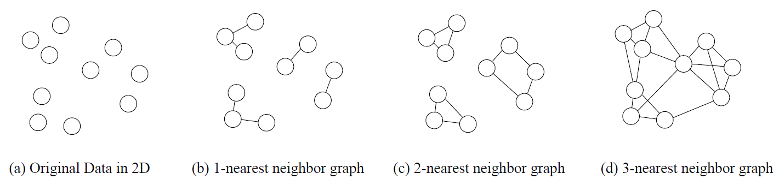
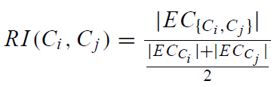
KNN Graphs & Interconnectivity
k-nearest graphs from an original data in 2D:
EC_{{Ci ,Cj } :}The absolute inter-connectivity between C_{i} and C_{j}: the sum of the weight of the edges that connect vertices in C_{i} to vertices in C_{j}
Internal inter-connectivity of a cluster C_{i} : the size of its min-cut bisector EC_{Ci} (i.e., the weighted sum of edges that partition the graph into two roughly equal parts)
Relative Inter-connectivity (RI):

Slide 35
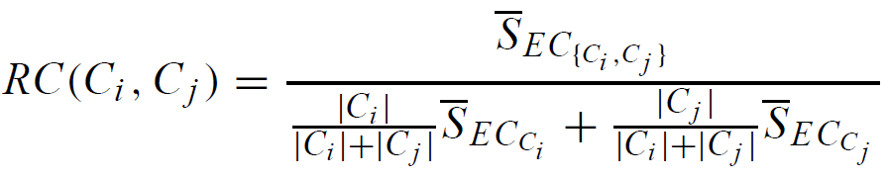



Relative Closeness & Merge of Sub-Clusters
Relative closeness between a pair of clusters C_{i} and C_{j} : the absolute closeness between C_{i} and C_{j} normalized w.r.t. the internal closeness of the two clusters C_{i} and C_{j}
and are the average weights of the edges that belong in the min-cut bisector of clusters C_{i} and C_{j} , respectively, and is the average weight of the edges that connect vertices in C_{i} to vertices in C_{j}
Merge Sub-Clusters:
Merges only those pairs of clusters whose RI and RC are both above some user-specified thresholds
Merge those maximizing the function that combines RI and RC

Slide 36
c

Slide 37
Overall Framework of CHAMELEON
Construct (K-NN)
Sparse Graph
Partition the Graph
Data Set
K-NN Graph
P and q are connected if q is among the top k closest neighbors of p
Merge Partition
Relative interconnectivity: connectivity of c₁ and c₂ over internal connectivity
Relative closeness: closeness of c₁ and c₂ over internal closeness
Final Clusters

Slide 38
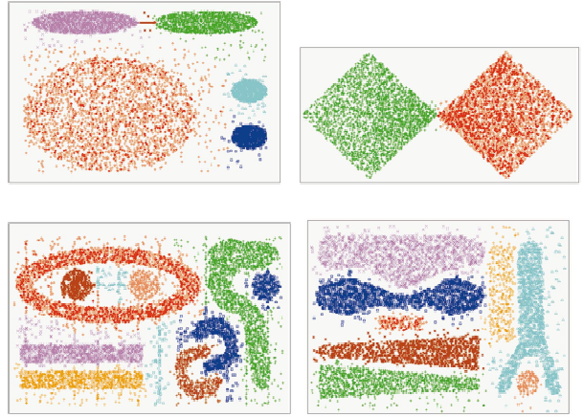
CHAMELEON (Clustering Complex Objects)

Slide 39
Concept-Concept Co-occurence
SELECT ci.term, ci1.term, count(*) n
FROM conceptinvertedindex ci, conceptpostinglist cp,
conceptinvertedindex ci1, conceptpostinglist cp1
where ci.termid=cp.termid
and ci.term = 'United States'
and ci1.termid=cp1.termid
and cp.docid=cp1.docid
and cp.parid=cp1.parid
and cp.sentid=cp1.sentid
group by ci.term, ci1.term
order by n desc;
term | term | n
United States | United States | 110
United States | North Korea | 47
United States | Iran | 32
United States | China | 31
United States | US | 28
United States | Thai | 22
United States | Middle East | 16
United States | Pyongyang | 12
United States | PRC | 11
United States | Thailand | 9
United States | Obama | 8
United States | DPRK | 8
United States | Israel | 8
United States | State | 8
United States | Beijing | 7
United States | Japan | 5
United States | Bosworth | 5
United States | Bangkok | 5
United States | IAEA | 5
United States | UNSC | 5
United States | Russia | 5
United States | South Asia | 4

Slide 40
Concept-Term Co-occurence
SELECT ci.term, ci1.term, count(*) n
FROM conceptinvertedindex ci, conceptpostinglist cp,
invertedindex ci1, postinglist cp1
where ci.termid=cp.termid
and ci.term = 'United States'
and ci1.termid=cp1.termid
and cp.docid=cp1.docid
and cp.parid=cp1.parid
and cp.sentid=cp1.sentid
group by ci.term, ci1.term
order by n desc;
term | term | n
United States | state | 126
United States | unit | 112
United States | korea | 57
United States | north | 53
United States | nuclear | 47
United States | weapon | 40
United States | thai | 37
United States | china | 31
United States | iran | 27
United States | tip | 24
United States | author | 23
United States | said | 23
United States | illicit | 21
United States | concern | 20

Slide 41
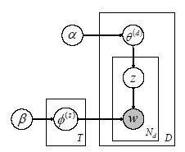
Topic Model
Generative method - specifies how a document is generated.
Define document distribution over topics.
Select each word in the document by sampling a word from this topic distribution at random.

Slide 42
Topic Model
The Gibbs sampling -
Consider each word token in the text collection in turn
Estimate probability of assigning the current word token to each topic, conditioned on the topic assignments to all other word tokens.
From this conditional distribution, a topic is sampled and stored as the new topic assignment for this word token.

Slide 43
Topic Model
Estimate sampling a new word instance w_{i} from topic j:
Sampling a new word in document d from topic j:
Notes:
The Gibbs sampling procedure considers each word token in the text collection in turn, and estimates the probability of assigning the current word token to each topic, conditioned on the topic assignments to all other word tokens. From this conditional distribution, a topic is sampled and stored as the new topic assignment for this word token. This conditional distribution is represented by, where zi=j is the topic assignment of token i to topic j, z-i refers to the topic assignments of all other word tokens, and “.” refers to all other known or observed information such as all other word and document indices w-i and di, and hyperparameters and. Griffiths and Steyvers (2004) showed that can be calculated from:
(4.15)

Slide 44
Topic Models Related to Events
Identify topics related to event ‘attack’
Note on topic model parameterization: 50 topics, alpha=5 (large), phi=0.5 (large), iterations=100 (very small, should be higher for convergence – just a test), burn-in=10, sample lag=2, thin interval=1.
// Identify topics highly likely to generate terms affiliated with ‘attack’
SELECT i.term, i.termid, p.topicid, p.phi
FROM _phi p, invertedindex i, _nw n
where p.termid=i.termid
and n.termid=i.termid
and i.term='attack'
and p.topicid=n.topicid
order by p.phi desc
limit 20;

Slide 45
Topic Models Related to Attack
term | termid | topicid | phi
attack | 71 | 18 | 0.0135349
attack | 71 | 33 | 0.0026009
attack | 71 | 15 | 0.0023404
attack | 71 | 20 | 0.0023344
attack | 71 | 19 | 0.0011068
attack | 71 | 40 | 0.0003311
attack | 71 | 42 | 0.0002832
attack | 71 | 22 | 0.0002763
attack | 71 | 43 | 0.0002721
attack | 71 | 26 | 0.0002527
attack | 71 | 7 | 0.0002282
attack | 71 | 2 | 0.0001683
attack | 71 | 13 | 0.0001455
attack | 71 | 31 | 0.0001453
attack | 71 | 49 | 0.0001335
attack | 71 | 14 | 0.0001308
attack | 71 | 29 | 0.0001068
attack | 71 | 28 | 0.0001026
attack | 71 | 38 | 0.0001
attack | 71 | 10 | 0.0000952

Slide 46
Topic Models Related to Attack
Clearly, topic 18 has a very high likelihood generating the word ‘attack’. What does topic 18 look like?
// list the probabilities of words being generated by topic 18 in descending order:
SELECT i.term, p.phi
FROM _phi p, invertedindex i
where p.termid=i.termid
and p.topicid=18
order by p.phi desc
limit 20;

Slide 47
Topic Models Related to Attack
term | phi
in | 0.067238
al | 0.028876
bin | 0.019418
attack | 0.013535
laden | 0.012561
bomb | 0.010009
terrorist | 0.009661
said | 0.009242
qaeda | 0.008696
offici | 0.008154
oper | 0.007893
intellig | 0.006949
group | 0.006148
arrest | 0.005611
state | 0.005553
american | 0.005158
after | 0.005094
not | 0.005001
secur | 0.004873
unit | 0.00466
These words compare favorably with the Serif type=conflict, subtype=attack instance words including: attack, operation, bombing, straddling, violent, fought, activities, war, terrorism, projects, attacking.
Other words that are highly likely in topic 18 above are included in other entity types, e.g., bin laden and american are persons affiliated with an attack event, al qaeda is a non-governmental organizations associated with an attack event.

Slide 48
Topic Modeling Parameters
Parameter | Value
T – number of topics | 100
- Dirichlet hyperparameter for | 0.5
- Dirichlet hyperparameter for | 0.02
# of sampling iterations (assume convergence) | 200
Sample lag | 20
Sample thinning (prevent autocorrelation) | 2 (save every other sample)

Slide 49
Topics extracted from TREC 2005 Genomics MEDLINE collection
Topic 24: Cancer | Topic 1: Cell Death | Topic 158: Antibody | Topic 103: Transcription
tumor (0.0697) neoplasm (0.0402) carcinoma(0.0367) pathology (0.0234) NM (0.0222) NM23 (0.0197) cancer (0.0180) express (0.0142) malign (0.0125) tumour (0.0121) H (0.0113) surviv (0.0101) stage (0.0095) metastasi (0.0087) progress (0.0082) suppressor(0.0080) 23H (0.0080) NM23H (0.0080) correl (0.0079) primary (0.0074) | apoptosi (0.0596) protein (0.0553) cell (0.0474) oncogen (0.0303) BCL (0.0256) proto (0.0225) protooncogen(0.0202) BCL2 (0.01990) death (0.0194) express (0.0138) wild (0.0104) apoptot (0.0104) mediat (0.0102) caspas (0.0090) Bax (0.0084) induct (0.0083) myc (0.0082) regul (0.0079) tumor (0.0073) inhibitor (0.0071) | antibodi (0.07521) m (0.0462) IG (0.0442) g (0.0440) immunolog (0.0334) immunoglobulin (0.0317) anti (0.0266) monoclon (0.01942) Ig-m (0.0182) assai (0.0147) Ig-g (0.0144) antigen (0.0139) link (0.0119) epitop (0.0076) immunosorb (0.0075) elisa (0.0064) serum (0.0062) blood (0.0061) sera (0.0059) AB (0.0051) | transcript (0.0705) bind (0.0656) protein (0.0511) factor (0.0486) nuclear (0.0373) promot (0.0342) activ (0.0243) metabol (0.0240) DNA (0.0212) DNA-bind (0.0210) regul (0.0147) site (0.0145) genet (0.0141) element (0.0125)7 respons (0.0111) gene (0.0103) HNF (0.0097)1 transactiv (0.0084) regulatori (0.0079) HFN4 (0.0070)

Slide 50
Expanding Topic Models
Topic models help with broader view of collection content.
Most useful for unexplored collections.
Idea behind topic models can be expanded to include structured and unstructured information including entities and terms at multiple levels of aggregation.
Scalability is limited.
Run apriori.

Slide 51
Probabilistic Hierarchical Clustering
Algorithmic hierarchical clustering
Nontrivial to choose a good distance measure
Hard to handle missing attribute values
Optimization goal not clear: heuristic, local search
Probabilistic hierarchical clustering
Use probabilistic models to measure distances between clusters
Generative model: Regard the set of data objects to be clustered as a sample of the underlying data generation mechanism to be analyzed
Easy to understand, same efficiency as algorithmic agglomerative clustering method, can handle partially observed data
In practice, assume the generative models adopt common distributions functions, e.g., Gaussian distribution or Bernoulli distribution, governed by parameters
51

Slide 52

Generative Model
Given a set of 1-D points X = {x₁, …, x_{n}} for clustering analysis & assuming they are generated by a Gaussian distribution:
The probability that a point x_{i} ∈ X is generated by the model
The likelihood that X is generated by the model:
The task of learning the generative model: find the parameters μ and σ² such that
the maximum likelihood
52

Slide 53
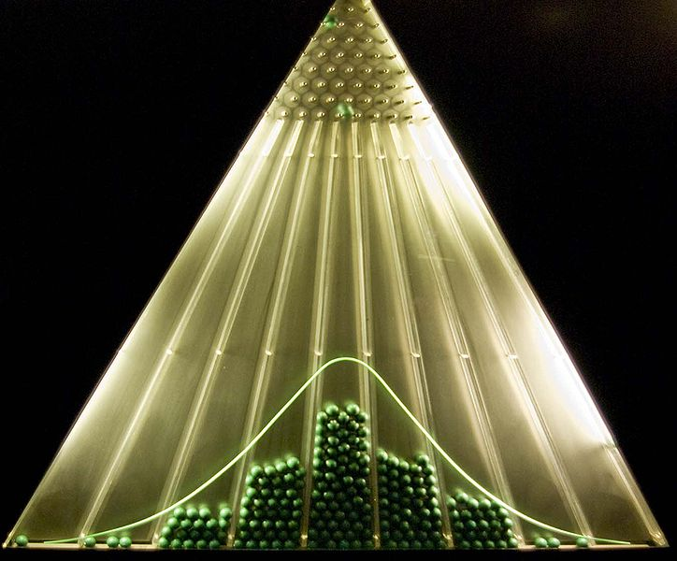
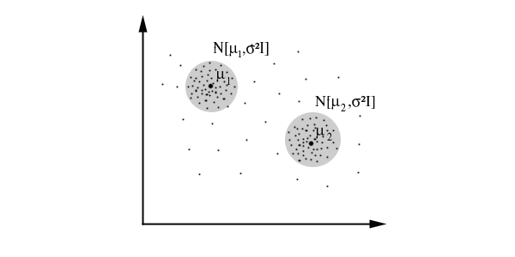
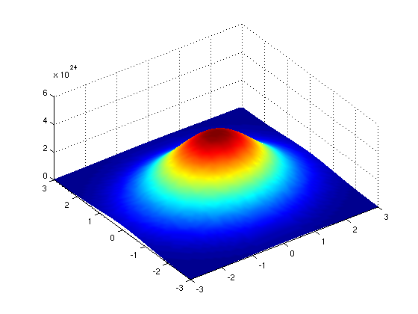
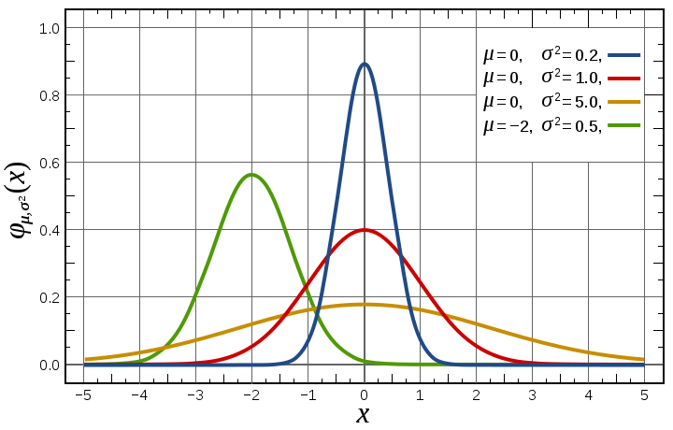
Gaussian Distribution
Bean machine: drop ball with pins
1-d Gaussian
2-d Gaussian
From wikipedia and http://home.dei.polimi.it

Slide 54

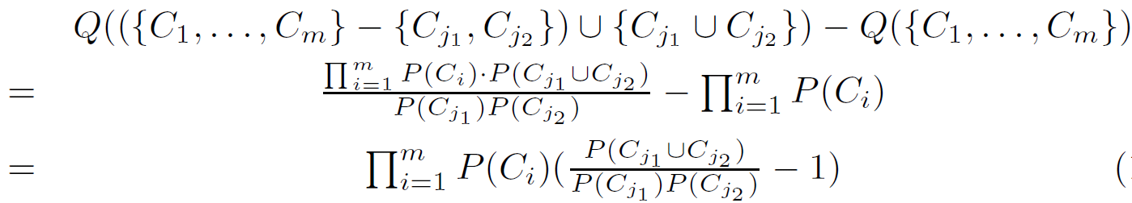
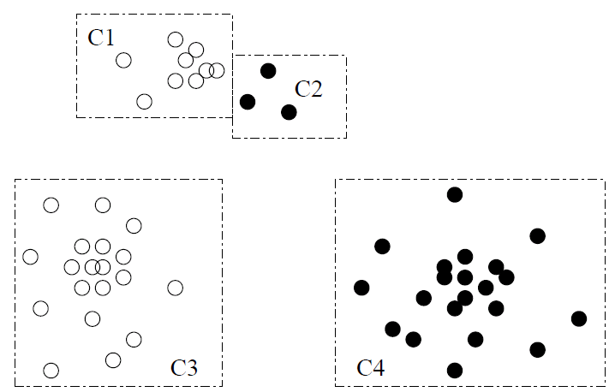

A Probabilistic Hierarchical Clustering Algorithm
For a set of objects partitioned into m clusters C₁, . . . ,C_{m}, the quality can be measured by,
where P() is the maximum likelihood
If we merge two clusters C_{j1} and C_{j2} into a cluster C_{j1}∪C_{j2}, then, the change in quality of the overall clustering is
Distance between clusters C₁ and C₂:
54

Slide 55
Cluster Analysis: Basic Concepts and Methods
Cluster Analysis: Basic Concepts
Partitioning Methods
Hierarchical Methods
Evaluation of Clustering
Summary
Density-Based Methods
Grid-Based Methods
55
55
Notes:
55

Slide 56
Assessing Clustering Tendency
56
Assess if non-random structure exists in the data by measuring the probability that the data is generated by a uniform data distribution
Test spatial randomness by statistic test: Hopkins Static
Given a dataset D regarded as a sample of a random variable o, determine how far away o is from being uniformly distributed in the data space
Sample n points, p₁, …, p_{n}, uniformly from D. For each p_{i}, find its nearest neighbor in D: x_{i} = min{dist (p_{i}, v)} where v in D
Sample n points, q₁, …, q_{n}, uniformly from D. For each q_{i}, find its nearest neighbor in D – {q_{i}}: y_{i} = min{dist (q_{i}, v)} where v in D and v ≠ q_{i}
Calculate the Hopkins Statistic:
If D is uniformly distributed, ∑ x_{i} and ∑ y_{i} will be close to each other and H is close to 0.5. If D is clustered, H is close to 1

Slide 57
Determine the Number of Clusters
Empirical method
# of clusters ≈√n/2 for a dataset of n points
Elbow method
Use the turning point in the curve of sum of within cluster variance w.r.t the # of clusters
Cross validation method
Divide a given data set into m parts
Use m – 1 parts to obtain a clustering model
Use the remaining part to test the quality of the clustering
E.g., For each point in the test set, find the closest centroid, and use the sum of squared distance between all points in the test set and the closest centroids to measure how well the model fits the test set
For any k > 0, repeat it m times, compare the overall quality measure w.r.t. different k’s, and find # of clusters that fits the data the best
57

Slide 58
Measuring Clustering Quality
Two methods: extrinsic vs. intrinsic
Extrinsic: supervised, i.e., the ground truth is available
Compare a clustering against the ground truth using certain clustering quality measure
Ex. BCubed precision and recall metrics
Intrinsic: unsupervised, i.e., the ground truth is unavailable
Evaluate the goodness of a clustering by considering how well the clusters are separated, and how compact the clusters are
Ex. Silhouette coefficient
58

Slide 59
Measuring Clustering Quality: Extrinsic Methods
59
Clustering quality measure: Q(C, C_{g}), for a clustering C given the ground truth C_{g}.
Q is good if it satisfies the following 4 essential criteria
Cluster homogeneity: the purer, the better
Cluster completeness: should assign objects belong to the same category in the ground truth to the same cluster
Rag bag: putting a heterogeneous object into a pure cluster should be penalized more than putting it into a rag bag (i.e., “miscellaneous” or “other” category)
Small cluster preservation: splitting a small category into pieces is more harmful than splitting a large category into pieces

Slide 60
Cluster Analysis: Basic Concepts and Methods
Cluster Analysis: Basic Concepts
Partitioning Methods
Hierarchical Methods
Evaluation of Clustering
Summary
Density-Based Methods
Grid-Based Methods
60
60
Notes:
60

Slide 61
Summary
Cluster analysis groups objects based on their similarity and has wide applications
Measure of similarity can be computed for various types of data
Clustering algorithms can be categorized into partitioning methods, hierarchical methods, density-based methods, grid-based methods, and model-based methods
K-means and K-medoids algorithms are popular partitioning-based clustering algorithms
Birch and Chameleon are interesting hierarchical clustering algorithms, and there are also probabilistic hierarchical clustering algorithms
DBSCAN, OPTICS, and DENCLU are interesting density-based algorithms
STING and CLIQUE are grid-based methods, where CLIQUE is also a subspace clustering algorithm
Quality of clustering results can be evaluated in various ways

Slide 62
References (1)
R. Agrawal, J. Gehrke, D. Gunopulos, and P. Raghavan. Automatic subspace clustering of high dimensional data for data mining applications. SIGMOD'98
M. R. Anderberg. Cluster Analysis for Applications. Academic Press, 1973.
M. Ankerst, M. Breunig, H.-P. Kriegel, and J. Sander. Optics: Ordering points to identify the clustering structure, SIGMOD’99.
Beil F., Ester M., Xu X.: "Frequent Term-Based Text Clustering", KDD'02
M. M. Breunig, H.-P. Kriegel, R. Ng, J. Sander. LOF: Identifying Density-Based Local Outliers. SIGMOD 2000.
M. Ester, H.-P. Kriegel, J. Sander, and X. Xu. A density-based algorithm for discovering clusters in large spatial databases. KDD'96.
M. Ester, H.-P. Kriegel, and X. Xu. Knowledge discovery in large spatial databases: Focusing techniques for efficient class identification. SSD'95.
D. Fisher. Knowledge acquisition via incremental conceptual clustering. Machine Learning, 2:139-172, 1987.
D. Gibson, J. Kleinberg, and P. Raghavan. Clustering categorical data: An approach based on dynamic systems. VLDB’98.
V. Ganti, J. Gehrke, R. Ramakrishan. CACTUS Clustering Categorical Data Using Summaries. KDD'99.

Slide 63
References (2)
D. Gibson, J. Kleinberg, and P. Raghavan. Clustering categorical data: An approach based on dynamic systems. In Proc. VLDB’98.
S. Guha, R. Rastogi, and K. Shim. Cure: An efficient clustering algorithm for large databases. SIGMOD'98.
S. Guha, R. Rastogi, and K. Shim. ROCK: A robust clustering algorithm for categorical attributes. In ICDE'99, pp. 512-521, Sydney, Australia, March 1999.
A. Hinneburg, D.l A. Keim: An Efficient Approach to Clustering in Large Multimedia Databases with Noise. KDD’98.
A. K. Jain and R. C. Dubes. Algorithms for Clustering Data. Printice Hall, 1988.
G. Karypis, E.-H. Han, and V. Kumar. CHAMELEON: A Hierarchical Clustering Algorithm Using Dynamic Modeling. COMPUTER, 32(8): 68-75, 1999.
L. Kaufman and P. J. Rousseeuw. Finding Groups in Data: an Introduction to Cluster Analysis. John Wiley & Sons, 1990.
E. Knorr and R. Ng. Algorithms for mining distance-based outliers in large datasets. VLDB’98.

Slide 64
References (3)
G. J. McLachlan and K.E. Bkasford. Mixture Models: Inference and Applications to Clustering. John Wiley and Sons, 1988.
R. Ng and J. Han. Efficient and effective clustering method for spatial data mining. VLDB'94.
L. Parsons, E. Haque and H. Liu, Subspace Clustering for High Dimensional Data: A Review, SIGKDD Explorations, 6(1), June 2004
E. Schikuta. Grid clustering: An efficient hierarchical clustering method for very large data sets. Proc. 1996 Int. Conf. on Pattern Recognition,.
G. Sheikholeslami, S. Chatterjee, and A. Zhang. WaveCluster: A multi-resolution clustering approach for very large spatial databases. VLDB’98.
A. K. H. Tung, J. Han, L. V. S. Lakshmanan, and R. T. Ng. Constraint-Based Clustering in Large Databases, ICDT'01.
A. K. H. Tung, J. Hou, and J. Han. Spatial Clustering in the Presence of Obstacles, ICDE'01
H. Wang, W. Wang, J. Yang, and P.S. Yu. Clustering by pattern similarity in large data sets, SIGMOD’ 02.
W. Wang, Yang, R. Muntz, STING: A Statistical Information grid Approach to Spatial Data Mining, VLDB’97.
T. Zhang, R. Ramakrishnan, and M. Livny. BIRCH : An efficient data clustering method for very large databases. SIGMOD'96.
Xiaoxin Yin, Jiawei Han, and Philip Yu, “LinkClus: Efficient Clustering via Heterogeneous Semantic Links”, in Proc. 2006 Int. Conf. on Very Large Data Bases (VLDB'06), Seoul, Korea, Sept. 2006.

Slide 65
Cluster Analysis: Basic Concepts and Methods
Cluster Analysis: Basic Concepts
What Is Cluster Analysis?
What is Good Clustering? Measuring the Quality of Clustering
Major categories of clustering methods
Clustering structures
Calculating Distance between Clusters
Partitioning Methods
k-Means: A Classical Partitioning Method
Alternative Methods: k-Medoids, k-Median, and its Variations
Hierarchical Methods
Agglomerative and Divisive Hierarchical Clustering
BIRCH: A Hierarchical, Micro-Clustering Approach
Chameleon: A Hierarchical Clustering Algorithm Using Dynamic Modeling
Density-Based Methods
DBSCAN and OPTICS: Density-Based Clustering Based on Connected Regions
DENCLUE: Clustering Based on Density Distribution Functions
Link-Based Cluster Analysis
SimRank: Exploring Links in Cluster Analysis
LinkClus: Scalability in Link-Based Cluster Analysis
Grid-Based Methods
STING: STatistical INformation Grid
WaveCluster: Clustering Using Wavelet Transformation
CLIQUE: A Dimension-Growth Subspace Clustering Method
Summary
65
Notes:
65

Slide 66
STOP Clustering #1

Slide 67
BIRCH (Balanced Iterative Reducing and Clustering Using Hierarchies)
Zhang, Ramakrishnan & Livny, SIGMOD’96
Incrementally construct a CF (Clustering Feature) tree, a hierarchical data structure for multiphase clustering
Phase 1: scan DB to build an initial in-memory CF tree (a multi-level compression of the data that tries to preserve the inherent clustering structure of the data)
Phase 2: use an arbitrary clustering algorithm to cluster the leaf nodes of the CF-tree
Scales linearly: finds a good clustering with a single scan and improves the quality with a few additional scans
Weakness: handles only numeric data, and sensitive to the order of the data record

Slide 68
Clustering Feature Vector in BIRCH
Clustering Feature (CF): CF = (N, LS, SS)
N: Number of data points
LS: linear sum of N points:
SS: square sum of N points
CF = (5, (16,30),(54,190))
(3,4)
(2,6)
(4,5)
(4,7)
(3,8)

Slide 69
CF-Tree in BIRCH
Clustering feature:
Summary of the statistics for a given subcluster: the 0-th, 1st, and 2nd moments of the subcluster from the statistical point of view
Registers crucial measurements for computing cluster and utilizes storage efficiently
A CF tree is a height-balanced tree that stores the clustering features for a hierarchical clustering
A nonleaf node in a tree has descendants or “children”
The nonleaf nodes store sums of the CFs of their children
A CF tree has two parameters
Branching factor: max # of children
Threshold: max diameter of sub-clusters stored at the leaf nodes

Slide 70
The CF Tree Structure
Root
B = 7
L = 6
CF₁
CF₂
CF₃
CF₆
child₁
child₂
child₃
child₆
Non-leaf node
CF₁
CF₂
CF₃
CF₅
child₁
child₂
child₃
child₅
Leaf node
Leaf node
prev
CF₁
CF₂
CF₆
next
prev
CF₁
CF₂
CF₄
next

Slide 71
The Birch Algorithm
Cluster Diameter
For each point in the input
Find closest leaf entry
Add point to leaf entry and update CF
If entry diameter > max_diameter, then split leaf, and possibly parents
Algorithm is O(n)
Concerns
Sensitive to insertion order of data points
Since we fix the size of leaf nodes, so clusters may not be so natural
Clusters tend to be spherical given the radius and diameter measures

Slide 72
CHAMELEON: Hierarchical Clustering Using Dynamic Modeling (1999)
CHAMELEON: G. Karypis, E. H. Han, and V. Kumar, 1999
Measures the similarity based on a dynamic model
Two clusters are merged only if the interconnectivity and closeness (proximity) between two clusters are high relative to the internal interconnectivity of the clusters and closeness of items within the clusters
Graph-based, and a two-phase algorithm
Use a graph-partitioning algorithm: cluster objects into a large number of relatively small sub-clusters
Use an agglomerative hierarchical clustering algorithm: find the genuine clusters by repeatedly combining these sub-clusters

Slide 73
Cluster Analysis: Basic Concepts and Methods
Cluster Analysis: Basic Concepts
Partitioning Methods
Hierarchical Methods
Density-Based Methods
Grid-Based Methods
Evaluation of Clustering
Summary
73
73
Notes:
73

Slide 74
Density-Based Clustering Methods
Clustering based on density (local cluster criterion), such as density-connected points
Major features:
Discover clusters of arbitrary shape
Handle noise
One scan
Need density parameters as termination condition
Several interesting studies:
DBSCAN: Ester, et al. (KDD’96)
OPTICS: Ankerst, et al (SIGMOD’99).
DENCLUE: Hinneburg & D. Keim (KDD’98)
CLIQUE: Agrawal, et al. (SIGMOD’98) (more grid-based)

Slide 75
Density-Based Clustering: Basic Concepts
Two parameters:
Eps: Maximum radius of the neighbourhood
MinPts: Minimum number of points in an Eps-neighbourhood of that point
N_{Eps}(q): {p belongs to D | dist(p,q) ≤ Eps}
Directly density-reachable: A point p is directly density-reachable from a point q w.r.t. Eps, MinPts if
p belongs to N_{Eps}(q)
core point condition:
|N_{Eps} (q)| ≥ MinPts
p
MinPts = 5
Eps = 1 cm
q

Slide 76
Density-Reachable and Density-Connected
Density-reachable:
A point p is density-reachable from a point q w.r.t. Eps, MinPts if there is a chain of points p₁, …, p_{n}, p₁ = q, p_{n} = p such that p_{i+1} is directly density-reachable from p_{i}
Density-connected
A point p is density-connected to a point q w.r.t. Eps, MinPts if there is a point o such that both, p and q are density-reachable from o w.r.t. Eps and MinPts
p
p₁
q
p
q
o

Slide 77
DBSCAN: Density-Based Spatial Clustering of Applications with Noise
Relies on a density-based notion of cluster: A cluster is defined as a maximal set of density-connected points
Discovers clusters of arbitrary shape in spatial databases with noise
Outlier
Border
Eps = 1cm
MinPts = 5
Core

Slide 78
DBSCAN: The Algorithm
Arbitrary select a point p
Retrieve all points density-reachable from p w.r.t. Eps and MinPts
If p is a core point, a cluster is formed
If p is a border point, no points are density-reachable from p and DBSCAN visits the next point of the database
Continue the process until all of the points have been processed
If a spatial index is used, the computational complexity of DBSCAN is O(nlogn), where n is the number of database objects. Otherwise, the complexity is O(n²)

Slide 79
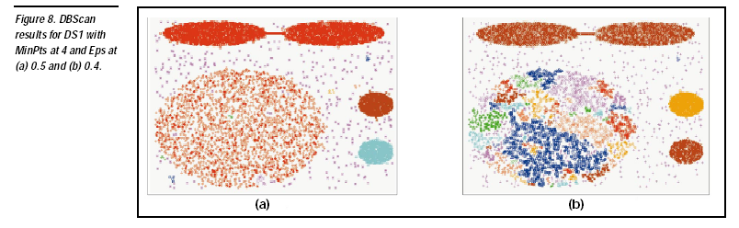

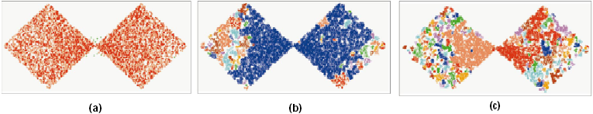
DBSCAN: Sensitive to Parameters
DBSCAN online Demo:
http://webdocs.cs.ualberta.ca/~yaling/Cluster/Applet/Code/Cluster.html

Slide 80
OPTICS: A Cluster-Ordering Method (1999)
OPTICS: Ordering Points To Identify the Clustering Structure
Ankerst, Breunig, Kriegel, and Sander (SIGMOD’99)
Produces a special order of the database wrt its density-based clustering structure
This cluster-ordering contains info equiv to the density-based clusterings corresponding to a broad range of parameter settings
Good for both automatic and interactive cluster analysis, including finding intrinsic clustering structure
Can be represented graphically or using visualization techniques

Slide 81
OPTICS: Some Extension from DBSCAN
Index-based: k = # of dimensions, N: # of points
Complexity: O(N*logN)
Core Distance of an object p: the smallest value ε such that the ε-neighborhood of p has at least MinPts objects
Let N_{ε}(p): ε-neighborhood of p, ε is a distance value
Core-distance_{ε, MinPts}(p) = Undefined if card(N_{ε}(p)) < MinPts
MinPts-distance(p), otherwise
Reachability Distance of object p from core object q is the min radius value that makes p density-reachable from q
Reachability-distance_{ε, MinPts}(p, q) =
Undefined if q is not a core object
max(core-distance(q), distance (q, p)), otherwise

Slide 82
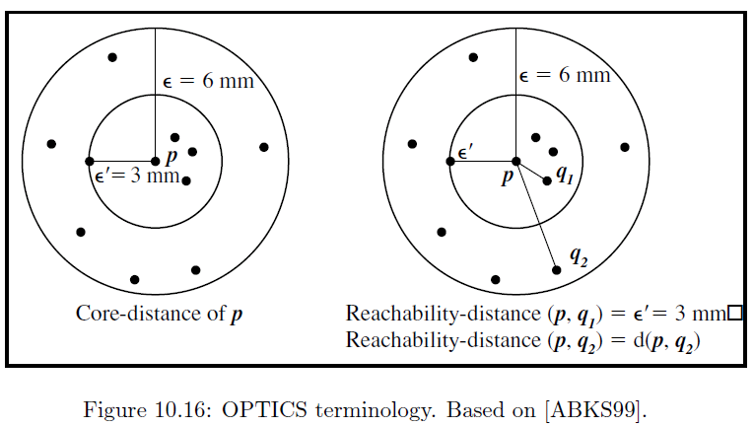
Core Distance & Reachability Distance

Slide 83
Reachability-distance
undefined
‘
Cluster-order of the objects

Slide 84
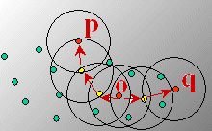
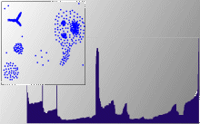
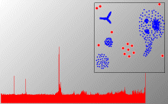
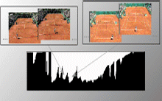
Density-Based Clustering: OPTICS & Applications demo: http://www.dbs.informatik.uni-muenchen.de/Forschung/KDD/Clustering/OPTICS/Demo

Slide 85
DENCLUE: Using Statistical Density Functions
DENsity-based CLUstEring by Hinneburg & Keim (KDD’98)
Using statistical density functions:
Major features
Solid mathematical foundation
Good for data sets with large amounts of noise
Allows a compact mathematical description of arbitrarily shaped clusters in high-dimensional data sets
Significant faster than existing algorithm (e.g., DBSCAN)
But needs a large number of parameters
total influence on x
influence of y on x
gradient of x in the direction of x_{i}

Slide 86
Denclue: Technical Essence
Uses grid cells but only keeps information about grid cells that do actually contain data points and manages these cells in a tree-based access structure
Influence function: describes the impact of a data point within its neighborhood
Overall density of the data space can be calculated as the sum of the influence function of all data points
Clusters can be determined mathematically by identifying density attractors
Density attractors are local maximal of the overall density function
Center defined clusters: assign to each density attractor the points density attracted to it
Arbitrary shaped cluster: merge density attractors that are connected through paths of high density (> threshold)

Slide 87
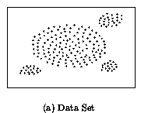
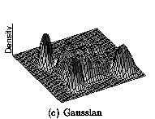
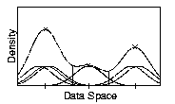
Density Attractor

Slide 88
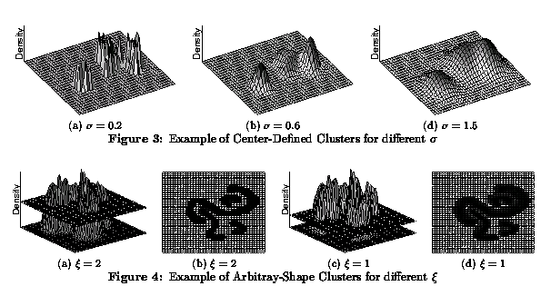
Center-Defined and Arbitrary

Slide 89
Cluster Analysis: Basic Concepts and Methods
Cluster Analysis: Basic Concepts
Partitioning Methods
Hierarchical Methods
Density-Based Methods
Grid-Based Methods
Evaluation of Clustering
Summary
89
89
Notes:
89

Slide 90
Grid-Based Clustering Method
Using multi-resolution grid data structure
Several interesting methods
STING (a STatistical INformation Grid approach) by Wang, Yang and Muntz (1997)
WaveCluster by Sheikholeslami, Chatterjee, and Zhang (VLDB’98)
A multi-resolution clustering approach using wavelet method
CLIQUE: Agrawal, et al. (SIGMOD’98)
Both grid-based and subspace clustering

Slide 91
STING: A Statistical Information Grid Approach
Wang, Yang and Muntz (VLDB’97)
The spatial area is divided into rectangular cells
There are several levels of cells corresponding to different levels of resolution

Slide 92
The STING Clustering Method
Each cell at a high level is partitioned into a number of smaller cells in the next lower level
Statistical info of each cell is calculated and stored beforehand and is used to answer queries
Parameters of higher level cells can be easily calculated from parameters of lower level cell
count, mean, s, min, max
type of distribution—normal, uniform, etc.
Use a top-down approach to answer spatial data queries
Start from a pre-selected layer—typically with a small number of cells
For each cell in the current level compute the confidence interval

Slide 93
STING Algorithm and Its Analysis
Remove the irrelevant cells from further consideration
When finish examining the current layer, proceed to the next lower level
Repeat this process until the bottom layer is reached
Advantages:
Query-independent, easy to parallelize, incremental update
O(K), where K is the number of grid cells at the lowest level
Disadvantages:
All the cluster boundaries are either horizontal or vertical, and no diagonal boundary is detected

Slide 94
CLIQUE (Clustering In QUEst)
Agrawal, Gehrke, Gunopulos, Raghavan (SIGMOD’98)
Automatically identifying subspaces of a high dimensional data space that allow better clustering than original space
CLIQUE can be considered as both density-based and grid-based
It partitions each dimension into the same number of equal length interval
It partitions an m-dimensional data space into non-overlapping rectangular units
A unit is dense if the fraction of total data points contained in the unit exceeds the input model parameter
A cluster is a maximal set of connected dense units within a subspace
94
Notes:
94

Slide 95
CLIQUE: The Major Steps
Partition the data space and find the number of points that lie inside each cell of the partition.
Identify the subspaces that contain clusters using the Apriori principle
Identify clusters
Determine dense units in all subspaces of interests
Determine connected dense units in all subspaces of interests.
Generate minimal description for the clusters
Determine maximal regions that cover a cluster of connected dense units for each cluster
Determination of minimal cover for each cluster
95
Notes:
95

Slide 96
Salary (10,000)
Vacation(week)
7
7
6
6
5
5
4
4
3
3
2
2
1
1
0
age
0
age
20
30
40
50
60
20
30
40
50
60
τ = 3
Vacation
Salary
30
50
age
96
Notes:
96

Slide 97
Strength and Weakness of CLIQUE
Strength
automatically finds subspaces of the highest dimensionality such that high density clusters exist in those subspaces
insensitive to the order of records in input and does not presume some canonical data distribution
scales linearly with the size of input and has good scalability as the number of dimensions in the data increases
Weakness
The accuracy of the clustering result may be degraded at the expense of simplicity of the method
97
Notes:
97

Slide 98
Extra slides unused in class

Slide 99
A Typical K-Medoids Algorithm (PAM)
Total Cost = 20
10
9
8
Arbitrary choose k object as initial medoids
Assign each remaining object to nearest medoids
7
6
5
4
3
2
1
0
0
1
2
3
4
5
6
7
8
9
10
K=2
Randomly select a nonmedoid object,O_{ramdom}
Total Cost = 26
Do loop
Until no change
10
10
9
Compute total cost of swapping
9
Swapping O and O_{ramdom}
If quality is improved.
8
8
7
7
6
6
5
5
4
4
3
3
2
2
1
1
0
0
1
2
3
4
5
6
7
8
9
10
0
0
1
2
3
4
5
6
7
8
9
10

Slide 100
PAM (Partitioning Around Medoids) (1987)
PAM (Kaufman and Rousseeuw, 1987), built in Splus
Use real object to represent the cluster
Select k representative objects arbitrarily
For each pair of non-selected object h and selected object i, calculate the total swapping cost TC_{ih}
For each pair of i and h,
If TC_{ih} < 0, i is replaced by h
Then assign each non-selected object to the most similar representative object
repeat steps 2-3 until there is no change

Slide 101
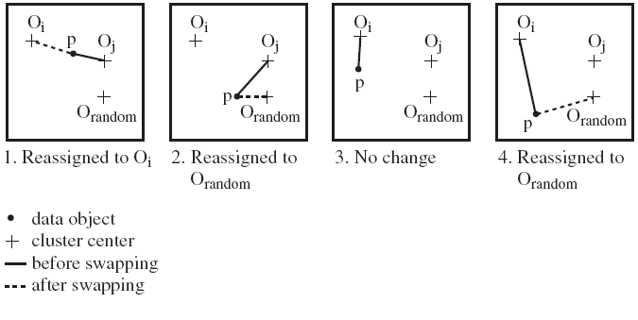
PAM Clustering: Finding the Best Cluster Center
Case 1: p currently belongs to o_{j}. If o_{j} is replaced by o_{random} as a representative object and p is the closest to one of the other representative object o_{i}, then p is reassigned to o_{i}

Slide 102
What Is the Problem with PAM?
Pam is more robust than k-means in the presence of noise and outliers because a medoid is less influenced by outliers or other extreme values than a mean
Pam works efficiently for small data sets but does not scale well for large data sets.
O(k(n-k)² ) for each iteration
where n is # of data,k is # of clusters
Sampling-based method
CLARA(Clustering LARge Applications)

Slide 103
CLARA (Clustering Large Applications) (1990)
CLARA (Kaufmann and Rousseeuw in 1990)
Built in statistical analysis packages, such as SPlus
It draws multiple samples of the data set, applies PAM on each sample, and gives the best clustering as the output
Strength: deals with larger data sets than PAM
Weakness:
Efficiency depends on the sample size
A good clustering based on samples will not necessarily represent a good clustering of the whole data set if the sample is biased

Slide 104
CLARANS (“Randomized” CLARA) (1994)
CLARANS (A Clustering Algorithm based on Randomized Search) (Ng and Han’94)
Draws sample of neighbors dynamically
The clustering process can be presented as searching a graph where every node is a potential solution, that is, a set of k medoids
If the local optimum is found, it starts with new randomly selected node in search for a new local optimum
Advantages: More efficient and scalable than both PAM and CLARA
Further improvement: Focusing techniques and spatial access structures (Ester et al.’95)

Slide 105
ROCK: Clustering Categorical Data
ROCK: RObust Clustering using linKs
S. Guha, R. Rastogi & K. Shim, ICDE’99
Major ideas
Use links to measure similarity/proximity
Not distance-based
Algorithm: sampling-based clustering
Draw random sample
Cluster with links
Label data in disk
Experiments
Congressional voting, mushroom data

Slide 106
Similarity Measure in ROCK
Traditional measures for categorical data may not work well, e.g., Jaccard coefficient
Example: Two groups (clusters) of transactions
C₁. <a, b, c, d, e>: {a, b, c}, {a, b, d}, {a, b, e}, {a, c, d}, {a, c, e}, {a, d, e}, {b, c, d}, {b, c, e}, {b, d, e}, {c, d, e}
C₂. <a, b, f, g>: {a, b, f}, {a, b, g}, {a, f, g}, {b, f, g}
Jaccard co-efficient may lead to wrong clustering result
C₁: 0.2 ({a, b, c}, {b, d, e}} to 0.5 ({a, b, c}, {a, b, d})
C₁ & C₂: could be as high as 0.5 ({a, b, c}, {a, b, f})
Jaccard co-efficient-based similarity function:
Ex. Let T₁ = {a, b, c}, T₂ = {c, d, e}

Slide 107
Link Measure in ROCK
Clusters
C₁:<a, b, c, d, e>: {a, b, c}, {a, b, d}, {a, b, e}, {a, c, d}, {a, c, e}, {a, d, e}, {b, c, d}, {b, c, e}, {b, d, e}, {c, d, e}
C₂: <a, b, f, g>: {a, b, f}, {a, b, g}, {a, f, g}, {b, f, g}
Neighbors
Two transactions are neighbors if sim(T₁,T₂) > threshold
Let T₁ = {a, b, c}, T₂ = {c, d, e}, T₃ = {a, b, f}
T₁ connected to: {a,b,d}, {a,b,e}, {a,c,d}, {a,c,e}, {b,c,d}, {b,c,e}, {a,b,f}, {a,b,g}
T₂ connected to: {a,c,d}, {a,c,e}, {a,d,e}, {b,c,e}, {b,d,e}, {b,c,d}
T₃ connected to: {a,b,c}, {a,b,d}, {a,b,e}, {a,b,g}, {a,f,g}, {b,f,g}
Link Similarity
Link similarity between two transactions is the # of common neighbors
link(T_{1,} T₂) = 4, since they have 4 common neighbors
{a, c, d}, {a, c, e}, {b, c, d}, {b, c, e}
link(T_{1,} T₃) = 3, since they have 3 common neighbors
{a, b, d}, {a, b, e}, {a, b, g}

Slide 108
Rock Algorithm
Method
Compute similarity matrix
Use link similarity
Run agglomerative hierarchical clustering
When the data set is big
Get sample of transactions
Cluster sample
Problems:
Guarantee cluster interconnectivity
any two transactions in a cluster are very well connected
Ignores information about closeness of two clusters
two separate clusters may still be quite connected

