Slide 1
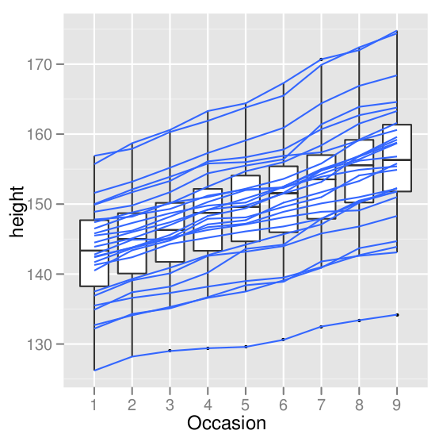
Data visualization and graphic design
Part I: The grammar of graphics and ggplot2
Part II: Principles of data visualization
Allan Just and Andrew Rundle
EPIC Short Course
June 23, 2011
Wickham 2008
Notes:
R can be downloaded from http://cran.r-project.org/ and is available free for Windows, Mac OS X, and Linux.

Slide 2
Part I: The grammar of graphics and ggplot2
Objectives
Revisit the grammar of graphics to describe graphs
Discuss in greater depth the components of the grammar with examples
Customizing plot limits, labels, axes
Exporting for PowerPoint or elsewhere…

Slide 3
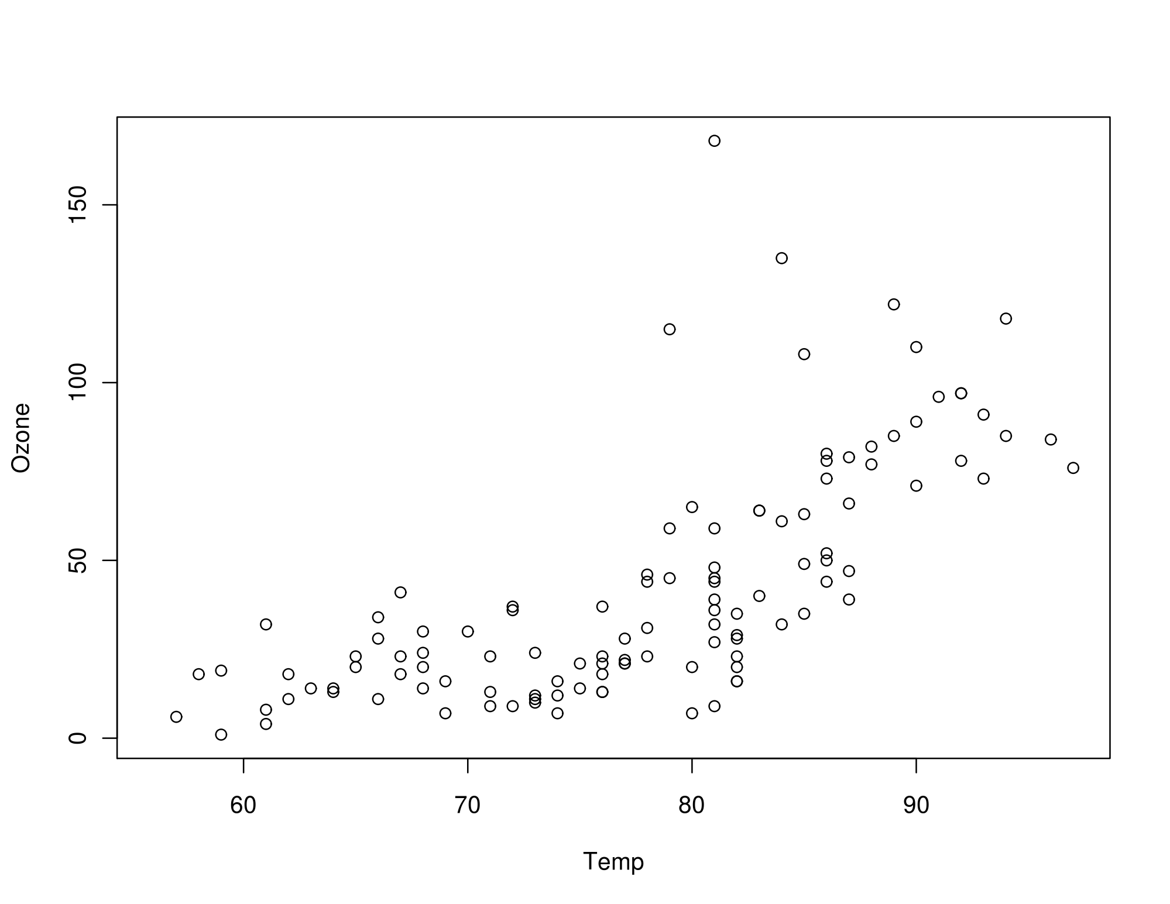
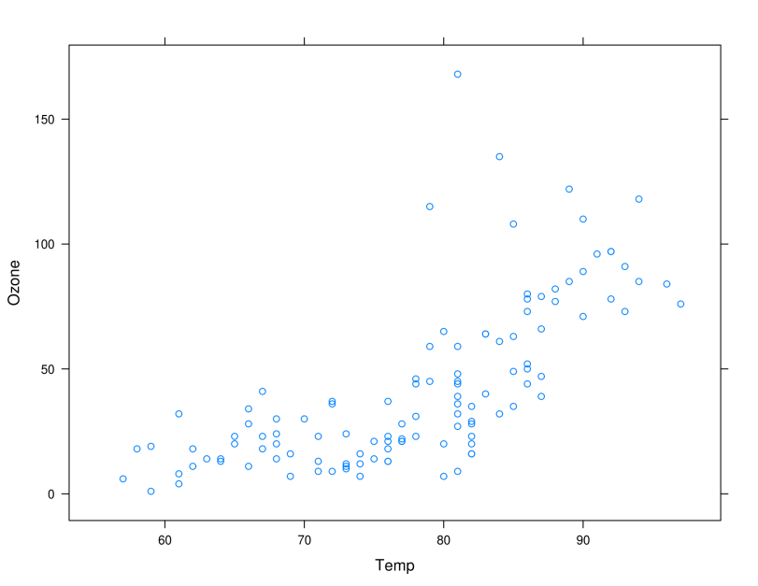
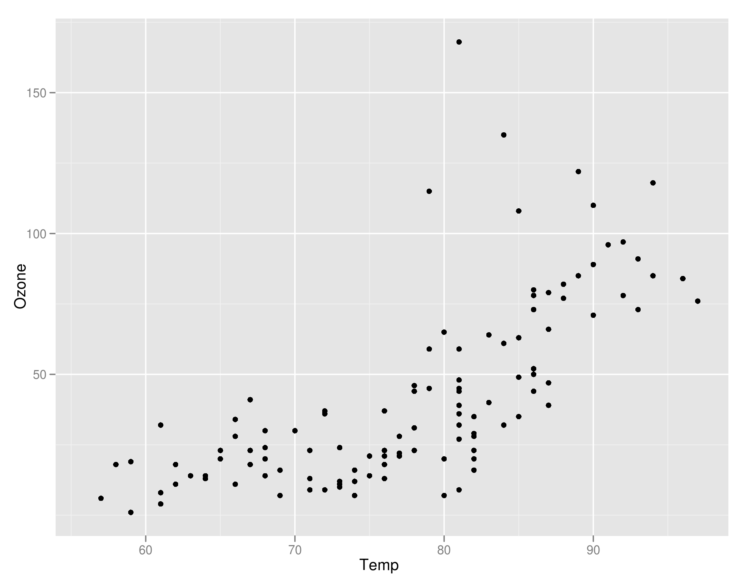
R graphics – 3 main "dialects"
base: with(airquality, plot(Temp, Ozone))
lattice: xyplot(Ozone ~ Temp, airquality)
ggplot2:
ggplot(airquality, aes(Temp, Ozone)) + geom_point( )
Notes:
Daily NYC air quality measures from 1973 (Chambers 1983)

Slide 4
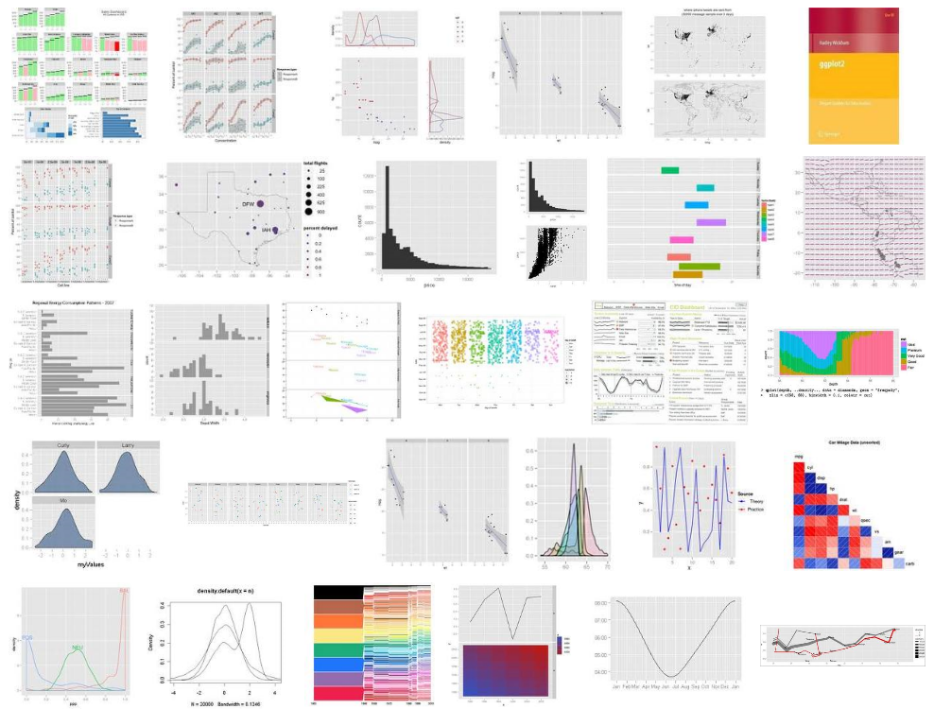
Google image search: ggplot2

Slide 5

ggplot2 philosophy
Written by Hadley Wickham (Rice Univ.)
Extends The Grammar of Graphics (Wilkinson, 2005)
All graphs can be constructed by combining specifications with data (Wilkinson, 2005).
A specification is a structured way to describe how to build the graph from geometric objects (points, lines, etc.) projected on to scales (x, y, color, size, etc.)

Slide 6
ggplot2 philosophy
When you can describe the content of the graph with the grammar, you don’t need to know the name of a particular type of plot…
Dot plot, forest plot, Manhattan plot are just special cases of this formal grammar.
…a plotting system with good defaults for a large set of components that can be combined in flexible and creative ways…

Slide 7
Building a plot in ggplot2
data to visualize (a data frame)
map variables to aesthetic attributes
geometric objects – what you see (points, bars, etc)
scales map values from data to aesthetic space
faceting subsets the data to show multiple plots
statistical transformations – summarize data
coordinate systems put data on plane of graphic
Wickham 2009

Slide 8
A basic ggplot2 graph
ggplot(airquality) + geom_point(aes(x = Temp, y = Ozone))
Aesthetics map variables to scales
Data
Geometric objects to display

Slide 9
We are skipping "qplot" !
ggplot(airquality) + geom_point(aes(Temp, Ozone))
There is a more brief syntax:
qplot(Temp, Ozone, data = airquality)
BUT:
Can't build up complex or polished graphics
Written to be similar to syntax of base graphics

Slide 10
Building a plot in ggplot2
data to visualize (a data frame)
map variables to aesthetic attributes
geometric objects – what you see (points, bars, etc)
scales map values from data to aesthetic space
ggplot(airquality) + geom_point(aes(x = Temp, y = Ozone))
Aesthetics map variables to scales
Data
Geometric objects to display
Wickham 2009

Slide 11
Building a plot in ggplot2
data to visualize (a data frame)
map variables to aesthetic attributes
geometric objects – what you see (points, bars, etc)
statistical transformations – summarize data
scales map values from data to aesthetic space
faceting subsets the data to show multiple plots
coordinate systems put data on plane of graphic
Wickham 2009

Slide 12
Moving beyond templates
data(airquality)
str(airquality)
Let’s do the scatterplot template again…

Slide 13
ggplot2: the parts of speech data
ggplot2 expects a data.frame:
Rows: observations
Columns: variables
diamonds <- data.frame(carat, cut, price)
carat cut price
1 0.23 Ideal 326
2 0.21 Premium 326
3 0.23 Good 327
4 0.29 Premium 334
Different layers can work with different data
(e.g. a precomputed summary in another data frame)

Slide 14
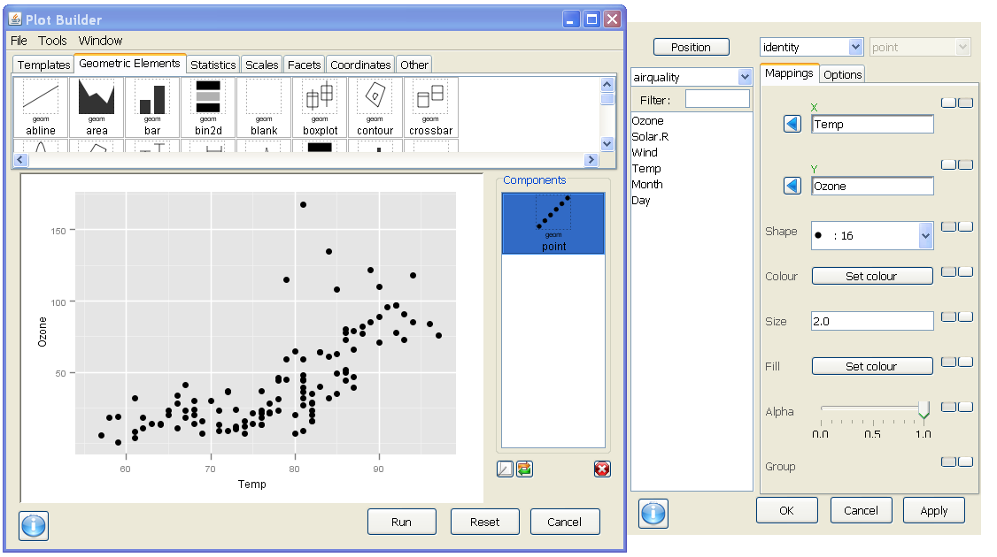
data in Deducer
Drop-down of data.frames currently loaded

Slide 15
ggplot2: the parts of speech aesthetics
aesthetics map variables in the data to visual properties of geoms
aesthetics include:
x, y position (the first two by default),
color, fill,
shape, linetype,
size, group,
(depending on the geom)
Done within a call to aes(x, y, ...)
If done in a call to ggplot(), mappings inherited by all geoms by default:
ggplot(airquality, aes(x = Temp, y = Ozone)) + geom_point()
But you can add, override, or remove these for subsequent layers

Slide 16
ggplot2: the parts of speech aesthetics
aesthetics map variables in the data to visual properties of geoms
aesthetics include:
x, y position
color, fill,
shape, size, linetype,
alpha, group,
(depending on the geom)

Slide 17
Different aesthetics for different geoms
geom_point()
X
Y
Shape
Colour
Size
Fill
Alpha
Group

Slide 18
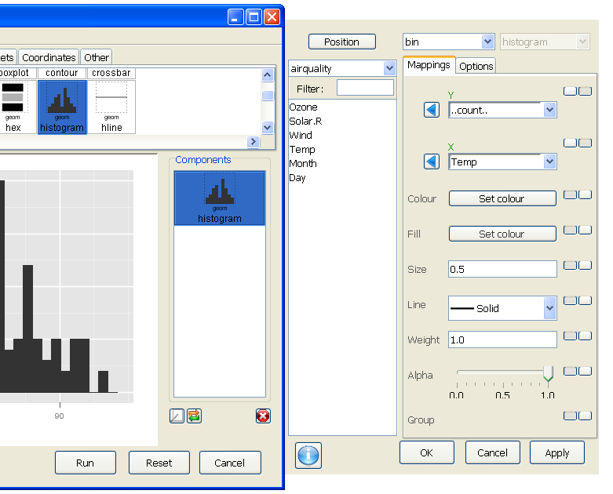
Different aesthetics for different geoms
geom_histogram()
Y
X
Colour
Fill
Size
Line
Weight
Alpha
Group
Points &
lines
Areas (inside
Polygons)

Slide 19
ggplot2: the parts of speech aesthetics
aesthetics map variables in the data to visual properties of geoms
Mapping: variable ↔ visual property
Done within call to aes(x, y, ...)
ggplot(data = airquality) +
geom_point(aes(x = Temp, y = Ozone, color = Month))
Color is mapped to month
Setting: fixed value → visual property
Done outside call to aes(x, y, ...)
ggplot(data = airquality) +
geom_point(aes(x = Temp, y = Ozone), color = "red")
Color is set to "red" – not looking for a variable named "red"

Slide 20
Deducer: mapping vs setting
Column of buttons
switch between states
These two are
being mapped
Remainder are set
(using default settings)

Slide 21
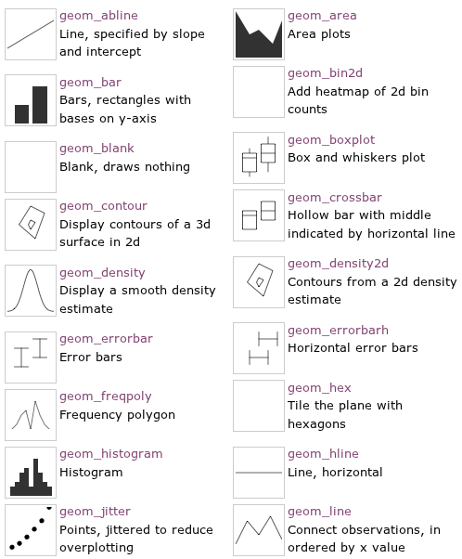
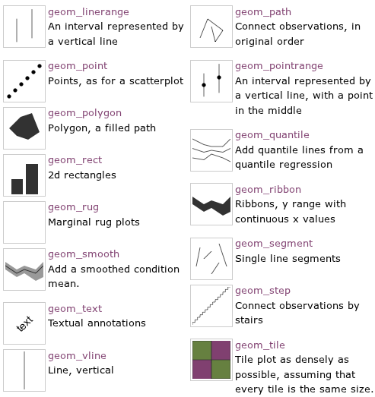
ggplot2: the parts of speech geometric objects
geoms can be simple (point, line, polygon, bar) or built from these components (boxplot, histogram, …)

Slide 22
ggplot2: the parts of speech statistical transformations
Stats are transformations that summarize the data
Each stat has a default geom and vice-versa
Geom | Stat (default)
geom_histogram | "bin"
geom_boxplot | "boxplot"
geom_point | "identity"

Slide 23
If you specify a geom
you can change the stat

Slide 24
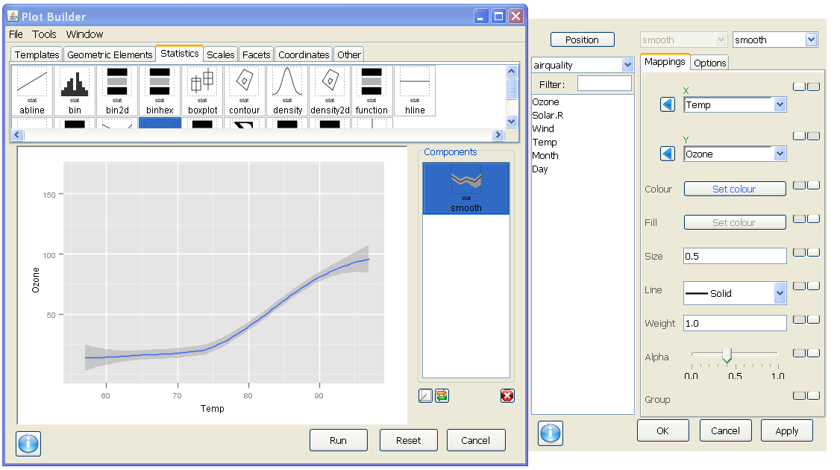
If you specify the stat
You can change the geom

Slide 25
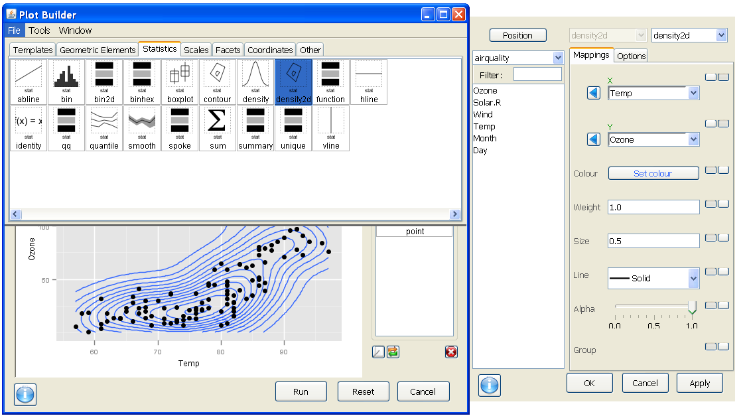
Some cool stats

Slide 26
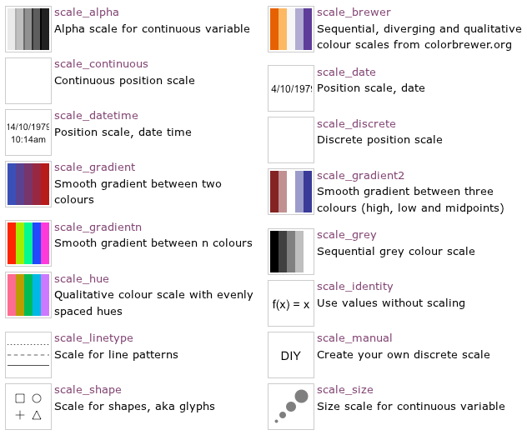
ggplot2: the parts of speech scales
scales control the mapping between data and aesthetics

Slide 27
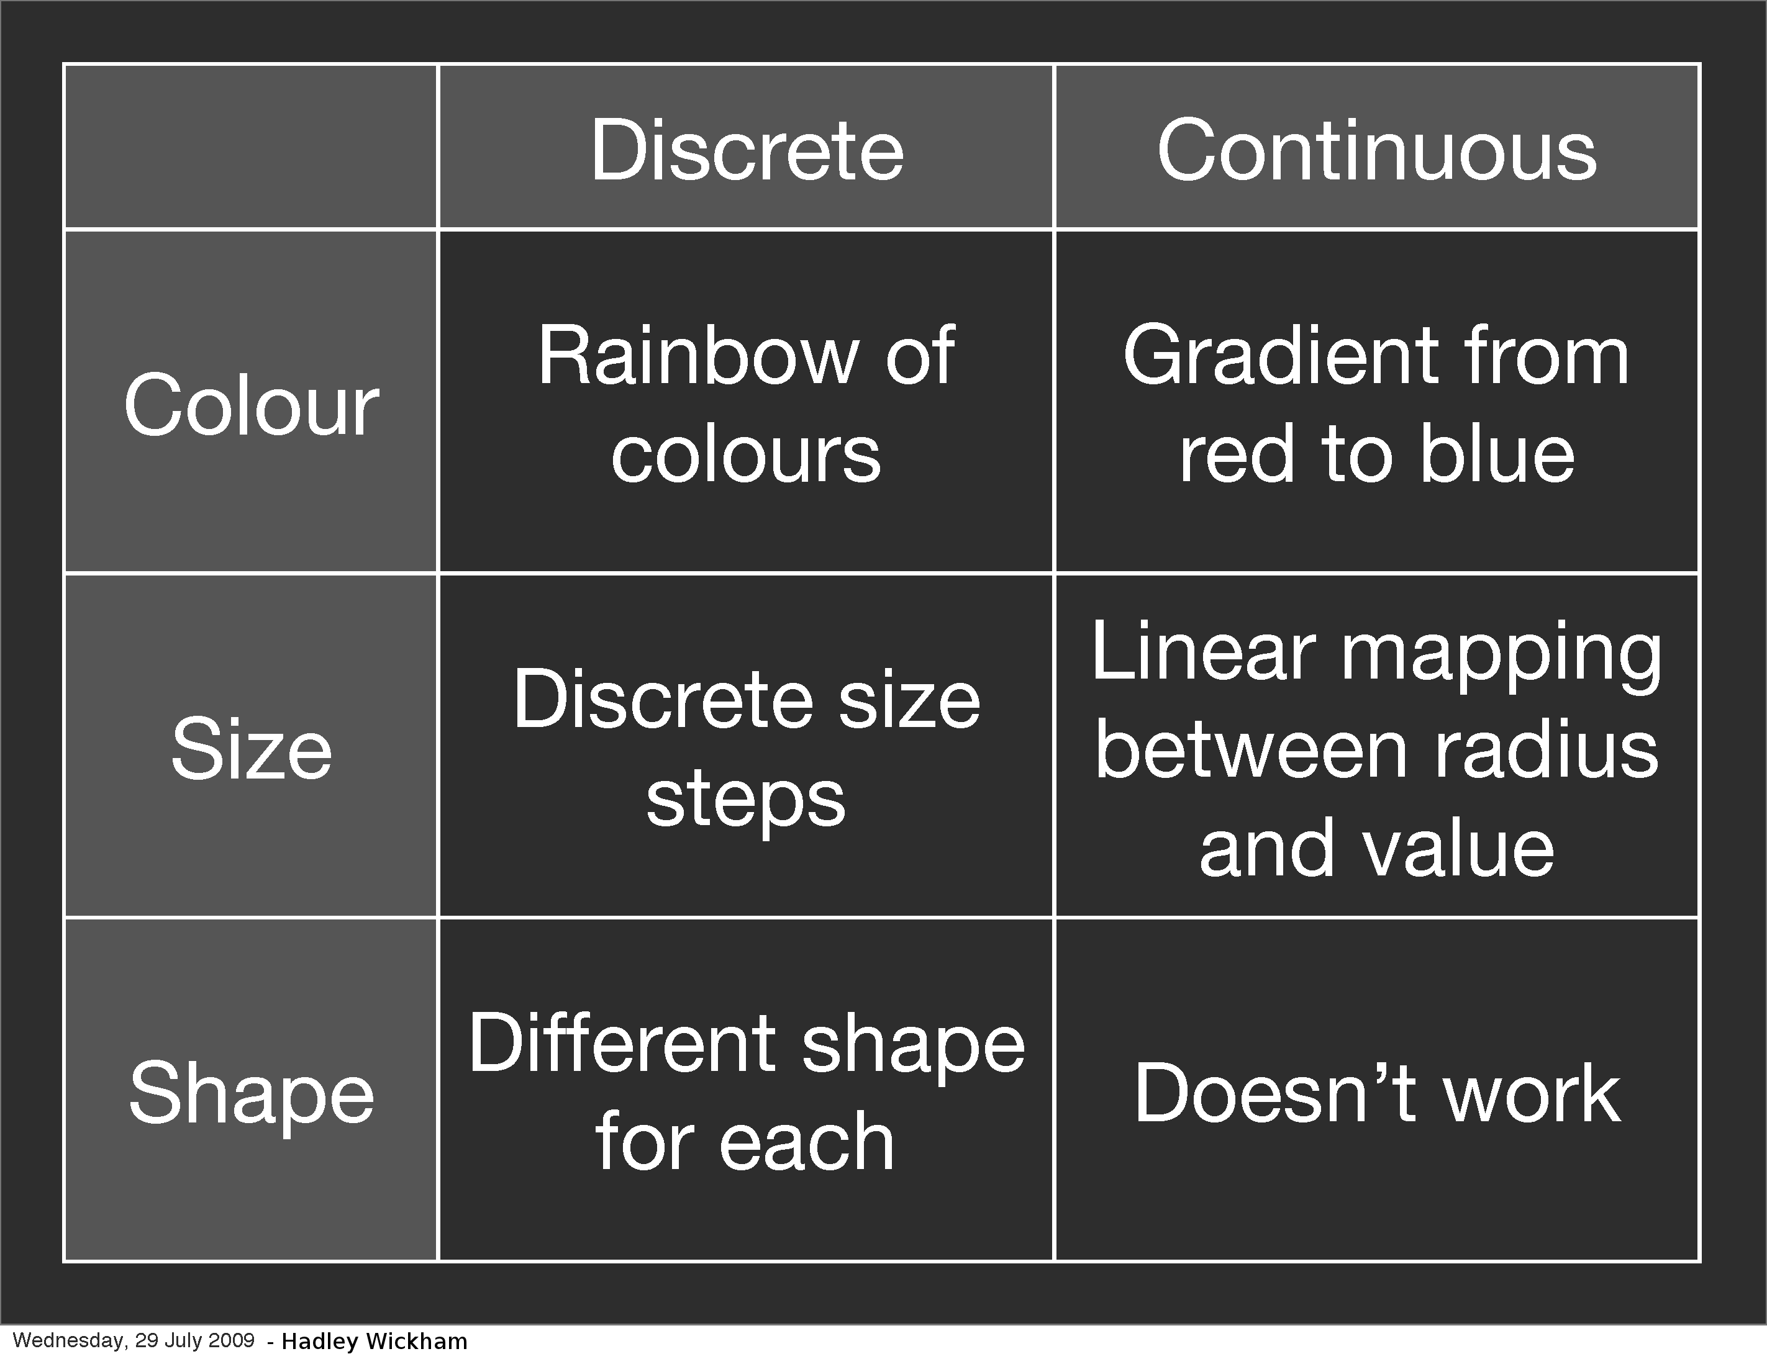

Slide 28
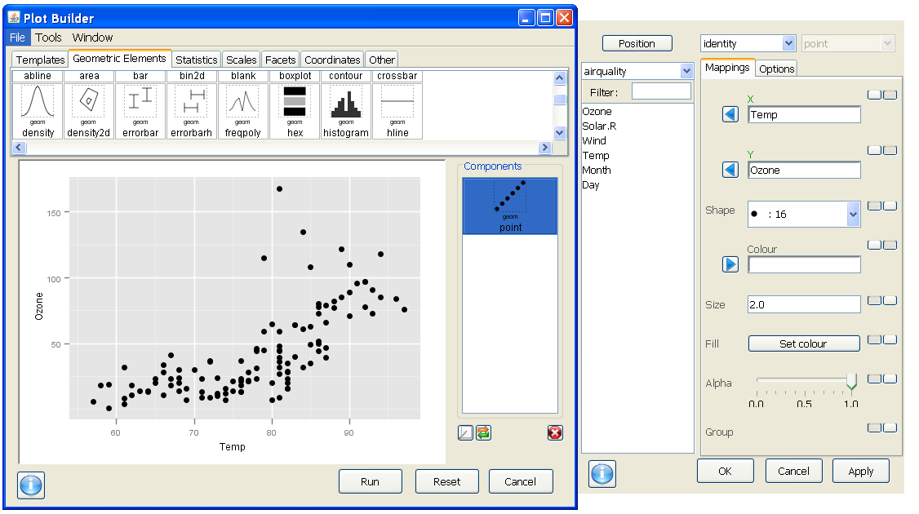
Imagine we wanted to show month for lookup – not gradation

Slide 29
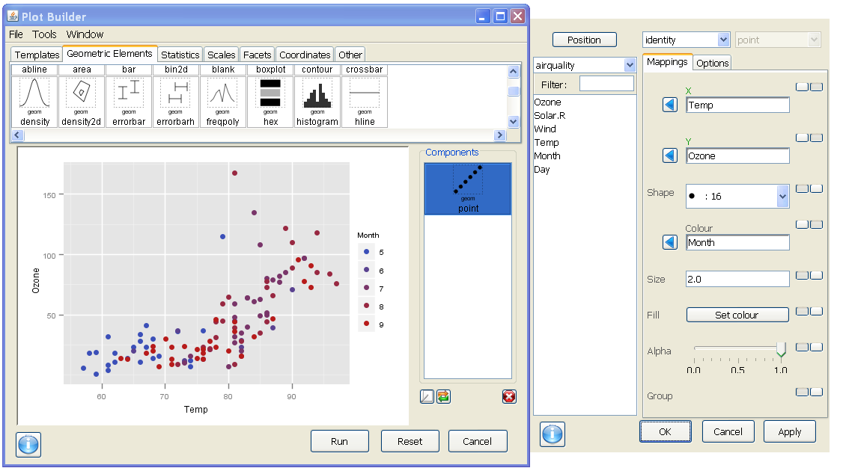
But by default – continuous variables map to a color gradient

Slide 30
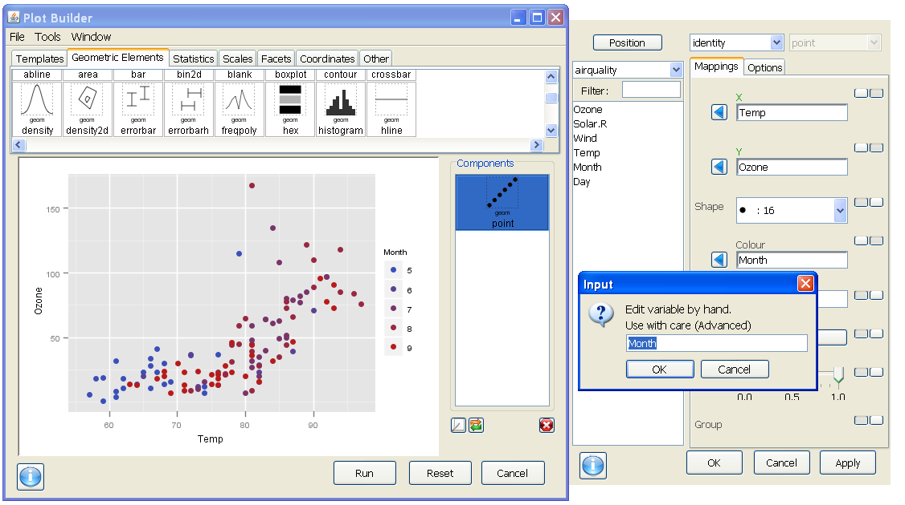
Trick! If you right-click in a mapped field you can edit

Slide 31

Recall that R stores categorical variables as factors

Slide 32
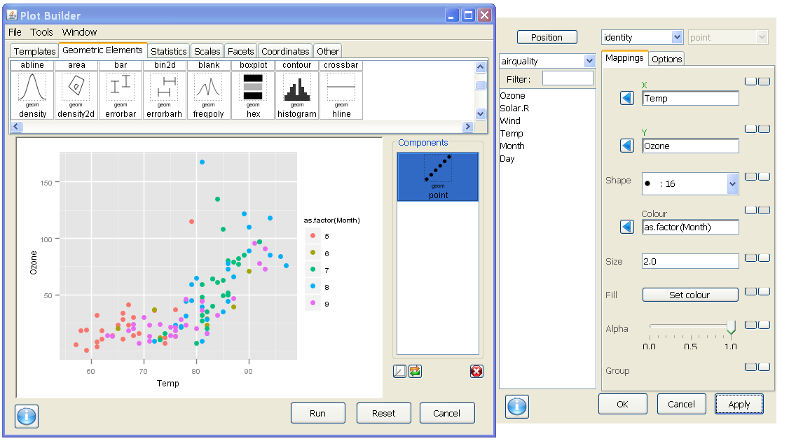
But now we have an ugly variable name and labels are still bad

Slide 33
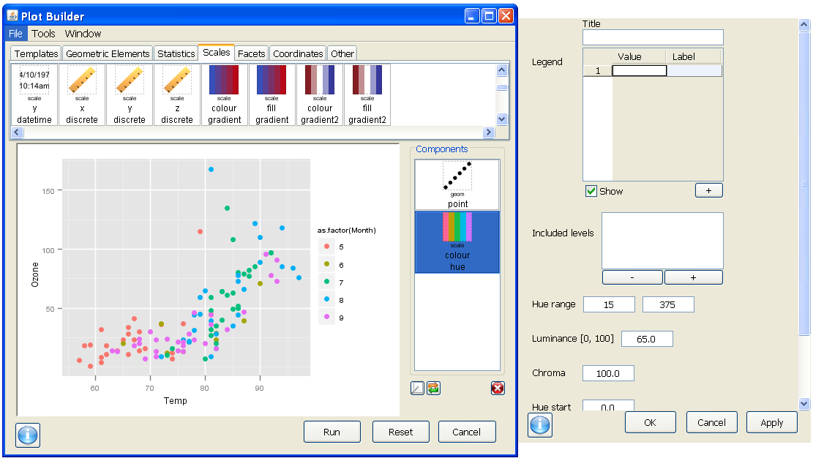
We can add in a call to the color scale for discrete vars – "colour hue"

Slide 34
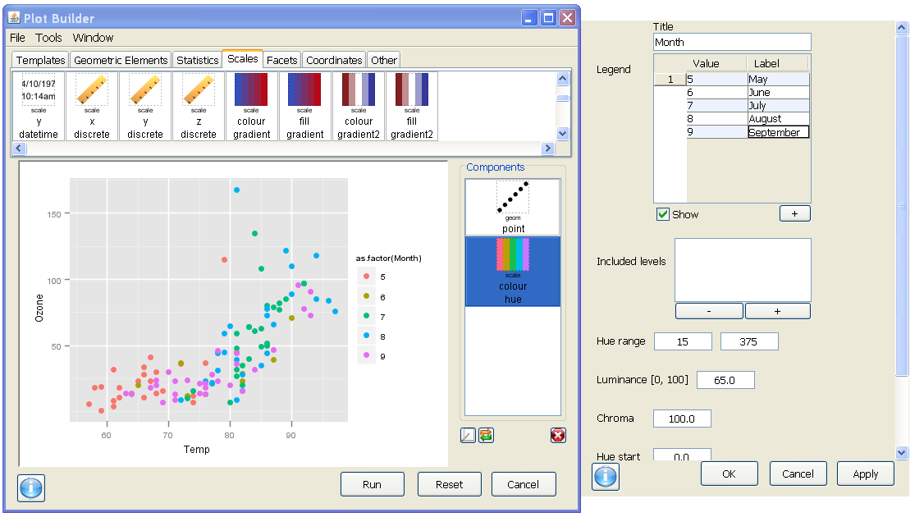
Menus allow us to fix the title and specify meaningful labels

Slide 35
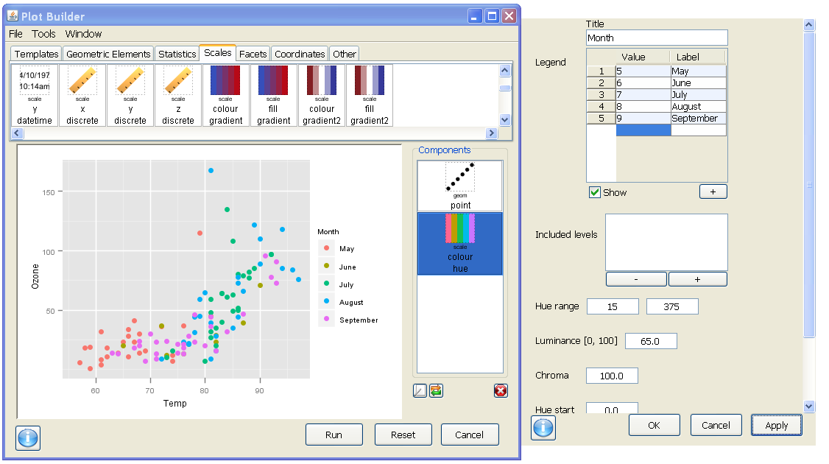
Mission accomplished!

Slide 36
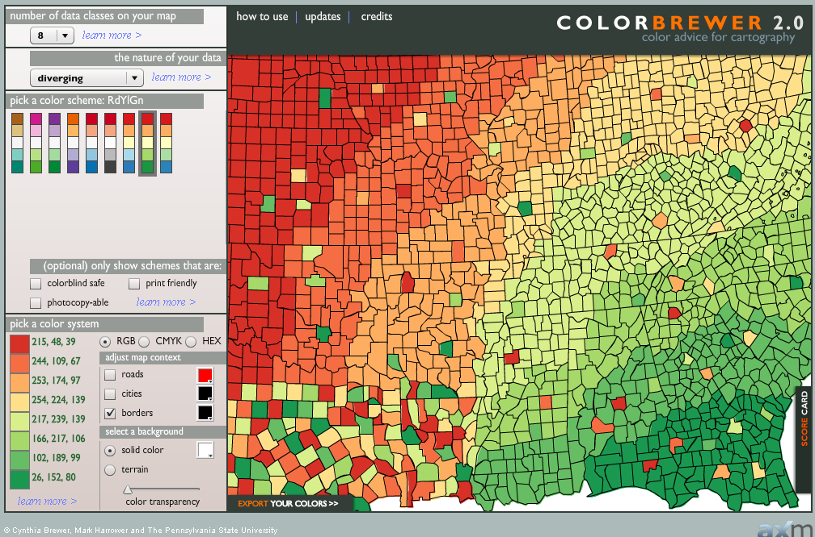
Picking colors – RColorBrewer package
colorbrewer.org

Slide 37
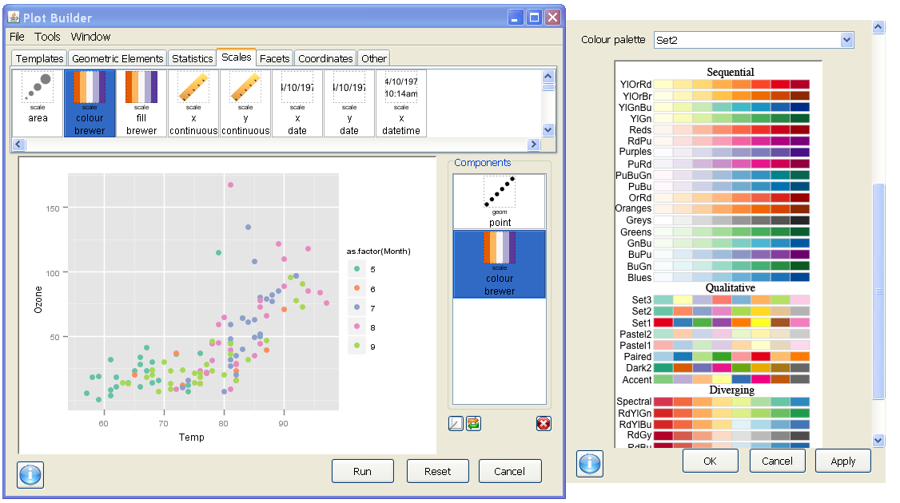
Using one of the qualitative palettes

Slide 38
ggplot2: the parts of speech facets
facets are subsets of the data to be displayed next to each other as "small multiples"
facet_grid(rowvar ~ columnvar)
Use a period to represent no split: facet_grid( . ~ .)
facet_wrap( ~ facetvar)
wrap a 1D ribbon of plot panels into a 2D space
can specify ncol = #, nrow = #
scales control whether shared or independent scales
“fixed” (default)
Also possible: “free_x”, “free_y”, “free”

Slide 39
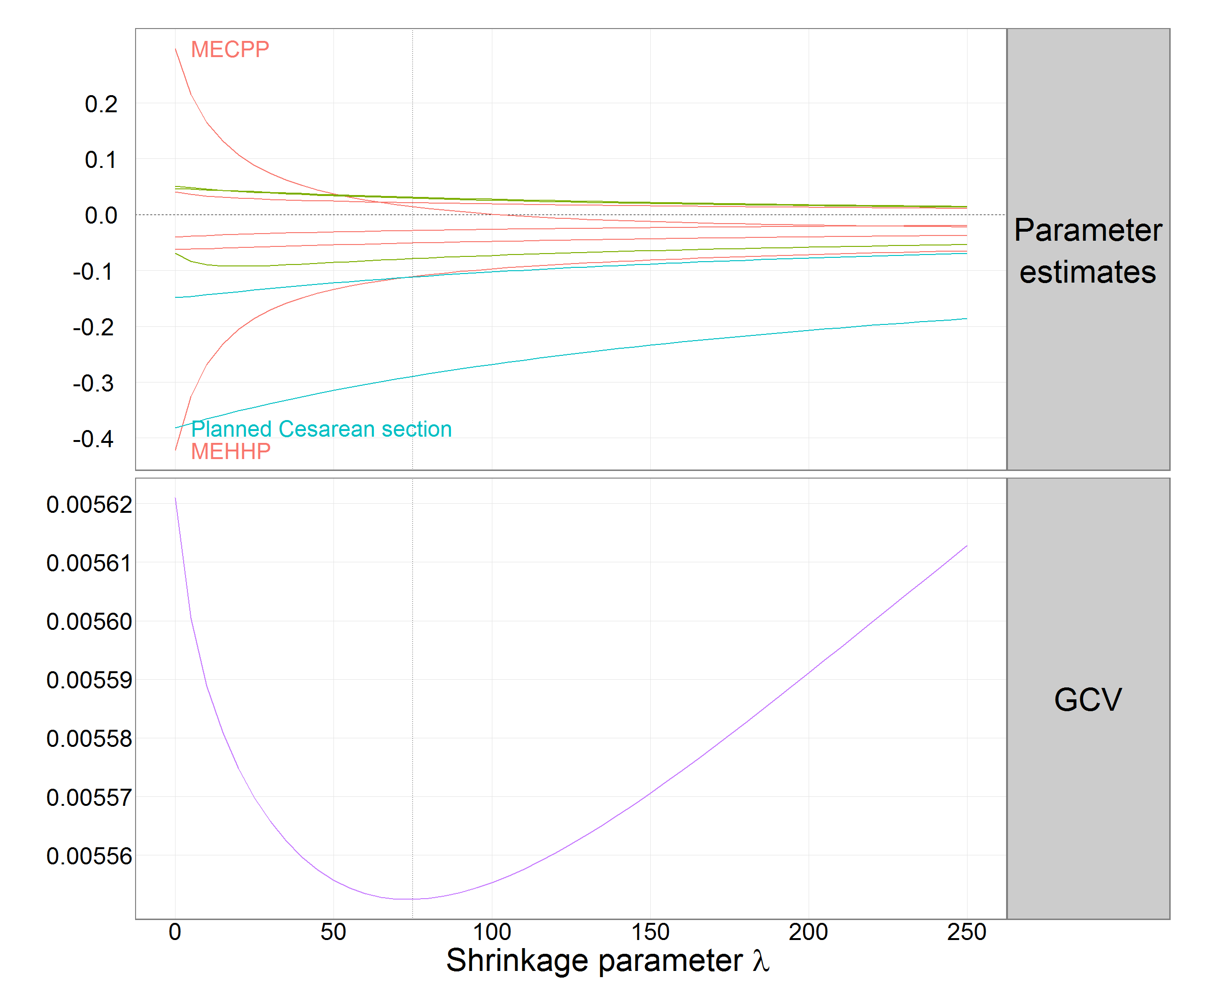
Example of facetting for a common x-axis:
+ facet_grid(datatype ~ ., scales = "free_y") +

Slide 40
Let’s facet our airquality scatterplot by Month
facet_grid()
A bug in Deducer – menu for rows and columns are switched in facet_grid in the GUI
obvious when we look at our call
Also – some issues in implementation of facet_wrap (specification of ncol or nrow)
Let’s modify this in code to see how it should work

Slide 41
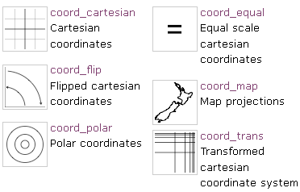
ggplot2: the parts of speech coordinate systems
"coordinate systems adjust the mapping from coordinates to the 2d plane of the computer screen"
Default is coord_cartesian()
Could use coord_polar() for cyclical data like a windrose
had.co.nz/ggplot2/

Slide 42
Example with coord_flip
How do we make horizontal boxplots?
Using Ozone from airquality,
start with geom_boxplot:
Let’s use our old trick to categorize the Month variable
happens automatically because boxplots are continuous by discrete.
Design will be Ozone ~ as.factor(Month)

Slide 43
ggplot2: the parts of speech coordinate systems
"coordinate systems adjust the mapping from coordinates to the 2d plane of the computer screen"
Default is coord_cartesian()
This is the best place to zoom in to your data
A cautionary example…
had.co.nz/ggplot2/

Slide 44
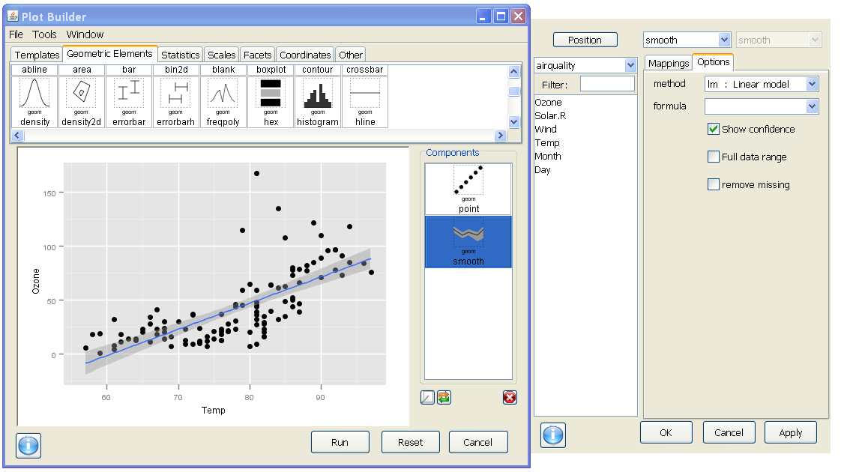
Let's say we wanted to zoom in on y-values less than 100

Slide 45
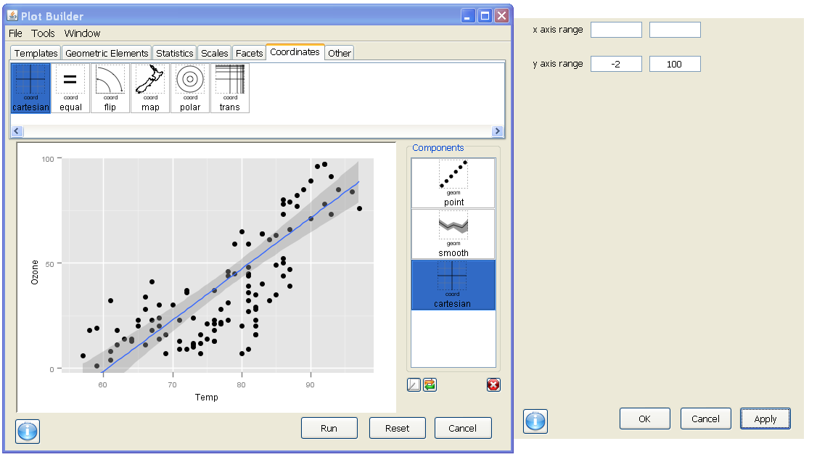
With coord_cartesian we can set a range for our axis…

Slide 46
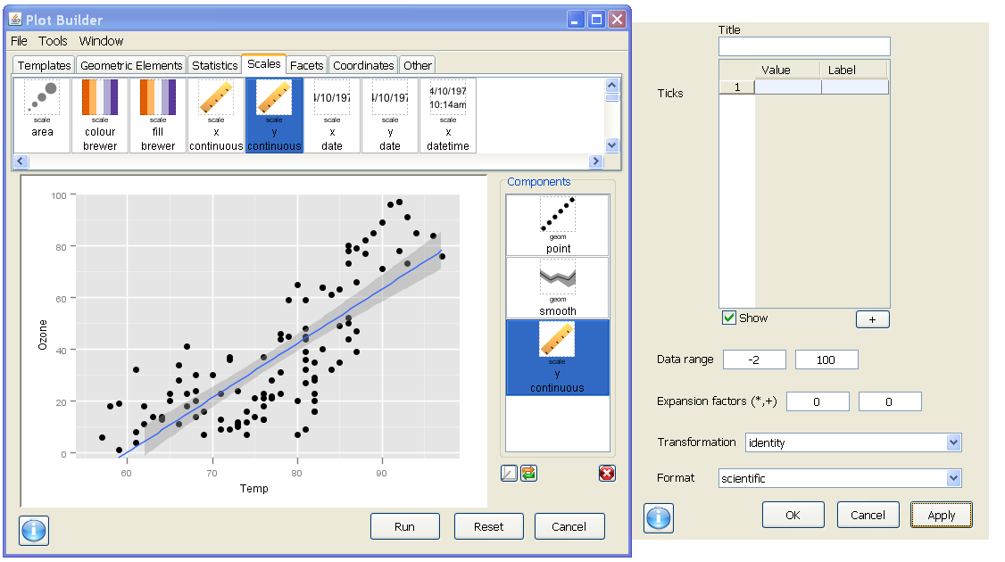
Whereas scale_y_continuous is actually subsetting our data range …

Slide 47
"Other" – a little bit of polish
Themes are sets of specifications for adjustable elements like labels, legends, titles, tickmarks, margins, and backgrounds
theme_grey() the default look of ggplot2
theme_bw() an alternative in black & white

Slide 48
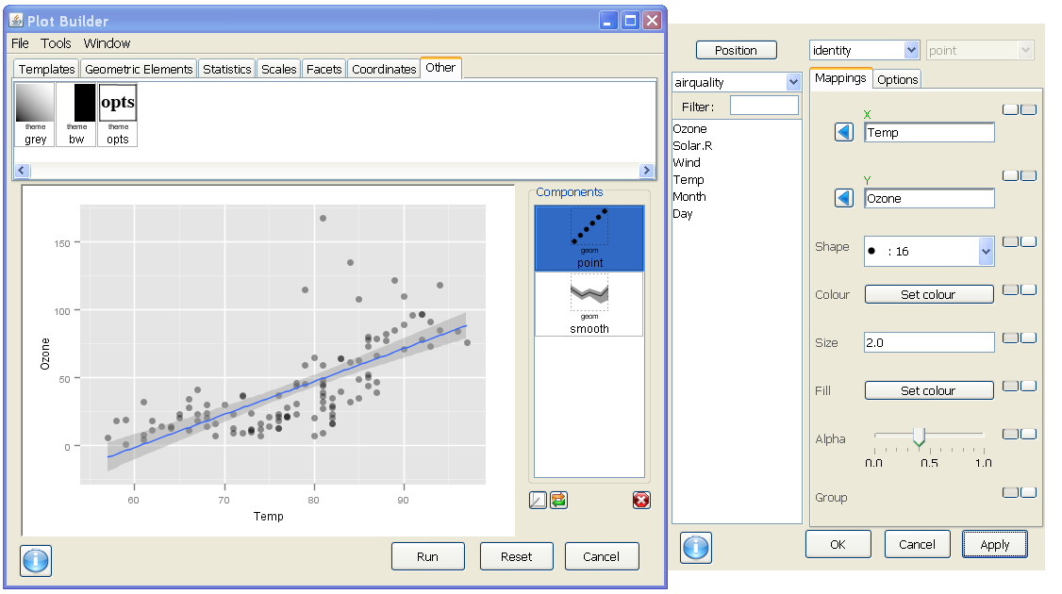
Note the grey background with light gridlines – default theme_grey()

Slide 49
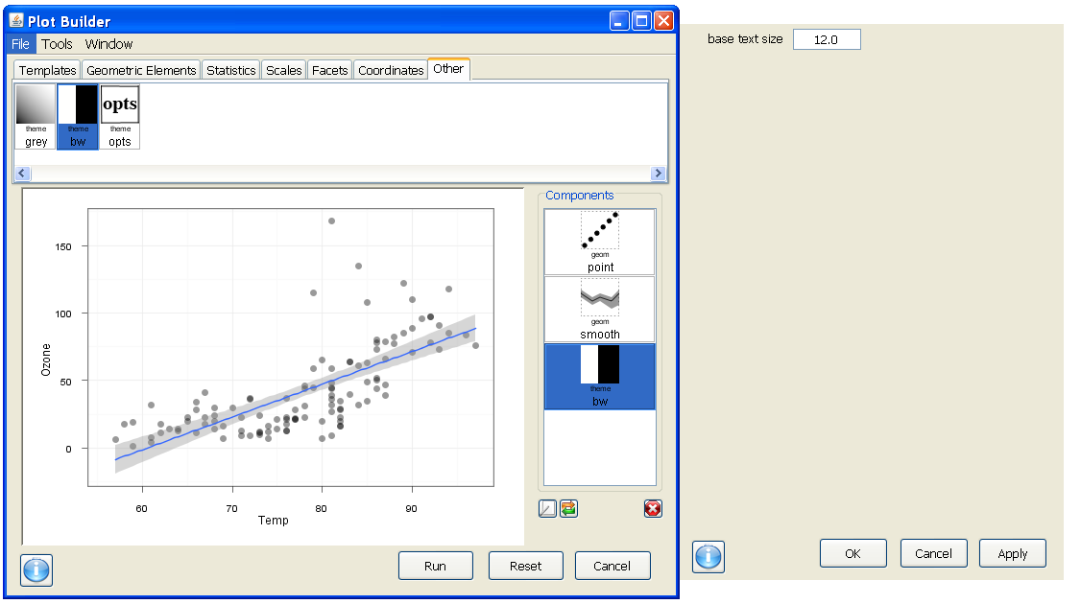
The new theme changed our gridlines to be dark on white

Slide 50
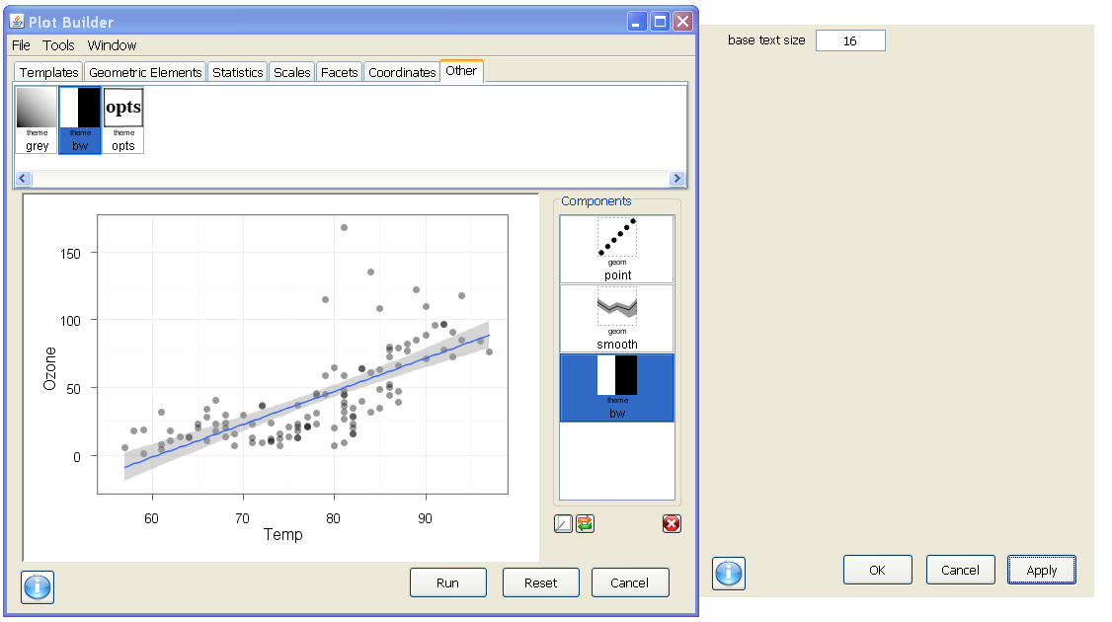
We can boost base_size to scale all of the figure text up in size

Slide 51
Saving your code/process
R is fundamentally a command line language
Can't easily reload R code into Deducer's plot builder
Deducer specific .ggp file type to reload the plot builder
Plot Builder → File → Save
But, saving the R code allows you and others to reuse the code from within R

Slide 52
Saving your output
after you hit 'Run' and exit the Plot Builder…
The plot window JavaGD has a File menu with options for saving as:
PDF
PNG
JPG
and others …
I prefer PNG for PowerPoint, PDF to send to colleagues

Slide 53
Saving your output
I like to leave space to do my title in powerpoint
To control the size of the output
Use the ggsave() function:
ggsave(file, fig, height = 6.5, width = 10)
defaults to 300 dpi
A default powerpoint slide is 7.5" high
and 10" wide

Slide 54
Getting help!
In R:
in the JGR console → Help
?ggsave
In the Plot Builder:
Right-click on any tile in the top portion of the Plot Builder to get option to open the relevant ggplot2 help webpage
Click on button in lower left
for Deducer help page

Slide 55
Deducer recap
Currently implements almost all of ggplot2
Add new features to the plot with
Geometric Elements or Statistics
Modify features or the look of the plot with
Scales, Facets, Coordinates, Other
Save a .ggp file to bring back into plot builder
Save R code for automation, a larger audience of R users, or additional customization
Export graphs with ggsave() function

Slide 56
Infant mortality - 1970
Your turn: let's look at a new dataset
data(Leinhardt)
str(Leinhardt)
# how many records?
?Leinhardt #bring up help
Packages & Data → Data Viewer
What is the top rate of infant mortality
per 1000 live births?
To Plot!
How did infant mortality vary by region?

Slide 57
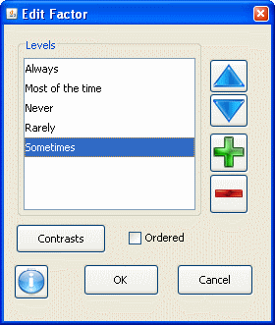
Reorder categorical variable levels
R stores categorical variables as factors
Order of the factor levels matters:
determines order of facets
determines order in discrete scales
(and their legends)
Use an order that is meaningful
Not just “Alabama ordering
Deducer menu
Data – Edit Factor

Slide 58
Preview for tomorrow
Advanced graphs with ggplot2
Objectives
Redesign graphics to aid graphical perception
Compare data graphic designs for small datasets
Explore graphical display strategies for large datasets
Combine data with statistical summaries and estimates of uncertainty
Advanced polishing of your plots
Extending ggplot2 with other packages

Slide 59
Since R is free,
you should install it at home or
work and play with it!

Slide 60
A few helpful R links
Download R: http://cran.r-project.org/ available for Windows, Mac OS X, and Linux
Advice – A clearly stated question with a reproducible example is far more likely to get help. You will often find your own solution by restating where you are getting stuck in a clear and concise way.
Writing reproducible examples: https://gist.github.com/270442
General R links
http://statmethods.net/ Quick-R for SAS/SPSS/Stata Users - An all around excellent reference site
http://www.ats.ucla.edu/stat/R/ Resources for learning R from UCLA with lots of examples
http://www.r-bloggers.com/learning-r-for-researchers-in-psychology/ This is a nice listing of R resources
http://stackoverflow.com/questions/tagged/r Q&A forum for R programming questions - lots of good help!
see also: http://crossvalidated.com for general stats & R
http://rstudio.org Integrated Development Environment for command line programming with R
ggplot2 links
http://had.co.nz/ggplot2/ ggplot2 help & reference – lots of examples
http://groups.google.com/group/ggplot2 ggplot2 user group – great for posting questions
https://github.com/hadley/ggplot2/wiki ggplot2 wiki: answers many FAQs, tips & tricks
http://www.slideshare.net/hadley/presentations Over 100 presentations by Hadley Wickham, author of ggplot2. A four-part video of a ½ day workshop by him starts here: http://had.blip.tv/file/3362248/
Setting up JGR in Windows
JGR requires a JDK – speak to your IT person if this seems daunting (http://www.oracle.com/technetwork/java/javase/downloads/index.html)
On Windows, JGR needs to be started from a launcher. For R version 2.13.0 on Windows with a 32bit R you will likely want to get the file jgr-1_62.exe as a launcher from here: http://www.rforge.net/JGR/
A discussion of the features of JGR can be found in this article (starting on page 9):
http://stat-computing.org/newsletter/issues/scgn-16-2.pdf
Deducer - an R package which works best in a working instance of JGR – has drop-down menus for ggplot2 functionality
http://www.deducer.org/pmwiki/pmwiki.php?n=Main.DeducerManual
There are great videos linked here introducing the Deducer package (although the volume is quite low)
This slide last updated 06/19/2011

Slide 61
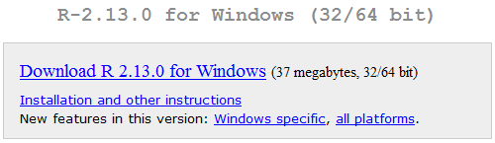
Installing R, JGR, Deducer Part I: R on Windows (shown), or Mac, or Linux
R is available from a set of mirrors known as The Comprehensive R Archive Network (CRAN)
http://cran.r-project.org/
Closest mirror and link for windows:
http://software.rc.fas.harvard.edu/mirrors/R/bin/windows/base/
Uses a Windows installer – default options are fine

Slide 62
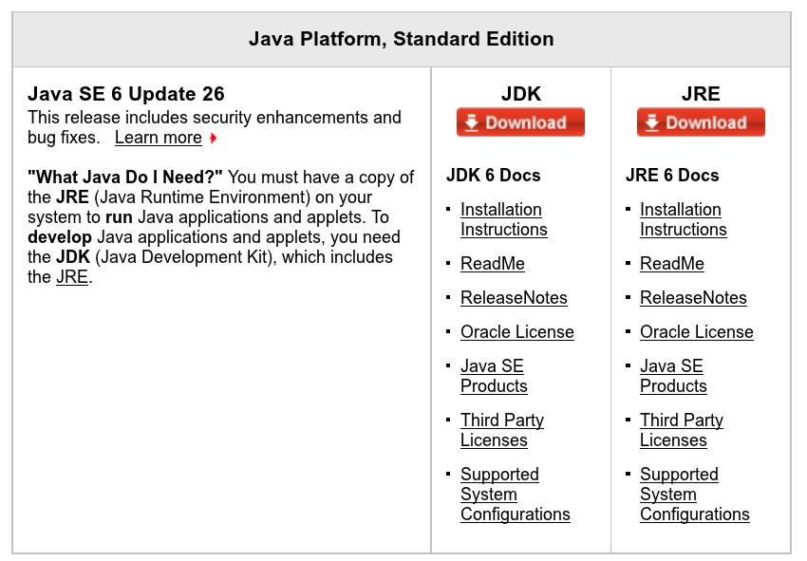
Installing R, JGR, Deducer Part II: JGR on Windows (shown), or Mac, or Linux
JGR requires a Java Development Kit (JDK)
You probably don't have this*
Available free at:
http://www.oracle.com/technetwork/java/javase/downloads/index.html
After selecting JDK (screenshot on the right)
and accepting the license agreement,
you will need to select your version. JGR only works
with 32bit Java, which is currently:
(third from the bottom in the list of versions)
Windows x86 76.81 MB jdk-6u26-windows-i586.exe
*if you did have a JDK (and not just a JRE)
you would have a folder named something like …
C:\Program Files\Java\jdk1.6.0_20\

Slide 63

Installing R, JGR, Deducer Part II: JGR on Windows (shown), or Mac, or Linux
JGR requires a launcher file on Windows:
http://www.rforge.net/JGR/web-files/jgr-1_62.exe
Leave this as your desktop shortcut to start JGR
You cannot start JGR from within R on Windows

Slide 64
Installing R, JGR, Deducer Part III: Installing Deducer
Deducer is one of thousands of R packages
From within JGR
to install packages: Packages & Data → Package Installer
to load packages: Packages & Data → Package Manager
Note: on Windows 7 you may need to start R and JGR with administrative privileges in order to install new packages. You can do so from the right-click menu on their icons.

Slide 65

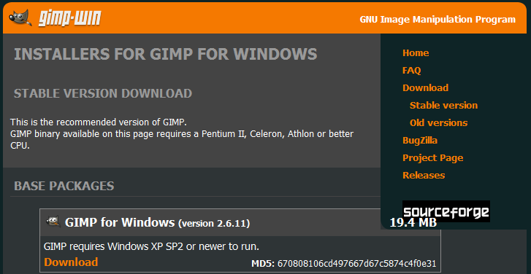
Installing GIMP (Windows)
http://gimp-win.sourceforge.net/stable.html
Select the link to the top Base package (GIMP for Windows)
and save the downloaded file
gimp-#.#.##-i686-setup-1.exe
to your desktop.
Run the installation program from your desktop accepting defaults
for other versions of GIMP or more info see: http://www.gimp.org/

Slide 66
The axis
Sparse labels, at meaningful locations if possible
Meaningful ordering of categorical data (not Alabama)
Rotated text to make it easier to read
Cleveland’s dotplot as an alternative to bar chart
Gridlines where meaningful

Slide 67
Box and Whiskers
First definition:
Implemented definitions for different statistical packages
Figure from http://flowingdata.com/2008/02/15/how-to-read-and-use-a-box-and-whisker-plot/

Slide 68
Data visualization with R and ggplot2:
Designing better data graphics with free software
Allan C. Just
PhD Student
Environmental Health Sciences
Mailman School of Public Health
Columbia University
June, 2011
A list of useful links can be found at the end
Wickham 2008
Attribution-NonCommercial-ShareAlike 3.0 United States License. http://creativecommons.org/licenses/by-nc-sa/3.0/us/
Notes:
R can be downloaded from http://cran.r-project.org/ and is available free for Windows, Mac OS X, and Linux.

Slide 69
Data visualization
Objectives
After this workshop participants will be able to:
Design data rich graphics using R
Select graph types, layouts, colors, and labels using theories of visual perception
Combine data with statistical and graphical summaries
Export data graphics from R in appropriate formats for PowerPoint presentations or manuscript submission

