Slide 1
Introduction to Git and GitHub
Jay Urbain, PhD

Slide 2
Agenda
Introduction
Exploring GitHub
Using Git with GitHub
Contributing on GitHub
Bonus Content

Slide 3
I. Introduction

Slide 4
Why learn version control?
Version control is useful when you write code, and data scientists write code
Enables teams to easily collaborate on the same codebase
Enables you to contribute to open source projects
Attractive skill for employment

Slide 5
What is Git?
Version control system that allows you to track files and file changes in a repository (“repo”)
Primarily used by software developers
Most widely used version control system
Alternatives: Mercurial, Subversion, CVS
Runs from the command line (usually), gui’s available
Can be used alone or in a team

Slide 6
What is GitHub?
A website, not a version control system
Allows you to put your Git repos online
Largest code host in the world
Alternative: Bitbucket
Benefits of GitHub:
Backup of files
Visual interface for navigating repos
Makes repo collaboration easy
“GitHub like a Dropbox for Git”
Note: Git does not require GitHub

Slide 7
Git can be challenging to learn
Designed (by programmers) for power and flexibility over simplicity
Hard to know if what you did was right
Hard to explore since most actions are “permanent” (in a sense) and can have serious consequences
We’ll focus on the most important 10% of Git

Slide 8
II. Exploring GitHub

Slide 9
GitHub setup
Create an account at github.com
There’s nothing to install
“GitHub for Windows” & “GitHub for Mac” are GUI clients (alternatives to command line)

Slide 10
Navigating a GitHub repo (1 of 2)
Example repo: https://github.com/jayurbain/DataScienceIntro
Account name, repo name, description
Folder structure
Viewing files:
Rendered view (with syntax highlighting)
Raw view
README.md:
Describes a repo
Automatically displayed
Written in Markdown

Slide 11
Navigating a GitHub repo (2 of 2)
Commits:
One or more changes to one or more files
Revision highlighting
Commit comments are required
Most recent commit comment shown by filename
Profile page

Slide 12
Creating a repo on GitHub
Click “Create New” (plus sign):
Define name, description, public or private
Initialize with README (if you’re going to clone)
Notes:
Nothing has happened to your local computer
This was done on GitHub, but GitHub used Git to add the README.md file

Slide 13
Basic Markdown
Easy-to-read, easy-to-write markup language
Usually (always?) rendered as HTML
Many implementations (aka “flavors”)
Let’s edit README.md using GitHub!
Common syntax:
## Header size 2
*italics* and **bold**
[link to GitHub](https://github.com)
* bullet
`inline code` and ```code blocks```
Valid HTML can also be used within Markdown

Slide 14
III. Using Git with GitHub

Slide 15
Git installation and setup
Installation: tiny.cc/installgit
Open Git Bash or Power Shell (Windows) or Terminal (Mac/Linux):
git config --global user.name “YOUR FULL NAME”
git config --global user.email “YOUR EMAIL”
Use the same email address you used with your GitHub account

Slide 16
Preview of what you’re about to do
Copy your new GitHub repo to your computer
Make some file changes locally
Save those changes locally (“commit” them)
Update your GitHub repo with those changes

Slide 17
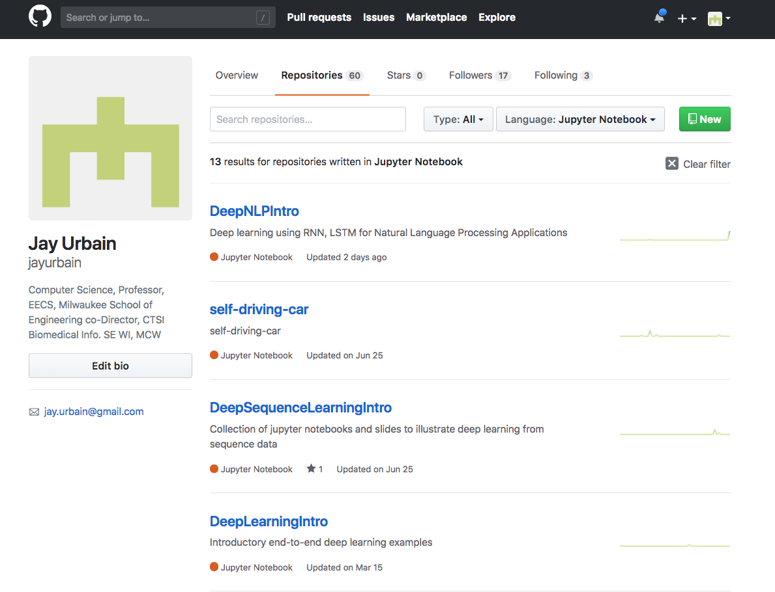
Create repo on github

Slide 18
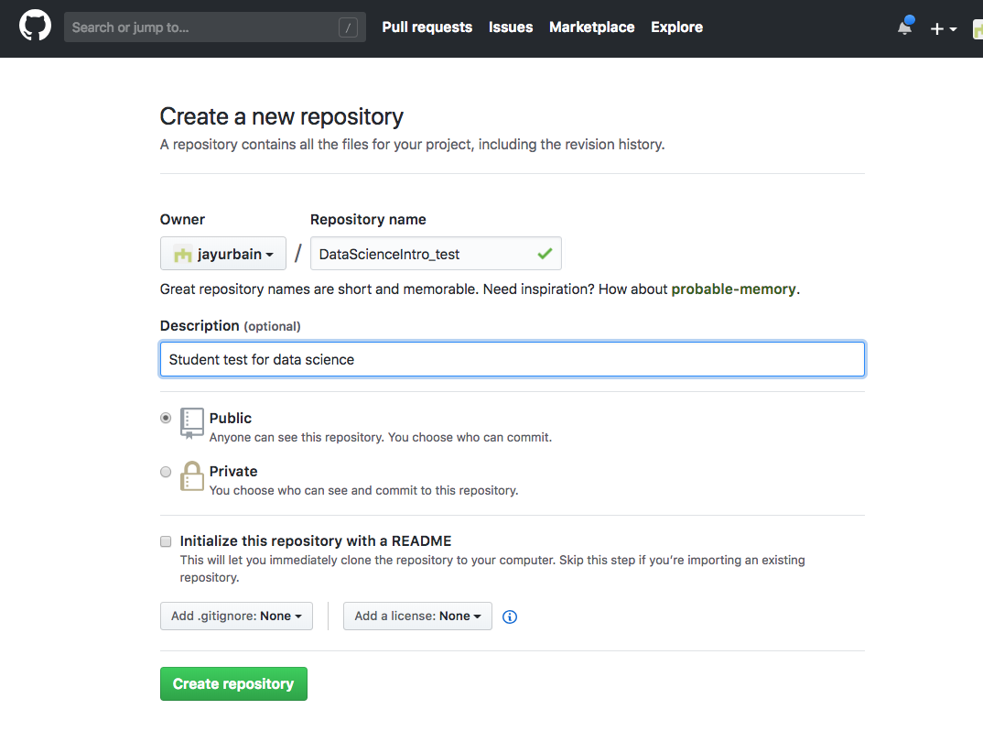
Create repo on github

Slide 19
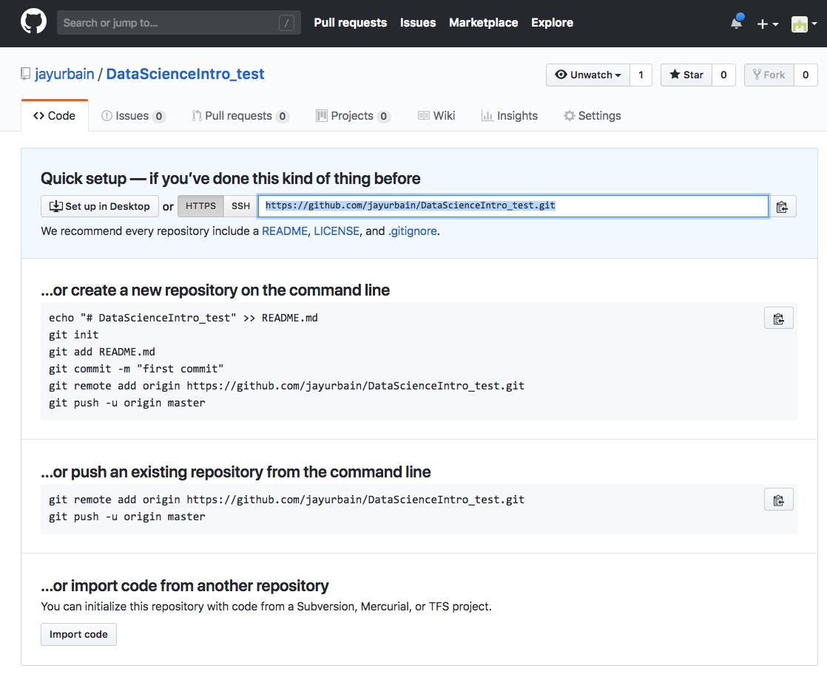
Create repo on github
Copy
Repository
url

Slide 20
Cloning a GitHub repo
Cloning = copying to your local computer
Like copying your Dropbox files to a new machine
First, change your working directory to where you want the repo you created to be stored: cd
Then, clone the repo: git clone <URL>
Get HTTPS or SSH URL from GitHub (ends in .git)
Clones to a subdirectory of the working directory
No visual feedback when you type your password
Navigate to the repo (cd) then list the files (ls)

Slide 21
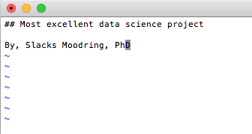
Making changes
Change directories into your cloned repository.
Create and add something to README.md

Slide 22
Making changes, checking your status
Making changes:
Modify README.md in any text editor
Create a new file: touch <filename>

Slide 23
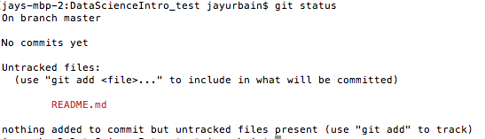
Making changes, checking your status
Check your status:
git status
File statuses (possibly color-coded):
Untracked (red)
Tracked and modified (red)
Staged for committing (green)
Committed

Slide 24
Committing changes
Stage changes for committing:
Add a single file: git add <filename>
Add all “red” files: git add . # stages all but not deleted
Add all “red” files: git add –A # stages all
Check your status:
Red files have turned green
Commit changes:
git commit -m “message about commit”
Check your status again!
Check the log: git log

Slide 25
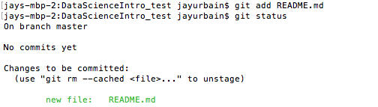
Committing changes
Stage changes for committing:
Add a single file: git add <filename>
Add all “red” files: git add . # stages all but not deleted
Add all “red” files: git add –A # stages all
Check your status:
Red files have turned green

Slide 26
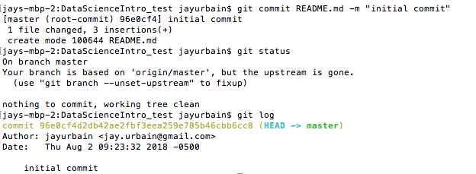
Committing changes
Commit changes:
git commit -m “message about commit”
Check your status again!
Check the log: git log

Slide 27
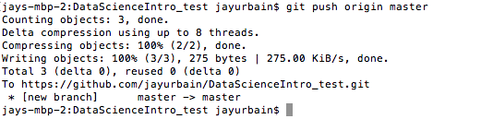
Pushing to GitHub
Everything you’ve done to your cloned repo (so far) has been local
You’ve been working in the “master” branch
Push committed changes to GitHub:
Like syncing local file changes to Dropbox
git push <remote> <branch>
Often: git push origin master
Refresh your GitHub repo to check!

Slide 28
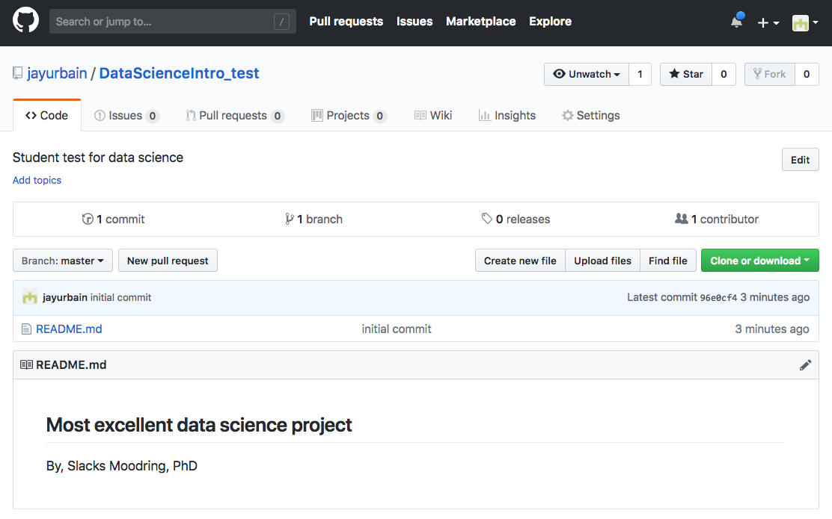
Pushing to GitHub
Refresh repository on github

Slide 29
Quick recap of what you’ve done
Created a repo on GitHub
Cloned repo to your local computer (git clone)
Automatically sets up your “origin” remote
Made file changes
Staged changes for committing (git add)
Committed changes (git commit)
Pushed changes to GitHub (git push)
Inspected along the way (git remote, git status, git log)

Slide 30

Note: Checking your remotes
A “remote alias” is a reference to a repo not on your local computer
Like a connection to your Dropbox account
View remotes: git remote -v
“origin” remote was set up by “git clone”
Note: Remotes are repo-specific

Slide 31
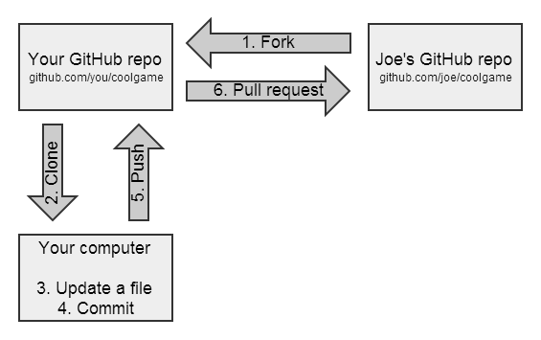
GitHub flow for contributing

Slide 32
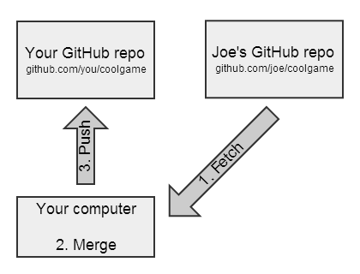
GitHub flow for syncing a fork

Slide 33
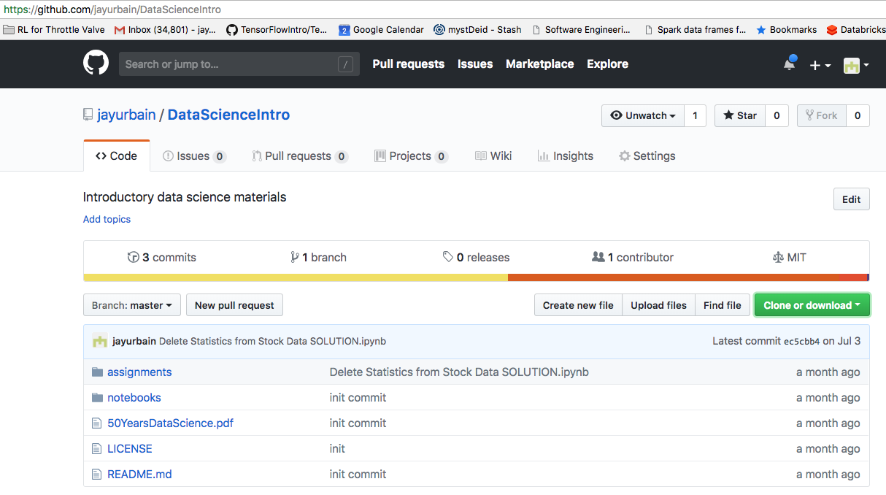
Forking a repo on GitHub
What is forking?
Copy a repo to your account (including history)
Does not stay in sync with the “upstream”
Why fork?
You want to make modifications
You want to contribute to the upstream
Fork
repository

Slide 34
Forking a repo on GitHub
Clone your fork: git clone <your URL>
$ git clone https://github.com/slacksmoodring/datascienceintro_test
Note: Don’t clone inside your other local repo

Slide 35
Recipe for submitting homework
First:
git clone https://github.com/jayurbain/datascienceintro
For each homework:
cd datascienceintro
git pull # for each home work, make sure your local repository is up to date
Work on your homework files
git add . or git add <filename> # only if you need to add new files
git status
git commit -m “message”
Submit files, typically *.ipynb + *.html, feedback, and other items to Blackboard!
Note: If you would like to suggests about the course repository:
Make comments in the issues section of: https://github.com/jayurbain/datascienceintro

Slide 36
Recipe for submitting homework
Navigate to DataScienceIntro (locally)
git pull upstream master
Copy your homework file(s) to your folder
git add . or git add <filename>
git status
git commit -m “message”
git push origin master
Submit url to your homework with feedback on Blackboard!
Note: If you would like to suggest a change to the course repository:
Create GitHub pull request (from your fork)

Slide 37
Two ways to initialize Git
Initialize on GitHub:
Create a repo on GitHub (with README)
Clone to your local machine
Initialize locally:
Initialize Git in existing local directory: git init
Create a repo on GitHub (without README)
Add remote: git remote add origin <URL>

Slide 38
Deleting or moving a repo
Deleting a GitHub repo:
Settings, then Delete
Deleting a local repo:
Just delete the folder!
Moving a local repo:
Just move the folder!

Slide 39
Excluding files from a repo
Create a “.gitignore” file in your repo: touch .gitignore
Specify exclusions, one per line:
Single files: pip-log.txt
All files with a matching extension: *.pyc
Directories: env/
Templates: github.com/github/gitignore

Slide 40
Gists: lightweight repos
You have access to Gist: gist.github.com
Add one or more files
Supports cloning, forking, commenting, committing
Can be public or secret (not private)
Useful for snippets, embedding, iPython nbviewer, etc.

Slide 41
Useful to learn next
Working with branches
Rolling back changes
Resolving merge conflicts
Fixing LF/CRLF issues

