Slide 1
Python for Data Science
Jay Urbain, PhD

Slide 2
Topics
Rationale for Python
Python packages for data science
Hands-on tutorials

Slide 3
Why Python?
Lots of momentum in data science and machine learning.
Easy to learn
Language of choice for 8 of 10 top US computer science programs (Philip Guo, CACM).
Full featured
Not just a statistics language. Has full capabilities for data acquisition, cleaning, databases, high performance computing, etc.
Powerful and efficient libraries:
NumPy, Pandas for data manipulation, processing, and analysis.
SciPy, StatsModels for statistics.
State of the art machine learning: SciKit-learn, TensorFlow, Keras, PyTorch.
Can be used for end-to-end development
Data exploration, analysis, modeling, and deployment.

Slide 4
SciPy
Scientific Programming for Python.
Python-based ecosystem of open-source software for mathematics, science, and engineering. In particular, these are some of the core packages:
NumPy – base N-dimensional array package
SciPy library – library for scientific computing
Matplotlib - plotting
iPython – enhanced interactive console
Sympy – symbolic mathematics
Pandas – data structures & analysis
StatsModels – statistics, like R syntax

Slide 5
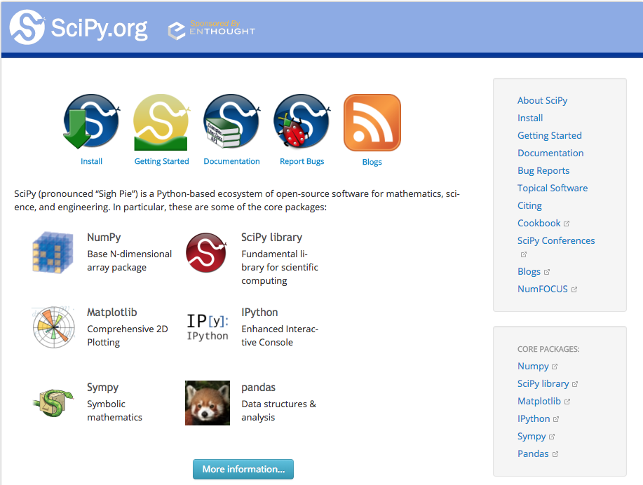
https://www.scipy.org/

Slide 6
NumPy
NumPy stands for Numerical Python.
Fundamental package for scientific computing in Python.
Provides Python with an extensive math library capable of performing numerical computations effectively and efficiently.
Underpins Pandas and many machine learning libraries.
Vector based versus iterative processing
NumPy Manual
NumPy User Guide
NumPy Reference
Scipy Lectures

Slide 7
Why NumPy
NumPy has a number of key features that give it great advantages over Python lists.
One such feature is speed. When performing operations on large arrays NumPy can often perform several orders of magnitude faster than Python lists.
This speed comes from the nature of NumPy arrays being memory-efficient and from optimized algorithms used by NumPy for doing arithmetic, statistical, and linear algebra operations.
NumPy is that it has multidimensional array data structures that can represent vectors and matrices.
Machine learning algorithms rely on matrix operations.
For example, when training a Neural Network, you often have to carry out many matrix multiplications. NumPy is optimized for matrix operations and it allows us to do Linear Algebra operations effectively and efficiently, making it very suitable for solving machine learning problems.
NumPy has become so popular that a lot of Python packages, such as Pandas, are built on top of NumPy.

Slide 8
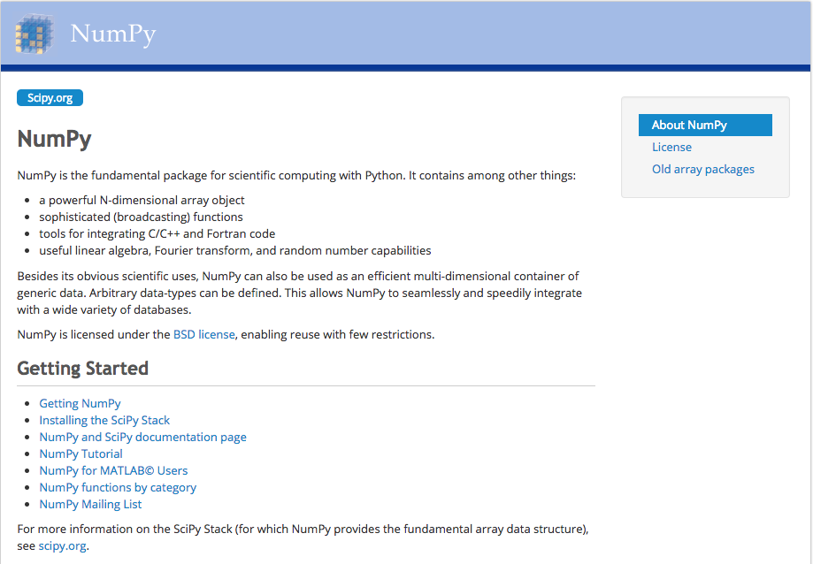
http://www.numpy.org/

Slide 9
Pandas
pandas - Python Data Analysis Library
Open-source data structures and data analysis tools tools for Python
Key data structures:
Series
Dataframe (similar to R dataframe abstraction)
Uses NumPy, MatplotLib
Developed by Wes McKinney

Slide 10
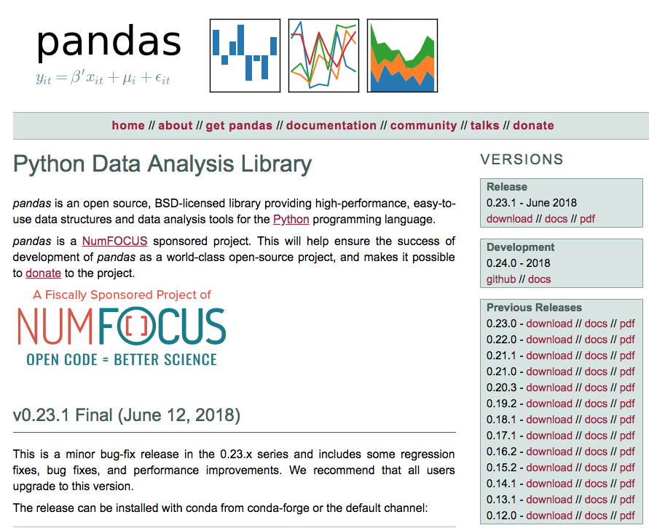
https://pandas.pydata.org/

Slide 11
Pandas
A fast and efficient DataFrame object for data manipulation and indexing.
Tools for reading and writing data between in-memory data structures.
Handling of missing data.
Flexible reshaping and pivoting of data sets.
Label-based slicing, fancy indexing, and subsetting of large data sets.
Aggregating or transforming data with a powerful group by engine.
High performance merging and joining of data sets.
Hierarchical axis indexing provides a way of working with high-dimensional data in a lower-dimensional data structure.
Time series-functionality.
Highly optimized for performance, with critical code paths written in Cython or C.

Slide 12
MatplotLib
Python 2D plotting library.
Produces publication quality figures in a variety of hardcopy formats and interactive environments across platforms.
Matplotlib can be used in Python scripts, the Python and IPython shells, the Jupyter notebook, web application servers, and four graphical user interface toolkits.

Slide 13
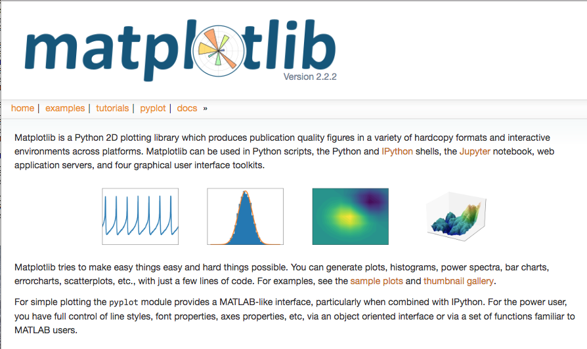
https://matplotlib.org/

Slide 14
StatsModels
Python module that provides classes and functions for the estimation of many different statistical models.
Conducting statistical tests, and statistical data exploration.
Provides result statistics for each estimator.

Slide 15
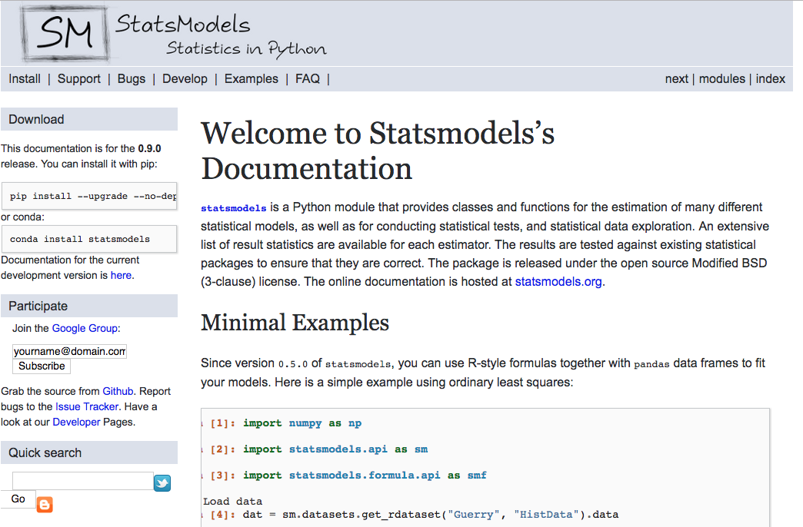
https://www.statsmodels.org/stable/index.html

Slide 16
scikit-learn
Machine learning in Python
Tools for data mining and data analysis.
Classification, regression, dimensionality reduction, model selection.
Relatively easy to use, and reusable in various contexts.
Built on NumPy, SciPy, and matplotlib.
Extensive examples and support.
Does not include deep learning.

Slide 17
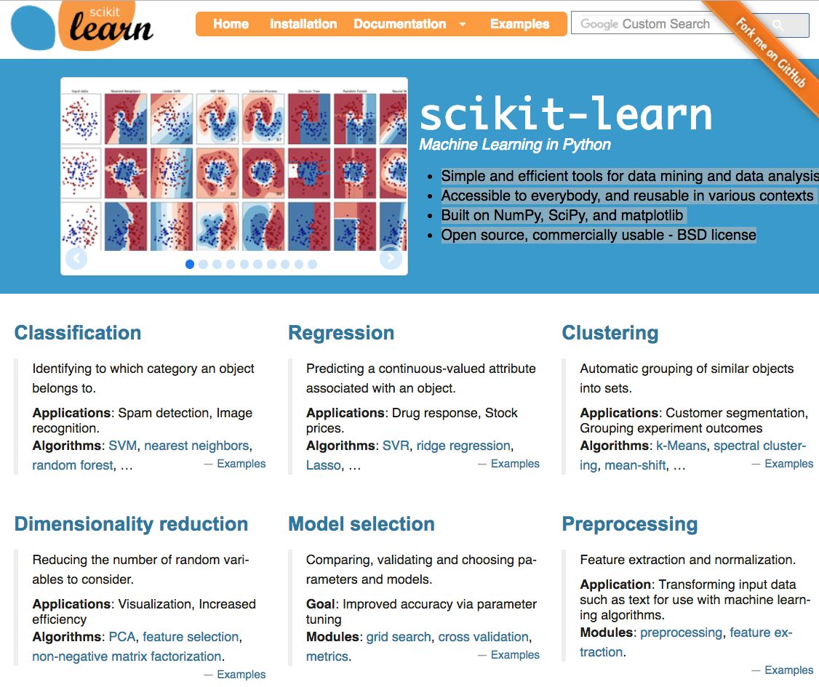
http://scikit-learn.org/stable/index.html

Slide 18
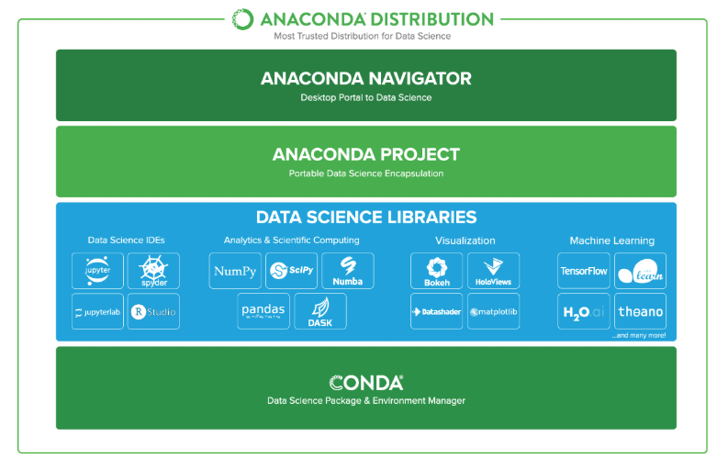
Anaconda
Most popular Python distribution for data science
Includes most packages already discussed
Very efficient and flexible package management
https://www.anaconda.com/distribution/

Slide 19
Students TODO:
Start numpy notebooks.
Python Objects, Map, Lambda, and List Comprehensions

