Slide 1
Exploratory Data Analysis Pandas DataFrame
Jay Urbain, PhD

Slide 2
Topics
Data science process
Getting data
Data - defined
Descriptive statistics
Visualization

Slide 3
Data Science Process
Define problem/ask questions – hypothesize
Data collection
Data exploration
Data modeling
Data analysis
Visualization and communication of results

Slide 4
Collecting data
Internal sources
Already collected by an organization
E.g., transaction data, click-stream data, survey data, text, images
External sources
Outside source through download or API
Web service, RDF (Resource Description Framework), RSS (Rich Site Summary) web feed, data download (UCI Machine Learning repository), web scraping.
E.g., Census, Medicaid, Google trends, Twitter API, Google Maps, stock market data, research datasets
Outside source where acquisition requires special processing
E.g., data on websites/web scraping, pictures, printed form, i.e., pdf.

Slide 5
APIs, wrappers
HTML Parsing
curl requests and BeautifulSoup
APIs
Makes the call for us (the author is “allowing us” to access the data)
http://www.pythonforbeginners.com/api/list-of-python-apis
Examples:
Google
Amazon (price data)
Twitter (tweets)
Facebook (social network)
Web services that we author

Slide 6
Data
Datum
A qualitative or quantitative value
Data
Set of such values

Slide 7
Data types
Simple:
Numeric: integers, floats
Boolean: binary or true false values
Strings: sequence of symbols
Complex:
Tuples, sets, lists, dictionaries, arrays, records
Date and time
Time series
Images
Temporal
Text
Geolocation

Slide 8
Types of data values
Quantitative variable: is numerical and can be either:
discrete - a finite number of values are possible in any bounded interval.
For example: number of students is a discrete variable
• continuous - an infinite number of values are possible in any bounded interval
For example: Height and weight are a continuous variables
Categorical variable: no inherent ordering among the values
For example: {SE, CS BE, CE, EE}
Ordinal variable: ordering among the values
For example: {assistant professor, associate professor, professor}

Slide 9
Data formats
Structured data
Each data record represented in a potentially complex form: dictionary, graph, relational data, tabular data.
Data has type
Tabular data
Structured data where each row represents a single record or sample
Each column represents a single feature or measurement
Example: database, csv, tsv, xlsx, etc.
Unstructured data
Text
Images
Semi-structured data
Mix of structured and unstructured data. E.g., XML, JSON, etc.

Slide 10
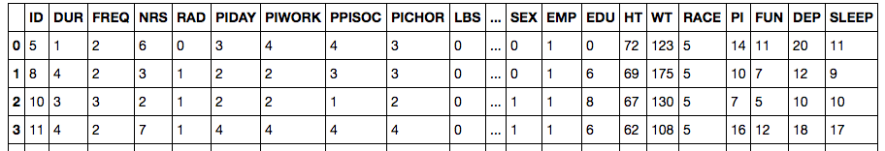
Tabular data
Typically work with tabular data, often need to put data into tabular form.
Each record is a single object or event, and has measurements.
Each measurement is an attribute or value of the data
The number of attributes is the dimension.
Assume each record has the same kind of object

Slide 11
Scale
Ratio scale (numerical):
Units are equally spaced
True zero
Mathematical operations of +, -, /, * are valid
E.g., height, weight
Interval scale (numerical):
Units are equally spaced, but there is no true zero.
Mathematical operations of +, -, /, * are not valid
E.g., temperatures measured in Celsius or Fahrenheit, 0 degrees on a compass.
Never an absence of value. 0 degrees F is a meaningful value and is a temperature. 0 degrees on a compass is a direction.
Ordinal scale (categorical)
The order of the units/categories is important.
E.g., grades: A, B, C, …
Nominal scale (categorical, ordered=True):
Categories have no order with respect to another
E.g., major: SE, CS, ME, BE, EE, CE

Slide 12
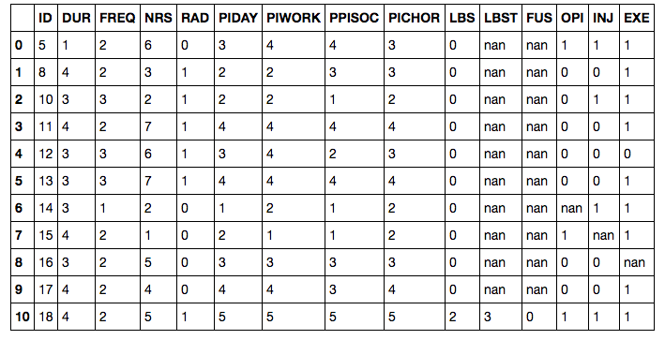
Common data problems
Missing values
How to fill in?, delete?
Wrong values
How to identify, how to correct?
Inconsistent values
Date formats, naming conventions
Data integration
How to join data?
Data not in a properly formatted table
Convert cross-tabulation to table
Not applicable
Data can not answer our hypothesis

Slide 13
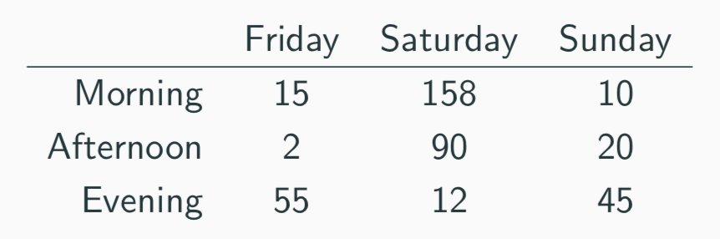
Messy data
Measuring individual deliveries; the variables are Time, Day, and Number of Produce.
Problem: each column header represents a single value rather than a variable.
Row headers are “hiding” the Day variable.
The values of the variable, “Number of Produce”, is not recorded in a single column.
How to fix?

Slide 14
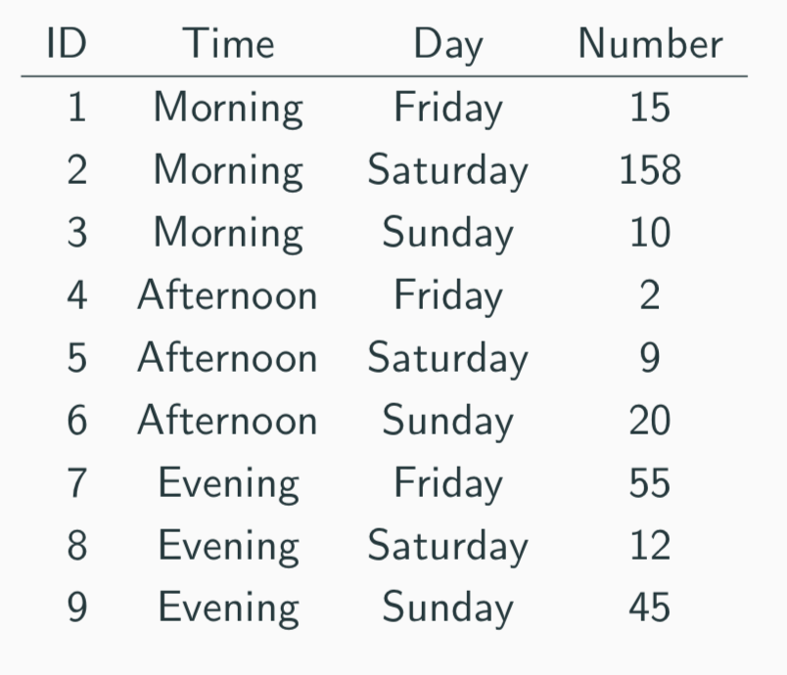
Messy data
We need to reorganize the information to make explicit the event were observing and the variables associated to this event.

Slide 15
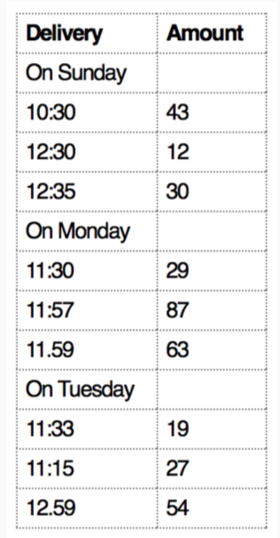
Messiness
What object or event are we measuring? What are the variables in this dataset?
How to fix?

Slide 16
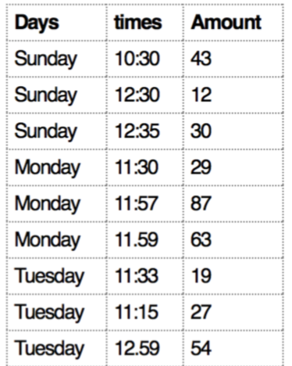
Messiness
Measuring individual deliveries; the variables are Time, Day, Number of Produce:

Slide 17
Common causes of messiness
Column headers are values, not variable name
Variables are stored in rows or columns
Multiple (different) variables are stored in one column
Multiple types of experimental units stored in same table
Note:
We want each file to correspond to a dataset, each column to represent a single variable, and each row to represent a single observation.
We want to tabularize the data. This makes Python happy, makes us happy.
Take the database course!

Slide 18
Pandas Data Structures
Series (1 dimensional)
DataFrame (2 dimensional, a table)
Querying
iloc[], for querying based on position (integer)
loc[], for querying rows based on label
Querying the DataFrame directly
Projecting a subset of columns • Use a Boolean mask to filter data

Slide 19
Setting Data in Pandas
To add new data
df[column] = [a, b, c] # assumes pandas col. is broadcast compatible with list
To set default data (or overwrite all data):
df[column]=2 # all values in column

Slide 20
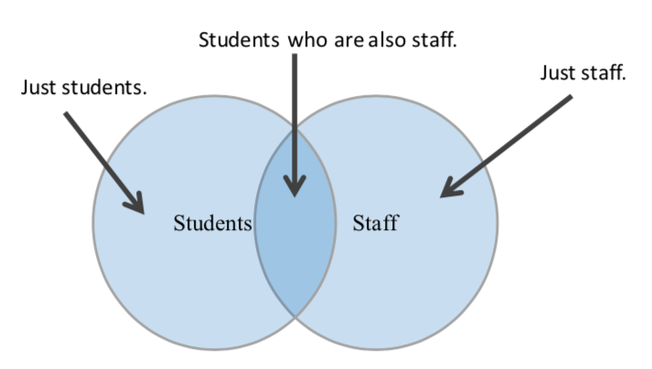
Venn Diagram for DataFrames
Details in hands-on tutorials

Slide 21
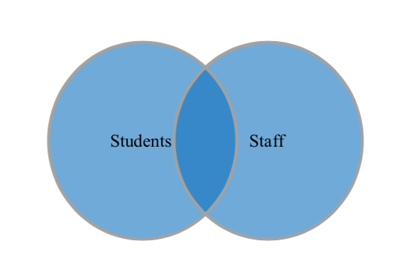
Full Outer join (union)
Details in hands-on tutorials

Slide 22
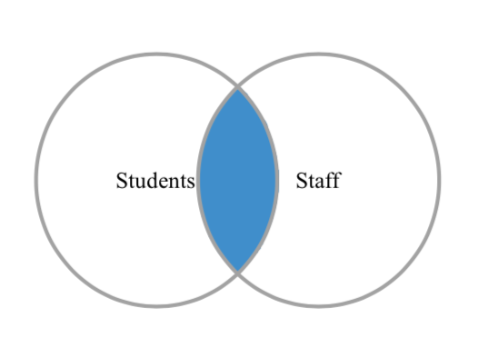
Inner join (intersection)
Details in hands-on tutorials

Slide 23
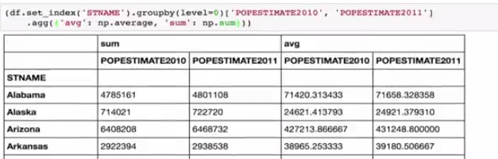
Aggregate statistics
Need to summarize aggregate statistics

Slide 24
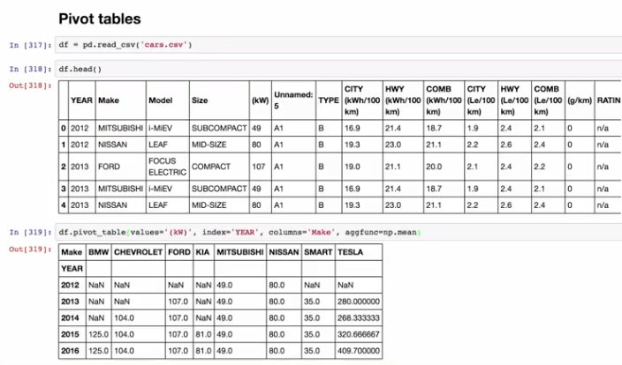
Pivot tables
Summarizing data in dataframe
Rows represent one value, the columns are another value.
Aggregates in cells. Allows you to see relationships between variables.

Slide 25
Next
Start Pandas notebook tutorials

