Slide 1

Decision Trees Jay Urbain, PhD
Credits:
Gareth James, Daniela Witten, Trevor Hastie , Robert Tibshirani. An Introduction to Statistical Learning: with Applications in R.
Trevor Hastie, Robert Tibshirani, Jerome Friedman. The Elements of Statistical Learning: Data Mining, Inference, and Prediction.
Tom Mitchell, Machine Learning, CMU
Nazli Goharian, IIT/Georgetown
Jiawei Han, Micheline Kamber, and Jian Pei, Data Mining
1
Notes:
1
Go light on scalable optimization, emphasize apriori

Slide 2
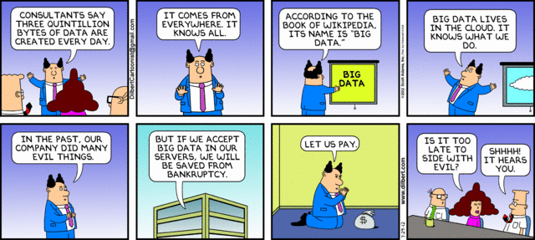

Slide 3
Tree-based Methods
Tree-based methods for regression and classification.
Involve stratifying or segmenting the predictor space into a number of simple regions.
Since the set of splitting rules used to segment the predictor space can be summarized in a tree, these types of approaches are known as decision-tree methods.

Slide 4
Pros and Cons
Tree-based methods are simple and useful for interpretation.
However they typically are not competitive with the best supervised learning approaches in terms of prediction accuracy.
Need to augment trees with bagging, random forests, and boosting methods.
These methods grow multiple trees which are then combined to yield a single consensus prediction.
Combining a large number of trees can often result in dramatic improvements in prediction accuracy, at the expense of some loss of interpretation.

Slide 5
Basics of Decision Trees
Decision trees can be applied to both regression and classification problems.
We first consider regression problems, and then move on to classification.

Slide 6
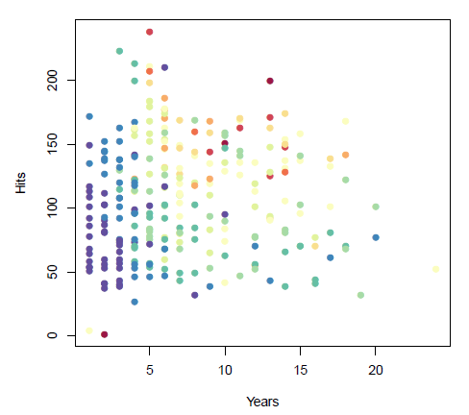
Baseball salary data
How to stratify (segment) the data?
Salary is color-coded from low (blue, green) to high (yellow, red)

Slide 7
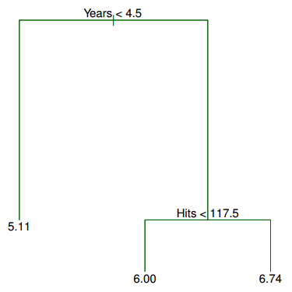
DT for Baseball salary data
Regression tree for predicting the log salary of a baseball player.
Based on the number of years played and the number of hits made in the previous year.
The label at each node (X_{j} < t^{k}) indicates the left-hand branch, X_{j} ≥ t_{k} is the right-hand branch.
E.g., The left-hand branch corresponds to Years<4.5,right-hand branch Years>=4.5.
The number in each leaf is the mean of the response for the observations that fall there.

Slide 8
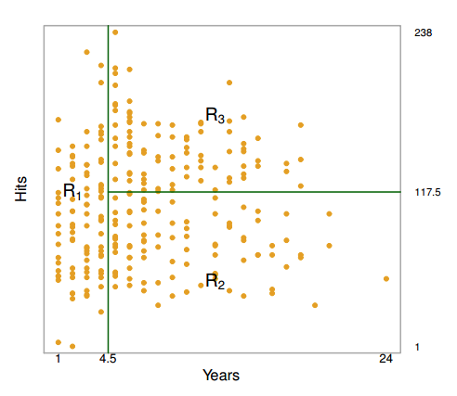
DT Results
The tree below stratifies (or segments) the players into three regions of predictor space:
R1 ={X | Years< 4.5},
R2 ={X | Years>=4.5, Hits<117.5}, and
R3 ={X | Years>=4.5, Hits>=117.5}.

Slide 9
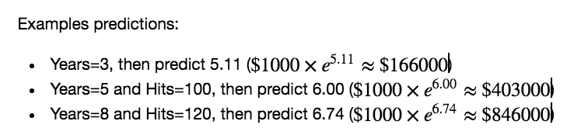
DT Results
The tree below stratifies (or segments) the players into three regions of predictor space:
R1 ={X | Years< 4.5},
R2 ={X | Years>=4.5, Hits<117.5}, and
R3 ={X | Years>=4.5
Note: salary scaled by ln()

Slide 10
DT Terminology
The regions R₁, R₂, and R₃ are known as terminal nodes (leafs)
Decision trees are typically drawn upside down, in the sense that the leaves are at the bottom of the tree.
The points along the tree where the predictor space is split are referred to as internal nodes
In the hitters tree, the two internal nodes are indicated by the text Years<4.5 and Hits<117.5.

Slide 11
Interpretation of Results
Years is the most important factor in determining Salary, and players with less experience earn lower salaries than more experienced players.
Given that a player is less experienced, the number of Hits that he made in the previous year seems to play little role in his Salary.
But among players who have been in the major leagues for five or more years, the number of Hits made in the previous year does affect Salary, and players who made more Hits last year tend to have higher salaries.
An over-simplification, but compared to a regression model, it is easy to display, interpret and explain.

Slide 12
Tree-building process
Divide the predictor space, i.e., the set of possible values for attributes X₁,X₂,...,X_{p} into j distinct and non-overlapping regions, R₁, R₂, . . . , R_{J} .
For every observation that falls into the region R_{j}, (leaf) we make the same prediction, which is simply the mean of the response values for the training observations in R_{j}.

Slide 13
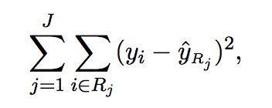
Details of the tree-building process
Theoretically, the regions could have any shape.
However, with DTs, the predictor space is partitioned into high-dimensional rectangles, or boxes, for ease of interpretation.
The goal is to find boxes R₁,...,R_{J} that minimize the RSS, given by:
Where yˆ_{Rj} is the mean response for the training observations (targets) within the j^{th} box.

Slide 14
More details of tree-building process
Computationally infeasible to consider every possible partition of the feature space into j boxes.
Take a top-down, greedy approach that is known as recursive binary splitting.
The approach is top-down because it begins at the top of the tree and then recursively splits the predictor space; each split is indicated via two new branches further down on the tree.
It is greedy because at each step of the tree-building process, the best split is made at that particular step, rather than looking ahead and picking a split that will lead to a better tree in some future step.

Slide 15
Details— Continued
First select the predictor X_{j} and the cutpoint s such that splitting the predictor space into the regions {X|X_{j} < s} and {X|X_{j} ≥ s} leads to the greatest possible reduction in RSS.
Next, repeat the process, looking for the next best predictor and best cutpoint in order to split the data further so as to minimize the RSS within each of the resulting regions.
This time, instead of splitting the entire predictor space, split one of the two previously identified regions. We now have three regions.
Again, split one of these three regions further, so as to minimize the RSS.
The process continues until a stopping criterion is reached, e.g., we may continue until no region contains more than five observations, or we’ve exhausted the number of features.

Slide 16
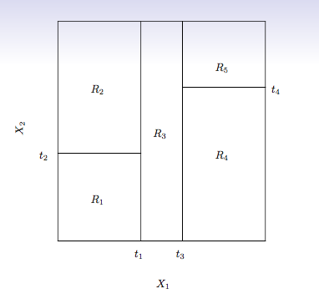
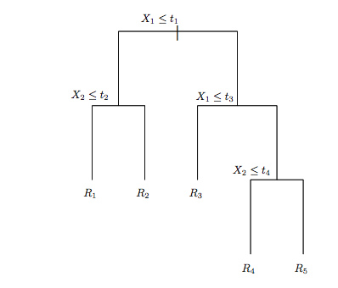
Predictions
Predict the response for a given test observation using the mean of the training observations in the region to which that test observation belongs.
Right: The output of recursive binary splitting on a 2D example.
Left: Tree corresponding to the partition in(right image)

Slide 17
Pruning a tree
The process described above may produce good predictions on the training set, but is likely to overfit the data, leading to poor test set performance. Why?

Slide 18
Pruning a tree
The process described above may produce good predictions on the training set, but is likely to overfit the data, leading to poor test set performance. Why?
A smaller tree with fewer splits (i.e., fewer regions R₁, . . . , R_{J} ) might lead to lower variance and better interpretation at the cost of a little bias.
One alternative is to grow the tree only so long as the decrease in the RSS due to each split exceeds some (high) threshold.
This strategy will result in smaller trees, however, a seemingly worthless split early on in the tree might be followed by a very good split that leads to a large reduction in RSS later on.

Slide 19
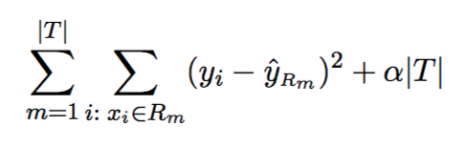
Pruning a tree
A better strategy is to grow a very large tree T₀, and then prune it back in order to obtain a subtree.
Cost complexity pruning is used to do this.
Consider a sequence of trees indexed by a non-negative tuning parameter α. For each value of α there corresponds a subtree T ⊂ T₀ such that:
is as small as possible.
|T| indicates the number of terminal nodes of the tree T, R_{m} is the rectangle corresponding to the m^{th} terminal node, and yˆ^{Rm} is the mean of the training observations in R_{m}.

Slide 20
Choose the best subtree
The tuning parameter α controls a trade-off between the subtree’s complexity and its fit to the training data.
Select an optimal value αˆ using cross-validation.
Then return to the full data set and obtain the subtree corresponding to αˆ.

Slide 21
Summary: tree algorithm
Use recursive binary splitting to grow a large tree on the training data, stopping only when each terminal node has fewer than some minimum number of observations.
Apply cost complexity pruning to the large tree in order to obtain a sequence of best subtrees, as a function of α.
Use K-fold cross-validation to choose α. For each k = 1,...,K:
Repeat Steps 1 and 2 on the (K−1)/K^{th} fraction of the training data, excluding the k^{th} fold.
Evaluate the mean squared prediction error on the data in the left-out k^{th} fold, as a function of α.
Average the results, and pick α to minimize the average error.
Return the subtree from Step 2 that corresponds to the chosen value of α.

Slide 22
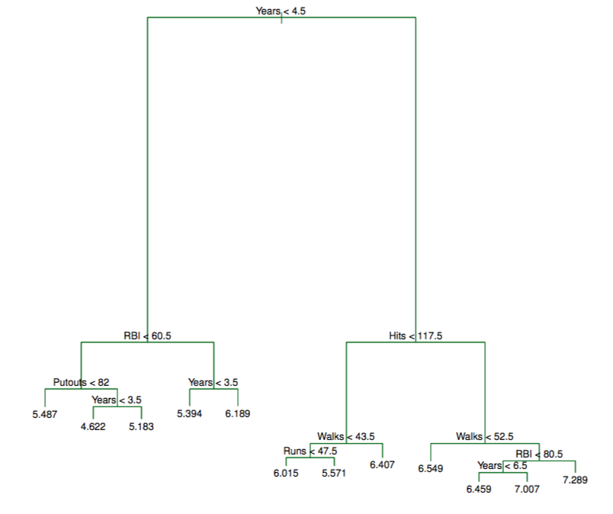
Baseball example

Slide 23
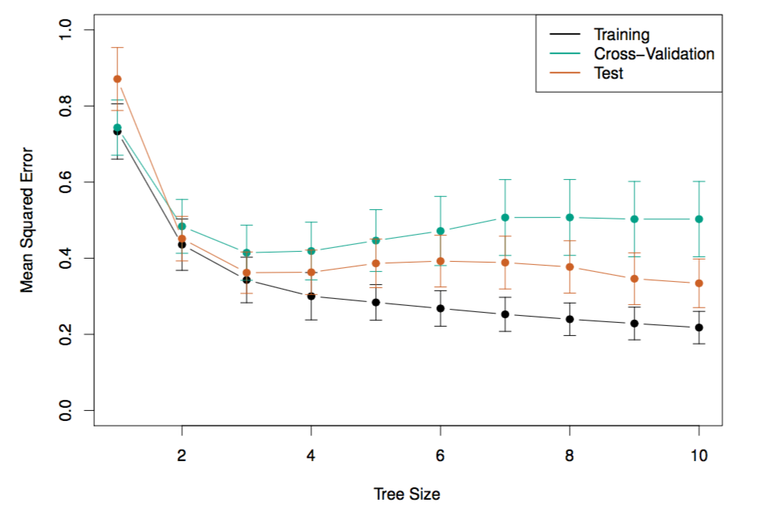
Baseball example

Slide 24
Classification Trees
Very similar to a regression tree, except that it is used to predict a qualitative (class) response rather than a quantitative one.
For a classification tree, we predict that each observation belongs to the most commonly occurring class of training observations in the region to which it belongs.

Slide 25

Classification Trees
Use recursive binary splitting to grow a classification tree.
In the classification setting, RSS cannot be used as a criterion for making the binary splits
A natural alternative to RSS is the classification error rate. This is simply the fraction of the training observations in that region that do not belong to the most common class:
pˆmk represents the proportion of training observations in the m^{th} region that are from the k^{th} class.
However classification error is not sufficiently sensitive for tree-growing, and in practice two other measures are preferable.

Slide 26
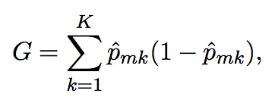
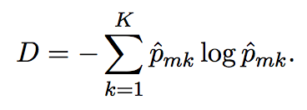
Gini index and Deviance
The Gini index is defined by:
Is a measure of total variance across the K classes. The Gini index takes on a small value if all of the pˆmk’s are close to zero or one.
For this reason the Gini index is referred to as a measure of node purity — a small value indicates that a node contains predominantly observations from a single class.
An alternative to the Gini index is cross-entropy, given by K
It turns out that the Gini index and the cross-entropy are very similar numerically.

Slide 27
Example: heart data
Data contain a binary outcome HD for 303 patients who presented with chest pain.
An outcome value of Yes indicates the presence of heart disease based on an angiographic test, while No means no heart disease.
There are 13 predictors including Age, Sex, Chol (a cholesterol measurement), and other heart and lung function measurements.
Cross-validation yields a tree with six terminal nodes.

Slide 28
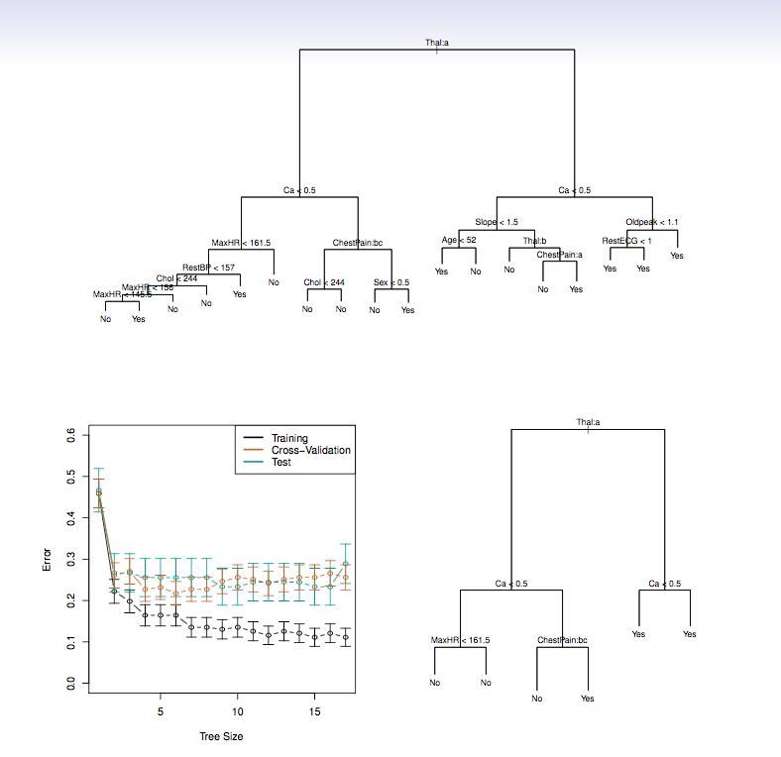
Example: heart data

Slide 29
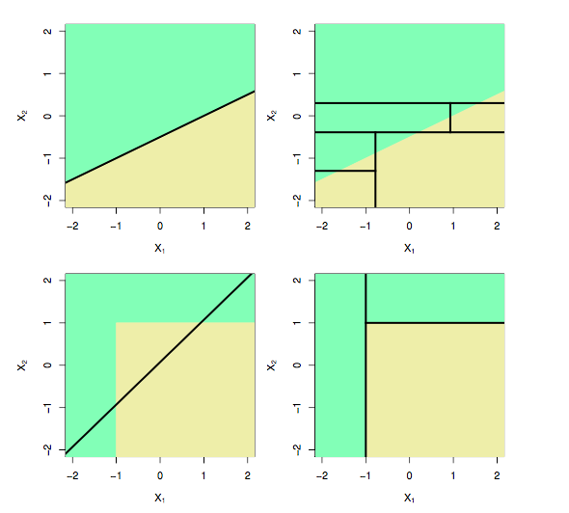
Trees versus Linear Models
Top Row: True linear boundary; Bottom row: true non-linear boundary. Left column: linear model; Right column: tree-based model

Slide 30
Advantages of Trees
Trees are very easy to explain to people.
Can generate conjunctive rules. Tree is a disjunction of conjunctive rules.
Some believe that decision trees more closely mirror human decision-making than do the regression and classification approaches we talked about earlier.
Trees can be displayed graphically, and are easily interpreted even by a non-expert (especially if they are small).
Trees can easily handle qualitative predictors without the need to create dummy variables.

Slide 31
Disadvantages of Trees
Unfortunately, trees generally do not have the same level of predictive accuracy as some of the other regression and classification approaches seen in this book.
However, by aggregating many decision trees, the predictive performance of trees can be substantially improved. We introduce these concepts later.
STOP – supplemental material

Slide 32
DT Classification
Classifying a sample using a decision tree:
Starting at the root node of the tree
Test the attribute specified by this node.
Move down the tree branch corresponding to the value of the attribute in the given example.
Repeat process for each subtree rooted at the new node.
Each leaf represents classification of instance.

Slide 33
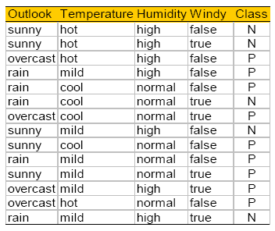
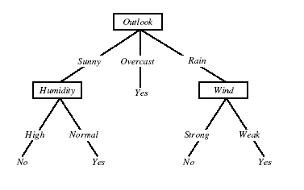
DT for Play Tennis

Slide 34
Play Tennis Example
How to classify?:
{outlook=sunny, temperature=hot, humidity=high, wind=strong}
Decision trees represent a disjunction of conjunctions of the attribute values of instances.
For positive classification, the previous decision tree corresponds to:
(outlook=sunny ^ humidity=high) v (outlook=overcast) v
(outlook=rain ^ wind=weak)

Slide 35
Appropriate problems DT’s
Instances describable by attribute-value pairs
Target function is discrete values
Note DT's can be modified to handle real valued parameters.
Disjunctive hypothesis may be required
Possibly noisy training data
Examples:
Gene expression
Equipment, or medical diagnosis
Credit risk analysis
Modeling calendar scheduling preferences
Skeletal tracking (random forests)

Slide 36
Top-down induction (creation) of DTs
Main loop:
A <- select the “best” decision attribute for next node
Assign A as decision attribute for node
For each value of A, create new descendant of node
Sort training examples to current leaf nodes
If training examples perfectly classified, then STOP
Else iterate over new leaf nodes
Note: Show how samples are sorted

Slide 37
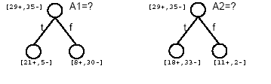
Which attribute is best?

Slide 38
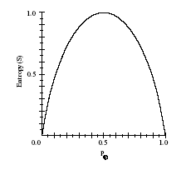

Entropy
Given S, a set of training examples:
Entropy measures the impurity of S
p+ is proportion of positive examples of S
p- is proportion of negative examples of S

Slide 39

Entropy
Entropy(S) = expected number of bits needed to encode class(+/-) of randomly drawn member of S (under the optimal, shortest-length code)
MDL – minimum description length
Why?
Information theory (Claude Shannon): optimal length code assigns
-log₂p bits to message having probability p.
So, expected number of bits to encode + or – examples of random member of S:

Slide 40
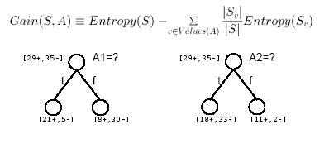
Information Gain
Gain(S,A) = expected reduction in entropy due to sorting of A

Slide 41
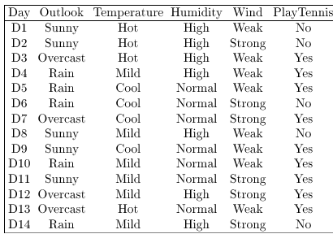
Calculating Info Gain (Humidity)
entropy(s) |  |  |  | 0.940286 |  | // 9/14*(-LOG(9/14,2))+5/14*(-LOG(5/14,2))
entropy (s, humidity for high) |  |  |  | 0.985228 |  | // 3/7*(-LOG(3/7,2))+4/7*(-LOG(4/7,2))
entropy (s, humidity for normal) |  |  |  | 0.591673 |  | // 6/7*(-LOG(6/7,2))+1/7*(-LOG(1/7,2))
Gain(S, Humidity) = entropy(s) - 7/14*entropy (s, humidity for high) - 7/14*entropy (s, humidity for normal)
Gain(S, Humidity) = |  |  |  | 0.151836 |  | // D2- 7/14*D4 - 7/14*D6

Slide 42
Training Examples

Slide 43
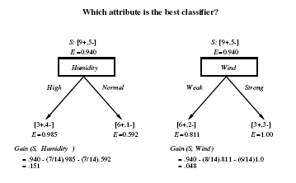
Selecting the Next Attribute

Slide 44
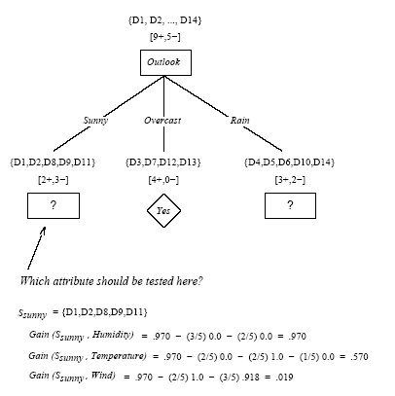

Slide 45
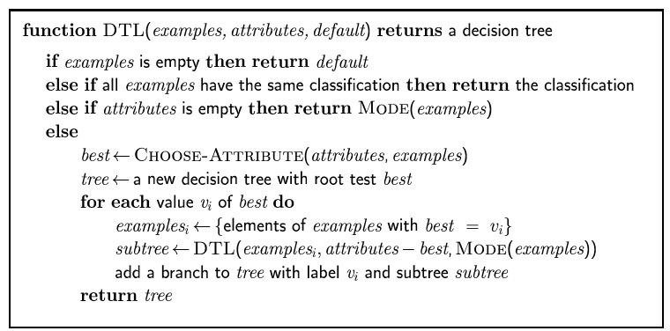
Decision tree learning
Aim: find a small tree consistent with the training examples
Idea: (recursively) choose "most significant" attribute as root of (sub)tree

Slide 46
Hypothesis Space Search by ID3
Hypothesis space is complete!
Target function is surely in there…
Outputs a single hypothesis
No backtracking
Local minima
Statically based search choices
Robust to noisy data
Inductive bias: approximate “prefer shortest tree”

Slide 47
Inductive Bias of ID3
Note H is the power set of instances X
Unbiased?
Not really…
Prefer short trees, and for those with high info gain attributes near the root
Bias is a preference for some hypothesis, rather than a restriction of hypothesis space H
Occam’s razor: prefer the shortest hypothesis that fits the data.

Slide 48
Occam’s Razor
Why prefer short hypotheses?
Argument in favor:
Fewer short hypo’s than long hypo’s
A short hypo that fits data unlikely to be coincidence
A long hypo that fits data might be coincidence
Argument opposed:
There are many ways to define small sets of hypo’s
e.g., all trees with a prime number of nodes use attributes with “Z”
What’s so special about small sets based on size of hypothesis?

Slide 49
Supervised vs. Unsupervised Learning
Supervised learning (classification)
Training data (observations, measurements, etc.) is accompanied by labels indicating the class of each observation
New data is classified based on a model built from the training set
Supervised learning (regression)
Training data (observations, measurements, etc.) is accompanied by numeric output value for each observation
Numeric output values are predicted based on a model built from the training set
Unsupervised learning (clustering, frequent item sets, subsequences)
The class labels of training data is unknown
Given a set of measurements, observations, etc. with the aim of establishing the existence of classes, associations, or clusters in the data

Slide 50
Prediction Problems: Classification vs. Numeric Prediction
Classification
predicts categorical class labels
classifies data (constructs a model) based on the training set and the values (class labels) in a classifying attribute and uses it in classifying new data
Numeric Prediction (Regression)
models continuous-valued functions, i.e., predicts unknown or missing values
Typical applications
Credit/loan approval:
Medical diagnosis: if a tumor is cancerous or benign
Fraud detection: if a transaction is fraudulent
Web page categorization: which category it is

Slide 51
Classification—Two-Step Process
Model construction: describing a set of predetermined classes
Each tuple/sample is assumed to belong to a predefined class, as determined by the class label attribute
The set of tuples used for model construction is training set
The model is represented as a statistical model, neural net, classification rules, decision trees, or mathematical formulae
Model usage: for classifying future or unknown objects
Estimate accuracy of the model
The known label of test sample is compared with the classified result from the model
Accuracy rate is the percentage of test set samples that are correctly classified by the model
Test set is independent of training set (otherwise overfitting)
If the accuracy is acceptable, use the model to classify new data
Note: If the test set is used to select models, it is called validation (test) set

Slide 52
Process (1): Model Construction
Classification
Algorithms
Training
Data
Classifier
(Model)
IF rank = ‘professor’
OR years > 6
THEN tenured = ‘yes’

Slide 53
Process (2): Using the Model in Prediction
Classifier
Testing
Data
Unseen Data
(Jeff, Professor, 4)
Tenured?

Slide 54
Classification: Basic Concepts
Classification: Basic Concepts
Decision Tree Induction
Bayes Classification Methods
Rule-Based Classification
Model Evaluation and Selection
Techniques to Improve Classification Accuracy: Ensemble Methods
Summary
54
Notes:
54

Slide 55
Play Tennis? (Tom Mitchell, Machine Learning)

Slide 56
Decision Trees (DT)
Widely used, practical method for inductive inference (probable from evidence).
Method for approximating discrete valued functions.
Exhaustively search hypothesis space.
Can be used for representing if-then-else rules.

Slide 57
DT Representation
Classify instances by sorting them down a tree from the root to some leaf node.
Each node in the tree specifies a test of some attribute (feature) of the instance.
Each branch descending from that node represents one of the possible values for this attribute.
Leaf node provides classification instance.

Slide 58
DT Classification
Classifying a sample using a decision tree:
Starting at the root node of the tree
Test the attribute specified by this node.
Move down the tree branch corresponding to the value of the attribute in the given example.
Repeat process for each subtree rooted at the new node.
Each leaf represents classification of instance.

Slide 59
DT for Play Tennis

Slide 60
Play Tennis Example
How to classify?:
{outlook=sunny, temperature=hot, humidity=high, wind=strong}
Decision trees represent a disjunction of conjunctions of the attribute values of instances.
For positive classification, the previous decision tree corresponds to:
(outlook=sunny ^ humidity=high) v (outlook=overcast) v
(outlook=rain ^ wind=weak)

Slide 61
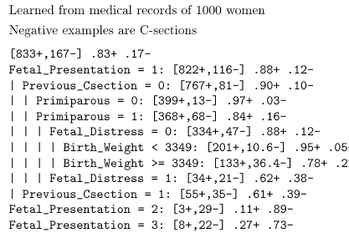
Predict C-Section Risk Example

Slide 62
Appropriate problems DT’s
Instances describable by attribute-value pairs
Target function is discrete values
Note DT's can be modified to handle real valued parameters (regression)
Disjunctive hypothesis may be required
Possibly noisy training data
Examples:
Gene expression
Equipment, or medical diagnosis
Credit risk analysis
Modeling calendar scheduling preferences
Skeletal tracking (random forests)

Slide 63
Top-down induction (creation) of DTs
Main loop:
A <- select the “best” decision attribute for next node
Assign A as decision attribute for node
For each value of A, create new descendant of node
Sort training examples to current leaf nodes
If training examples perfectly classified, then STOP
Else iterate over new leaf nodes
Note: Show how samples are sorted

Slide 64
Which attribute is best?

Slide 65
Entropy
Given S, a set of training examples:
Entropy measures the impurity of S
p+ is proportion of positive examples of S
p- is proportion of negative examples of S
-0.5*math.log(0.5,2) -0.5*math.log(0.5,2)

Slide 66
Entropy
Entropy(S) = expected number of bits needed to encode class(+/-) of randomly drawn member of S (under the optimal, shortest-length code)
MDL – minimum description length
Why?
Information theory (Claude Shannon): optimal length code assigns
-log₂p bits to message having probability p.
So, expected number of bits to encode + or – examples of random member of S:

Slide 67
Information Gain
Gain(S,A) = expected reduction in entropy due to sorting of A

Slide 68
Calculating Info Gain (Humidity)
entropy(s) ) //D2 |  |  |  | 0.940286 |  | // 9/14*(-LOG(9/14,2))+5/14*(-LOG(5/14,2))
entropy (s, humidity for high) //D4 |  |  |  | 0.985228 |  | // 3/7*(-LOG(3/7,2))+4/7*(-LOG(4/7,2))
entropy (s, humidity for normal) //D6 |  |  |  | 0.591673 |  | // 6/7*(-LOG(6/7,2))+1/7*(-LOG(1/7,2))
Gain(S, Humidity) = entropy(s) - 7/14*entropy (s, humidity for high) - 7/14*entropy (s, humidity for normal)
Gain(S, Humidity) = |  |  |  | 0.151836 |  | // D2- 7/14*D4 - 7/14*D6

Slide 69
Training Examples

Slide 70
Selecting the Next Attribute

Slide 71
Decision tree learning
Aim: find a small tree consistent with the training examples
Idea: (recursively) choose "most significant" attribute as root of (sub)tree

Slide 72
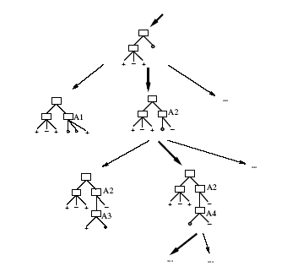
Hypothesis Space Search by ID3

Slide 73
Hypothesis Space Search by ID3
Hypothesis space is complete!
Target function is surely in there…
Outputs a single hypothesis
No backtracking
Local minima
Statically based search choices
Robust to noisy data
Inductive bias: approximate “prefer shortest tree”

Slide 74
Inductive Bias of ID3
Note H is the power set of instances X
Unbiased?
Not really…
Prefer short trees, and for those with high info gain attributes near the root
Bias is a preference for some hypothesis, rather than a restriction of hypothesis space H
Occam’s razor: prefer the shortest hypothesis that fits the data.

Slide 75
Occam’s Razor
Why prefer short hypotheses?
Argument in favor:
Fewer short hypo’s than long hypo’s
A short hypo that fits data unlikely to be coincidence
A long hypo that fits data might be coincidence
Argument opposed:
There are many ways to define small sets of hypo’s
e.g., all trees with a prime number of nodes use attributes with “Z”
What’s so special about small sets based on size of hypothesis?

Slide 76
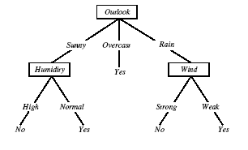
Overfitting in Decision Trees
Consider adding noisy training example D15:
Sunny, Hot, Normal, Strong, Play tennis=No

Slide 77

Overfitting
Consider error of hypothesis h over:
Training data: error_{train}(h)
Entire distribution D of data: error_{D}(h)
Hypothesis h ϵ H overfits training data if there is an alternative hypothesis h’ ϵ H such that:

Slide 78
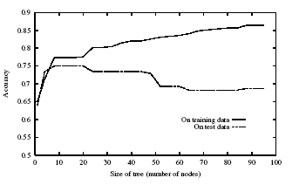
Overfitting

Slide 79
Avoiding Overfitting
Avoid Overfitting:
Stop growing when data split is not statistically significant
Grow full tree, then prune
Grow many trees w/ randomly selected reduced numbers of attributes, learn function to weight trees (Random Forests – state of the art technique)
How to select best tree:
Measure performance over training data
Measure performance over separate validation set
Minimum Description Length
MDL: minimize (size(tree)+size(misclassification))

Slide 80
Reduced-Error Pruning
Start with completed tree
Split data into training and validation set
Do until further pruning is harmful:
Evaluate impact on validation set of pruning each possible node (plus those below it)
Greedily remove the one that most improves validation set accuracy
Produces smallest version of most accurate subtree

Slide 81
Rule Post-Pruning
Convert tree to equivalent rules
Prune each rule independently of others
Evaluate impact on validation set
Sort final rule into desired sequence of use.
Most frequently used method, C4.5

Slide 82
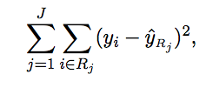
Regression
The goal is to find boxes R₁,...,R_{J} that minimize the RSS, given by
where y^{Rj} is the mean response for the training observations within the j^{th} box.

Slide 83
Summary
Learning needed for unknown environments
For supervised learning, the aim is to find a simple hypothesis approximately consistent with training examples that performs well on unseen data
Decision tree learning using information gain
Learning performance = prediction accuracy measured on test set
Overfitting hampers a machine learners ability to generalize to unseen examples

Slide 84
Pros and Cons
Tree-based methods are simple and useful for interpretation.
However they typically are not competitive with the best supervised learning approaches in terms of prediction accuracy.
Hence we also discuss bagging, random forests, and boosting. These methods grow multiple trees which are then combined to yield a single consensus prediction.
Combining a large number of trees can often result in dramatic improvements in prediction accuracy, at the expense of some loss interpretation.

Slide 85
STOP DT

Slide 86
Classification: Basic Concepts
Classification: Basic Concepts
Decision Tree Induction
Bayes Classification Methods
Rule-Based Classification
Model Evaluation and Selection
Techniques to Improve Classification Accuracy: Ensemble Methods
Summary
86
Notes:
86

Slide 87
Bayesian Classification: Why?
A statistical classifier: performs probabilistic prediction, i.e., predicts class membership probabilities
Foundation: Based on Bayes’ Theorem.
Performance: A simple Bayesian classifier, naïve Bayes, makes strong independence assumptions, but can perform well.
Comparable performance with basic decision trees and selected neural network classifiers
Incremental: Each training example can incrementally increase/decrease the probability that a hypothesis is correct (online learning) — prior knowledge can be combined with observed data
Standard: Provides a theoretically sound standard of optimal decision for which other methods can be measured

Slide 88
Naïve Bayes Classifier
Bayes theorem
Combines probability of each feature with respect to a class label.
Makes strong independence assumption between features, i.e., independence between features
Sample applications:
Classify email as spam based on sender, and text
Diagnose meningitis based on chest-xray, symptom
Classify fruit from shape and color
Determine life style from education and salary

Slide 89
Review conditional probability
Can factor joint probability using the chain rule:
P(a ^ b) = P(a | b) P(b) = P(b | a) P(a)
And express the joint probability by conditioning on a or b:
P(a | b) P(b) = P(b | a) P(a)
… and derive Bayes Theorem:
P(a | b) = P(b | a) P(a)/ P(b)
P(b | a) = P(a | b) P(b)/ P(a)

Slide 90
Naïve Bayes Classifier
Lets say we have a hypothesis H, & we want to calculate the probability of the hypothesis being correct.
Hypothesis H: given feature x₁, x₂ => object is a Peach
Calculate probability that x₁, x₂ is a Peach
P(H: x₁, x₂ is a Peach)
P(H: x₁, x₂ is an Apricot)
Calculate each of these probabilities
Choose the highest probability

Slide 91
Naïve Bayes Classifier
P(H|X) Posterior probability of hypothesis H (class)
X: {x₁, x_{2…,} x_{n}}
Shows the confidence/probability of H given X
x₁: shape=round, x₂: color=orange
H: x₁, x₂ is a peach
P(H) Prior probability of hypothesis H
Represents the probability of H just happening, regardless of data.
E.g. What is the probability of picking a peach from a fruit bin without knowledge of shape and color.

Slide 92
Bayes Theorem - Learning
P(X|H) Likelihood - the evidence X conditioned on hypothesis H
Shows the confidence (probability) of X given H
Given H is true (i.e., X is a peach) calculate the probability that X is round and orange, i.e., x₁=round, x₂=orange.
P(X) Prior probability of X
Represents the probability that sample is round and orange.

Slide 93
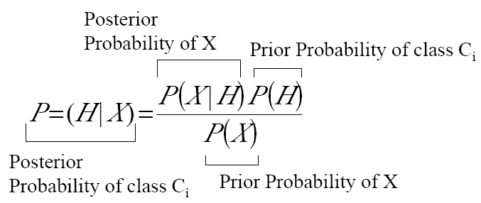
Bayes Theorem - Classification
Likelihood

Slide 94

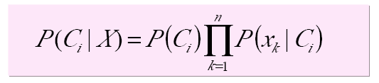
Naïve Bayes Classification
Hypothesis H is the class C_{i.}
Note: P (X) can be ignored (for classification) as it is constant for all classes.
Assuming the independence assumption, P(X|C_{i}) is:
Therefore:
P(C_{i}) is the ratio of total samples in class C_{i} to all samples.

Slide 95
Naïve Bayes Classification
For categorical attribute:
P(x_{k}|C_{i}) is the frequency of samples having value x_{k} for class C_{i}
For continuous (numeric) attribute:
P(x_{k}|C_{i}) is calculated via a Gaussian density function. with a mean μ and standard deviation σ

Slide 96
Naïve Bayes Classification
Having pre-calculated all P(x_{k}|C_{i}), an unknown example X is classified as follows:
For all classes calculate P(C_{i}|X)
Assign X to the class with the highest P(C_{i}|X)

Slide 97
Play Tennis?
Incoming sample: X = <sunny, cool, high, true>

Slide 98
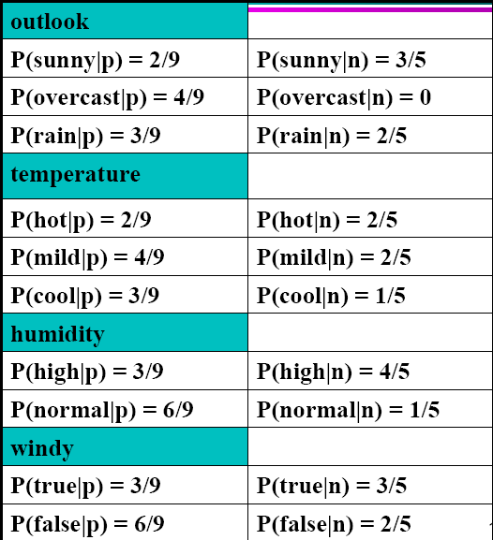

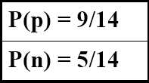
Play Tennis Example: estimating P(x_{i}|C)

Slide 99
Play Tennis Example: estimating P(C_{i}|x_{i})
An incoming sample: X = <sunny, cool, high, true>
P(p|X) = P(X|p)*P(p) =
P(p)*P(sunny|p)*P(cool|p)*P(high|p)*p(true|p)
9/14 * 2/9 * 3/9 * 3/9 * 3/9= 0.0053
// >>> .0053/(.0053+.026) =0.16932907348242812
P(n|X) = P(X|p)*P(n) =
P(n)*P(sunny|n)*P(cool|n)*P(high|n)*p(true|n)
5/14 * 3/5 * 1/5 * 4/5 * 3/5 = 0.0206
// >>> .026/(.0053+.026) = 0.8306709265175718
Class n (no play) has higher probability than class p (play) for example X.

Slide 100
Avoiding the Zero-Probability Problem
Naïve Bayesian prediction requires each conditional prob. be non-zero. Otherwise, the likelihood will be zero:
Ex. Suppose a dataset with 1000 tuples, income=low (0), income=medium (990), and income = high (10)
Use Laplacian correction (or Laplacian smoothing)
Adding 1 to each case
Prob(income = low) = (0+1)/(1000+3) = 1/1003
Prob(income = medium) = 991/1003
Prob(income = high) = 11/1003
The “corrected” prob. estimates are close to their “uncorrected” counterparts

Slide 101
Avoiding the Zero-Probability Problem
Standard approach: use logarithms
Log of products == sum of logs

Slide 102
Naïve Bayes Classifier: Comments
Advantages
Easy to implement
Good results obtained in most of the cases
Disadvantages
Assumption: class conditional independence, therefore loss of accuracy
Practically, dependencies exist among variables
E.g., hospitals: patients: Profile: age, family history, etc.
Symptoms: fever, cough etc., Disease: lung cancer, diabetes, etc.
Dependencies among these cannot be modeled by Naïve Bayes Classifier
How to deal with these dependencies? Bayesian Networks

Slide 103
Classification: Basic Concepts
Classification: Basic Concepts
Decision Tree Induction
Bayes Classification Methods
Rule-Based Classification
Model Evaluation and Selection
Techniques to Improve Classification Accuracy: Ensemble Methods
Summary
103
Notes:
103

Slide 104
Using IF-THEN Rules for Classification
Represent the knowledge in the form of IF-THEN rules
R: IF age = youth AND student = yes THEN buys_computer = yes
Rule antecedent/precondition vs. rule consequent
Assessment of a rule: coverage (support) and accuracy (confidence)
n_{covers} = # of tuples covered by R
n_{correct} = # of tuples correctly classified by R
coverage(R) = n_{covers} /|D| /* D: training data set */
accuracy(R) = n_{correct} / n_{covers}
If more than one rule are triggered, need conflict resolution or priority scheme
Size ordering: assign the highest priority to the triggering rules that has the “toughest” most specific requirement (i.e., most attribute tests)
Class-based ordering: decreasing order of prevalence or misclassification cost per class
Rule-based ordering (decision list): rules are organized into one long priority list, according to some measure of rule quality or by experts

Slide 105
Rule Extraction from a Decision Tree
Rules are easier to understand than large trees
One rule is created for each path from the root to a leaf
Each attribute-value pair along a path forms a conjunction: the leaf holds the class prediction
Rules are mutually exclusive and exhaustive
age?
<=30
31..40
>40
student?
yes
credit rating?
no
yes
excellent
fair
no
yes
no
yes
Example: Rule extraction from our buys_computer decision-tree
IF age = young AND student = no THEN buys_computer = no
IF age = young AND student = yes THEN buys_computer = yes
IF age = mid-age THEN buys_computer = yes
IF age = old AND credit_rating = excellent THEN buys_computer = no
IF age = old AND credit_rating = fair THEN buys_computer = yes

Slide 106
Rule Induction: Sequential Covering Method
Sequential covering algorithm: Extracts rules directly from training data
Typical sequential covering algorithms: FOIL, AQ, CN2, RIPPER
Rules are learned sequentially, each for a given class C_{i} will cover many tuples of C_{i} but none (or few) of the tuples of other classes
Steps:
Rules are learned one at a time
Each time a rule is learned, the tuples covered by the rules are removed
Repeat the process on the remaining tuples until termination condition, e.g., when there are no more training examples, or when the quality of a rule returned is below a user-specified threshold

Slide 107
Sequential Covering Algorithm
while (enough target tuples left)
generate a rule
remove positive target tuples satisfying this rule
Examples covered
by Rule 2
Examples covered
by Rule 1
Examples covered
by Rule 3
Positive examples

Slide 108
Rule Generation
To generate a rule
while(true)
find the best predicate p
if foil-gain(p) > threshold then add p to current rule
else break
A3=1
A3=1&&A1=2
A3=1&&A1=2
&&A8=5
Positive examples
Negative examples

Slide 109
How to Learn-One-Rule?
Start with the most general rule possible: condition = empty
Add new attributes by adopting a greedy depth-first strategy
Picks the attribute that most improves the rule quality
Rule-Quality measures: consider both coverage and accuracy
Foil-gain (in FOIL & RIPPER): assesses info_gain by extending condition:
favors rules that have high accuracy and cover many positive tuples
Rule pruning based on an independent set of test tuples
Pos/neg are # of positive/negative tuples covered by R.
If FOIL_Prune is higher for the pruned version of R, prune R
pos’, neg’
predicted

Slide 110
Classification: Basic Concepts
Classification: Basic Concepts
Decision Tree Induction
Bayes Classification Methods
Rule-Based Classification
Model Evaluation and Selection
Techniques to Improve Classification Accuracy: Ensemble Methods
Summary
110
Notes:
110

Slide 111
Model Evaluation and Selection
Evaluation metrics: How can we measure accuracy? Other metrics to consider?
Use validation test set of class-labeled tuples instead of training set when assessing accuracy
Methods for estimating a classifier’s accuracy:
Holdout method, random subsampling
Cross-validation
Bootstrap
Comparing classifiers:
Confidence intervals
Cost-benefit analysis and ROC Curves
111

Slide 112
Classifier Evaluation Metrics: Confusion Matrix
Confusion Matrix:
Actual class\Predicted class | C₁ | ¬ C₁
C₁ | True Positives (TP) | False Negatives (FN)
¬ C₁ | False Positives (FP) | True Negatives (TN)
Example of Confusion Matrix: BOLD red is correct classification
Actual class\Predicted class | buy_computer = yes | buy_computer = no | Total
buy_computer = yes | 6954 | 46 | 7000
buy_computer = no | 412 | 2588 | 3000
Total | 7366 | 2634 | 10000
Given m classes, an entry, CM_{i,j} in a confusion matrix indicates # of tuples in class i that were labeled by the classifier as class j
May have extra rows/columns to provide totals
112

Slide 113
Classifier Evaluation Metrics: Accuracy, Error Rate, Sensitivity and Specificity
A\P | C | ¬C
C | TP | FN | P
¬C | FP | TN | N
 | P’ | N’ | All
Class Imbalance Problem:
One class may be rare, e.g. fraud, or HIV-positive
Significant majority of the negative class and minority of the positive class
Sensitivity : True Positive recognition rate
Sensitivity = TP/P
Specificity: True Negative recognition rate
Specificity = TN/N
Classifier Accuracy: percentage of test set tuples that are correctly classified
Accuracy = (TP + TN)/All
Error rate: 1 – accuracy, or
Error rate = (FP + FN)/All
113

Slide 114
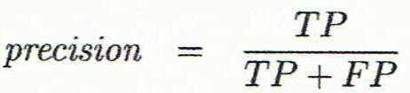
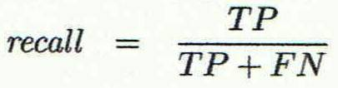
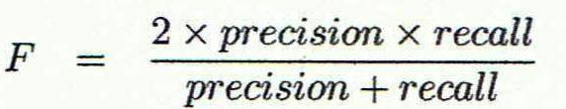
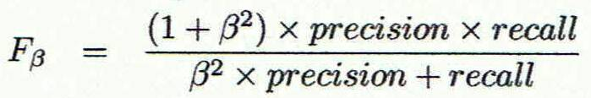
Classifier Evaluation Metrics: Precision and Recall, and F-measures
Precision: exactness – what % of tuples that the classifier labeled as positive are actually positive
Recall: completeness – what % of positive tuples did the classifier label as positive?
Perfect score is 1.0
Inverse relationship between precision & recall (show curve)
F measure (F₁ or F-score): harmonic mean of precision and recall,
F_{ß}: weighted measure of precision and recall
ß = 0.5 weighs precision twice the weight of recall
114

Slide 115
Classifier Evaluation Metrics: Example
Actual Class\Predicted class | cancer = yes | cancer = no | Total | Recognition(%)
cancer = yes | 90 | 210 | 300 | 30.00 (sensitivity TP/P)
cancer = no | 140 | 9560 | 9700 | 98.56 (specificity TN/N)
Total | 230 | 9770 | 10000 | 96.40 (accuracy TP+TN/All)
Precision = 90/230 = 39.13% Recall = 90/300 = 30.00%
115

Slide 116
Evaluating Classifier Accuracy: Holdout & Cross-Validation Methods
Holdout method
Given data is randomly partitioned into two independent sets
Training set (e.g., 2/3) for model construction
Test set (e.g., 1/3) for accuracy estimation
Random sampling: a variation of holdout
Repeat holdout k times, accuracy = avg. of the accuracies obtained
Cross-validation (k-fold, where k = 10 is most popular)
Randomly partition the data into k mutually exclusive subsets, each approximately equal size
At i-th iteration, use D_{i} as test set and others as training set
Leave-one-out: k folds where k = # of tuples, for small sized data
*Stratified cross-validation*: folds are stratified so that class distribution in each fold is approximately the same as the initial data
116

Slide 117

Evaluating Classifier Accuracy: Bootstrap
Bootstrap
Works well with small data sets
Samples the given training tuples uniformly with replacement
i.e., each time a tuple is selected, it is equally likely to be selected again and re-added to the training set
Several bootstrap methods, a common one is .632 boostrap
A data set with d tuples is sampled d times, with replacement, resulting in a training set of d samples. The data tuples that did not make it into the training set end up forming the test set. About 63.2% of the original data end up in the bootstrap, and the remaining 36.8% form the test set (since (1 – 1/d)^{d} ≈ e⁻¹ = 0.368)
Repeat the sampling procedure k times, overall accuracy of the model:
Note: Training set accuracy
Used in model accuracy
117

Slide 118


Estimating Confidence Intervals: Classifier Models M₁ vs. M₂
Suppose we have 2 classifiers, M₁ and M₂, which one is better?
Use 10-fold cross-validation to obtain and
These mean error rates are just estimates of error on the true population of future data cases
What if the difference between the 2 error rates is just attributed to chance?
Use a test of statistical significance
Obtain confidence limits for our error estimates
118

Slide 119
Estimating Confidence Intervals: Null Hypothesis
Perform 10-fold cross-validation
Assume samples follow a t distribution with k–1 degrees of freedom (here, k=10)
Use t-test (or Student’s t-test)
Null Hypothesis: M₁ & M₂ are the same
If we can reject null hypothesis, then
we conclude that the difference between M₁ & M₂ is statistically significant
Chose model with lower error rate
119

Slide 120
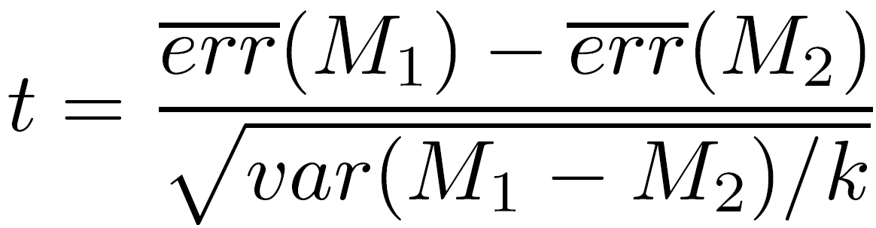
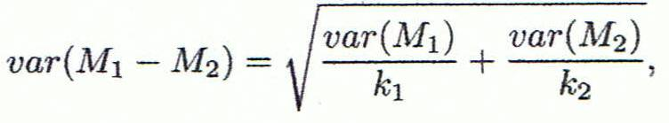
Estimating Confidence Intervals: t-test
If only 1 test set available: pairwise comparison
For i^{th} round of 10-fold cross-validation, the same cross partitioning is used to obtain err(M₁)_{i} and err(M₂)_{i}
Average over 10 rounds to get
t-test computes t-statistic with k-1 degrees of freedom:
If two test sets available: use non-paired (2-sample) t-test
and
where
where
where k₁ & k₂ are # of cross-validation samples used for M₁ & M₂, resp.
120

Slide 121
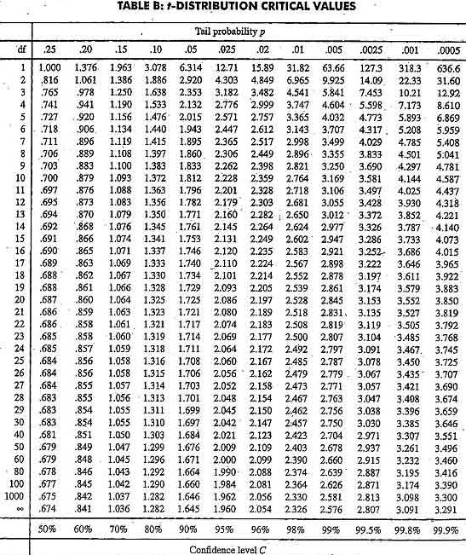
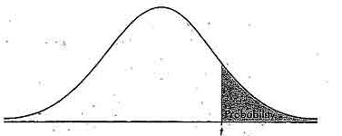
Estimating Confidence Intervals: Table for t-distribution
Symmetric
Significance level, e.g., sig = 0.05 or 5% means M₁ & M₂ are significantly different for 95% of population
Confidence limit, z = sig/2
121

Slide 122
Estimating Confidence Intervals: Statistical Significance
Are M₁ & M₂ significantly different?
Compute t. Select significance level (e.g. sig = 5%)
Consult table for t-distribution: Find t value corresponding to k-1 degrees of freedom (here, 9)
t-distribution is symmetric: typically upper % points of distribution shown → look up value for confidence limit z=sig/2 (here, 0.025)
If t > z or t < -z, then t value lies in rejection region:
Reject null hypothesis that mean error rates of M₁ & M₂ are same
Conclude: statistically significant difference between M₁ & M₂
Otherwise, conclude that any difference is chance
122

Slide 123
Model Selection: ROC Curves
ROC (Receiver Operating Characteristics) curves: for visual comparison of classification models
Originated from signal detection theory
Shows the trade-off between the true positive rate and the false positive rate
The area under the ROC curve is a measure of the accuracy of the model
Rank the test tuples in decreasing order: the one that is most likely to belong to the positive class appears at the top of the list
The closer to the diagonal line (i.e., the closer the area is to 0.5), the less accurate is the model
Vertical axis represents the true positive rate
Horizontal axis rep. the false positive rate
The plot also shows a diagonal line
A model with perfect accuracy will have an area of 1.0
123

Slide 124
Issues Affecting Model Selection
Accuracy
classifier accuracy: predicting class label
Speed
time to construct the model (training time)
time to use the model (classification/prediction time)
Robustness: handling noise and missing values
Scalability: efficiency in disk-resident databases
Interpretability
understanding and insight provided by the model
Other measures, e.g., goodness of rules, such as decision tree size or compactness of classification rules
124
Notes:
124

Slide 125
Classification: Basic Concepts
Classification: Basic Concepts
Decision Tree Induction
Bayes Classification Methods
Rule-Based Classification
Model Evaluation and Selection
Techniques to Improve Classification Accuracy: Ensemble Methods
Summary
125
Notes:
125

Slide 126
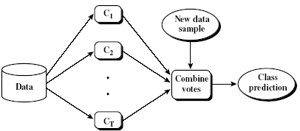
Ensemble Methods: Increasing the Accuracy
Ensemble methods
Use a combination of models to increase accuracy
Combine a series of k learned models, M₁, M₂, …, M_{k}, with the aim of creating an improved model M*
Popular ensemble methods
Bagging: averaging the prediction over a collection of classifiers
Boosting: weighted vote with a collection of classifiers
Ensemble: combining a set of heterogeneous classifiers
126

Slide 127
Bagging: Boostrap Aggregation
Analogy: Diagnosis based on multiple doctors’ majority vote
Training
Given a set D of d tuples, at each iteration i, a training set D_{i} of d tuples is sampled with replacement from D (i.e., bootstrap)
A classifier model M_{i} is learned for each training set D_{i}
Classification: classify an unknown sample X
Each classifier M_{i} returns its class prediction
The bagged classifier M* counts the votes and assigns the class with the most votes to X
Prediction: can be applied to the prediction of continuous values by taking the average value of each prediction for a given test tuple
Accuracy
Often significantly better than a single classifier derived from D
For noisy data: not considerably worse, more robust
Proved improved accuracy in prediction
127

Slide 128
Boosting
Analogy: Consult several doctors, based on a combination of weighted diagnoses—weight assigned based on the previous diagnosis accuracy
How boosting works?
Weights are assigned to each training tuple
A series of k classifiers is iteratively learned
After a classifier M_{i} is learned, the weights are updated to allow the subsequent classifier, M_{i+1}, to pay more attention to the training tuples that were misclassified by M_{i}
The final M* combines the votes of each individual classifier, where the weight of each classifier's vote is a function of its accuracy
Boosting algorithm can be extended for numeric prediction
Compared with bagging: Boosting tends to have greater accuracy, but it also risks overfitting the model to misclassified data
Note: Weighted Majority
128

Slide 129
Adaboost (Freund and Schapire, 1997)
Given a set of d class-labeled tuples, (X₁, y₁), …, (X_{d}, y_{d})
Initially, all the weights of tuples are set the same (1/d)
Generate k classifiers in k rounds. At round i,
Tuples from D are sampled (with replacement) to form a training set D_{i} of the same size
Each tuple’s chance of being selected is based on its weight
A classification model M_{i} is derived from D_{i}
Its error rate is calculated using D_{i} as a test set
If a tuple is misclassified, its weight is increased, o.w. it is decreased
Error rate: err(X_{j}) is the misclassification error of tuple X_{j}. Classifier M_{i} error rate is the sum of the weights of the misclassified tuples:
The weight of classifier M_{i}’s vote is

Slide 130
Random Forest (Breiman 2001)
Random Forest:
Each classifier in the ensemble is a decision tree classifier and is generated using a random selection of attributes at each node to determine the split
During classification, each tree votes and the most popular class is returned
Two Methods to construct Random Forest:
Forest-RI (random input selection): Randomly select, at each node, F attributes as candidates for the split at the node. The CART (Gini) or Info Gain methodology is used to grow the trees to maximum size
Forest-RC (random linear combinations): Creates new attributes (or features) that are a linear combination of the existing attributes (reduces the correlation between individual classifiers)
Comparable in accuracy to Adaboost, but more robust to errors and outliers
Insensitive to the number of attributes selected for consideration at each split, and faster than bagging or boosting
130

Slide 131
Classification of Class-Imbalanced Data Sets
Class-imbalance problem: Rare positive example but numerous negative ones, e.g., medical diagnosis, fraud, oil-spill, fault, etc.
Traditional methods assume a balanced distribution of classes and equal error costs: not suitable for class-imbalanced data
Typical methods for imbalance data in 2-class classification:
Oversampling: re-sampling of data from positive class
Under-sampling: randomly eliminate tuples from negative class
Threshold-moving: moves the decision threshold, t, so that the rare class tuples are easier to classify, and hence, less chance of costly false negative errors
Ensemble techniques: Ensemble multiple classifiers introduced above
Still difficult for class imbalance problem on multiclass tasks
131

Slide 132
Classification: Basic Concepts
Classification: Basic Concepts
Decision Tree Induction
Bayes Classification Methods
Rule-Based Classification
Model Evaluation and Selection
Techniques to Improve Classification Accuracy: Ensemble Methods
Summary
132
Notes:
132

Slide 133
Summary (I)
Classification is a form of data analysis that extracts models describing important data classes.
Effective and scalable methods have been developed for decision tree induction, Naive Bayesian classification, rule-based classification, and many other classification methods.
Evaluation metrics include: accuracy, sensitivity, specificity, precision, recall, F measure, and F_{ß} measure.
Stratified k-fold cross-validation is recommended for accuracy estimation.
Bagging and boosting can be used to increase overall accuracy by learning and combining a series of individual models.
133

Slide 134
Summary (II)
Significance tests and ROC curves are useful for model selection.
There have been numerous comparisons of the different classification methods; the matter remains a research topic
No single method has been found to be superior over all others for all data sets
Issues such as accuracy, training time, robustness, scalability, and interpretability must be considered and can involve trade-offs, further complicating the quest for an overall superior method
134

Slide 135
References (1)
C. Apte and S. Weiss. Data mining with decision trees and decision rules. Future Generation Computer Systems, 13, 1997
C. M. Bishop, Neural Networks for Pattern Recognition. Oxford University Press, 1995
L. Breiman, J. Friedman, R. Olshen, and C. Stone. Classification and Regression Trees. Wadsworth International Group, 1984
C. J. C. Burges. A Tutorial on Support Vector Machines for Pattern Recognition. Data Mining and Knowledge Discovery, 2(2): 121-168, 1998
P. K. Chan and S. J. Stolfo. Learning arbiter and combiner trees from partitioned data for scaling machine learning. KDD'95
H. Cheng, X. Yan, J. Han, and C.-W. Hsu, Discriminative Frequent Pattern Analysis for Effective Classification, ICDE'07
H. Cheng, X. Yan, J. Han, and P. S. Yu, Direct Discriminative Pattern Mining for Effective Classification, ICDE'08
W. Cohen. Fast effective rule induction. ICML'95
G. Cong, K.-L. Tan, A. K. H. Tung, and X. Xu. Mining top-k covering rule groups for gene expression data. SIGMOD'05
135

Slide 136
References (2)
A. J. Dobson. An Introduction to Generalized Linear Models. Chapman & Hall, 1990.
G. Dong and J. Li. Efficient mining of emerging patterns: Discovering trends and differences. KDD'99.
R. O. Duda, P. E. Hart, and D. G. Stork. Pattern Classification, 2ed. John Wiley, 2001
U. M. Fayyad. Branching on attribute values in decision tree generation. AAAI’94.
Y. Freund and R. E. Schapire. A decision-theoretic generalization of on-line learning and an application to boosting. J. Computer and System Sciences, 1997.
J. Gehrke, R. Ramakrishnan, and V. Ganti. Rainforest: A framework for fast decision tree construction of large datasets. VLDB’98.
J. Gehrke, V. Gant, R. Ramakrishnan, and W.-Y. Loh, BOAT -- Optimistic Decision Tree Construction. SIGMOD'99.
T. Hastie, R. Tibshirani, and J. Friedman. The Elements of Statistical Learning: Data Mining, Inference, and Prediction. Springer-Verlag, 2001.
D. Heckerman, D. Geiger, and D. M. Chickering. Learning Bayesian networks: The combination of knowledge and statistical data. Machine Learning, 1995.
W. Li, J. Han, and J. Pei, CMAR: Accurate and Efficient Classification Based on Multiple Class-Association Rules, ICDM'01.
136

Slide 137
References (3)
T.-S. Lim, W.-Y. Loh, and Y.-S. Shih. A comparison of prediction accuracy, complexity, and training time of thirty-three old and new classification algorithms. Machine Learning, 2000.
J. Magidson. The Chaid approach to segmentation modeling: Chi-squared automatic interaction detection. In R. P. Bagozzi, editor, Advanced Methods of Marketing Research, Blackwell Business, 1994.
M. Mehta, R. Agrawal, and J. Rissanen. SLIQ : A fast scalable classifier for data mining. EDBT'96.
T. M. Mitchell. Machine Learning. McGraw Hill, 1997.
S. K. Murthy, Automatic Construction of Decision Trees from Data: A Multi-Disciplinary Survey, Data Mining and Knowledge Discovery 2(4): 345-389, 1998
J. R. Quinlan. Induction of decision trees. Machine Learning, 1:81-106, 1986.
J. R. Quinlan and R. M. Cameron-Jones. FOIL: A midterm report. ECML’93.
J. R. Quinlan. C4.5: Programs for Machine Learning. Morgan Kaufmann, 1993.
J. R. Quinlan. Bagging, boosting, and c4.5. AAAI'96.
137

Slide 138
References (4)
R. Rastogi and K. Shim. Public: A decision tree classifier that integrates building and pruning. VLDB’98.
J. Shafer, R. Agrawal, and M. Mehta. SPRINT : A scalable parallel classifier for data mining. VLDB’96.
J. W. Shavlik and T. G. Dietterich. Readings in Machine Learning. Morgan Kaufmann, 1990.
P. Tan, M. Steinbach, and V. Kumar. Introduction to Data Mining. Addison Wesley, 2005.
S. M. Weiss and C. A. Kulikowski. Computer Systems that Learn: Classification and Prediction Methods from Statistics, Neural Nets, Machine Learning, and Expert Systems. Morgan Kaufman, 1991.
S. M. Weiss and N. Indurkhya. Predictive Data Mining. Morgan Kaufmann, 1997.
I. H. Witten and E. Frank. Data Mining: Practical Machine Learning Tools and Techniques, 2ed. Morgan Kaufmann, 2005.
X. Yin and J. Han. CPAR: Classification based on predictive association rules. SDM'03
H. Yu, J. Yang, and J. Han. Classifying large data sets using SVM with hierarchical clusters. KDD'03.
138

Slide 139


Slide 140
Decision Tree Induction: An Example
Training data set: Buys_computer
The data set follows an example of Quinlan’s ID3 (Playing Tennis)
Resulting tree:
age?
<=30
overcast
>40
31..40
student?
yes
credit rating?
no
yes
excellent
fair
no
yes
no
yes

Slide 141
Algorithm for Decision Tree Induction
Basic algorithm (a greedy algorithm)
Tree is constructed in a top-down recursive divide-and-conquer manner
At start, all the training examples are at the root
Attributes are categorical (if continuous-valued, they are discretized in advance)
Examples are partitioned recursively based on selected attributes
Test attributes are selected on the basis of a heuristic or statistical measure (e.g., information gain)
Conditions for stopping partitioning
All samples for a given node belong to the same class
There are no remaining attributes for further partitioning – majority voting is employed for classifying the leaf
There are no samples left

Slide 142
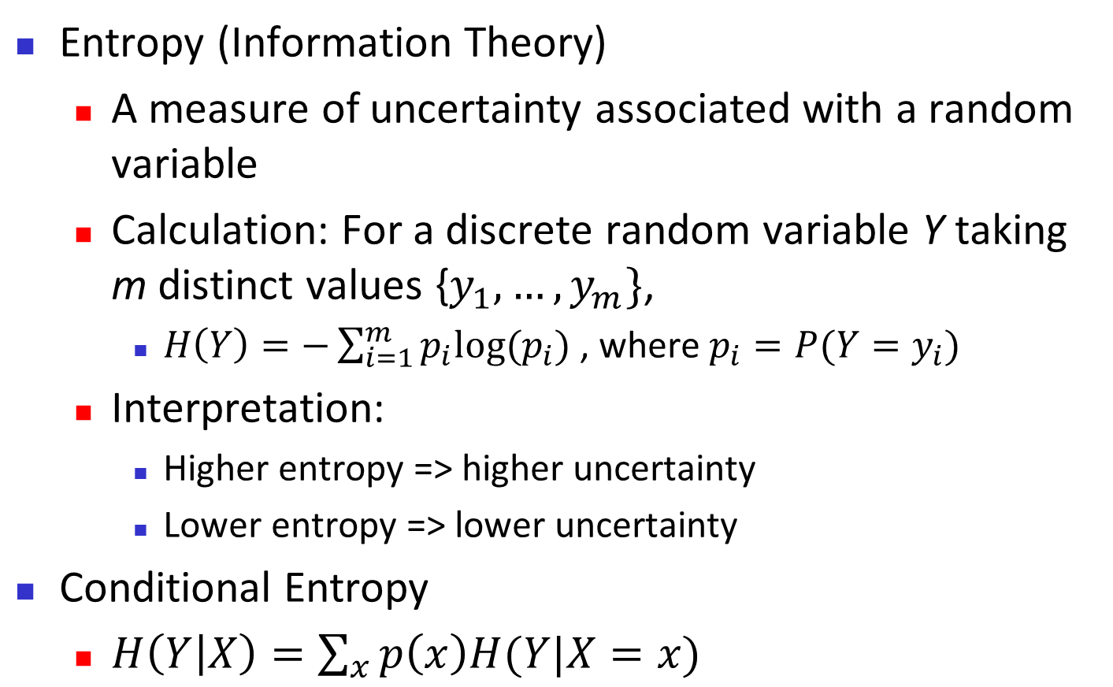
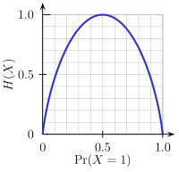
Brief Review of Entropy
m = 2

Slide 143
Attribute Selection Measure: Information Gain (ID3/C4.5)
Select the attribute with the highest information gain
Let p_{i} be the probability that an arbitrary tuple in D belongs to class C_{i}, estimated by |C_{i, D}|/|D|
Expected information (entropy) needed to classify a tuple in D:
Information needed (after using A to split D into v partitions) to classify D:
Information gained by branching on attribute A
Notes:
I : the expected information needed to classify a given sample
E (entropy) : expected information based on the partitioning into subsets by A

Slide 144
Attribute Selection: Information Gain
Class P: buys_computer = “yes”
Class N: buys_computer = “no”
means “age <=30” has 5 out of 14 samples, with 2 yes’es and 3 no’s. Hence
Similarly,

Slide 145
Computing Information-Gain for Continuous-Valued Attributes
Let attribute A be a continuous-valued attribute
Must determine the best split point for A
Sort the value A in increasing order
Typically, the midpoint between each pair of adjacent values is considered as a possible split point
(a_{i}+a_{i+1})/2 is the midpoint between the values of a_{i} and a_{i+1}
The point with the minimum expected information requirement for A is selected as the split-point for A
Split:
D1 is the set of tuples in D satisfying A ≤ split-point, and D2 is the set of tuples in D satisfying A > split-point

Slide 146
Gain Ratio for Attribute Selection (C4.5)
Information gain measure is biased towards attributes with a large number of values
C4.5 (a successor of ID3) uses gain ratio to overcome the problem (normalization to information gain)
GainRatio(A) = Gain(A)/SplitInfo(A)
Ex.
gain_ratio(income) = 0.029/1.557 = 0.019
The attribute with the maximum gain ratio is selected as the splitting attribute

Slide 147
Gini Index (CART, IBM IntelligentMiner)
If a data set D contains examples from n classes, gini index, gini(D) is defined as
where p_{j} is the relative frequency of class j in D
If a data set D is split on A into two subsets D₁ and D₂, the gini index gini(D) is defined as
Reduction in Impurity:
The attribute provides the smallest gini_{split}(D) (or the largest reduction in impurity) is chosen to split the node (need to enumerate all the possible splitting points for each attribute)

Slide 148
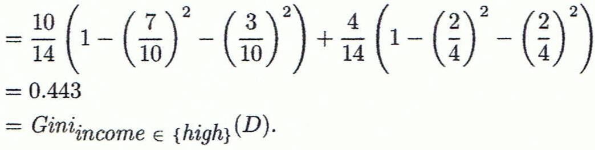
Computation of Gini Index
Ex. D has 9 tuples in buys_computer = “yes” and 5 in “no”
Suppose the attribute income partitions D into 10 in D₁: {low, medium} and 4 in D₂
Gini_{{low,high}} is 0.458; Gini_{{medium,high}} is 0.450. Thus, split on the {low,medium} (and {high}) since it has the lowest Gini index
All attributes are assumed continuous-valued
May need other tools, e.g., clustering, to get the possible split values
Can be modified for categorical attributes

Slide 149
Comparing Attribute Selection Measures
The three measures, in general, return good results but
Information gain:
biased towards multivalued attributes
Gain ratio:
tends to prefer unbalanced splits in which one partition is much smaller than the others
Gini index:
biased to multivalued attributes
has difficulty when # of classes is large
tends to favor tests that result in equal-sized partitions and purity in both partitions

Slide 150
Other Attribute Selection Measures
CHAID: a popular decision tree algorithm, measure based on χ² test for independence
C-SEP: performs better than info. gain and gini index in certain cases
G-statistic: has a close approximation to χ² distribution
MDL (Minimal Description Length) principle (i.e., the simplest solution is preferred):
The best tree as the one that requires the fewest # of bits to both (1) encode the tree, and (2) encode the exceptions to the tree
Multivariate splits (partition based on multiple variable combinations)
CART: finds multivariate splits based on a linear comb. of attrs.
Which attribute selection measure is the best?
Most give good results, none is significantly superior than others

Slide 151
Overfitting and Tree Pruning
Overfitting: An induced tree may overfit the training data
Too many branches, some may reflect anomalies due to noise or outliers
Poor accuracy for unseen samples
Two approaches to avoid overfitting
Prepruning: Halt tree construction early ̵ do not split a node if this would result in the goodness measure falling below a threshold
Difficult to choose an appropriate threshold
Postpruning: Remove branches from a “fully grown” tree—get a sequence of progressively pruned trees
Use a set of data different from the training data to decide which is the “best pruned tree”

Slide 152
Enhancements to Basic Decision Tree Induction
Allow for continuous-valued attributes
Dynamically define new discrete-valued attributes that partition the continuous attribute value into a discrete set of intervals
Handle missing attribute values
Assign the most common value of the attribute
Assign probability to each of the possible values
Attribute construction
Create new attributes based on existing ones that are sparsely represented
This reduces fragmentation, repetition, and replication

Slide 153
Classification in Large Databases
Classification—a classical problem extensively studied by statisticians and machine learning researchers
Scalability: Classifying data sets with millions of examples and hundreds of attributes with reasonable speed
Why is decision tree induction popular?
relatively faster learning speed (than other classification methods)
convertible to simple and easy to understand classification rules
can use SQL queries for accessing databases
comparable classification accuracy with other methods
RainForest (VLDB’98 — Gehrke, Ramakrishnan & Ganti)
Builds an AVC-list (attribute, value, class label)

Slide 154
Scalability Framework for RainForest
Separates the scalability aspects from the criteria that determine the quality of the tree
Builds an AVC-list: AVC (Attribute, Value, Class_label)
AVC-set (of an attribute X )
Projection of training dataset onto the attribute X and class label where counts of individual class label are aggregated
AVC-group (of a node n )
Set of AVC-sets of all predictor attributes at the node n

Slide 155
Rainforest: Training Set and Its AVC Sets
Training Examples
AVC-set on Age
AVC-set on income
Age | Buy_Computer
 | yes | no
<=30 | 2 | 3
31..40 | 4 | 0
>40 | 3 | 2
income | Buy_Computer
 | yes | no
high | 2 | 2
medium | 4 | 2
low | 3 | 1
AVC-set on
credit_rating
AVC-set on Student
student | Buy_Computer
 | yes | no
yes | 6 | 1
no | 3 | 4
Credit rating | Buy_Computer
 | yes | no
fair | 6 | 2
excellent | 3 | 3

Slide 156
BOAT (Bootstrapped Optimistic Algorithm for Tree Construction)
Use a statistical technique called bootstrapping to create several smaller samples (subsets), each fits in memory
Each subset is used to create a tree, resulting in several trees
These trees are examined and used to construct a new tree T’
It turns out that T’ is very close to the tree that would be generated using the whole data set together
Adv: requires only two scans of DB, an incremental alg.
156
Notes:
156

Slide 157
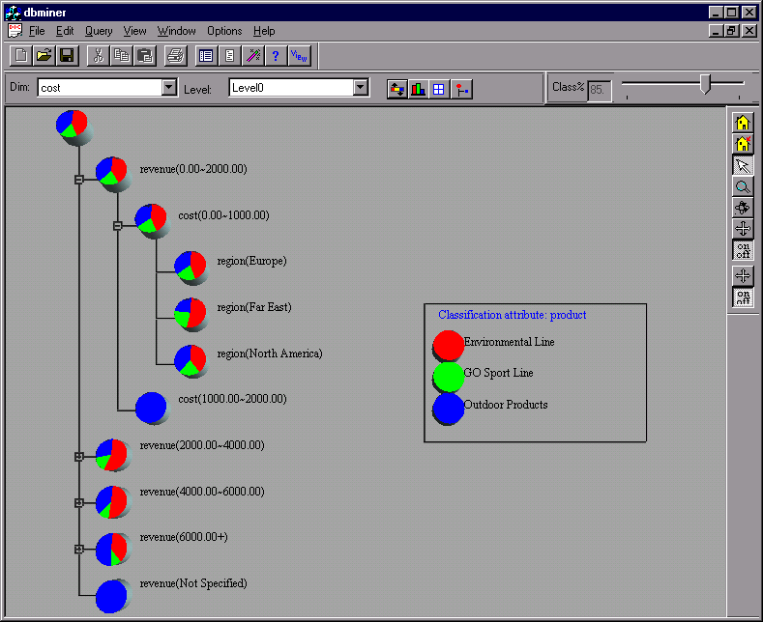
Presentation of Classification Results

Slide 158
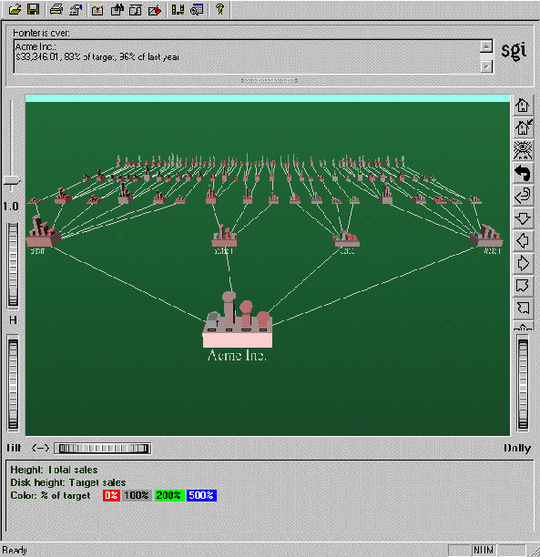
Visualization of a Decision Tree in SGI/MineSet 3.0

Slide 159
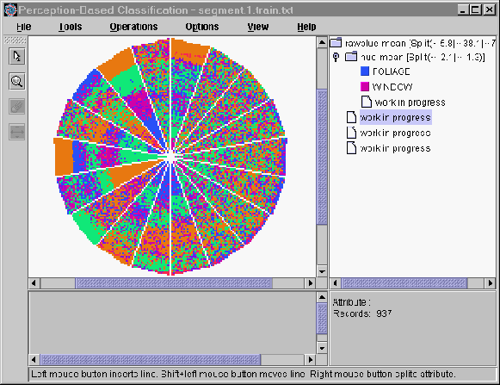
Interactive Visual Mining by Perception-Based Classification (PBC)

Slide 160
Issues: Evaluating Classification Methods
Accuracy
classifier accuracy: predicting class label
predictor accuracy: guessing value of predicted attributes
Speed
time to construct the model (training time)
time to use the model (classification/prediction time)
Robustness: handling noise and missing values
Scalability: efficiency in disk-resident databases
Interpretability
understanding and insight provided by the model
Other measures, e.g., goodness of rules, such as decision tree size or compactness of classification rules
160
Notes:
160

Slide 161
Predictor Error Measures
Measure predictor accuracy: measure how far off the predicted value is from the actual known value
Loss function: measures the error betw. y_{i} and the predicted value y_{i}’
Absolute error: | y_{i} – y_{i}’|
Squared error: (y_{i} – y_{i}’)²
Test error (generalization error): the average loss over the test set
Mean absolute error: Mean squared error:
Relative absolute error: Relative squared error:
The mean squared-error exaggerates the presence of outliers
Popularly use (square) root mean-square error, similarly, root relative squared error
161
Notes:
161

Slide 162
Scalable Decision Tree Induction Methods
SLIQ (EDBT’96 — Mehta et al.)
Builds an index for each attribute and only class list and the current attribute list reside in memory
SPRINT (VLDB’96 — J. Shafer et al.)
Constructs an attribute list data structure
PUBLIC (VLDB’98 — Rastogi & Shim)
Integrates tree splitting and tree pruning: stop growing the tree earlier
RainForest (VLDB’98 — Gehrke, Ramakrishnan & Ganti)
Builds an AVC-list (attribute, value, class label)
BOAT (PODS’99 — Gehrke, Ganti, Ramakrishnan & Loh)
Uses bootstrapping to create several small samples
162
Notes:
162

Slide 163
Data Cube-Based Decision-Tree Induction
Integration of generalization with decision-tree induction (Kamber et al.’97)
Classification at primitive concept levels
E.g., precise temperature, humidity, outlook, etc.
Low-level concepts, scattered classes, bushy classification-trees
Semantic interpretation problems
Cube-based multi-level classification
Relevance analysis at multi-levels
Information-gain analysis with dimension + level
163
Notes:
163
Emphasize: DT c4.5, InfoGain, NB, add BayesNet

Slide 164
Bayesian Classification: Why?
A statistical classifier: performs probabilistic prediction, i.e., predicts class membership probabilities
Foundation: Based on Bayes’ Theorem.
Performance: A simple Bayesian classifier, naïve Bayes, makes strong independence assumptions, but can perform well.
Comparable performance with basic decision trees and selected neural network classifiers
Incremental: Each training example can incrementally increase/decrease the probability that a hypothesis is correct (online learning) — prior knowledge can be combined with observed data
Standard: Can provide a standard of optimal decision making against which other methods can be measured

Slide 165
Bayes’ Theorem: Basics
Total probability Theorem:
Bayes’ Theorem:
Let X be a data sample (“evidence”): class label is unknown
Let H be a hypothesis that X belongs to class C
Classification is to determine P(H|X), (i.e., posteriori probability): the probability that the hypothesis holds given the observed data sample X
P(H) (prior probability): the initial probability
E.g., X will buy computer, regardless of age, income, …
P(X): probability that sample data is observed
P(X|H) (likelihood): the probability of observing the sample X, given that the hypothesis holds
E.g., Given that X will buy computer, the prob. that X is 31..40, medium income

Slide 166
Prediction Based on Bayes’ Theorem
Given training data X, posteriori probability of a hypothesis H, P(H|X), follows the Bayes’ theorem
Informally, this can be viewed as
posteriori = likelihood x prior/evidence
Predicts X belongs to C_{i} iff the probability P(C_{i}|X) is the highest among all the P(C_{k}|X) for all the k classes
Practical difficulty: It requires initial knowledge of many probabilities, which may involve significant computational cost

Slide 167
Classification Is to Derive the Maximum Posteriori
Let D be a training set of tuples and their associated class labels, and each tuple is represented by an n-D attribute vector X = (x₁, x₂, …, x_{n})
Suppose there are m classes C₁, C₂, …, C_{m}.
Classification is to derive the maximum posteriori, i.e., the maximal P(C_{i}|X)
This can be derived from Bayes’ theorem
Since P(X) is constant for all classes, only
needs to be maximized

Slide 168
Naïve Bayes Classifier
A simplified assumption: attributes are conditionally independent (i.e., no dependence relation between attributes):
This greatly reduces the computation cost: Only counts the class distribution
If A_{k} is categorical, P(x_{k}|C_{i}) is the # of tuples in C_{i} having value x_{k} for A_{k} divided by |C_{i, D}| (# of tuples of C_{i} in D)
If A_{k} is continous-valued, P(x_{k}|C_{i}) is usually computed based on Gaussian distribution with a mean μ and standard deviation σ
and P(x_{k}|C_{i}) is

Slide 169
Naïve Bayes Classifier: Training Dataset
Class:
C1:buys_computer = ‘yes’
C2:buys_computer = ‘no’
Data to be classified:
X = (age <=30,
Income = medium,
Student = yes
Credit_rating = Fair)

Slide 170
Naïve Bayes Classifier: An Example
P(C_{i}): P(buys_computer = “yes”) = 9/14 = 0.643
P(buys_computer = “no”) = 5/14= 0.357
Compute P(X|C_{i}) for each class
P(age = “<=30” | buys_computer = “yes”) = 2/9 = 0.222
P(age = “<= 30” | buys_computer = “no”) = 3/5 = 0.6
P(income = “medium” | buys_computer = “yes”) = 4/9 = 0.444
P(income = “medium” | buys_computer = “no”) = 2/5 = 0.4
P(student = “yes” | buys_computer = “yes) = 6/9 = 0.667
P(student = “yes” | buys_computer = “no”) = 1/5 = 0.2
P(credit_rating = “fair” | buys_computer = “yes”) = 6/9 = 0.667
P(credit_rating = “fair” | buys_computer = “no”) = 2/5 = 0.4
X = (age <= 30 , income = medium, student = yes, credit_rating = fair)
P(X|C_{i}) : P(X|buys_computer = “yes”) = 0.222 x 0.444 x 0.667 x 0.667 = 0.044
P(X|buys_computer = “no”) = 0.6 x 0.4 x 0.2 x 0.4 = 0.019
P(X|C_{i})*P(C_{i}) : P(X|buys_computer = “yes”) * P(buys_computer = “yes”) = 0.028
P(X|buys_computer = “no”) * P(buys_computer = “no”) = 0.007
Therefore, X belongs to class (“buys_computer = yes”)

Slide 171
Avoiding the Zero-Probability Problem
Naïve Bayesian prediction requires each conditional prob. be non-zero. Otherwise, the predicted prob. will be zero
Ex. Suppose a dataset with 1000 tuples, income=low (0), income= medium (990), and income = high (10)
Use Laplacian correction (or Laplacian estimator)
Adding 1 to each case
Prob(income = low) = 1/1003
Prob(income = medium) = 991/1003
Prob(income = high) = 11/1003
The “corrected” prob. estimates are close to their “uncorrected” counterparts

Slide 172
Naïve Bayes Classifier: Comments
Advantages
Easy to implement
Good results obtained in most of the cases
Disadvantages
Assumption: class conditional independence, therefore loss of accuracy
Practically, dependencies exist among variables
E.g., hospitals: patients: Profile: age, family history, etc.
Symptoms: fever, cough etc., Disease: lung cancer, diabetes, etc.
Dependencies among these cannot be modeled by Naïve Bayes Classifier
How to deal with these dependencies? Bayesian Belief Networks (Chapter 9)

