Slide 1
Dimensionality Reduction PCA
Jay Urbain, PhD
Credits:
James, G., Witten, D., Hastie, T., and Tibshirani, R. (2013) An Introduction to Statistical Learning, with applications in R, www.StatLearning.com, Springer-Verlag,

Slide 2
The Goals of Unsupervised Learning
Goal: discover interesting things about objects and their attributes.
Is there an informative way to visualize the data?
Can we discover subgroups among the variables or among the observations?
Two important methods:
Clustering, a broad class of methods for discovering unknown subgroups in data.
Principal components analysis, a tool used for data visualization, compression, or data pre-processing before supervised or unsupervised techniques are applied.

Slide 3
Challenge of Unsupervised Learning
Unsupervised learning is more subjective than supervised learning: no simple goal for the analysis, such as predicting a response.
But techniques for unsupervised learning are of growing importance in a number of fields:
Medicine: subgroups of breast cancer patients grouped by their gene expression measurements.
Commerce: groups of shoppers characterized by their browsing and purchase histories.
Reviews: movies grouped by the ratings assigned by movie viewers.
NLP: identifying concepts in text, similar documents, etc.

Slide 4
An advantage of unsupervised learning
Easier to obtain unlabeled data than labeled data, which can require human annotation.
For example:
Named entities in medical record text.
Human activity from surveillance cameras.
Sentiment of tweets.
Additionally there are relationships in the data beyond labels.
Humans can learn without supervision.

Slide 5
Principal Components
We wish to visualize n observations with measurements on a set of p features, X₁, X₂, . . . , X_{p} as part of exploratory data analysis.
We could examine 2-D scatter plots of the data, each of which contains two of p parameters.
However there are (n choose 2) = n!/[2!*(n-2)!] = n*(n-1)/2 such scatter plots.
E.g., if p=10, there are 45 plots!
Some data is very high dimensional.
Clearly, a better method is needed to visualize the n observations when p is large.

Slide 6
Principal Components
We would like to find a low-dimensional representation of the data that captures as much of the information as possible.
If we can obtain a 2D representation of the data that captures most of the information, then we can plot the observations in this low-dimensional space.
PCA – principal components analysis – is such a tool.

Slide 7

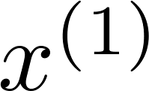
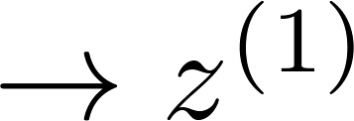
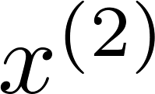
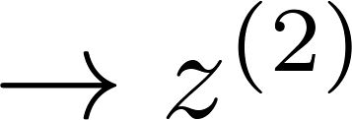
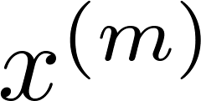
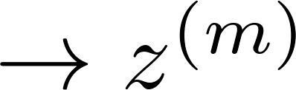


Basic idea: project data into lower dimensional space
Reduce data from
2D to 1D
(inches)
(cm)
Notes:
Map 2D to 1D

Slide 8
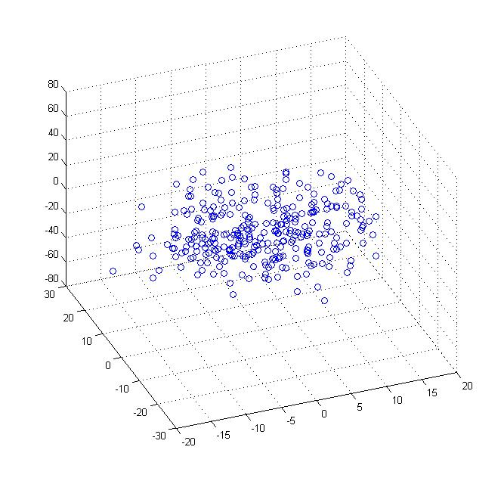
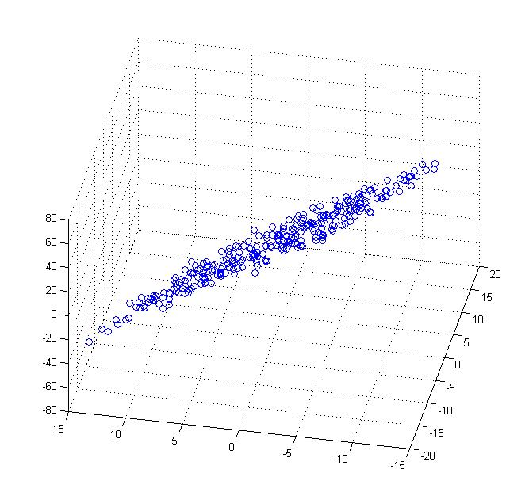
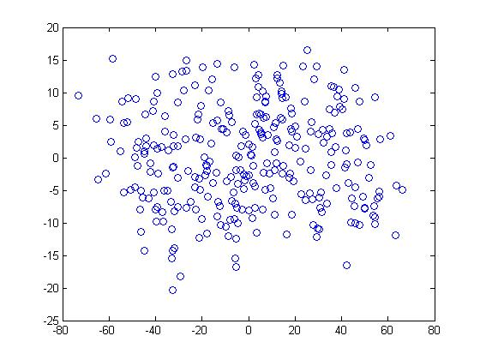


Data Projection
Reduce data from 3D to 2D
Notes:
Pca3d2d in lecture-slides/assets/pca/
Label axes

Slide 9

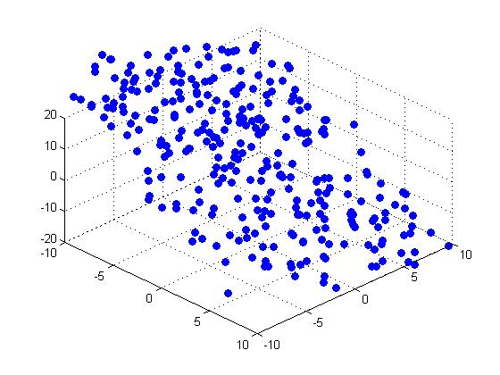


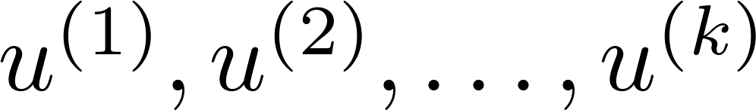
Principal Component Analysis (PCA) problem formulation
Reduce from 2-dimension to 1-dimension: Find a direction (a vector )
onto which to project the data so as to minimize the projection error.
Reduce from n-dimension to k-dimension: Find vectors
onto which to project the data, so as to minimize the projection error.
Notes:
Change numbers to LATEX as well

Slide 10
PCA is not linear regression
Linear regression
PCA
Notes:
Add animation to block left graph

Slide 11

Principal Components Analysis: details
The first principal component of a set of features
X₁, X₂, . . . , X_{p} is the normalized linear combination of the p features:
Z₁ =φ₁₁X₁ +φ₂₁X₂ +...+φ_{p1}X_{p}
that has the largest variance. By normalized, we mean that
We refer to the elements φ₁₁, . . . , φ_{p1} as the loadings of the first principal component.
Together, the loadings make up the principal component loading vector:
φ₁ =(φ₁₁ φ₂₁ ... φ_{p1})^{T}
The loadings are constrained so that their sum of squares is equal to one. Otherwise setting these elements to be arbitrarily large in absolute value could result in an arbitrarily large variance.

Slide 12
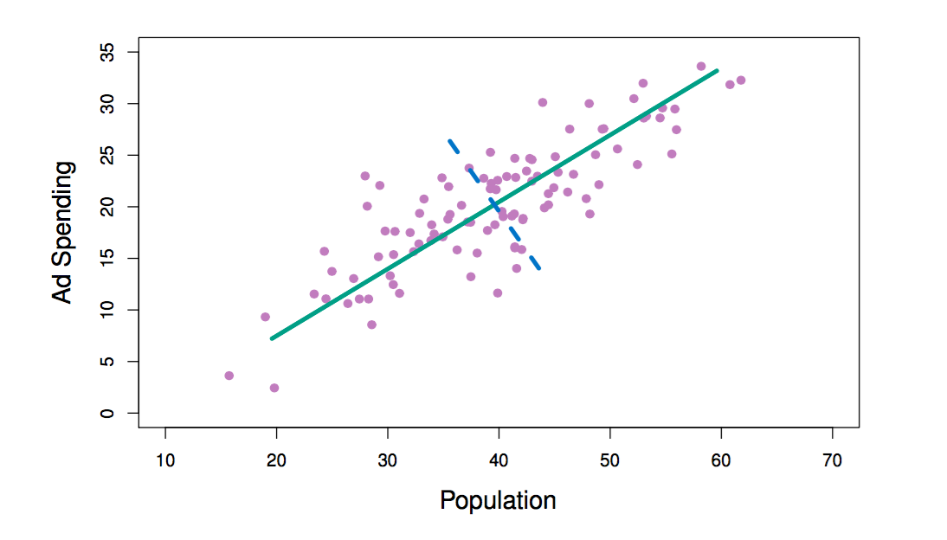
PCA: Advertising Dataset Example
The population size (pop) and ad spending (ad) for 100 different cities are shown as purple circles. The green solid line indicates the first principal component direction, and the blue dashed line indicates the second principal component direction.

Slide 13

Computation of Principal Components
Given an n × p data set X (n instances and p features)
*Since we are only interested in variance, assume that each of the variables in X has been centered to have mean zero (i.e., the column means of X are zero).
We then look for the linear combination of the sample feature values of the form:
z_{i1} =φ₁₁X_{i1} +φ₂₁X_{i2} +...+φ_{p1}X_{ip} (1)
for i = 1, . . . , n that has largest sample variance, subject to the constraint that:
Since each of the x_{ij} has mean zero, then so does z_{i1} (for any values of φ_{j1}). Therefore the sample variance of the z_{i1} can be written as:
*Use z-score for zero-mean and normalization.

Slide 14
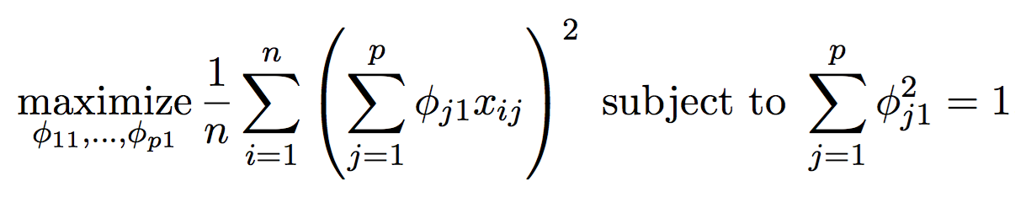
Computation: continued
Plugging in equation (1) the first principal component loading vector solves the optimization problem:
This problem can be solved via a singular-value decomposition of the matrix X, a standard technique in linear algebra.
We refer to Z₁ as the first principal component, with realized values z₁₁, . . . , z_{n1}

Slide 15
Geometry of PCA
The loading vector φ₁ with elements φ₁₁, φ₂₁, . . . , φ_{p1} defines a direction in p-dimensional feature space along which the data that vary the most.
If we project the n data points x₁,...,x_{n} onto this direction, the projected values are the principal component scores z₁₁,...,z_{n1} themselves.

Slide 16
Further principal components
The second principal component is the linear combination of X₁, . . . , X_{p} that has maximal variance among all linear combinations that are uncorrelated with Z₁.
The second principal component scores z₁₂,z₂₂,...,z_{n2} take the form
z_{i2} =φ₁₂x_{i1} +φ₂₂x_{i2} +...+φ_{p2}x_{ip},
where φ₂ is the second principal component loading vector, with elements φ₁₂, φ₂₂, . . . , φ_{p2}

Slide 17
Principal components: continued
Constraining Z₂ to be uncorrelated with Z₁ is equivalent to constraining the direction φ₂ to be orthogonal (perpendicular) to the direction φ₁. And so on.
The principal component directions φ₁, φ₂, φ₃, . . . are the ordered sequence of right singular vectors of the matrix X, and the variances of the components are 1 times the n squared of the singular values.
There are at most min(n − 1, p) principal components.

Slide 18


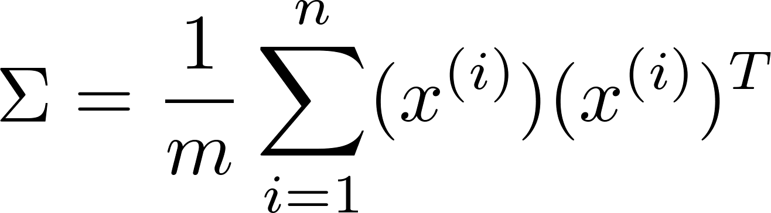

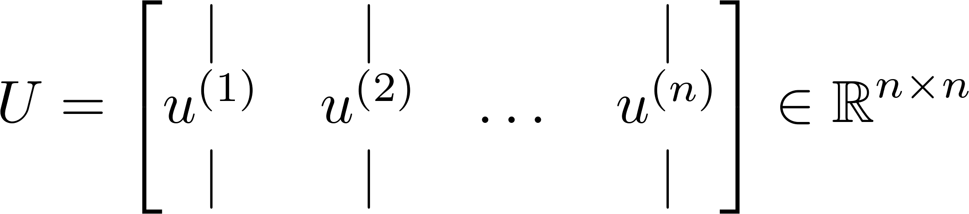
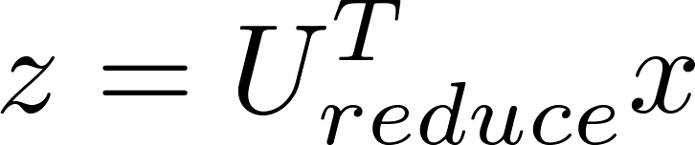
Principal Component Analysis (PCA) algorithm
Reduce data from -dimensions to -dimensions
Compute “covariance matrix”:
Compute “eigenvectors” of matrix :
[U,S,V] = svd(Sigma);
From U, we get:

Slide 19
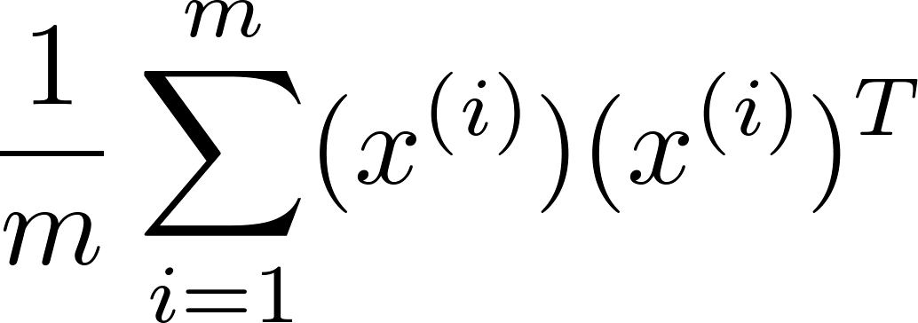
Principal Component Analysis (PCA) algorithm summary
After mean normalization (ensure every feature has zero mean) and optionally feature scaling:
Sigma =
[U,S,V] = svd(Sigma);
Ureduce = U(:,1:k);
z = Ureduce’*x;

Slide 20
Reconstruction from compressed representation
X_{approx} = U_{reduce} * Z⁽¹⁾
Notes:
Make points have 0 mean on x1 and x2

Slide 21

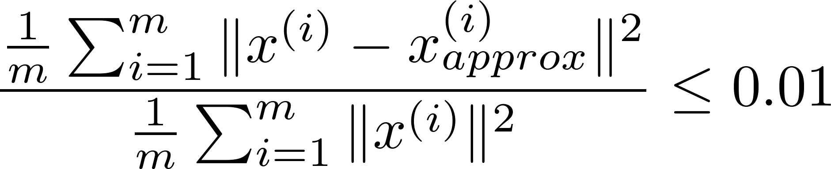
Choosing (number of principal components)
Average squared projection error:
Total variation in the data:
Typically, choose to be smallest value so that
“99% of variance is retained”
(1%)

Slide 22
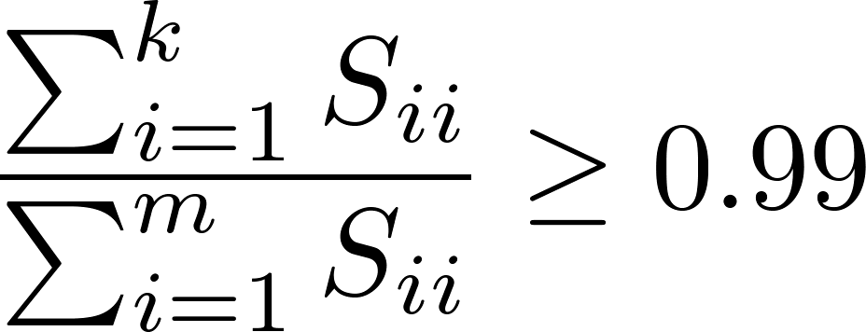
Choosing (number of principal components)
[U,S,V] = svd(Sigma)
Pick smallest value of for which
(99% of variance retained)

Slide 23
Illustration: USA arrests data
For each of the fifty states in the United States, the data set contains the number of arrests per 100,000 residents for each of three crimes: Assault, Murder, and Rape.
Also record the Urban Pop (the percent of the population in each state living in urban areas).
The principal component score vectors have length n = 50, and the principal component loading vectors have length p = 4.
PCA was performed after standardizing each variable to have mean zero and standard deviation one.

Slide 24
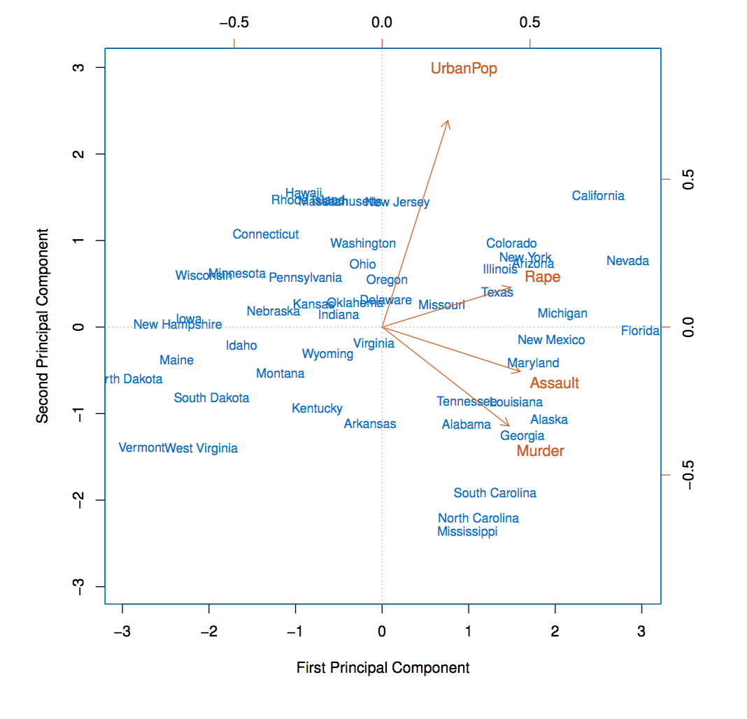
USAarrests data: PCA plot

Slide 25
Figure details
First two principal components for the USArrests data.
The blue state names represent the scores for the first two principal components.
The orange arrows indicate the first two principal component loading vectors (with axes on the top and right).
For example, the loading for Rape on the first component is 0.54, and its loading on the second principal component 0.17 [the word Rape is centered at the point (0.54, 0.17)].
This figure is known as a biplot, because it displays both the principal component scores and the principal component loadings.

Slide 26
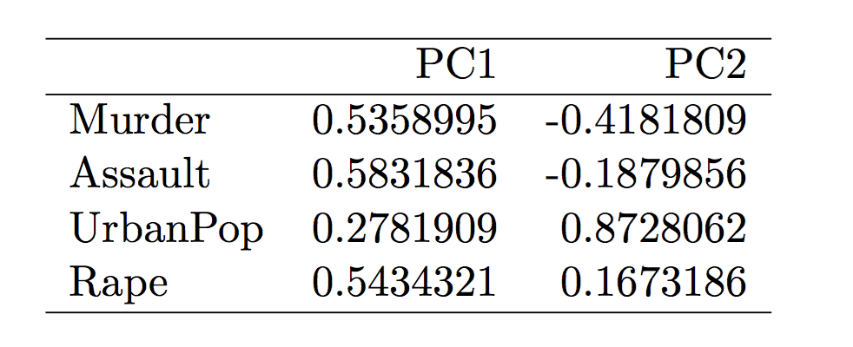
PCA Loadings

Slide 27
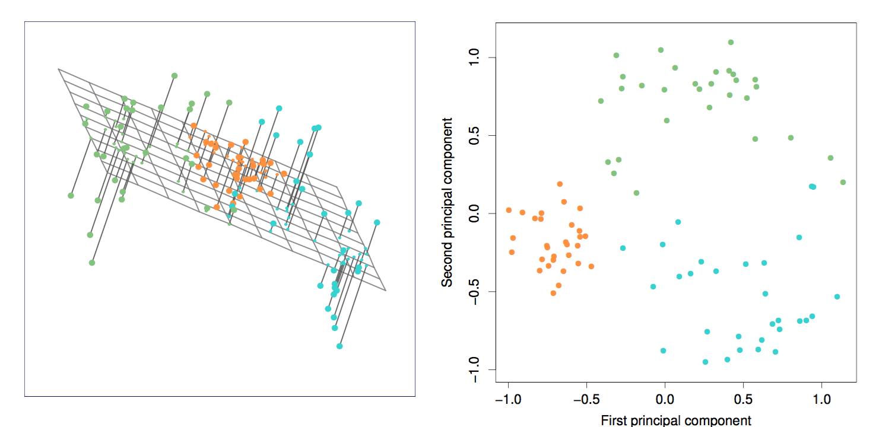
Interpretation of Principal Components

Slide 28
PCA find the hyperplane closest to the observations
The first principal component loading vector has a special property:
It defines the line in p-dimensional space that is closest to the n observations (using average squared Euclidean distance as a measure of closeness).
The notion of principal components as the dimensions that are closest to the n observations extends beyond just the first principal component.
I.e., the first two principal components of a data set span the plane that is closest to the n observations, in terms of average squared Euclidean distance.

Slide 29
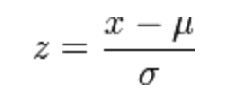
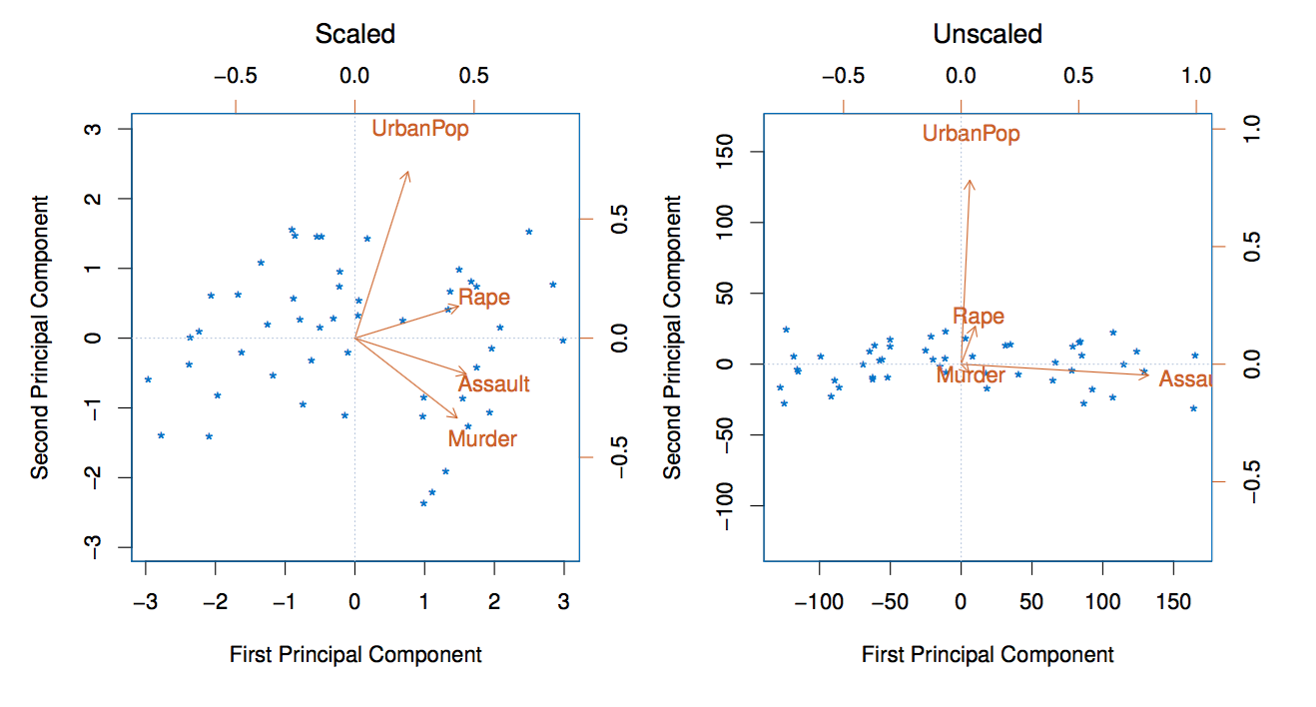
Scaling of the variables is important
If the variables are in different units, scaling each to have standard deviation equal to one is recommended.
If they are in the same units, you might (or might not) scale the variables.

Slide 30
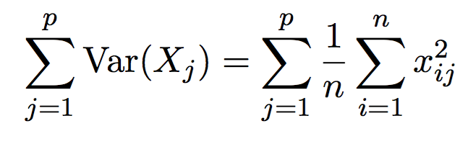
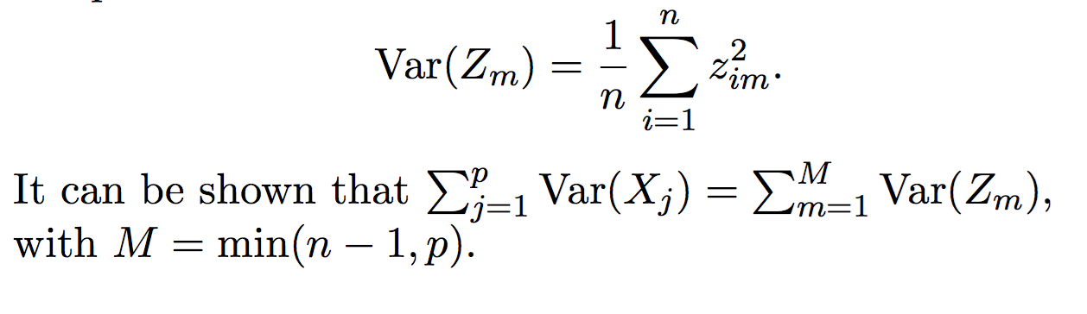
Proportion Variance Explained
To understand the strength of each component, we are interested in knowing the proportion of variance explained (PVE) by each one.
The total variance present in a data set (assuming that the variables have been centered to have mean zero) is defined as:
and the variance explained by the m^{th} principal component is

Slide 31
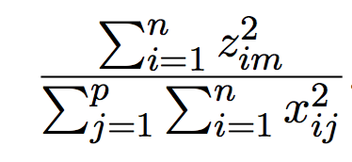
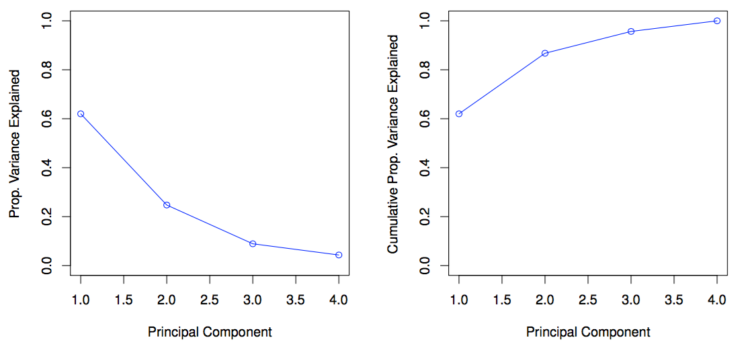
Proportion Variance Explained: continued
Therefore, the PVE of the m^{th} principal component is given by the positive quantity between 0 and 1.
The PVEs sum to one. We sometimes display the cumulative PVEs.

Slide 32
How many principal components should we use?
If we use principal components as a summary of our data, how many components are sufficient?
No simple answer to this question, as cross-validation is not available for this purpose.
When could we use cross-validation to select the number of components?
Proportion of variance explained: look for an “elbow”.

Slide 33
PCA vs Clustering
PCA looks for a low-dimensional representation of the observations that explains a good fraction of the variance.
Clustering looks for homogeneous subgroups among the observations.

