Slide 1
Logistic Regression
Jay Urbain, PhD

Slide 2
Topics
Linear Regression for Classification
Logistic regression
Model interpretation
Predicting default rates
Q & A

Slide 3
Linear Regression for classification
Linear regression can be used for classification in domains with numeric attributes.
Perform a regression for each class, set output to 1 for instances that belong to the class, and 0 for those that do not.
The result is a linear expression for each class.
Then, given a test instance of an unknown class, calculate the value of each linear expression and choose the one that is largest.
Called multinomial linear regression.
Problems: output is not a proper probability, assumes errors are not statistically significant.

Slide 4

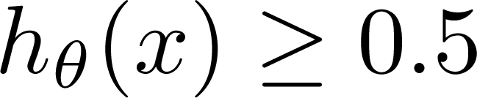
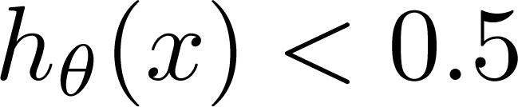
(Yes) 1
Malignant ?
0.5
(No) 0
Tumor Size
Tumor Size
Threshold classifier output at 0.5:
If , predict “y = 1”
If , predict “y = 0”

Slide 5
(Yes) 1
Malignant ?
(No) 0
Tumor Size
Tumor Size
Threshold classifier output at 0.5:
If , predict “y = 1”
If , predict “y = 0”

Slide 6
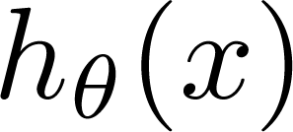
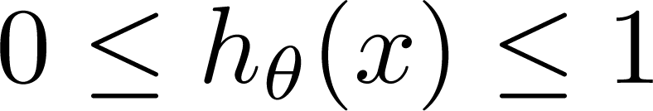
Classification: y = 0 or 1
can be > 1 or < 0
With regression
Logistic Regression:
Want proper probability
Classification

Slide 7
Logistic Regression
Q: What is logistic regression?
A: A generalization of the linear regression model to classification problems.

Slide 8
Logistic Regression – basic form
In linear regression, we used a set of input variables to predict the value of a continuous response variable.

Slide 9
Logistic Regression – basic form
In linear regression, we used a set of input variables to predict the value of a continuous response variable.
In logistic regression, we use a set of input variables to predict probabilities of class (category) membership.
Note: Class membership is not always binary, however, that is what we will focus on for this class.

Slide 10
Logistic Regression – basic form
In linear regression, we used a set of input variables to predict the value of a continuous response variable.
In logistic regression, we use a set of input variables to predict probabilities of class membership.
These probabilities can then mapped to class labels, thus predicting the class for each observation.
Note: Class membership is not always binary, however, that is what we will focus on for this class.

Slide 11
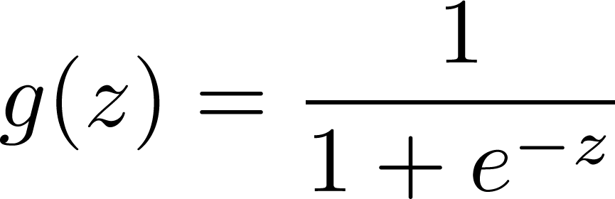
Logistic Regression – basic form
When performing linear regression, we use the following function:
When performing logistic regression, we use the following form:
Logistic function:

Slide 12
Logistic Regression – basic form
When performing linear regression, we use the following function:
When performing logistic regression, we use the following form:
Probability of y = 1, given x

Slide 13
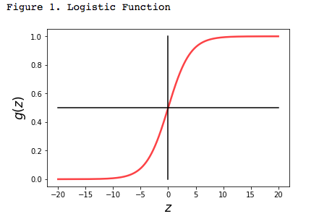
Logistic Regression – basic form
Optional in-class exercise: Create a plot of the logistic function.
How would you describe the shape of the function?

Slide 14
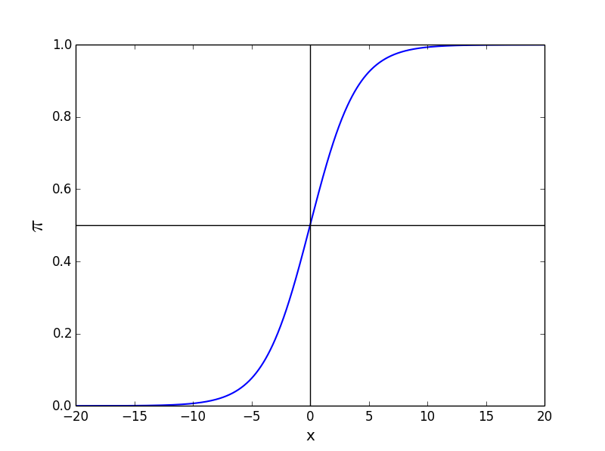
Logistic Regression – basic form
Why does this shape make sense?
The logistic function takes on an “S” (sigmoid) shape, where y is bounded by [0,1]

Slide 15
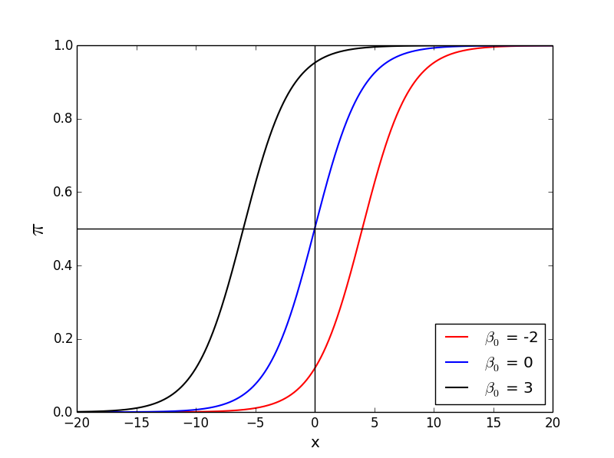
Logistic Regression – basic form
Changing the β₀ value shifts the function horizontally.

Slide 16
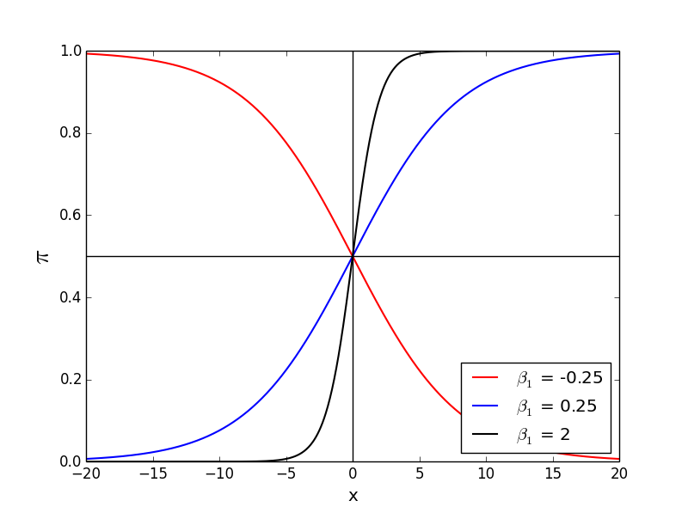
Logistic Regression – basic form
Changing the β₁ value changes the slope of the curve

Slide 17
Interpreting results
In order to interpret the outputs of a logistic function we must understand the difference between probability and odds.
The odds of an event are given by the ratio of the probability of the event by its complement:
What is the range of the odds ratio?
Notes:
Complement: 1 – p

Slide 18
Interpreting results
Question: You’re trying to determine whether a customer will convert or not. The customer conversion rate is 33.33%.
What are the odds that a customer will convert?
Take 2 minutes and work this out.
Notes:
Complement: 1 – p

Slide 19
Interpreting results
Question: You’re trying to determine whether a customer will convert or not. The customer conversion rate is 33.33%.
What are the odds that a customer will convert?
Take 2 minutes and work this out.
Notes:
Complement: 1 – p

Slide 20
Interpreting results
Question: You’re trying to determine whether a customer will convert or not. The customer conversion rate is 33.33%.
What are the odds that a customer will convert?
Take 2 minutes and work this out.
This means that for every customer that converts you will have two customers that do not convert
Notes:
Complement: 1 – p

Slide 21
Interpreting results
What would happen if we took the odds of the logistic function?

Slide 22
Interpreting results
What would happen if we took the odds of the logistic function?

Slide 23
Interpreting results
Notice if we take the logarithm of the odds, we return a linear equation
What is the range of the logit function?
the logit function or the log-odds is the logarithm of the odds p/(1 − p)
Notes:
The process we just went through is known as the logit transformation. The output form is referred to as the logit function and also the log-odds function. Note that the base used here is Eulers number (e).

Slide 24
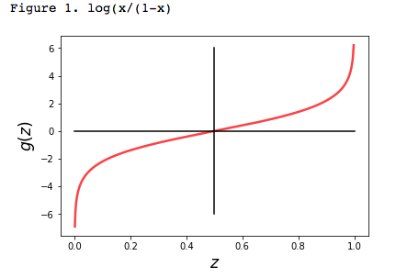
Interpreting results
Notice if we take the logarithm of the odds, we return a linear equation
This simple relationship between the odds ratio and the parameter β is what makes logistic regression such a powerful tool.
The value of the logit function heads towards infinity as p approaches 1 and towards negative infinity as it approaches 0.
Notes:
The process we just went through is known as the logit transformation. The output form is referred to as the logit function and also the log-odds function.

Slide 25
Interpreting results
In linear regression, the parameter β₁ represents the change in the response variable for a unit change in x.
Notes:
Q: What do you think that the b1 represents in the case of the logistic function?

Slide 26
Interpreting results
In linear regression, the parameter β₁ represents the change in the response variable for a unit change in x.
In logistic regression, β₁ represents the change in the log-odds for a unit change in x.
Notes:
Q: How to we change the b1 value from log-odds, to the odds?

Slide 27
Interpreting results
In linear regression, the parameter β₁ represents the change in the response variable for a unit change in x.
In logistic regression, β₁ represents the change in the log-odds for a unit change in x.
This means that gives us the change in the odds for a unit change in x.
Notes:
Q: How to we change the b1 value from log-odds, to the odds?

Slide 28
Interpreting results
Q: How to determine whether a coefficient is significant?
A: This is based off of the p-value, just as with the linear regression

Slide 29
Interpreting results
Example: Suppose we are interested in mobile purchase behavior. Let y be a class label denoting purchase/no purchase, and let x denote whether a phone was an iPhone.
We perform a logistic regression, and we get β₁ = 0.693.
Q: What does this mean?

Slide 30
Interpreting results
Example: Suppose we are interested in mobile purchase behavior. Let y be a class label denoting purchase/no purchase, and let x denote whether phone was an iPhone.
We perform a logistic regression, and we get β₁ = 0.693.
Q: What does this mean?
In this case the odds ratio is exp(0.693) = 2, meaning the likelihood of purchase is twice as high if the phone is an iPhone.

Slide 31
Interpreting results
Once we understand the basic form for logistic regression, we can easily extend the definition to include multiple input values.
Logit function
Notes:
The logit function

Slide 32
Interpreting results
Once we understand the basic form for logistic regression, we can easily extend the definition to include multiple input values.
Logistic function
Notes:
The logistic regression equation

Slide 33
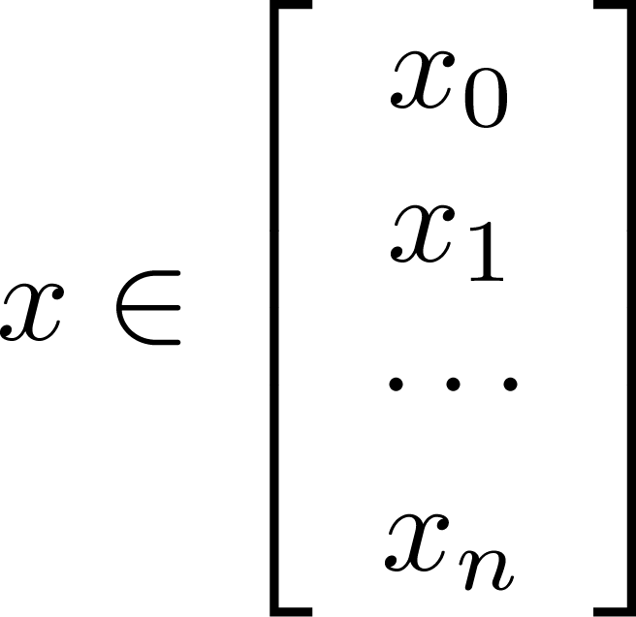
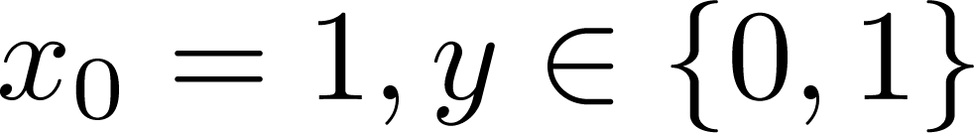
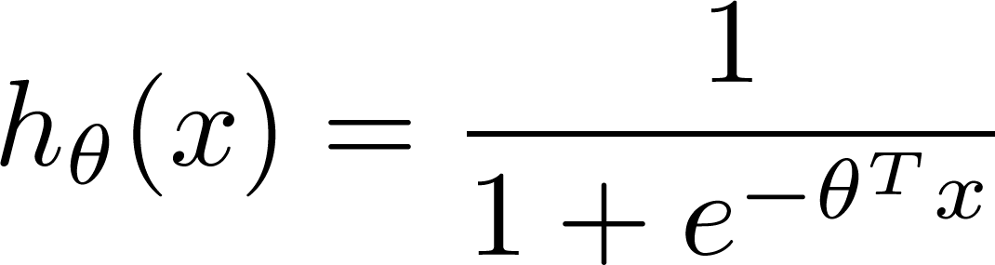

Training set:
m examples
How to choose parameters ?
Notes:
Set of real numbers

Slide 34
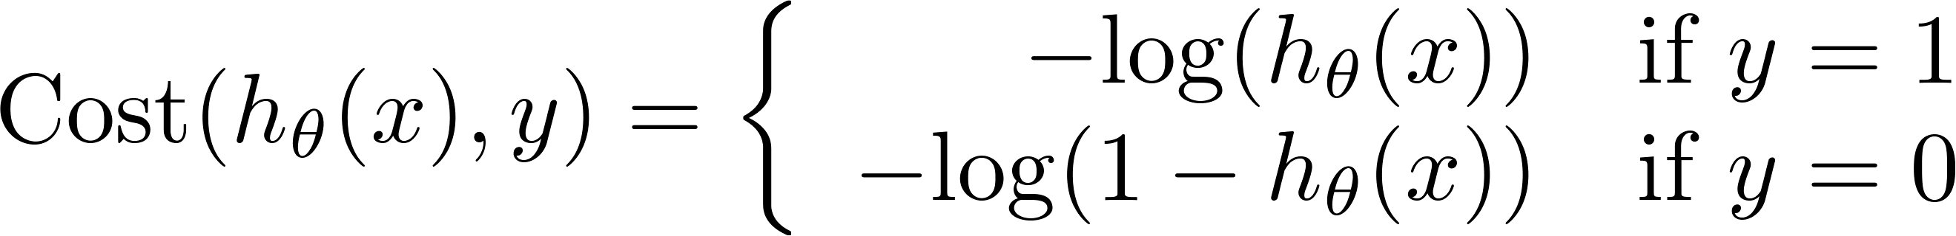
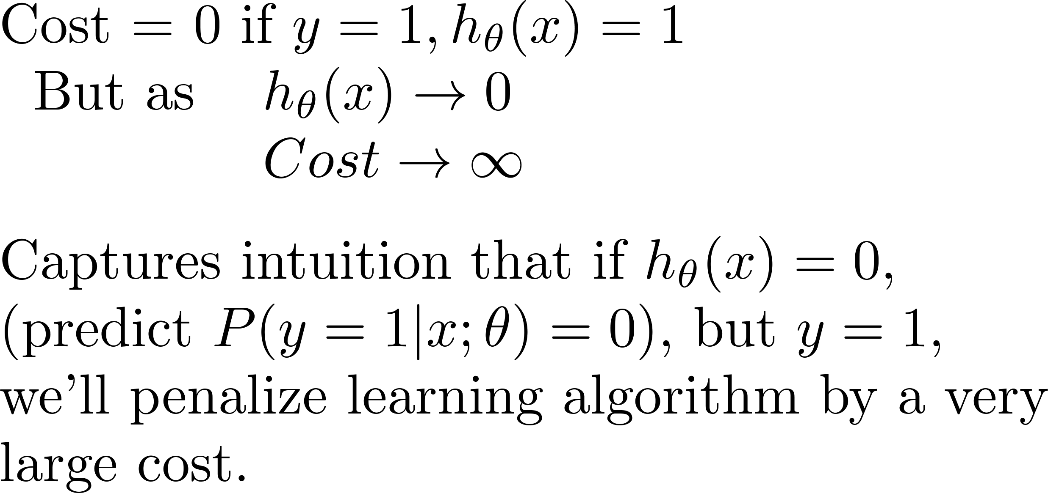
Logistic regression cost function
>>> -math.log(0.0000001,2)
23.25
>>> -math.log(1,2)
-0.00
If y = 1
Cost
0
1

Slide 35
Logistic regression cost function
If y = 0
Cost
0
1

Slide 36
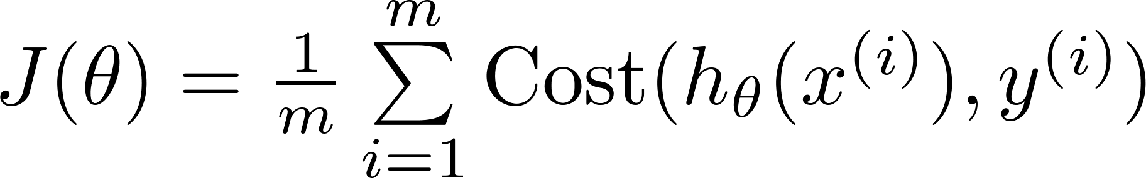
Logistic regression cost function with gradient Descent

Slide 37

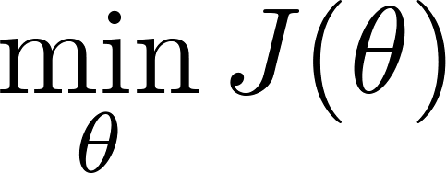
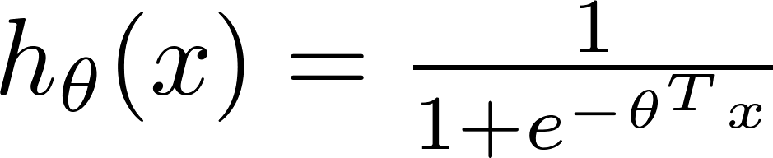
Logistic regression cost function
To fit parameters :
To make a prediction given new x :
Output

Slide 38


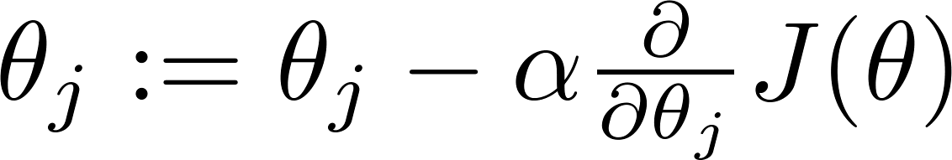


Gradient Descent
Want :
Repeat
(simultaneously update all )

Slide 39
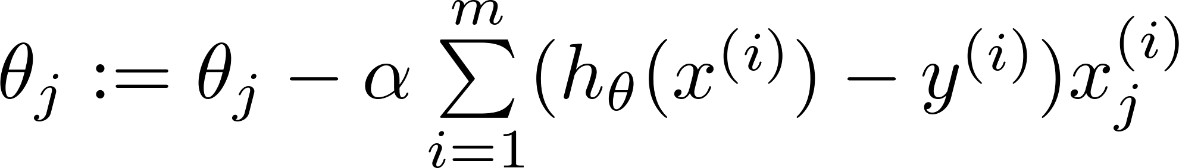
Gradient Descent
Want :
Repeat
(simultaneously update all )
Algorithm looks identical to linear regression!

Slide 40
Predicting default – Go to lab
This data set contains 10,000 records associated with credit card accounts with the following four fields:
Default | Binary variable indicating whether the credit card holder defaulted on their credit card obligations
Student | Binary variable indicating whether the credit card holder is a student
Balance | Continuous variable recording the credit card holders current outstanding balance
Income | Continuous variable representing the total annual income for the credit card holder

Slide 41
Predicting default
Part I: Exploration
Read in Default.csv and convert all data to numeric
Split the data into train and test sets
Create a histogram of all variables
Create a scatter plot of the income vs. balance
Mark defaults with a different color (and symbol)
What can you infer from this plot?

Slide 42
Predicting default: hands-on
Part II: Logistic Regression
Run a logistic regression on the balance variable
Use the training set
Use the scikit-learn
Interpret the results

Slide 43
Predicting default: review
Q: What is a Generalized Linear Model (GLM)?
A: GLMs generalize the distribution of the error term, and allow the conditional mean of the response variable to be related to the linear model by a link function.

Slide 44
Predicting default: review
Q: What is the error distribution and link function for the logistic regression?
A: The error term follows a Bernoulli distribution, and the logit is the link function that connects us to the linear predictor.

Slide 45
Predicting default: review
Q: Is the logit the only link function used for the Bernoulli distribution?
A: No, other link functions include the probit the tobit model. However, the logit simplifies things nicely and is probably the most commonly used.

Slide 46
Predicting default: review
Q: What is the difference between and ?
A: Nothing, these are equivalent expressions.
If you want to prove this to yourself (a) plot both equations, or (b) multiply both numerator and denominator by .

Slide 47
Predicting default: review
Q: Why not use a linear regression to predict probabilities of class membership?
A: The linear regression will make predictions that don’t make sense (e.g., probability outside of [0,1])
A: Transforming the linear regression into a step function will produce heteroskedastic errors
When the scatter of the errors is different, varying depending on the value of one or more of the independent variables, the error terms are heteroskedastic.

Slide 48
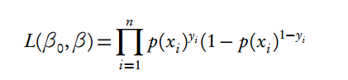
Predicting default: review
Q: How do we derive coefficients using maximum likelihood?
A: We find the coefficients that are the most likely, given the observed data. Formally, we estimate the coefficients that maximize the likelihood function. This is done using an iterative procedure.
Check out http://www.stat.cmu.edu/~cshalizi/uADA/12/lectures/ch12.pdf for details on the estimation of the coefficients.
Notation for the product of a series

