Slide 1
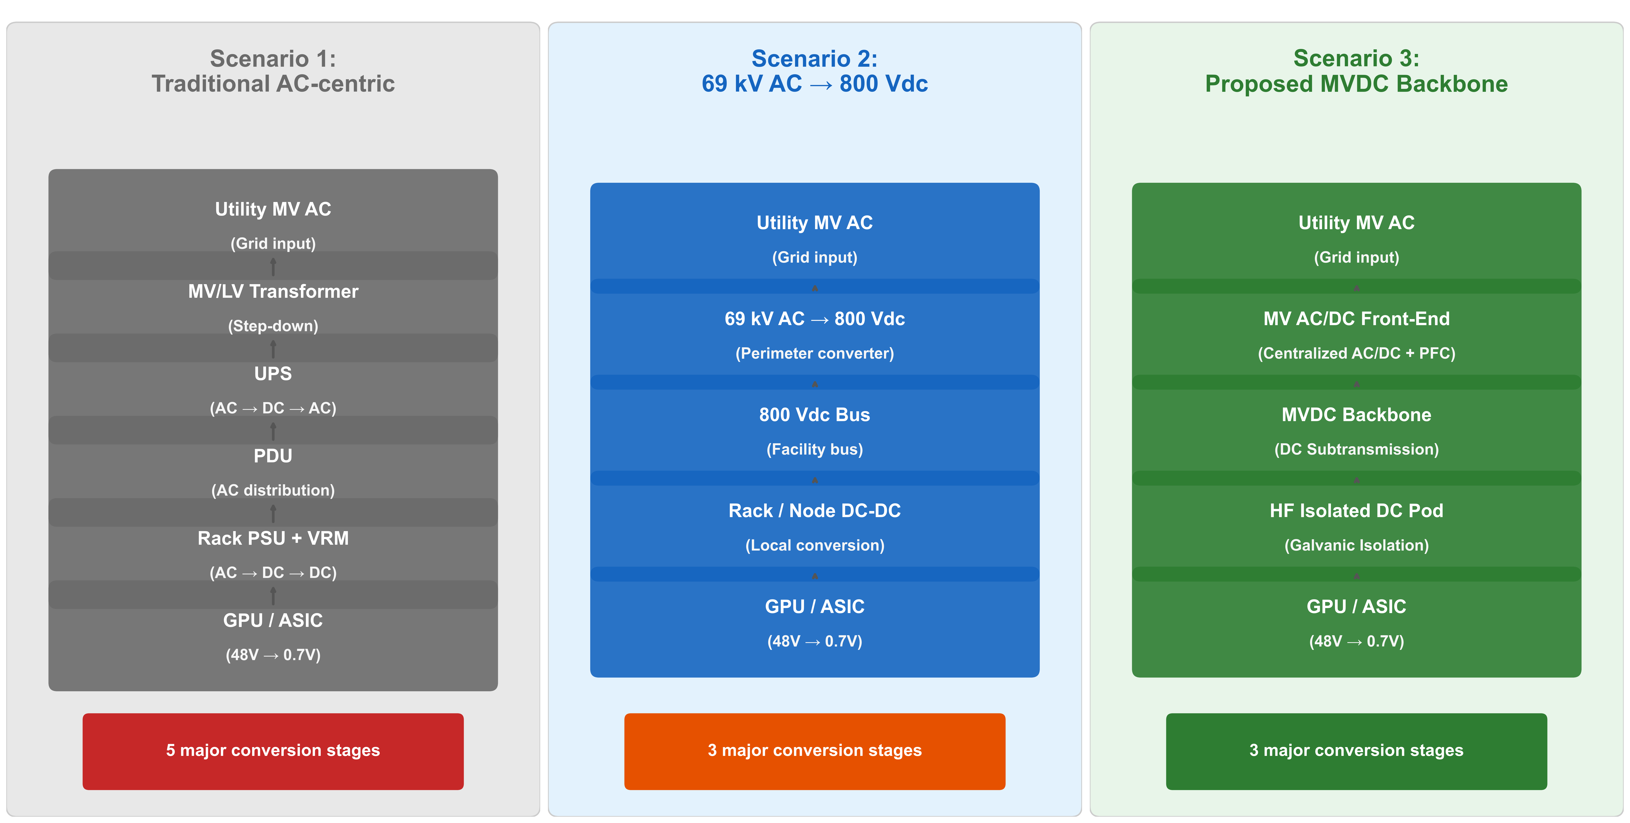
Direct Current Subtransmission Backbone for AI Factories
Technical briefing based on the public-data modeling stack in SavannahY/DC2
Scenario 2 is the explicit AC-fed SST + 800 VDC baseline.
Scenario 3 adds the MVDC subtransmission backbone while keeping the same downstream 800 VDC structure.
Scenario 3(M) is the campus-scale proof layer with a shared 69 kV DC backbone and four compute blocks.
https://github.com/SavannahY/DC2

Slide 2
Architecture Under Test
Scenario 2 and Scenario 3 share the SST + 800 VDC downstream structure; the backbone is the differentiator.
Scenario 3(M) extends Scenario 3 into a shared multi-block campus backbone rather than a single equivalent path.

Slide 3
Evidence Stack
What is modeled with public data today, and what is still outside the evidence boundary.
Source-anchored path model for Scenarios 1/2/3
Shared-campus multi-node model for Scenarios 1(M)/2(M)/3(M)
Public ESIF annual bins and MIT Supercloud burst library
OpenDSS AC-boundary cross-checks and harmonics-mode scans
RTS-GMLC mirrored-area and local N-1 sensitivity screens
SMART-DS same-feeder common-network and equal-total harmonic benchmark
ANDES RMS dynamic benchmark under normal and weakened corridor stress
Reduced-order MVDC fault-duty and interruption-timescale screen
Supported now:
Campus-scale efficiency direction
Centralized AC-boundary PQ and voltage benefits
Weak-grid RMS voltage robustness
Fault interruption timescale as a first-order issue
Not proven yet:
IEEE 519 compliance margins
Converter EMT stability and controls
Deployable selective protection design
Site-specific interconnection margins

Slide 4
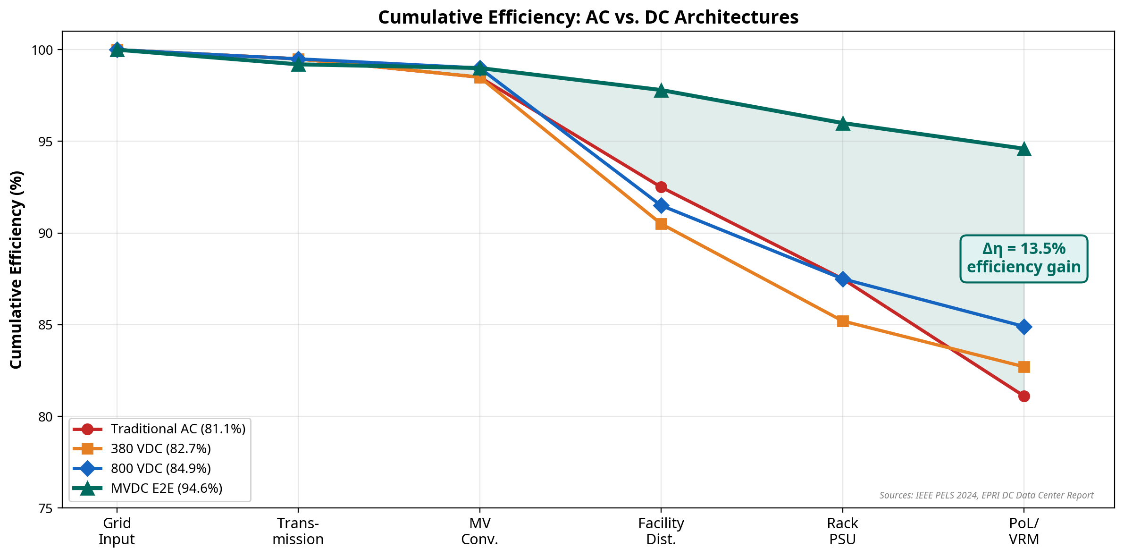
Steady-State and Campus-Scale Results
Single-path, 100 MW IT: S2 91.82% vs S3 92.17%
Annual loss: 78.06 vs 74.45 GWh/yr
Multi-node, 100 MW IT: S2(M) 85.16% vs S3(M) 86.69%
Multi-node annual loss: 152.70 vs 134.55 GWh/yr
The single-path gain is modest.
The campus-scale multi-node result is the stronger efficiency case.

Slide 5
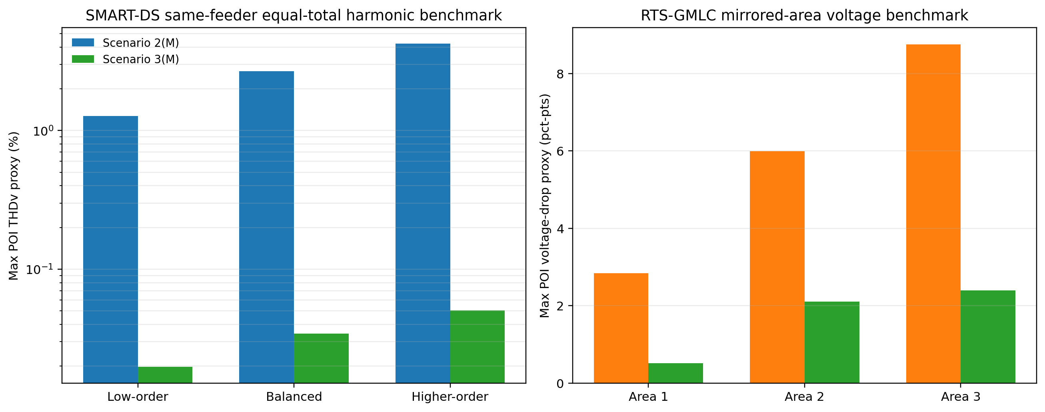
Public Network Proof of Benefits 2 and 3
RTS mirrored areas: harmonic proxy ratio >= 4.47x
RTS mirrored areas: voltage-drop ratio >= 2.85x
SMART-DS same-feeder equal-total harmonic benchmark: 64.49x to 83.69x lower THDv proxy
SMART-DS surviving local N-1 cases: 5 for S2(M) vs 9 for S3(M)
This is the strongest current support for centralized AC-boundary PQ ownership and voltage robustness.

Slide 6
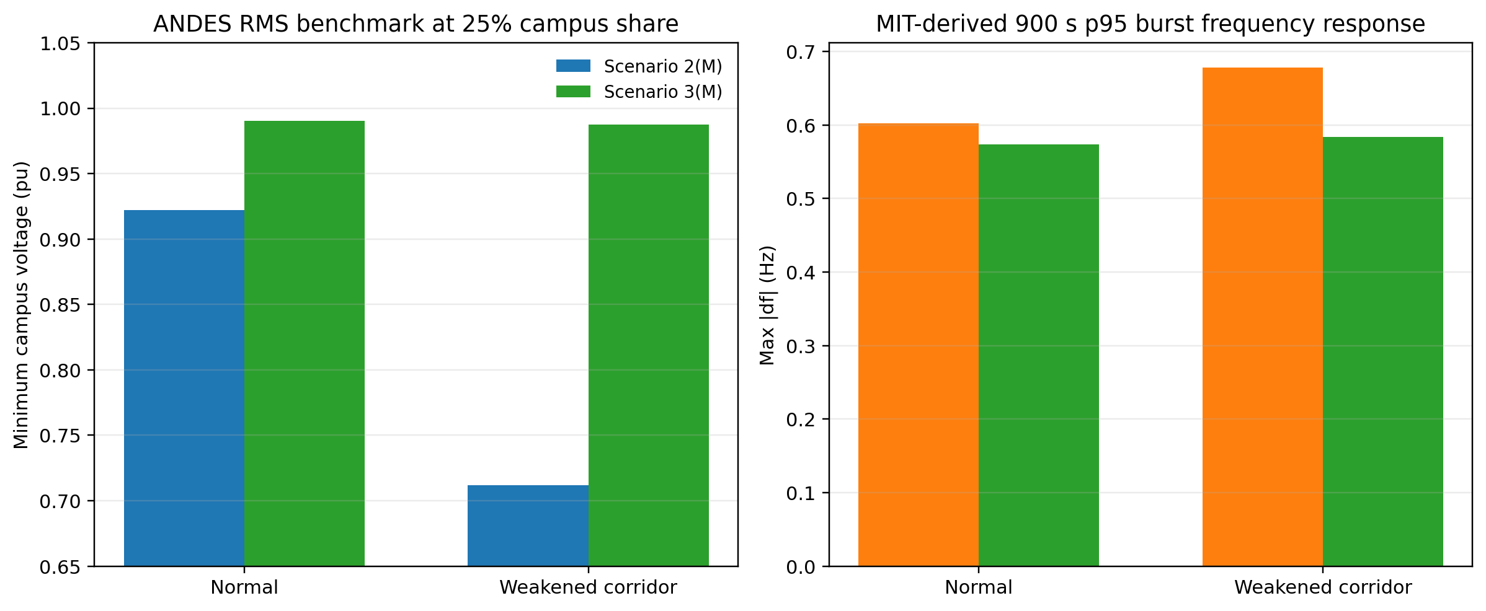
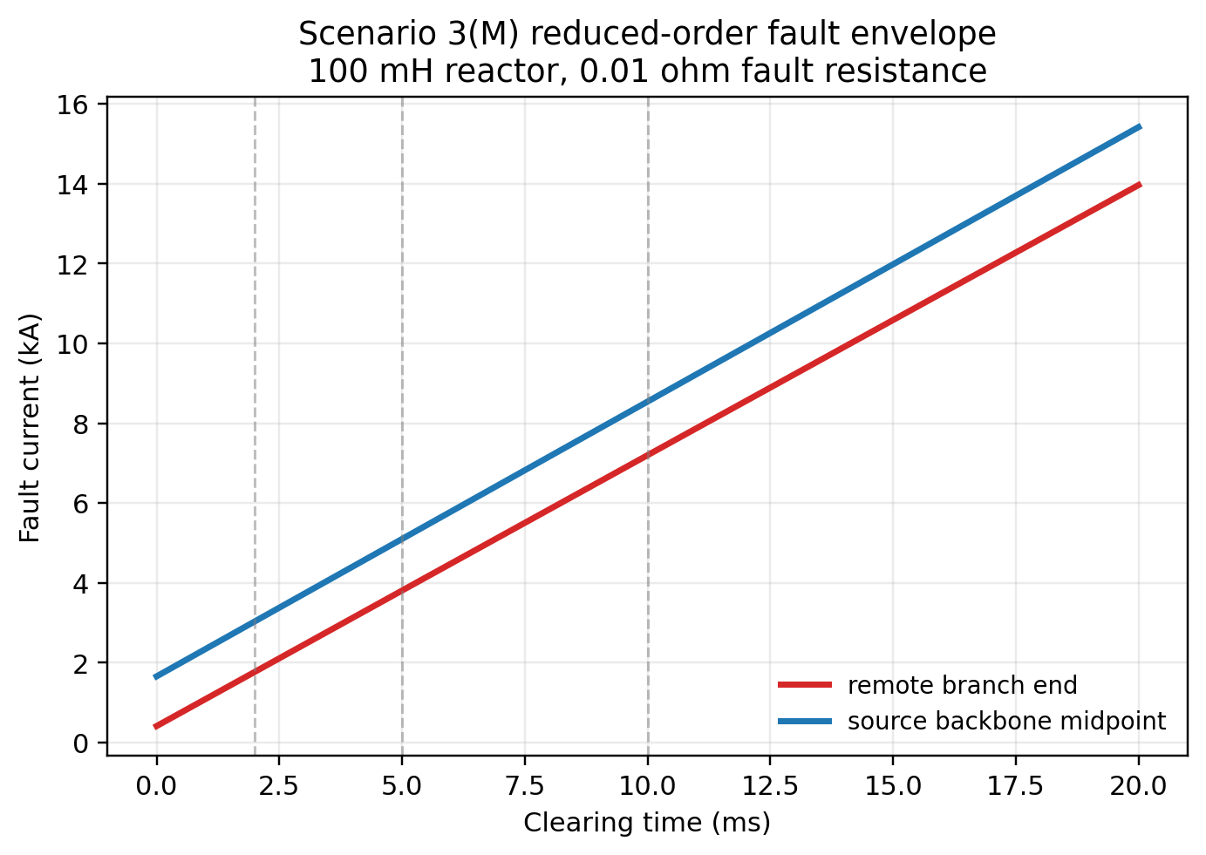
RMS Dynamic Benchmark and Fault Envelope
Strongest converged RMS separation: weakened corridor, 900 s p95 burst, 25% campus share, Vmin 0.7118 pu vs 0.9875 pu.
Fault screen: source-backbone midpoint reaches 8.53 kA at 5 ms in the worst public sweep; fastest time to 5 kA is 2.43 ms.

Slide 7
What the Current Evidence Supports
Supported at the current evidence level:
Scenario 3(M) is the stronger campus-scale architecture case.
Benefit 2: centralized AC-boundary harmonic sensitivity is lower.
Benefit 3: upstream AC-boundary voltage and weak-grid RMS robustness are better.
Fault interruption timescale is a first-order design issue for the MVDC backbone.
Still not proven:
Exact IEEE 519 compliance margins
Converter-aware EMT stability
Deployable breaker and protection settings
Site-specific utility interconnection limits
Uniform internal dynamic stress reduction

Slide 8
Next Technical Steps
Replace proxy curves for the centralized AC/DC front end and isolated DC pod with measured or vendor-qualified data.
Promote the RMS benchmark into converter-aware EMT studies for the centralized front end, isolated pod, and buffer controls.
Turn the fault envelope into a selective protection and grounding study with explicit interruption technology assumptions.
Extend the public common-network workflow into a site-specific PCC study when utility Thevenin and short-circuit data are available.
Use the repo as the reproducible base package: code, figures, white paper, and slide deck are all versioned together.
https://github.com/SavannahY/DC2

