Slide 1
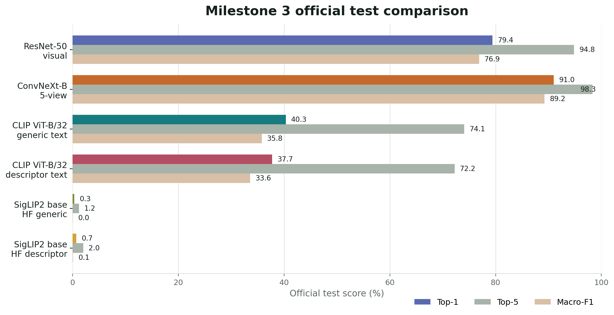
MILESTONE 3 PRELIMINARY RESULTS
Visual branch is strong; VLM baselines expose the text-grounding gap
Official 555-class NABirds test results now include cached zero-shot CLIP and SigLIP2 baselines alongside the visual models.
91.0%
custom ConvNeXt-B 5-view top-1
40.3%
CLIP ViT-B/32 generic prompt top-1
37.7%
CLIP descriptor prompt top-1
-2.6 pt
descriptor prompt delta vs generic CLIP
Takeaway: zero-shot text grounding is measurable, but not yet competitive with the visual branch. Descriptors need cleanup before they help CLIP.
Baseline comparison uses the same official 24,633-image test split.
Sources: milestone2 official visual analyses; milestone3 cached CLIP/SigLIP2 eval JSONs; image/text features saved on Modal volume.
Notes:
Present this as evidence that the evaluation path is now real. The visual model remains the performance anchor. CLIP is the useful text-side baseline; the SigLIP2 HF run is included transparently but appears non-informative and needs follow-up debugging.

Slide 2
CLIP/SIGLIP EVALUATION SETUP
Expert descriptors are aligned to NABirds IDs and cached for reuse
We keep the official leaf classes intact and preserve variant labels inside the prompt text.
Descriptor CSV
Join on raw_class_id
Variant prompts
555
958
1,665
1,011 class-description rows from the uploaded file.
Restrict to the 555 image-bearing official classes.
Class label plus visual field marks; no class splitting.
leaf classes
filled rows
prompt rows
Text features
Image features
Cosine retrieval
Mean prompt embedding per class for generic and descriptor sets.
Full-image test embeddings saved in reusable shards.
Top-1, top-5, macro-F1, prediction CSV, error assets.
Prompt example
Broad-billed Hummingbird (Adult Male): small body, long straight bill, long straight tail, rich green plumage, blue throat, red bill, golden-green upperparts.
Embedding cache is now part of the experiment contract
Policy: preserve labels like Adult male, Female/juvenile, Immature, Breeding, and Nonbreeding.
Text and image embeddings are written to Modal volume paths before scoring, so reruns can evaluate new prompt sets without recomputing image features.
Known issue: 279 classes are variant labels sharing base-species descriptors, so descriptor prompts can blur the exact sex/age/morph target.
Sources: reports/milestone3/nabirds_descriptor_prompts.csv; descriptor_prompt_summary.json; Modal cached feature manifests.
Notes:
The key correction from the initial plan is that we do not split male, female, juvenile, breeding, or nonbreeding labels into new classes. The prompt carries the variant distinction while the target space remains official NABirds.

Slide 3
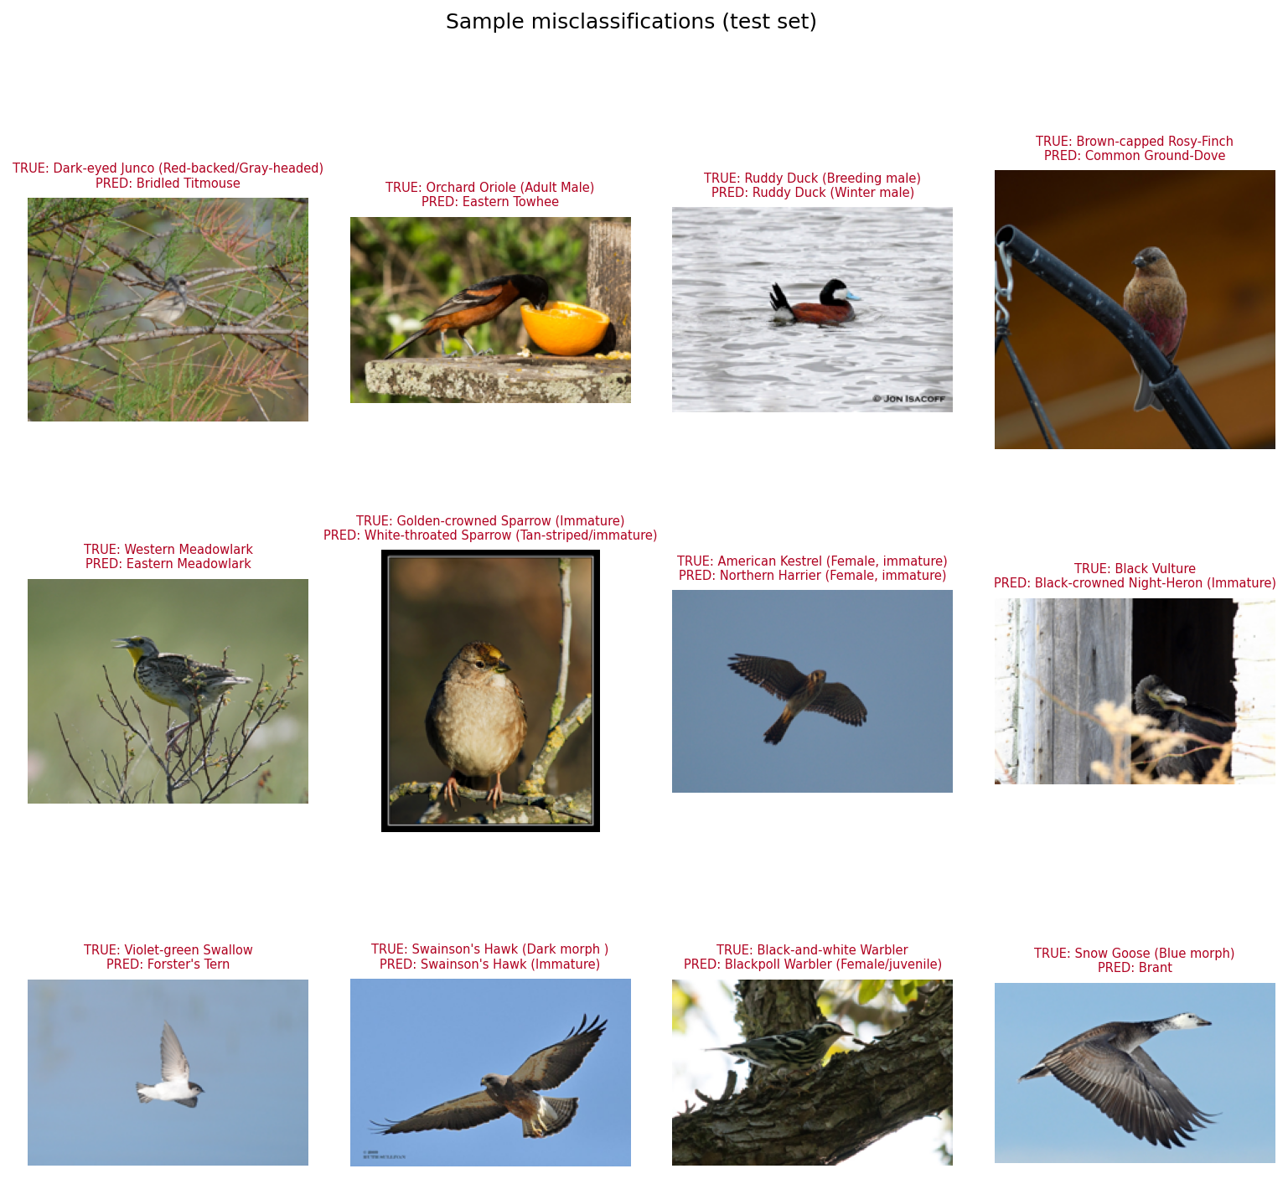
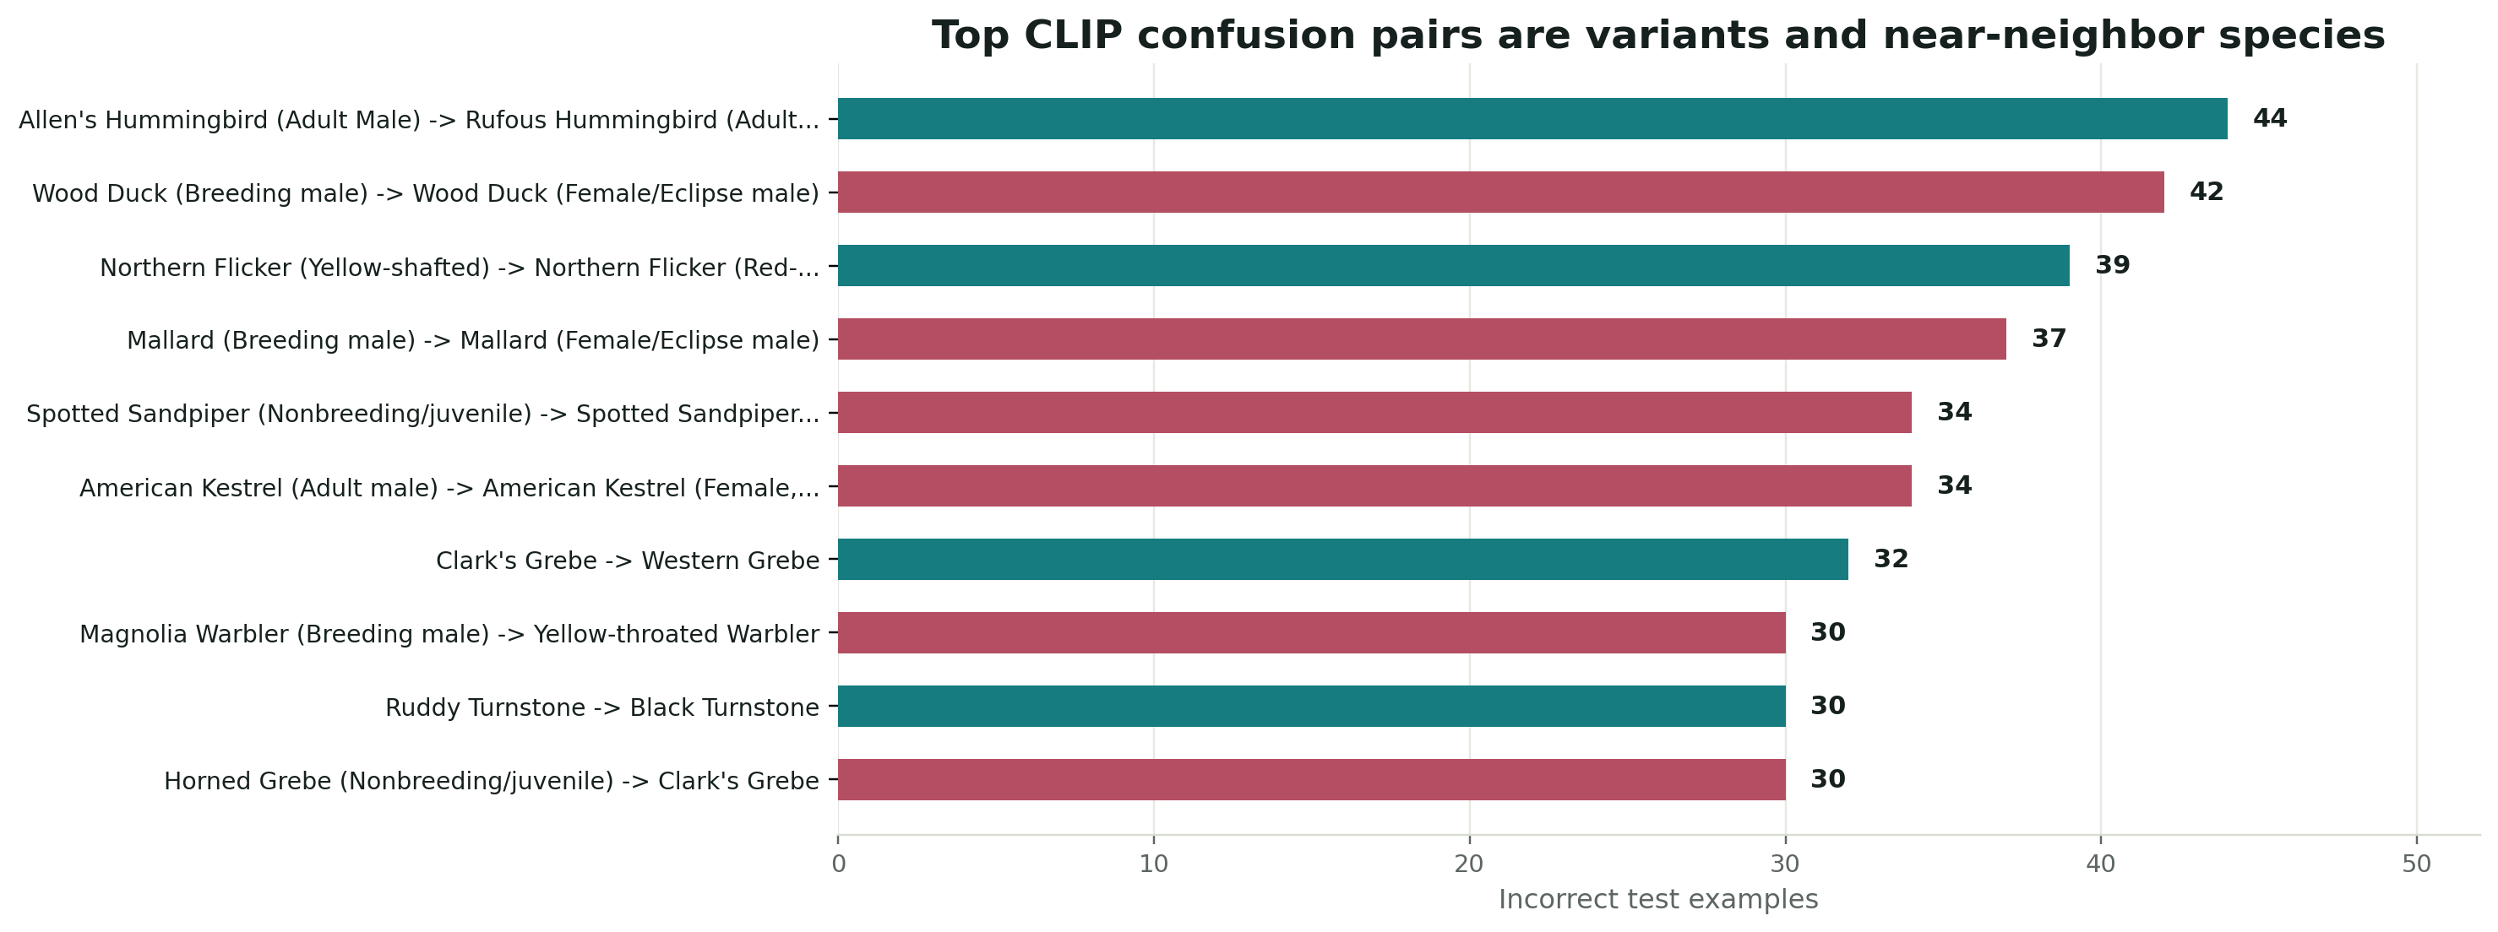
ERROR ANALYSIS
Remaining errors concentrate in variants and near-neighbor species
The CLIP baseline fails in places a human field guide would also flag: sex/age labels, seasonal plumage, morphs, and look-alike species.
Highest-count confusion examples
Sample CLIP mistakes from the official test split
Allen's vs Rufous hummingbird; Wood Duck and Mallard male vs female/eclipse; Yellow- vs Red-shafted Flicker; Spotted Sandpiper breeding vs nonbreeding/juvenile; Western vs Eastern Meadowlark.
Interpretation: descriptor prompts need variant-specific field marks. Shared base descriptors are not enough for age, sex, morph, and seasonal labels.
Sources: clip_vit_b32_generic_cached_test_predictions.csv; analyze_predictions.py; visualize_prediction_errors.py.
Notes:
This slide should be read as evidence for the next data cleanup step. The model is not random; its top failures are exactly the label distinctions that require fine-grained field marks.

Slide 4
LIMITATIONS AND NEXT STEPS
Move from zero-shot baselines to cleaned descriptors, cached adapters, and fusion
The milestone result is a working evaluation path plus evidence that prompt quality and variant specificity matter.
Current limitations
Next engineering sequence
Descriptor normalization is still imperfect
Clean descriptors
Many rows include long or redundant field marks, and some descriptors mix nonvisual or broad natural-language phrasing.
Shorten to visible field marks; add targeted variant terms for adult male, female/juvenile, immature, breeding, and nonbreeding classes.
Variant labels often share base descriptors
Run prompt ablations
279 official classes inherit shared descriptors across sex, age, morph, breeding, or nonbreeding variants.
Compare class-only, descriptor-only, label+descriptor, variant-only, and manually cleaned descriptor prompt sets using cached image features.
No official adapter result yet
Train cached adapter and fuse logits
Zero-shot CLIP is complete; SigLIP2 HF scoring appears non-informative and needs debugging before adapter or LoRA work.
Freeze image encoder, train a residual adapter over saved features, then combine VLM logits with the custom visual branch.
Embedding persistence
M4 target: cleaned prompts + adapter/fusion on the official test split.
Saved artifacts: CLIP and SigLIP2 image shards plus CLIP/SigLIP2 text features on Modal volume. Full CLIP cached scoring now runs in seconds after feature generation.
Next work: descriptor cleanup, cached adapter training on Modal, VLM/visual logit fusion, and expanded prompt error analysis.
Notes:
The recommendation is to stay lightweight: exploit cached embeddings first, use a residual adapter, and defer LoRA or full model fine-tuning until the descriptor set has been cleaned.

