Slide 1
BASIC ERLANG part 1
Data types
Pattern matching
Functions
Expressions
Records
Exercises

Slide 2
Documentation
All is covered by Erlang documentation
http://erlang.org/doc/index.html
A free Learn You Some Erlang for Great Good version
http://learnyousomeerlang.com/

Slide 3
Data types
Term
A valid Erlang expression
Number
Erlang supports integer, float, $char, and base#value numbers.
1> 4.
4
3> $a.
97
4> 2#101.
5
5>integer_to_list(5,2).
"101"

Slide 4
Data types - Atom
Literal and constant.
It starts with a lowercase letter.
1> atom.
atom
It can contain alphanumeric characters , underscore “_” or at sign “@”.
2> savas_1@ericsson.
savas_1@ericsson
Single quotes are used to enclose
3> 'This is also an atom'.
'This is also an atom'

Slide 5
Data types – Tuple
A tuple can contain a fix number of any data type.
1> T = {1, a, [2,b], {3,c}}.
{1,a,[2,b],{3,c}}
A number of BIFs are used to manipulate
2> element(2,T).
a
3> size(T).
4
4> setelement(3, T, 111).
{1,a,111,{3,c}}

Slide 6
Data Types – List
A list can contain anything.
1> L = [1, a, {2,b}, [1, a, {2,b}]].
[1,a,{2,b},[1,a,{2,b}]]
A list is either an empty list [] or consists of a head and a tail.
2> [Head|Tail] = L.
[1,a,{2,b},[1,a,{2,b}]]
3> Head.
1
4> Tail.
[a,{2,b},[1,a,{2,b}]]

Slide 7
LIST (continued)
Building list
1> L = [e1, e2, e3].
[e1,e2,e3]
2> [H|T] = L.
[e1,e2,e3]
3> [H,H,H|T].
[e1,e1,e1,e2,e3]
4> [H|[H|[H|T]]].
[e1,e1,e1,e2,e3]
5> [H,H|T] == [H|[H|T]].
true
6> [1] == [1|[]].
true

Slide 8
Data types - string
String is a list of integers
Double quotes (") are used to enclose
1> "erlang".
"erlang"
2> [$e,$r, $l, $a, $n, $g].
"erlang"
3> $e.
101
4> [101|"rlang"].
"erlang"

Slide 9
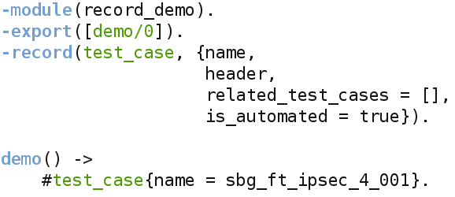
Data types - record
A record is a structure to store a fixed number of elements.
It has a name, followed by field names.
A field value can be set to a default value.
It is set to undefined otherwise.

Slide 10
Data types - boolean
There is no Boolean data type in Erlang.
We use the atoms true and false as Boolean instead.
1> 2 =< 3.
true
2> a == b.
false

Slide 11
Data Types - Others
We will not cover other data types in this session.
Reference
Fun
Bit Strings and Binaries
Port Identifier
Pid
Map

Slide 12
Data types – type conventions
Erlang supports a number of BIFs for type conventions.
1> atom_to_list(erlang).
"erlang“
2> list_to_atom("erlang").
erlang
3> integer_to_list(1).
"1"
4> list_to_integer("1").
1
5> tuple_to_list({1,2,3}).
[1,2,3]
6> list_to_tuple([1,2,3]).
{1,2,3}

Slide 13
Variables
Variable is an Erlang expression that can be bound to a value.
They start with either an uppercase letter or underscore.
Text
_
Number_of_boards
You may not change the value of a variable once it is bound to a value.

Slide 14
Pattern Matching
A left-hand side pattern matches against a right-hand side.
If the pattern is an unbound variable and pattern match succeeds, the variable will be bound to the value.
1> X = 1.
1
If the pattern is already bound to a value, the expression will evaluate the same value.
2> {X, Y} = {1, 3}.
{1,3}
It is an error if pattern match fails.
3> {X, Y} = {2, 3}.
** exception error: no match of right hand side value {2,3}

Slide 15
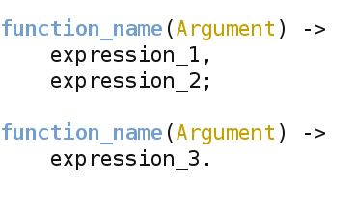
Function
Declaration
Evaluation
m:f/N – f must be exported

Slide 16
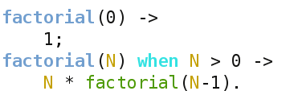
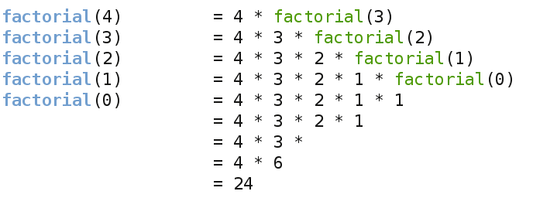
Function (continued)
Recursion
How the Recursion evaluates

Slide 17
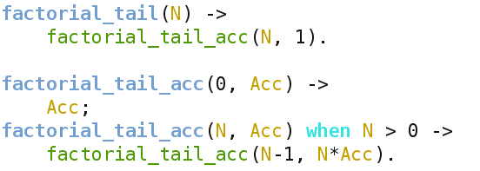
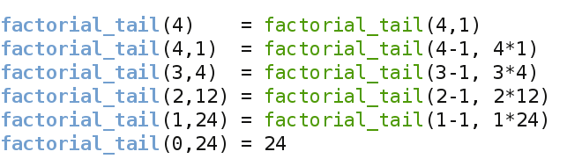
Function (continued)
Tail Recursion
How the Recursion evaluates

Slide 18
Function (continued)
BIFs
Implemented in C into the Erlang VM
BIFs belonging to erlang are auto-imported.
Difficult to do in Erlang
Most of them can be used as guard
1> atom_to_list('Erlang').
"Erlang"
2> is_atom("Erlang").
false
3> tuple_size({a,b,c,d}).
4
4> length([a,b,c,d]).
4

Slide 19
Expressions
We will cover a number of Erlang expressions – not all.
Terms, Variables, Patterns and Function calls
Case
Term Comparisons
Arithmetic Expressions
Boolean Expressions
Fun Operations
Guard Expressions
List Operations
List Comprehensions

Slide 20
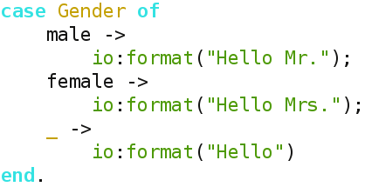
Expressions - case
Case expressions uses pattern matching.
The expression between case and of will be evaluated, and the patterns are matched in order. Once a match is successful, the case clause will be evaluated.

Slide 21
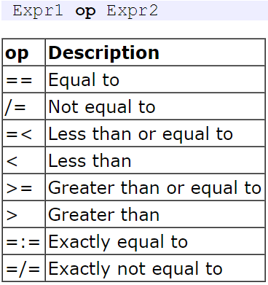
Expressions – Term Comparisons
number < atom < tuple <list
1> 1 < a.
true
2> a < {1,2}.
true
3> {a,2} < {1,2,3}.
true
4> {1,2} < {a,2}.
true
5> {a,2} < [1,2].
true
6> [1,2] < [a].
true

Slide 22
Expressions – Arithmetic Expressions
op Expression
1> -1.
-1
Expression_1 op Expression_2
2> 5 + 2.
7
3> 5 - 2.
3
4> 5 * 2.
10
5> 5 / 2.
2.5
6> 5 div 2.
2
7> 5 rem 2.
1

Slide 23
Expressions – Boolean Expressions
op Expression
1> not true.
false
Expression_1 op Expression_2
2> true or false.
true
3> true and false.
false
4> true xor false.
true

Slide 24
Expressions – Fun Operations
A fun expression begins with the keyword fun and ends with the keyword end.
1> fun(X) -> X + 1 end.
#Fun<erl_eval.6.80484245>
It is possible to assign a fun expression to a variable.
2> Increment = fun(X) -> X + 1 end.
#Fun<erl_eval.6.80484245>
Pass it as an argument to another function.
3> Fun = fun(F, X) -> F(X) end.
#Fun<erl_eval.6.80484245>
4> Fun(Increment, 100).
101

Slide 25
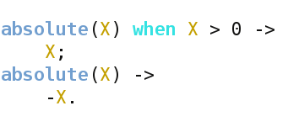
Expressions – Guard Expressions
It is a test for a condition.
You may not use user-defined functions as a guard expression.
You may have sequence of guard expressions.
Semicolon “;” is used as orelse when separating guard expressions.
Comma “,” is used as andalso when separating guard expressions.

Slide 26
Expressions – List Operations
List1 ++ List2
Concatenate List2 to List1.
1> [1,2] ++ [a,b,1,2].
[1,2,a,b,1,2]
List1 -- List2
Subtract first occurrence of each element in List2 from List1.
2> [1,2,a,b,a,1] -- [1,a].
[2,b,a,1]

Slide 27
Expressions – List Comprehensions
List comprehensions are to build or modify lists.
Syntax is the following:
[Expression || Generator, (GuardsOrGenerator)]
Expression is any Erlang expression and it is required.
Generator is sequence of values and it is required ( Pattern <- List )
Guard is a test for whether the pattern will be used in the expression or not. Guards and additional generators are optional.
[2,4,6,8,10]
[1,2,3]

Slide 28
Data Storage exercise
new()
Creates a new storage
add(Key, Value, List)
Inserts {Key, Value} pair into List
deletes(Key, List)
Removes all entries associated with Key from List
find(Key, List)
Finds all entries associated with Key from List
is_defined(Key, List)
Returns true if List contains at least one entry associated with Key, otherwise false.
Notes:
Let’s write a program that stores {Key, Value} pairs in a list.
The solution is in the same repo as the small exercises
github.com/SavasAydin/erlang_exercises.git
You can use rebar to build this application.
https://github.com/rebar/rebar
It is an Erlang build tool that makes it easy to compile and test Erlang applications, port drivers and releases.

Slide 29
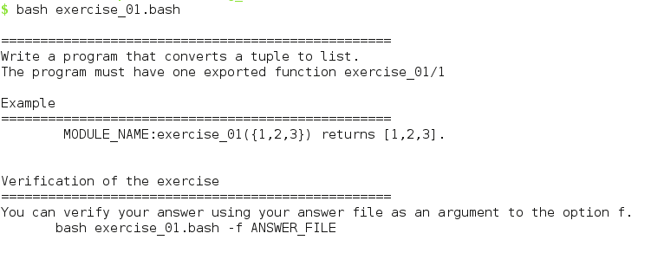
Exercises
The exercises can be cloned with the following command:
git clone https://github.com/SavasAydin/erlang_exercises.git
Below is an example of how to run them

