Slide 1
The Policy Process and Injury and Violence Prevention
Kate Fox, MPP
Deputy Associate Director for Policy (Acting)
CDC/NCIPC, Office of Policy and Partnerships
Donovan Newton, MPA
Policy Analyst
CDC/NCIPC, Division of Analysis, Research, and Practice Integration
National Center for Injury Prevention and Control
Notes:
Planned talk time is about 10-15 minutes.

Slide 2
Overview
Overview of Policy
Policy Process
Importance of Policy Evaluation
State Health Department’s Role

Slide 3
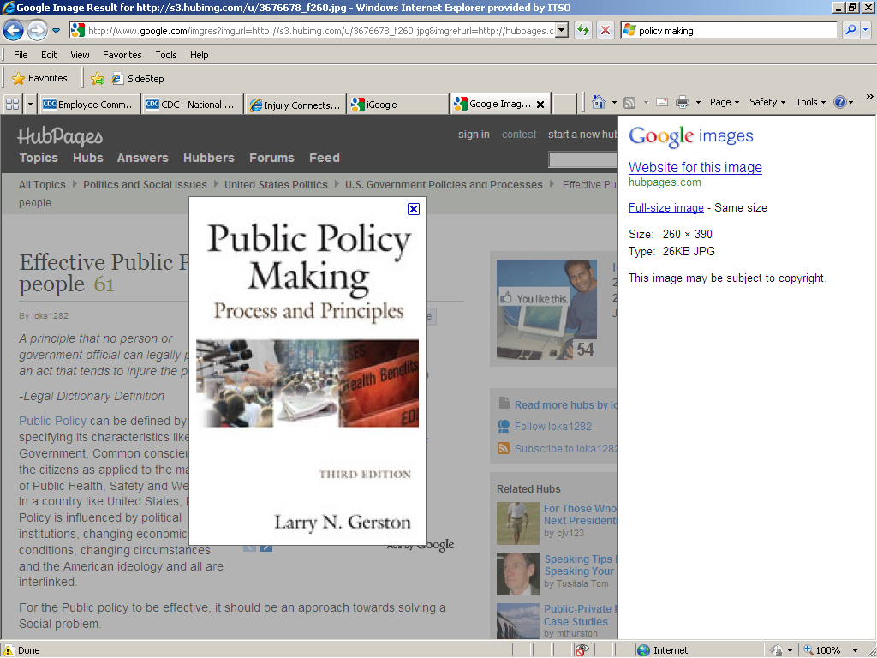
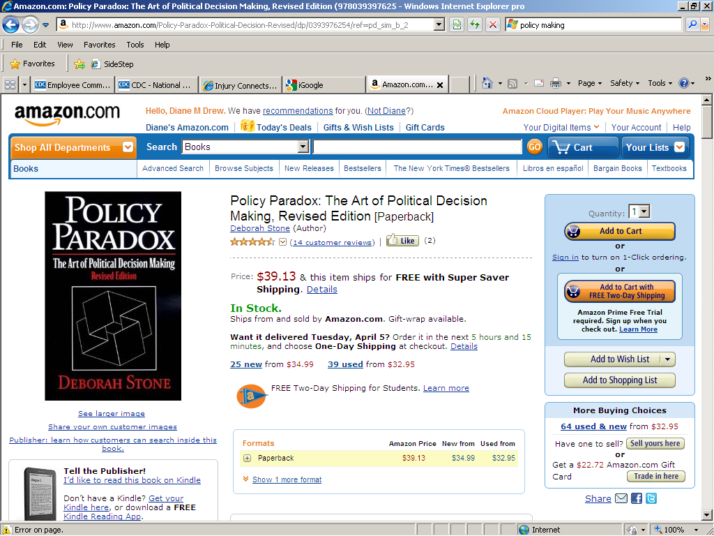
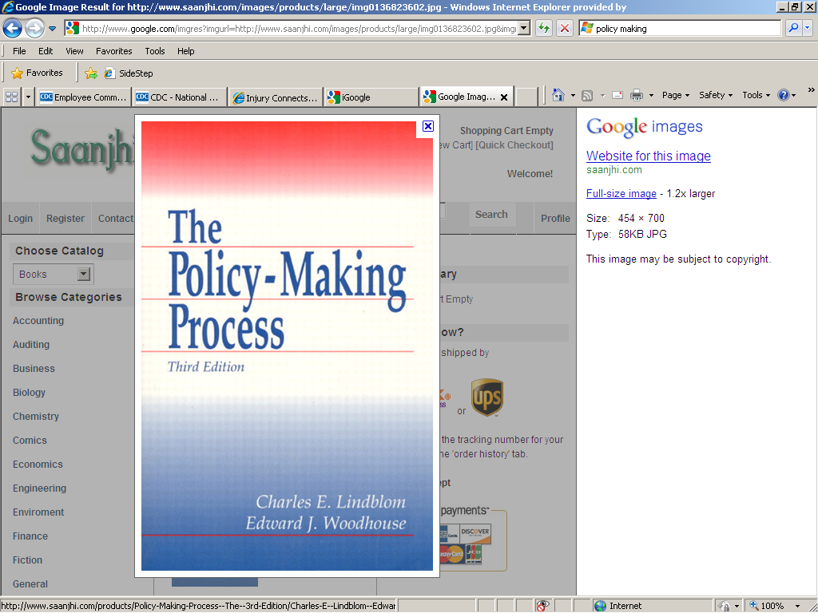
What is Policy?
Law, regulation, procedure, administrative action, incentive, or voluntary practice
Implemented by governments and other institutions
Frequently reflected in resource allocations
Notes:
CDC’s definition of policy is a law, regulation, procedure, administrative action, incentive, or voluntary practice of governments and other institutions.
Policy decisions are frequently reflected in resource allocations—for example, policies in schools can improve nutritional content of school meals
Health can be influenced by policies in many different sectors, e.g., transportation policies can encourage physical activity (pedestrian- and bicycle-friendly community design).

Slide 4
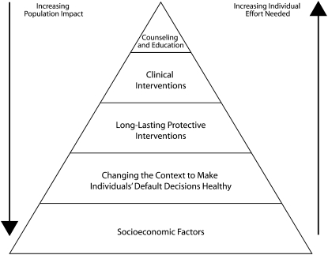
Policy and the Health Impact Pyramid
Am J Public Health. 2010 April; 100(4): 590–595. doi: 10.2105/AJPH.2009.185652
Notes:
I’m sure that many of you recognize the policy impact pyramid.
Interventions at the top of the pyramid are require the most individual effort and have the least impact on the population
Intervention at the bottom of the pyramid require less individual effort and have a greater population impact
Policies lie at the next to lowest level of the pyramid (use pointer in presentation), having a great population impact with lower levels of effort to achieve this impact
Cost effective—important in areas such as injury that have a high burden and low resources available for interventions
Policy intervention examples:
Injury
Seat belt laws
Booster seat laws
Alcohol ignition interlock laws
State pain clinic laws
Alcohol sales laws (outlet density, hours, state control/regulation, taxes)
Other
Tobacco taxes
Smoke-free laws

Slide 5
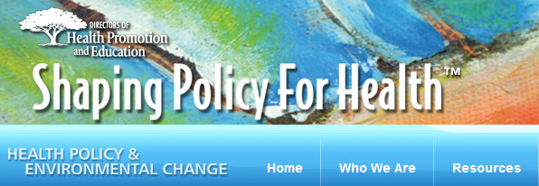
Types and Levels of Policy
Organizational
Local education agencies and/or schools or school districts
Private hospital or other healthcare delivery sites
Community-based organizations
Governmental agencies
Business, industry, or corporations
Professional associations or accrediting organizations
Regulatory
State
Federal
Legislative
Local
State
Federal
Notes:
Organizational, which include internal rules or practices established by management within an agency or organization, such as:
Local education agencies and/or schools or school districts i.e. anti-bullying policies or removal of vending machines at schools,
Private hospital or other healthcare delivery sites (i.e. physicians’ offices), i.e. a systematic, required use of an evidence-informed program to prevent Shaken Baby Syndrome as a component of a hospital stay for all new mothers,
Community-based organizations, i.e., worksite wellness programs ,
Governmental agencies, i.e., restricting the use of government-owned electronic communication devices while driving,
Business, industry, or corporations, i.e., health insurance company reimbursement policies, and
Professional associations or accrediting organizations, i.e., CEU requirements to demonstrate competencies in public health or injury prevention.
Policy interventions at each of these levels are particularly valuable because they are systems-based and affect populations by changing the context in which individuals take action or make decisions (i.e., make individual’s default decisions healthy , such as water fluoridation, seatbelt use, airbags, and smoke-free laws) or require behavior change across the population as opposed to addressing behavior change on an individual basis. This type of population based approach can be less expensive and more cost-effective. However, the ultimate effectiveness of a policy intervention depends on the level of awareness, education, acceptance, funding, implementation, enforcement, and compliance that accompany its creation or passage .
Regulatory, which is a rule, principle, or method created by government agencies with regulation authority for products or services
State, i.e., standards regarding main drain covers and starting blocks in swimming pools
Federal, i.e., rules governing manufacturing and marketing of tobacco products or pharmaceuticals
Legislative, which is a law or ordinance
Local (city or county), i.e., sobriety checkpoints
State, i.e., primary enforcement seatbelt laws
Federal, i.e., statute regarding maximum blood alcohol concentration

Slide 6
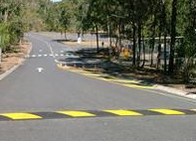
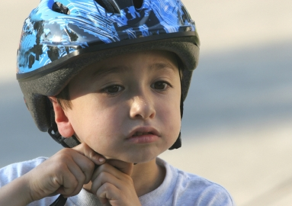

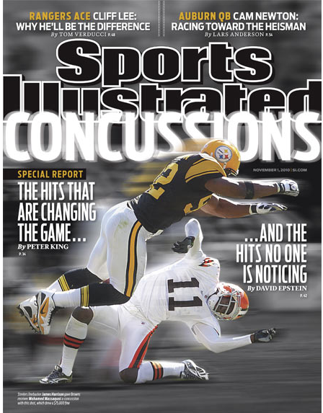


What does Policy Influence?
Behaviors
Social Norms
Environments
Organizations
Systems
Notes:
Policy interventions affect various community and societal to improving the public’s health. They can influence or change:
Behaviors
Social Norms
Environments
Organizations
Systems

Slide 7
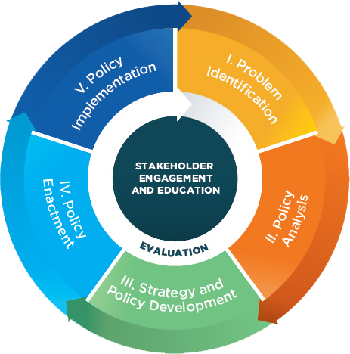
The Policy Process
Notes:
The policy change process may not necessarily begin with problem identification and end with evaluation. Nor will policy efforts always move through the domains in a linear fashion; for instance, some aspects of policy analysis may occur at the same time as the policy strategy and development.
Problem identification
Process of collecting, analyzing, summarizing, and interpreting data and other scientifically based information relevant to the frequency and severity of injuries and their consequences.
Describe the problem in clear, compelling ways- including groups that are affected (demographically, geographically, etc), how their lives are impacted personally – individual stories often illustrate this impact best, and that there are proven ways to prevent the problem.
The problem identification process is critical to understanding where our efforts need to be concentrated and to making the case for action. However, when communicating the problem to policymakers, it is critical to have a proposed science-based solution.
Use partners and their access to media and other communication channels to help convey educational health messages to policymakers and the public.
Proactively share data linked to possible solutions with decision makers
Policy analysis
Review and/or draft potential policies
Find common goals with complementary issues- could be in other parts of the state govt or within health
Use data and science to ensure health effects are considered and based on the best available science
Ensure policy is feasible for stakeholders (parties required to take action related to implementation or enforcement)
Strategy and Policy Development
Thinking about your stakeholders is especially important in this step—who are they? What are their values? How can you engage them?
Think about the key barriers to implementing and enforcing this policy?
Conduct cost/benefit analysis and predict how much science-based prevention efforts will cost an organization, the public sector, and/or society.
Also consider the secondary and/or tertiary benefits for your policy solution
Policy Enactment—getting it done!
Work with coalitions, networks, or advisory committees
Identify champions and provide them with data and information to personalize an injury issue
Educate decision makers about the burden of injuries and potential interventions
Use communication strategies to change the environmental context to increase demand for policies and programs as solutions: the audience (policymakers) must be able to see the relevance and value for them. They need to understand both the problem and the solution in plain, compelling terms. Social math can be effective in doing this.
Policy Implementation
Raise awareness of and support for policy by public and media (The media can be an excellent channel for raising awareness and garnering support by the public!)
Educate and engage the public—work with partners to educate and engage with the public and implement programs to enforce existing policies that address preventing injuries and their consequences.
Work with enforcement entities to ensure policies are implemented appropriately and consistently.
Both the media and the public need to be brought on board so the policy can be implemented effectively and maintained.
6. Stakeholder Engagement and Education and Policy Evaluation
These components happen in each step of the policy process
One ex. of CDC’s work in policy evaluation is the Return to Play Case Study and our new Tools for Policy Evaluation

Slide 8
Why is Policy Evaluation Important?
Informs policy implementation
Demonstrates impacts and value of policy
Informs evidence base and future policies
Demonstrates accountability for resources invested
Documents policy content and development
Examples include:
Comparing the content of antibullying statutes
Evaluating the implementation of Return-to-Play laws
Modeling the impact of alcohol control policies on youth violence
Notes:
So why is policy evaluation important to Injury and Violence Prevention?
Policy strategies are one of the critical ways communities can address injury and violence prevention at a population-based level. However, frequently there is limited evidence about the effectiveness of policy approaches. Policy evaluation helps to ensure that funded policies are effective in their goals to reduce injury and violence prevention.
There are a number of different purposes of policy evaluation, including:
Assessing compliance and implementation of policies
Demonstrating the impact of a policy
Informing and expanding the evidence base for effective policies
Informing future policies
Documenting policy content and development
EXAMPLES
To compare the content of various antibullying statutes to evidence-based model policy components, Srabstein and colleagues developed an Anti-bullying Public Health Policy Criteria Index. The Index was based on antibullying research and elements of effective policy. The evaluation reviewed state laws dealing with school bullying, harassment, or intimidation and compared them using the Index. The analysis revealed that only 16 of the states had statutes incorporating comprehensive basic public health antibullying principles, as measured by the Index.
To evaluate the implementation of Return-to-Play laws, NCIPC used a case study design to examine implementation efforts in two states. The evaluation examined stakeholder perceptions, barriers to implementation, and successes. In-depth interviews were conducted with a variety of stakeholders at different levels, including state health departments and interscholastic and school coaches. The evaluation provides an understanding of key implementation factors within states and a comparison of barriers and facilitators across the states to inform the efforts of other states with similar laws.
Using data from the Youth Risk Behavioral Surveillance Survey as well as area-level alcohol policy information, Markowitz and colleagues used statistical modeling to examine the impact of various alcohol control policies on measures of youth violence and drinking. They obtained data on 18 different alcohol control policy variables from the Alcohol Policy Information System (available from the national Institute on Alcohol Abuse and Alcoholism) and also contacted state officials directly. Merging this information with violence data based on respondent residence and year of survey allowed for an analysis of the relationships between the different policies and youth violence. The analyses provided evidence of a negative relationship between alcohol prices and youth violence.

Slide 9

Core SVIPP Policy Resources and Technical Assistance
State Health Department’s Role in the Policy Process
Policy Technical Assistance and Consultation
http://www.cdc.gov/injury/stateprograms/publications.html

Slide 10
Thank You!
For more information please contact Centers for Disease Control and Prevention
1600 Clifton Road NE, Atlanta, GA 30333
Telephone: 1-800-CDC-INFO (232-4636)/TTY: 1-888-232-6348
E-mail: cdcinfo@cdc.gov Web: http://www.cdc.gov
The findings and conclusions in this report are those of the authors and do not necessarily represent the official position of the Centers for Disease Control and Prevention.
National Center for Injury Prevention and Control

