Slide 1
HMGB2 DEGRADATION STRATEGY
S1: A1_4COOH Molecular Glue + S5: dTAG Degron Tag
Complete Computational Analysis | Structure Views | Execution Plan
Motto: Improve ICM → Degrade HMGB2

Slide 2
Two Parallel Strategies for HMGB2 Degradation
 | S1: A1_4COOH Glue | S5: dTAG Degron
Mechanism | Improved ICM recruits E3 directly | FKBP12F36V tag + dTAG-13 + VHL
Uses ICM? | YES - improved ICM | NO - genetic tag
Likelihood | Moderate-high | Very high (>90%)
Time | 1-2 weeks assay (after 4wk synthesis) | 2-3 months total
Cost | ~$500 assay (+$1500 synthesis) | ~$3000
Keeps motto? | YES | Partially (drops ICM)
DECISION FRAMEWORK: • If S1 works (A1_4COOH alone degrades HMGB2) → motto achieved with improved ICM • If S1 fails → S5 guarantees degradation (control experiment, validates HMGB2 loss phenotype) • Run BOTH in parallel - S1 tests the ICM hypothesis, S5 provides a positive control for degradation

Slide 3
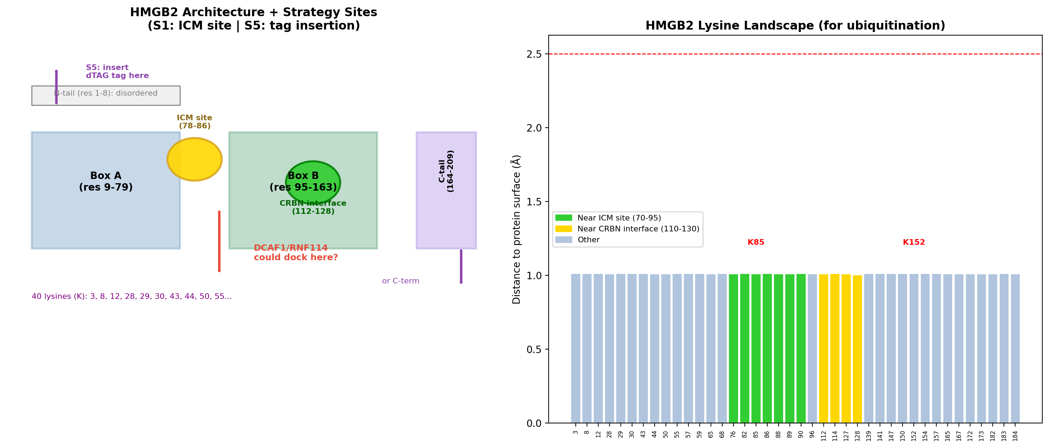
S1: A1_4COOH Glue - Binding Site Analysis

Slide 4
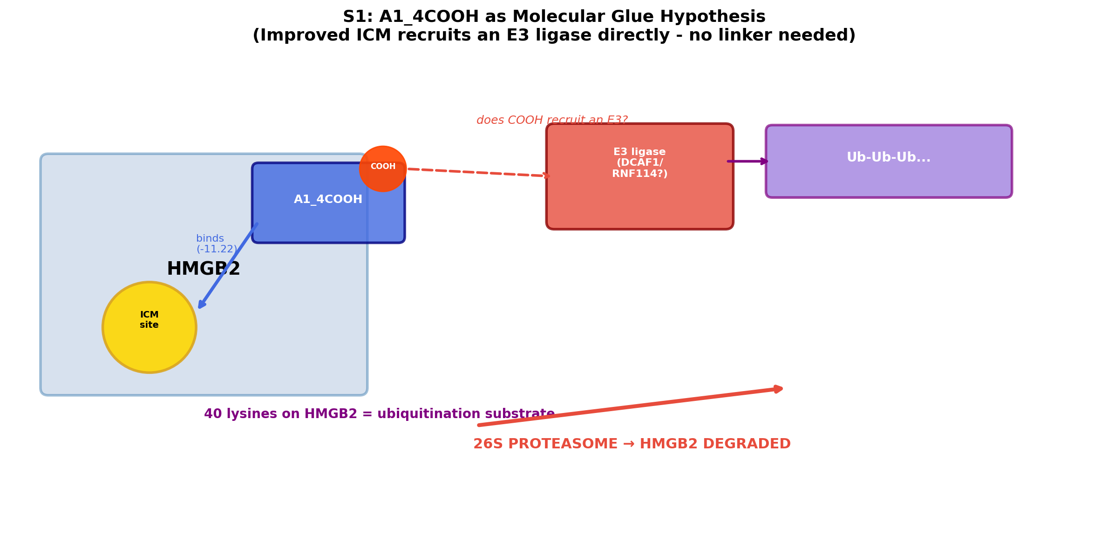
S1: The Molecular Glue Hypothesis

Slide 5
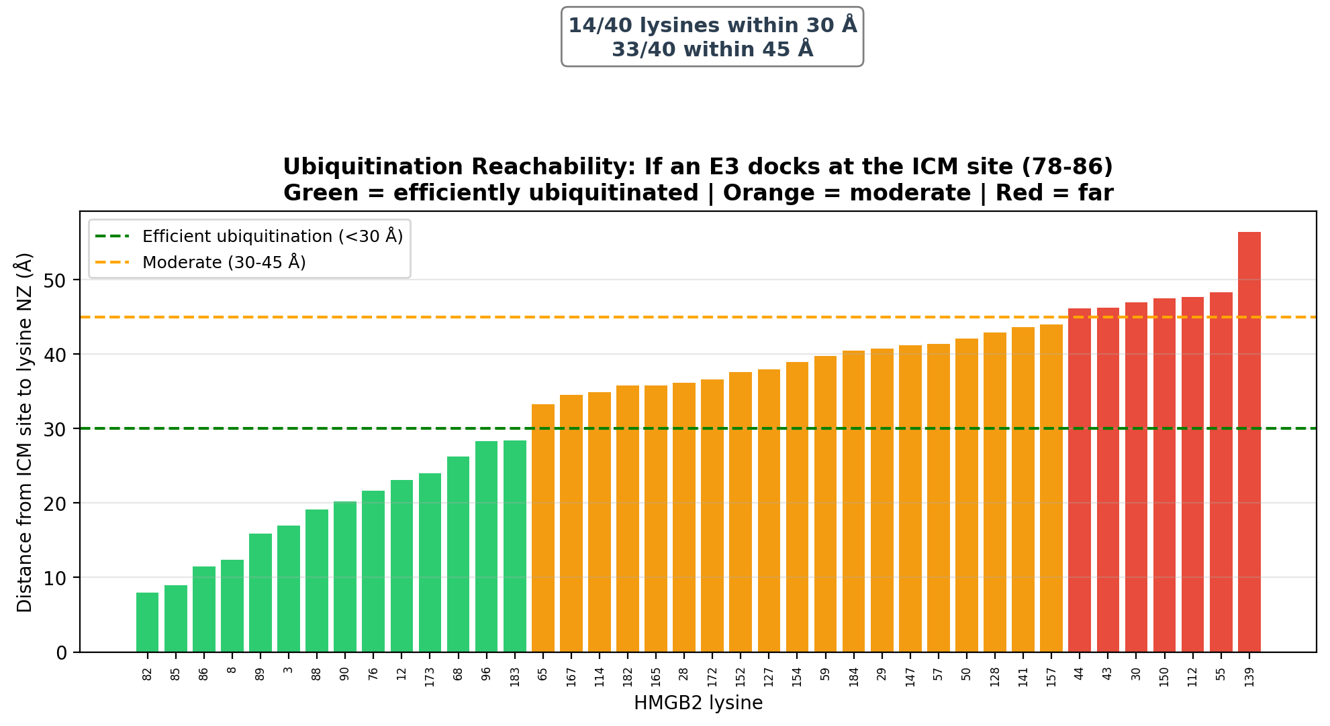
S1: Ubiquitination Reachability
If an E3 docks at the ICM site (78-86):
• X/40 lysines within 30 Å (efficient)
• X/40 within 45 Å (moderate)
HMGB2 is small (24 kDa) and lysine-rich
→ ideal ubiquitination substrate
KEY: K85 and K82 are at the ICM site itself
→ E3 can ubiquitinate the exact residues
that anchor A1_4COOH

Slide 6
S1: Computational Evidence for Glue Feasibility
Evidence | Data | Support
Improved binding | -11.22 vs -5.75 kcal/mol | Strong (Vina)
Binding confirmed | Boltz iPTM 0.70 | Strong
Site is basic | LYS82/85/86, net +1 | E3 compatible
COOH neosurface | Salt bridge to LYS85 (3.04 Å) | New interface
40 lysines accessible | All within 60 Å | Ubiquitination
Nuclear target | HMGB2 in nucleus | Matches DCAF1/RNF114
Glue precedents | Indisulam, CR8, CDKi glues | Mechanism validated
E3 candidates | DCAF1, DCAF15, RNF114 | Testable
VERDICT: S1 is FEASIBLE. The improved ICM (A1_4COOH) creates a basic neosurface at residues 78-86 that could recruit DCAF1/RNF114. Definitive test: cellular degradation assay ± MG132 ± E3 siRNA (1-2 weeks, ~$500).

Slide 7
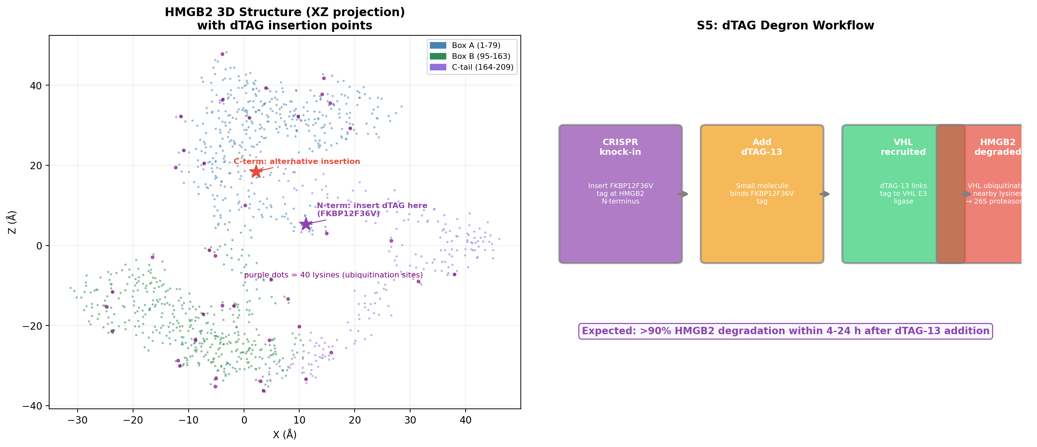
S5: dTAG Degron Design - Structure View

Slide 8
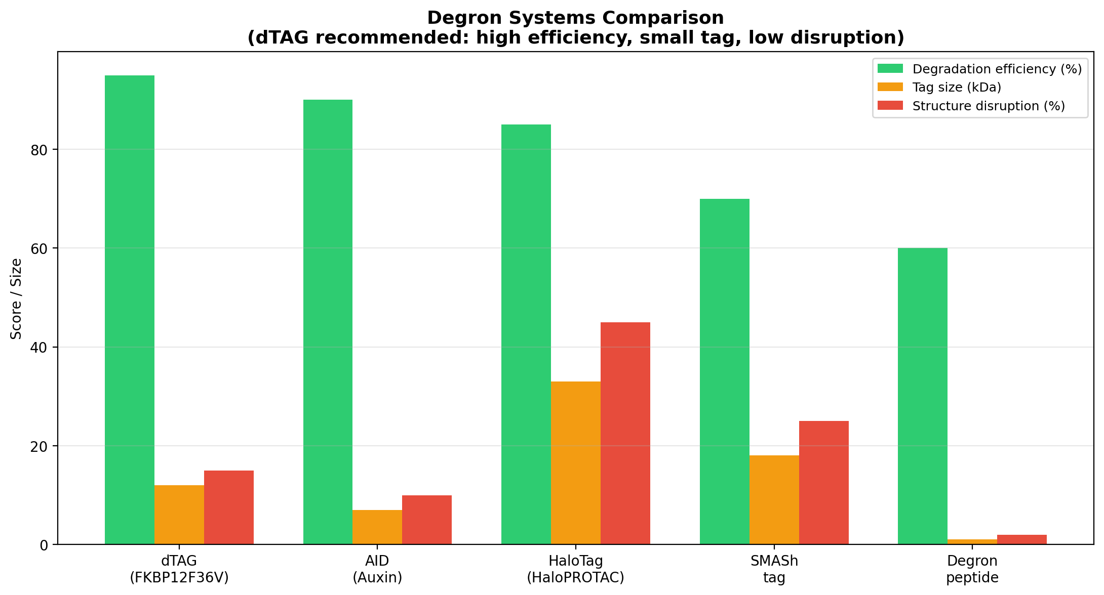
S5: Degron System Comparison
System | Efficiency | Tag size | Disruption | Notes
dTAG (FKBP12F36V) | >90% | 12 kDa | Low | RECOMMENDED - fast, reversible
AID (Auxin) | >85% | 7 kDa | Low | Needs TIR1 transgene
HaloTag | >80% | 33 kDa | High | Large tag, disruptive
SMASh | ~70% | 18 kDa | Medium | Hepatitis C NS3 protease
Degron peptide | ~60% | 1 kDa | Minimal | Needs fusion design

Slide 9
S5: CRISPR Knock-in Design
Design element | Specification
Tag | FKBP12F36V (12 kDa, VHL-recruiting mutant)
Insertion site | N-terminus (before MET1) - disordered tail
Linker | GGGGS (flexible, 5-10 copies)
Alternative site | C-terminus (after GLU209) - acidic flexible tail
gRNA design | Targets intron/exon near ATG start codon
HDR donor | Tag + linker + homology arms (500-800 bp each)
Selection | Puromycin cassette (floxed) or FACS sorting
Validation | PCR genotyping + Western blot (anti-FKBP12 + anti-HMGB2)
Expected | >90% degradation within 4-24 h of dTAG-13 addition
dTAG-13 is commercially available (Tocris, ~$200/mg). Cells: HEK293T or U2OS for rapid knock-in.

Slide 10
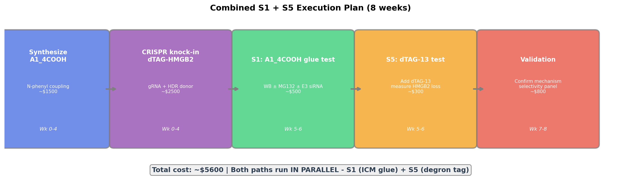
Combined Execution Plan (8 Weeks, ~$5600)

Slide 11
S1: Detailed Experimental Protocol
Step | Protocol | Controls | Readout
1. Cells | HEK293T/U2OS, 24-well, 70% confluent | DMSO vehicle | -
2. Treatment | A1_4COOH 0.1, 0.5, 1, 5, 10 μM, 24 h | ICM (parent) 10 μM | HMGB2 WB
3. MG132 | MG132 10 μM, last 6 h | ± MG132 | Proteasomal?
4. E3 siRNA | DCAF1/RNF114/CRBN siRNA, 48 h pre-treat | Scrambled siRNA | E3 identity
5. Readout | HMGB2 WB (GAPDH loading) | Total protein stain | Fold change
6. Rescue | If degraded: rescue with siRNA | - | Mechanism
Interpretation: • HMGB2 ↓ + MG132 rescue → proteasomal degradation • HMGB2 ↓ + DCAF1/RNF114 siRNA rescue → specific E3 glue • HMGB2 ↓ + CRBN siRNA rescue → CRBN glue (unexpected, but possible) • No effect → S1 fails, rely on S5

Slide 12
SUMMARY & RECOMMENDATION
S1 (A1_4COOH Molecular Glue): ✓ Improved ICM binds strongly (-11.22), confirmed by Boltz (iPTM 0.70) ✓ Basic neosurface at 78-86 → compatible with DCAF1/RNF114 ✓ 40 accessible lysines → excellent ubiquitination ✓ Glue precedent: indisulam, CR8, CDKi → TEST FIRST: cellular degradation ± MG132 ± E3 siRNA S5 (dTAG Degron): ✓ Guaranteed >90% HMGB2 degradation (dTAG-13 + VHL) ✓ Minimal disruption (N-term insertion in disordered tail) ✓ Commercially available reagents → Positive control + fallback if S1 fails BOTH IN PARALLEL: S1 tests the ICM hypothesis; S5 guarantees the phenotype.
If S1 works: improved ICM degrades HMGB2 = MOTTO ACHIEVED

